Slide 1
DIAGNOSTICs LEBT
STATUS
Franck Senée BI FORUM
Lund 2019-02-10

Slide 2
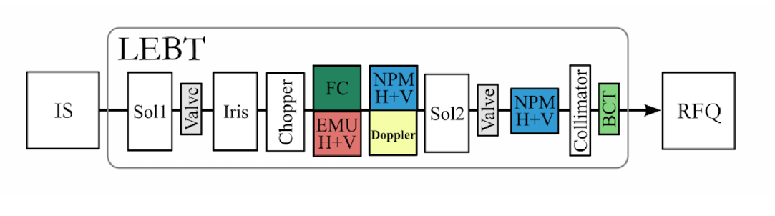
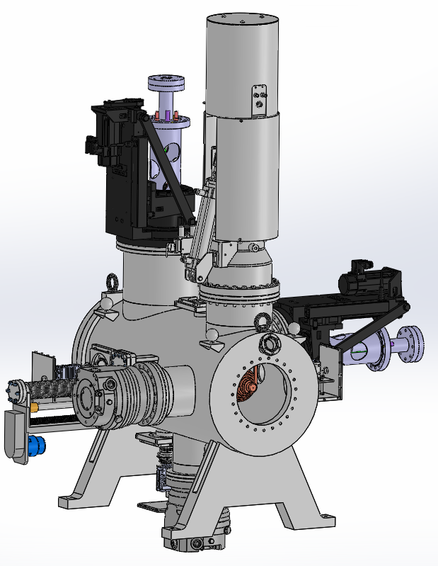

ESS LEBT
LEBT tank
CEA: 2 emu (H & V) & 1 doppler unit
ESS ion source parameters:
Protons beam
75 keV
Current max = 100 mA
Pulse length = 6 ms
Repetition rate = 14 Hz
Duty cycle 8%
FC
EMU V
EMU H
NPM H
DOPPLER
BEAM
Nov. 3rd 2015

Slide 3
Beam profil and Commissioning phases at catania
DBOX
DBOX
TANK
DBOX
Phase 2: Doppler design (Ø max = 80 mm)
Phase 3: EMU design
(Ø min = 6 mm)
DBOX
1- delivery at CEA Saclay for EMU and Doppler acceptance tests
2- send to Catania for the 3 phases using the « commissioning Diagnostic BOX » entirely equipped

Slide 4
EMU: Allison scanners type
EMU @ IRFU: philippe abbon - philippe daniel-thomas - jean-françois denis - patrick girardot - françoise gougnaud - tom joannem - nicolas misiara - jerome neyret - FRANCK SENÉE - Olivier tuske

Slide 5
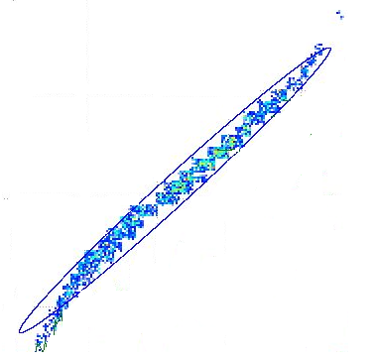
Principle
intensity
intensity
intensity
y’1
Angle y’
y’2
Angle y’
y’3
Angle y’
y’3
y’1
y1
Beam Axis
y’2
y’2
y2
y’1
y’3
y
y3
x
y1
y2
y3
z

Slide 6
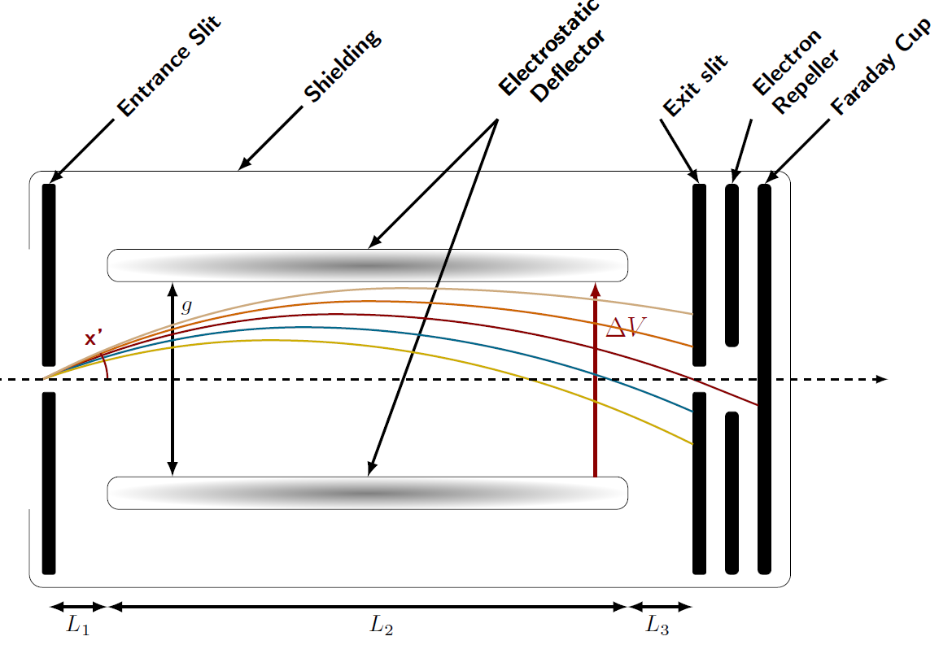

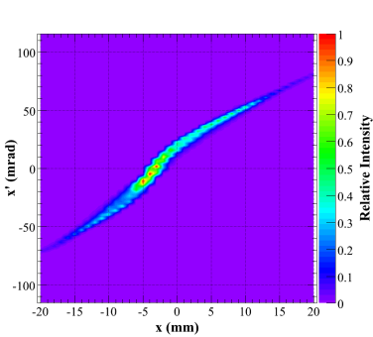

Allison scanner
thermal
screen
I (µA)
0.39 π.mm.mrad
with $L_{1}$= $L_{3}$
U: kinetic energy (eV) of the beam particles (H+)

Slide 7
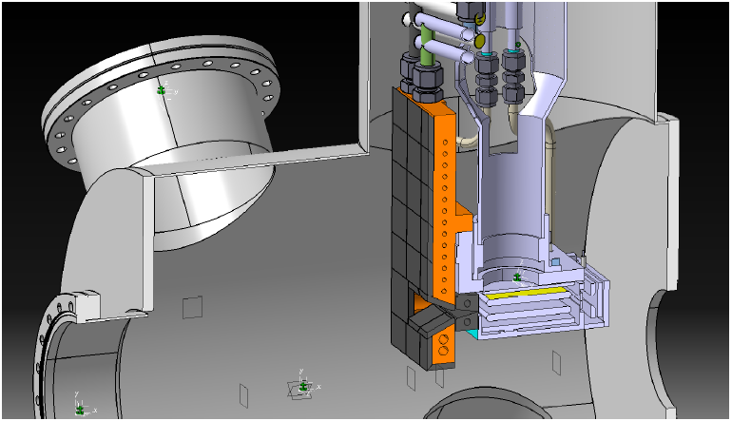
Design overview
Actuator
repeler
Beam-Stopper
100 µm Slit for beamlet selection
Deviation plates
CF
7

Slide 8
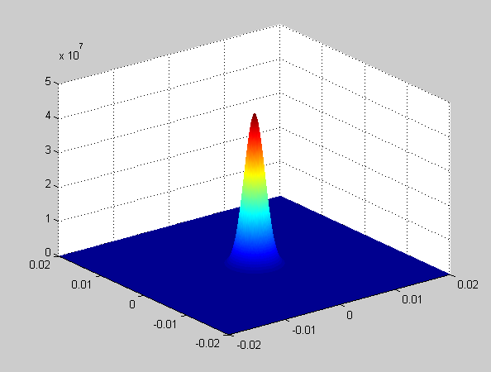
Thermo-mechanical calculations
Hypothesis
  gaussian power deposition
  Beam characteristics
  (Réf : « L5_LEBT_EMU » 2015/30/01)
  Nodal power deposition
  Material physical datas :
    Advanced Energy Technology Group
http://aries.ucsd.edu/LIB/PROPS/PANOS/cu.html
  Steady-state based + transient thermal analysis
Description | Value | Unit
Beam energy | 75 | kV
Beam intensity at peak | 100 | mA
Repetition rate | 14 | Hz
Duty cycle | 8 | %
MINIMAL radius beam size (rms) | 3 | mm
MAXIMAL beam size diameter | 80 | mm
Average power absorbed | 625 | W
DOC réf: ESS-0036400
N. MISIARA

Slide 9
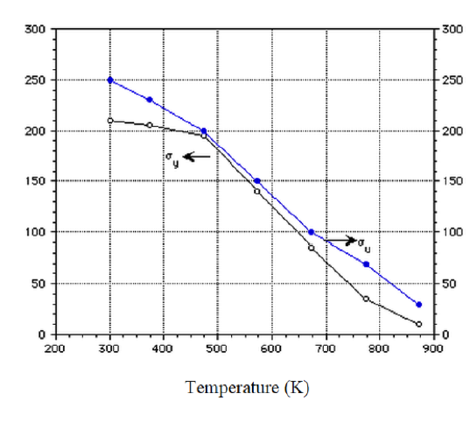
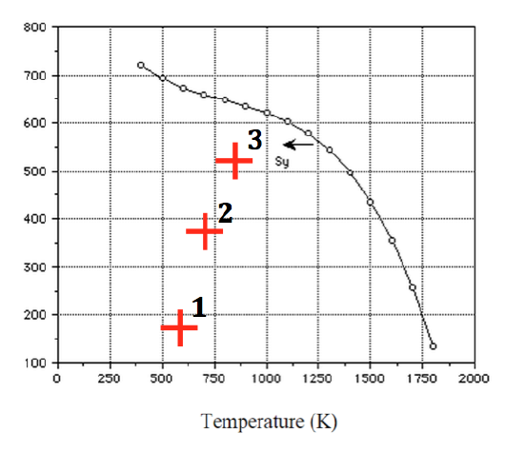
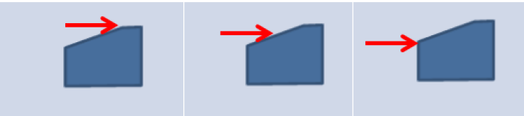
Tmc: TZM entrance slit
Cu
TZM
selected
2
3
1
Elasticity limit [MPa] for Copper (left) and for TZM (right) versus temperature [k]
1
2
3
Von Mises (MPa) stress
TZM alloy: Titanium – Molybdenum – Zirconia

Slide 10
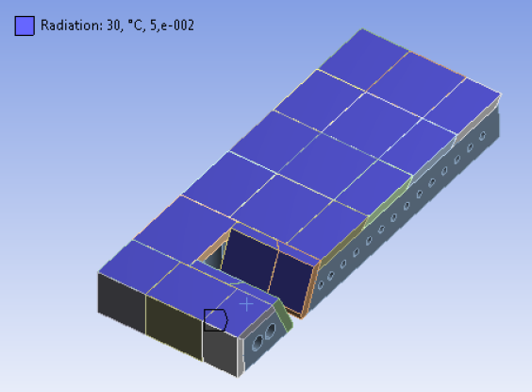
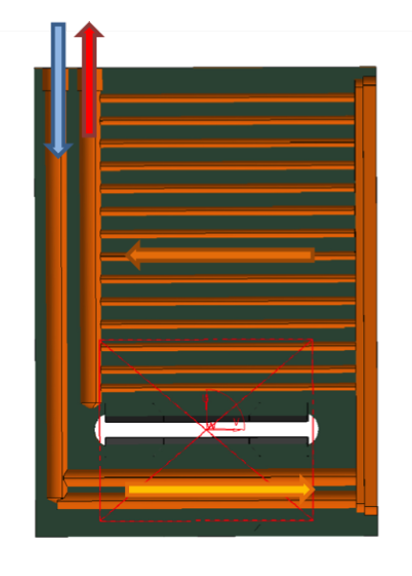
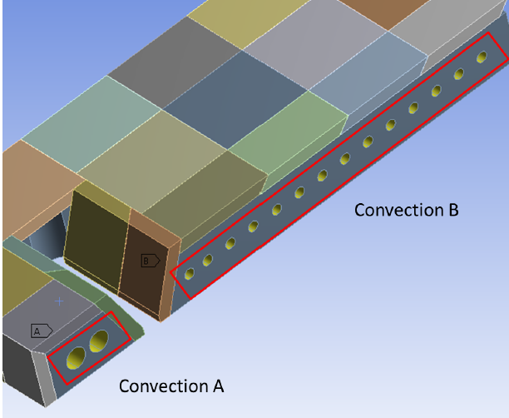
Tm calculations: BEAM STOPPER
6 bars
Thickness
W= 5 mm
Cu= 20 mm

Slide 11
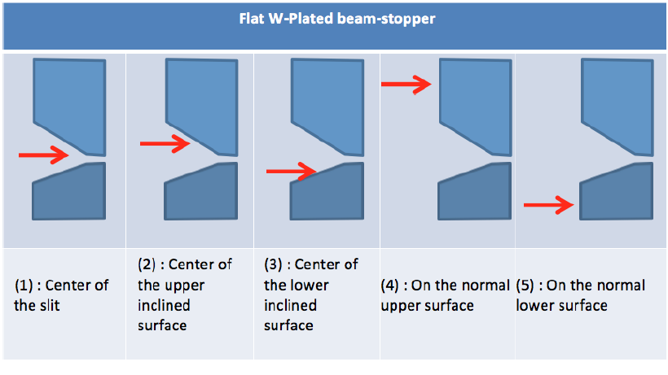
Tm calculations: BEAM STOPPER
ANSYS simulation: Von Mises [Mpa] stress

Slide 12
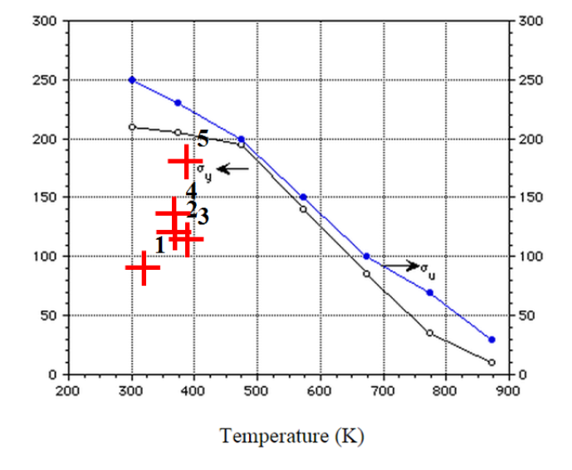
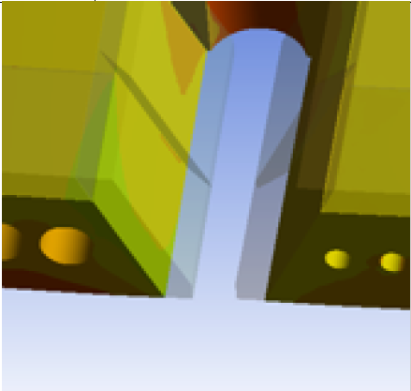
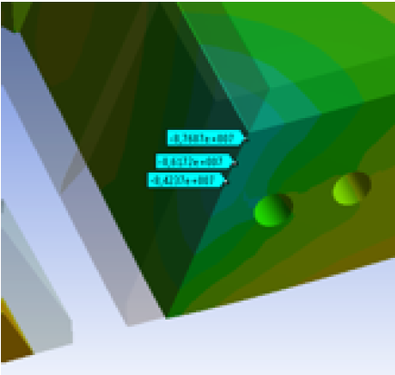
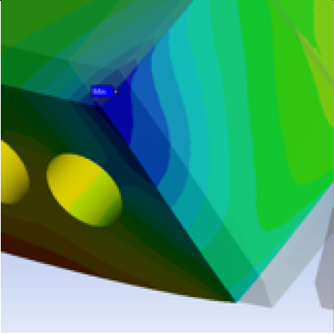
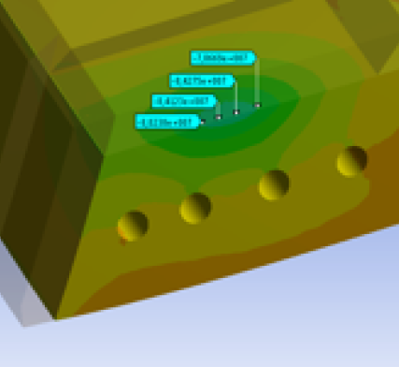
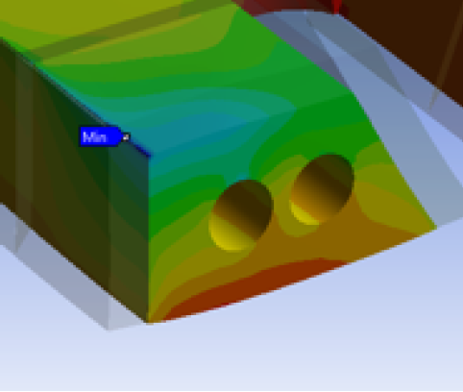
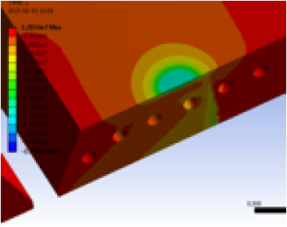
Tm calculations: BEAM STOPPER
4
1
2
W+Cu
selected
3
4
5
W+Cu
Cu

Slide 13
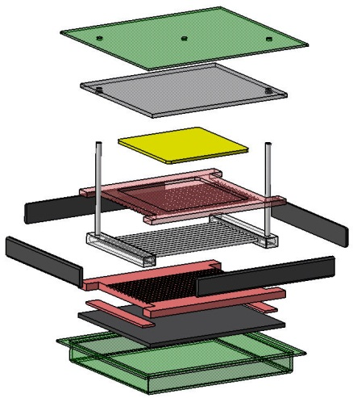
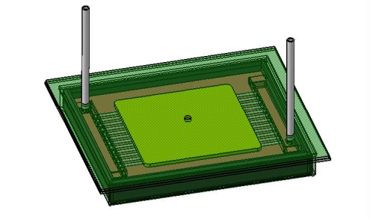
HIP TECHNIQue: EMIT-4d example
Assembly by HIP of W-Cu
Works before assembly:
- New design for assembly whole parts
- Machining W plates and Copper
- Nickel-W face being in contact with the Copper
- Manufacturing of the water box
- Machining of the Carbon inserts and stainless steel container
HIP cycle: 950°C/1400bars/2h
Goal→ improving the mechanic contact
Machining after HIP:
- Remove the container
- Final machining
Exploded view of the necessary
whole parts
Positioning the assembly inside the container and closing it with TIG soldering

Slide 14

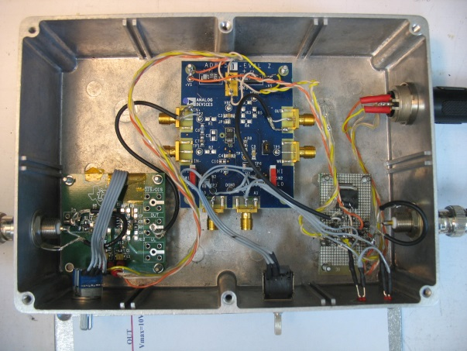
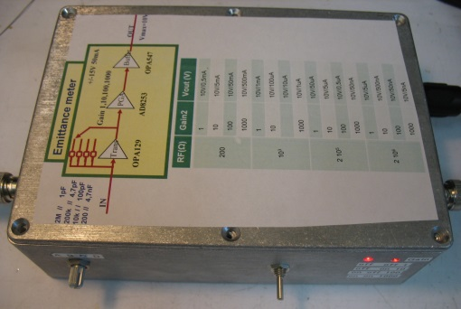
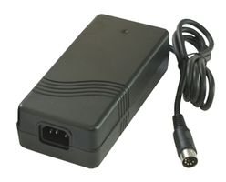
I/V Converter + splitter for Read-Out Faraday Cup EMU
RF
I/V converter
D
2M //
1pF
+/-15V 50mA
C
200k //
4,7pF
B
10k / /
100pF
Gain 1,10,100,1000
Splitter 3 voies
SCOPE
1K //
4,7nF
A
Keithley
Trans
PGA
Buffer
DACQ
I max=5mA
IN
OUT
Diode protection
BAS416
OPA129
AD8253
OPA547
Proto checked on the IFMIF injector at Rokkasho in December 2015
PCB is in manufacturing progress
Gain1RF(Ω) | Gain2 | Vout (V)
A 1 10³ | 1 | 10V/10mA
 | 10 | 10V/1mA
 | 100 | 10V/0,1mA
 | 1000 | 10V/0,01mA
B 10⁴ | 1 | 10V/1mA
 | 10 | 10V/100uA
 | 100 | 10V/10uA
 | 1000 | 10V/1uA
C 2 10⁵ | 1 | 10V/50uA
 | 10 | 10V/5uA
 | 100 | 10V/0,5uA
 | 1000 | 10V/50nA
D 2 10⁶ | 1 | 10V/5uA
 | 10 | 10V/500nA
 | 100 | 10V/50nA
 | 1000 | 10V/5nA
IN
OUT
Kit développement SO8 OPA129
FAR : 2334129
Kit PGA AD8250
RS : 794-6717
Commutateur rotatif BCD
RS : 639-4783
Alimentation +/- 15V
FAR : 1550964
Boite blindée
FAR : 278956
Commutateur rotatif
Coudé BCD
FAR : 2374799
Gain1: A,B,C,D
Gain2: 1,10,100,1000

Slide 15
Status and schedule
Delivery of the Actuators → May 2016
Delivery of the mechanic (TZM slits, deviation plates…) → June 2016
Delivery of the Beam-stoppers (W+Cu & HIP technics) → June 2016
Electrotechnics: Study and cabling specifications → in progress (CEA is waiting for the EMU cabinet layout at Catania)
Epics Command System → in progress
I/V converter → in progress
Acceptance test at CEA Saclay: Oct-Nov 2016,
then send to Catania

Slide 16
THE DOPPLER UNIT
DOppler @ IRFU: françoise gougnaud - pierre mattei - yves lussignol - FRANCK SENÉE- Olivier tuske

Slide 17
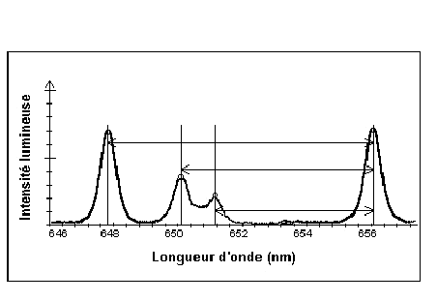
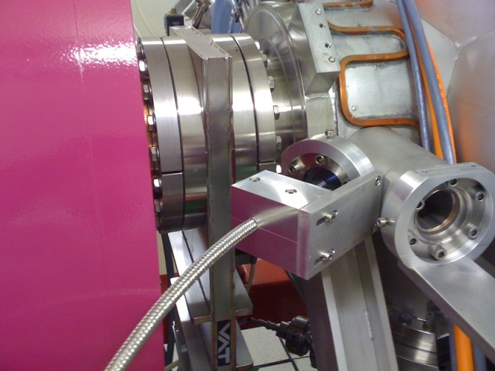
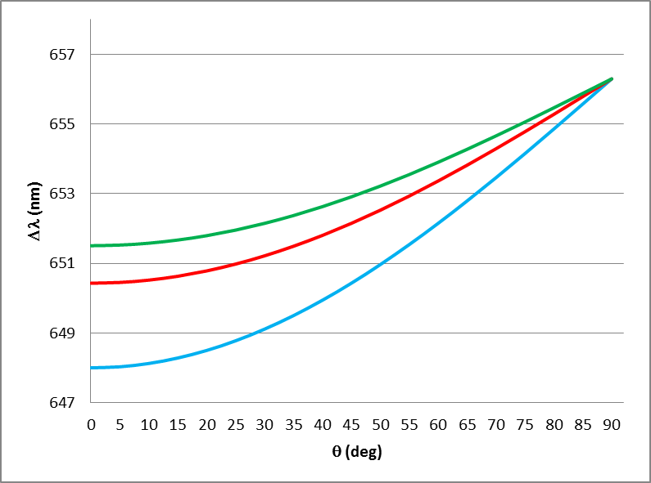


THE DOPPLER UNIT: principLe
Doppler shift of the H_{α} ray
$$∆λ=λ_{0}\frac{v}{c}\cos{θ}$$
Hydrogen beam
H⁰(H⁺) H⁰(H₂⁺) H⁰(H₃⁺)
Plasma H⁰ (light emission excited residual gas)
656.3 nm
ΔλH⁺
ΔλH₂⁺
θ
ΔλH₃⁺
$∆λ$measured by a spectrometer which is able to separate the species
Spectrometer
The intensity of the spectroscopics rays is proportional to the species quantity produced, but the production rate of the H_{α} ray by the residuel gas interaction is different for each species
➔
implying that corrections using recombined cross sections must be applied
θ
expected Δλ versus angle, for 75 keV beam

Slide 18
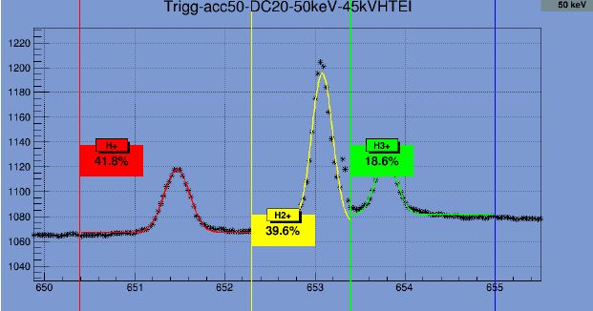
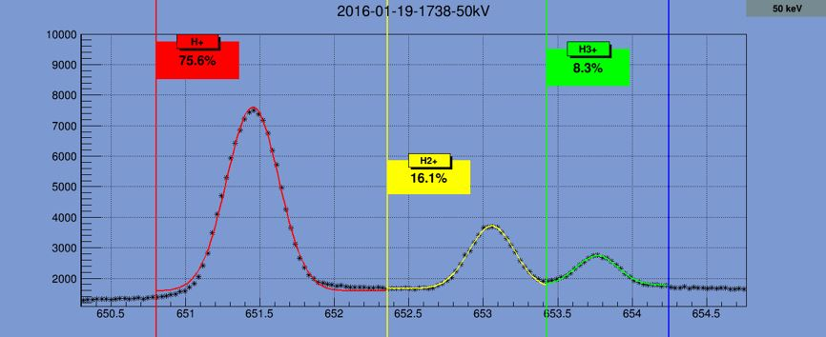
THE DOPPLER UNIT: principLe
IFMIF species fraction measurements

Slide 19
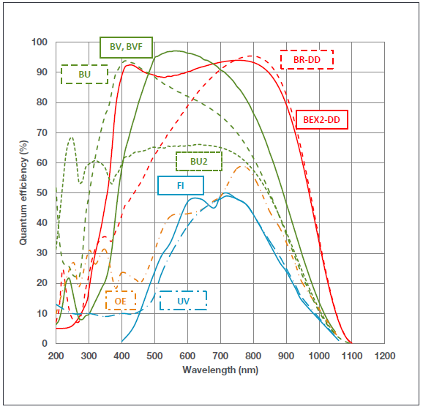
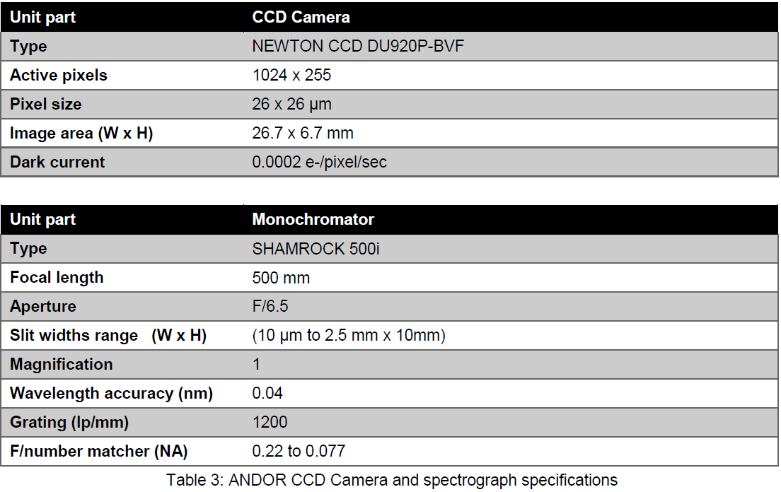
THE DOPPLER UNIT: optimisation
Optimisation of the light which comes from the beam in order to make species fraction measurement inside pulse length of 5 ms
INPUTS:
EPICS compatible Hardware : ANDOR company
Monochromator characteristics
Magnification=2,86
Optical fiber NA=0,22 and L=25 m

Slide 20

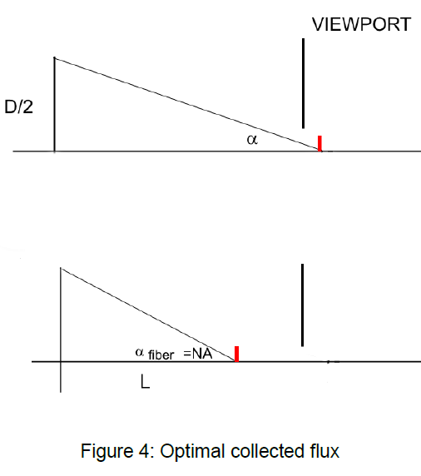

THE DOPPLER UNIT : optimisation by optical coupling
F: Incident light flux
R: apparent radiance of the light
G: etendue
Inside vacuum chamber outside
OF
In order to optimize the light collection we have to move closer to the source detector to increase α.
but the NA of the optical fiber necessitates a minimal distance L.
L mini for Flux maxi
problem, L is inside the vacuum chamber!

Slide 21
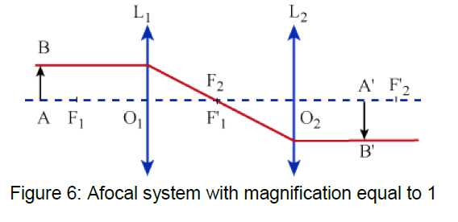
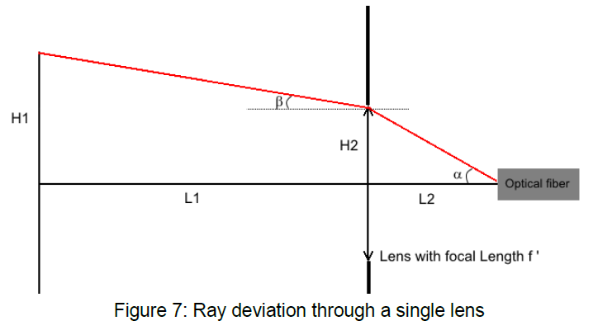

THE DOPPLER UNIT : optimisation by optical coupling
Needs an optical system for shifting the image of the optimal point downstream to the viewport (outside the source)
Afocal system:
Single lens:

Slide 22
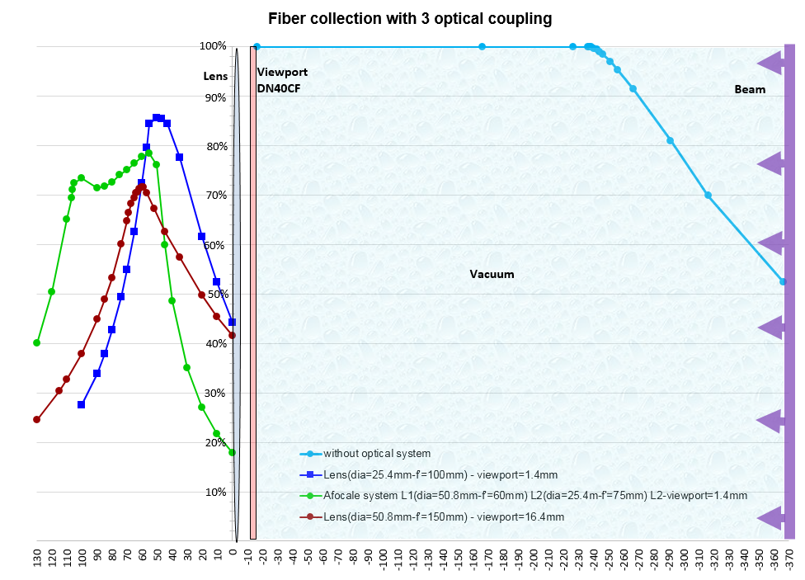
The doppler unit: APILUX SIMULATION
distance (mm) between the beam and the optical fiber

Slide 23
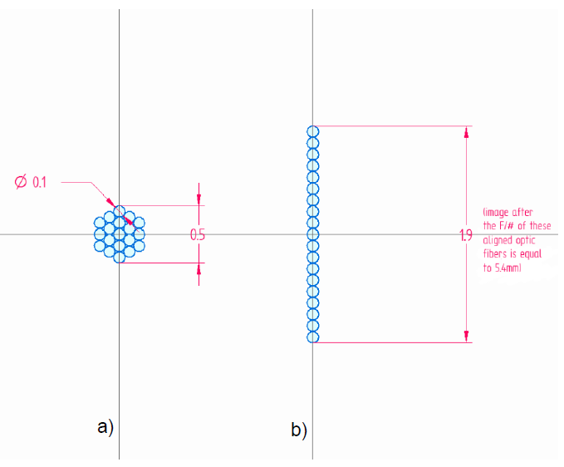
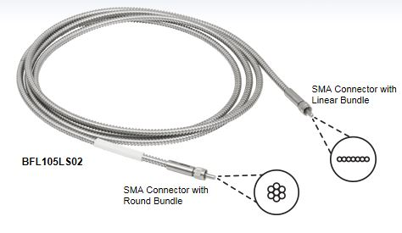
THE DOPPLER UNIT : optimisation of the optical fiber
injector side
spectrometer side
1,9 mm « theoretical »
2,66 mm in reality
Magnification F/# = 2,86
(2,66 mm before and 7,6 mm after the F/# )
12% of the collected light will then be cut off by the height size of the active CCD sensor (6.7 mm)

Slide 24
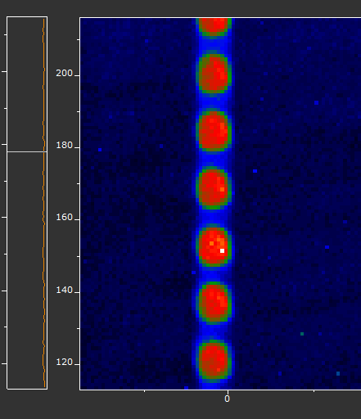
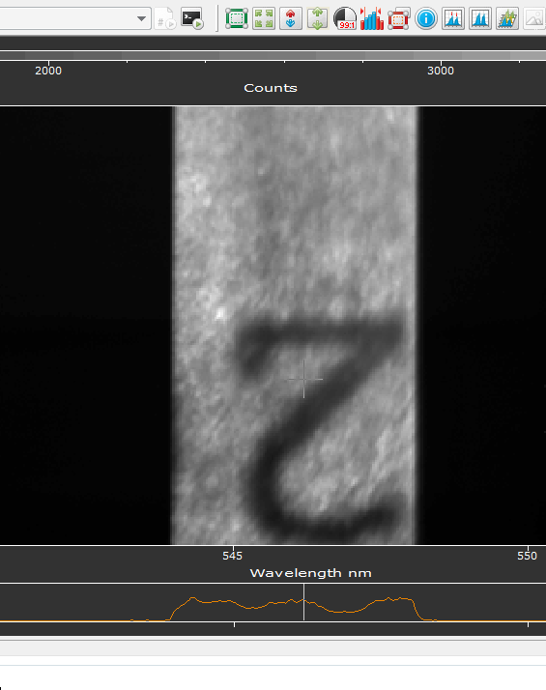
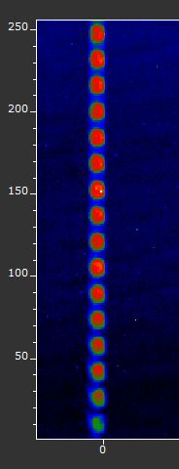

THE DOPPLER UNIT: first measurements
Spectrometer calibration
Bundle image (16/19 → 16% lost)

Slide 25
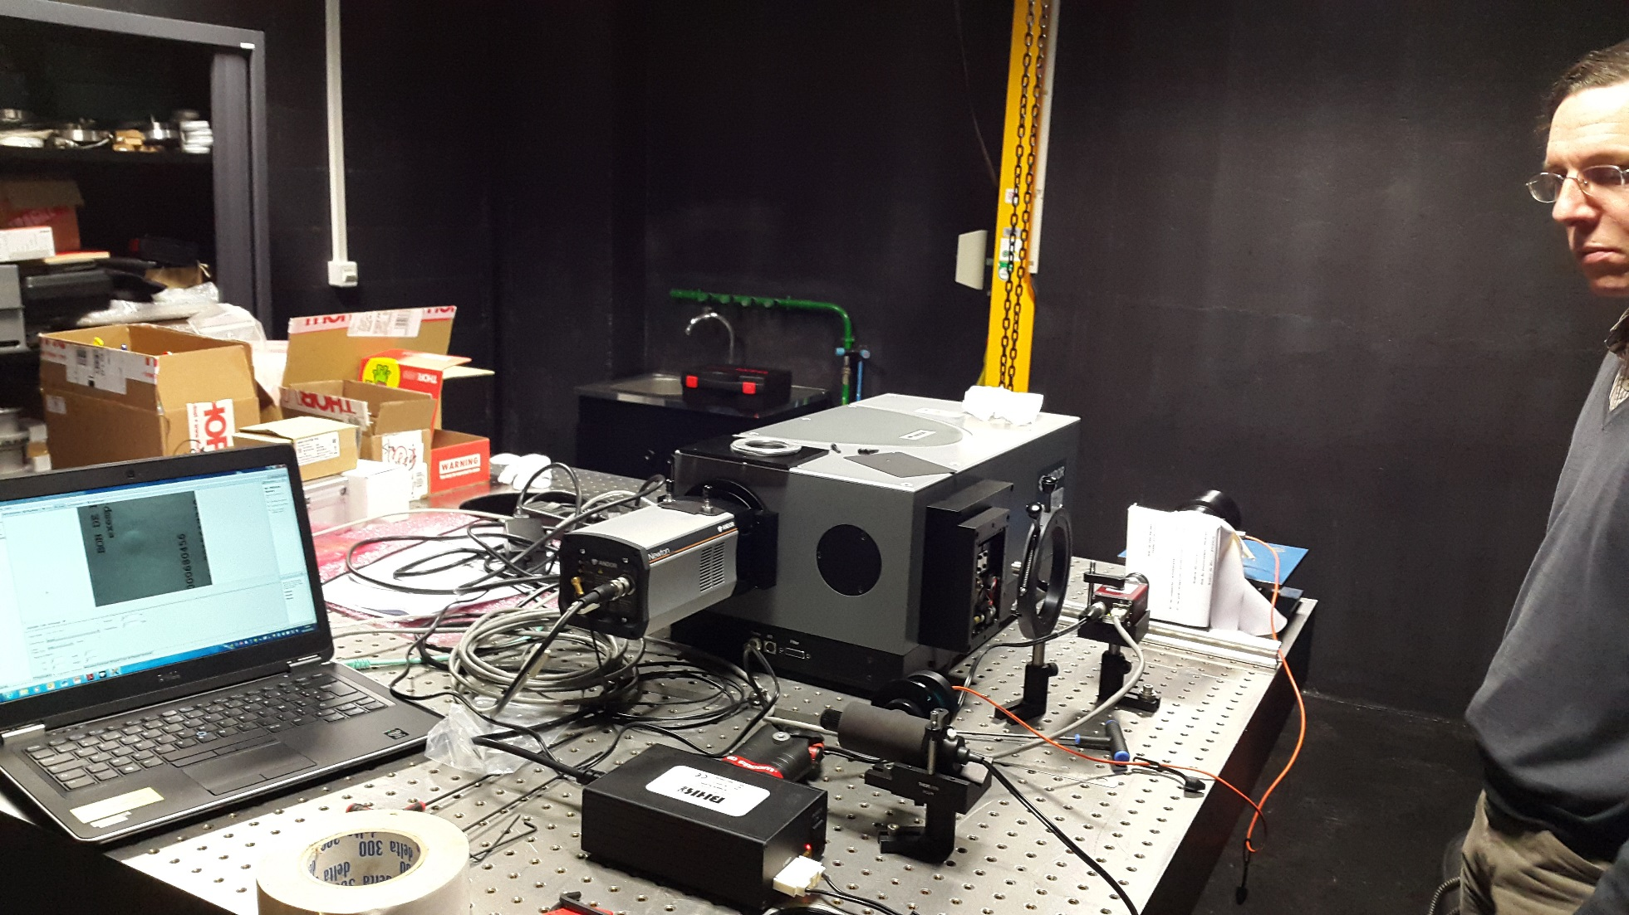
THE DOPPLER UNIT: future measurements
Photometry measurements and transmission measurements are in progress in the LIDO laboratory at CEA Saclay

Slide 26
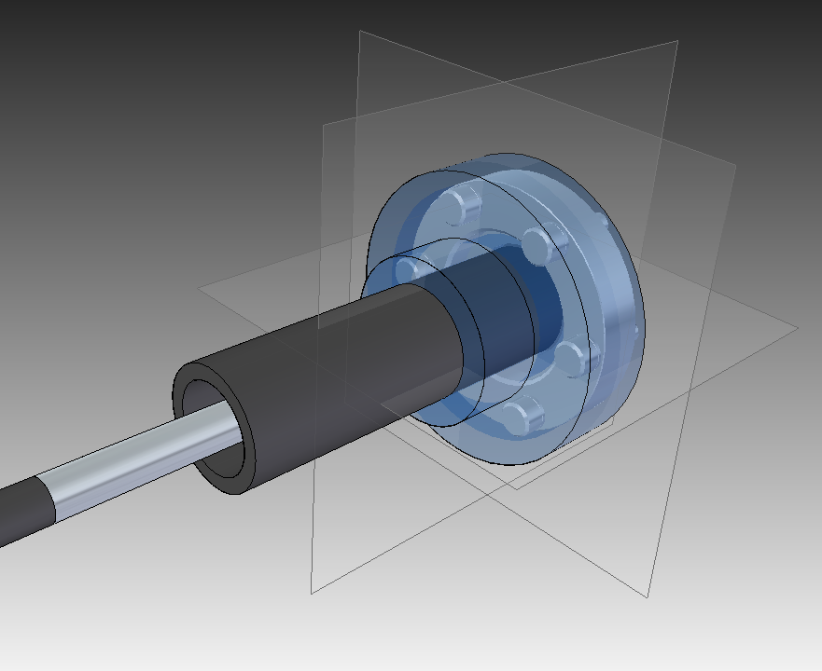
Status and schedule
Spectrograph → checked
Fiber bundle → checked
Mechanical interface between the viewport and the optical system → in progress
EPICS Control System → in progress
Photometry measurements and transmission measurements → in progress
Interface Viewport / Optical system
Acceptance test: June - July 2016 at CEA Saclay

