Slide 1
Oslo ESS in-kind contribution Target Proton Beam Imaging System
Assoc. Prof. Erik Adli, Ole Røhne, Håvard Gjersdal, Martin Jaekel
Dep. of Physics, University of Oslo, Norway
Maja Olvegård, Uppsala University
Thomas Shea, Cyrille Thomas, ESS
Mark Ibison, University of Liverpool / Cockroft Insititute
ESS, February 10, 2016

Slide 2
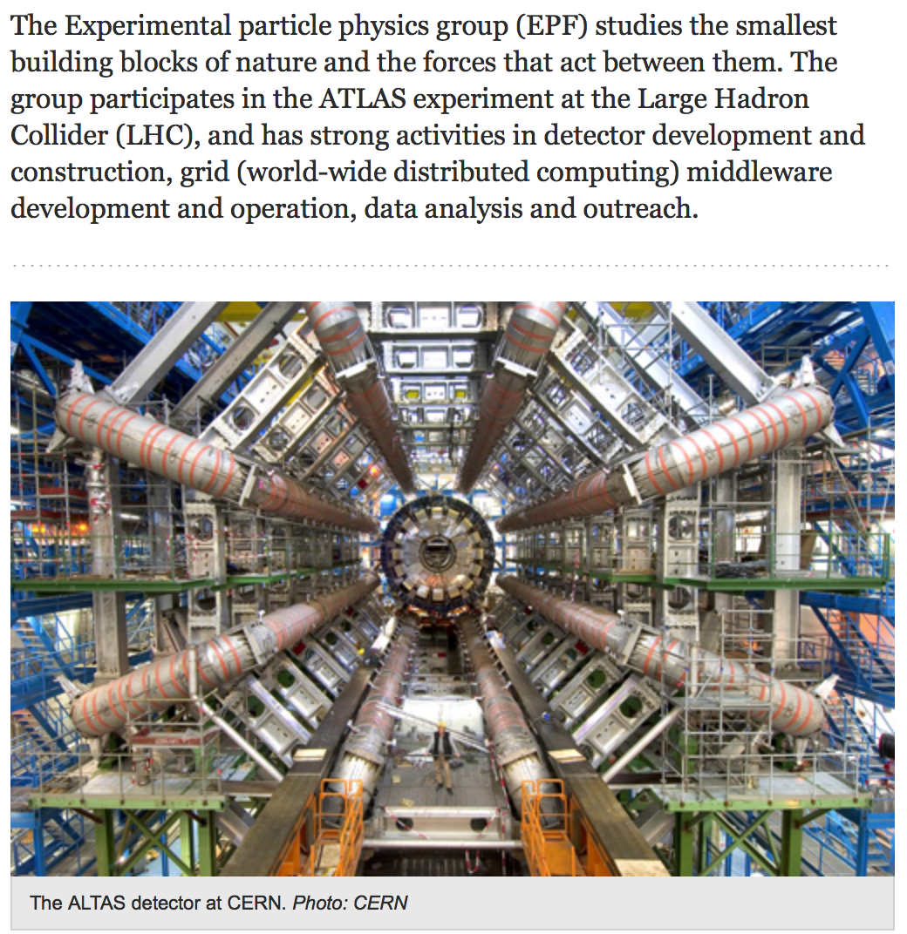
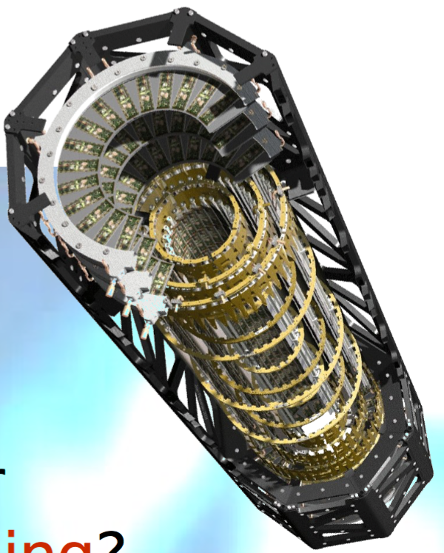
Oslo High Energy Physics Group
The Oslo ESS in-kind team are part of the High Energy Physics Group, Department of Physics, University of Oslo.

Slide 3
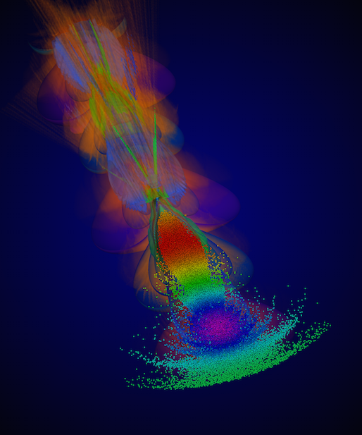
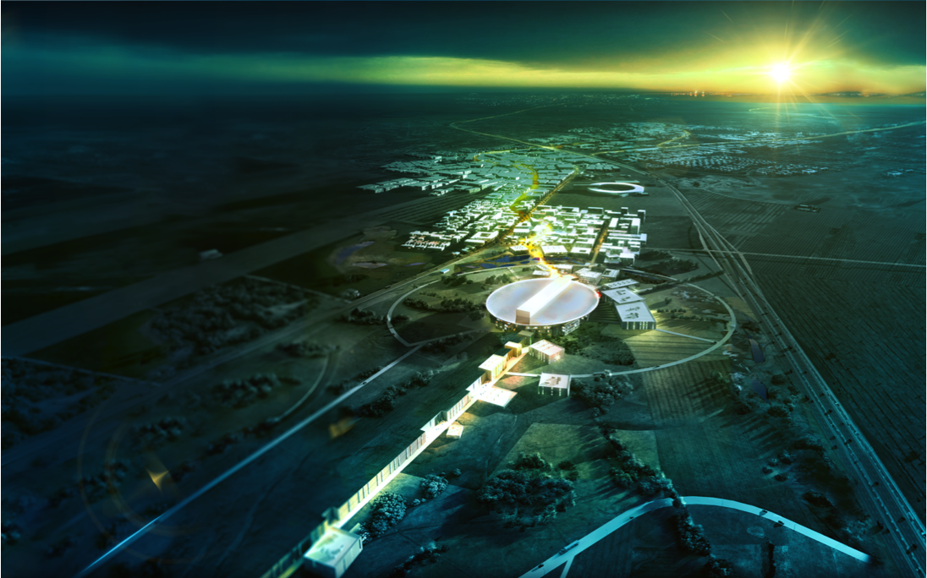
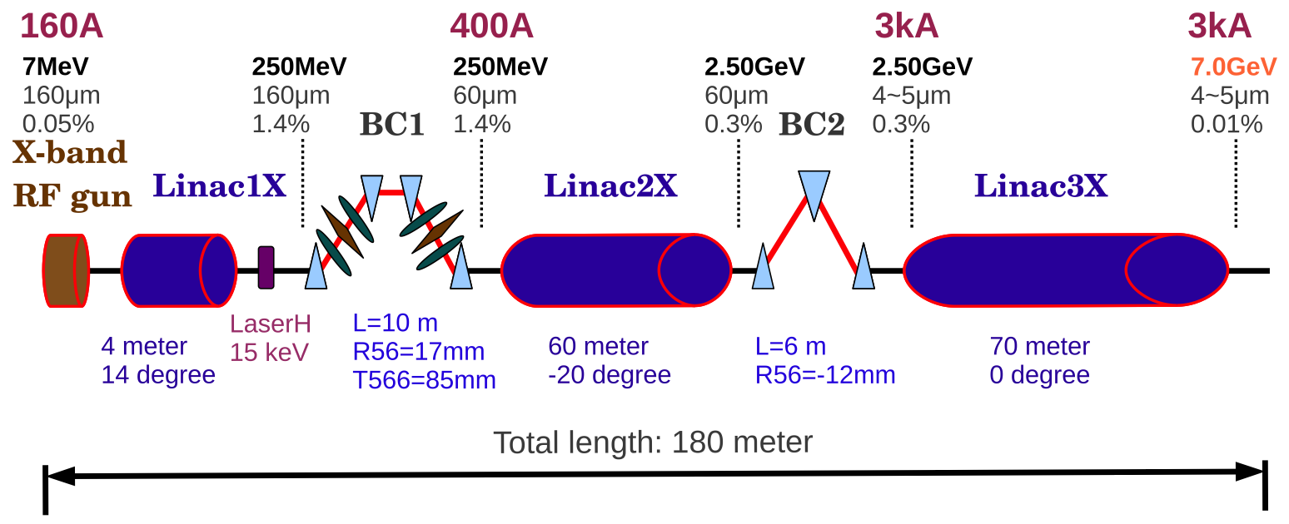
Oslo particle accelerator activities
Compact Linear Collider
(Option for Multi-TeV electron positron collider)
European Spallation Source
(The world’s most powerful proton driver)
Plasma wakefield acceleration
(Novel acceleration techniques)
Compact light sources
(X-band technology)

Slide 4
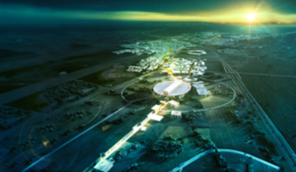
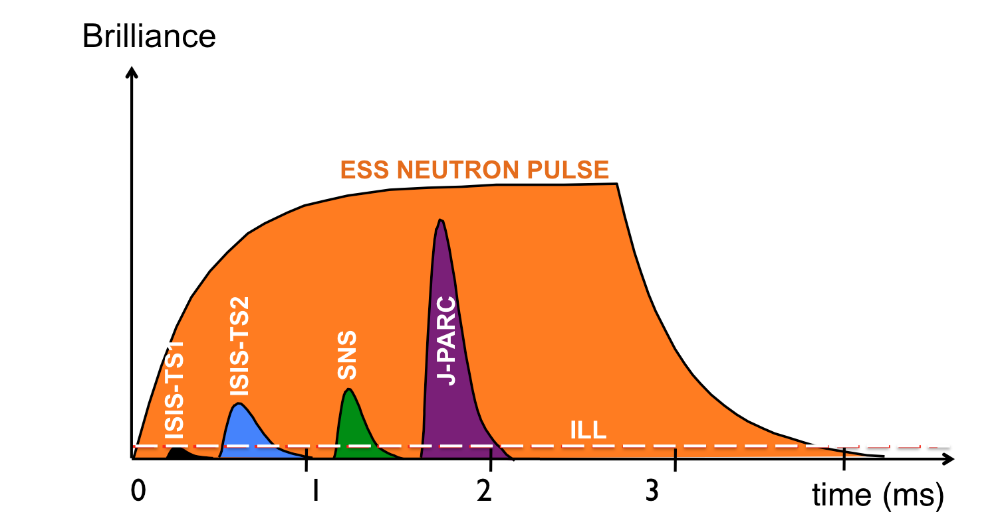
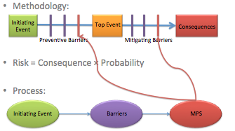
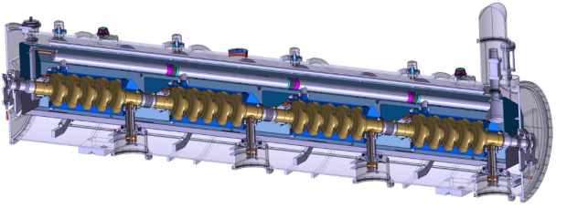
ESS: Norwegian accelerator involvement
Oslo: currently involved in the development of a novel and robust Machine Protection System with one PhD student (located at ESS).
The accelerator will be the world’s most powerful proton driver (5 MW). Superconducting part: 310 m of Niobium Cavities in 2.1 K (liquid) He bath.
Norway: 2.5% of construction cost, of which “In-Kind” will be 150 MNOK (18 MEUR).
Accelerator initiatives :
Oslo HoA signed: from january 2016 : for ~2 MEUR accelerator in-kind project on target beam imaging systems.
Univ. of Agder: under discussions, 2 man-years at the Univ. of Agder: expert on ion sources (200 kEUR)

Slide 5
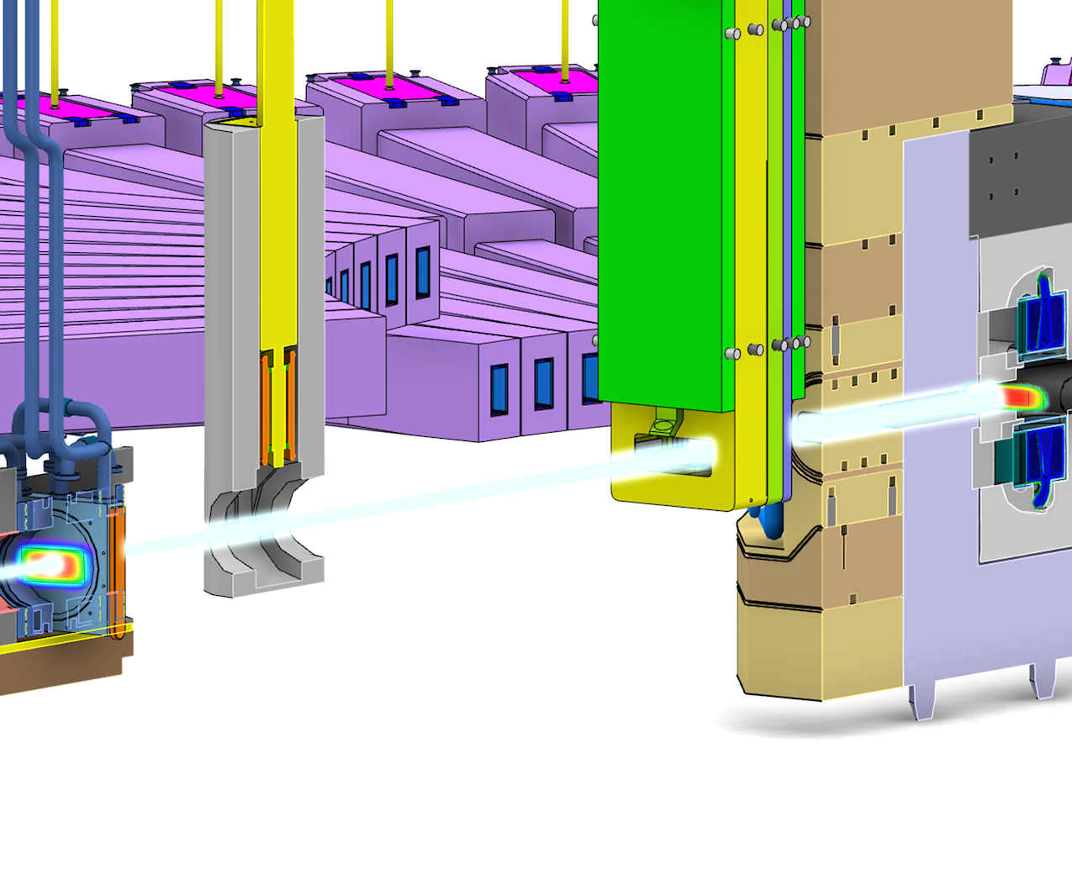
The Imaging Systems
Beam Profile Monitors inside a 5 MW target area
2 systems at the target
1 at the Tune-up dump (not shown)
Proton Beam Instrumentation Plug
Optics for Target imaging
Optics for Proton Beam Window imaging
Proton Beam WIndow
Rotating 33 sector tungsten target
Beam position monitor (BPM)
Aperturemonitor
Proton Beam Instrumentation Plug
Multi-wire grid
Upstream: position, current, aperture, and loss monitors

Slide 6
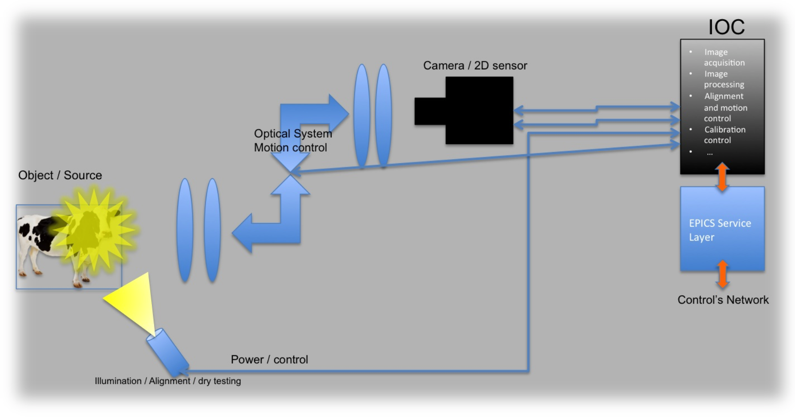
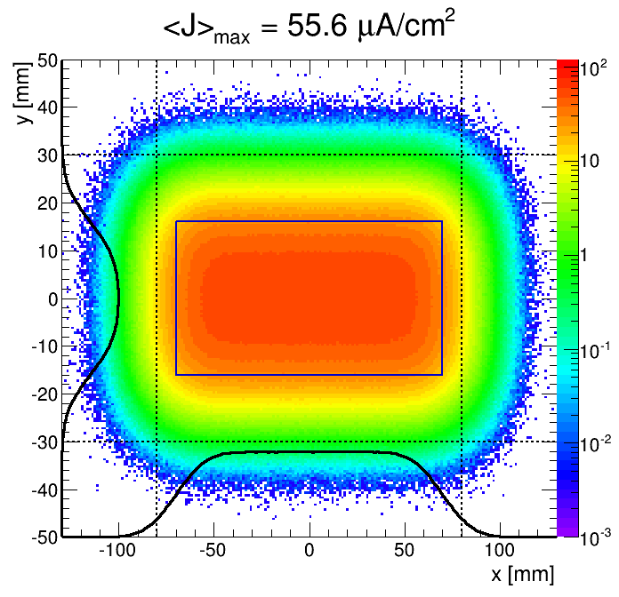
The sub-systems
3) Electronics
The end product
(what we care about) :
1) Photon source
2) Optical system
5) Commissioning GUIs
4) “Auxiliary equipment”
Development of the imaging system will be a collaboration Oslo and ESS

Slide 7
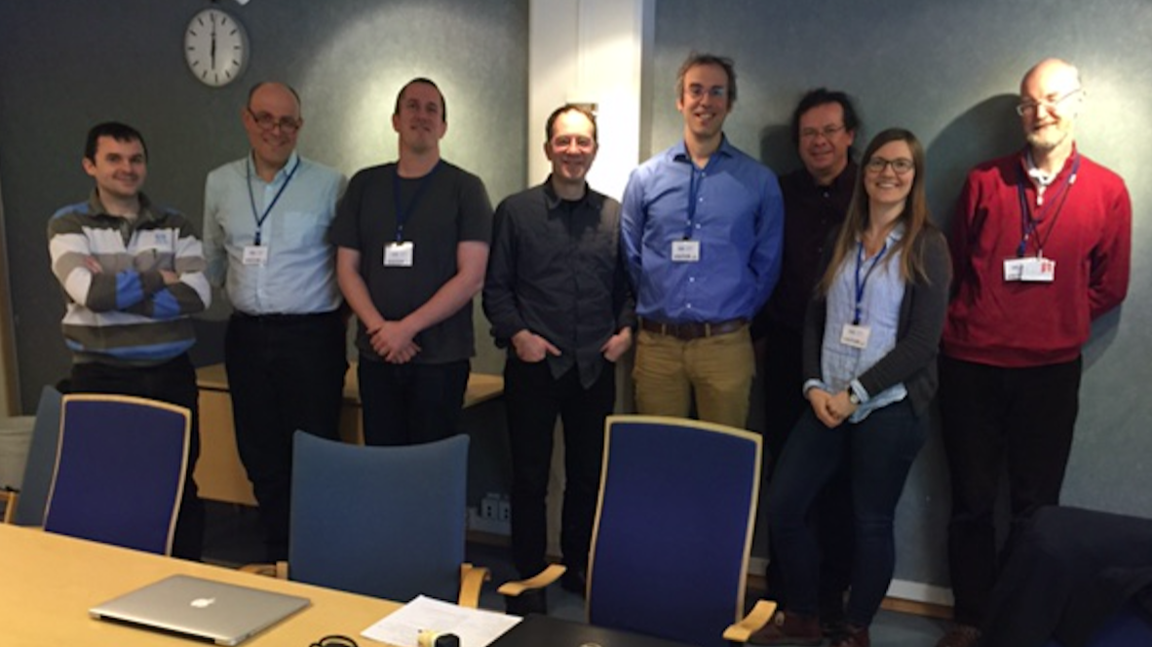
Oslo in-kind team
Erik Adli, project leader, ~ 20% (in practice, as needed)
Håvard Gjersdal, researcher, 100% for 4 years
Ole Røhne, senior researcher, 25% for 4 years
Martin Jaekel, senior researcher, 100% for 6 months (until completion of the PDR)
Maja Olvegård, representant for the Uppsala Univ. cooperation, researcher, 15% (for 4 years?)
Oslo Electronics workshop: estimated 1500 hours
Oslo Mechanical workshop: estimated 500 hours
Other expertise consulting cost: 50 kEUR
The Oslo group is well-connected with CERN detector and accelerator groups, and we profit from easy access to CERN expertise
2.6 FTEs + workshop up to PDR
1.6 FTEs + workshop after PDR

Slide 8
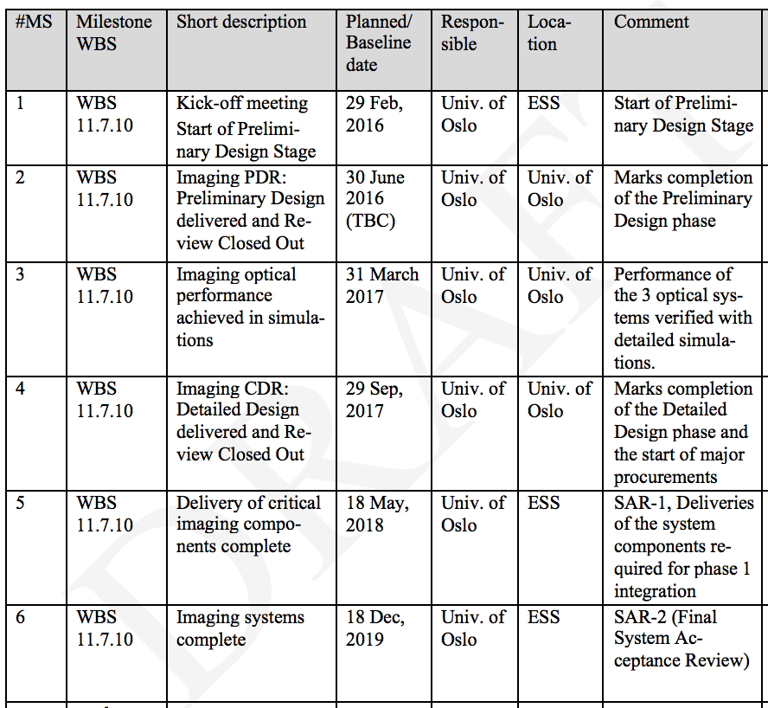
Schedule :

Slide 9
Optical system

Slide 10
(Draft) High level requirements
Source Dimensions: ~200 x 100mm (beam raster)
Optical Path Length: ~12.5m to shield wall
Resolution: <1mm
Physical Aperture: <100mm (mirrors) – shielding
Depth of Field: >4mm (angle of source plane)
Magnification: <0.1 overall (camera sensor)
Alignment, Access & Maintenance:
PBIP slices to be individually removable

Slide 11
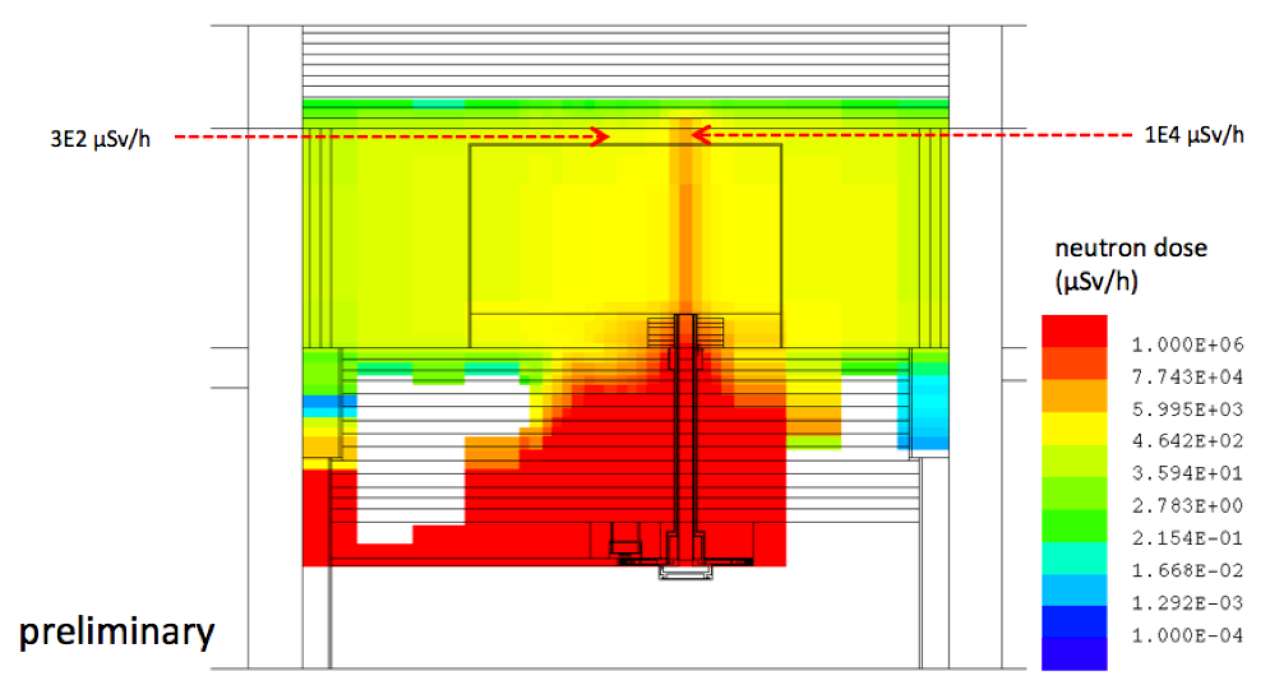
Target radiation environment
Greatly limits choice of materials and amount of automation possible.

Slide 12
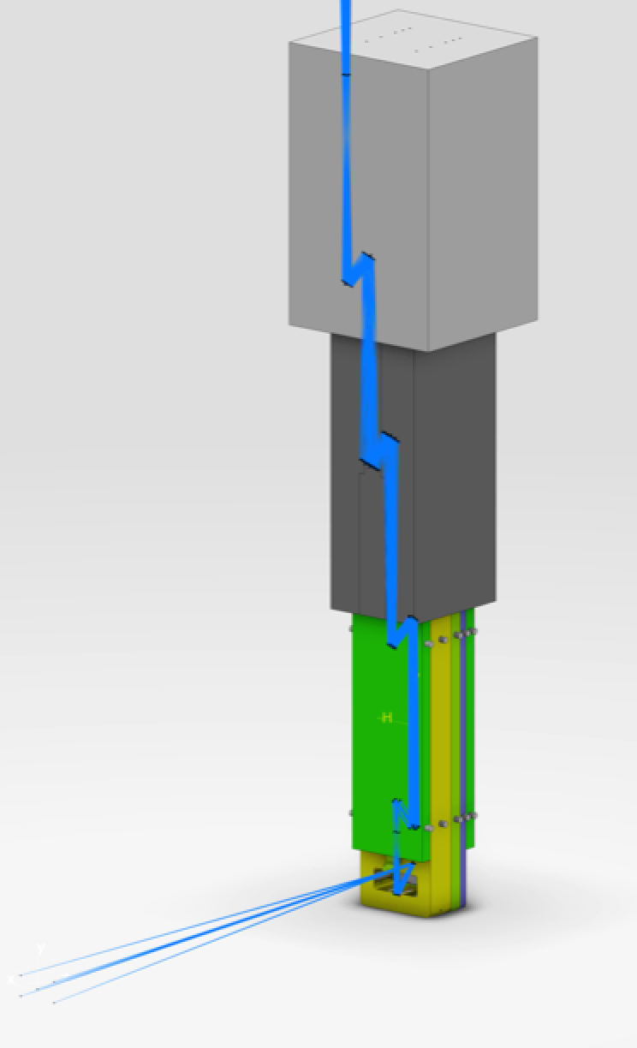
M4
6000 mm
Light cannot go straight up through plug. Shielding requirement seems to impose a narrow path (100 mm) and at least two turns.
500+1500 mm
M3
500+1500 mm
M2
Minimum
complexity
optical system?
2000 mm
See next talk: Dr. Mark Ibison, U. Liverpool, for the current state of the optical system design.
Significant challenge to find a robust light transport option, that fulfills requirements. Backup: fibres?
M1
2000 mm

Slide 13
The alignment problem
(early version)
?
N mirror system: (5N) dimensional alignment space, in each plane.
2 mirrors give a unique solution to angle/position of a ray of light.
For alignment, we need access to the light path for every second mirror, as minimum! (Each mirror will be much more comfortable).
We require, and have been promised (?), easy access and plenty of time to perform final alignment in plug, and plug-slices at first installation.
Will be very challenging to re-align plug after final installation. “All-nighter”
Must ensure that components are not misalignment during plug transport and final installation. Combination of rigid mounting, and cooling of all plug components, shock tolerances? “The PBIB is an optics table”
For me : one the main risks of the overall imaging system.

Slide 14
Thermo-mechanical analysis
Optics reaction to temperature increase must be investigated and mitigated.

Slide 15
Electronics

Slide 16
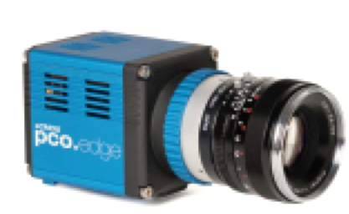
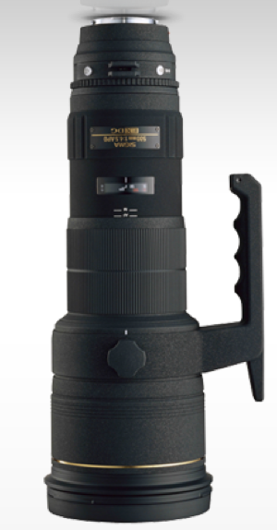
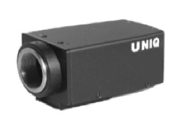
Auxiliary system
Auxiliary systems includes :
Spectrum analyzer, filters, illumination system
All the equipment must be easily accessible, under operation conditions :
“Tom’s room|” ?
Main camera, connected to the ICS
OD,
Band filters
Beam splitter (permanent?)
Spectrometer,
analyzer camera
OD,
Band filters
Beam splitter (for illumination)
Illumination laser

Slide 17
Need integration to ICS (“slow readout”), and “fast readout” for a “pulse OK” signal (to be considered for the BIS).
Started discussion with ESS on which standards to use, and what framework ESS will provide.

Slide 19
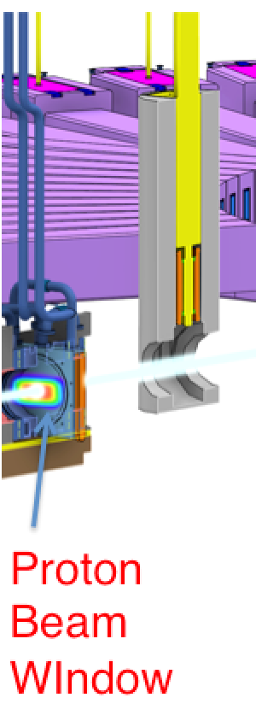
Possible photon sources
Scintillator light is current baseline for photon source (see next slides). Other generators of photons must be understood and taken into account either as alternative signal source, or as background.

Slide 20
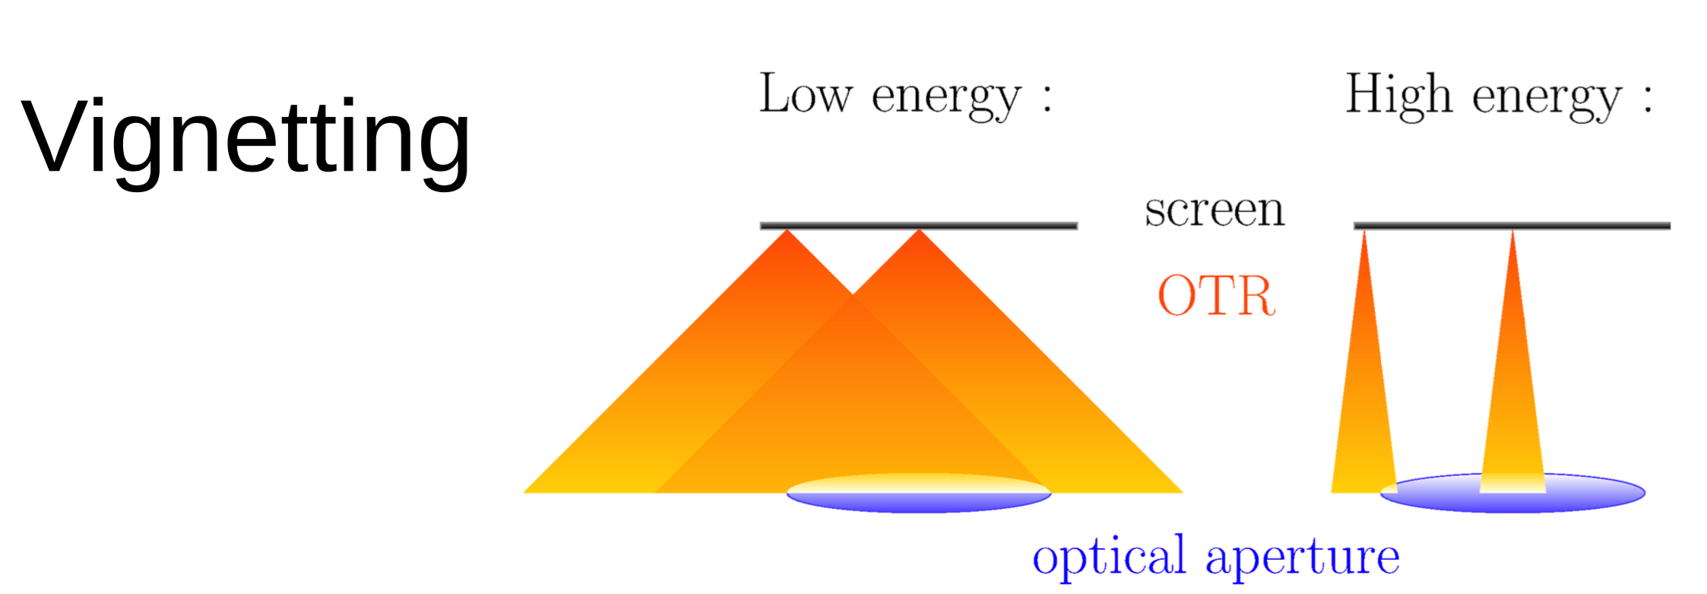
OTR light?
OTR: very robust photon source, but can it be used to produce a good image, and for which intensities? γ = 3 produce very wide light cones. Under study.

Slide 21
Coating development

Slide 22
Scintillator should be coated
Target philosophy: minimize the amount of material to introduce in the target chamber
“We have agreed with Target division that a 100 microns thick coating with the density of alumina would be appropriate for the aluminum proton beam window (Thermal load due to energy deposition in the coating).”

Slide 23
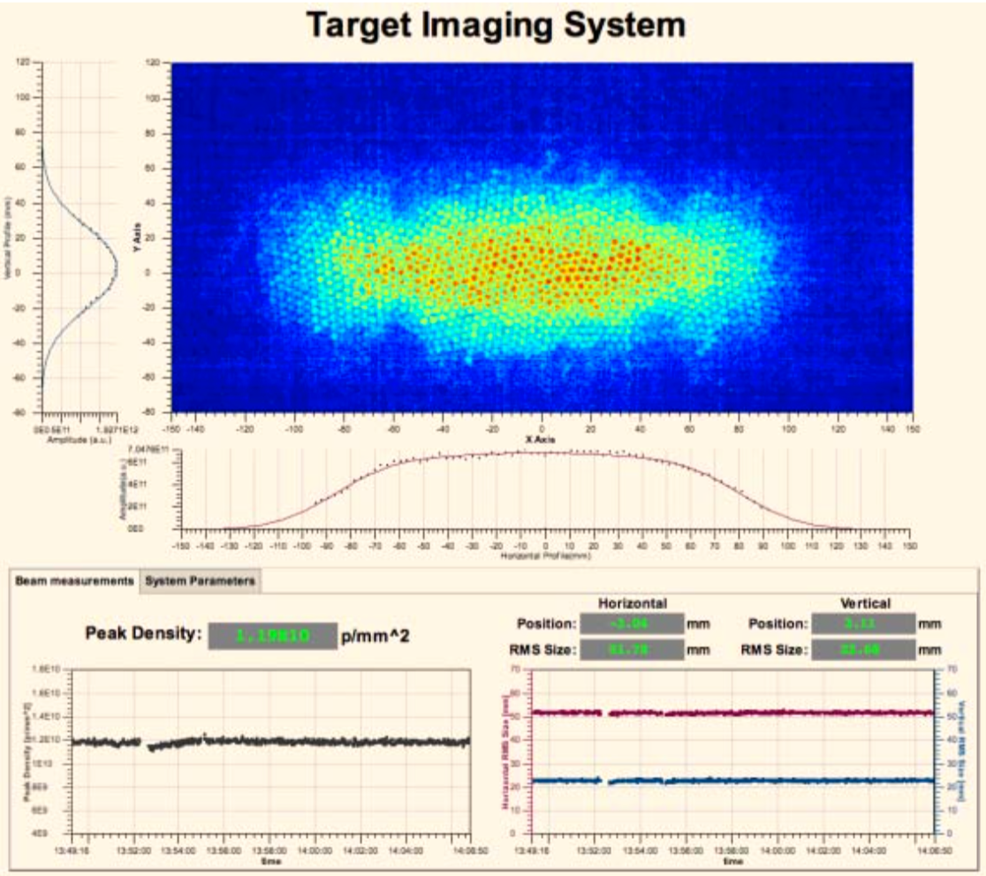
Predecessor: SNS system
SNS: Spallation Neutron Source, Oak Ridge, USA. Start-up 2006
Has a (poorly) working imaging system. 1 mirror, 3 lenses (fused silica) with fiber optics as main light optics source
could not focus because of fiber optics
trashy photo, because of fiber optics
Metal coating, Alumina doped with Chrome, Ruby lines
ruby lines disappears with flux
ruby lines decrease with temperature (cease to work at about 100 K)
Uniformity
ESS: 5 MW avg beam power, SNS 1.4 MW avg beam power (but higher peak surface current)
ESS coating must be thinner (why?)
GOTO :
http://www.lanl.gov/conferences/biw10/preprints/TUPSM003_preprint.pdf
Start of lifetime, looks ok?

Slide 24
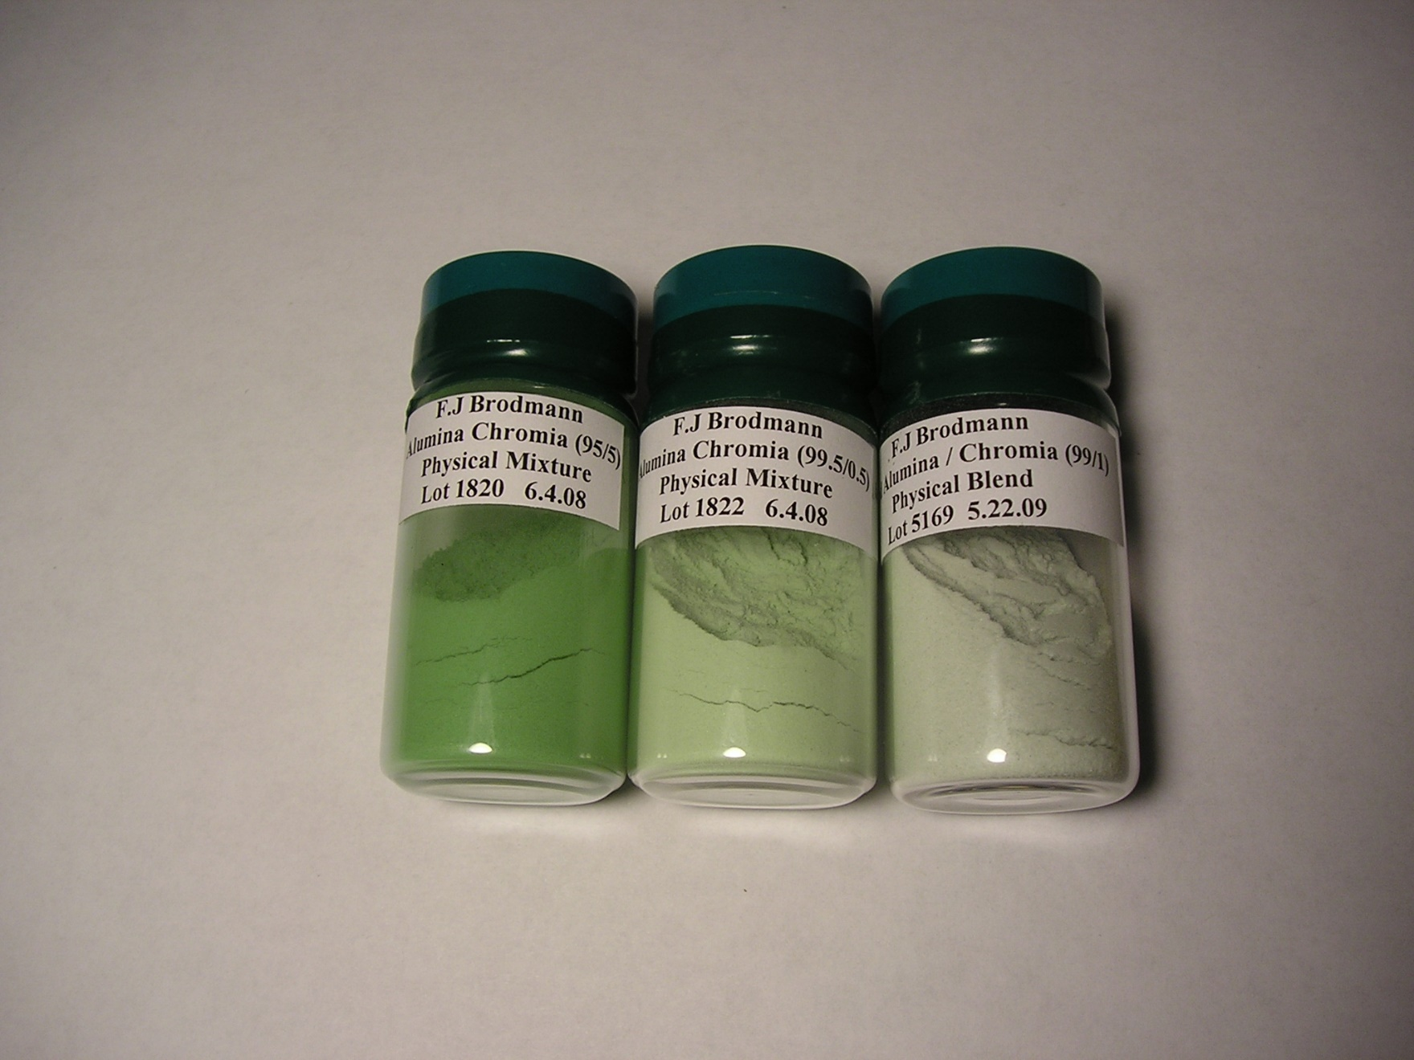
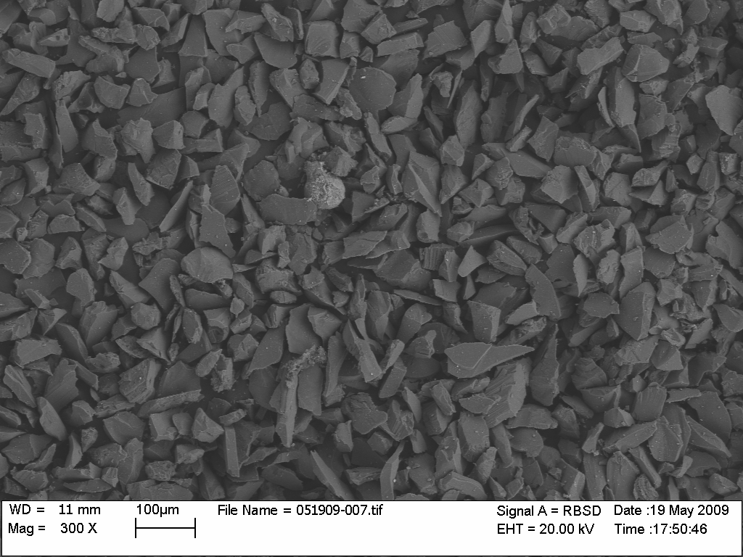
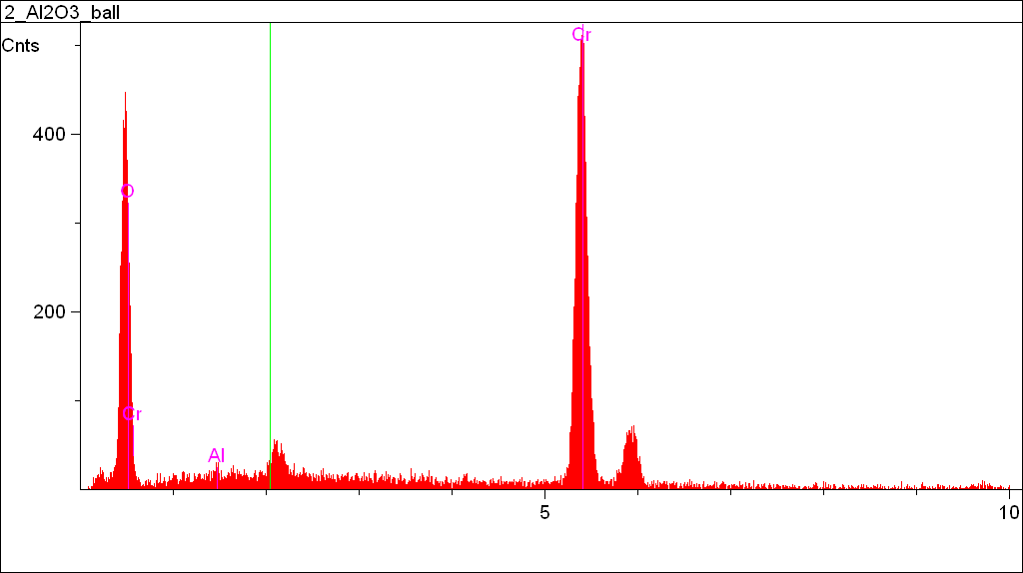
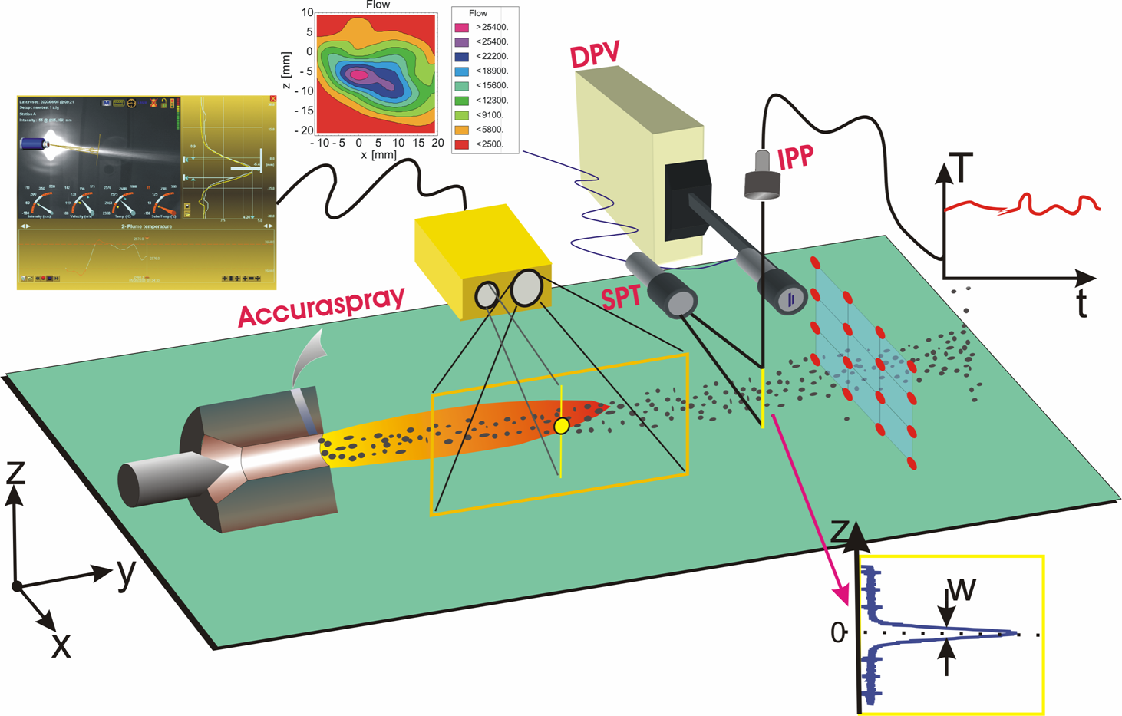
Scintillating coating
Coating must be flame/plasma sprayed onto surfaces.

Slide 25
SNS coating: challenge “numero uno”

Slide 26
SNS coating: challenge “numero dos”

Slide 27
Same base type of Scintillator also the one used for high power proton beam at CERN
Al₂O₃Cr0₃
The accelerator community, worldwide, seems to have not pushed scintillator development the last few decades. Opportunity to make progress?

Slide 28
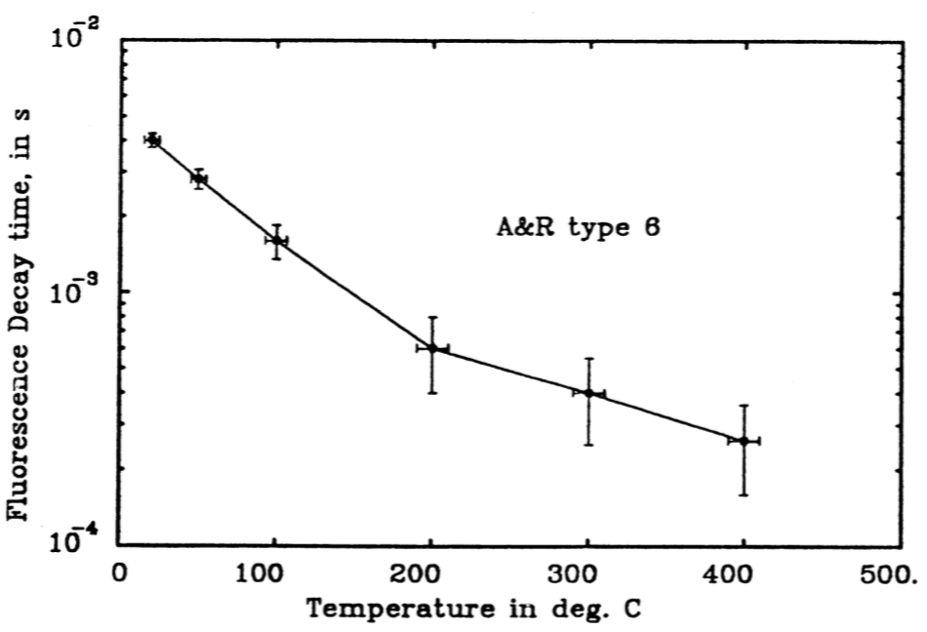
ESS + Oslo in-kind: scintillator research
In short: existing coatings are not expected to work satisfactory for the 5 MW ESS proton beam.
Coating R&D initiated by ESS. Oslo will participate. Attempt to synergy with CERN developments and interest, plus a number of other institutes.
Very interesting R&D collaboration taking form! (ESS, Oslo, Stony Brook, University West Trollhattan, GKN aerospace, Julich … ?)

Slide 29
Summary
Oslo in-kind partner for very challenging target proton beam imaging systems.
R&D will be done in cooperation with ESS.
The goal is robust and precise imaging monitors for the target (and dump), much improved over the SNS variant
Potential upside of the collaboration: improved scintillator technology for accelerator community ?

