Slide 1
BCM electronics: status and plans BI forum (Feb. 10th and 11th 2016)
Hooman Hassanzadegan
ESS, BI section

Slide 2
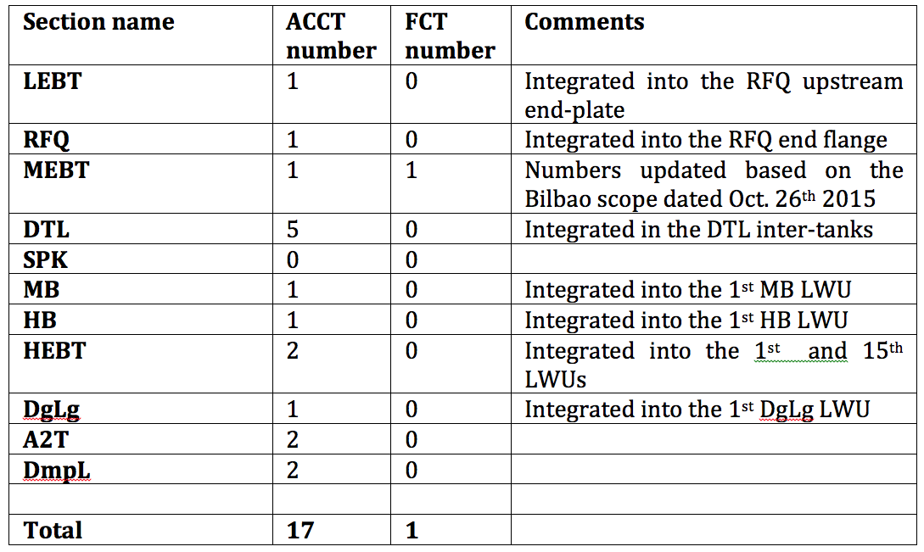
BCM no. and distribution
Draft summary of BCM number per linac section

Slide 3
BCM requirements (general)
3

Slide 4
Extract from the L-4 BCM requirements
4

Slide 5
BCM requirements (MPS)
5

Slide 6
BCM requirements (Beam Physics, LLRF, BI)
6

Slide 7
7
Slide taken from Tom Shea’s presentation: Beam Instrumentation to Protect the ESS Linac, 2015.08.15, CERN

Slide 8
8
Slide taken from Tom Shea’s presentation: Beam Instrumentation to Protect the ESS Linac, 2015.08.15, CERN

Slide 9
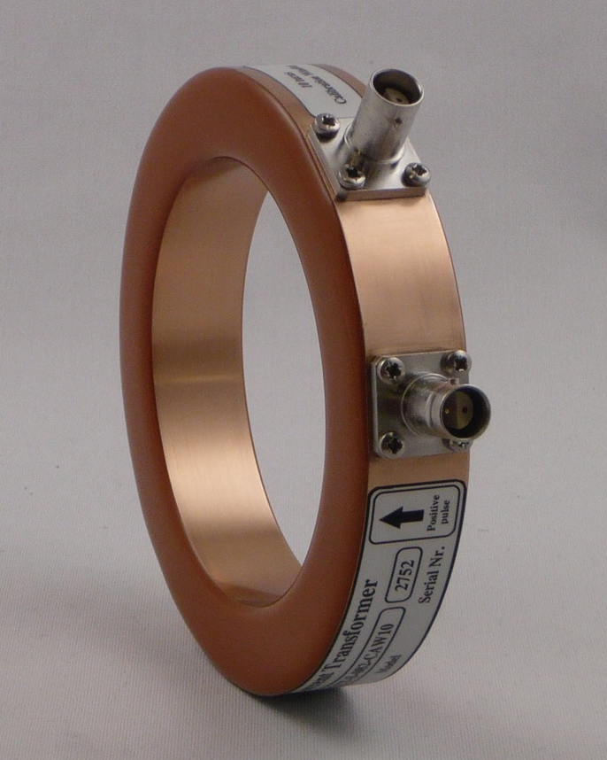
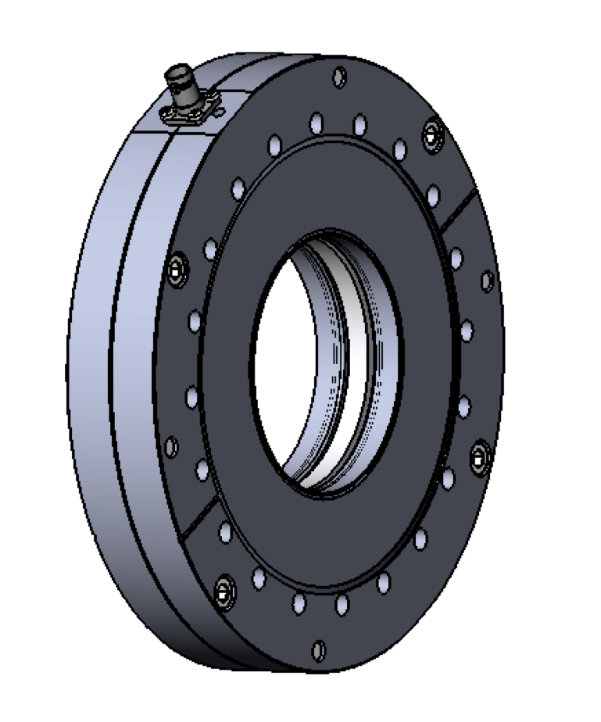
With the current Bergoz design, the ceramic will be exposed to the beam (ex. after particles are deflected by quad). The ceramic may then break as a result of charge building up on it (happened two times at SNS as reported by Tom Shea). This can be prevented by putting a thin conductive plate in front of the ceramic leaving a little gap on one end so that it doesn’t make a path for the image current.
Bergoz ACCT toroids
Based on the current design, the calibration cable needs to be terminated in 100 Ohm near the toroid.
Examples of Bergoz in-air (left) and flanged (right) ACCT toroids. Both sensors include a calibration winding. The later also includes shielding and ceramic break.

Slide 10
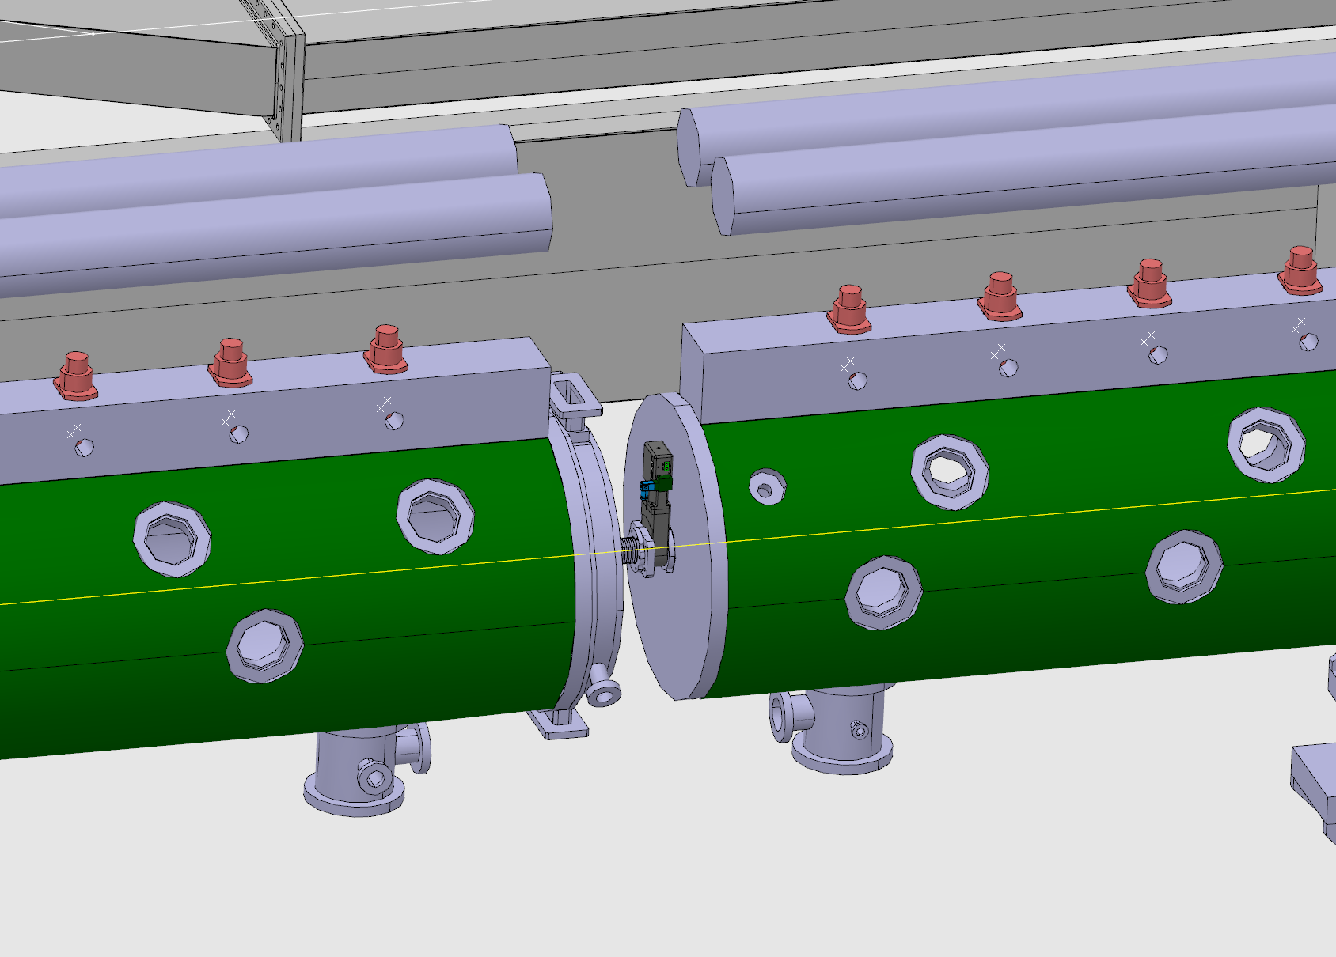
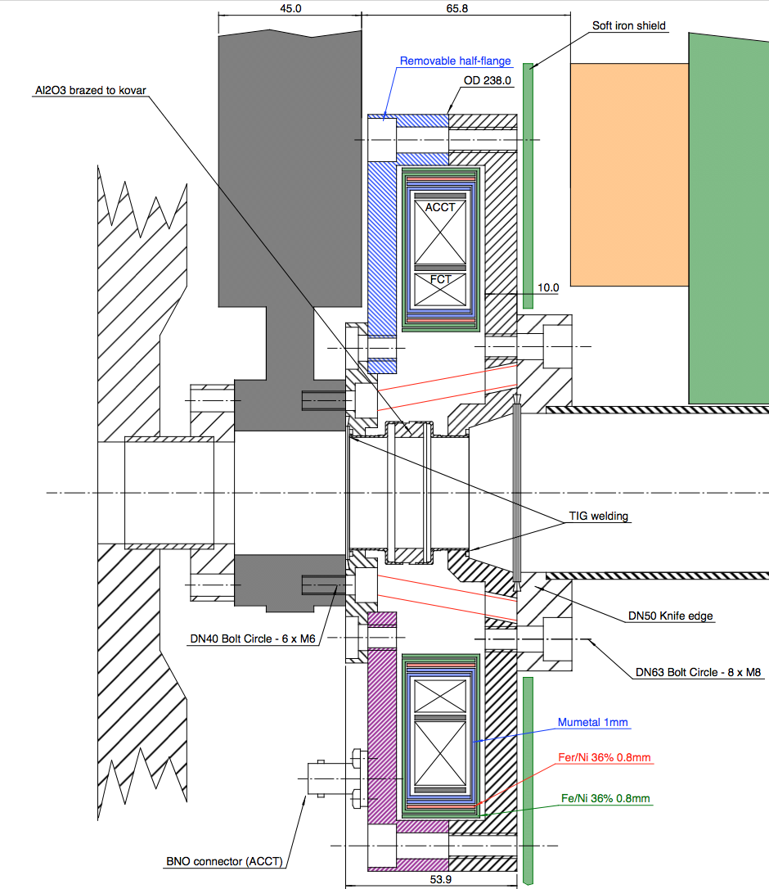
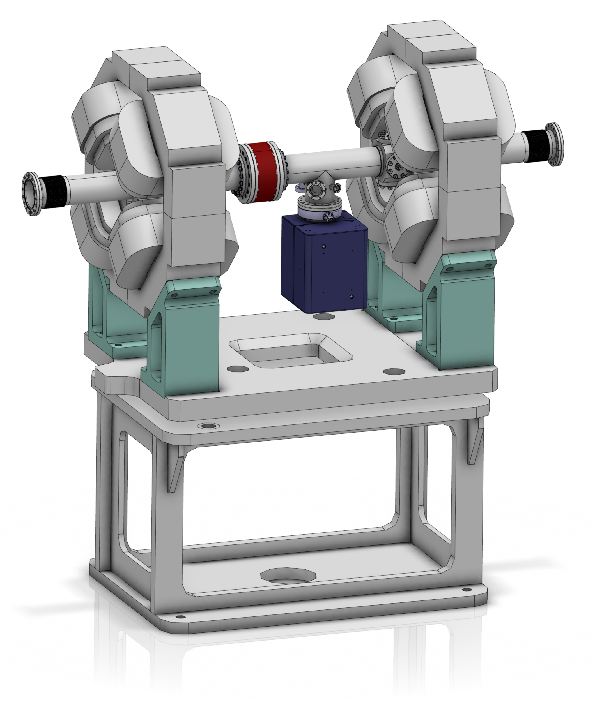
Mechanical integration
ACCT integration into the DTL inter-tanks
ACCT integration into the LWU
Example of ACCT integration into the RFQ-MEBT interface (IFMIF)

Slide 11
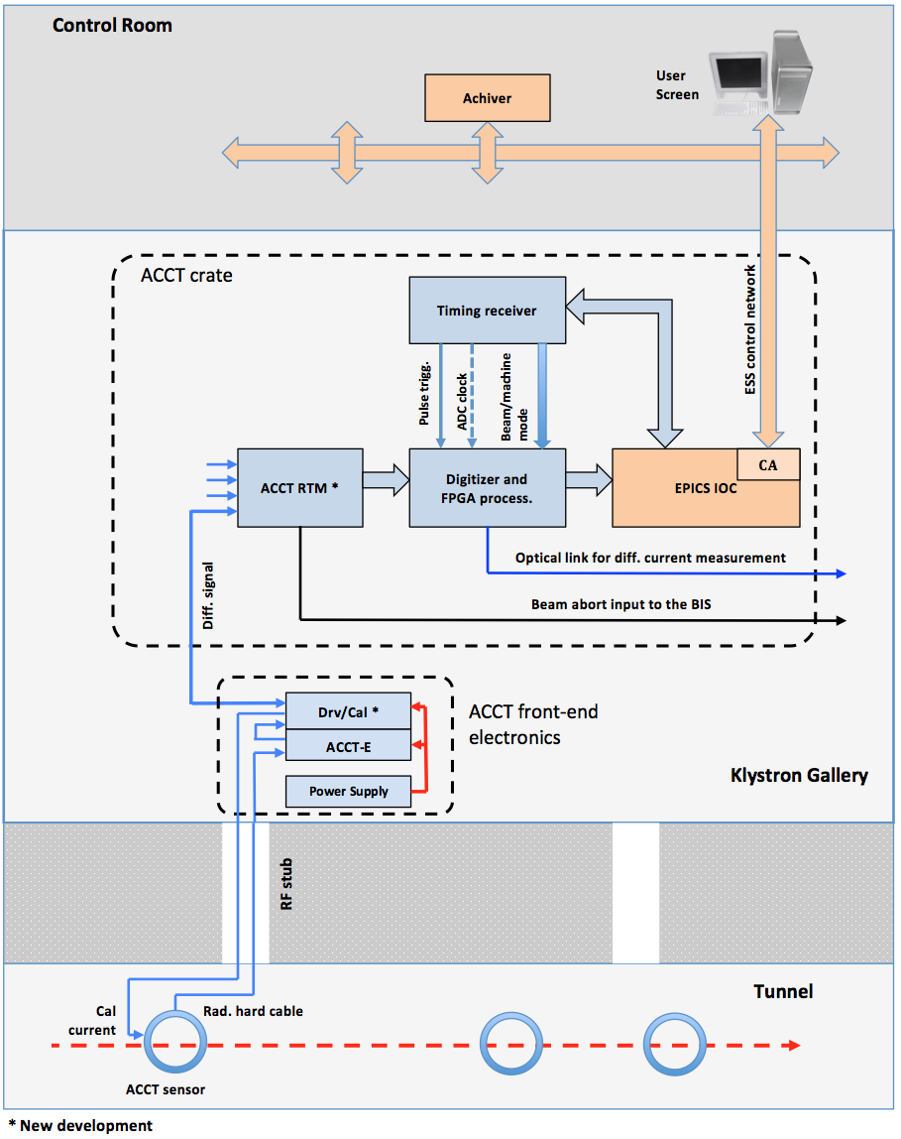
BCM system layout
Wrt the ACCT differential receiver, options include:
A custom RTM paired with a commercial AMC
A differential receiver FMC plugged onto a carrier AMC
A custom interface module matching the differential signal to a commercial RTM
Current thinking is to provide two identical outputs for the “Drv” so that they can be fed in parallel into two AMCs for redundancy.

Slide 12
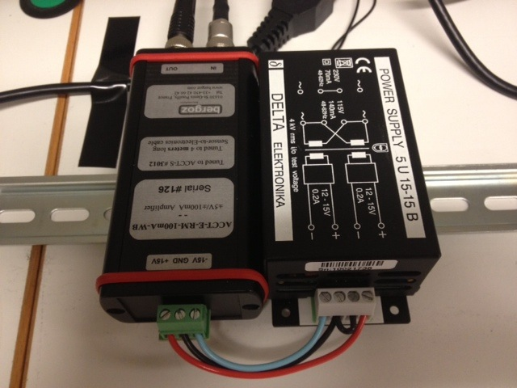
Bergoz front-end electronics
The Bergoz front-end unit (i.e. ACCT-E-RM) converts the ACCT output current into a proportional voltage with a full-scale range of +/-10 V.
It is important to connect the ACCT-E-RM output to high impedance.
The ACCT-E-RM is supplied by a Bergoz +/-15 V power supply.
Both the ACCT-E-RM and power supply are rail mount
The front-end electronics should be installed in a small wall-mount box in the klystron gallery at the head of the RF stub.

Slide 13
Drv/Cal module
The ACCT-E-RM output is fed into the Drv/Cal module that should sit next to the ACCT-E-RM and supplied by the same power supply.
The Drv/Cal module will then convert the single-ended output of the ACCT-E-RM to differential and feed this signal into a CAT-8A cable that is terminated in 100 Ohm at both ends.
The Drv/Cal module will also generate a calibration current pulse out of the digital calibration pulse from the RTM. The Drv/Cal module will then convert this pulse to have a fixed current and feeds it into the ACCT calibration winding.
The Drv/Cal module will be a new development. Circuit schematics has been received form M. Werner (DESY) based on an ESS-DESY MoU and technical annex.

Slide 14
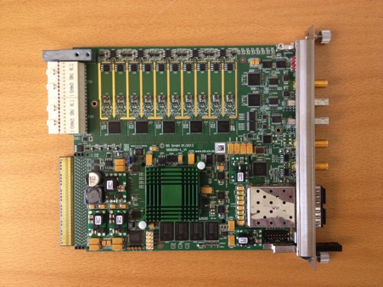
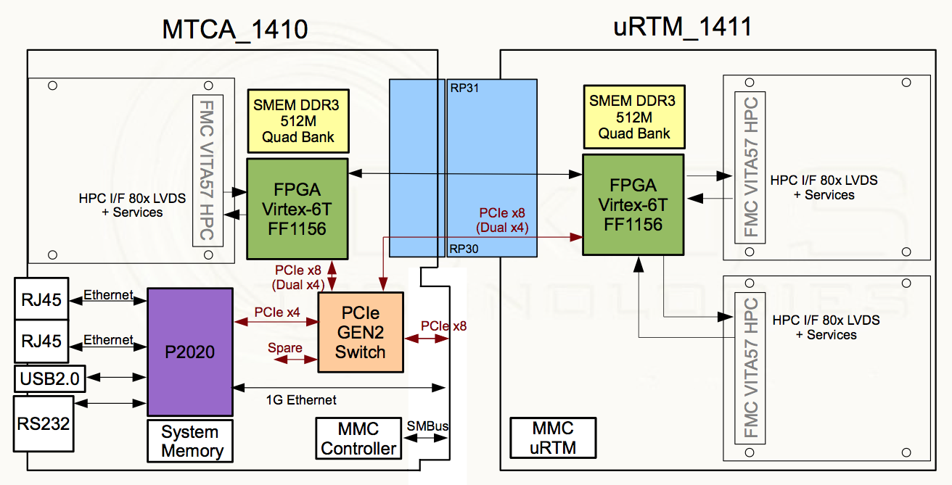
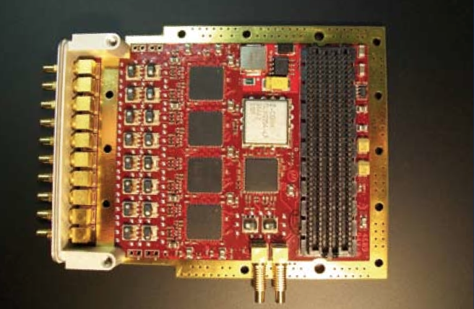
AMC/RTM
Solution A – Struck (or similar) ADC/FPGA AMC to be paired with a custom RTM:
- Custom ACCT RTM or
- Commercial RTM + custom interface module
+
Solution B – IOxOS (or similar) carrier AMC with a COTS differential receiver FMC:
+

Slide 15
Struck SIS8300-L specifications
Ten 16-bit/125 MSPS ADC input channels
4x4 Gbit (default) DDR3 memory
Two Gigabit transmitter/receiver SFP slots
Two dedicated user clock inputs (TCLKA and TCLKB)
8 bidirectional differential interfaces to the backplane bus
Virtex 6 FPGA

Slide 16
Differential ACCT layout (preliminary)
LEBT
MEBT
DTL
LEDP…
2.4? m
6.4? m
10.0? m
42.4? m
IS
LEBTCHOP
FC
RFQ
MEBTCHOP
FC
FC
FC
1
2
3
4
5
6
7
valve
valve
valve
FCT
valve
valve
valve
Beam
destination:
1
S
S
2
S
3
S
S
S
4
S
>4
Explanation:
ADC/FPGA module
PERMIT
BIS
FC
Faraday Cup
Signal splitter
at ACCT-E box
ADC/FPGA module
PERMIT
S
Redundancy by two ADC/FPGA modules in parallel.
Beam destination has to be communicated to the ADC/FPGA modules (over backplane).
This scheme assumes that valves are always open during beam operation.
Signal splitter: the output of the ACCT-E box is connected to a dual output differential signal transmitter. Attention: a power supply with higher current may be necessary!
Draft differential interlock layout provided by M. Werner (DESY)

Slide 17
Permit handler
From ADC
Baseline & droop
Scaler
Cross-bar-switch
Diff-Interlock
Check shape
From ADC
Baseline & droop
Scaler
Diff-Interlock
Check shape
From ADC
Baseline & droop
Scaler
Number of diff. Interlock stages: see description!
Check shape
From ADC
Baseline & droop
Scaler
Check shape
Diff-Interlock
Test signals
From ADC
Baseline & droop
Scaler
Check shape
Diff-Interlock
BIS-Interface
BIS
From ADC
Baseline & droop
Scaler
Check shape
Diff-Interlock
provided by
ESS / MPS
From ADC
Baseline & droop
Scaler
Check shape
From ADC
Baseline & droop
Scaler
MEBT chopper protection
FPGA pins
Check shape
From ADC
Baseline & droop
Scaler
PERMIT
BIS Backbone
Check shape
From ADC
Baseline & droop
Scaler
Not all connections are shown!
Check shape
BCM Firmware block diagram (draft) V03
01.12.2015
Trigger
Serial Timing data receiver (provided by ESS)
Manual calibration support
FPGA pins
Data interface to DDR memory
(provided by ESS)
17
Draft BCM firmware block diagram layout provided by M. Werner (DESY)

Slide 18
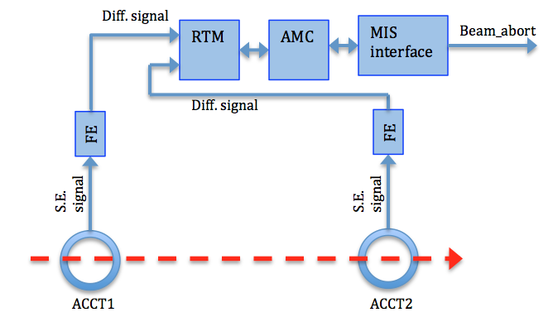
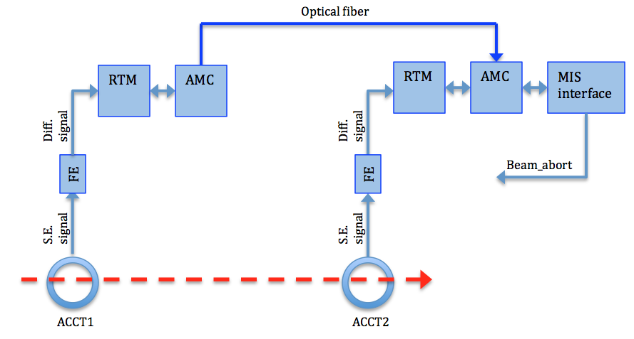
Differential current measurement with the ACCTs
The implementation of the optical line needs significant effort. The idea is to start with the differential line that should be enough for down to the DTL end. The optical line can be added later for the downstream sections where the ACCT separation is much larger.
differential ACCT signal transmission over differential lines
differential ACCT signal transmission over optical fiber

Slide 19
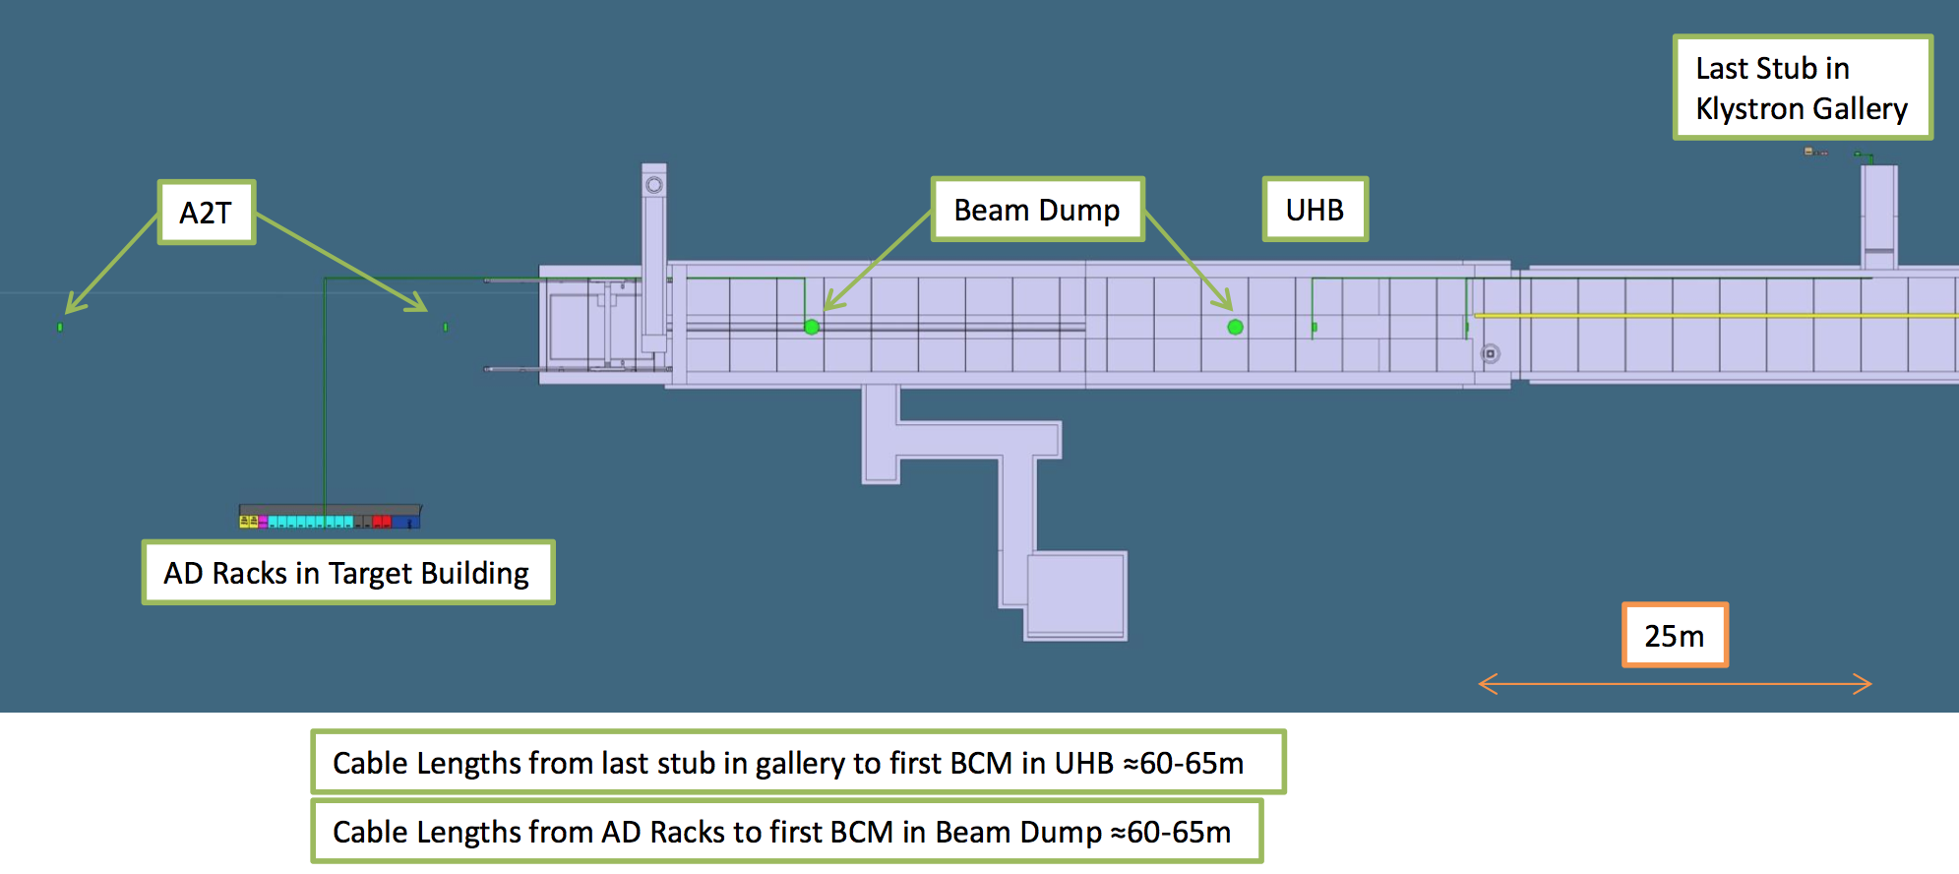
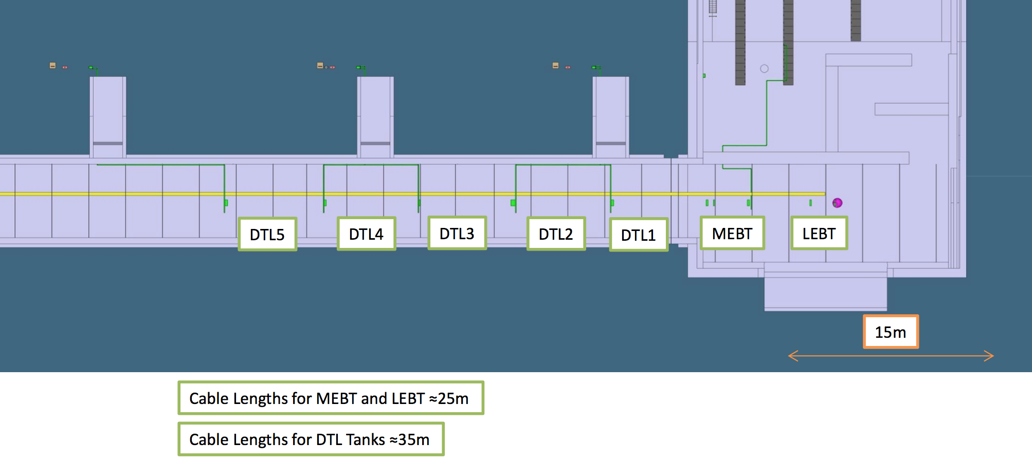
ACCT cabling
Based on the Bergoz ACCT specifications, the ACCT-to-FE cable length should not be longer than 25 m. In areas where this will not be possible, the FE electronics can be slightly modified by the manufacturer to allow longer cable lengths at the expense of degrading the ACCT response time, rise time and bandwidth to some degree.
The ACCT-FE cable length is expected to be about 25 m in the LEBT and MEBT sections. The length then increases to about 35 m in the DTL and 60-65 m in the high-energy end of the linac.
We need to talk to Bergoz to see how much the ACCT response will become slower as a result of the increased cable length.

Slide 20
Timing requirement for the electronics
Trigger/consistency check:
Although the ACCT firmware will include a self-trigger mechanism that will trigger on the edge of the beam pulse, an external trigger will still be needed for the purpose of consistency check. The beam can then be stopped if the frequency of the trigger is not within the acceptable range, or if a beam pulse does not arrive shortly after each trigger.
Beam/machine mode data:
The beam/machine mode data need to be transferred to the ACCT readout electronics using the timing system. The ACCT readout electronics will know the expected pulse current/width from the beam mode and the expected beam destination from the machine mode. This information will then be used to correctly configure the electronics including the width of the averaging filters and the masking/unmasking of some interlocks.
ADC clock:
Although this is not strictly required, it is generally preferred that the ADC clock frequency be locked to RF. An external ADC clock of 88.0525 MHz (¼ of the 352.21 MHz RF frequency) can be provided by the timing receiver module and transferred to the ACCT AMC through a dedicated clock line of backplane.

Slide 21
LEBT ACCT plan (next 15 months)
An ACCT toroid should be delivered by Oct. 2016 to Catania-Italy for the ESS LEBT (type and size should be confirmed by Catania).
A pre-version of the LEBT ACCT firmware should to be developed and integrated into the generic Struck SIS8300-L firmware by the end of 2016. This pre-version will include MPS feature, but interfacing with the timing system and ACCT calibration is not foreseen for this version.
The commercial electronics, including the MTCA chassis, power supply, CPU, MCH, Struck SIS8300-L and RTM should be procured and integrated by Oct. 2016 -> this may be postponed to the end of 2016 to match the firmware delivery date.
Software development should go in parallel with the firmware and become available by the end of 2016. This effort can be minimized if an already-existing ACCT software could be modified and used for the new firmware.
Assuming a commercial RTM (ex. SIS8900) will be used, a custom interface module should be provided to match the ACCT-E output to the RTM input. This can be a temporary solution until final boards become available.
Test with the ion source and LEBT is planned to start in mid-March 2017.

Slide 22
Supporting slides…

Slide 23
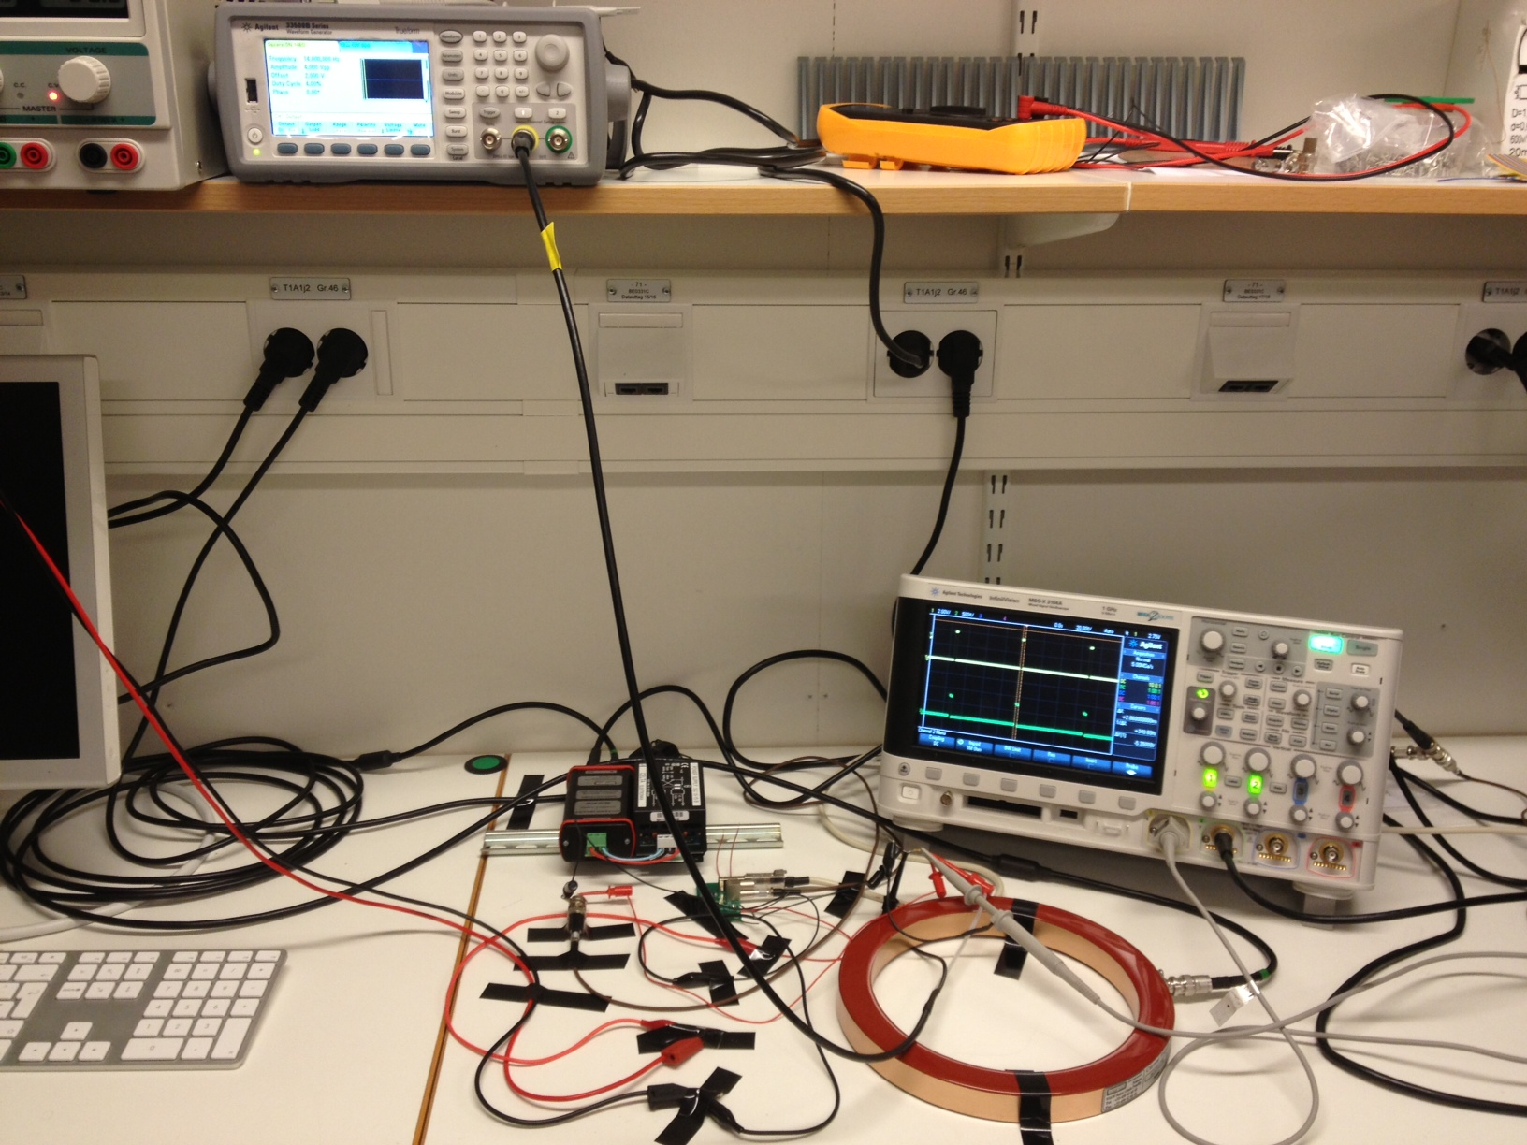
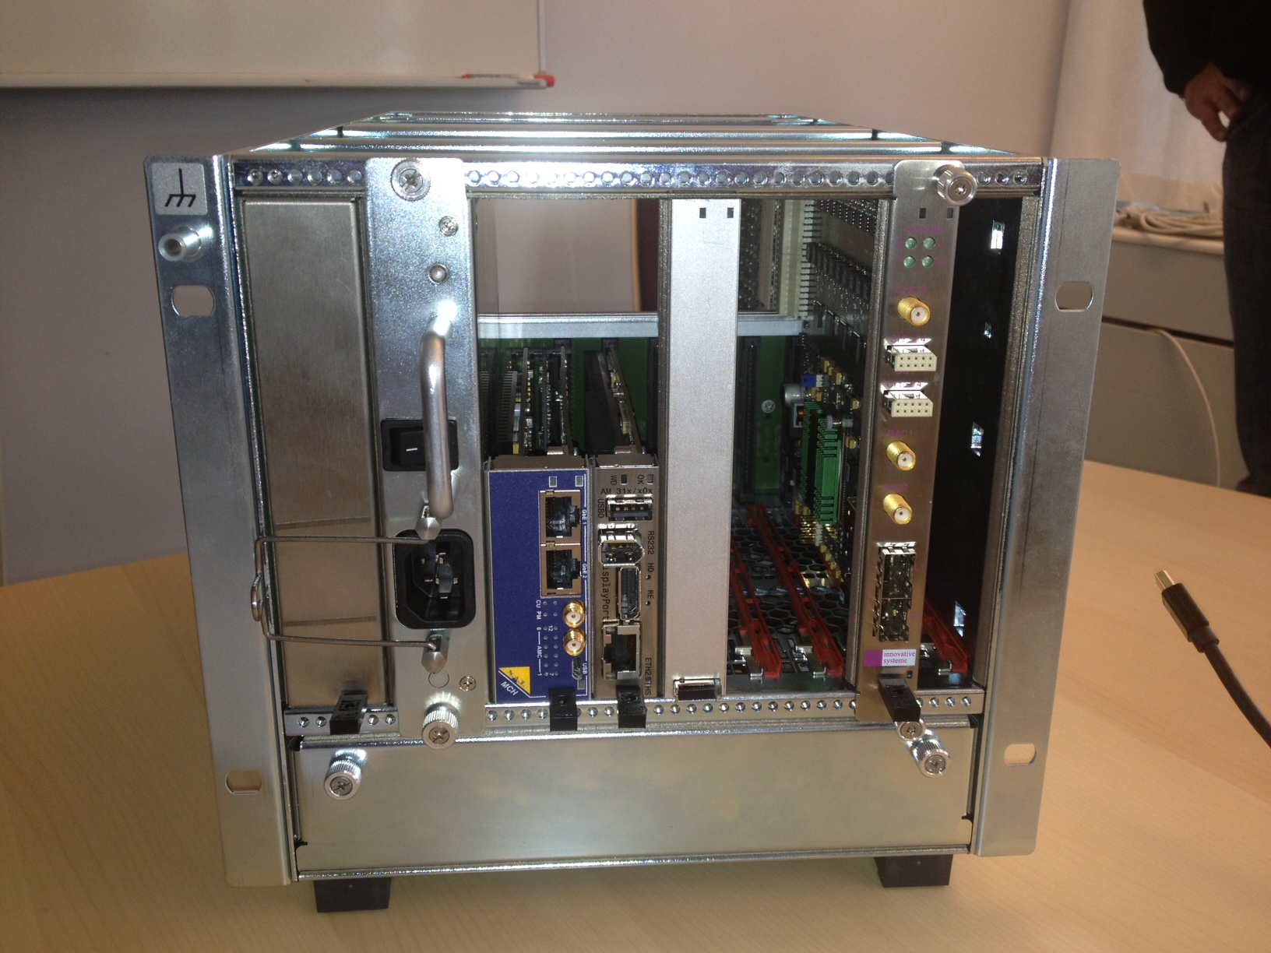
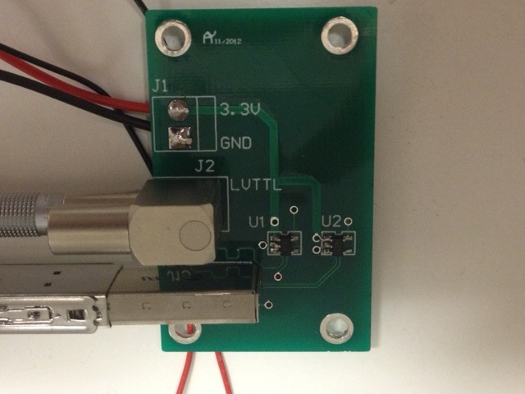
ACCT tests
MTCA.4 demo crate hosting a Struck digitizer card and a RTM
ACCT test setup (electronics lab.)
TTL – LVDS converter board
(trigger input for the digitizer)

Slide 24
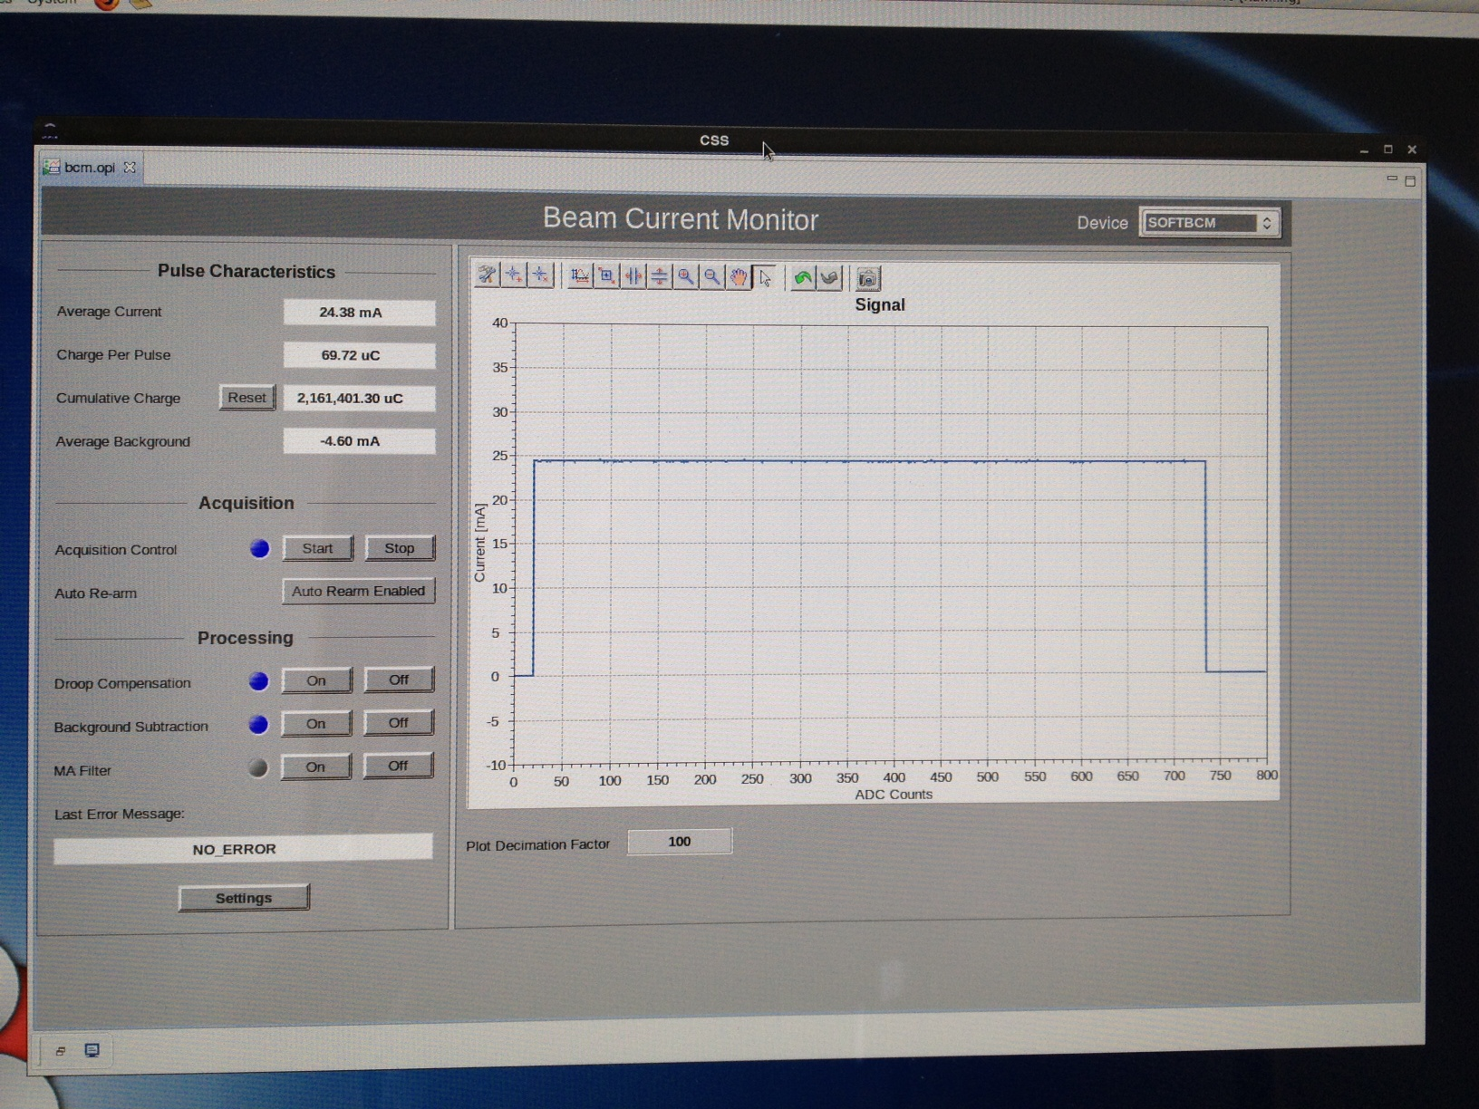
EPICS integration and controls
EPICS-integrated BCM GUI showing pulse current, charge and profile

Slide 25
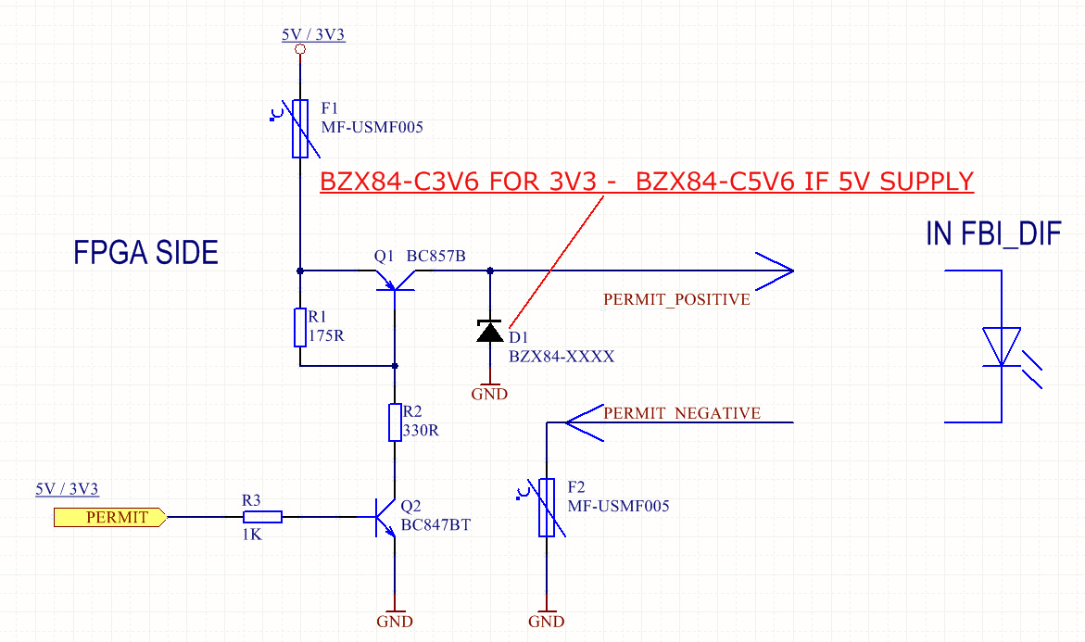
MIS interface
Based on the ESS MPS requirements, the MIS interface should consist of a beam_permit interface that is driven by the ACCT FPGA and a permit_test interface driven by the MIS.
With the ACCT RTM option, both the both beam_permit and permit_test interface circuits will be implemented on the RTM.
There will be one or two (for redundancy) of these interfaces on the ACCT RTM. Aggregation will then be done at firmware level.
With the FMC option, the interface circuits should be replaced by another FMC with similar electrical specifications (details TBD).
circuit schematics of the beam_permit and permit_test interfaces (source: ESS MPS group)

