Slide 1
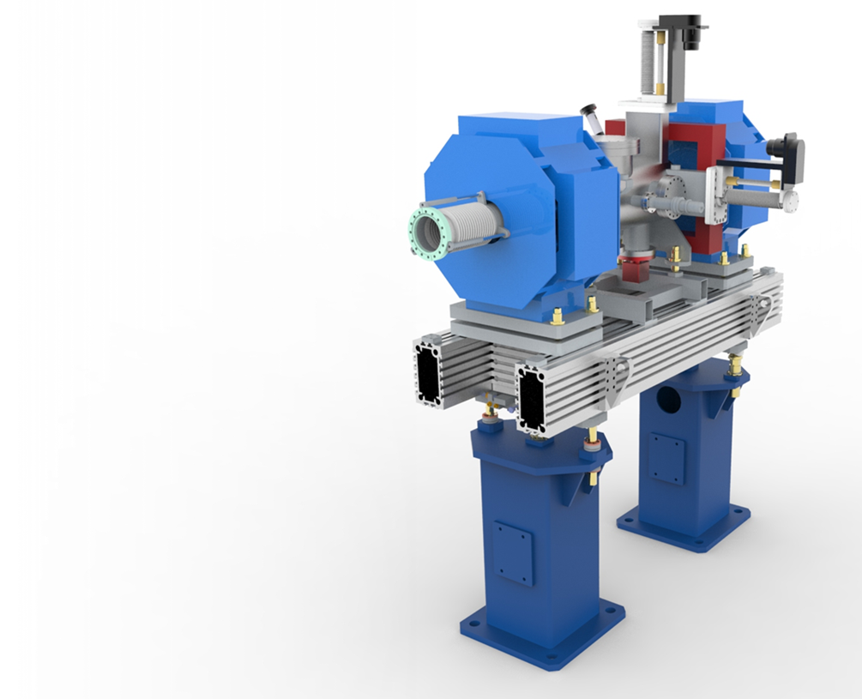
Update on Work Package 12
Beam Transport Modules (LWUs) - UK-A-6
Dr Paul Aden, STFC Daresbury Laboratory
ESS Beam Diagnostics Forum, Lund, 11th February 2016

Slide 2
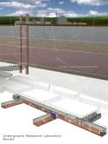
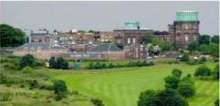
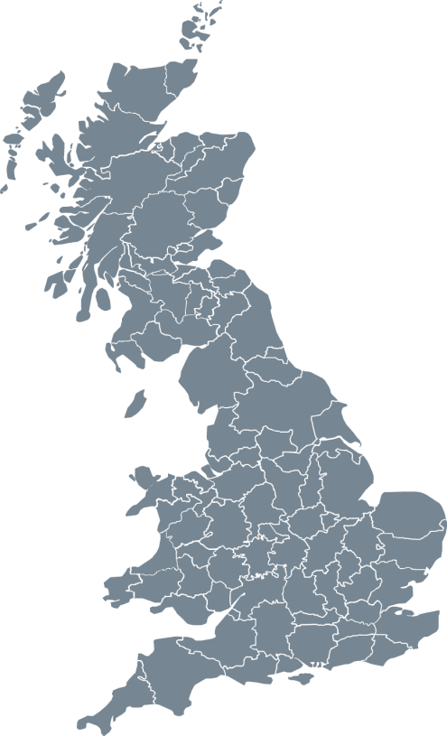
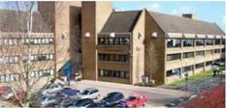
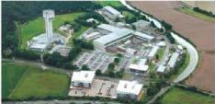

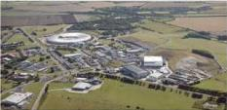
STFC
UK Astronomy Technology Centre
Edinburgh, Scotland
Boulby Underground
Laboratory
North Yorkshire
Polaris House
Swindon, Wiltshire
Daresbury Laboratory
Sci-Tech Daresbury Warrington, Cheshire
Chilbolton Observatory
Stockbridge, Hampshire
Rutherford Appleton Laboratory
Harwell Didcot, Oxfordshire

Slide 3

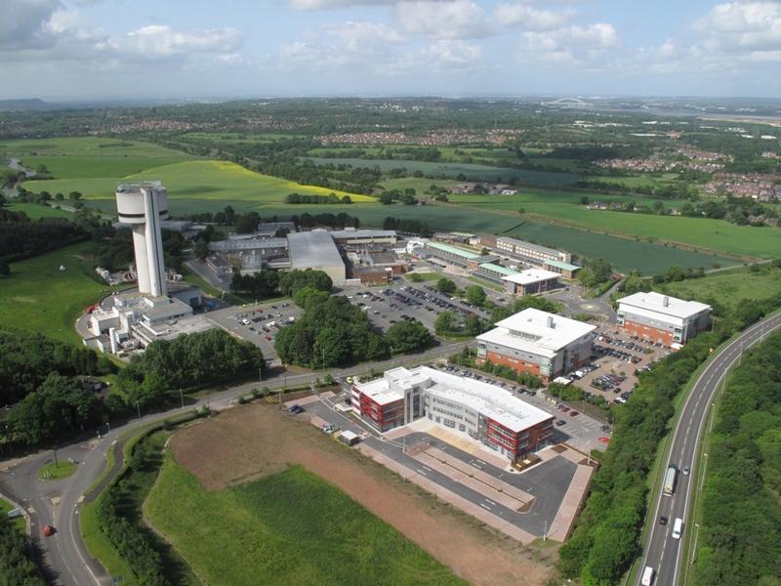
STFC, Daresbury Laboratory

Slide 4
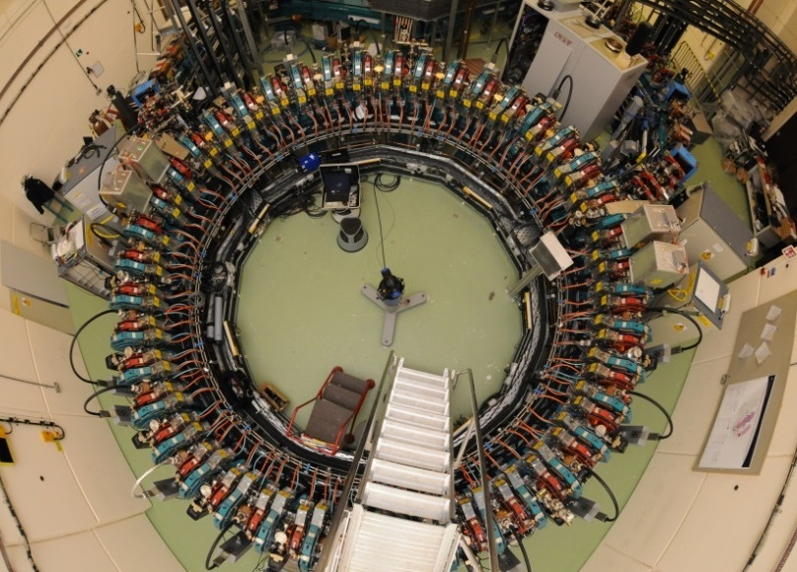
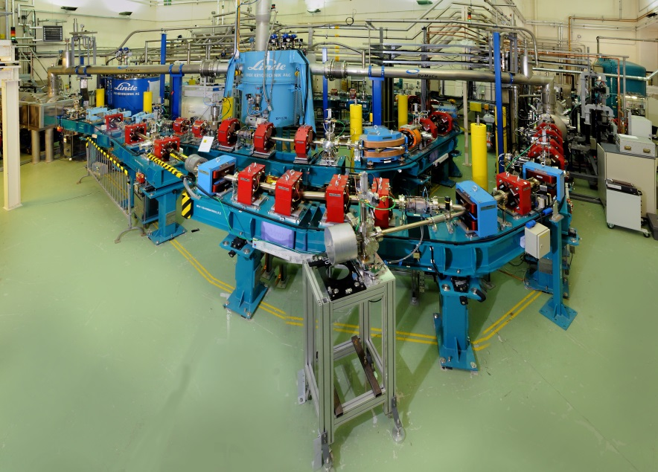
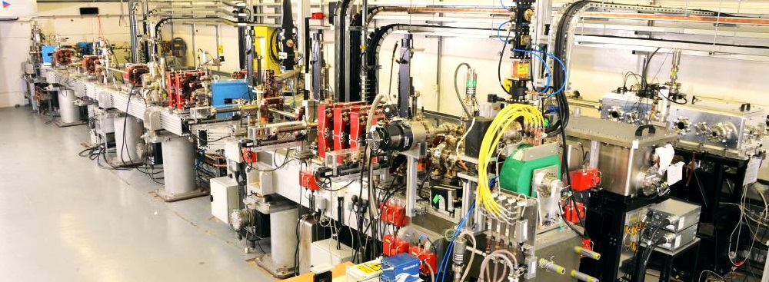
3 Onsite Accelerators
EMMA
ALICE
VELA
Notes:
ALICE (Accelerators and Lasers In Combined Experiments) is an accelerator which has been designed and built at Daresbury Laboratory. It was formerly known as ERLP (Energy Recovery Linac Prototype).
EMMA (Electron Model for Many Applications) is a non-scaling FFAG (Fixed Field, Alternating Gradient) accelerator and is currently under operation at Daresbury Laboratory. It is the first time to demonstrate this type of accelerator.
The Versatile Electron Linear Accelerator (VELA)

Slide 5
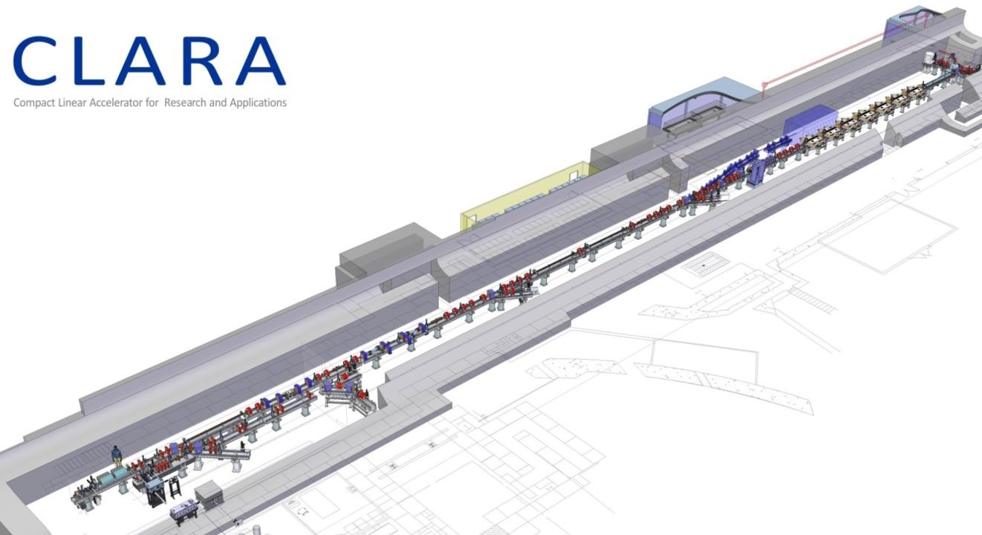
CLARA - under construction
Notes:
Compact Linear Accelerator for Research and Applications
Uk X-ray Free Electron Laser (FEL),
Part of ASTeC’s future strategy is to develop a next-generation light source test facility to be constructed at Daresbury Laboratory. This new proposed test accelerator will be known as CLARA (Compact Linear Accelerator for Research and Applications). The CLARA project aims to build on the UK’s existing expertise and experimental experience in free electron lasers, to pave the way for a state-of-the-art FEL facility in the UK, while simultaneously contributing to international R&D.

Slide 6

BTM WP Scope
To design, procurement and assemble;
  2 Prototypes
  3 Test Chambers
  75 LWUs
  52 Beam pipe modules
  2 Differential pumping systems
  2 mobile installation cleanrooms
Particle control only on 52/75 LWUs
BPM work package
  Only electrical centre measurement
  BPMs are to be supplied by DESY
Notes:
Over the next four years we have been asked to delivery …

Slide 7
Schedule
2015 | 2016 | 2017 | 2018 | 2019 | 2020
Prototypes
PDR Nov 15
CDR June 16
BTM Assembly
BP Assembly
LWU Assembly
Installation Cleanrooms
Differential Pumping System 1
Differential Pumping System 2

Slide 8
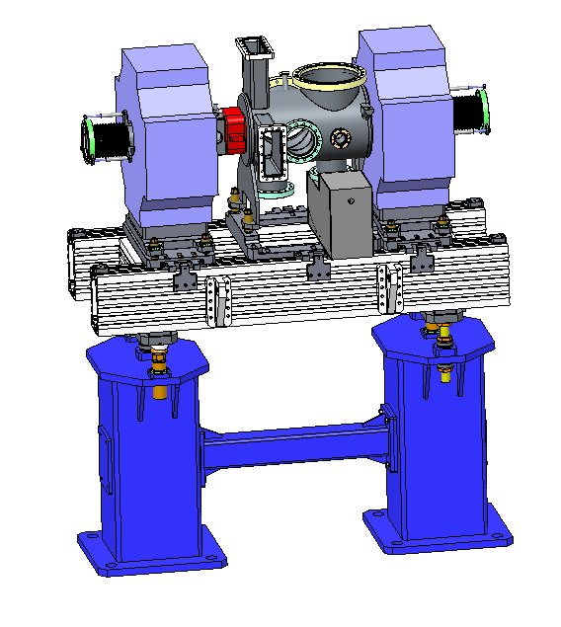
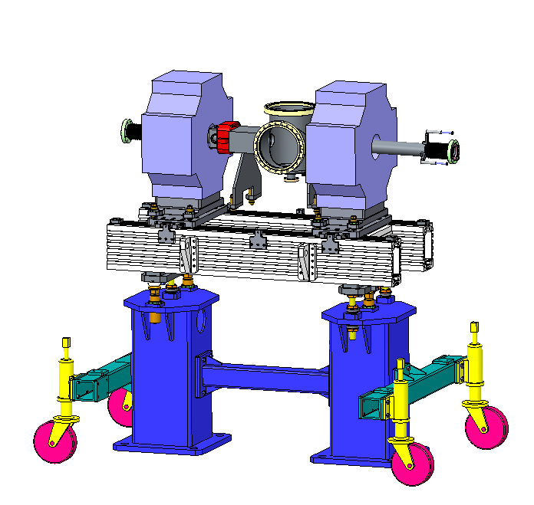
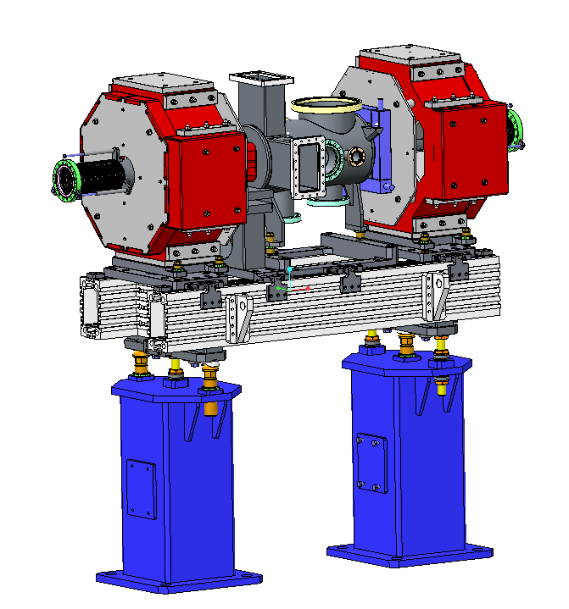
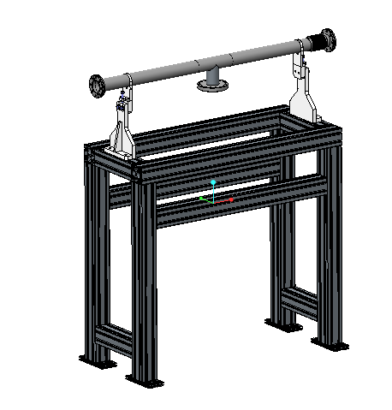
Design Progress

Slide 9
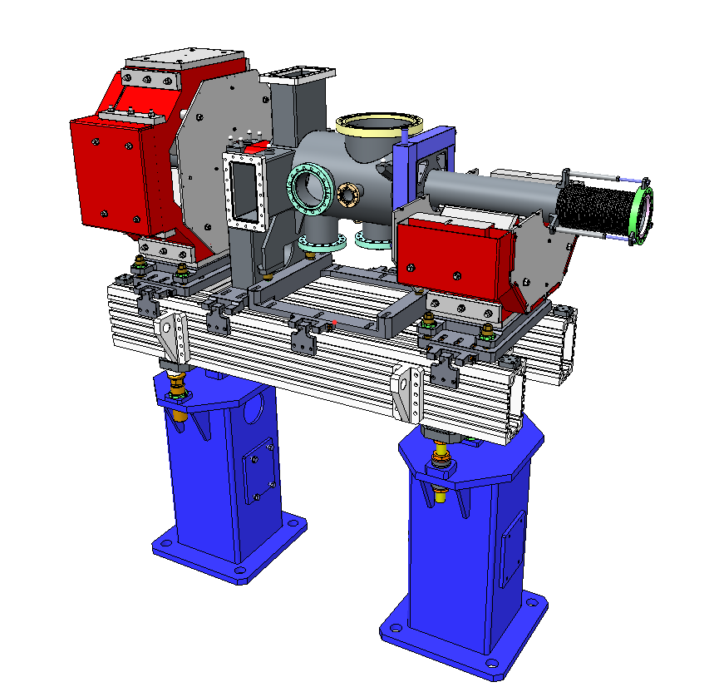
Latest Design Work
Quadrupole Magnets
‘Particle Free’ Chamber
- ISO 5 or better
BPM on entrance or exit
Aluminium slotted girder
Fiducials, laser tracker alignment
-50µm Accuracy
Semi–kinematic
girder adjustment
Built in lifting points
Pedestals

Slide 10
Design
Based on many years experience developing accelerator modules
Slotted girders allows for versatility
Optimised for ground vibrations
Fiducial mounts for survey and alignment
  ±50µm alignment to local girder network
Girder adjustment ±25mm
Magnet/Chamber adjustment ±25mm, ±5mm due to other items
Large space between pedestals for access/egress

Slide 11
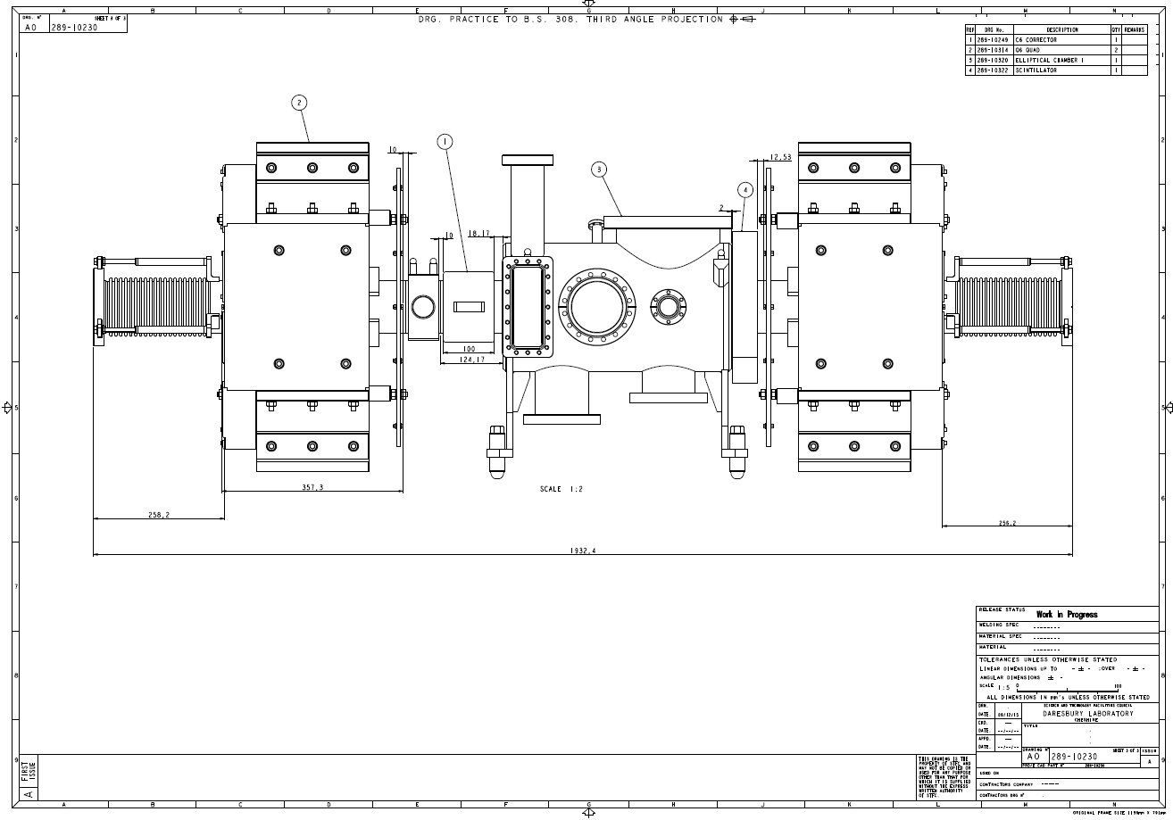
Space is tight - Elliptical

Slide 12
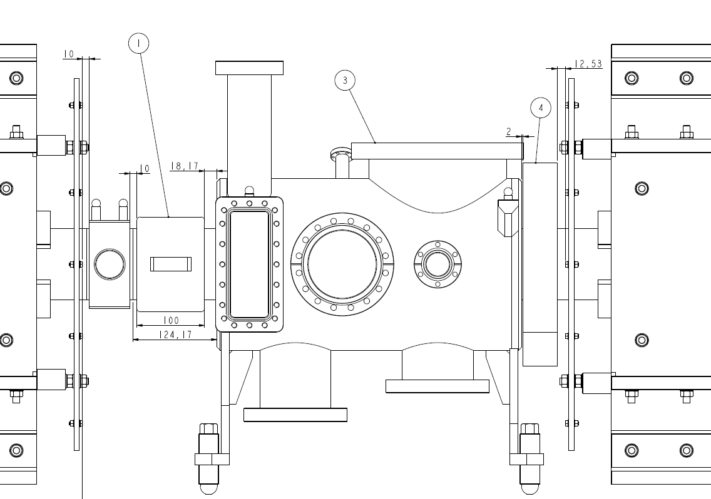
Space is tight - Elliptical
10mm
12mm
8mm

Slide 13
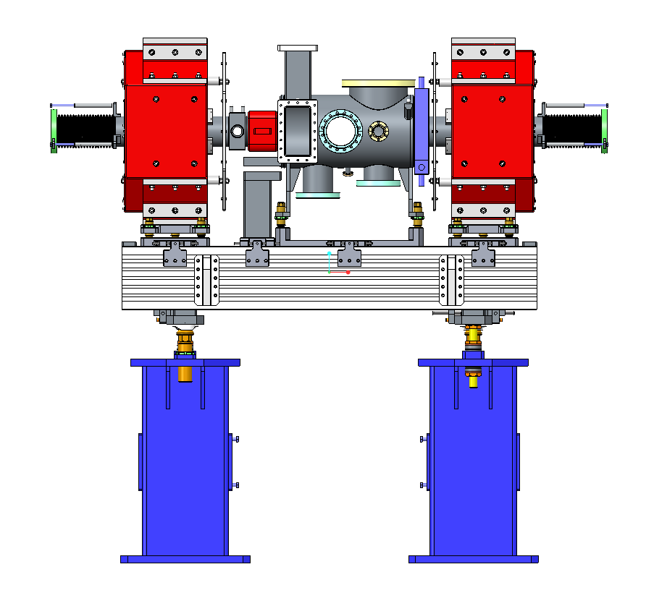
Example

Slide 14
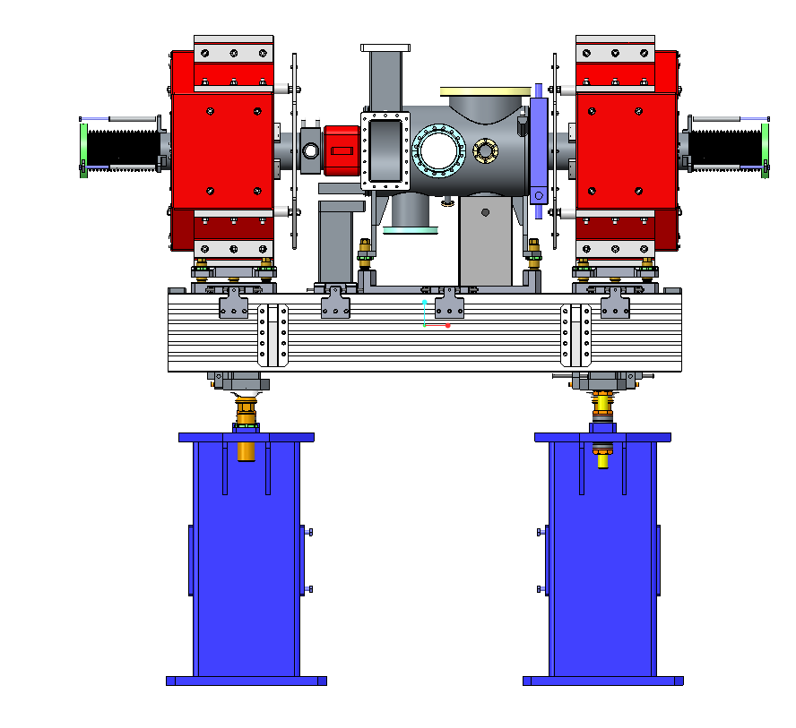
Example
Space requirements?

Slide 15
Example

Slide 16

Need to know ASAP
Dimensions will be fixed in March
Dimensions needed by end of March
Changes after this point will possibly impact delivery
Changes after June WILL impact delivery

Slide 17
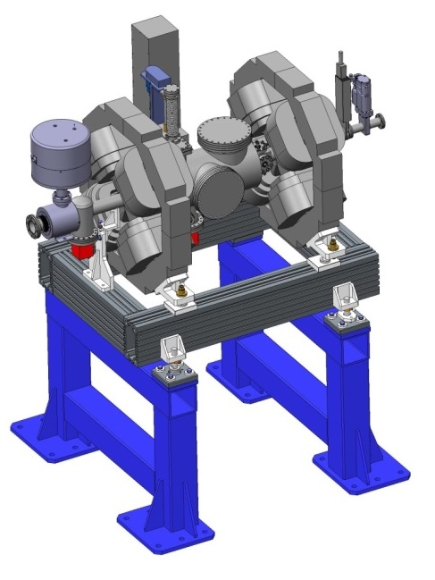
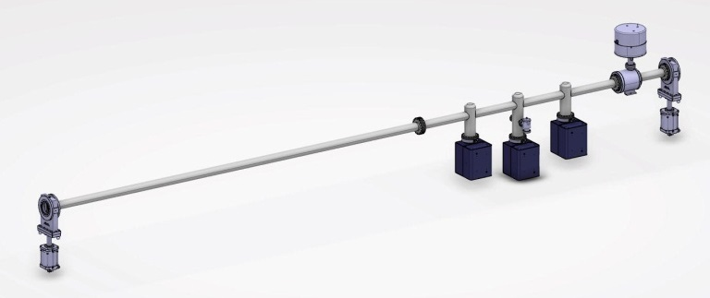
Differential Pumping Sections
Design work not yet started on HEDP
Pumping ratio to be 100:1 (1 x 10⁻⁹ mbar on cryo side)
Early concepts;
Notes:
Similar to previous work at stfc

Slide 18
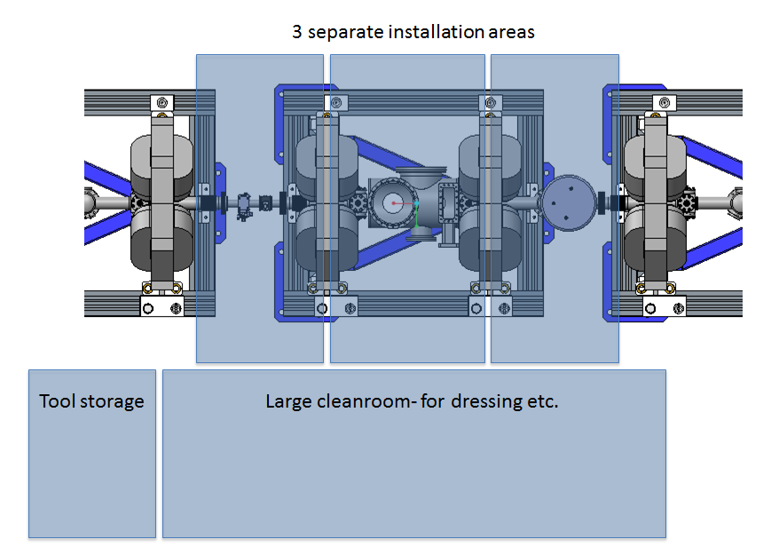
Mobile Installation Cleanrooms

Slide 19
Design
Vacuum Requirements:
  1 x 10⁻⁹ mbar
  UHV Cleanliness
  Particle free to ISO 5 or better
Vacuum requirements within STFC Vacuum Specs & inc.
  Cleaning
  Baking
  RGA Scanning
  Particle counting
STFC Vacuum Specs: ASTEC-VAC-QCD-SPC001-008
Notes:
Well defined UHV specs

Slide 20
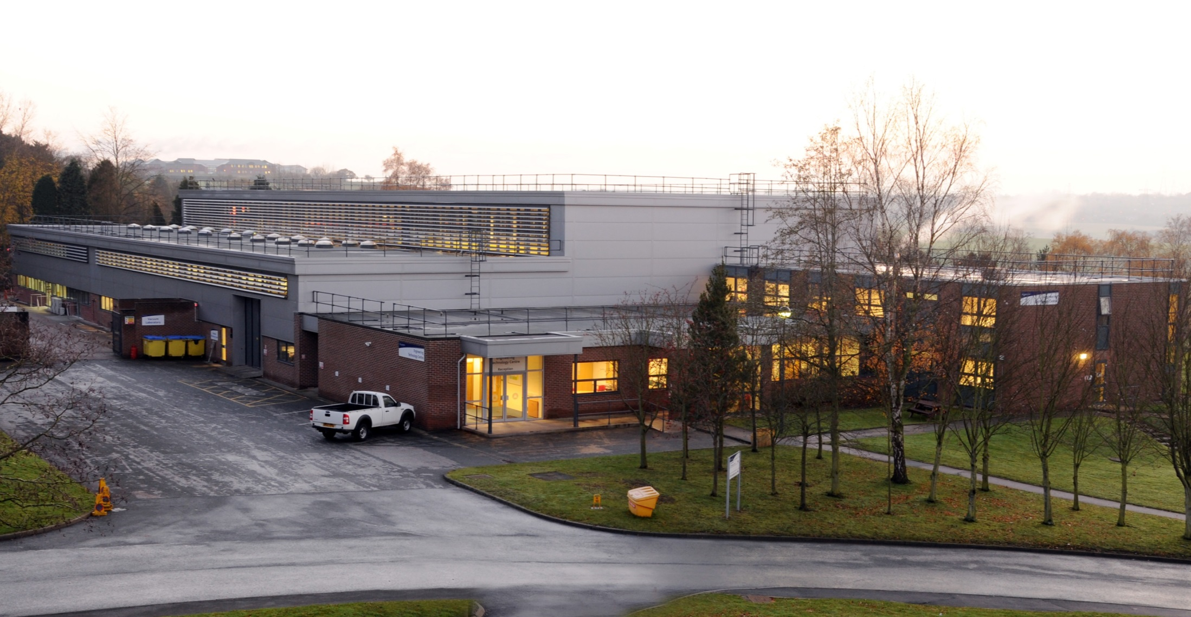
Assembly locations & Facilities
Engineering technology centre
Notes:
Engineering technology centre

Slide 21
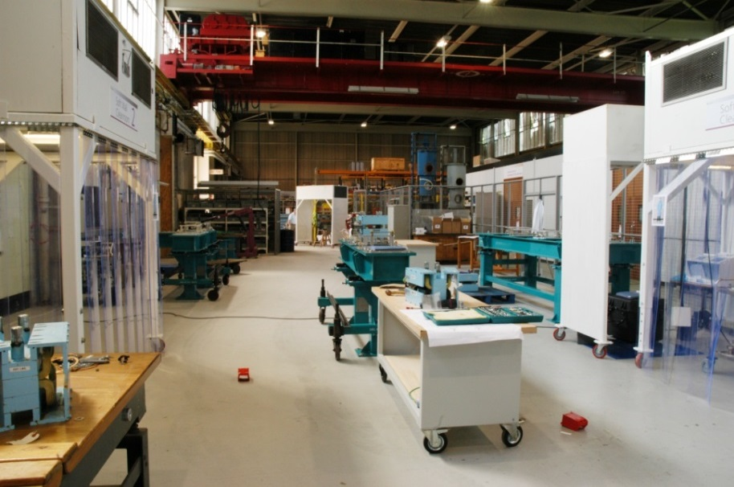
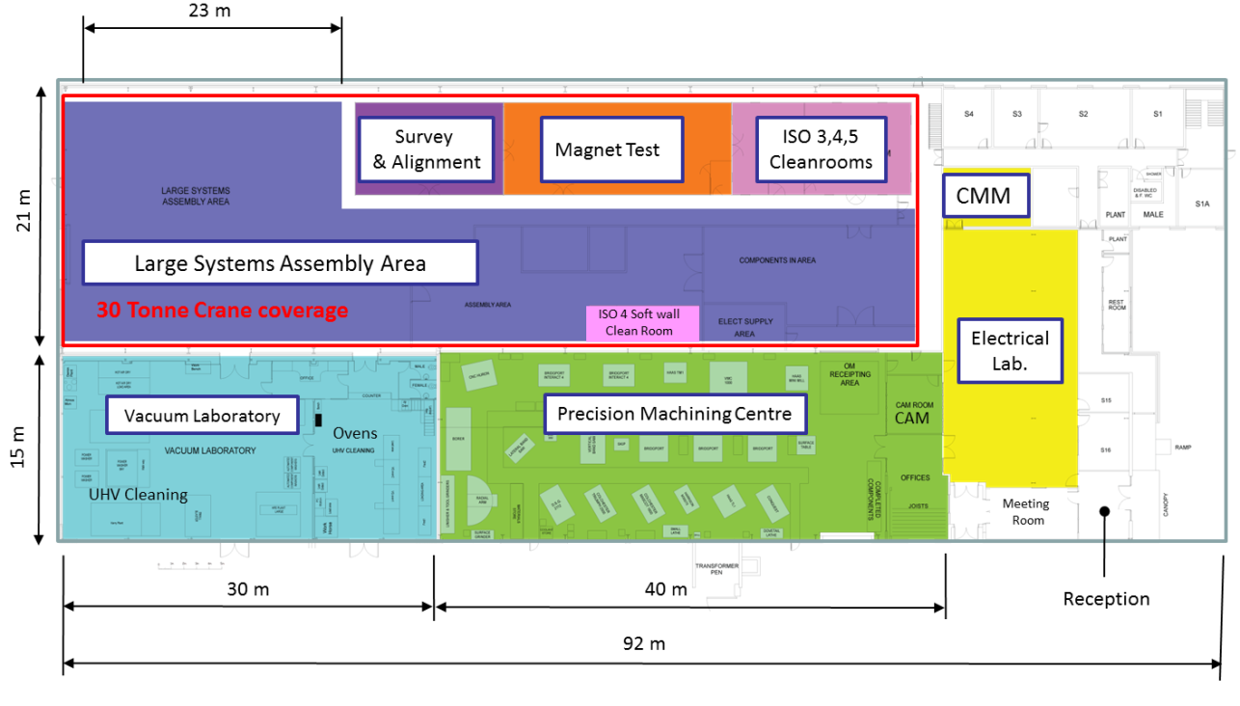
ETC Build Area
Soft wall cleanrooms
& Assembly Area
Notes:
Large Volume Assembly area with overhead crane, softwall cleanroooms, ISO 4 Cleanrooms, large vacuum laboratory,

Slide 22
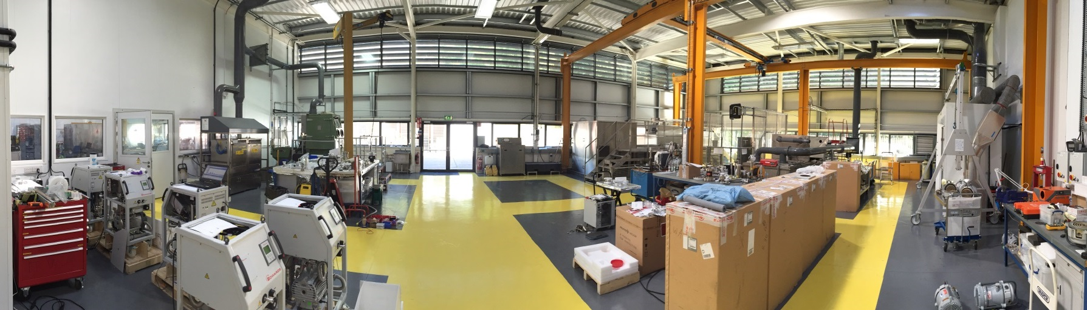
Vacuum Laboratory
Cleaning vacuum components to UHV standards with aqueous and solvent base systems
Pre clean with Auto Wash (industrial dish washer)
Solvent cleaning with HFE 72 DE capability 0.3 m cube, 3 m long chambers possible.
A demin water plant > 2 x Auto washers,
Alkali degrease bath, Power wash bay.
3 x Solvent cleaning HFE72DE Slurry blaster,
Drying cabinet, Cranes.

Slide 23
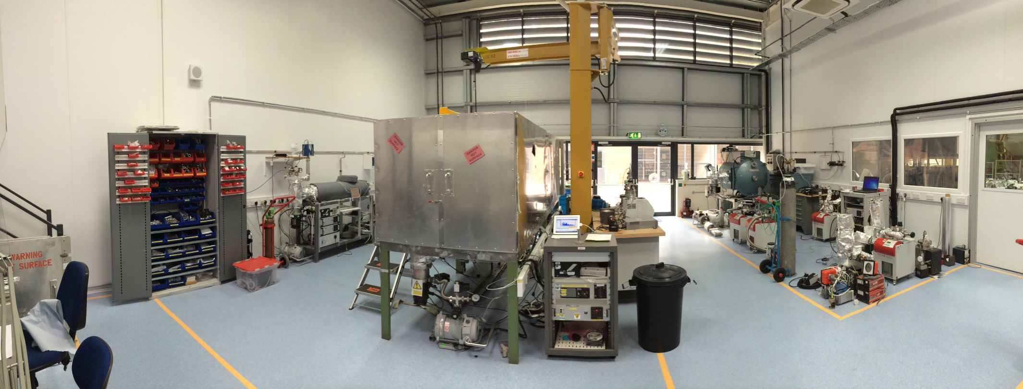
Vacuum Laboratory
4 x ovens to 250ºC
vacuum furnace to 1100ºC
Air oven to 150ºC
Leak detection & test facilities.

Slide 24
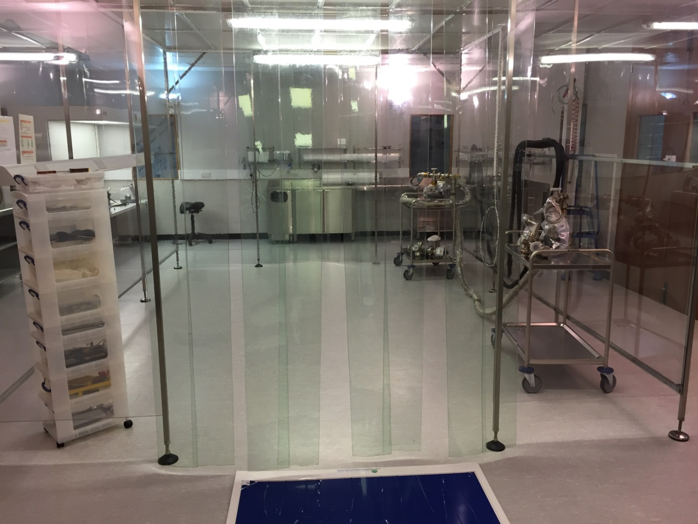
Cleanrooms
Change area
6m² - ISO 7
Outer area
80m² - ISO 6
Inner area
12m² - ISO 3
(at rest)

Slide 25
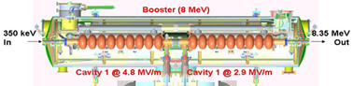
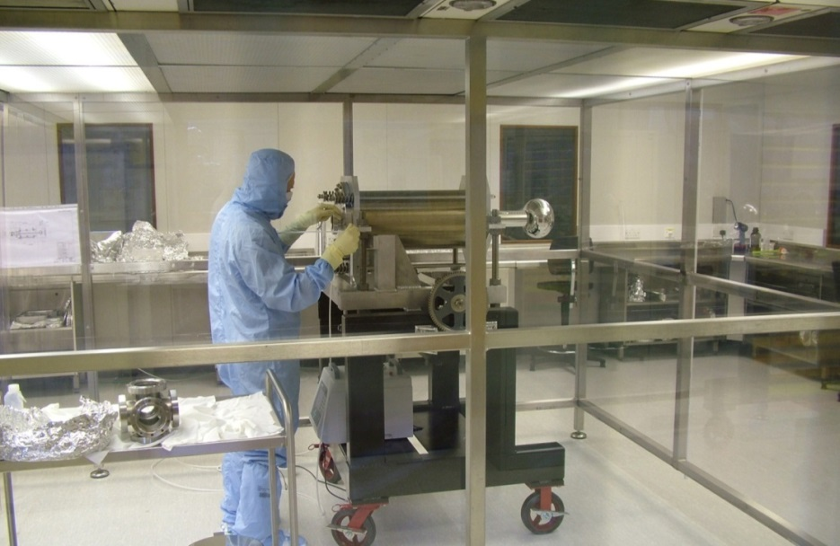
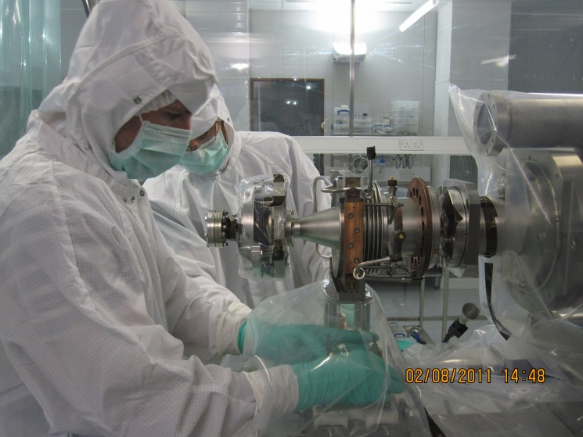
Low particulate experience on ALICE
ALICE Cathode in
ISO 4 Cleanroom

Slide 26
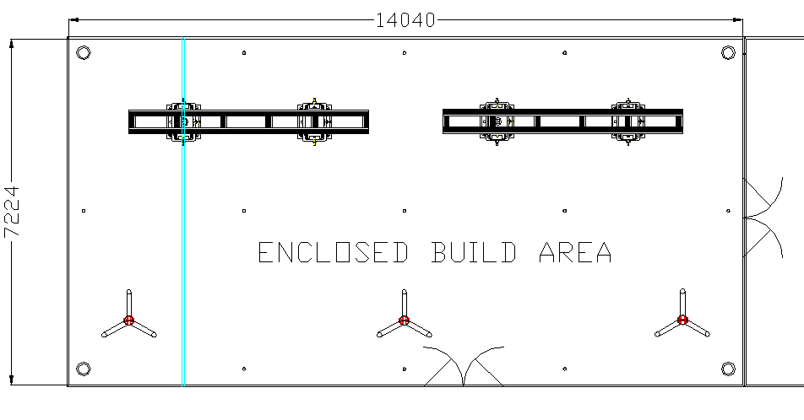
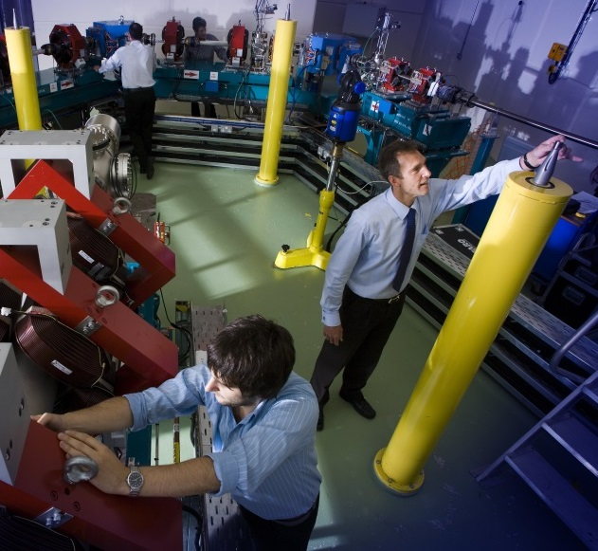
New Temperature Controlled
Survey Alignment Room
Temperature Range 20 - 26°C
Stability ± 1°C over the full area of the room
A fixed 3D survey network
Capacity to align 6 BTM modules in the room
4 x Steel Survey Pillars
Filled with Sand
11 x Floor mounted nests
Survey & Alignment Room
ALICE @ Daresbury
Notes:
rj

Slide 27
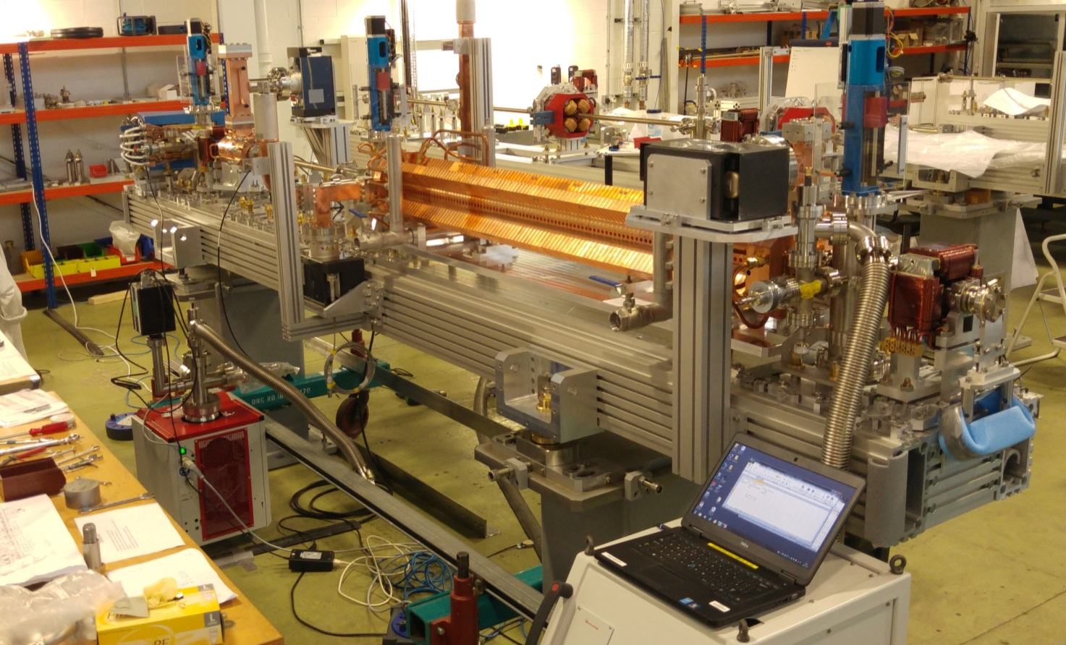
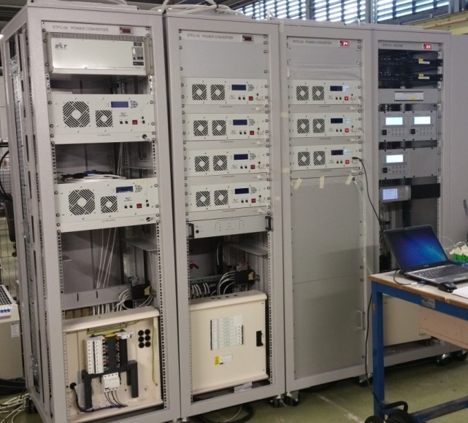
On-going Similar builds at Daresbury
Extreme Light Infrastructure – Nuclear Physics Facility
Delivery to Romania – over 18months period from 04/16
21 Modules
21 Racks
ELI - NP
Notes:
And Also 4 CLARA modules,
PSUs, Vacuum equipment, No Diagnostics, No RF.,
Racks include - PSUs, control, instrumentation, with EPICs,
Everything can be operated without overall control system

Slide 28
Need to know ASAP
Dimensions will be fixed in March
Dimensions needed by end of March
Changes after this point will possibly impact delivery
Changes after June WILL impact delivery

Slide 29
Thank You
ESS BI Forum, Dr Paul Aden, 11-02-16

Slide 30
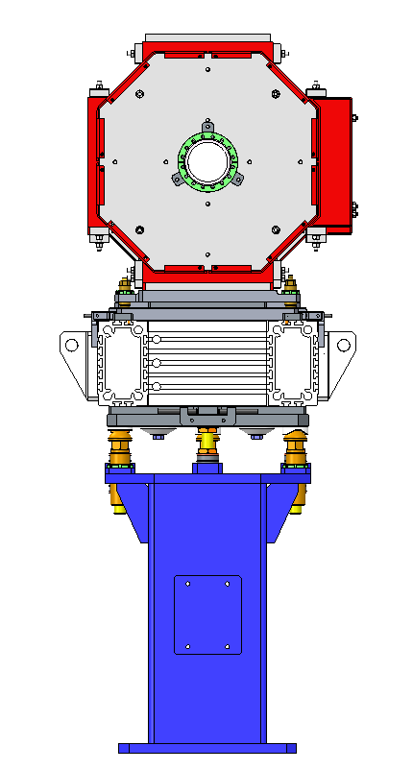
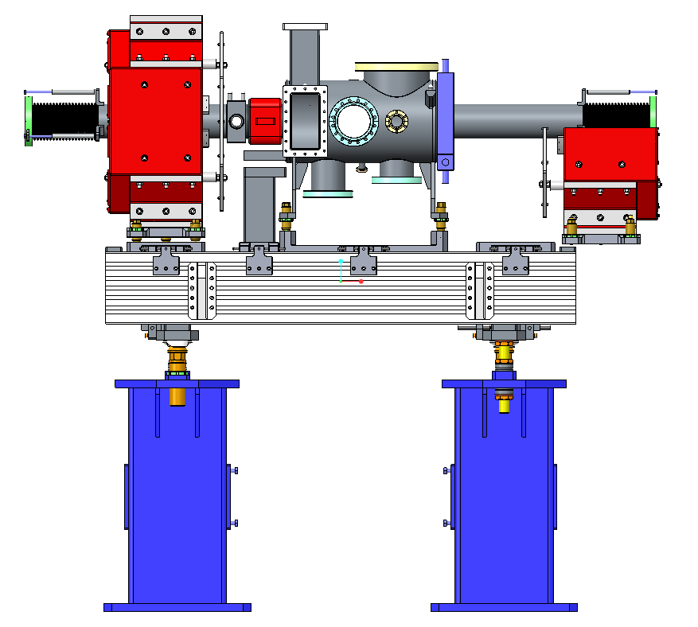
Elliptical LWU

Slide 31
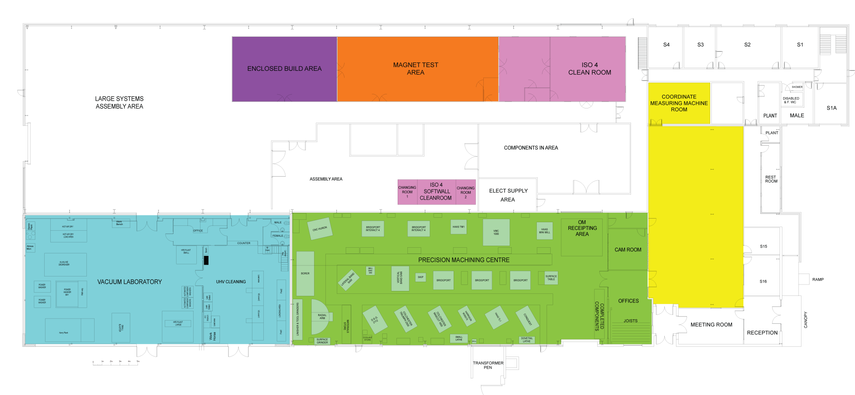
ETC Floor Plan
23 m
Survey
& Alignment
Magnet Test
ISO 3,4,5
Cleanrooms
21 m
CMM
Large Systems Assembly Area
30 Tonne Crane coverage
ISO 4 Soft wall
Clean Room
Electrical
Lab.
Vacuum Laboratory
Precision Machining Centre
CAM
15 m
Ovens
UHV Cleaning
Meeting
Room
30 m
40 m
Reception
92 m

Slide 32
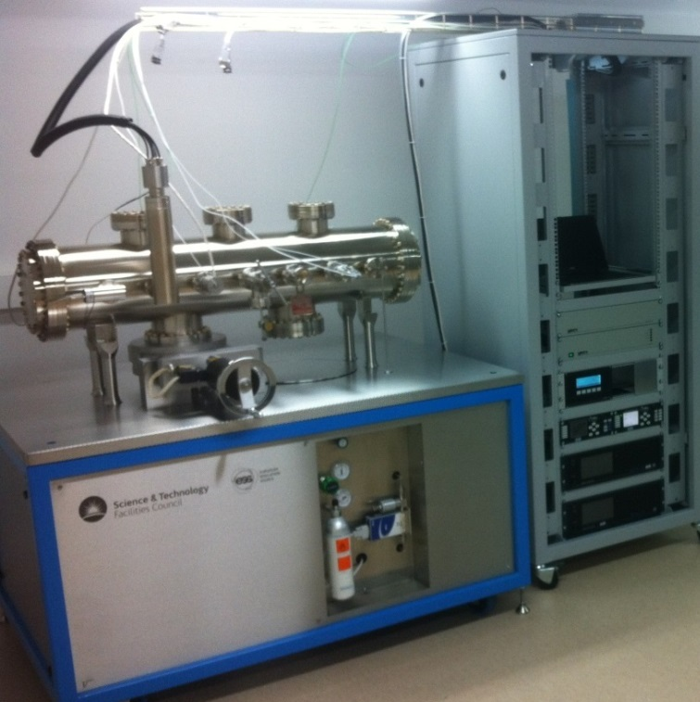
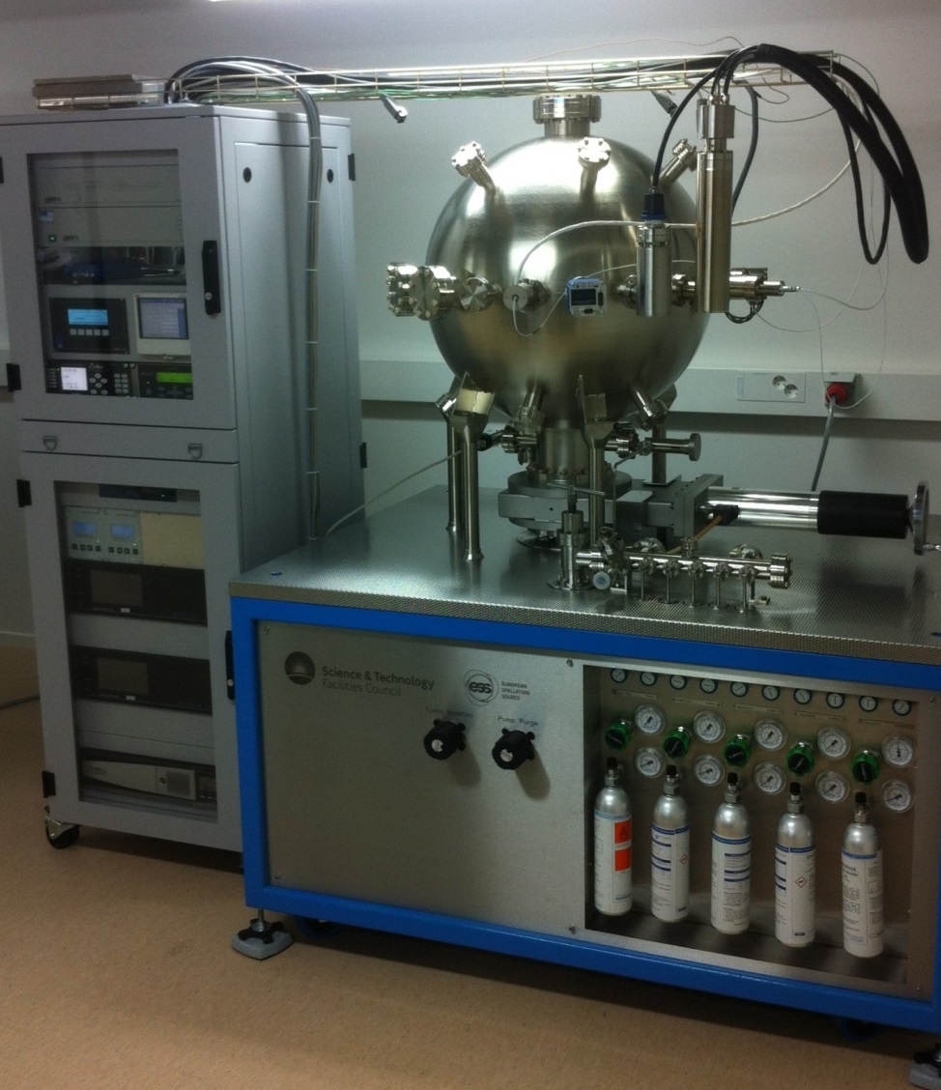
Vacuum Test Facilities
Delivered to ESS July 2015

Slide 33
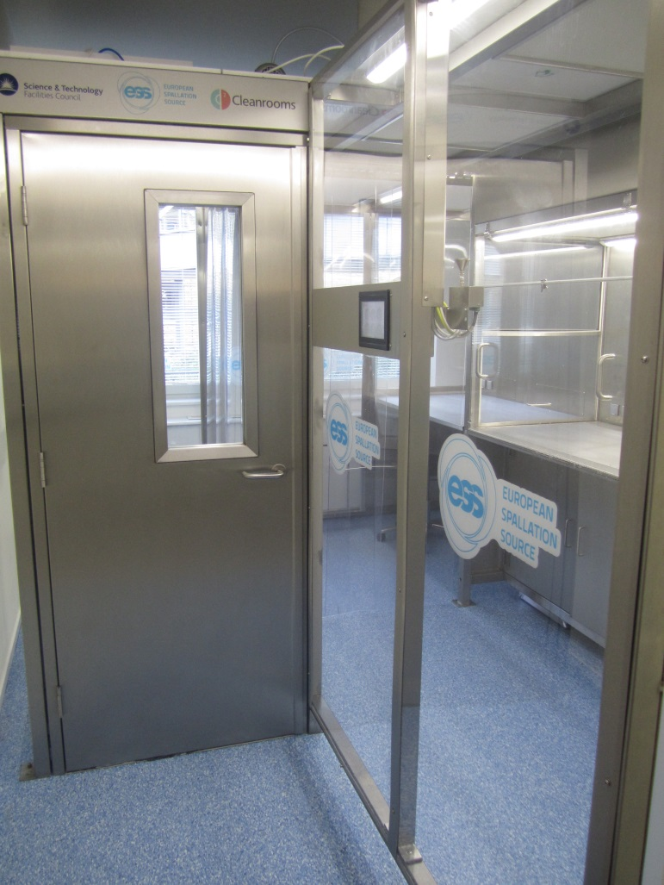
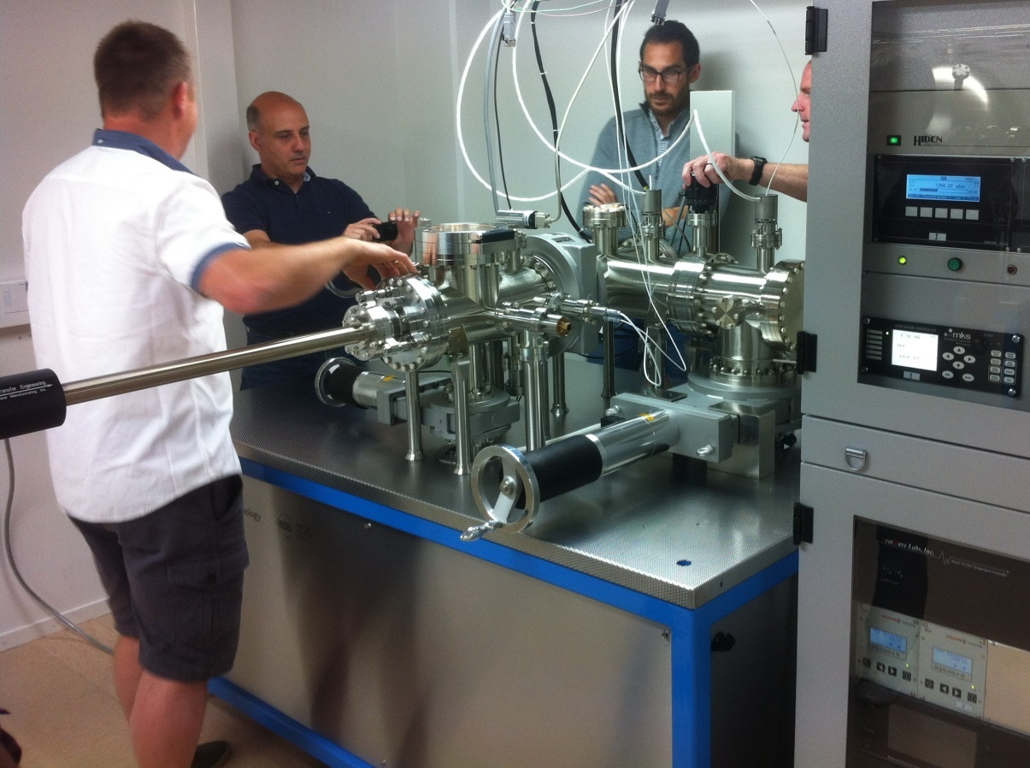
Vacuum Test Facilities
Delivered to ESS July 2015
Notes:
Particle test facility to ESS will be a ‘particle free’ accelerator and this.
Outgassing system to provide in vacuum material characterisation

Slide 34
Overview In/Out
In
  Girder design & procurement
  Chamber design (within given parameters) & procurement
  Vacuum design & procurement
  Survey & Alignment
  Particulate Control
Out
  BPM Procurement & Design
  BCM Design
  Bolt in diagnostics
  Magnet Design & Procurement
  Installation & Onsite testing
Full excluded / included list in stfc document tdl-1224-meng-spec-0005

Slide 35
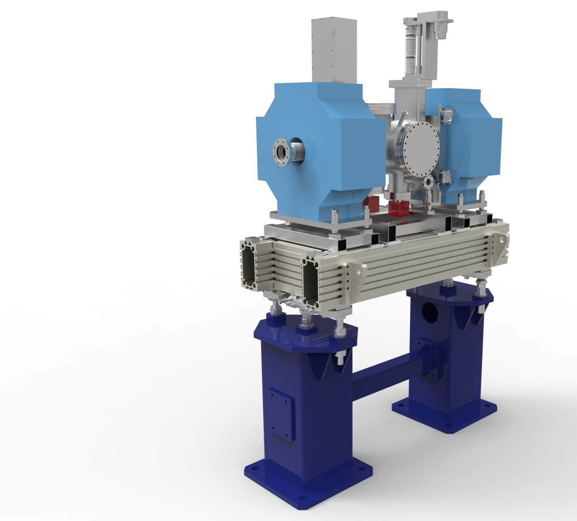
Schedule
Prototype
  FDR 10/11/15
  Build to start 10/2/16
  Delivery July 16
Production Units
  PDR 10/11/15
  Beam pipe build to start 8/8/16
  LWU Build to Start 1/2/17
Notes:
Prototype 2 - FDR 14/7/16

