Slide 1
ESS Optical Design for Proton Beam Window and Target Imaging
Progress Report
for the ESS Beam Diagnostics Forum
10 February 2016
Mark Ibison
University of Liverpool
Notes:
The purpose of the Optical Diagnostic in the target area of the ESS is to allow accelerator performance to be monitored and also to provide input to an automated machine protection system. This would be activated to shut down the accelerator rapidly in case beam steering or scanning failed, to prevent damage to components in the vicinity due to radiation exposure or overheating.
The next slide is intended to give an overview of the environment of the project.

Slide 2
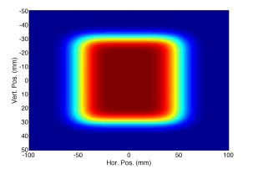
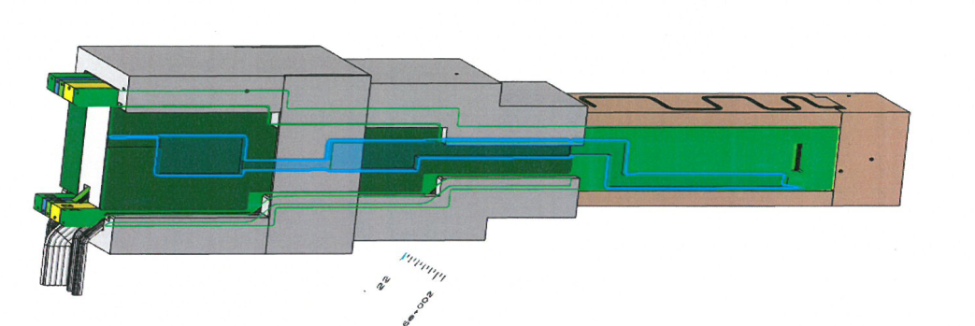
ESS Target Instrumentation
Optical Systems Design
ESS Target Monolith (section)
Target Wheel
Source:
Proton beam raster scan on exit window (PBW)
- also on the target
Camera:
At end of light path, outside shield
neutrons
PBIP Slice
containing optical path
Proton beam
Proton beam
Context: Image proton beam at window and target
Observe images remotely => long optical path
Notes:
On its way to the target, protons leave the accelerator through the Proton Beam Window (PBW) which has a thin scintillating coating to produce light in the visible part of the spectrum. The beam then passes through a port at the lower end of the Proton Beam Instrumentation Plug (PBIP) which contains several steel-shielded removeable ‘slices’.
Two of these slices contain optical paths for the diagnostics, one slice to transport light from the PBW upstream of the Plug, and one for light from the Target Window on the target wheel, which is also coated with scintillator, on the downstream side. Mirrors have been chosen for the optical elements rather than lenses, for their radiation resistance and good transmission properties. Unlike lenses, they do not suffer from chromatic aberration, and additionally they work outside the visible spectrum, so allowing IR and UV imaging.
The object of the project is to design reflective optics to transport light efficiently up through the Plug, without compromise to the shielding effectiveness. Multiple mirrors allow the light path to be folded, avoiding long clear paths which could stream radiation through the shield. Curved mirrors used in combination can also help to minimise optical aberrations or imperfections, which would otherwise reduce image quality.
To date, an initial optical layout for the PBW system has been outlined in simulation, and is undergoing optimisation. It is also being assessed for radiation shielding properties. Further work will consider component tolerancing and environmental factors. Later in 2016 the complete design will undergo a Preliminary Design Review process in preparation for building a prototype, which will constitute a further project in itself.

Slide 3
ESS Target – Proton Beam Instrumentation Plug (PBIP)
Light Ray-Path within Optics slice of the PBIP
Thickness = 100mm
Overall Height = 4.4m
Radiation Shielding = Steel
Shielding material fills the volume not occupied by the light path and mirrors
Proton beam, after exiting the window, passes centrally through the PBIP
First mirror is displaced (to left of centre)
Proton Beam Window with fluorescent coating
Notes:
Light from the source - the thin coating on the PBW – propagates forward at a small angle to the proton beam direction until it reaches the first mirror. It is then reflected through 90° into the plane of the PBIP slice, and is transported vertically by the mirror system until it emerges horizontally after another 90° reflection at the very top of the PBIP.
The short horizontal cross-path in the lower section is created by 2 plane mirrors, but all others are curved and therefore have focussing properties.
Colours indicate rays from 5 different field points on the source object, which define its rectangular extent.

Slide 4
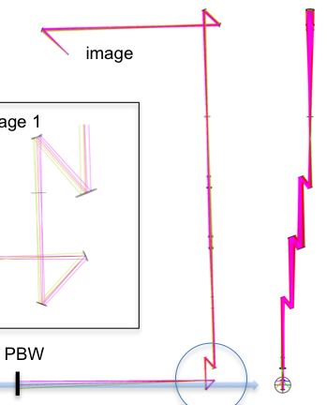
ESS Optics Design - Requirements
Requirements Analysis to derive Optics System specification
Resolution: to provide useful input to Machine Protection System
Magnification/Aperture: Match object – intermediate – final image
Light Source: candidates considered, scintillator screens selected
Detection: Remote camera located in unrestricted area
3 separate systems (all similar): 1) Beam Window; 2) Target; 3) Dump
Experience of SNS Target optics, based on Mirrors + Fibres
Developed an entirely-reflective, multi-mirror concept
ZEMAX OpticStudio software specified from the outset
Early design previously presented at IPAC/IBIC 2014
Notes:
The previous slide showed the current state of the design – I will now describe briefly how this configuration came about.
Experience on the SNS (the equivalent US neutron source) and elsewhere has informed decisions such as the choice of light source and the optical transport concept. Although a fibre optics system such as on SNS might simplify designing for the convoluted path on ESS, it would also compromise on image quality, light transmission and radiation hardness and is therefore not the preferred option.
Some of the more demanding of the requirements are
Good image quality & brightness to minimise the processing time post-detection, so that the Machine Protection System can respond quickly
Clear aperture strictly constrained by maximum PBIP slice thickness (100mm)
Remote camera to be in human-accessible area requiring >13m enclosed light path
Zemax has been mandated by ESS for the project – it is one of the leading optical system design software products.

Slide 5
ESS Optical Design - Concepts
Apply 3rd Order aberration theory (geometrical optics)
to reflective systems
3-mirror systems can be fully corrected (in principle)
for all the most important aberrations
Break down full system into 3-mirror ‘blocks’
Build up design from blocks, each corrected in turn
Arrange appropriate magnification for each block:
matched to next block
Intermediate image positions
keep aperture under control
Notes:
It is assumed that pure geometrical (ray) optics is a good approximation in this case. Zemax can apply physical (diffractive) optics if required, but in this situation it adds complication and slows down calculations without significantly improving results.
3rd order Optical Theory uses ray optics to build relationships between parameters, including distances between elements and optical powers, i.e. mirror radii of curvature.
The term ‘correction’ here means reducing one or more of the various ‘aberration coefficients’ to zero.
In principle, correction is easier in multi-mirror systems as they have more parameters to be varied.
The idea of a ‘block’ is a mirror-system with a specific function, such as to create a real image of a distant object (focal telescope) or a parallel beam from a real object (collimator).

Slide 6
3rd Order Correction of 3-Mirror Systems Parameter Definitions
Distances |  | measured from Mirror Vertices: + to R, - to L
Distances | From | To
 | M1 | M2 | d1
 | M2 | M3 | d2
 | Object | M1 | s1
 | M3 | Image | s3'
 | Entrance Pupil | M1 | t1
s1
Entrance
pupil
object
t1
M1
d1
M2
d2
M3
image
s3'
One Example of a Conceptual Layout for a 3-mirror System (CC-CC-CC)
M1
object
I₁
I₂
M2
M3
Notes:
Certain key parameters must be defined unambiguously – these are meaningful both in theoretical calculation and also in Zemax modelling.
They must obviously include the 2 inter-mirror distances d1 and d2, the initial object and the final image distance s1 and s3’. Less explicitly, intermediate image distances are also involved as parameters.
There are of course many different configurations of 3 mirror systems: theory helps us by predicting the radii of mirrors which will produce images at the required distances and magnifications.
The example shows a possible layout for 3 concave mirrors, forming an intermediate image between the 1st and 2nd mirror, and a final image after the 3rd mirror.
It is assumed in the theory that the 3 mirrors in a system all share a common axis, i.e. their vertices are coaxial (see picture).
However, to avoid obscuration of rays by opposed mirrors, appropriate offsets must be provided unless mirrors are to have holes in them!
Also, arrangements must be made for interfacing one 3-mirror subsystem to the next, to build up a complete optical transport chain by matching the final image of the 1st to the first object of the 2nd. This can be done by making the Exit Pupil coincident with the Entrance Pupil of the following system.

Slide 7
Calculation of Mirror System Parameters
ABERRATIONS OF A 3-MIRROR SYSTEM |  |  |  | (3rd Order Analysis) |  | NOTE: | Enter parameters in RED - others are calculated
 | Input Parameters |  |  |  |  |  |  |  | Magnifications
Component | Initial Object Distance | Final Image Distance | Mirror Sepn 1 | Mirror Sepn 2 | Paraxial Ray-Height Ratio 1 | Paraxial Ray-Height Ratio 2 | Initial Entrance Pupil Distance | Distance to M1 of Next System | Primary m1 | Secondary m2 | Tertiary m3 | System m_{S}
 | s1 | s3' | d1 | d2 | Ω1 = s2/s1' | Ω2 = s3/s2' | t1 | d3 | -v1/v1' | -v2/v2' | -v3/v3' | m1m2m3
1st System | -4.53E+03 | -6.00E+02 | -1200 | 800 | -1.2 | 0.3 | 0 | 1200 | -0.1204 | -1.7460 | 1.75 | 0.3679
Conjugate |  |  |  |  |  |  |  |  |  |  | 3
2nd System | -6.00E+02 | -6.00E+02 | -300 | 300 | 0.5 | 2 | -1335.2941 | 8.16E+02 | -1 | -1 | -1 | -1
Relay
Telescope (Focussing) | -1.00E+12 | -215.944 | -500 | 130.334 | -1.561 | 0.5248 |  |  | 0 | -0.9 | 1.5 | 0
Notes:
It has proved convenient to build an EXCEL sheet incorporating the basic relationships between Object and Image Distances, and Mirror Separations, together with Ray-Height Ratios, for general systems of 3 mirrors. This allows other useful parameters to be calculated, including Magnifications. Candidate designs to fit the required geometry can therefore be quickly tried out to see what ‘works’.
Very often, one or more of the parameters will have its value already constrained, thereby reducing the solution space; other considerations will be the whole system magnification, which controls image size and therefore aperture (for real images).
Not shown here but also available are the mirror radii of curvature corresponding to these system parameters.

Slide 8
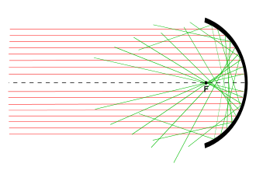
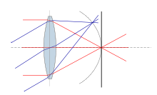
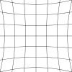
Optical Aberrations of 3rd Order (Seidel)
Aberrations arise because no optical system is ‘perfect’
Type | Effect | Example
Spherical | Spherical surfaces do not form perfect images | No single focal point for all rays
Coma | Off-axis (‘skew’) rays not focussed in image plane | Image of point source with Coma
Astigmatism | Rays in x- and y-planes have different foci | May occur even if there is Rotational symmetry
Field Curvature | Image formed on a curved surface, not a plane | Camera sensors are normally flat
Distortion | Image points perfect, but displaced from true positions | barrel pincushion
Notes:
First-order optics is by definition perfect, that is free from aberrations, but this applies only in the ‘paraxial’ regime of small-angle approximation where θ ~ sin (θ).
The Seidel aberrations are named ‘3rd order’ because they arise from these terms in the Wave Aberration Polynomial (see next slide). Higher-orders exist as they derive from a Taylor expansion, but are generally small enough to be ignored.

Slide 9
3rd Order Aberrations Optical Path Difference
spherical
coma
astigmatism
field curvature
distortion
W represents the difference between ‘perfect’ and ‘real’ imaging, in terms of the wavefront of rays between a point on the object and its corresponding image.
The coefficients W_{xyz} are measures of the various types of aberration present.
Notes:
The Wave Aberration Polynomial is an expansion of the wavefront error in any particular ray, due to the optical system.
In fact, if the function is plotted its shape can be used to indicate the principal type of aberration present from the order of the polynomial, i.e. if it is quadratic, cubic or quartic in ‘r’.
A section of the EXCEL sheet has been made to apply extra parameter conditions, so as to force 3rd order aberrations to become zero analytically.
For example, to correct the first three aberrations, there are particular values for the 3 mirror deformation constants which define their shapes.
Correction of the fourth aberration requires in addition a particular final image distance to be set.
The 5th aberration (distortion) remains an uncorrected residual.

Slide 10
Correction of 3-Mirror Systems requiring constraints on parameters
CORRECTION OF A 3-MIRROR SYSTEM of General Conics
Seidel Coeffs |  |  |  |  | Cartesian Deviations |  |  | Deformation Constants
Spherical | Coma | Astigmat |  |  | Dd1 | Dd2 | Dd3 | d1 | d2 | d3
A | B | C | Case I | W_{S} ≠ d₂/d₁ | 0.416951322 | -1.663E-12 | 110.1538902 | -0.1993707 | -0.489399326 | 96.70944579
0 | 0 | 0 | Case II | W_{S} = d₂/d₁
 |  | Additional Constraint |  |  | Cartesian Deviations |  |  | Deformation Constants
 |  | Field Curvature | Tertiary Image Distance |  | Dd1 | Dd2 | Dd3 | d1 | d2 | d3
 |  | D | Inverse v3' (=1/s3') | 0.00154019 | 0.416951322 | -1.616E-12 | -132.2271375 | -0.1993707 | -0.489399326 | -132.3225216
 |  | 0 | s3' | 649.268438 |  |  |  | prolate ellipsoid | prolate ellipsoid | hyperboloid
 |  |  |  |  | Magnifications |  |  | Curvature
 |  | Distortion |  |  | Primary m1 | Secondary m2 | Tertiary m3 | Primary c1 | Secondary c2 | Tertiary c3
 |  | E |  |  | -v1/v1' | -v2/v2' | -v3/v3' | (v1+v1')/2 | (v2+v2')/2 | (v3+v3')/2
 |  | 0.725707 |  |  | -0.120409392 | -1.7460317 | -1.893699612 | -0.001027042 | 0.001201389 | 0.002228431
 |  |  |  |  | System m_{S} |  |  | Radius
 |  |  |  |  | m1m2m3 |  |  | r1=1/c1 | r2=1/c2 | r3=1/c3
 |  |  |  |  | -0.398128795 |  |  | -973.6700699 | 832.3699422 | 448.7462594
Notes:
This section of the EXCEL sheet allows extra parameter conditions to be applied so as to force 3rd order aberrations to be made zero analytically.
To correct the first three aberrations, the 3 mirror deformation constants which define their shapes are fixed.
Correction of the fourth aberration in addition requires a change to the final image distance.
The 5th aberration (distortion) remains an uncorrected residual.

Slide 11
Design Methodology from Theory to Implementation
Break down into 3-mirror subsystems
Select suitable type of assembly for each system
Calculate optical properties using EXCEL
Build ZEMAX design of 1st system
Check image positions and sizes agree with calcs.
actual
ideal
Analyse optical performance with ZEMAX simulations.
Optimise to reduce aberrations; check image quality
Continue ZEMAX design for 2nd and other mirror system.
Repeat Analysis & Optimisation.
Run final ZEMAX optimisation
of full system. Check performance
Notes:
Having determined a suitable set of initial parameters, we move into the Design Process itself.
This slide shows an idealised flowchart of the process, with a linear progression through to a final design, iterating round the blue loop as we move from one sub-system to the next.
In practice, it proved necessary to follow the red dashed line, iterating round to generate almost a completely new design when problems are met in later stages of the process, which cannot be solved by local optimisation or adjustment.
Usually these issues are related to geometrical constraints or a lack of ‘free’ parameters available to allow the Zemax optimiser to make any improvement.

Slide 12
ZEMAX Preliminary Design presented at PBIP Design Meeting (Oct 2015)
Objective: show how to construct complete optical system from combined subsystems, under geometry constraints
Basic elements present, fields and dimensions indicative only
‘3-mirror block’ concept shown in each subsystem
At this stage, not yet optimised
Result: Accepted as a basis for further development
Started closer liaison with PBIP mechanical design team
Detailed, dimensioned CAD drawings later became available to aid in optics design
Notes:
The first attempt at a reasonably complete system design was intended only to illustrate the design concept and did not attempt to incorporate all constraints. The model combined a sequence of 3 subsystems each composed of 3 curved mirrors, plus a number of plane ‘fold’ mirrors to reverse the path where necessary.
For example, a single-point object field was specified, whereas the source is in reality an extended object (200mm x 100mm); and the optical path was not adapted to conform in detail to the PBIP internal structure.
The model did however prove useful as a discussion aid, especially when explaining some of the optical concepts involved.

Slide 13
ZEMAX Current Design as developed from Initial Sketch
Parameter Checking by
EXCEL Calculations
ZEMAX Shaded Model Raytrace Plot
Hand Sketch overlaid
on CAD Drawing
Notes:
For the detailed design, a hand sketching approach has now been developed to allow a concept to be explored directly in the physical environment of the PBIP Optics Slice.
It enables an appreciation of the disposition of shielding around the optical path to be obtained.
Working on a dimensioned CAD drawing of the PBIP allows distances to be estimated with sufficient precision (+10mm).
Transfer of the sketch into ZEMAX is not however a purely mechanical process:
Aperture constraints must be applied at all stages
Intermediate image positions must be assessed
Successful ray propagation is very dependent on precise tilt angles and off-axis decentres
Calculated parameters often have to be adjusted within ZEMAX to meet all constraints

Slide 14
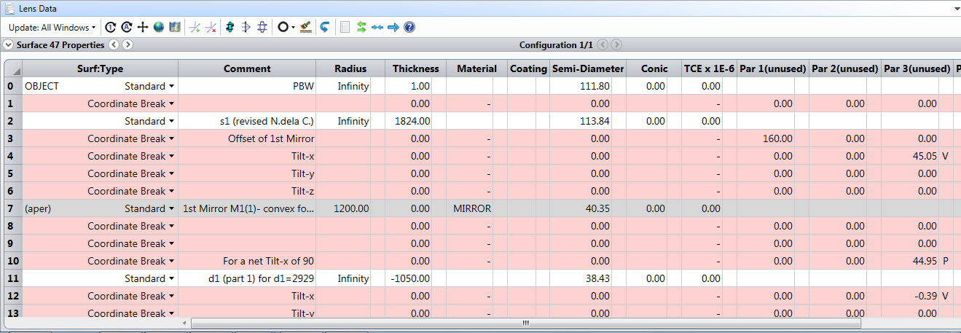
ZEMAX - The Design Process
EXCEL Calculations
Lens Data Editor
Analysis Tools
Footprint Diagram
System Parameters
Design drawings
Aberration Plot
Image Simulation
Optimisation Tools
Shaded Model
Quick Adjust
Merit Function Editor
STEP Files
Archive Files
Export to CAD
Notes:
Data entry into ZEMAX OpticStudio uses a tabular interface, similar to a spreadsheet such as EXCEL. Each element of the design is a ‘surface’ which is either physical (the Object plane, mirrors, or Image plane) or conceptual (a separation or air-gap between real surfaces, or a coordinate ‘break’ with a translation and/or rotation of the local coordinate system). Surface properties include Material, Radius of Curvature, Thickness and Shape (Conic constant).
Zemax works by attempting to propagate rays automatically from one surface to the next, keeping strictly to sequence. Various visual tools indicate progress of the rays, updated in real time, and assist in modifying the design to meet requirements. In particular, the Footprint Diagram highlights any transmission losses from vignetting or misalignment.
Output is available in CAD format (STEP file) which is convenient for import into other design software.

Slide 15
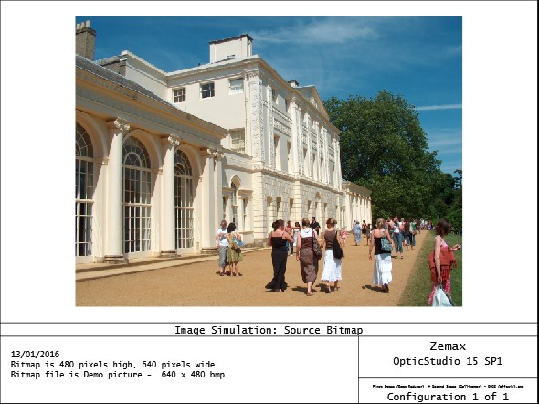
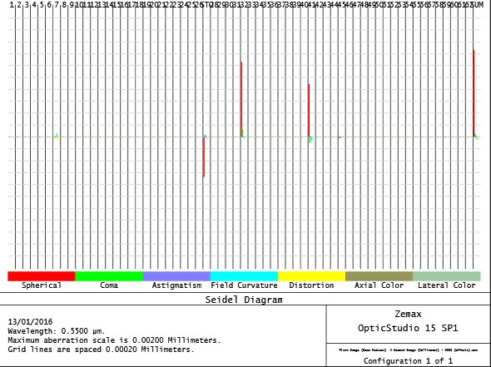
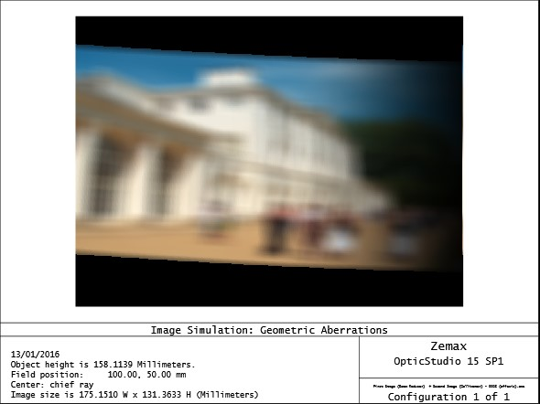
ZEMAX Design Process Image Quality Assessment
Aberrations
Image Simulation
Surface Number
Source Bitmap
+
0
-
Aberration
Seidel Plot
Simulated Image
Spherical (dominant)
Coma
Field curvature
Total residual aberration at Final Image
Notes:
Residual aberration is estimated by ZEMAX and displayed conveniently in a Seidel diagram, identifying the critical elements in the design. In this case there are large contributions to spherical aberration (red) from Surfaces 32 and 41, although some of this is partially counterbalanced by Surface 27. Other types of aberration also make minor appearances.
The plot does not give the complete story however, especially for off-axis systems, and it is essential to use another Analysis tool, Image Simulation. This traces a bitmap through the system, convolving it with an array of Point-Spread Functions. In this example, the obvious aberration is Distortion (tilt) as well as Spherical and non-uniform illumination. The tilt arises primarily from the skewed view of the source object from the first mirror, which is not seen ‘head-on’.
Other aberrations derive from the significant mirror tilts and from the off-axis imaging; the Seidel plot cannot estimate these.

Slide 16
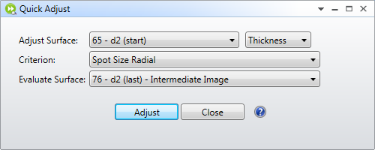
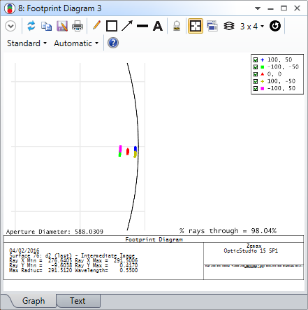
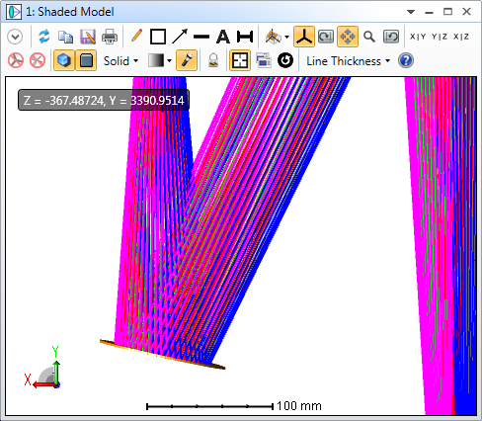
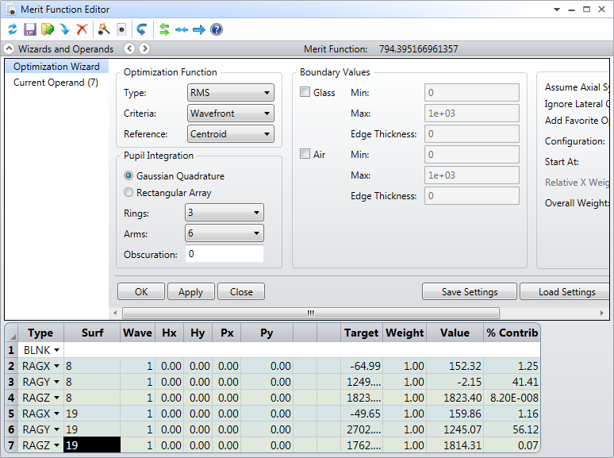
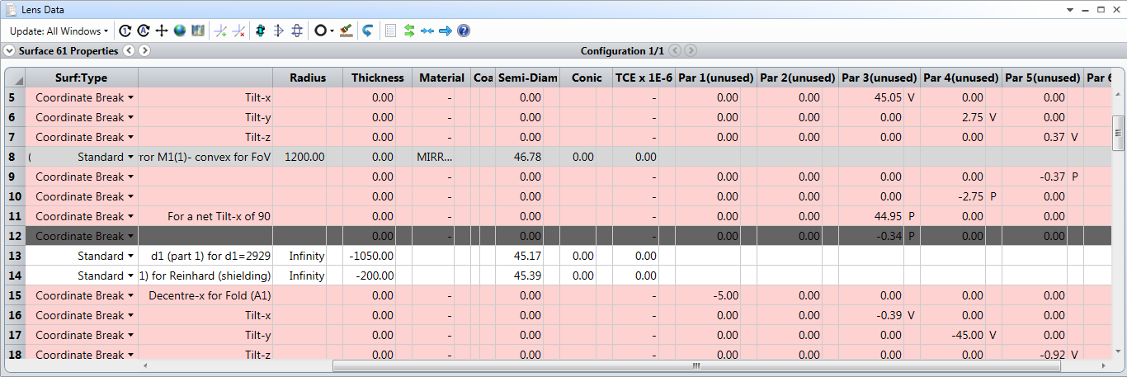
ZEMAX – Using the Optimiser
Example of Task:
Find Image Position (e.g. Intermediate Image)
Change single parameter, view result (e.g. Tilt)
Automatically find a solution for specified Variables, to fit a given set of Parameters
Quick Adjust
Slider
Merit Function Editor
Variables
Parameter names
Target Values
Notes:
The Zemax Optimiser is a powerful tool which can be used during design to adjust selected parameters to meet some constraint or achieve a target value.
In its simplest form, Quick Adjust will try to achieve or find the location of the ‘best’ image, by varying a single distance or a surface radius.
Interactively, Slider allows one or more parameters (e.g. a mirror tilt) to be varied across a range, while the result is viewed in real time.
When using the Merit Function Editor a large number of operands is provided to access almost any system parameter. A ‘damped least squares’ algorithm is built in, to find a local minimum efficiently; if necessary, the scope can be extended to search globally.
Why use the Optimiser?
When we want the ‘best possible’ system e.g. for final image quality, given the constraints (cost is always one!)
Where there are multiple parameters, which may be closely coupled and difficult to hand-optimise individually
If it is too time-consuming to investigate the whole of parameter space manually
What do we want to achieve?
The method works well as long as there are sufficient variables available which can affect the value of the ‘Merit Function’, so that the algorithm can make progress in minimising it - in the right direction!

Slide 17
Next Steps
Complete modifications for Shielding performance
adjusting the detailed optical path
Optimise design to improve Image Quality
to meet required standard
within constraints of PBIP geometry
Finalise optical path, mirrors and apertures:
to enable completion of PBIP Mechanical Design including Cooling System planning
to permit thermal calculations and deformations at mirror mountings, as input to Tolerancing process
Create Target & Dump imaging optics as variants of PBW
PDR for full optical system, Q2 2016
Notes:
PBIP design includes the physical layout allowing for maintenance access by removal of any of 5 individual ‘slices’, 2 of which contain optics. The volume available for optical paths is limited, and all remaining space will consist of solid metal (steel).
Shielding performance can only be calculated when the full configuration is defined including clear optical paths, cavities for mirrors, and services. It will use radiation transport codes such as FLUKA. Some optics design iteration is expected after feedback from the shielding calculations.
Tolerancing is the sensitivity analysis of the system’s optical response to perturbations, including effects such as misalignments; thermal expansion; manufacturing precision. It is supported in standard Zemax.
The Preliminary Design Review will formally accept the optical design to proceed to the next major phase.

