Slide 1


Accelerator
2012 November
Mats Lindroos
Head of ESS Accelerator division and projects

Slide 2
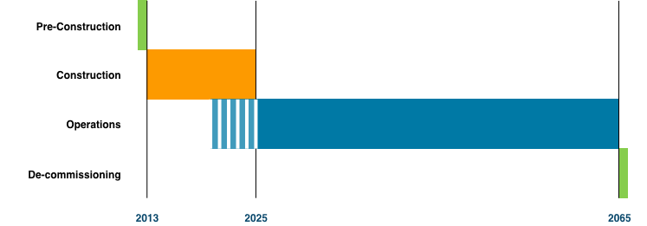
Programme Phases

Slide 3
 | Q1, 2012 | Q2, 2012 | Q3, 2012 | Q4, 2012 | 2013
Executive Report
Programme Plan
Technical design Report
Project Specifications, Construction
Prel. Project Spec., Operations
Prel. Project Spec., De-comm.
Transition Plan to Operations
Budget and Cost Book
Risk List Summary
ESS Framework Project (QMP)
ESS Board Meetings
STC meetings
AFC meetings
SAC meetings
TAC meetings
03-23
08-03
11-01
12-03
03-19
06-11
10-01
12-03
01-21
06-25
10-01
10-29
12-03
06-11
10-29
01-21
10-01
01-01
10-01
01-01
08-15
10-01
01-21
06-11
10-01
12-03
01-21
01-23
07-02
10-01
12-03
01-21
03-31
06-30
09-30
12-31
08-24
02-08
03-20
04-24
06-04
08-14
10-24
11-16
01-18
01-11/12
05-10/11
09-13/14
12-17/18
04-12
07-02/03
11-13/14
03-21/22
06-07/08
11-29/30
02-15/17
06-27/28
11-14/15

Slide 4
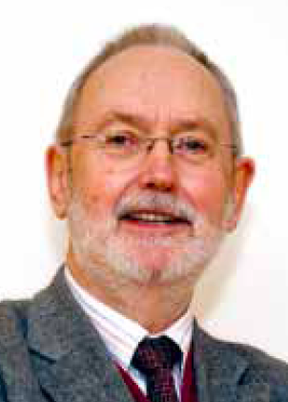
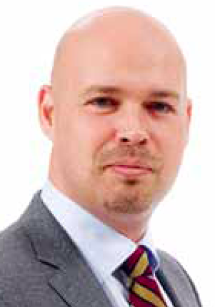
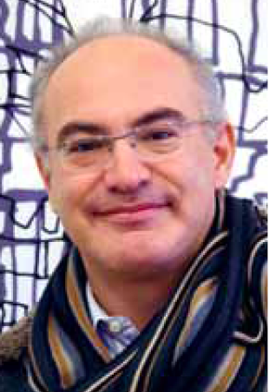
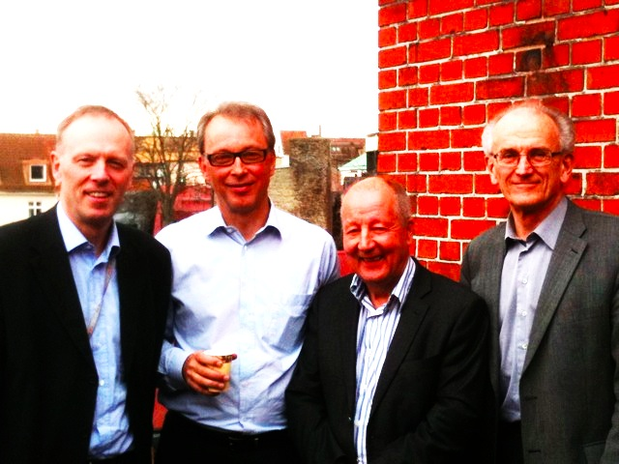
ESS Programme Organisation
ESS AB Board
Steering Comm (STC)
Adm Financial Comm
CEO
C. Carlile
Administration
Director
Collaboration Partners
Programme Director
Machine Director
Science
Director
Technology Adv. Comm
Science Adv. Comm
Programmme Office
Accelerator
Target
Conventional Facilities
Instruments
Neutron Science
Data Management
Preconstruction
Construction
Operation Phase

Slide 5
Technical Board and Collaboration board
Technical Board
All WP leaders and and ESS AB
Meets once a month
Minutes, action log and Decision log available
CCB for accelerator projects
Collaboration board
All collaboration partners
At ESS
EPG and CCB for ESS program

Slide 6
Programme Committees
Programme Director
EPG
Board, ,STC, AFC, SAC, TAC Programme Decisions
Programme Reviews
Programme Budget
CCB Machine
Programme Planning
Configuration control
Preparation of EPG Decisions
Definition of deliverables
Programme Office
CCB Facilities
Project Managers
Accelerator
Target
NSS
ICS
Energy
CF
Pre-Construction
ESS line organisation
Construction
Operations
De-Commissioning

Slide 7
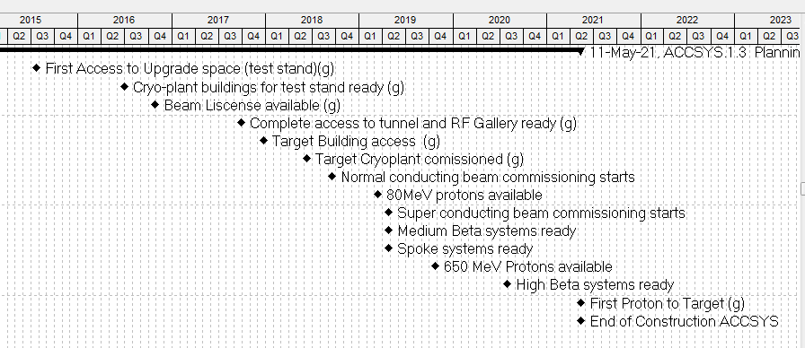
Accelerator milestones
First Neutrons at ESS!

Slide 8

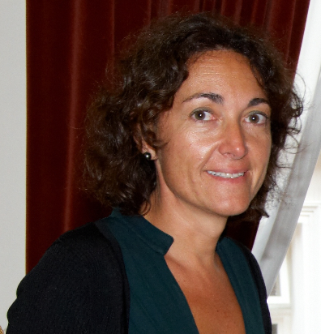

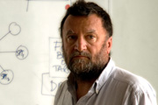
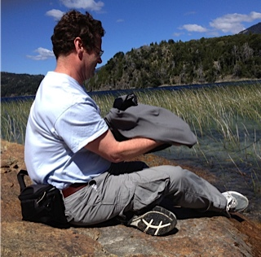
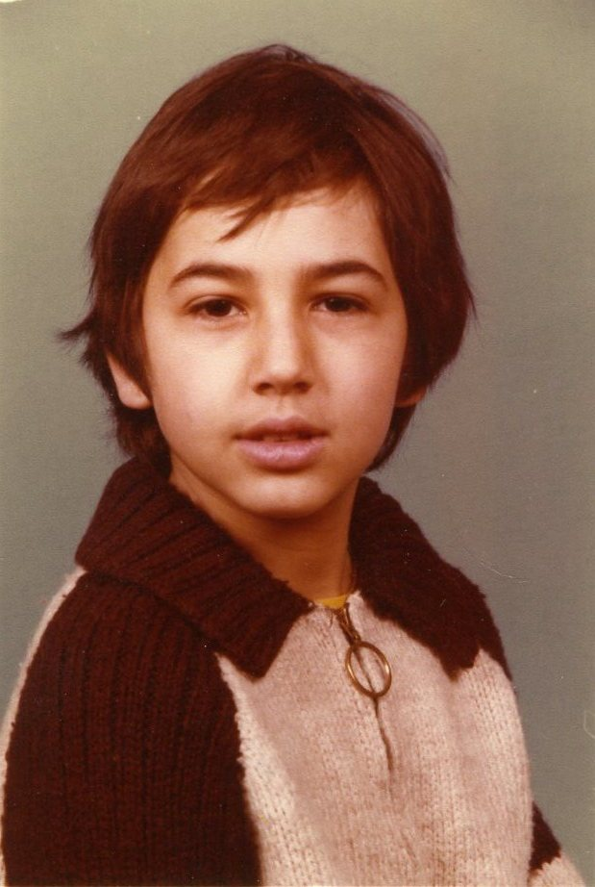
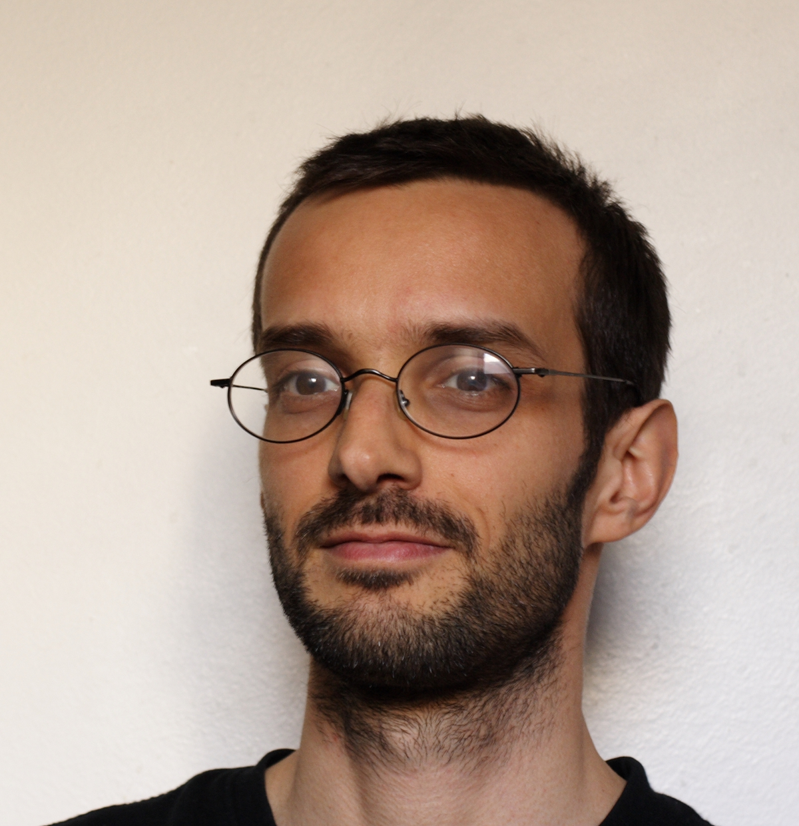
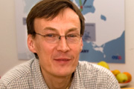

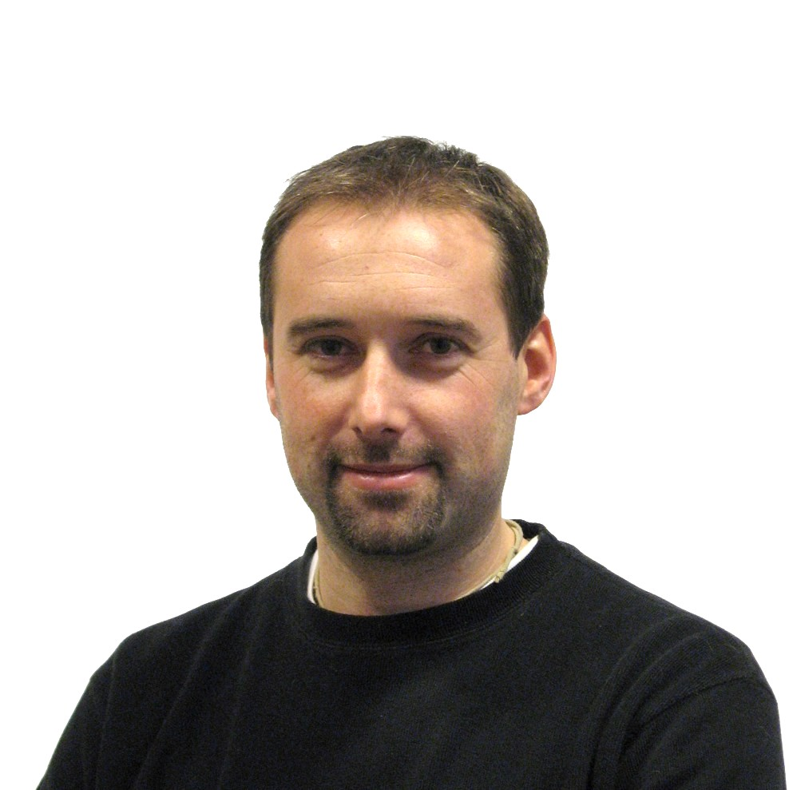
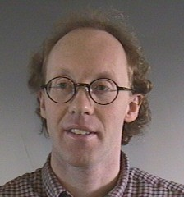
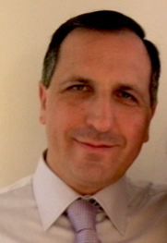

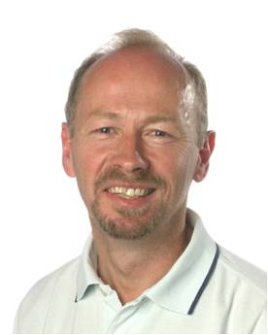



Accelerator Design Update
Steve Peggs
Cristina Oyon
David McGinnis
Work Package (work areas)
1. Management Coordination – ESS AB (Mats Lindroos)
2. Accelerator Science – ESS AB (Steve Peggs)
(3. Infrastructure Services – now ESS AB!)
4. SCRF Spoke cavities – IPN, Orsay (Sebastien Bousson)
5. SCRF Elliptical cavities – CEA, Saclay (Guillaume Devanz)
6. Front End and NC linac – INFN, Catania (Santo Gammino)
7. Beam transport, NC magnets and Power Supplies – Århus University (Søren Pape-Møller)
8. RF Systems – ESS AB (Dave McGinnis)
19. Test stands – Uppsala University (Roger Ruber)
Romuald Duperrier (30 years ago)
Guillaume Devanz
Mats Lindroos
Sebastien Bousson
Roger Ruber
Søren Pape Møller
Santo Gammino

Slide 9
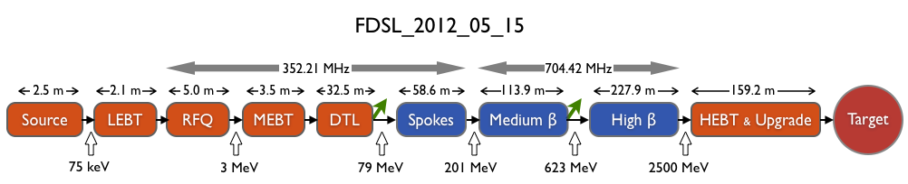
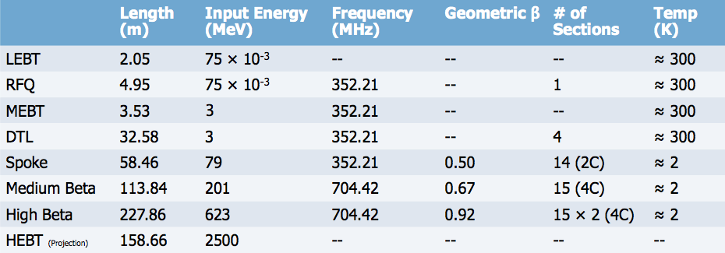
LINAC layout
9

Slide 10
Progress ADU
Re-baselining of ADU project in September to simplify reporting and align ADU deliverables with French-Swedish agreement

Slide 11
The collaboration
To build the ESS accelerator we need the ESS Collaboration partners
Uppsala University, FREIA
ESS-Bilbao, MEBT
INFN, Ion source and DTL
CEA, RFQ, Elliptical SCRF, Cryomdoules
CNRS, Spokes, Cryomodules
Lund University, Low level RF
Aarhus university, HEBT
ESS AB, integrator of ESS accelerator
ADU to ACCSYS
Prototyping, testing and construction

