Slide 1
Spallation
Eric Pitcher
Head of Target Division
www.europeanspallationsource.se
February 19, 2016

Slide 2
Outline
Preliminaries
  Units of energy and length
  Basic nuclear physics
  Length scales and wavelengths
Spallation physics
  Intranuclear cascade
  Evaporation
Spallation neutron sources
  Neutron production
  Neutron thermalization
  Energy balance
  Radiation shielding

Slide 3
Units of energy
Electron-volt: eV
1 eV = 1.6×10^{–19} joules
1 MeV = 1.6×10^{–13} joules
1 GeV = 1.6×10^{–10} joules
Binding energy of the electron in a H atom ~10 eV
Binding energy of a neutron in a nucleus ~10 MeV
Nuclear forces are about a million times greater than atomic forces.

Slide 4
To understand spallation, we need to start with some basic nuclear physics
The nucleus of an atom is a collection of neutrons and protons bound together by the strong nuclear force
Neutrons and protons bound together within a nucleus are called nucleons
Each nucleon is
bound to the
nucleus with a
binding energy
of about 8 MeV
A hadron is a class
of sub-atomic
particle to which
neutrons and
protons belong

Slide 5
Length scales and wavelengths
DeBroglie wavelength λ = h/p
h = the Planck constant
p = particle momentum
A particle’s interaction length is on par with its wavelength
Wavelength of a 25-meV “thermal” neutron = 2 Å
(same scale as the atomic spacing in a crystal lattice)
Wavelength of a 200-MeV proton = 2 fm
(close to the distance between nucleons in a nucleus)

Slide 6
Nuclear spallation
Spallation is a nuclear reaction whereby a high-energy hadron strikes a nucleus and imparts energy to the nucleus, leading to the emission of a number of nucleons from it
Spallation proceeds in two stages:
second stage: evaporation
first stage: intranuclear cascade

Slide 7
First stage: intranuclear cascade
Reaction probability
When passing through matter, a 200-MeV hadron with a 2-fm wavelength interacts only with individual nucleons within a nucleus
The probability of a spallation reaction occurring depends only on
the average density of nucleons and not on nuclear properties.
Material | Nucleon density (per cm³)
Water | 0.6 x 10²⁴
Aluminum | 1.6 x 10²⁴
Tungsten | 11.5 x 10²⁴
Mercury | 8.1 x 10²⁴

Slide 8
First stage: intranuclear cascade
Reaction outcome
The incident hadron transfers a fraction of its kinetic energy to the struck nucleon
The hadron-nucleon interaction may:
  Transfer energy to the nucleus as a whole through subsequent interactions with neighboring nucleons, leaving the nucleus in
  a highly excited state
  Produce pi mesons as
  reaction products
  Eject the energetic
  and forward directed
  nucleon from the
  nucleus
first stage: intranuclear cascade

Slide 9
Second stage: evaporation
The highly excited nucleus “boils” off nucleons, mostly neutrons, or clusters of nucleons as nuclei and hydrogen and helium atoms
For each nucleon emitted, the
nucleus de-excites by the
binding energy of the nucleon,
which is about 8 MeV
Each emitted neutron has 2 or
3 MeV kinetic energy
These evaporation particles are
emitted nearly isotropically
second stage: evaporation

Slide 10
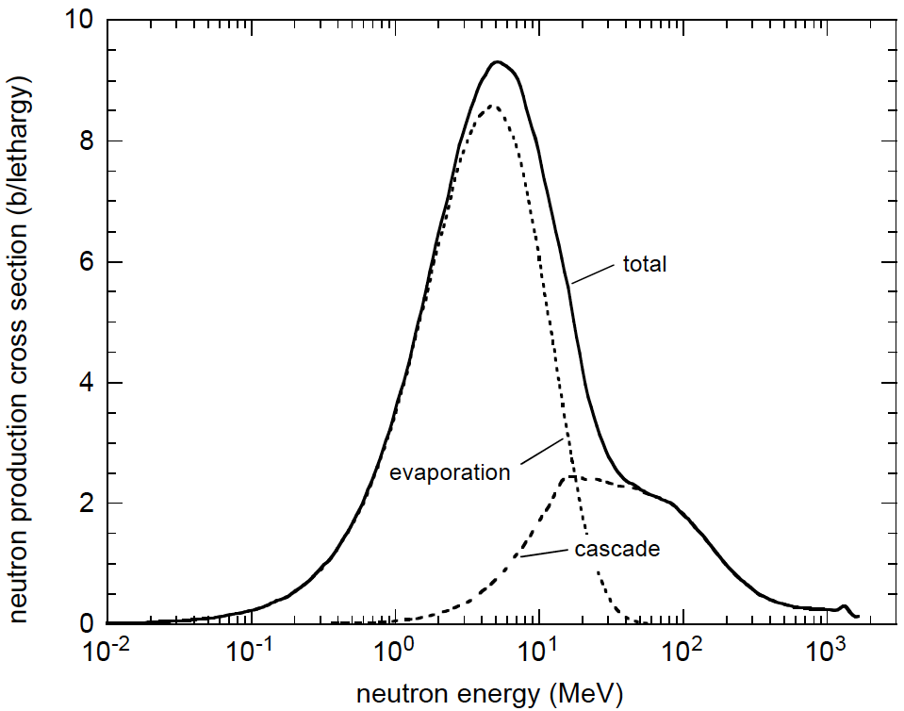
Neutron thermalization:
Slowing down energetic neutrons
Most neutrons produced via spallation have kinetic energies of a few MeV for which the deBroglie wavelength is 10 to 20 fm
For neutron scattering applications, neutrons need wavelengths in the range of 1 to 30 Å
➔ energies of 1 to 80 meV
Spallation neutrons must be slowed by nine orders of magnitude in energy
Energy distribution of neutrons produced via
spallation by 1.7-GeV protons on tungsten

Slide 11
Spallation sources: Potential applications
Neutron scattering research
Nuclear waste transmutation / energy production
Isotope production
  Rare isotopes for nuclear physics research
  Medical isotopes
  Research isotopes
Neutron source for nuclear physics research and nuclear cross section measurement
Irradiation facility for radiation damage studies

Slide 12
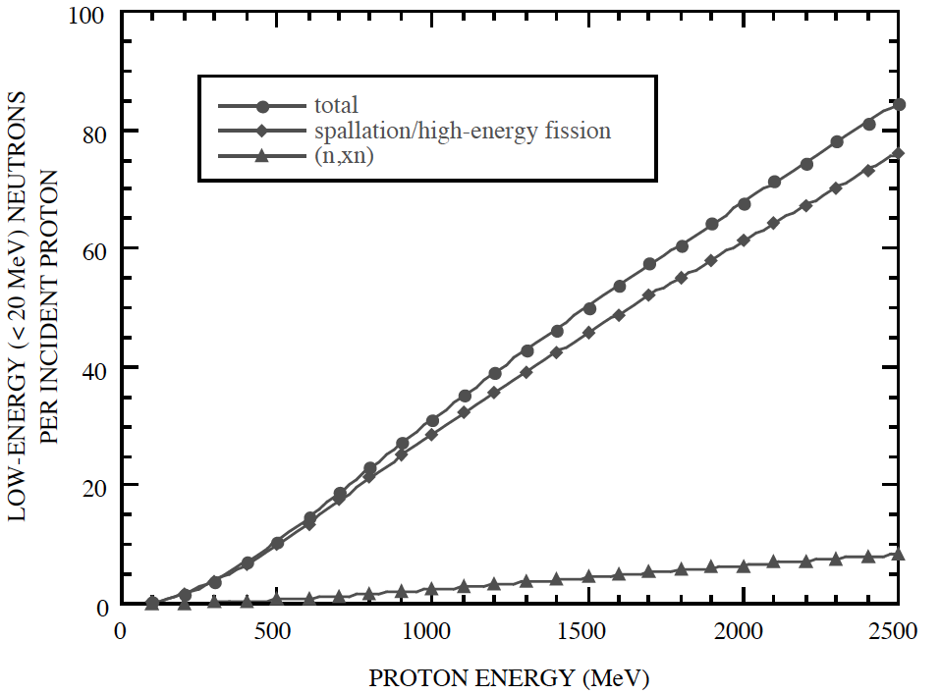
Neutron production versus beam energy
After a few hundred MeV, neutron production is linear with energy up to a few GeV
Some loss occurs at high energies for finite-sized targets
Neutron production versus beam energy for a 50-cm-diam by
200-cm-long tungsten cylinder bombarded on axis by protons.

Slide 13
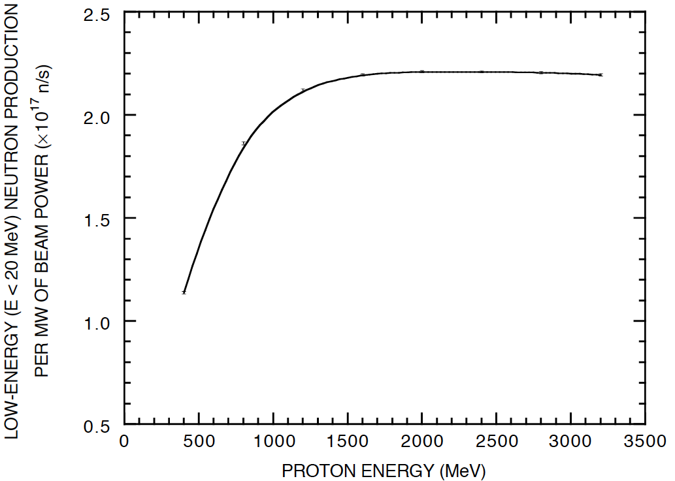
Neutron production versus beam power
From 1 – 3 GeV, neutron production is linear with beam power and independent of beam energy

Slide 14
Proton passage through matter
Due to their electric charge, protons lose energy as they pass through matter due to interactions with bound electrons
Bragg peak at the end of the track is prominent at low energy
Protons are also removed from the beam through nuclear interactions

Slide 15
Energy Balance
Spallation is an endothermic reaction:
A portion of the proton beam’s kinetic energy is converted to mass
Mass conversion is equal to the amount of energy that goes into releasing neutrons from the nucleus
For the ESS operating at 5 MW beam power,
Heating of structures 4.0 MW
Conversion to mass 0.9 MW ⬅ At full power, target station increases
Neutrinos 0.1 MW in mass by 0.2 mg/year

Slide 16
Neutron thermalization:
The Maxwell-Boltzmann distribution
Neutron thermalization is the process of reaching thermodynamic equilibrium with the scattering medium
We use hydrogenous media to slow and thermalize neutrons
  Water at ~room temperature (300 K)
  ➔ thermal moderator
  Liquid hydrogen at cryogenic temperature (20 K)
  ➔ cold moderator
A neutron can transfer nearly all of its energy to a hydrogen nucleus in a single collision
It takes typically 15 to 25 collisions with hydrogen to slow a 2-MeV neutron to near thermal energy

Slide 17
The target station produces neutrons, slows them, and leaks them to neutron guides
Beryllium reflects neutrons that might otherwise escape, boosting performance by a factor of 5
neutron guide
(start of the neutron
scattering instrument)
conversion
efficiency ~ 10^{–5}
Liquid hydrogen
moderator at 20 K
cold neutrons
tungsten target
produces about 60 neutrons per proton
≈ 10¹⁸ neutrons per second
2-GeV proton

Slide 18
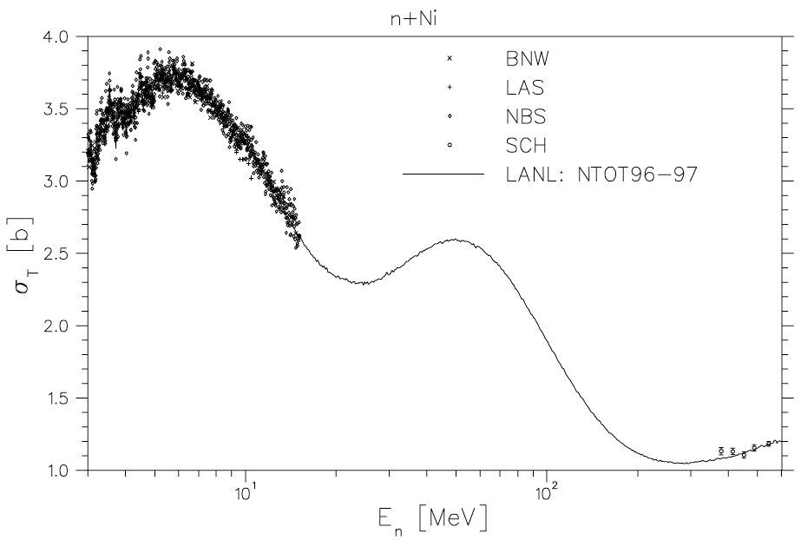
Shielding a spallation source
High-energy neutrons have a relatively small probability of interaction (denoted by σ_{T}) with matter

Slide 19
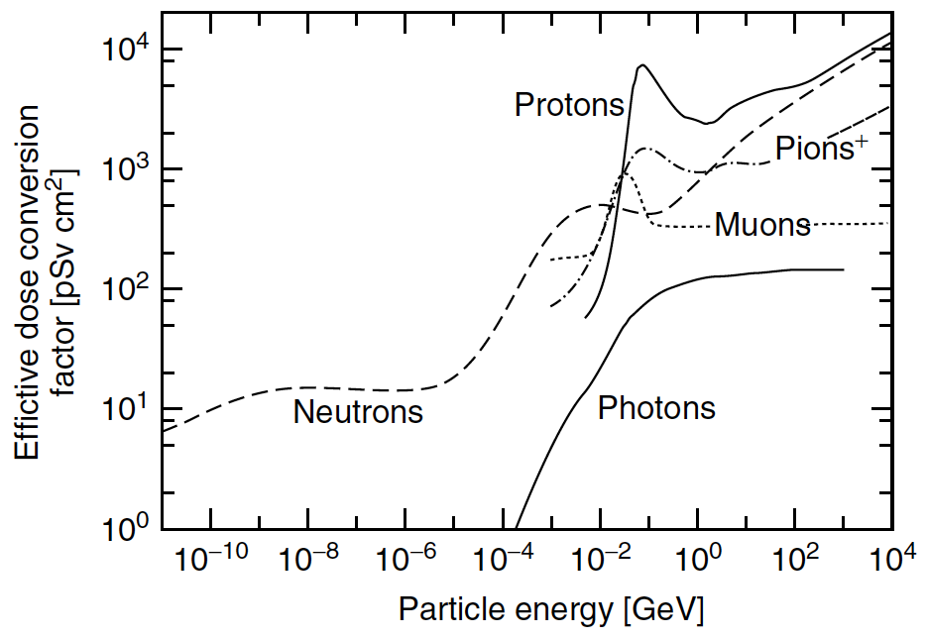
High-energy neutrons are not only penetrating, they cause high dose
Source: D. Filges and F. Goldenbaum, Handbook of Spallation Research, Wiley-VCH, 2009.

Slide 20
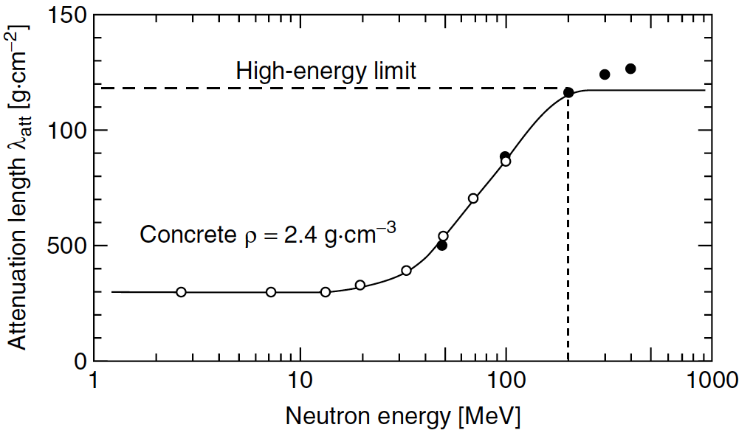
Concrete is most effective for shielding low-energy neutrons
Source: D. Filges and F. Goldenbaum, Handbook of Spallation Research, Wiley-VCH, 2009.

Slide 21
Practical solution for shielding a spallation source: Lots of steel and concrete
Steel effectively attenuates high energy neutrons and gammas
Concrete attenuates lower energy neutrons but creates gammas in the process
Often, laminated shields of steel and concrete are most effective
Dose as a function of depth in a 1.5-m-thick iron shield followed
by 50 cm of concrete. The source is a pencil beam of 600-MeV
protons normally incident on the iron slab.

Slide 22
Radioactivity and
Decay Heat
Radioactivity is a byproduct of the spallation process
The emitted particles, mostly betas and gammas, deposit heat in the radioactive material and surrounding structures

Slide 23
For further reading on spallation and spallation neutron sources
D. Filges and F. Goldenbaum, Handbook of Spallation Research, Wiley-VCH, 2009.

Slide 24
Thanks for your attention!

