Slide 1
The ESS Target Station
Eric Pitcher
Head of Target Division
www.europeanspallationsource.se
February 19, 2016

Slide 2
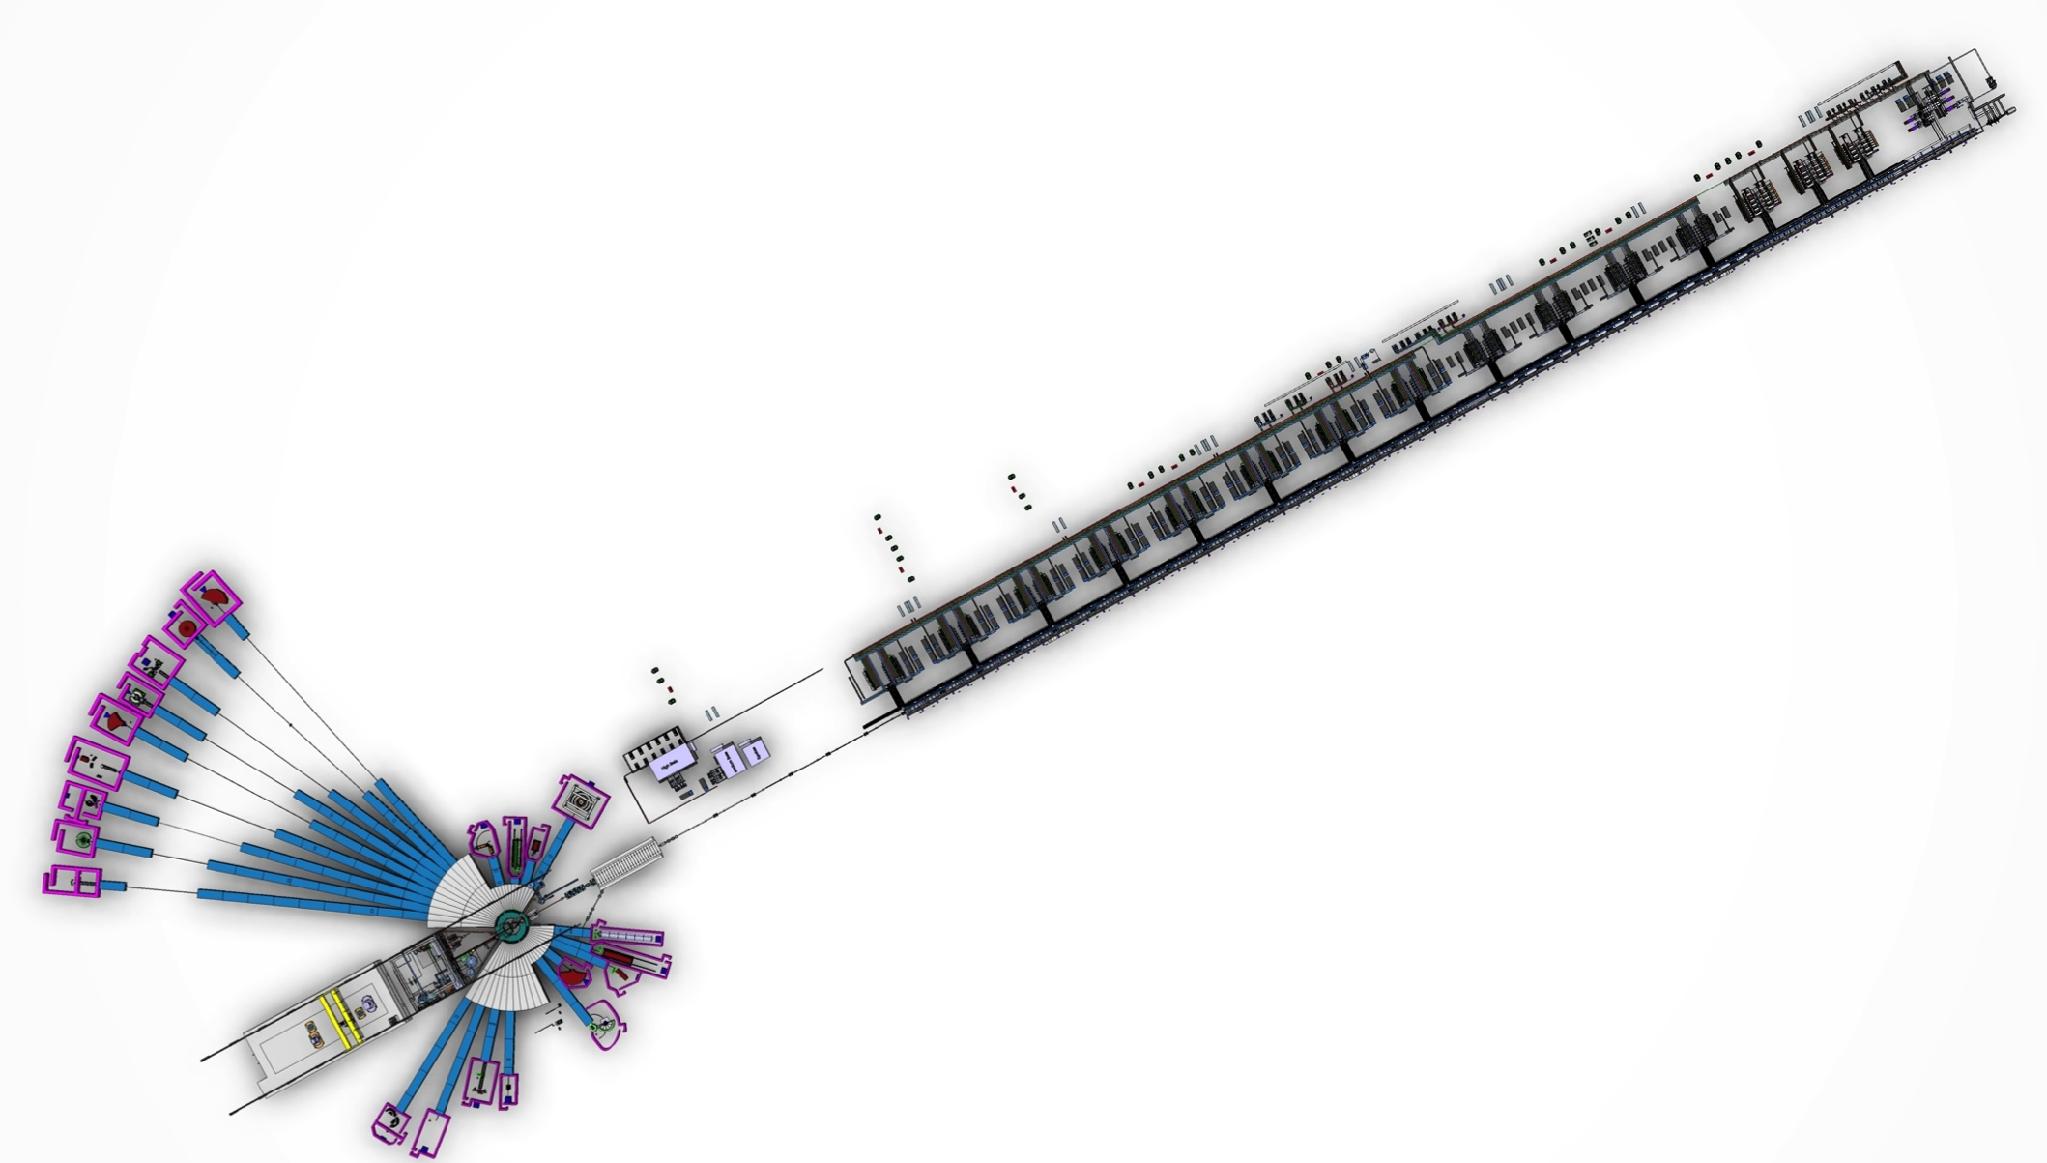
The target station is one of three technical components of ESS
Instruments
Accelerator
Target
130 m

Slide 3
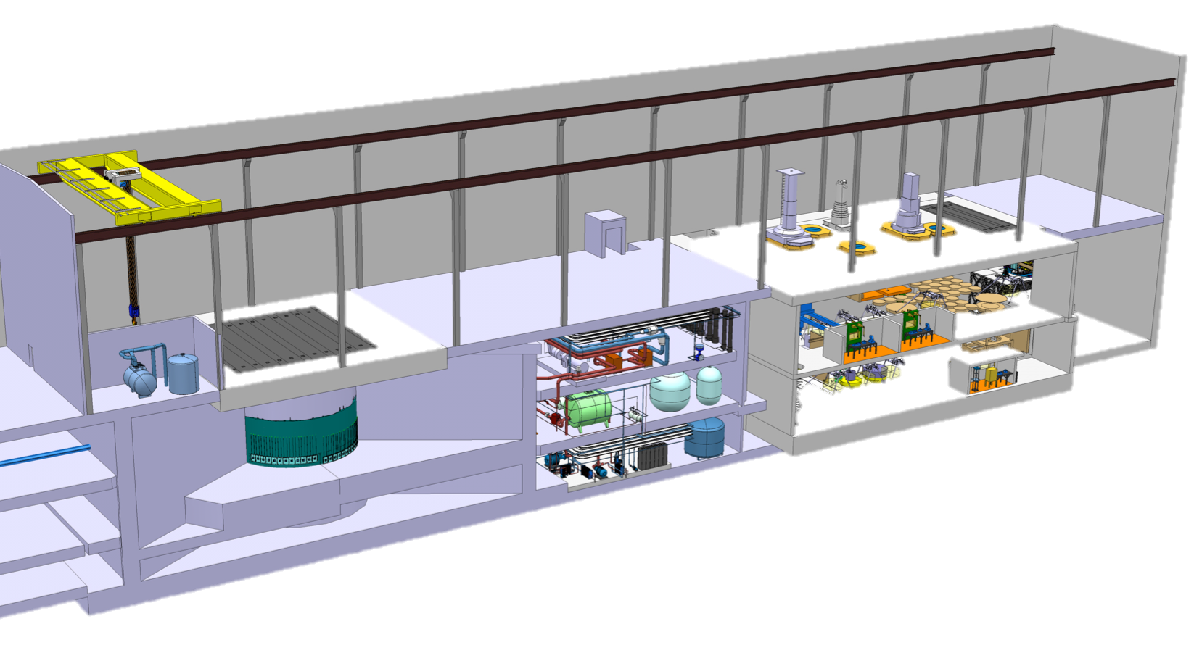
Target Station High Level Functions
Generate neutrons via the spallation process using protons produced by the accelerator
Slow the neutrons to speeds useful for neutron scattering
Direct neutrons to neutron scattering instruments
Safe, reliable
operation
with high
availability
Active cells
High bay
Target monolith
Utilities
Proton beam transport hall

Slide 4
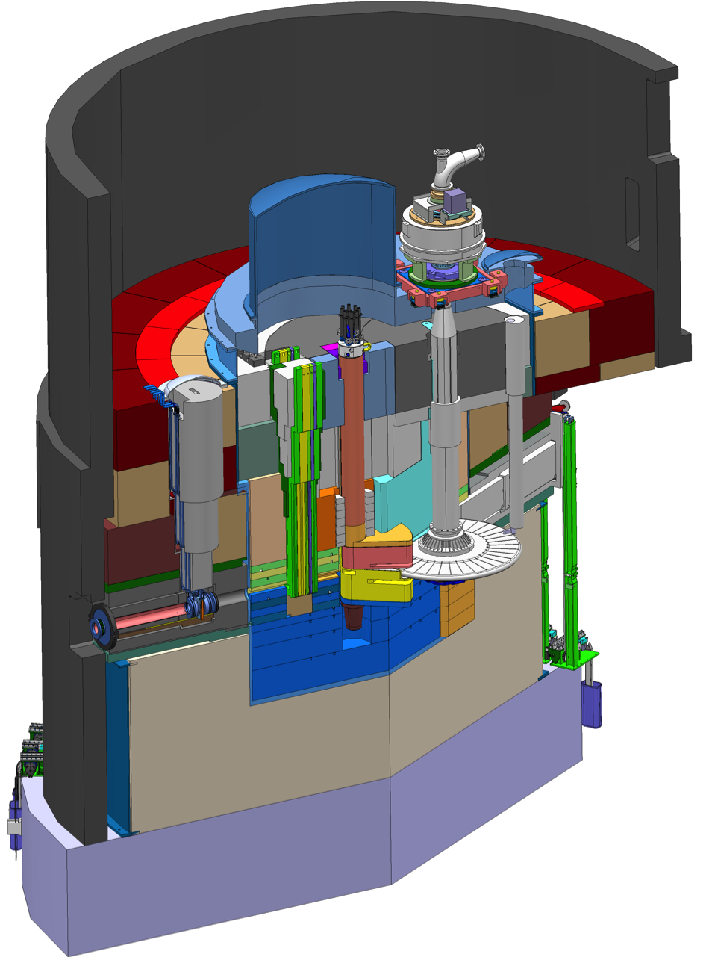
Target monolith and its internals
The proton beam
  Enters the monolith through a beam pipe
  Passes through a proton beam window made of aluminum
  Strikes the rim of the target wheel
  Induces spallation reactions within the tungsten target material, producing copious neutrons
The neutrons
  Leak from the target wheel
  Scatter into moderators filled with water and liquid hydrogen
  Downscatter to low energies
  Leak through neutron beam extraction ports that direct them to neutron scattering instruments
Monolith is filled with 6000 tons of steel to shield high-energy neutrons from escaping
monolith vessel
neutron beam extraction port
target diagnostics plug
proton
beam
target wheel
moderator-reflector
plug
proton
beam window
proton beam instrumentation plug

Slide 5
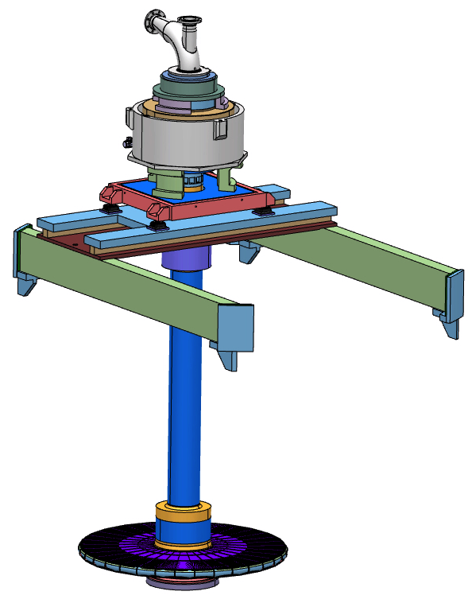
ESS will be the first neutron spallation source to employ a helium-cooled rotating target
Motors and bearings are mounted far away (5 meters) from the high radiation zone
Wheel is suspended on a 6 meter long shaft
Wheel contains 3 tons of tungsten
Helium removes 3 MW of heat deposited in the target by the 5-MW proton beam
Expected lifetime of 5 years

Slide 6
Target Wheel Rotation scheme
Target wheel has 36 sectors of
10° each
The beam pulse is 2.86 ms wide,
and pulses 14 times per second
The target rotates such that
each beam pulse strikes the
center of a new sector
Wheel rotation speed is
then 14 Hz/36 = 0.39 Hz

Slide 7
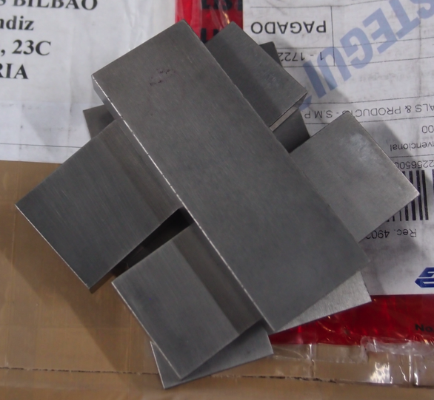
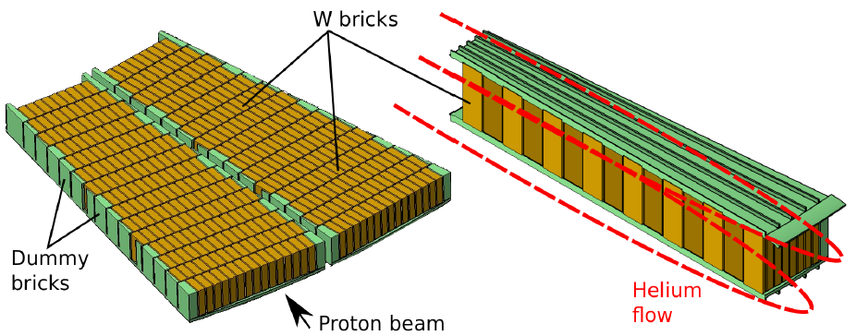
Tungsten Arrangement
3 tons of tungsten bricks
10 W x 30 D x 80 H mm³
About 7000 bricks in total
Figures courtesy of ESS-Bilbao.

Slide 8
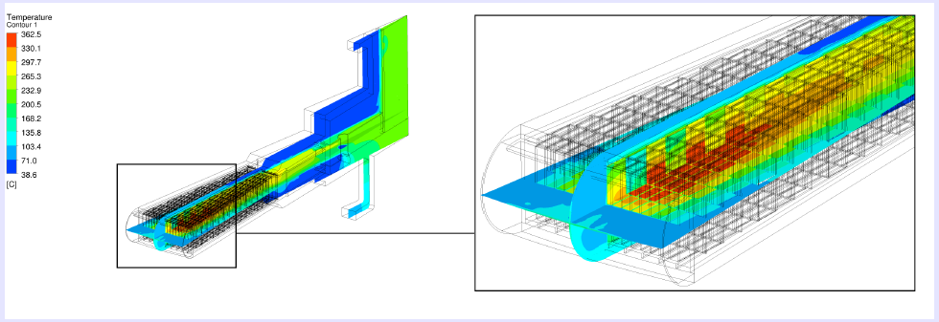
Helium cooling system has 3 MW capacity
3 MW capacity
30 kg helium inventory
3 kg/s flow rate
200°C ∆T
Helium flow arrangement and helium temperature in a single target sector (Courtesy ESS-Bilbao).

Slide 9
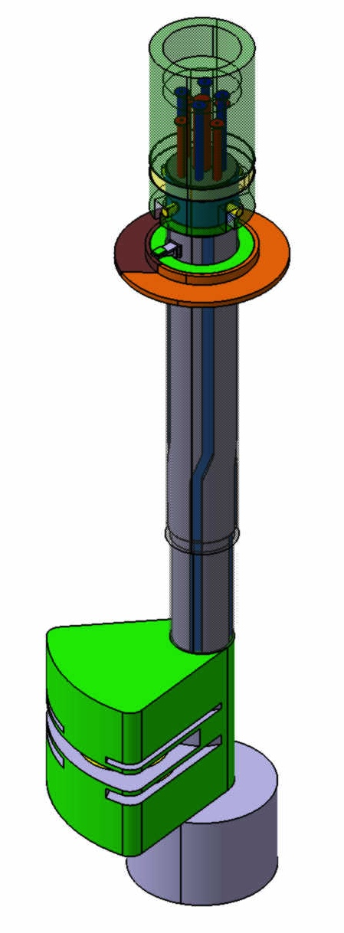
The two hydrogen moderators introduce unique challenges
Moderators are expected to last only one year so the configuration requires the moderators to be replaced with disturbing the target wheel
The design solution is a “twister” scheme
The higher beam power of ESS means a higher heat load in the hydrogen and its containment structure
The short height of the recently developed flat moderators requires more precise alignment to the neutron guides

Slide 10
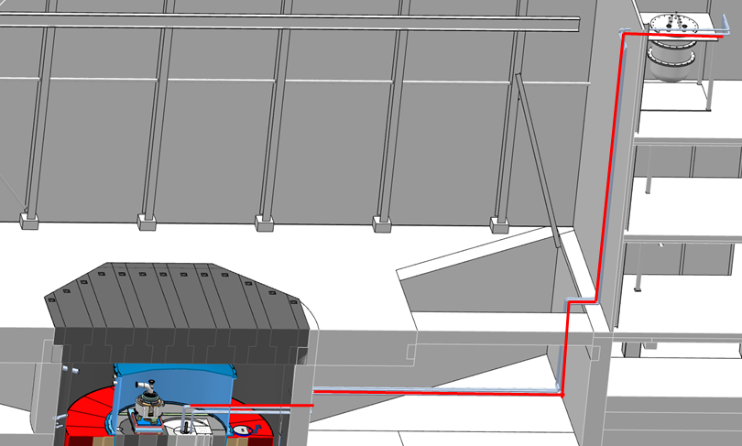
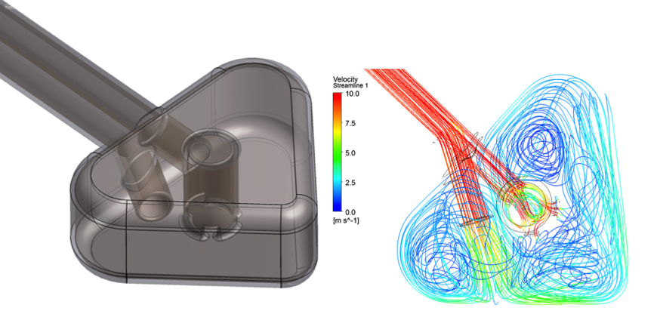
Hydrogen loop supplies cold moderators with liquid hydrogen at 17 K
25 kW liquid hydrogen loop heat capacity
He cryoplant (16 K), 35 kW capacity
Figures courtesy of FZ Jülich.

Slide 11
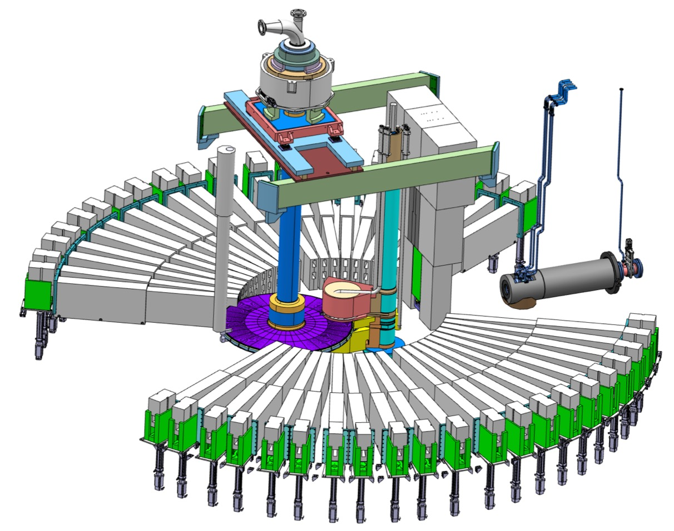
Monolith Systems
Monolith vessel (6 m diameter × 8 m tall)
Steel shielding (6000 tons)
Instrumentation plugs
Proton beam window
Neutron shutters
Neutron beam
extraction system

Slide 12
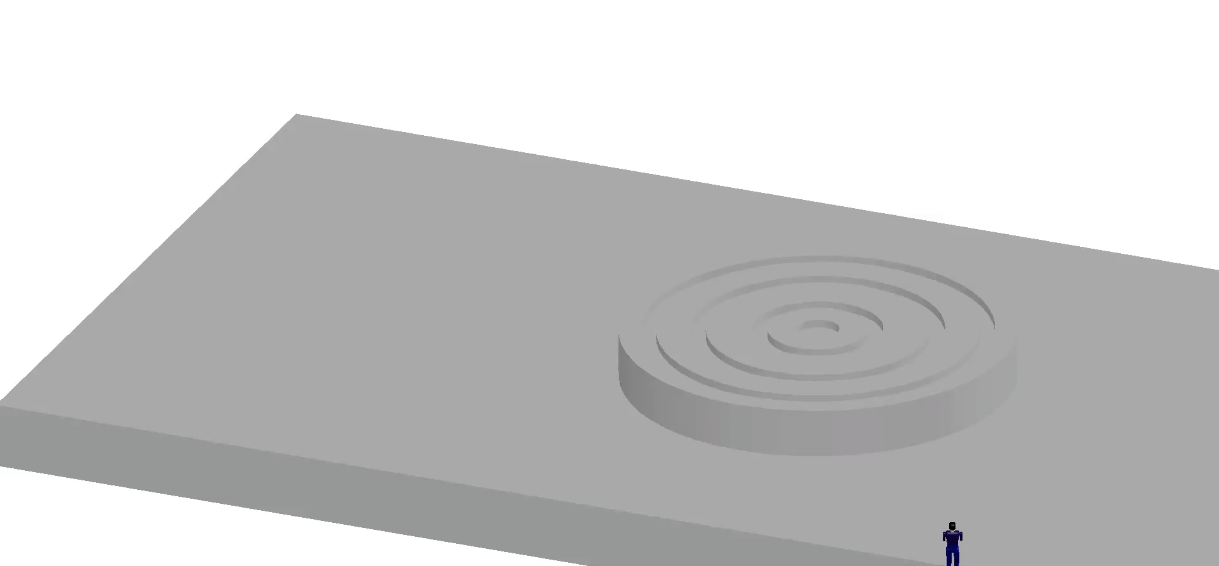
Monolith Installation

Slide 13
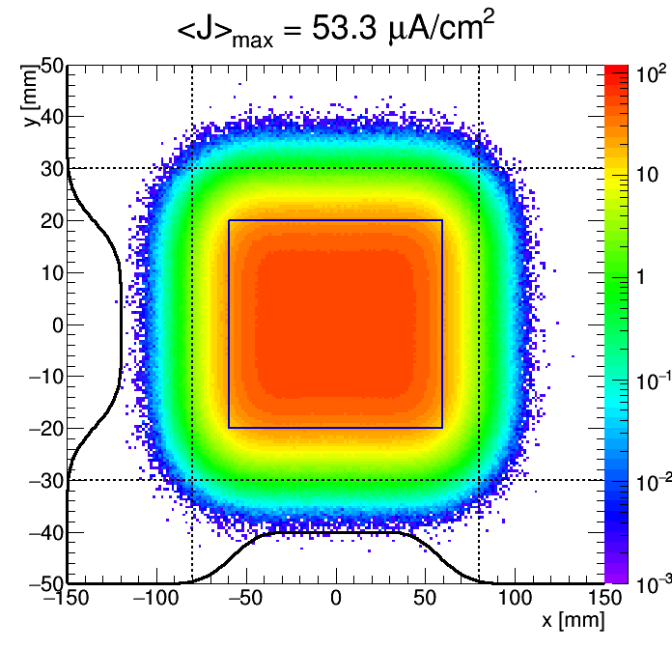
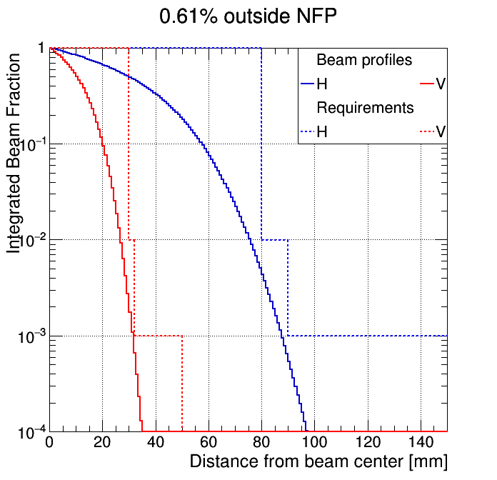
Unique beam expansion scheme uses raster magnets to achieve a flat profile on target

Slide 14
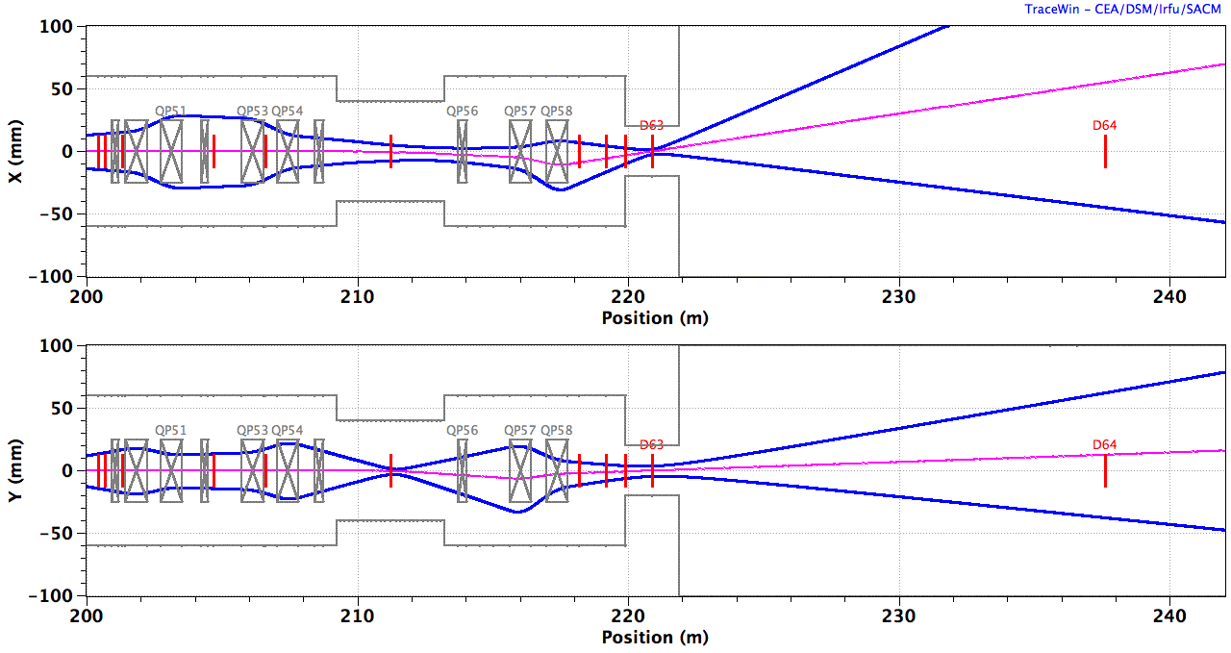
Beam raster forms a crossover at the center of the neutron shield wall
Quads 1-4
Raster
magnets
Quads 5,6
Target
B_{y} B_{y} B_{x} B_{x} | B_{x} B_{x} B_{y} B_{y}
4 cm
Magenta line: beam centroid
Blue line: 10 rms
2 m
Neutron
Shield Wall
Notes:
RSM physical apertures

Slide 15
First results indicate that beam optics can be adequately shielded from backstreaming neutrons
30 m
air
<1 µSv/h
GEOMETRY
concrete
concrete
<1 Sv/h?
steel
air
Sv/h
final quads
neutron shield wall
target
10⁹
10⁶
10³
PROMPT
NEUTRON
DOSE MAP
10⁰
10^{–3}
10^{–6}
10^{–9}

Slide 16
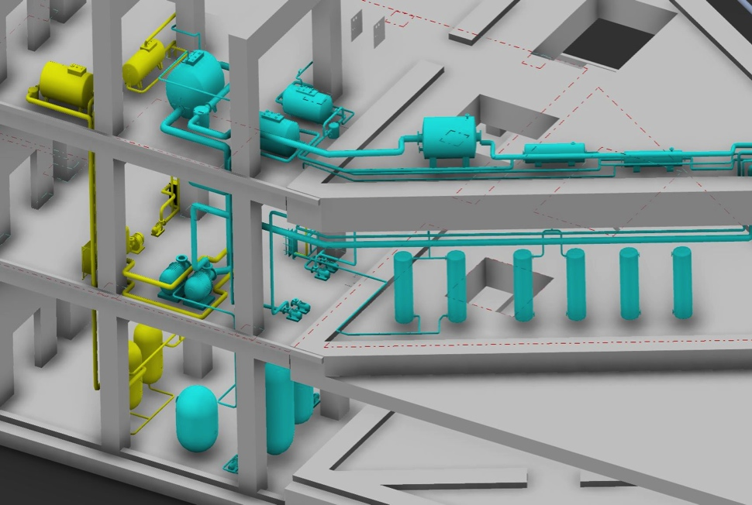
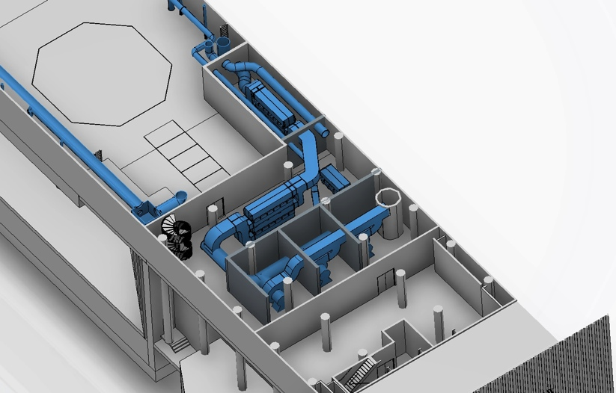
WP5: Fluid Systems
Water cooling systems for thermal moderators, reflector and shielding
Primary cooling system for proton beam window
Intermediate water systems
Helium purification systems
Ventilation system

Slide 17
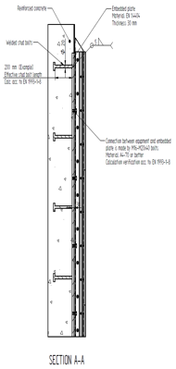
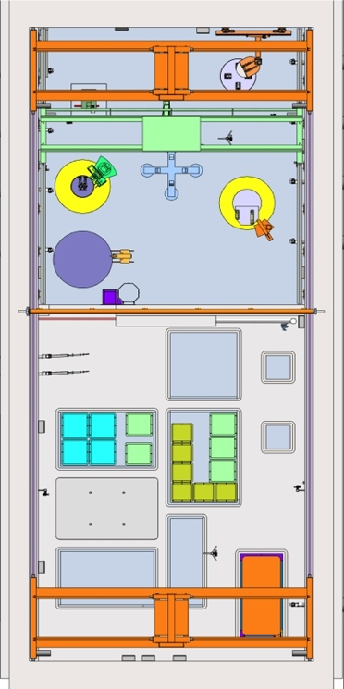
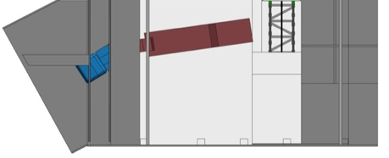
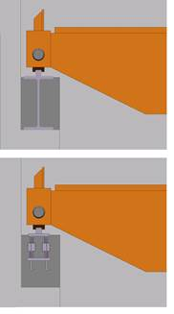
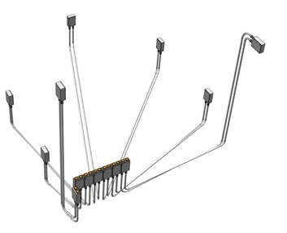
Remote handling systems provide the capability to remove and dismantle activated components
Hot cell and internals for processing and storing spent radioactive components
Transfer casks to transport activated components on site
Support systems (mock-up test stand, local shielding, etc.)
Waste shipment
Utility Penetrations
Concepts for embedded parts
Concepts for Electrical Penetrations
Options for Crane Rails

Slide 18
Summary
The ESS target station employs many innovative features:
  helium-cooled rotating tungsten target
  flat moderators
  proton beam expansion using raster magnets
  neutron beam ports that allow viewing of either the upper or lower moderator
  small angular separation between beamlines, doubling the number of neutron beam ports
The design fully achieves the specified performance while preserving the safety of employees, the public, and the environment as the paramount design criterion

