Slide 1
Neutron Instruments I:
Sources and Basics
ESS Engineering Lectures
22nd February 2016
Ken Andersen

Slide 2
Summary
Neutron facilities
  overview & trends
Reactor-based sources
Fission vs Spallation
Neutron source time structure
  the time of flight method
Long-pulse neutron sources

Slide 3
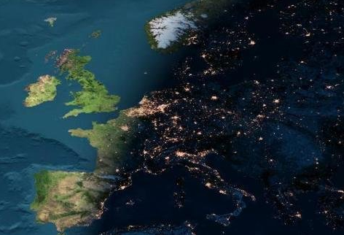
Main European neutron sources 2016
JEEP-II
ISIS
TUD
HZB
FRM2
LLB
BNC
ILL
PSI

Slide 4

Major neutron sources in the world
2000
2010
2020
ILL (F)
HZB (D)
LLB (F)
PSI (CH)
FRM-II (D)
HFIR (USA)
NIST (USA)
JRR-3 (J)
PIK (RU)
IBR-2/2M (RU)
ISIS-1 (UK)
ISIS-2 (UK)
LANSCE (USA)
SNS (USA)
J-PARC (J)
ESS (SE)
Continuous
Pulsed

Slide 5
Major neutron sources in the world
Fission/Spallation
Continuous/Pulsed
ILL (F) | X |  | X
HZB (D) | X |  | X
LLB (F) | X |  | X
PSI (CH) |  | X | X
FRM-II (D) | X |  | X
HFIR (USA) | X |  | X
NIST (USA) | X |  | X
JRR-3 (J) | X |  | X
PIK (RU) | X |  | X
IBR-2/2M (RU) | X |  |  | X
ISIS-1 (UK) |  | X |  | X
ISIS-2 (UK) |  | X |  | X
LANSCE (USA) |  | X |  | X
SNS (USA) |  | X |  | X
J-PARC (J) |  | X |  | X
ESS (SE) |  | X |  | X

Slide 6
The first neutron source
James Chadwick:
used Polonium as alpha emitter on Beryllium

Slide 7
Evolution of neutron sources
10²⁰
10¹⁵
Thermal flux n/cm²-s
10¹⁰
10⁵
Berkeley 37-inch cyclotron
350 mCi
Ra-Be source
1
Chadwick
1930
1940
1950
1960
1970
1980
1990
2000
2010
2020
(Updated from Neutron Scattering, K. Sköld and D. L. Price, eds., Academic Press, 1986)

Slide 8
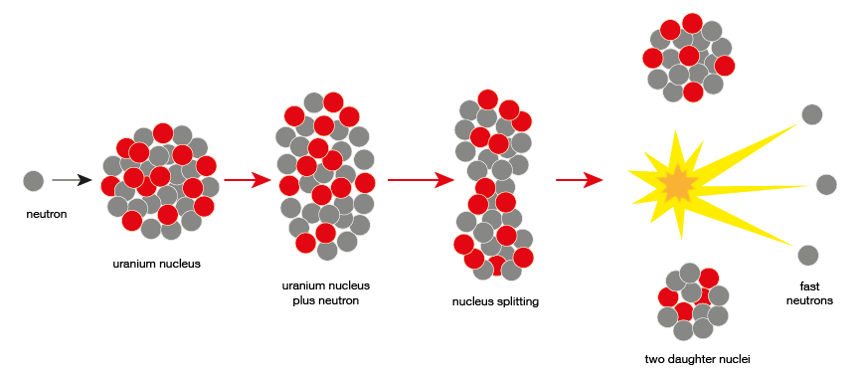
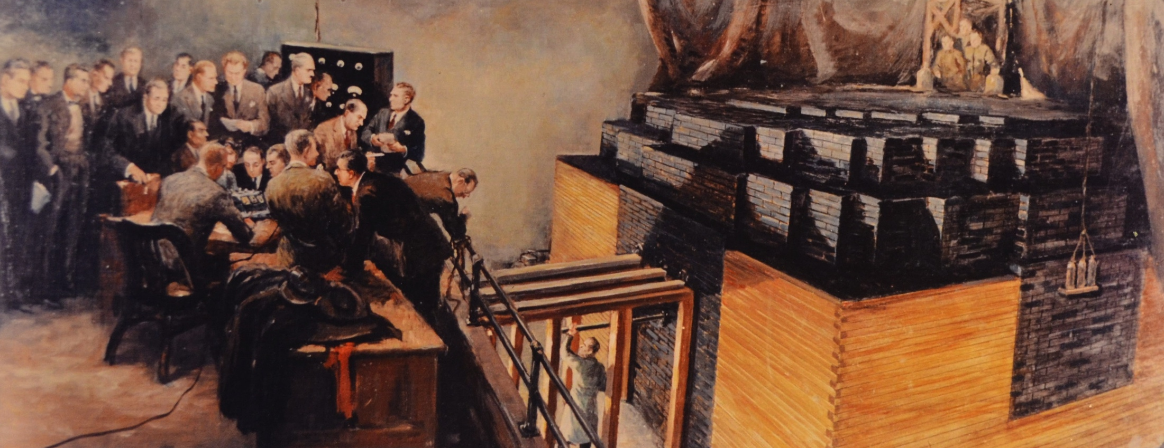
Nuclear Fission

Slide 9
Evolution of neutron sources
10²⁰
10¹⁵
MTR
NRU
HFIR
ILL
NRX
HFBR
Thermal flux n/cm²-s
X-10
10¹⁰
CP-2
CP-1
10⁵
Berkeley 37-inch cyclotron
350 mCi
Ra-Be source
Reactor Sources
1
Chadwick
1930
1940
1950
1960
1970
1980
1990
2000
2010
2020
(Updated from Neutron Scattering, K. Sköld and D. L. Price, eds., Academic Press, 1986)

Slide 10
Evolution of neutron sources
10²⁰
10¹⁵
MTR
NRU
HFIR
ILL
NRX
HFBR
FRM-II
Thermal flux n/cm²-s
X-10
10¹⁰
CP-2
CP-1
10⁵
Berkeley 37-inch cyclotron
350 mCi
Ra-Be source
Reactor Sources
1
Chadwick
1930
1940
1950
1960
1970
1980
1990
2000
2010
2020
(Updated from Neutron Scattering, K. Sköld and D. L. Price, eds., Academic Press, 1986)

Slide 11
Nuclear Spallation

Slide 12
Evolution of neutron sources
10²⁰
J-PARC
ISIS
SNS
10¹⁵
MTR
NRU
HFIR
ILL
NRX
HFBR
ZINP-P/
IPNS
FRM-II
Thermal flux n/cm²-s
X-10
WNR
KENS
SINQ
10¹⁰
ZINP-P
CP-2
CP-1
10⁵
Berkeley 37-inch cyclotron
350 mCi
Ra-Be source
Steady State Sources
Pulsed Sources
1
Chadwick
1930
1940
1950
1960
1970
1980
1990
2000
2010
2020
(Updated from Neutron Scattering, K. Sköld and D. L. Price, eds., Academic Press, 1986)

Slide 13
Evolution of neutron sources
10²⁰
ESS
J-PARC
ISIS
SNS
10¹⁵
MTR
NRU
HFIR
ILL
NRX
HFBR
ZINP-P/
IPNS
FRM-II
Thermal flux n/cm²-s
X-10
WNR
KENS
SINQ
10¹⁰
ZINP-P
CP-2
CP-1
10⁵
Berkeley 37-inch cyclotron
350 mCi
Ra-Be source
Steady State Sources
Pulsed Sources
1
Chadwick
1930
1940
1950
1960
1970
1980
1990
2000
2010
2020
(Updated from Neutron Scattering, K. Sköld and D. L. Price, eds., Academic Press, 1986)

Slide 14
Slow Neutrons vs Light
 | light | neutrons
λ | < μm | < nm
E | > eV | > meV
penetration | ~ μm | ~ cm
θ_{c} | 90° | 1°
B | 10¹⁸ p/cm²/ster/s (60W lightbulb) | 10¹⁴ n/cm²/ster/s (60MW reactor)
spin | 1 | ½
interaction | electromagnetic | strong force, magnetic
charge | 0 | 0

Slide 15
Why neutrons?
Thermal neutron have wavelengths similar to inter-atomic distances
Thermal neutrons have energies comparable to lattice vibrations
Neutrons are non-destructive
Neutrons interact weakly
  they penetrate into the bulk
Neutrons interact via a simple point-like potential
  amplitudes are straightforward to interpret
Neutrons have a magnetic moment
  great for magnetism
Neutrons see a completely different contrast to x-rays
  e.g. hydrogen is very visible

Slide 16
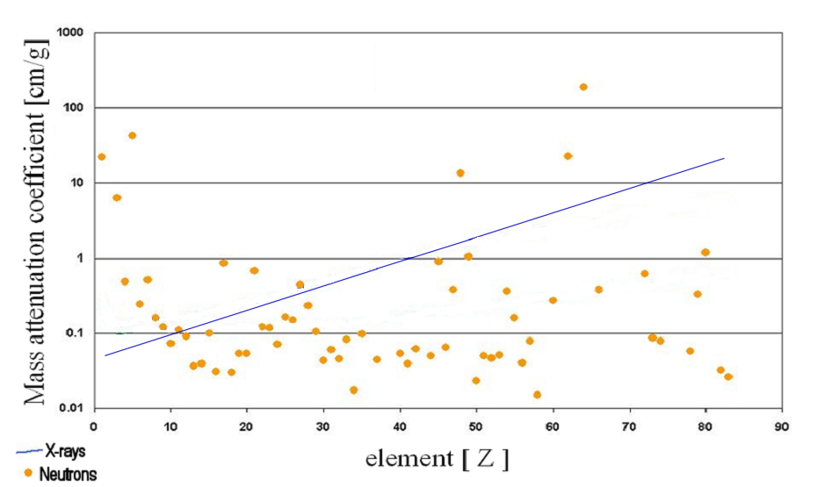
Why neutrons?
100 keV

Slide 17
ILL Reactor Neutron Source
Highly-enriched uranium
Compact design for high brightness
Heavy-water cooling
Single control rod
57MW thermal power
Cold, thermal, hot sources
2 m

Slide 18
ILL Reactor Neutron Source
Highly-enriched uranium
Compact design for high brightness
Heavy-water cooling
Single control rod
57MW thermal power
Cold, thermal, hot sources
 | cold | thermal | hot
moderator | liquid D₂ | Liquid D₂O | graphite
moderator temperature | 20K | 300K | 2000K
neutron wavelength | 3→20Å | 1→3Å | 0.3→1Å
2 m

Slide 19
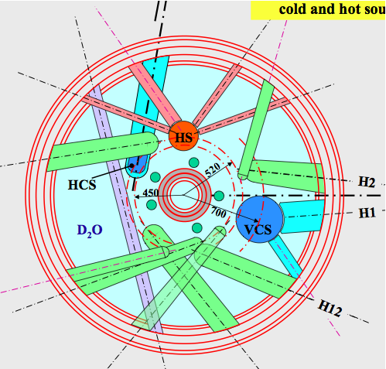
ILL Reactor Neutron Source
2nd guide hall
(7 instruments)
1st guide hall
(20 instruments)

Slide 20
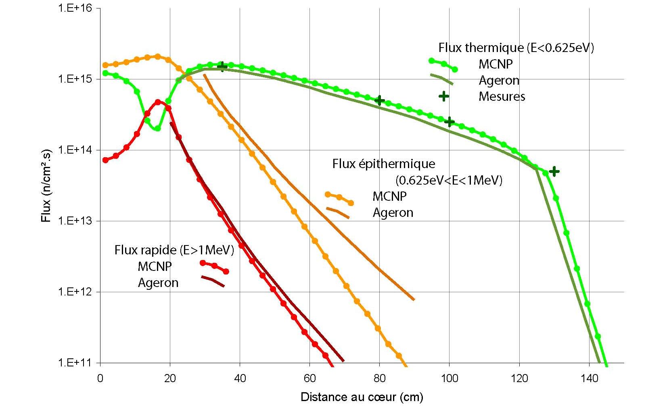
ILL Reactor Neutron Source

Slide 21
ILL Reactor Neutron Source
HCS
VCS
HS
Thermal beam tubes

Slide 22
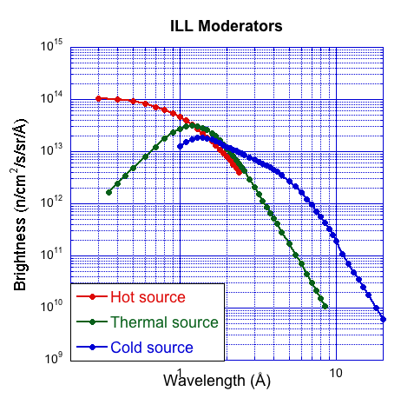
ILL Moderator Brightnesses

Slide 23
Spallation Sources
Spallation: 10x higher neutron brightness per unit heat
1 MW spallation source = 10 MW reactor
  e.g. 800 MeV at 1.25 mA (PSI)
  e.g. 3 GeV at 0.4 mA (J-PARC)
Peak brightness >> time-average brightness
0
100μs
ILL 57MW
1
ISIS-TS1 128kW
log(Intensity@λ=5Å)
0.1
0 20 40 60 80 100 120
time (ms)

Slide 24
Spallation Sources
Spallation: 10x higher neutron brightness per unit heat
1 MW spallation source = 10 MW reactor
  e.g. 800 MeV at 1.25 mA (PSI)
  e.g. 3 GeV at 0.4 mA (J-PARC)
Peak brightness >> time-average brightness
0
100μs
ILL 57MW
1
ISIS-TS1 128kW
ISIS-TS2 32kW
log(Intensity@λ=5Å)
0.1
0 20 40 60 80 100 120
time (ms)

Slide 25
Spallation Sources
Spallation: 10x higher neutron brightness per unit heat
1 MW spallation source = 10 MW reactor
  e.g. 800 MeV at 1.25 mA (PSI)
  e.g. 3 GeV at 0.4 mA (J-PARC)
Peak brightness >> time-average brightness
long pulse
3ms
ESS 5MW
ILL 57MW
1
ISIS-TS1 128kW
ISIS-TS2 32kW
log(Intensity@λ=5Å)
0.1
0 20 40 60 80 100 120
time (ms)

Slide 26
De Broglie Relations
Particle | Wave

Slide 27
The Time-of-Flight (TOF) Method
distance
time

Slide 28
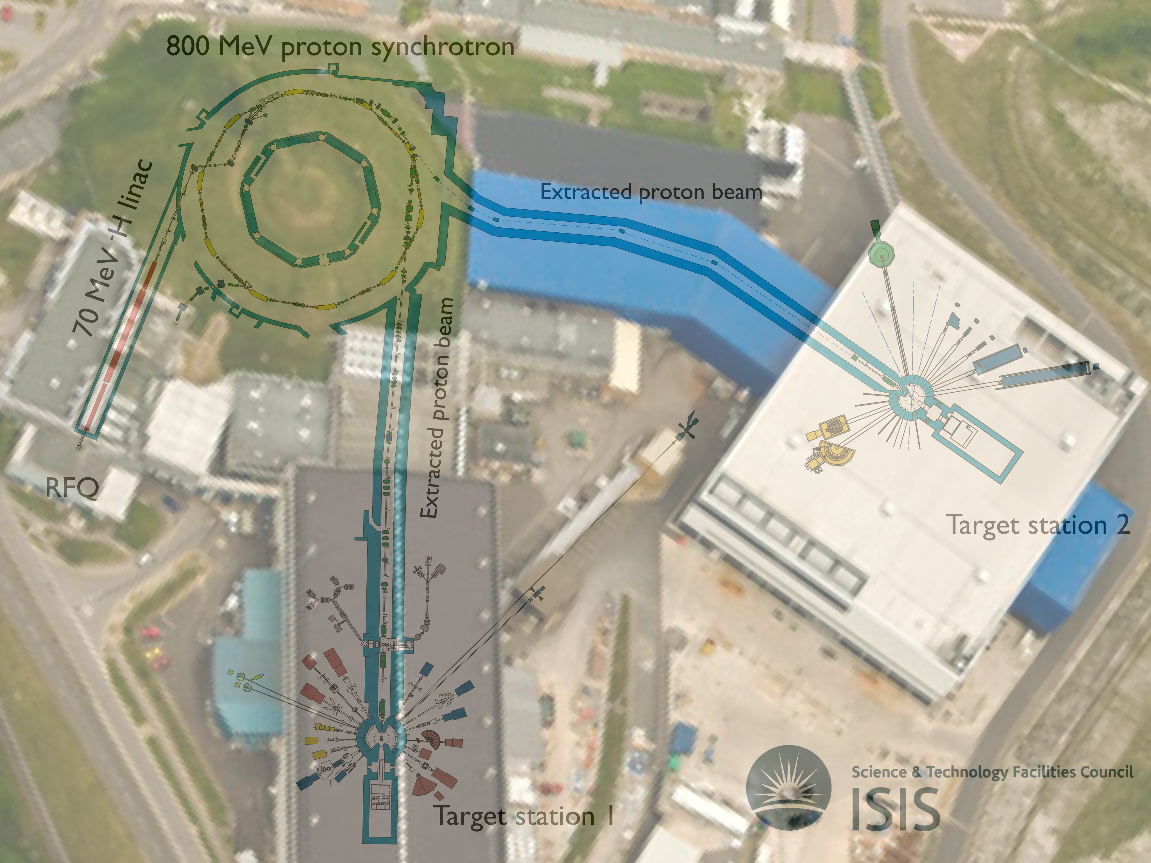
ISIS Spallation Source
ISIS, UK (160kW)

Slide 29
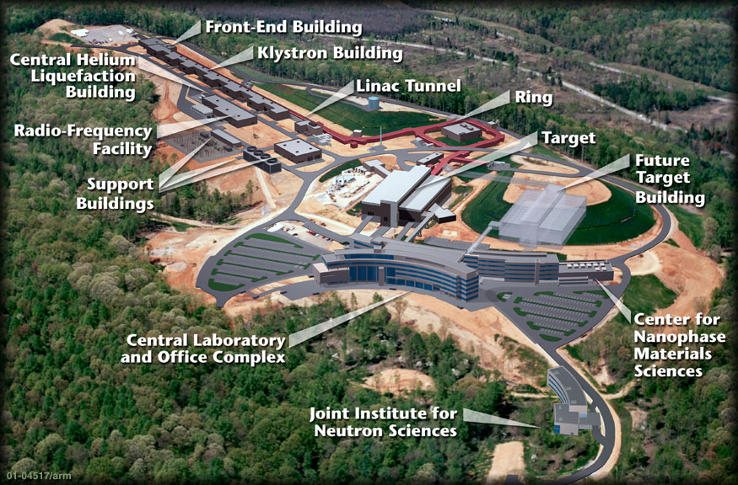
SNS, Oak Ridge, USA (1MW)

Slide 30
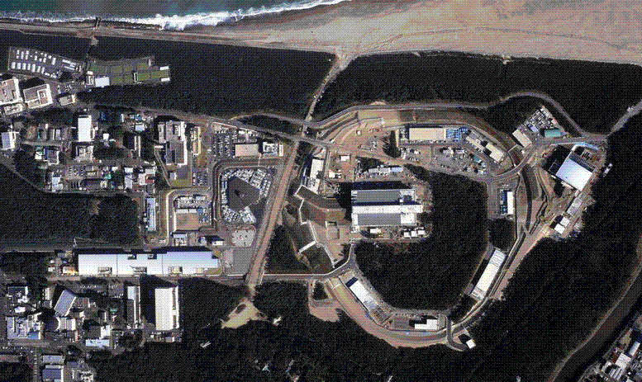
J-PARC, Tokai, Japan (500kW)

Slide 31
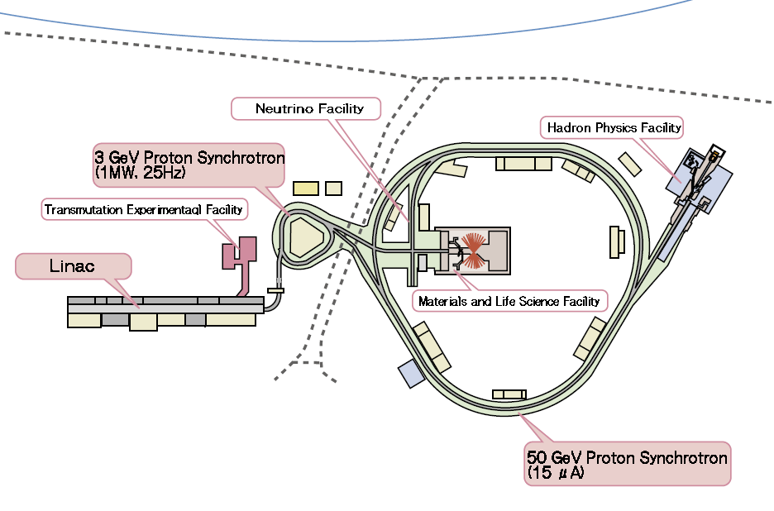
J-PARC, Tokai, Japan (500kW)

Slide 32
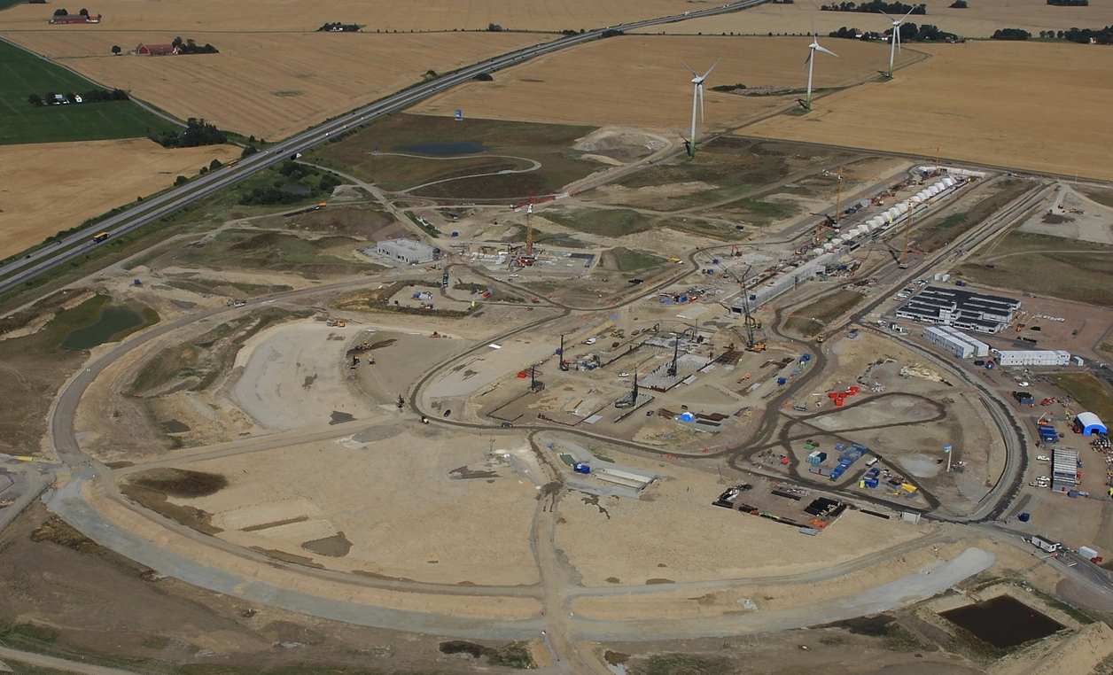
ESS, Lund, Sweden (5MW in 2025)

Slide 33
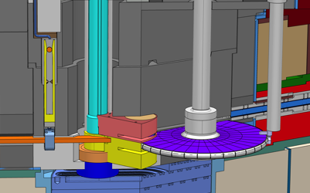
ESS target
2.5m tungsten wheel

Slide 34
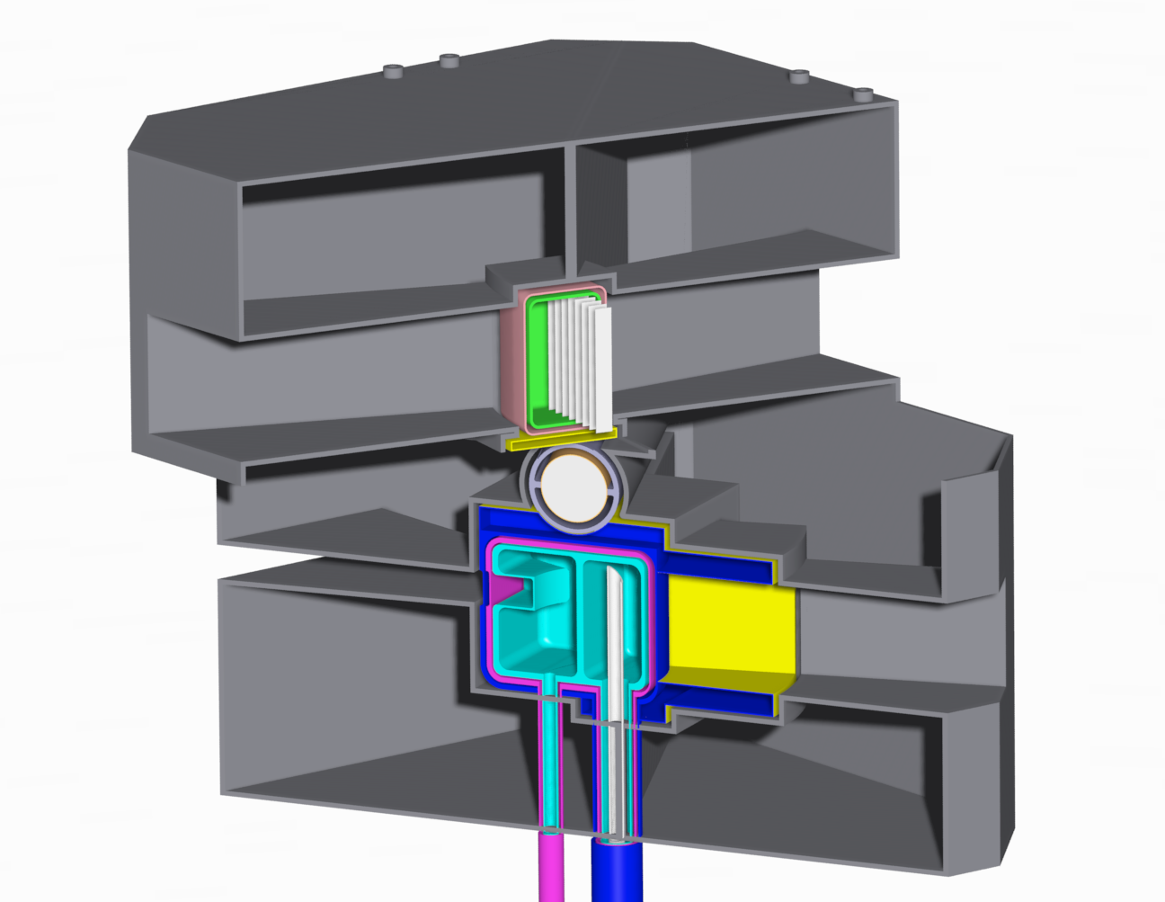
ISIS TS2 Target
Target: 66mm W

Slide 35
Target-Reflector-Moderator Neutronics
Target produces neutrons in > MeV range
Moderators contain H to thermalise neutrons
  largest scattering cross-section (80b)
  lower mass: same as neutron
  on average, ½ energy lost per collision
  100 MeV -> 10 meV requires about 25 collisions
Moderators embedded in reflector, usually D₂O-cooled Be
  minimal absorption
  large scattering cross-section (8b)
  little thermalisation

Slide 36
Target-Reflector-Moderator Neutronics
Target plane
Be
Target
protons in

Slide 37
Target-Reflector-Moderator Neutronics
10cm above/below Target
Be
protons in

Slide 38
Target-Reflector-Moderator Neutronics
10cm above/below Target
Be
protons in

Slide 39
Target-Reflector-Moderator Neutronics
10cm above/below Target
Be
protons in

Slide 40
Target-Reflector-Moderator Neutronics
10cm above/below Target
Be
protons in
0
100μs
200μs

Slide 41
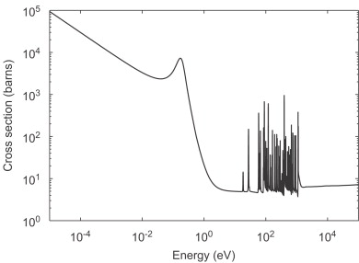
Target-Reflector-Moderator Neutronics
Decoupling
Cadmium absorption
Cd
protons in
0
100μs
200μs

Slide 42
Target-Reflector-Moderator Neutronics
Decoupling
Cadmium absorption
Cd
0
100μs
200μs

Slide 43
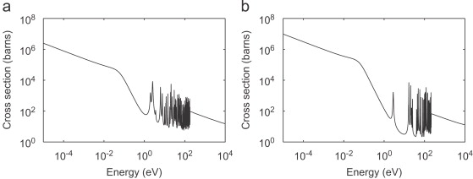
Target-Reflector-Moderator Neutronics
Decoupling
Poisoning
Cadmium absorption
Cd
Gd
Gadolinium absorption
0
100μs
200μs

Slide 44
Time-of-flight (TOF) resolution
distance
Δt
time

Slide 45
Time-of-flight (TOF) resolution
distance
Δt
time

Slide 46
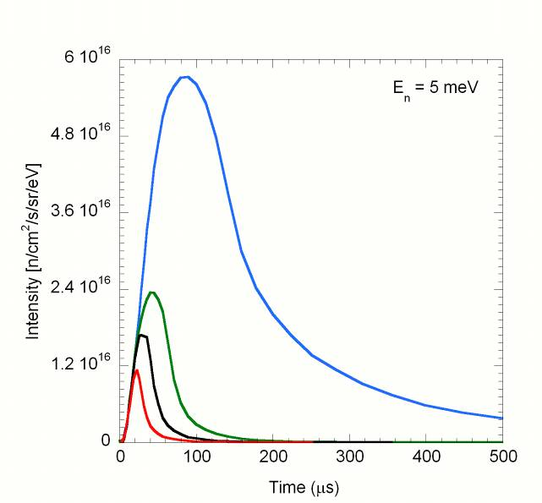
Moderator Decoupling and Poisoning
J-PARC H₂ moderators at 1MW
Peak Structure at 5meV
Coupled
Decoupled
Poisoned

Slide 47
Moderator Decoupling and Poisoning
Intensity
λ=1Å
λ=2Å
λ=5Å
time (μs)
0 100 200 300

Slide 48
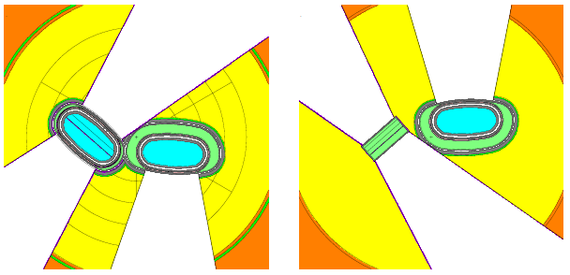
SNS moderators
Top
Bottom
decoupled poisoned H₂
coupled H₂
decoupled poisoned H₂O
coupled H₂
20 cm

Slide 49
ISIS TS2 Target
decoupled poisoned solid CH₄
coupled H₂
coupled solid CH₄

Slide 50
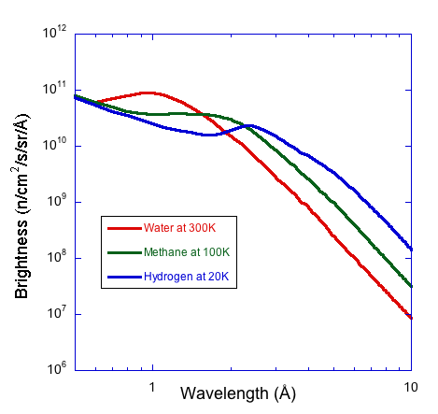
Moderator Temperature
ISIS-TS1 moderators at 160kW

Slide 51
Long-pulse performance
15
x10¹³
ESS 5 MW
2015 design
λ = 5 Å
Possibilities of pulse shaping
10
Brightness (n/cm²/s/sr/Å)
5
JPARC
0.3-1 MW
SNS
1-2 MW
ISIS TS1
128 kW
ISIS TS2
32 kW
ILL 57 MW
0
time (ms)
1
2
3
4

Slide 52
Thank You!

