Slide 1
Neutron Instruments II:
Principles and Technologies
ESS Engineering Lectures
22nd February 2016
Ken Andersen

Slide 2
Summary
Neutron instrument concepts
  time of flight
  Bragg’s law
Neutron Instrumentation
  guides
  detectors
  choppers
Neutron diffractometers
Neutron spectrometers

Slide 3
The time-of-flight (TOF) method
distance
Δt
time

Slide 4
Diffraction: Bragg’s Law

Slide 5

Diffraction: Bragg’s Law

Slide 6
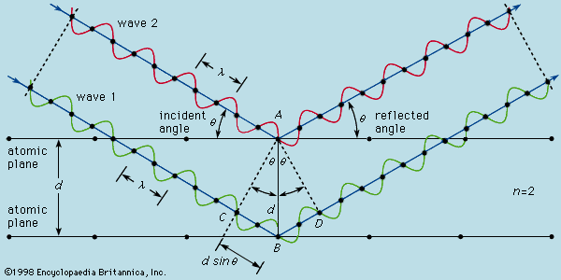
Diffraction: Bragg’s Law

Slide 7
Diffraction: Bragg’s Law

Slide 8
Diffraction: Bragg’s Law
2θ

Slide 9
Diffraction: Bragg’s Law
Wavevector:

Slide 10
Diffraction: Bragg’s Law
Wavevector:
θ
θ

Slide 11
Diffraction: Bragg’s Law
Wavevector:
θ
θ
Bragg’s Law:

Slide 12
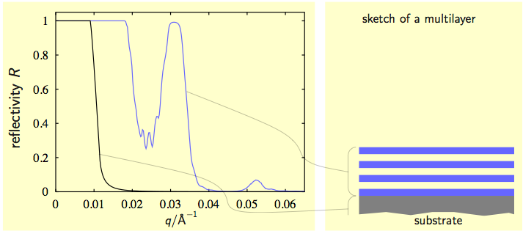
Neutron Supermirrors
Courtesy of J. Stahn, PSI

Slide 13
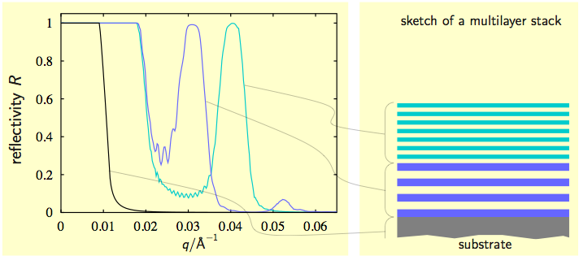
Neutron Supermirrors
Courtesy of J. Stahn, PSI

Slide 14
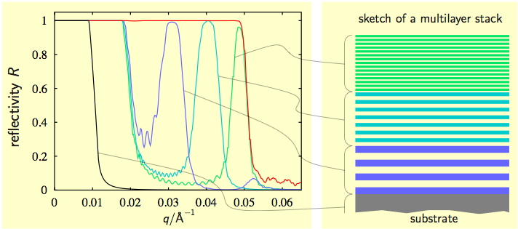
Neutron Supermirrors
Courtesy of J. Stahn, PSI

Slide 15
Neutron Supermirrors
Reflection: θ_{c}(Ni) = λ[Å] × 0.10°
Multilayer: θ_{c}(SM) = m × λ[Å] × 0.10°
λ _{c}
λ ₁
λ ₂
λ ₃
λ ₄
}
d₁
}
d₂
}
d₃
}
d₄

Slide 16
Neutron Supermirrors
Reflection: θ_{c}(Ni) = λ[Å] × 0.10°
Multilayer: θ_{c}(SM) = m × λ[Å] × 0.10°
λ _{c}
λ ₁
λ ₂
λ ₃
“m-number”
Supermirror critical angle
λ ₄
}
d₁
}
d₂
}
d₃
}
d₄

Slide 17
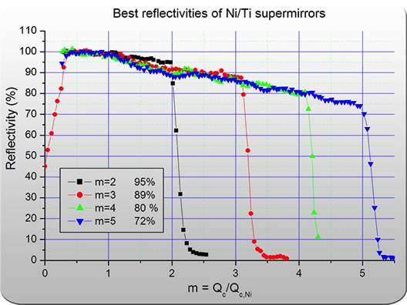
State-of-the-art Supermirrors
Mirrotron

Slide 18
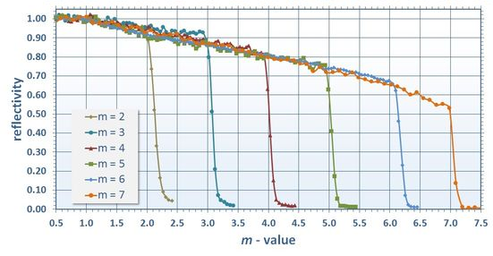
State-of-the-art Supermirrors
Mirrotron
Swiss Neutronics

Slide 19
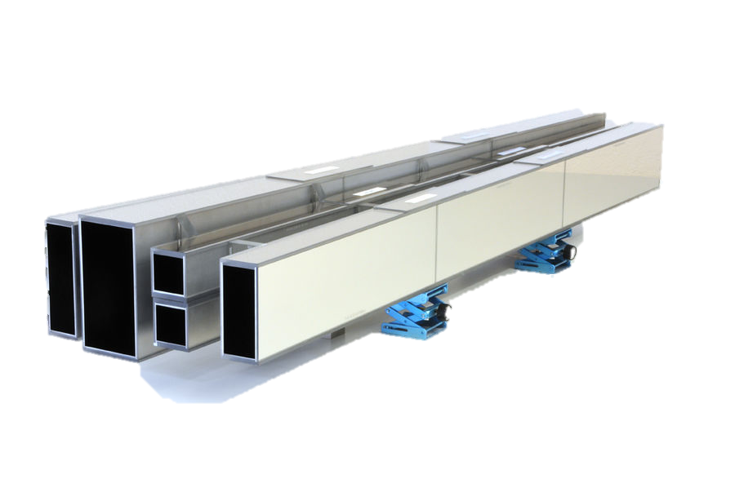
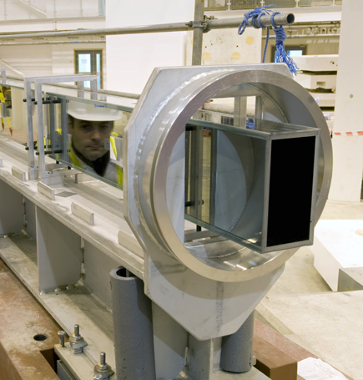
Neutron guides
WISH @ ISIS
Swiss Neutronics guides for NIST

Slide 20
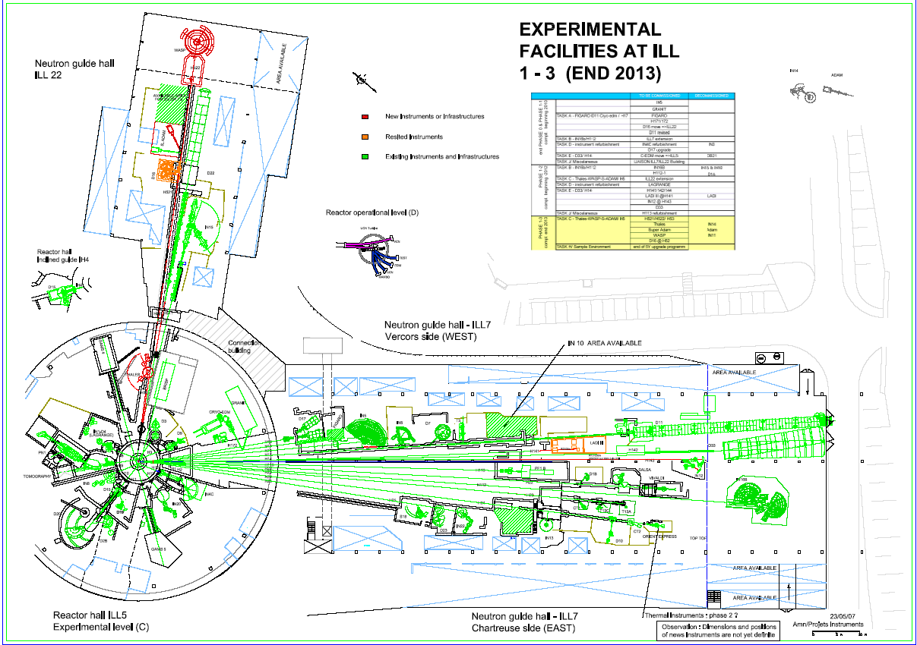
Distribution by Guides
Neutron Guides:
Creating space for instruments

Slide 21
Background Reduction
Guides can be used to reduce background
Distance:
  move away from fast-neutron source ~ 1/R²

Slide 22
Background Reduction
Guides can be used to reduce background
Distance:
  move away from fast-neutron source ~ 1/R²
Curved Guides:
  avoid direct line-of-sight
  avoid gammas
  avoid fast neutrons

Slide 23
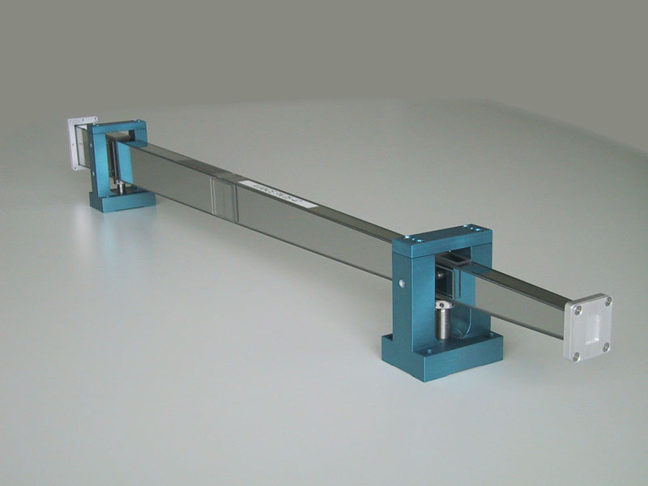
Focusing
Guides can also be used to increase flux
Converging guide increases flux, but increases divergence
(Liouville’s theorem)

Slide 24
industrial components
bacteria
magnetic domains
atomic structures
viruses
polymers, proteins
texture
magnetic structures
Wavevector Q [Å⁻¹]
cell membranes
charge density
10⁻³
10⁻²
10⁻¹
1
10¹
10²
10³
elementary particles
10⁻¹⁵
hydrogen modes
10³
lattice vibrations
spin dynamics
TOF & Crystal
Spectroscopy
10⁻¹²
rotational tunneling
1
Time [s]
molecular diffusion
Energy [meV]
dynamics of macromolecules
Backscattering
10⁻⁹
10⁻³
Spin-echo
domain wall dynamics
10⁻⁶
Length [m]
10⁻⁶
10⁻¹
10⁻²
10⁻³
10⁻⁵
10⁻⁶
10⁻⁷
10⁻⁸
10⁻⁹
10⁻¹⁰
10⁻¹¹
10⁻¹²
10⁻¹⁴
10⁻¹⁵
SANS
Imaging
Diffraction
Particle Physics
Reflectometry

Slide 25
industrial components
bacteria
magnetic domains
atomic structures
viruses
polymers, proteins
texture
magnetic structures
Wavevector Q [Å⁻¹]
cell membranes
charge density
10⁻³
10⁻²
10⁻¹
1
10¹
10²
10³
elementary particles
UV & X-ray FEL: Pump & Probe studies
10⁻¹⁵
hydrogen modes
10³
Inelastic X-ray Scattering
lattice vibrations
X-ray Spec.
Infrared
Light
FTIR
Raman
Brillouin
Dynamic Light Scattering
Laser PCS
spin dynamics
TOF & Crystal
Spectroscopy
10⁻¹²
rotational tunneling
1
Infra-red
Time [s]
molecular diffusion
Energy [meV]
dynamics of macromolecules
Visible Light
10⁻⁹
10⁻³
Backscattering
Spin-echo
Dielectric Spec.
domain wall dynamics
NMR
μSR
10⁻⁶
Length [m]
10⁻⁶
X-ray PCS
10⁻¹
10⁻²
10⁻³
10⁻⁵
10⁻⁶
10⁻⁷
10⁻⁸
10⁻⁹
10⁻¹⁰
10⁻¹¹
10⁻¹²
10⁻¹⁴
10⁻¹⁵
SANS
Imaging
Diffraction
Particle Physics
Reflectometry
X-ray Imaging
SAXS, X-ray Refl.
X-ray Diffraction
EXAFS & XANES
X-rays
NMR Imaging
Triangulation
NMR
NMR
Optical Microscopy
Optical Nanoscopy
Electron Microscopy
Microscopy
SNOM
AFM
STM
Scanning Techniques

Slide 26
industrial components
bacteria
magnetic domains
atomic structures
viruses
polymers, proteins
texture
magnetic structures
Wavevector Q [Å⁻¹]
cell membranes
charge density
10⁻³
10⁻²
10⁻¹
1
10¹
10²
10³
elementary particles
UV & X-ray FEL: Pump & Probe studies
10⁻¹⁵
hydrogen modes
10³
Inelastic X-ray Scattering
lattice vibrations
X-ray Spec.
Infrared
Light
FTIR
Raman
Brillouin
Dynamic Light Scattering
Laser PCS
spin dynamics
TOF & Crystal
Spectroscopy
10⁻¹²
rotational tunneling
1
Infra-red
Time [s]
molecular diffusion
Energy [meV]
dynamics of macromolecules
Visible Light
10⁻⁹
10⁻³
Backscattering
Spin-echo
Dielectric Spec.
domain wall dynamics
NMR
μSR
10⁻⁶
Length [m]
10⁻⁶
X-ray PCS
10⁻¹
10⁻²
10⁻³
10⁻⁵
10⁻⁶
10⁻⁷
10⁻⁸
10⁻⁹
10⁻¹⁰
10⁻¹¹
10⁻¹²
10⁻¹⁴
10⁻¹⁵
SANS
Imaging
Diffraction
Particle Physics
Reflectometry
X-ray Imaging
SAXS, X-ray Refl.
X-ray Diffraction
EXAFS & XANES
X-rays
NMR Imaging
Triangulation
NMR
NMR
Optical Microscopy
Optical Nanoscopy
Electron Microscopy
Microscopy
SNOM
AFM
STM
Scanning Techniques

Slide 27
Diffractometers
Measure structure (d-spacings)
Assume k_{i}=k_{f}
Measure k_{i} or k_{f} :
    Bragg diffraction
    Time-of-flight
Samples :
    Crystals
    Powders
    Liquids
    Large molecules or structures
    Surfaces

Slide 28
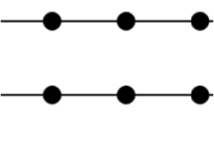
Powder diffractometers
Measure crystal structure using Bragg’s Law
Large single crystals are rarely available
Polycrystal

Slide 29
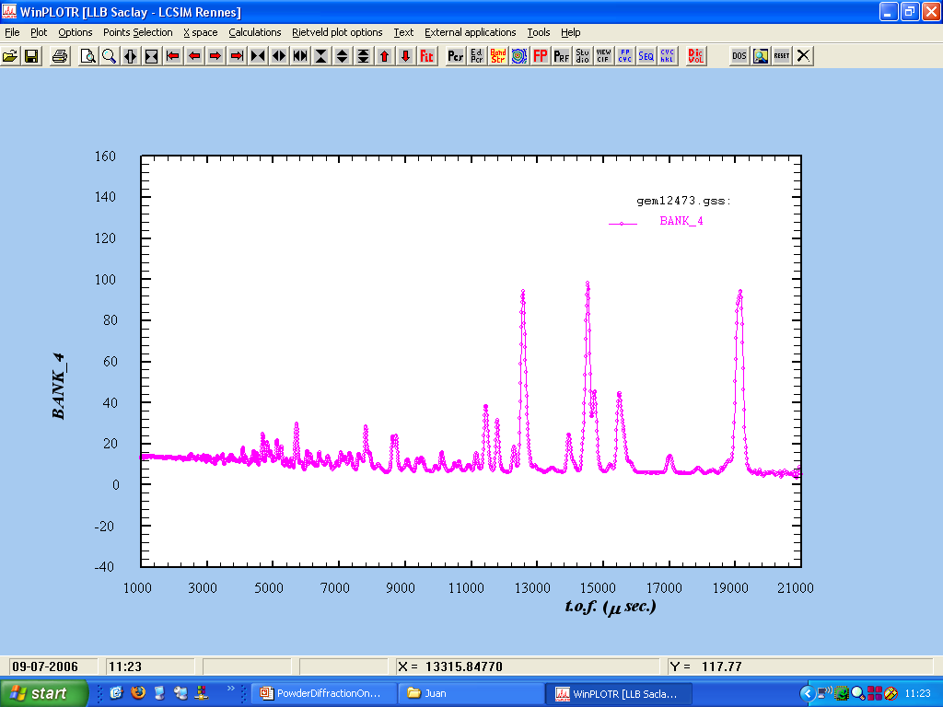
Time-of-flight (TOF) Method
distance
detector
sample
Δt
time

Slide 30
Time-of-flight (TOF) Method
distance
detector
sample
Δt
time

Slide 31
Long-Pulse Resolution
distance
sample
Pulse shaping
time

Slide 32
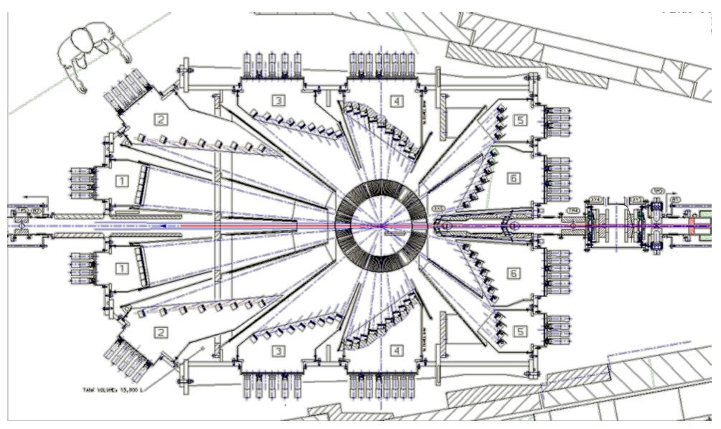
Time-of-flight (TOF) Method
POLARIS @ ISIS TS1

Slide 33
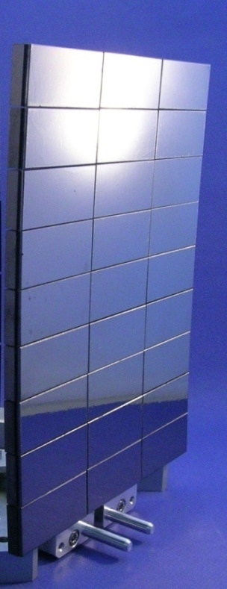
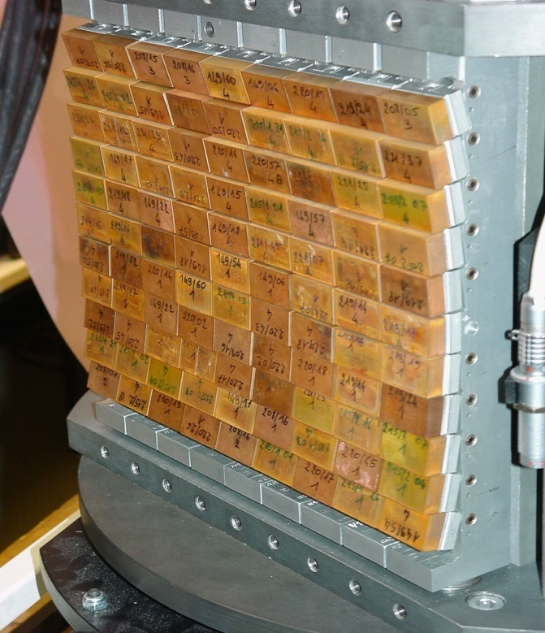
Crystal Monochromators
Graphite 002
Copper 200
 | d-spacing
Germanium 333 | 1.089 Å
Copper 200 | 1.807 Å
Silicon 111 | 3.135 Å
Graphite 002 | 3.355 Å

Slide 34
Pulsed source time structures (λ=5Å)
short pulse
log(Intensity@λ=5Å)
ILL 57MW
1
0
100μs
ISIS-TS1 128kW
ISIS-TS2 32kW
0.1
0.01
time (ms)
0 20 40 80 100 120

Slide 35
Pulsed source time structures (λ=5Å)
short pulse
log(Intensity@λ=5Å)
ILL 57MW
1
0
100μs
ISIS-TS1 128kW
ISIS-TS2 32kW
1%
0.1
0.01
time (ms)
0 20 40 80 100 120

Slide 36
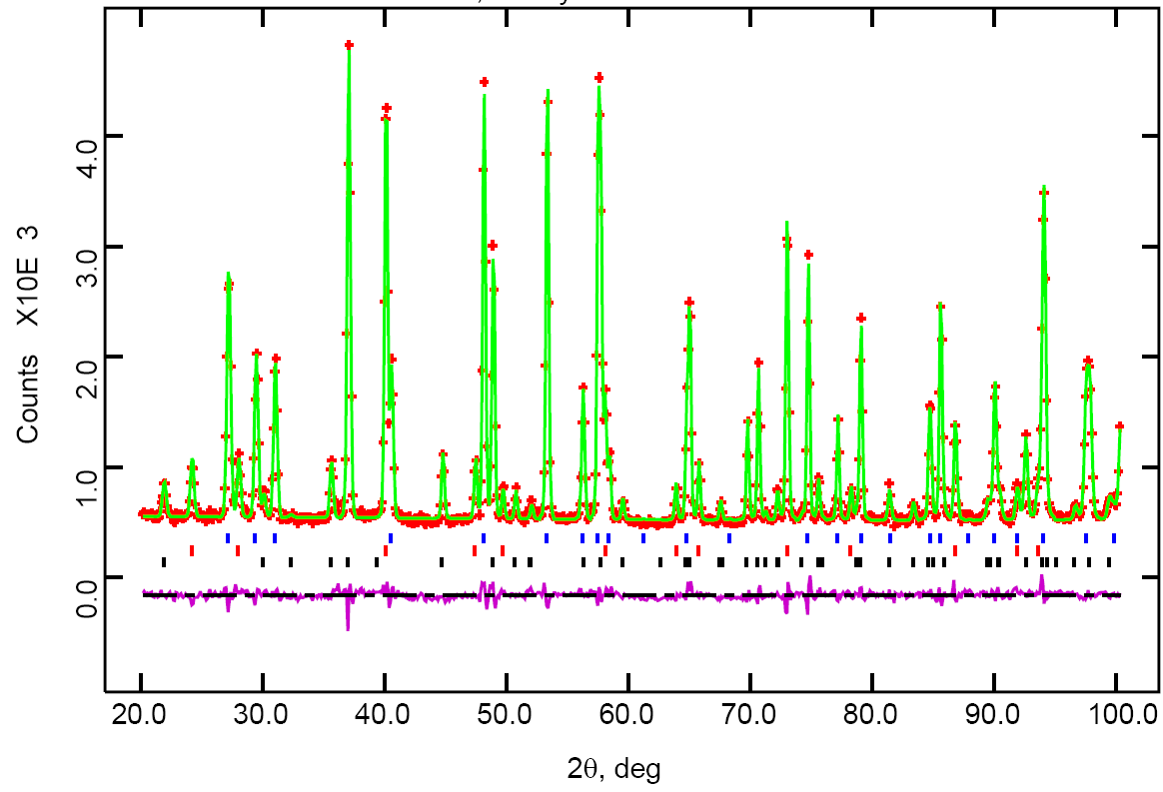
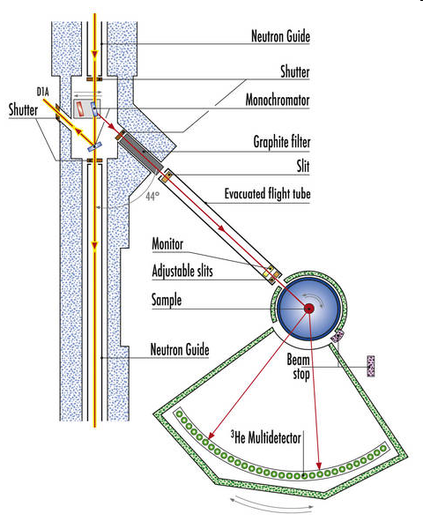
Constant-Wavelength Diffraction
D1B @ ILL
Rietveld refinement

Slide 37
Small-Angle Neutron Scattering
Probing the longest length scales available to neutrons
Detector
Monochromator
Δλ/λ
Sample
Collimator
2θ
Q
d
λ d 2θ
4-20 Å 5-3000 Å 0.1-20°

Slide 38
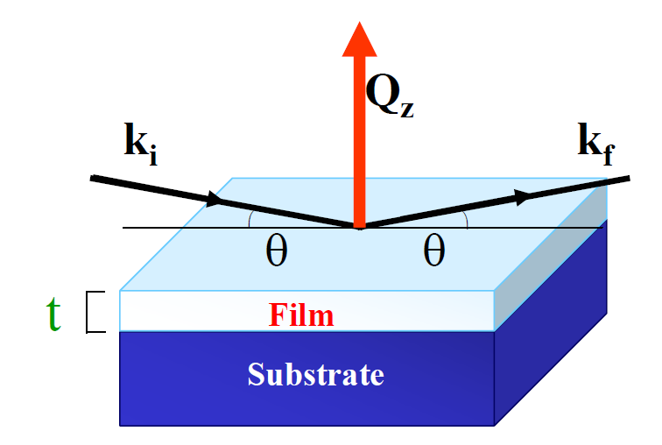
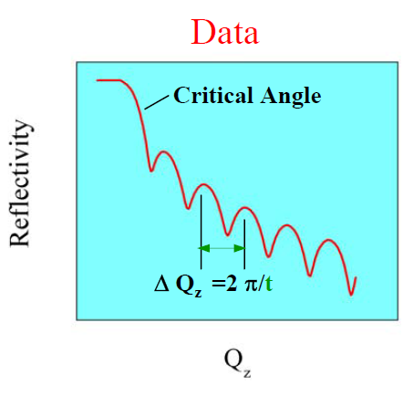
Reflectometry
Reflection from surfaces and interfaces
in
out
Log
Specular: θ_{in}=θ_{out}
Off-specular: θ_{in}≠θ_{out}
Depth profile of the scattering-length density

Slide 39
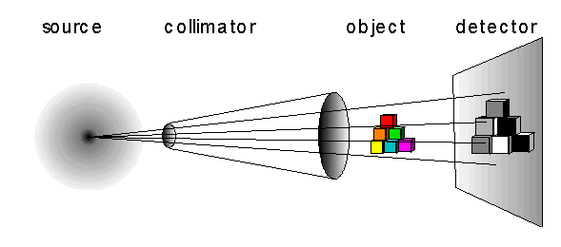
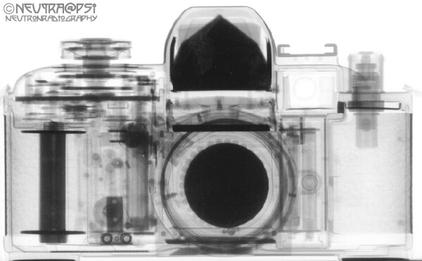
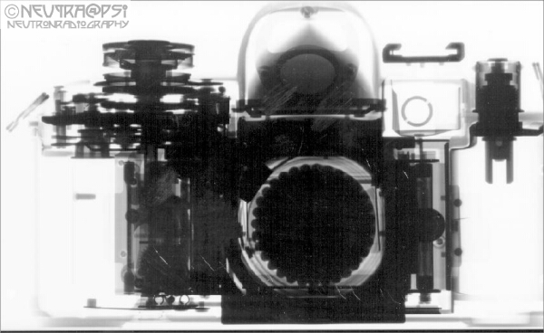
Neutron Imaging: Radiography & Tomography
Neutrons
X-rays

Slide 40
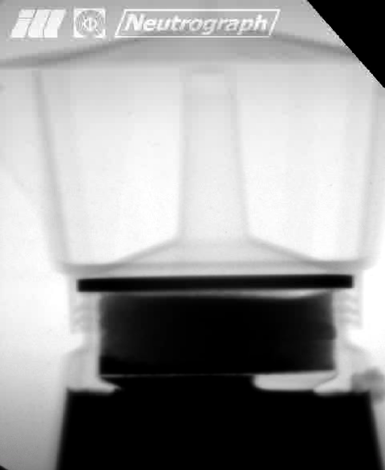
Neutron Imaging: Radiography & Tomography

Slide 41
industrial components
bacteria
magnetic domains
atomic structures
viruses
polymers, proteins
texture
magnetic structures
Wavevector Q [Å⁻¹]
cell membranes
charge density
10⁻³
10⁻²
10⁻¹
1
10¹
10²
10³
elementary particles
UV & X-ray FEL: Pump & Probe studies
10⁻¹⁵
hydrogen modes
10³
Inelastic X-ray Scattering
lattice vibrations
X-ray Spec.
Infrared
Light
FTIR
Raman
Brillouin
Dynamic Light Scattering
Laser PCS
spin dynamics
TOF & Crystal
Spectroscopy
10⁻¹²
rotational tunneling
1
Infra-red
Time [s]
molecular diffusion
Energy [meV]
dynamics of macromolecules
Visible Light
10⁻⁹
10⁻³
Backscattering
Spin-echo
Dielectric Spec.
domain wall dynamics
NMR
μSR
10⁻⁶
Length [m]
10⁻⁶
X-ray PCS
10⁻¹
10⁻²
10⁻³
10⁻⁵
10⁻⁶
10⁻⁷
10⁻⁸
10⁻⁹
10⁻¹⁰
10⁻¹¹
10⁻¹²
10⁻¹⁴
10⁻¹⁵
SANS
Imaging
Diffraction
Particle Physics
Reflectometry
X-ray Imaging
SAXS, X-ray Refl.
X-ray Diffraction
EXAFS & XANES
X-rays
NMR Imaging
Triangulation
NMR
NMR
Optical Microscopy
Optical Nanoscopy
Electron Microscopy
Microscopy
SNOM
AFM
STM
Scanning Techniques

Slide 42
Neutron Spectroscopy
Excitations: vibrations and other movements
Structural knowledge is usually prerequisite
    Measure diffraction first
k_{i} ≠ k_{f}
Measure k_{i} and k_{f}:
    Bragg Diffraction
    Time-of-flight
    Larmor precession
Methods:
    Fix k_{i} and scan k_{f} – ”direct geometry”
    Fix k_{f} and scan k_{i} – ”indirect geometry”
Energy scales: < μeV → > eV

Slide 43
Chopper Spectrometers
Direct geometry:
fix k_{i} by chopper phasing
scan through k_{f} by time-of-flight
distance
detector
sample
chopper
0
time

Slide 44
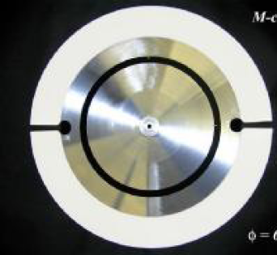
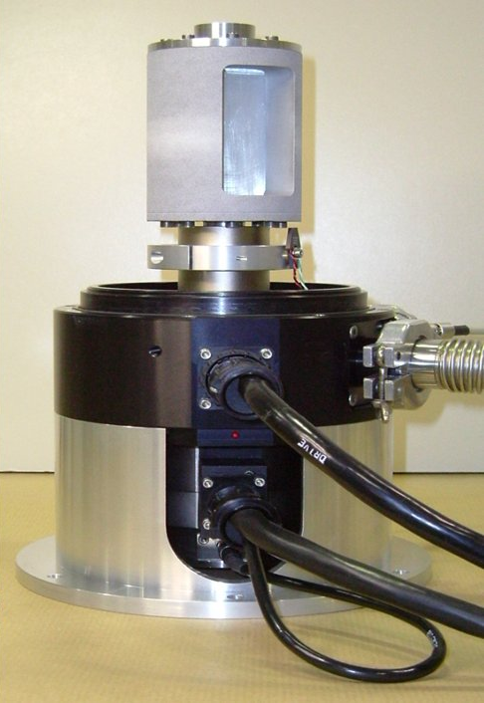
Neutron Choppers
Fermi choppers
Disk choppers
f < 600 Hz
Δt > 1μs
f < 300 Hz
Δt > 10μs

Slide 45
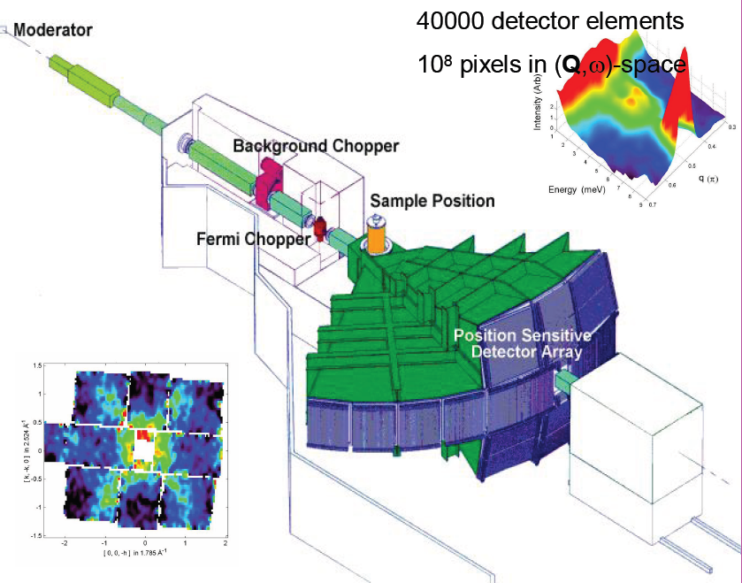
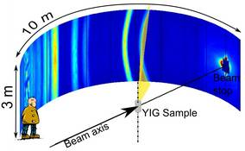
Chopper Spectrometers
General-Purpose Spectrometers
    Incident energy ranges from 1meV to 1eV
Huge position-sensitive detector arrays
    Single-crystal samples

Slide 46
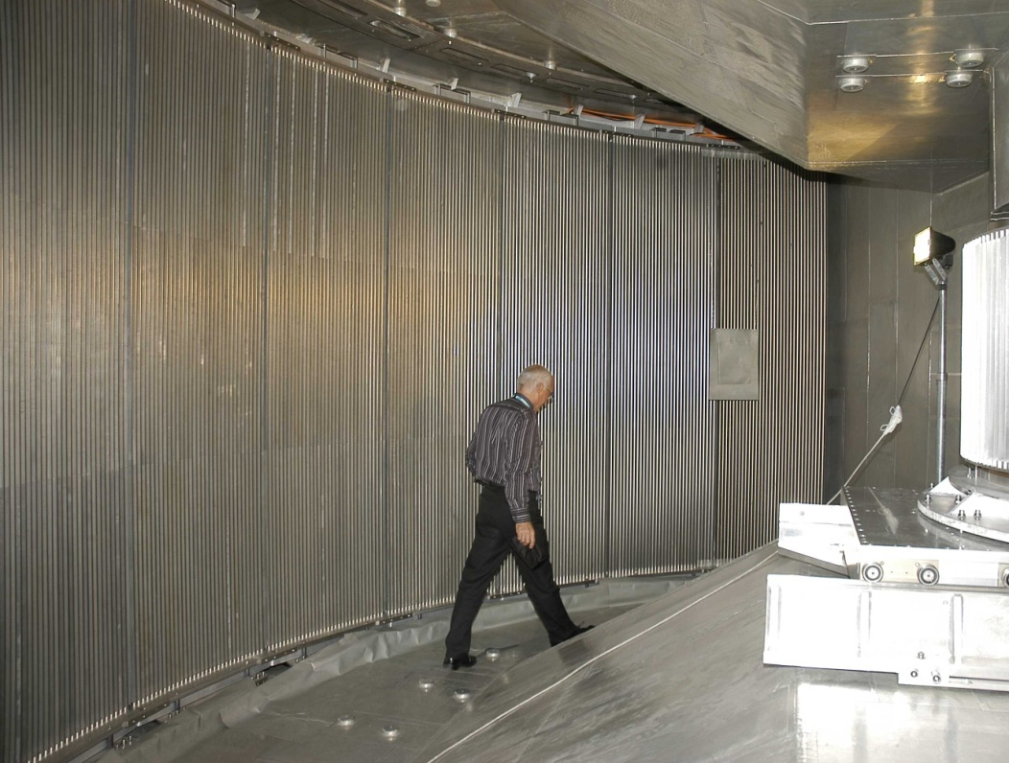
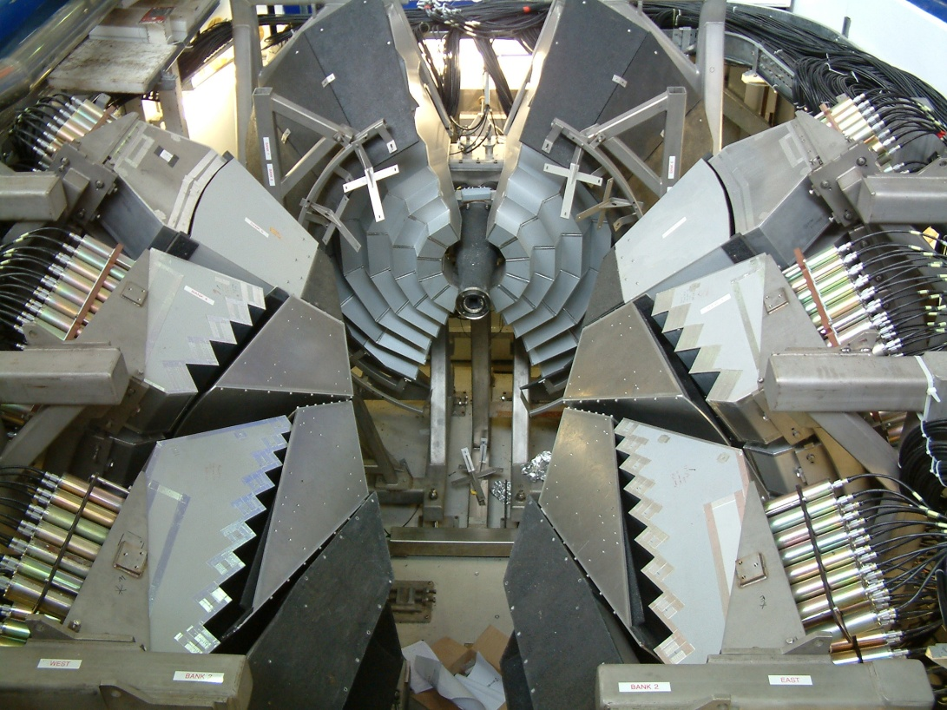
Detectors
³He gas tubes
n + ³He → ³H + ¹H + 0.764 MeV
>1mm resolution
High efficiency
Low gamma-sensitivity
³He supply problem
Scintillators
n + ⁶Li → ⁴He + ³H + 4.79 MeV
<1mm resolution
Medium efficiency
Some gamma-sensitivity
Magnetic-field sensitivity

Slide 47
Detectors
¹⁰B detectors
n + ¹⁰B → ⁷Li + ⁴He + 0.48 MeV
massive development programme
none yet in operation
many different types
inclined blades
boron layer thickness limited to ~ 1 μm
=> ~ 5% efficiency
perpendicular blades

Slide 48
Alternative to Direct Geometry
Indirect geometry:
fix k_{f} – usually by analyser crystals
scan through k_{i} by time-of-flight
distance
detector
analyser
sample
0
time

Slide 49
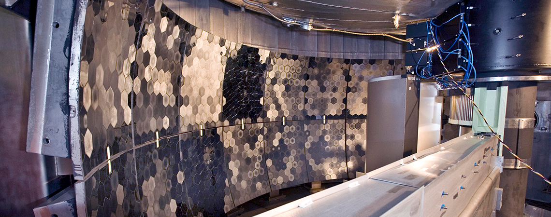
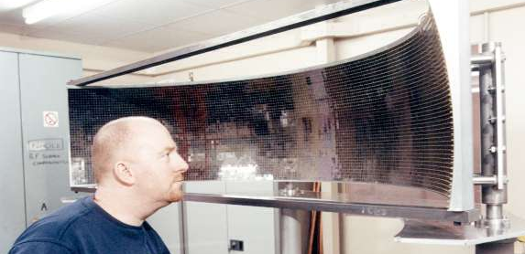
High Resolution 1: Backscattering
BASIS@SNS Si111 3μeV
OSIRIS@ISIS PG002 25μeV

Slide 50
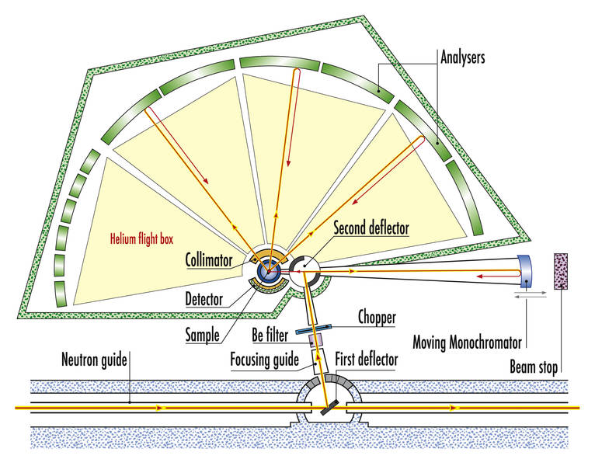
Continuous-Source Backscattering

Slide 51
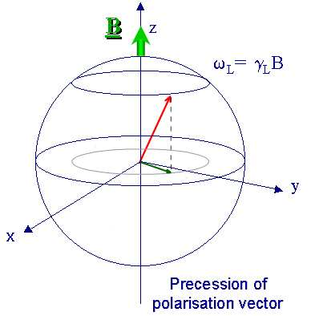
High Resolution 2: Neutron Spin Echo
High energy resolution < 1 μeV
Larmor precessions encode energy transfer
θ
ϕ
B₀
B₁
P_{z}
π-flipper
L₀
L₁

Slide 52
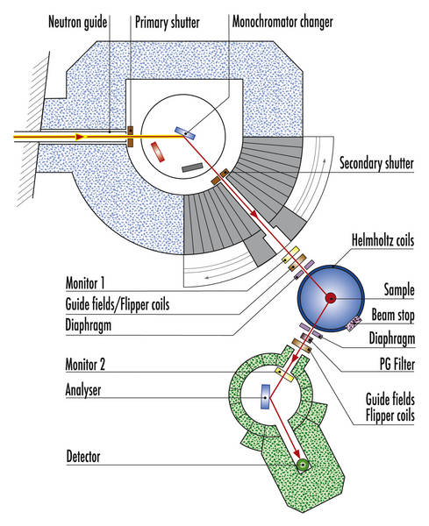
Triple-Axis Spectrometers
Single-crystal excitations
Very flexible
Measures a single point in -E space at a time
Scans:
    Constant : Scan E at constant k_{i} or k_{f}
    Constant E: Scan in any direction

Slide 53
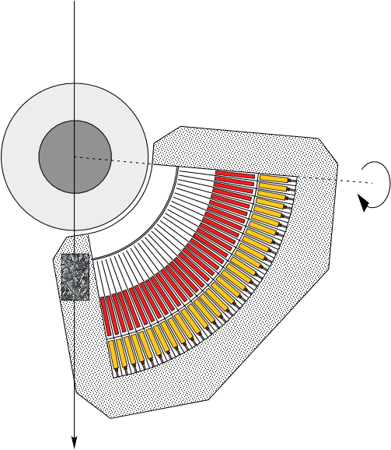
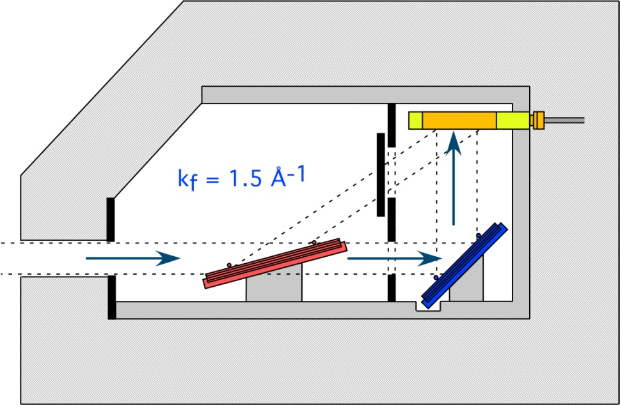
TAS with multiplexing
IN20 flat-cone multi-analyser
Top view
Side view
sample
31 channels
75º angular range
k_{f} = 3 Å⁻¹
k_{f} = 1.5 Å⁻¹

Slide 54
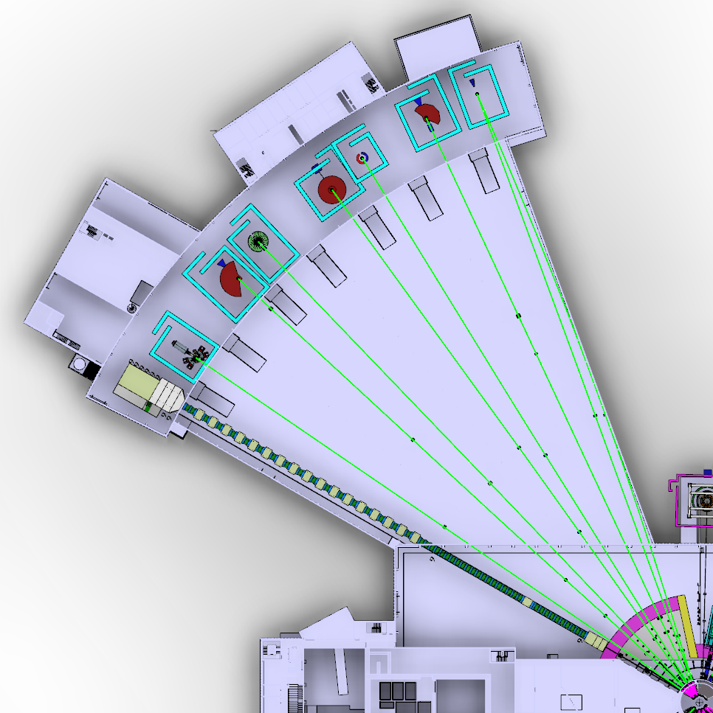
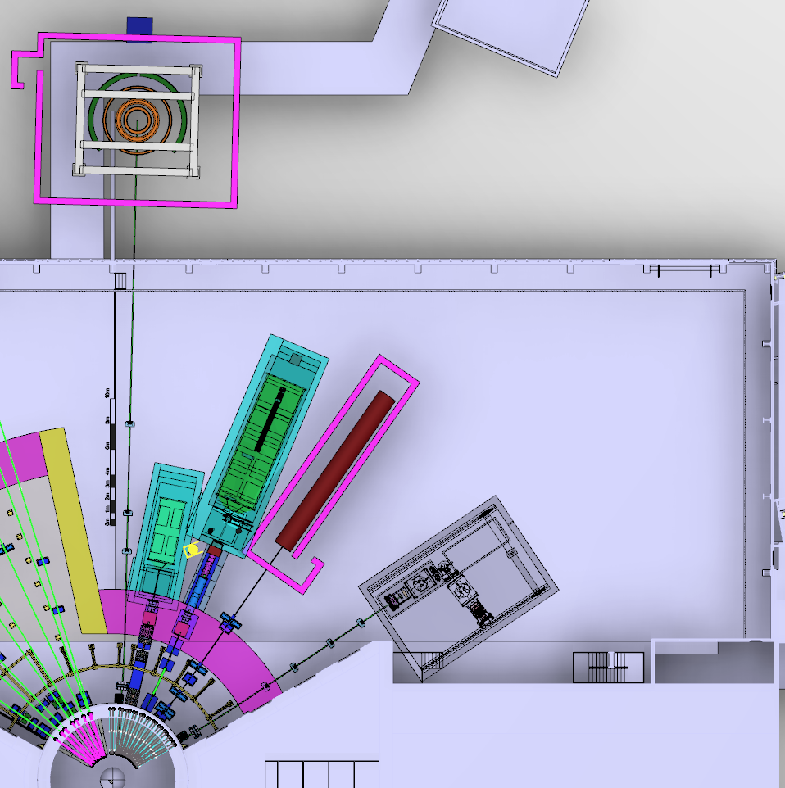
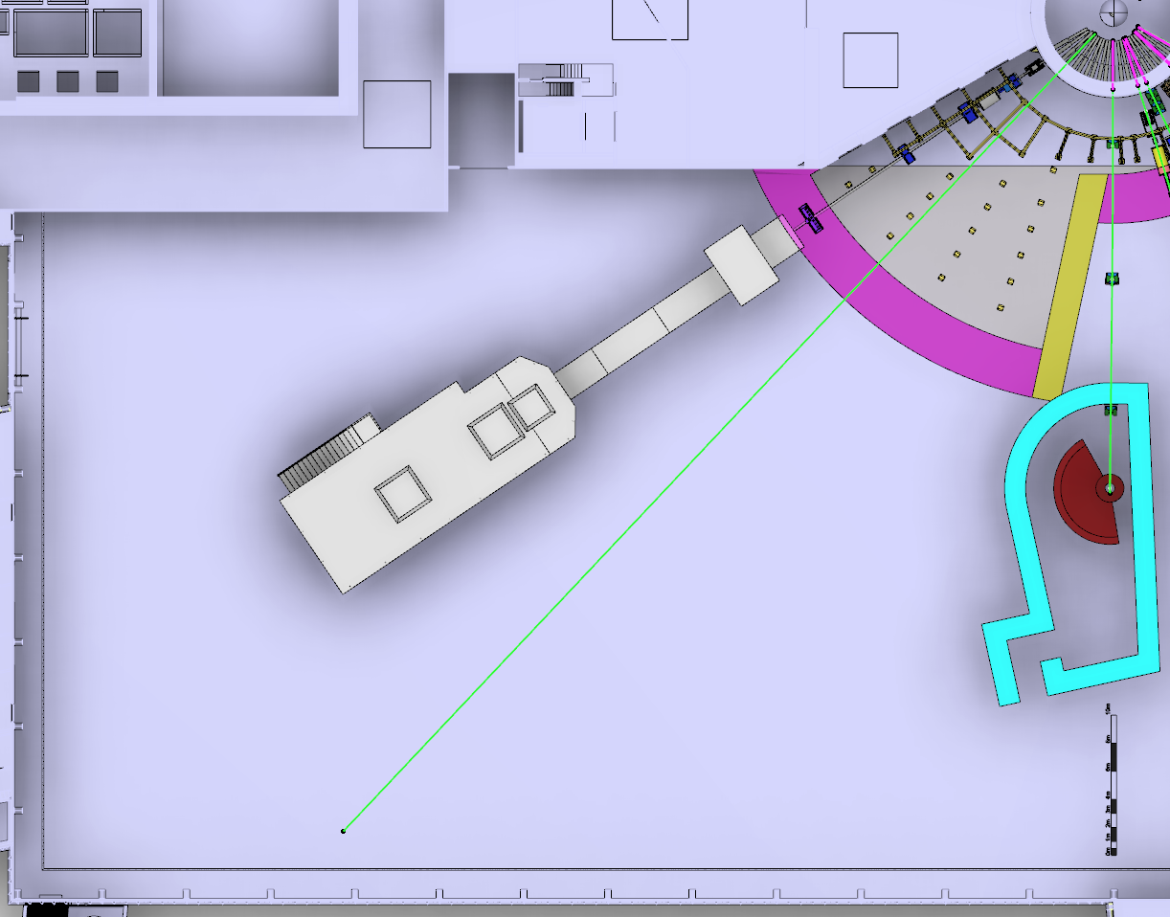
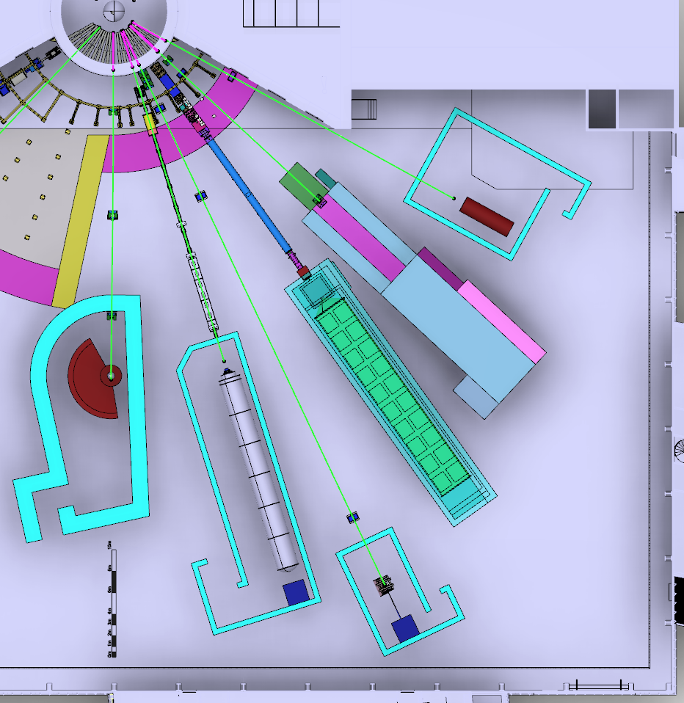
ESS Initial Instrument Suite
HEIMDAL – Powder Diffractometer
T-REX – Thermal Chopper Spectrometer
MAGIC – Magnetism Diffractometer
MIRACLES – Backscattering Spectrometer
BIFROST – Extreme-Environments Spectrometer
C-SPEC – Cold Chopper Spectrometer
BEER – Engineering Diffractometer
NMX – Macromolecular Crystallography
LOKI – Broadband SANS
FREIA – Liquids Reflectometer
ESTIA – Magnetism Reflectometer
VOR – Broadband Spectrometer
SKADI – Low-Q SANS
VESPA – Vibrational Spectroscopy
ODIN – Imaging
DREAM – Powder Diffactometer

Slide 55
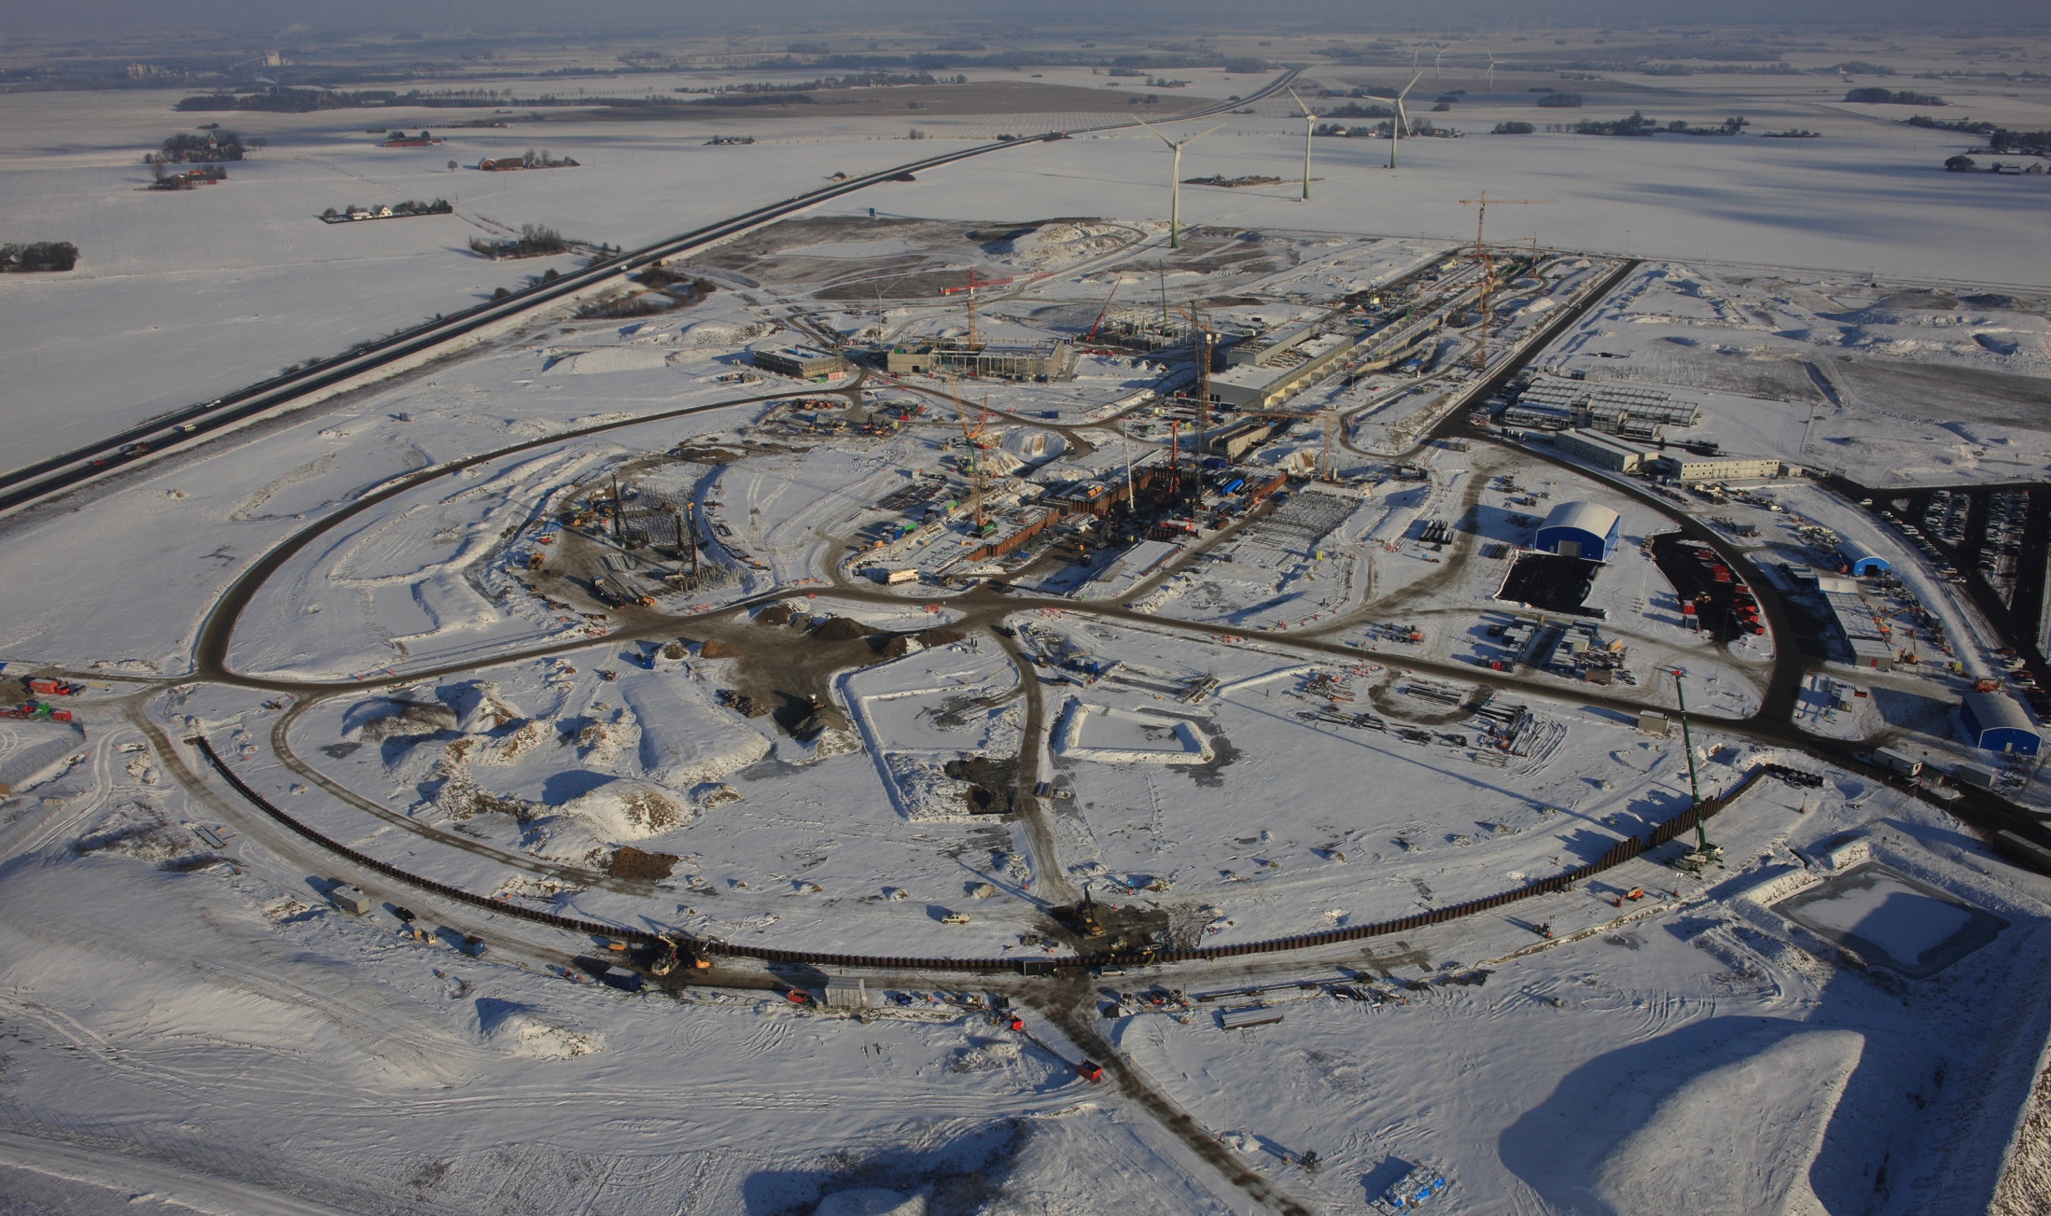
Thank you!
ESS, 18/1/2016
5th June 2015

