Slide 1
NMX uTPC detector overview and algorithms
01.02.2016
Dorothea Pfeiffer

Slide 2
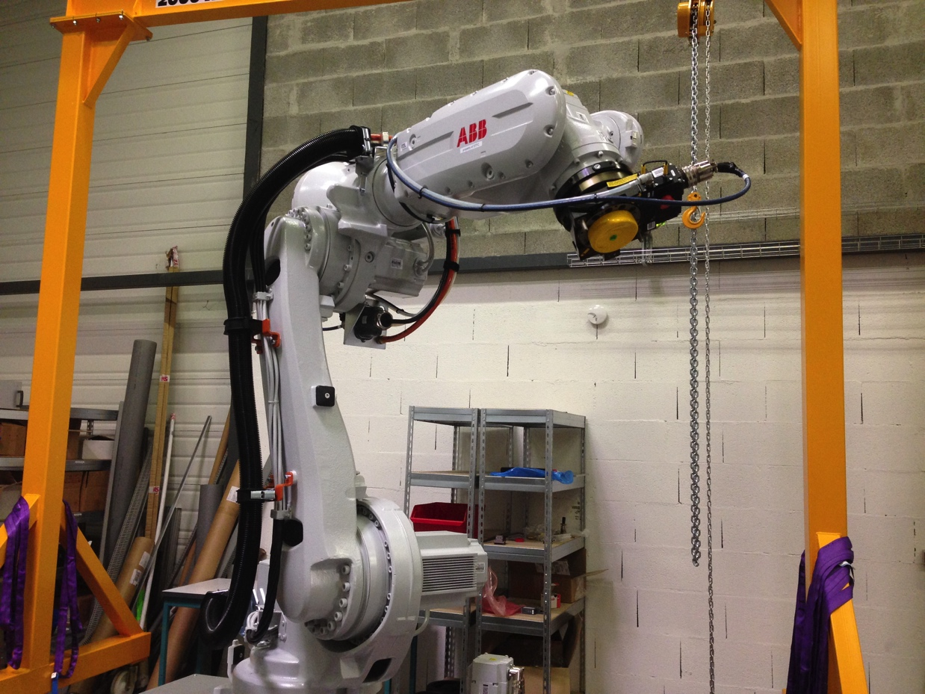
NMX detectors

Slide 3
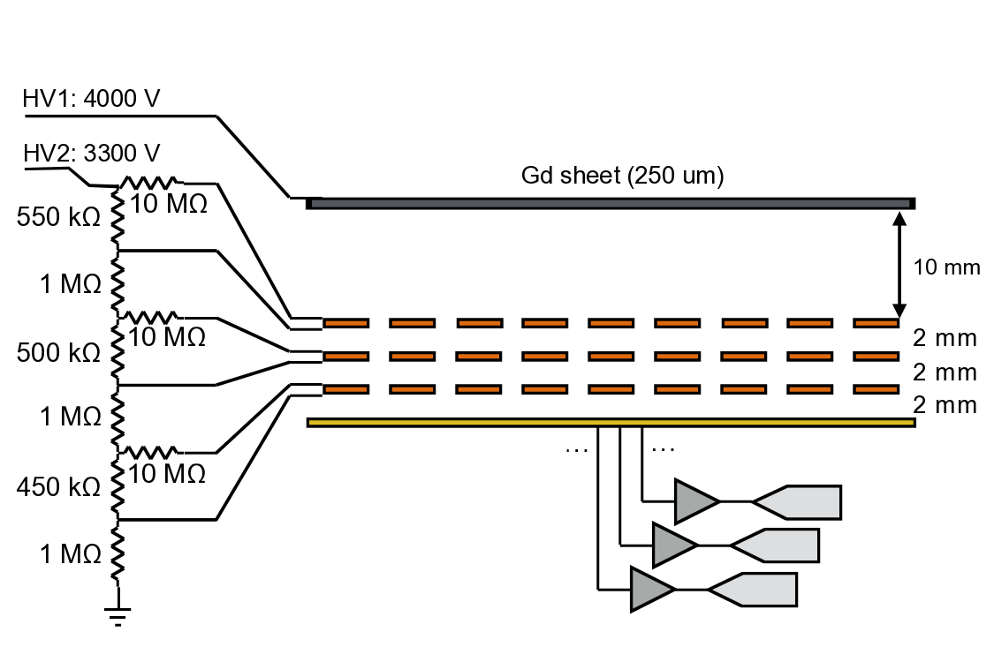
Gd-GEM backwards setup
conversion electron
Start of track
neutron

Slide 4
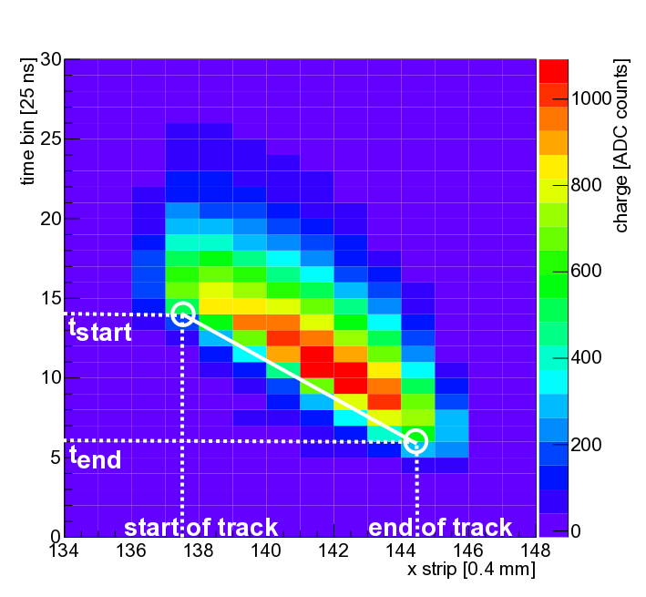
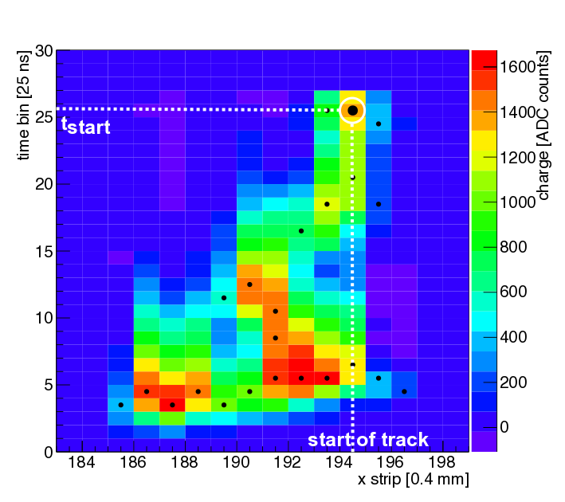
α particle and electron tracks
α particle track from 10B4C
electron track from Gd
Whereas α particles leave straight tracks, conversion electrons from Gd leave curvy track
Centroid calculation not sufficient to determine position

Slide 5
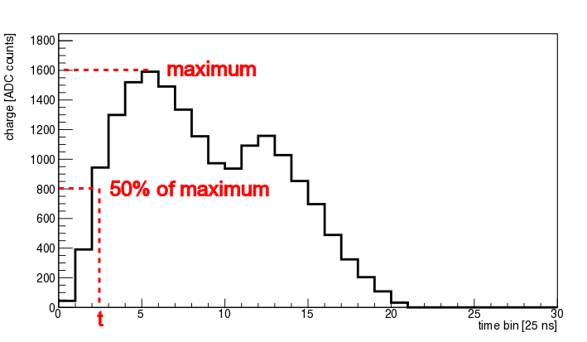
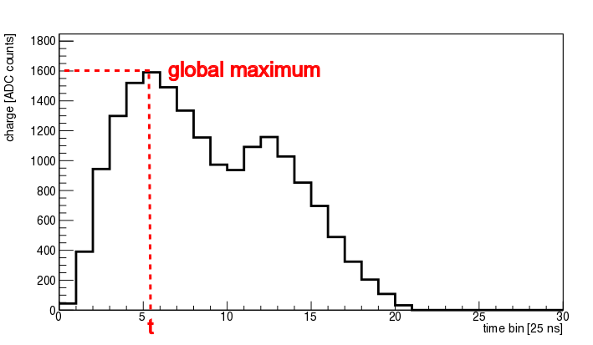
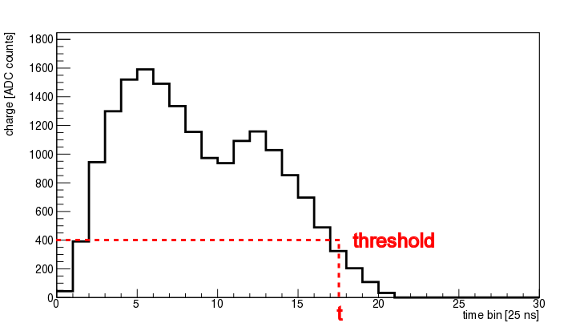
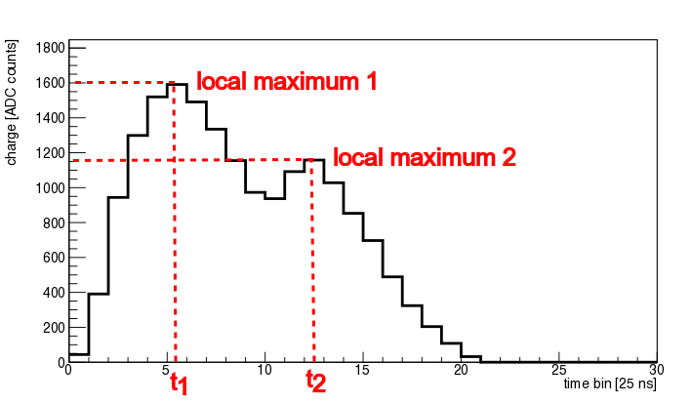
Tracking algorithms
Used for ¹⁰B₄C

Slide 6
Tracking algorithms
Analog chip like APV (development option)
Best results in determining the start of the track are obtained with last-local-maximum algorithm: start of the track is the strip with the latest local maximum
Falling-flank or global-maximum possible but lead to slightly worse results
Digital chip like VMM3 (base line):
Available modes:
TtP (threshold to peak)
ToT (time over threshold)
PaP (pulse at peak) = global maximum
PtT (peak to threshold)
When chips and data available, modes have to be evaluated
Suitable task here to get involved in!!
=> In general: per strip one time stamp and one amplitude

Slide 7
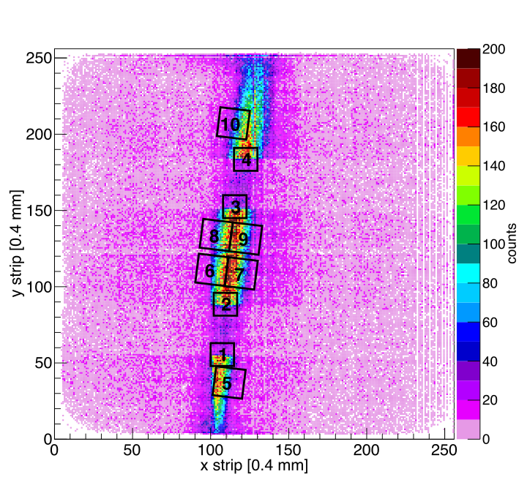
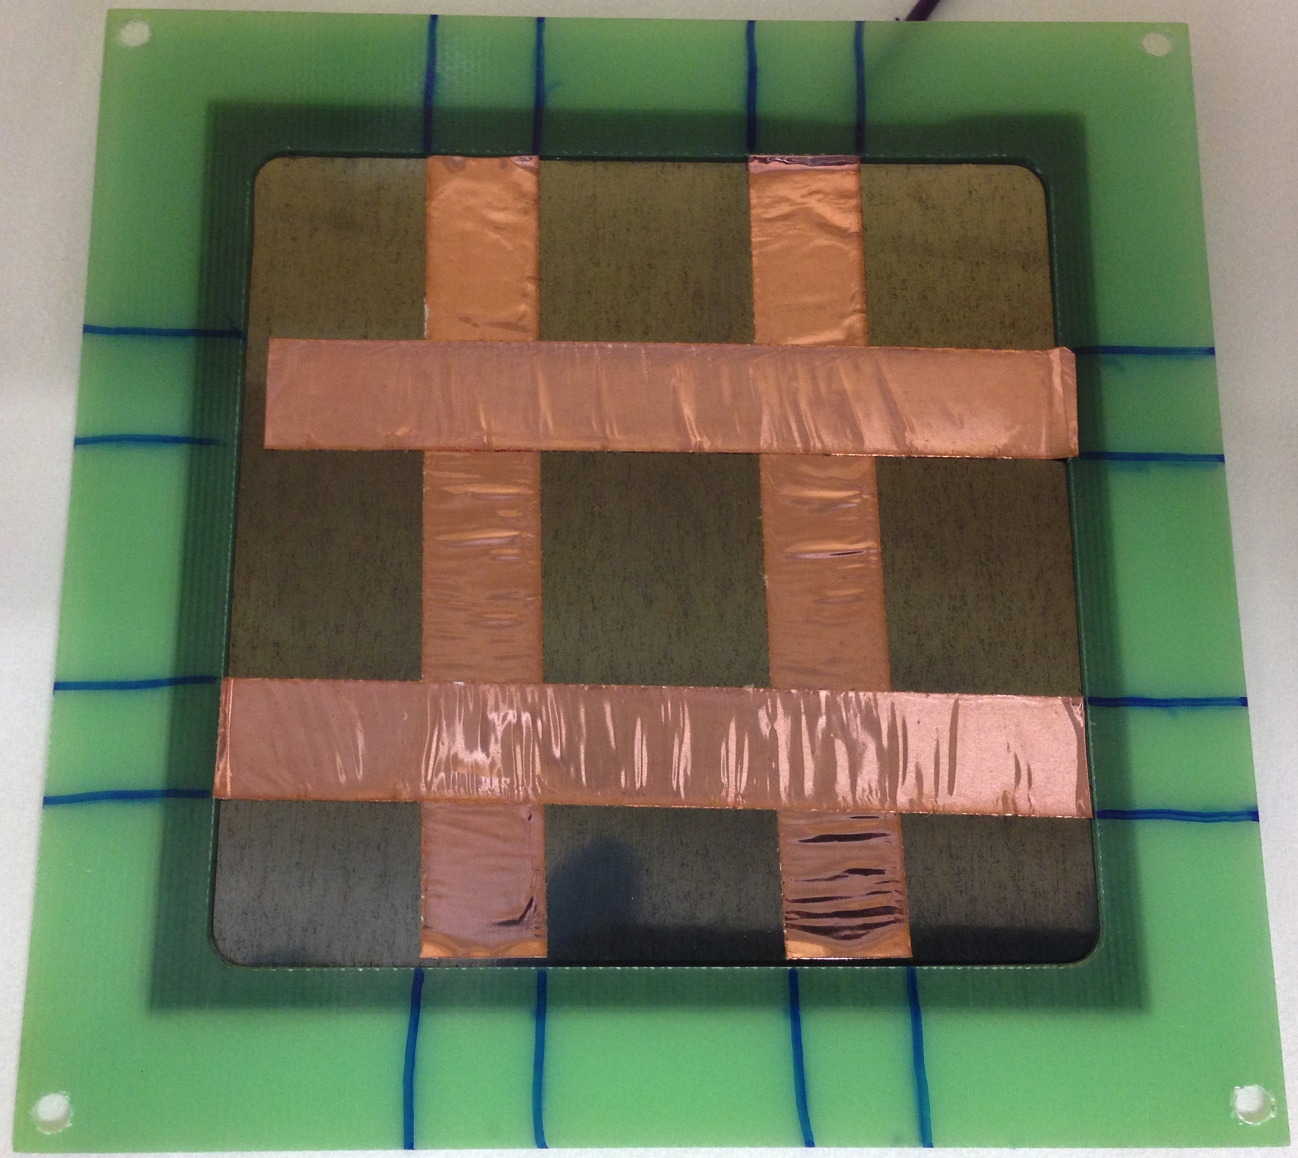
Reconstruction of start of track
Reconstruction of start of tracks in x and y
Cathode of 250 um of Gadolinium

Slide 8
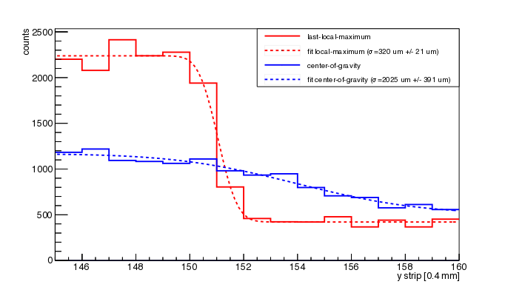
Position resolution
Region | σ [μm] | +/- error [μm]
1 (Tape) | 248 | 20
2 (Tape) | 341 | 22
3 (Tape) | 320 | 21
4 (Tape) | 242 | 17
5 (Beam) | 1542 | 46
6 (Beam) | 1949 | 58
7 (Beam) | 2053 | 55
8 (Beam) | 2312 | 72
9 (Beam) | 1924 | 54
10 (Beam) | 2417 | 100
Position resolution: σ <= 350 um
Scattering spread: σ ≈ 175 um
Divergence of beam: σ ≈ 1700 um

Slide 9
Natural Gadolinium (baseline)
Baseline:
Backwards and forwards mode:
Optimum thickness 6 um. Thinnest available foil 10um:
20% efficiency at 1.8 A
Alternative:
Backwards mode, one detector:
Optimum thickness 50 um or greater:
14% efficiency at 1.8 A
neutron
Backwards detector
e-
Gd
Forwards detector
e-

Slide 10
Comparison of baseline and upgrade
 | Gd | 1.8A | 3.5A | 157 Gd | 1.8 A | 3.5A
1 readout backwards, foil | 100 um | 14% | 20% | 10 um | 31% | 36%
2 readouts, freestanding foil | 10 um | 20% | 28% | 10 um | 38% | 42%
One readout:
Cheaper
mechanically simpler (thicker foil, foil can be supported)
less efficient
Two readouts (base line):
Expensive
mechanically complicated (freestanding 10 um thin foil)
rare cases where electrons from one neutron are detected in both detectors (which position is taken ?)
more efficient

Slide 11
Electronics per detector
3 detectors (60 cm x 60 cm)
One readout: 4 modules (30 cm x 30 cm) per detector, two readouts 8 modules (30 cm x 30 cm)
24 chips per module
24*4*3 = 288 chips or 576 chips for two readouts
64 channels per chip
288* 64= 18432 channels or 576*64 = 36864 channels for two readouts
McSTAS simulations (diffraction spots) needed for module size
and rate calculation !

Slide 12
Data before uTPC algorithm
Per hit/strip (raw data):
VMM3 data: up to 38 bits (depending on exact mode)
Channel-ID
Amplitude (10 bit)
Time stamp (12 bit)
Per neutron (intermediate data):
Average: 10 strips in x, 10 strips in y (3.8 kBit)
VMM3 data decoded into:
Strip ID (16 bit): Detector number (0-2), Module number (0-7), chip number (0-24), strip number (0-63)
Amplitude (10 bit), Time stamp (12 bit)
Clustering (also over several chips) has to be studied!
Exact data length/definition depends on chip type!

Slide 13
Data after uTPC algorithm
Per neutron (processed data):
Strip x, strip y, time (44 bit):
Strip ID (16 bit): Detector number (0-2), Module number (0-7), chip number (0-24), strip number (0-63)
Time stamp (12 bit)
Data rate:
VMM3: 0.9 MHz maximum rate per channel with a multiplicity of 4.7 strip
Less for our multiplicity of 10 strips, realistically let’s assume 1 0 MHz per chip due buffer and readout
Simulations needed to deduce real rate and architecture

