Slide 1
The ESS EPICS Environment
Timo Korhonen
Niklas Claesson, Klemen Strnisa
Integrated Control System Division
www.europeanspallationsource.se
EPICS Meeting 2016

Slide 2
Outline
ESS project constraints
The beginnings
Rationale
Principles
The development chain
Summary
Please listen also to Nicholas Senaud’s talk in this session!

Slide 3
ESS Project constraints
Highly distributed development
Less so than ITER but still…
Many in-kind contributions
How to integrate all contributions into one control system?
How to promote standardisation?
How to support the remote developers
Using our standard hardware?

Slide 4
Some history…
In 2005 (!) EPICS Meeting in Archamps there was a talk…
No name????
Dirk Zimoch, PSI
All right! 😃
(FR-3-1-LoadableDriverModules.pdf)

Slide 5
Rationale
Development of ESS systems will go on for many years
We want need to support different versions of
EPICS base, drivers, record templates
We need to standardize, as much as possible
We have to support our collaborators!
Off-site and on site
How to make the final integration as easy as possible?

Slide 6
The components
The environment handles two kinds of software components, EPICS modules and IOCs.
Modules provide a set of functionality in the form of resources (shared libraries, templates, substitution files...)
Modules are building blocks for IOCs.
Configuration of an IOC is done by loading and configuring modules run-time (boot time)
no compilation for individual IOCs
Modules can be centrally managed

Slide 7
What is a module?
Modules can be
Shared libraries (including SNL programs)
Database definition (DBD) files
EPICS templates and substitution files
Helper binaries and scripts (including the SNL compiler)
Miscellaneous configuration
StreamDevice protocol files
EtherCAT chain descriptions
Documentation
Test scripts

Slide 8
Management of modules
a module repository is managed centrally and exported to target machines via a network filesystem
The build system generates dependency files
Used during loading of modules
Different versions of modules can co-exist
Different EPICS versions can co-exist
Modules are centrally managed
Development can be distributed, though
A common repository is needed

Slide 9
IOC startup
Modules are loaded by using the command
require '<module>' ['<version>']
Dynamic linking (of libraries etc.) happens at this stage
The named module and all the libraries it depends on are loaded
Then the usual loading of EPICS databases and records, etc., can go on
IOC is “just” a startup script, loading and configuring modules
Module development and IOC integration can be separated

Slide 10
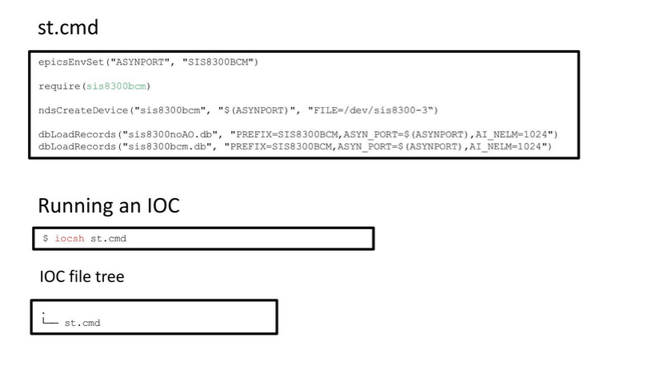
Creating an IOC

Slide 11
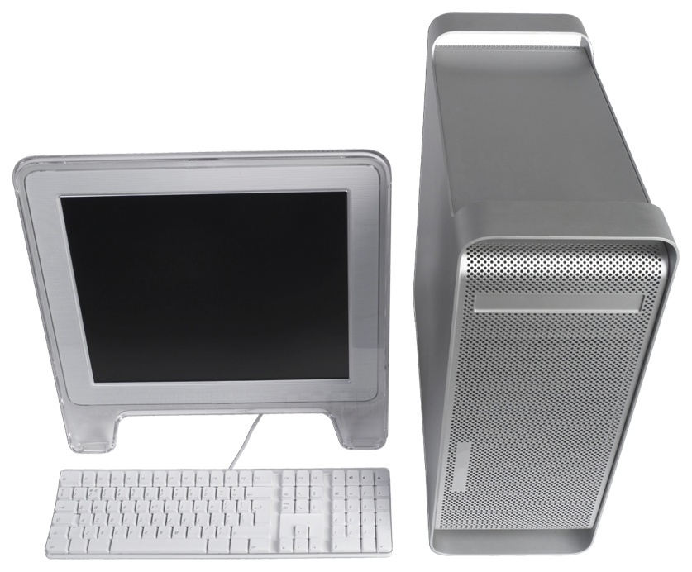
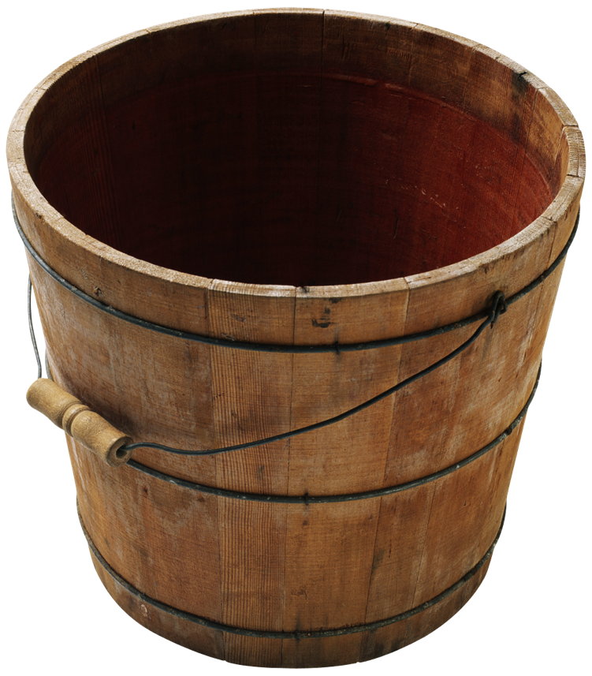
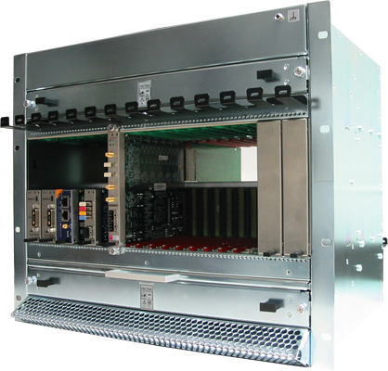
Deployment environment overview
EPICS Base
EPICS modules (community)
EPICS modules (ESS)
Community release
Community (various sources)
ESS internal or in-kind
Download, configure, test, etc.
Develop, configure, test, etc.
Download, configure, test, etc.
CCDB
Compilation, maintenance
Continuous integration, tests, etc.
EPICS core
EPICS modules
(RT)OS image
File system (NFS)
IOC Factory
File system (NFS)
st.cmd
Synchronization
System integration
Boot

Slide 12
Summary
EEE (ESS EPICS Environment) separates code development from integration
Embedded in a more extensive development environment (Leandro Fernandez et al)
It enables us to
Promote standardisation
Integrate early (as far as possible)
Manage the EPICS IOC software lifecycle
And so on..
Most of it is based on the work of Dirk Zimoch @ PSI
Niklas Claesson and Klemen Strnisa (Cosylab) have developed the ESS-specific system
Our collaborators (especially CEA Saclay) have been a great help
They have gone through the whole development
Not everything worked immediately…
Nicolas Senaud’s talk in this session
More details provided on request
But for detail questions, please ask the developers!

