Slide 1
EPICS Heartbeat Extension for PV Monitoring at the CLS
Michael Bree
Control Systems Engineer
Canadian Light Source

Slide 2
PV Monitor Motivation
Quick Diagnosis
- Common Problem: Lost PV!
- Which IOC/App is responsible?
Reactive --> Proactive
- Monitor system health
Notes:
Why Monitor PVs?

Slide 3
Monitor
CA_PROTO_SEARCH
Poll
Generate CA_PROTO_SEARCH
Acquire Client Statistics
Generate PV List
Determine PV Server & Status

Slide 4
PV Polling Issues
Inefficient
Slow to detect PV status changes
Must poll all PVs to get accurate status
Difficult to map PVs to Beacons; Beacons to Apps
Beacon ports change,
PVs appear, move, disappear, etc.

Slide 5
EPICS Heartbeat
An “enhanced beacon” added to App
- Does not replace beacon
Addresses all polling issues:
- Efficient & Fast – No polling
- Real-time status of all PVs
- Real-time status of all Apps
Maps PVs to Apps:
- No crawling, no grepping, no macros

Slide 6
E
Monitor
CA_PROTO_SEARCH
Poll
Generate CA_PROTO_SEARCH
EPICs Heartbeat
Acquire Client Statistics
Generate PV List
Determine PV Server & Status
Generate Complete PV List
Map PVs to Apps

Slide 7
Heartbeat Format
UDP broadcast every 30 seconds
JSON String with:
- EPICs App command line args – to identify App
- Sequence Number
- App Uptime
- Host System Time
TCP Port
API (Get PV List)

Slide 8
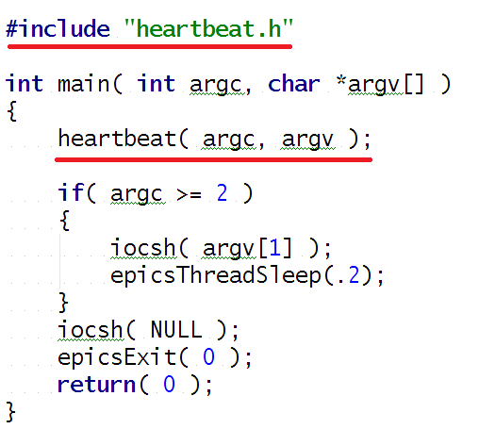
Example - Add to EPICs App

Slide 9
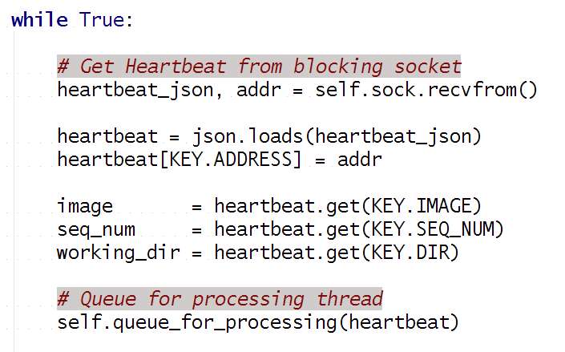
Example - Process Heartbeats

Slide 10
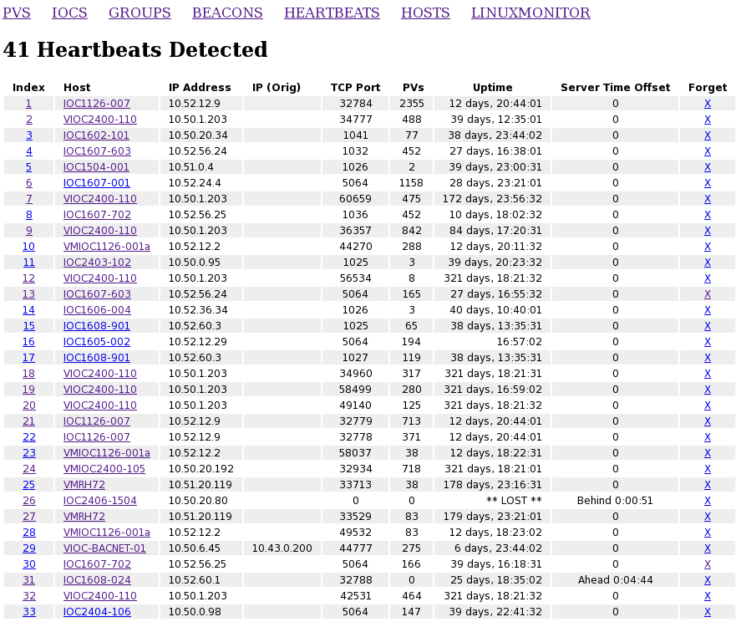

Slide 11
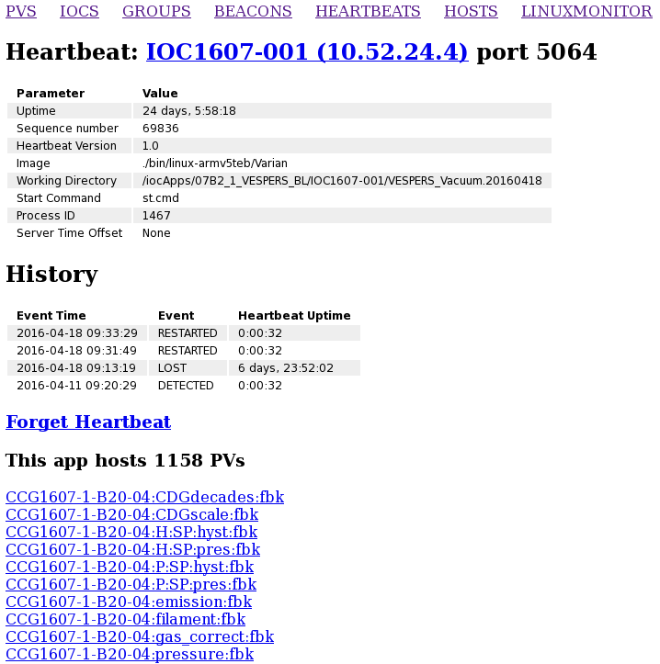

Slide 12
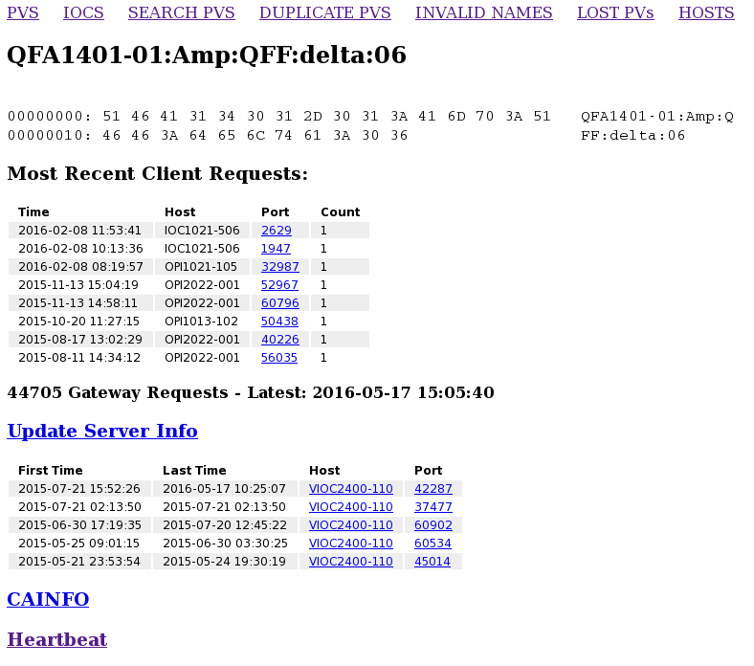

Slide 13
Heartbeat API
UDP (simple - fast - extensible)
Query: Four 32-bit fields:
Last Heartbeat Sequence Number
Handle
Command (CMD.PV_LIST = 0x4DA3F927)
- Command Specific (e.g., PV List Offset)
Response: JSON string with:
10 PV names from specified offset
Handle (from Query)

Slide 14
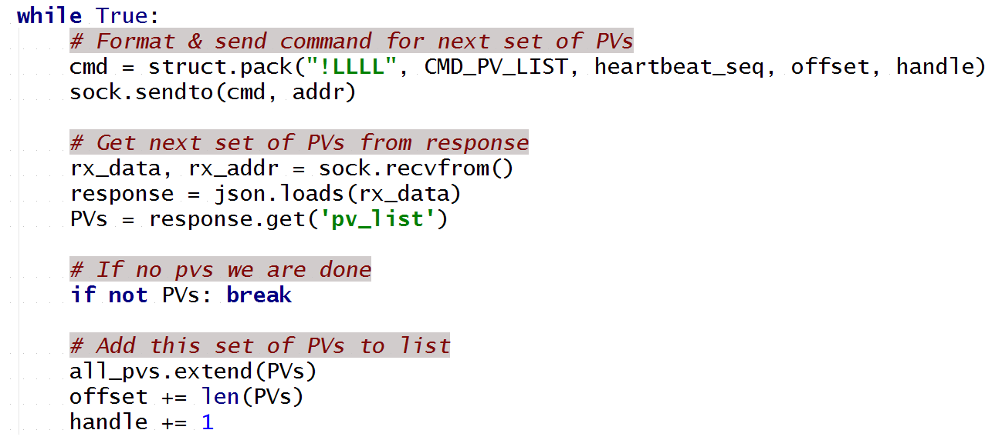
Example - Query PV List

Slide 15
Conclusion
Makes PV Monitor Fast, Efficient, Complete (All PVs)
Maps PVs to Apps with no crawling/grepping/macros
Extreme Simplicity.... Not restricted to PV Monitor
- Beamline Lead can easily display status of their Apps/PVs
- GUI can display status of Apps upon which it depends

