Slide 1





Developing a control system for a laser system with EPICS
Dr. David Michel
Epics Collaboration Meeting
ESS, Lund, May 2016

Slide 2

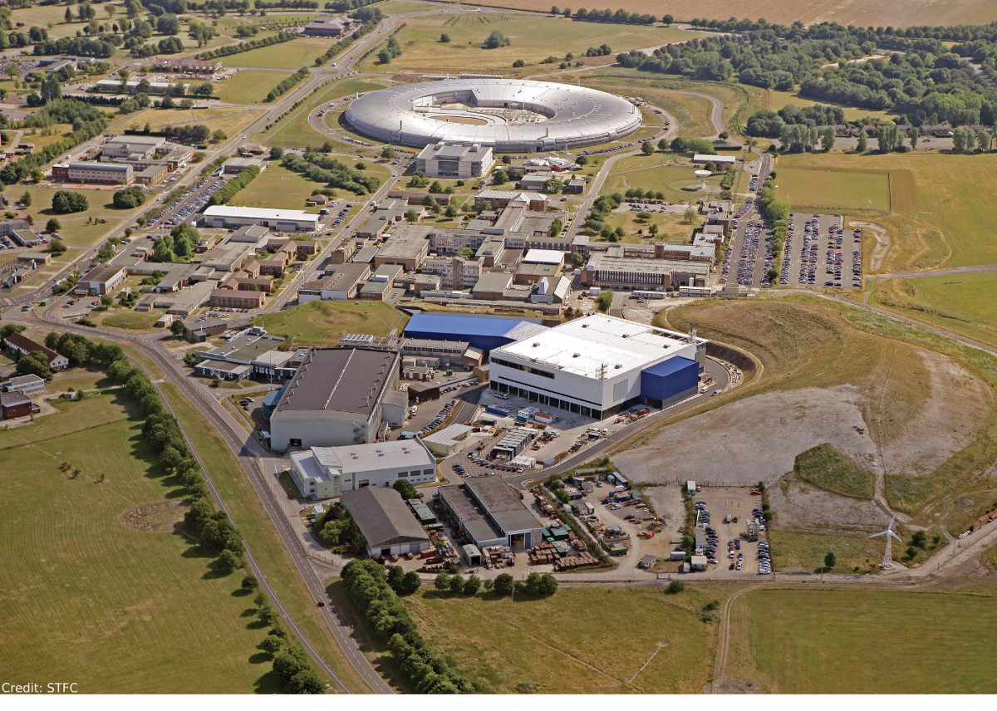



Slide 3



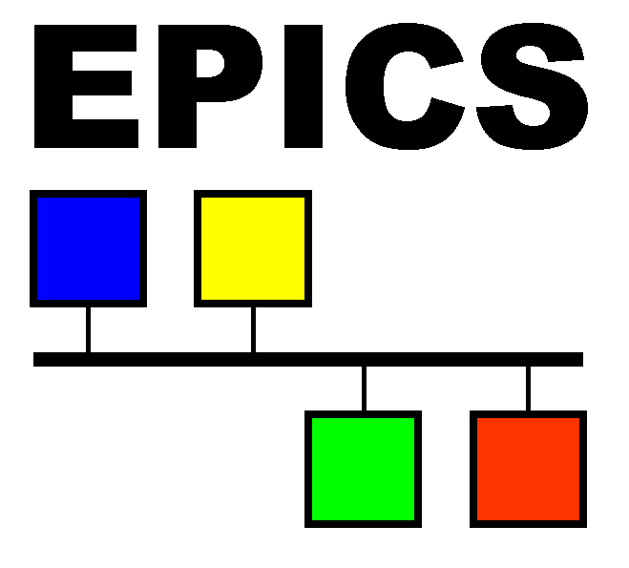

Slide 4
?
What kind
of Laser

Slide 5
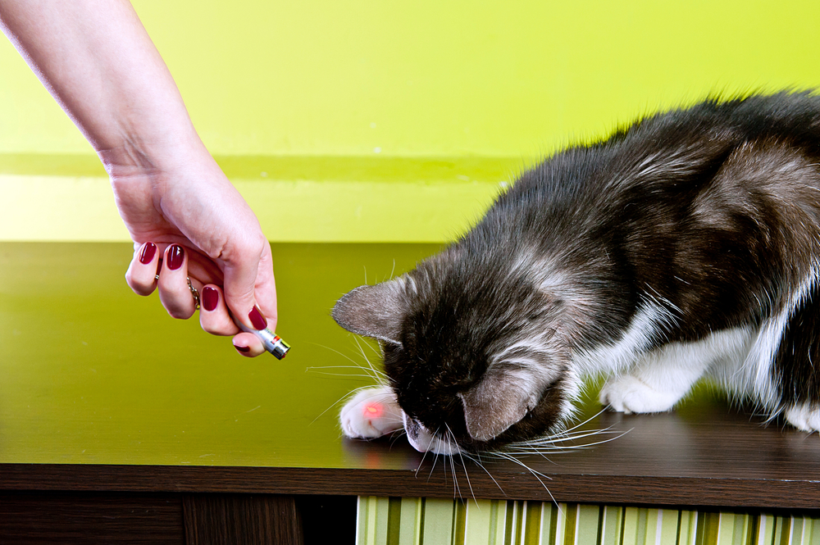



Slide 6
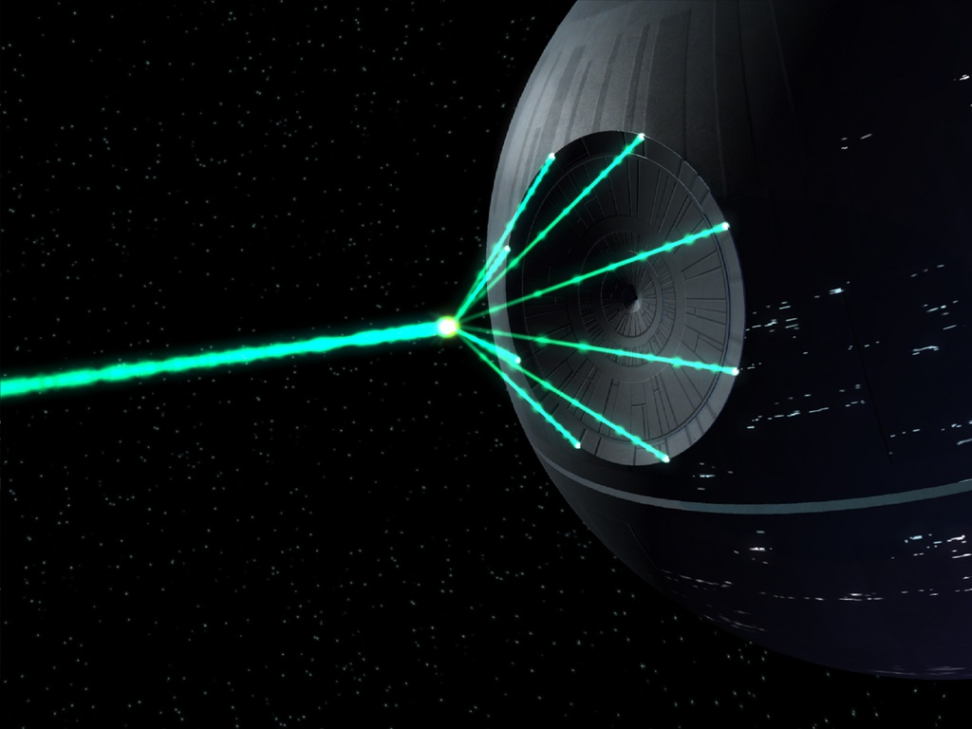

Slide 7
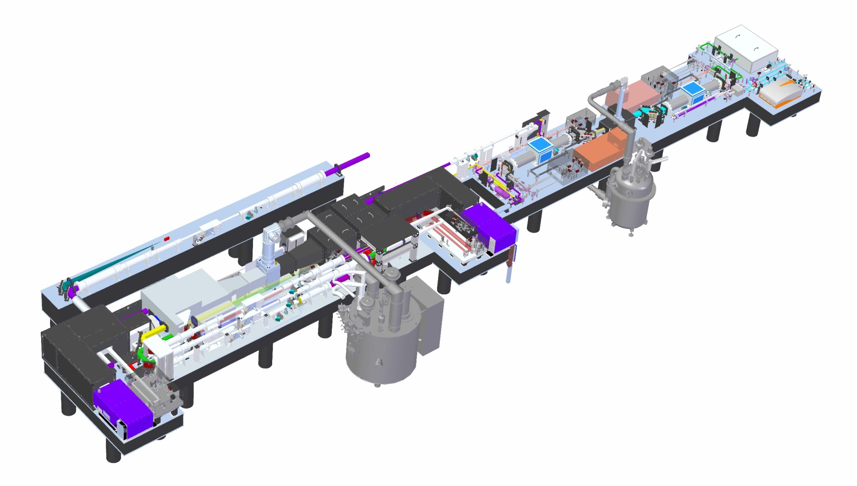
~
20m
100J over 10ns
@ 10Hz
10GW !!

Slide 8
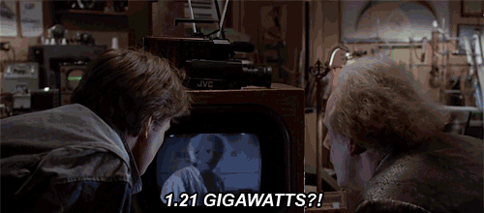

x8 !!

Slide 9
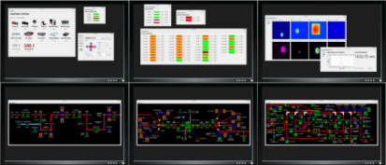






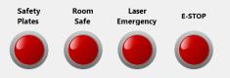




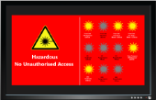






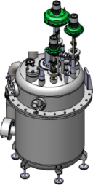


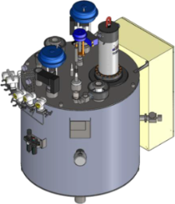

3x2 control monitor setup
TJ-SWITCH-01
TJ-D-P2-CAM-X
TJ-D-P4-CAM-X
TJ-D-P6-CAM-X
BT-D-CAM-1/2
CRK-FE-PA-1
CRK-FE-PA-2
CO-SCOPE-1
CO-SCOPE-2
graphics-srv-1
Interlock Safety Module
TJ-PMC-1/2
CO-RELAY-2
Pre-Amp2
PLC
CRK-TJ-1
Delay Generator
Moving parts…
Hazard Display #1
(outside)
Hazard Display #2
(inside)
FE-D-CAM-X
Vacuum system…
FE-SWITCH-01
Pre-Amp1
Laser Diode Rack
hilase-srv-1
hilase-srv-2
hilase-srv-5
FE-D-EM-3
FE-D-SPEC-1
CO-RELAY-1
FE-PMC-1/2/3
hilase-srv-6
CRK-FE-3
IDIL
CRK-FE-2
100J pump
HJ-SWITCH-01
HJ-SWITCH-02
HJ-D-P1-CAM-X
HJ-D-P4-CAM-X
BT-D-CAM-3/4
CRK-FE-FIBRE
HJ-D-P1-CAM-X
HJ-D-P2-CAM-X
HJ-D-P3-CAM-X
CRK-HJ-DIODE
TJ-SWITCH-02
TJ-D-P1-CAM-X
TJ-D-P3-CAM-X
TJ-D-P5-CAM-X
TJ-D-P7-CAM-X
HJ-P4-SHUT-1
HJ-PMC-1/2
HJ-PMC-3/4
HJ-D-EM-1
CO-RELAY-4
HJ-D-P4-SPEC-1
CO-RELAY-5
CRK-HJ-1
TJ-D-EM-1
hilase-srv-7
CRK-HJ-2
CO-RELAY-3
BT-PMC-1/2
HJ-AO-PC
NewPort XPS
Siemens PLC
TJ AO Driver
10J pump
HJ AO Driver
CRK-TJ-2
Linear stages…
(thermal lenses)
PLC
10J cryo
TJ wavefront
sensor
CRK-TJ-DIODE
100J cryo
CRK-TJ-CRYO

Slide 10

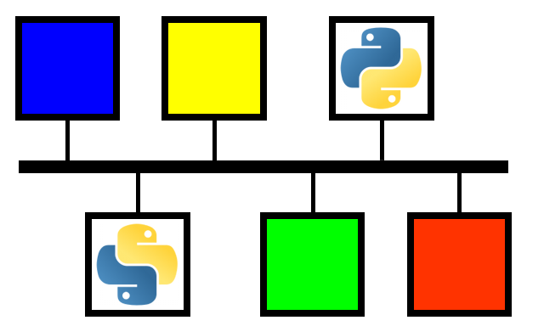
High–Level
Automation
3x2 control monitor setup
TJ-SWITCH-01
TJ-D-P2-CAM-X
TJ-D-P4-CAM-X
TJ-D-P6-CAM-X
BT-D-CAM-1/2
CRK-FE-PA-1
CRK-FE-PA-2
CO-SCOPE-1
CO-SCOPE-2
graphics-srv-1
Interlock Safety Module
TJ-PMC-1/2
CO-RELAY-2
Pre-Amp2
PLC
CRK-TJ-1
Delay Generator
Moving parts…
Hazard Display #1
(outside)
Hazard Display #2
(inside)
FE-D-CAM-X
Vacuum system…
FE-SWITCH-01
Pre-Amp1
Laser Diode Rack
hilase-srv-1
hilase-srv-2
hilase-srv-5
FE-D-EM-3
FE-D-SPEC-1
SoftIOC
CO-RELAY-1
hilase-srv-6
FE-PMC-1/2/3
CRK-FE-3
IDIL
CRK-FE-2
100J pump
HJ-SWITCH-01
HJ-SWITCH-02
HJ-D-P1-CAM-X
HJ-D-P4-CAM-X
BT-D-CAM-3/4
CRK-FE-FIBRE
HJ-D-P1-CAM-X
HJ-D-P2-CAM-X
HJ-D-P3-CAM-X
CRK-HJ-DIODE
TJ-SWITCH-02
TJ-D-P1-CAM-X
TJ-D-P3-CAM-X
TJ-D-P5-CAM-X
TJ-D-P7-CAM-X
HJ-P4-SHUT-1
HJ-PMC-1/2
HJ-PMC-3/4
HJ-D-EM-1
CO-RELAY-4
HJ-D-P4-SPEC-1
CO-RELAY-5
CRK-HJ-1
TJ-D-EM-1
hilase-srv-7
CRK-HJ-2
CO-RELAY-3
BT-PMC-1/2
HJ-AO-PC
PyEPICS
NewPort XPS
db solution
Siemens PLC
TJ AO Driver
10J pump
HJ AO Driver
CRK-TJ-2
Linear stages…
(thermal lenses)
PLC
10J cryo
TJ wavefront
sensor
CRK-TJ-DIODE
100J cryo
CRK-TJ-CRYO

Slide 11

High–Level
Automation
3x2 control monitor setup
TJ-SWITCH-01
TJ-D-P2-CAM-X
TJ-D-P4-CAM-X
TJ-D-P6-CAM-X
BT-D-CAM-1/2
CRK-FE-PA-1
CRK-FE-PA-2
CO-SCOPE-1
CO-SCOPE-2
graphics-srv-1
Interlock Safety Module
TJ-PMC-1/2
CO-RELAY-2
Pre-Amp2
PLC
CRK-TJ-1
Delay Generator
Moving parts…
Hazard Display #1
(outside)
Hazard Display #2
(inside)
FE-D-CAM-X
Vacuum system…
FE-SWITCH-01
Pre-Amp1
Laser Diode Rack
hilase-srv-1
hilase-srv-2
hilase-srv-5
FE-D-EM-3
FE-D-SPEC-1
CO-RELAY-1
FE-PMC-1/2/3
hilase-srv-6
CRK-FE-3
IDIL
CRK-FE-2
100J pump
HJ-SWITCH-01
HJ-SWITCH-02
HJ-D-P1-CAM-X
HJ-D-P4-CAM-X
BT-D-CAM-3/4
CRK-FE-FIBRE
HJ-D-P1-CAM-X
HJ-D-P2-CAM-X
HJ-D-P3-CAM-X
Knowing what to automate
People always want a lot of automation everywhere
Manage expectations/requirements
CRK-HJ-DIODE
TJ-SWITCH-02
TJ-D-P1-CAM-X
TJ-D-P3-CAM-X
TJ-D-P5-CAM-X
TJ-D-P7-CAM-X
HJ-P4-SHUT-1
HJ-PMC-1/2
HJ-PMC-3/4
HJ-D-EM-1
CO-RELAY-4
HJ-D-P4-SPEC-1
CO-RELAY-5
CRK-HJ-1
TJ-D-EM-1
hilase-srv-7
CRK-HJ-2
CO-RELAY-3
BT-PMC-1/2
HJ-AO-PC
NewPort XPS
Siemens PLC
TJ AO Driver
10J pump
HJ AO Driver
CRK-TJ-2
Linear stages…
(thermal lenses)
PLC
10J cryo
TJ wavefront
sensor
CRK-TJ-DIODE
100J cryo
CRK-TJ-CRYO

Slide 12
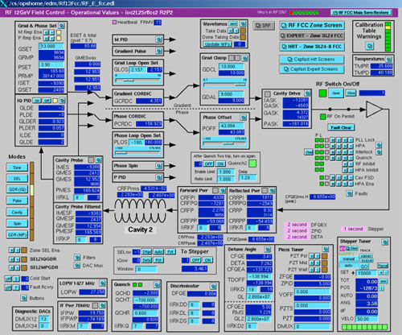


Slide 13
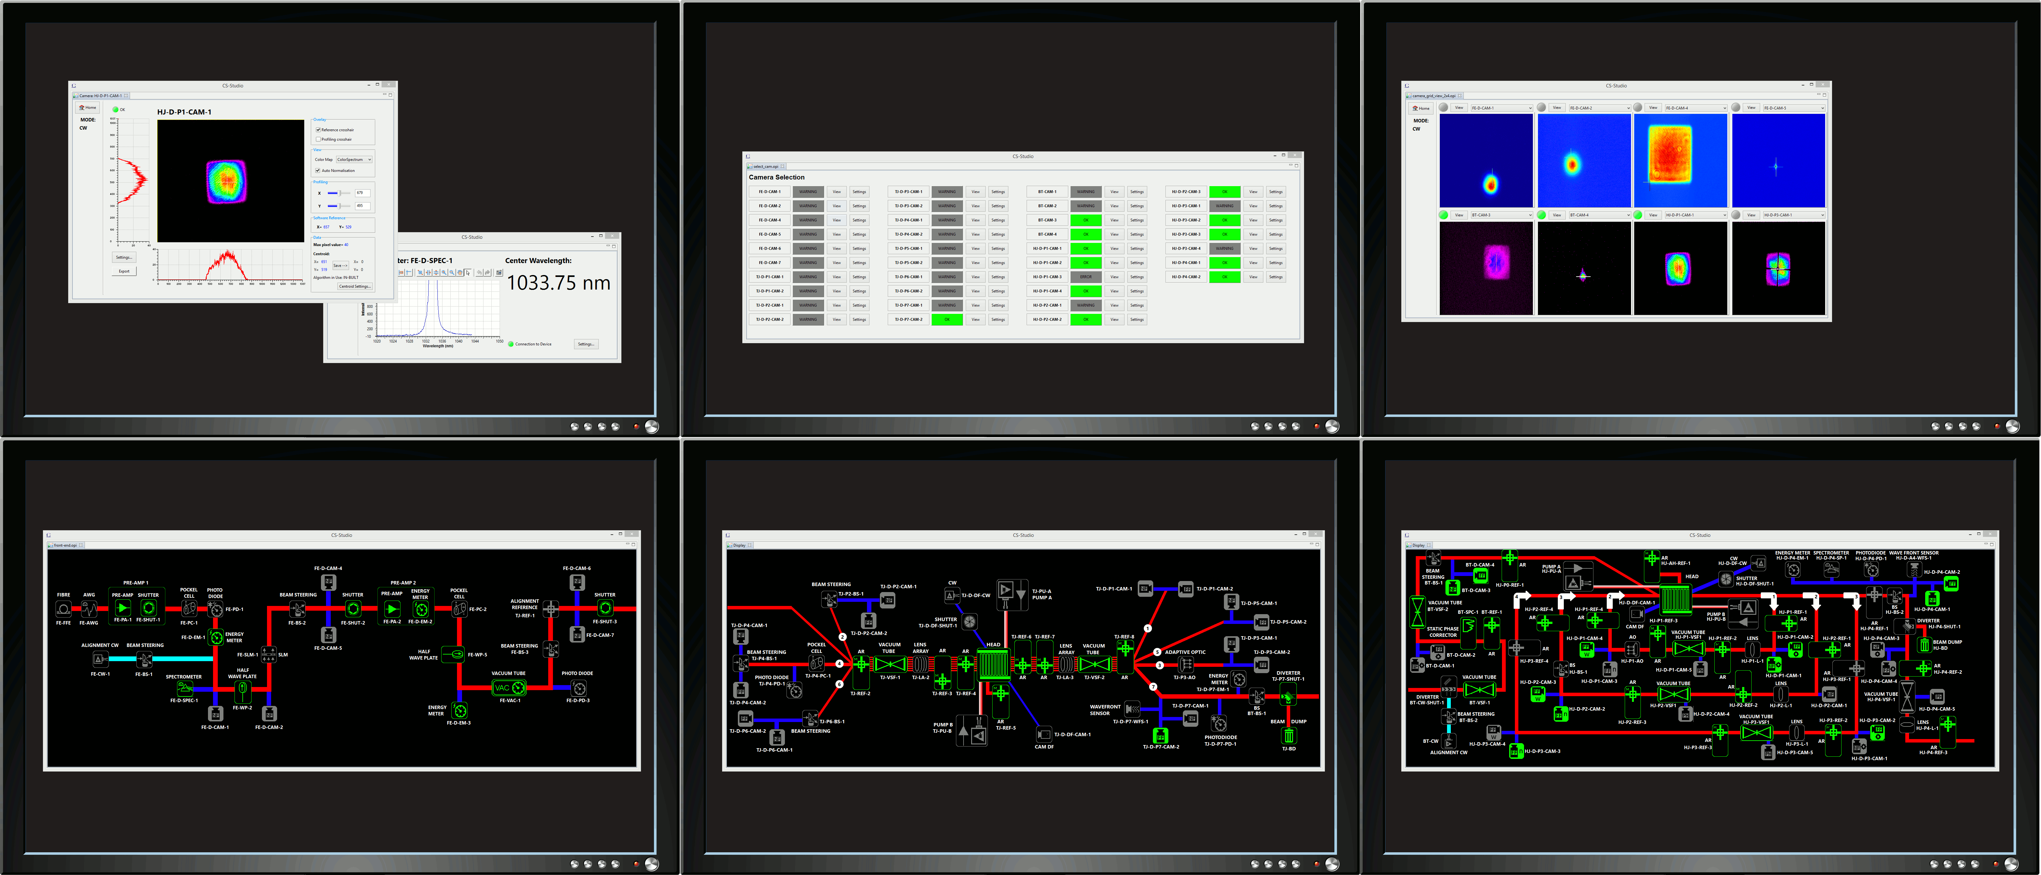

Slide 14
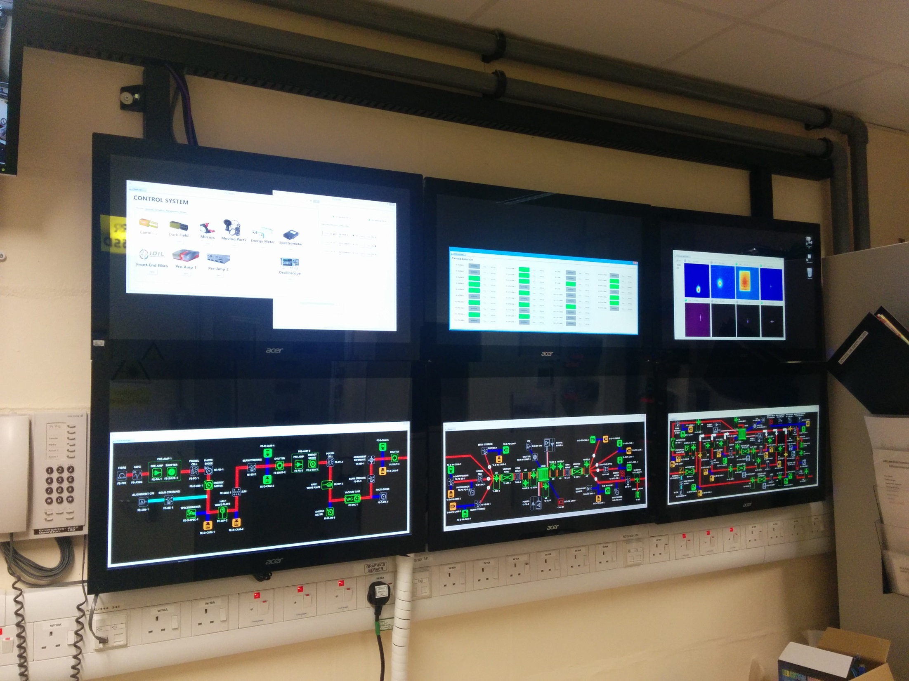

Slide 15
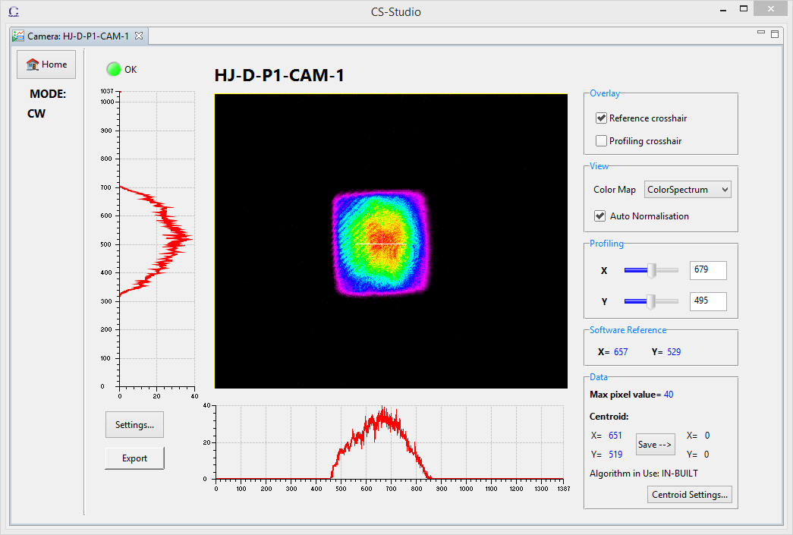
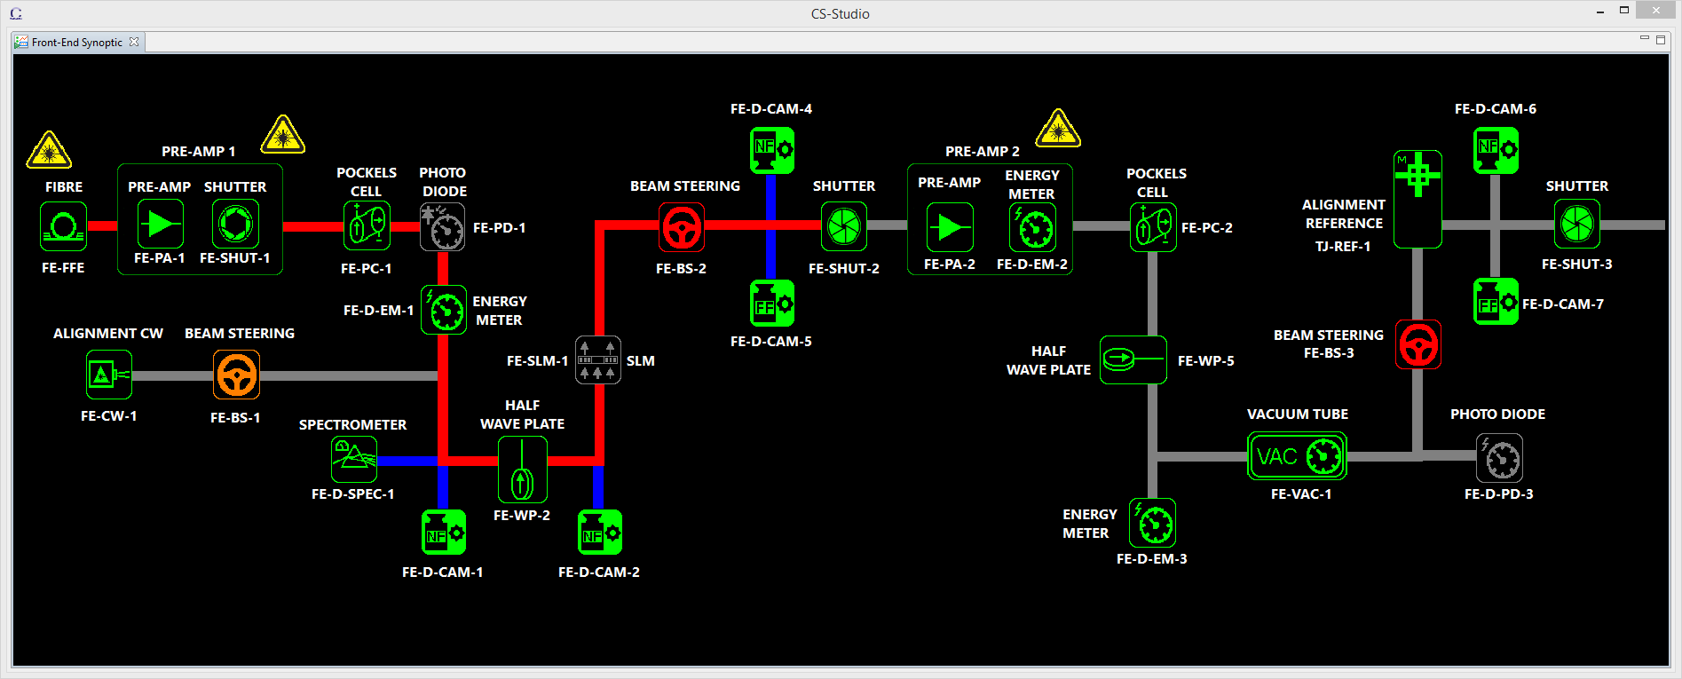
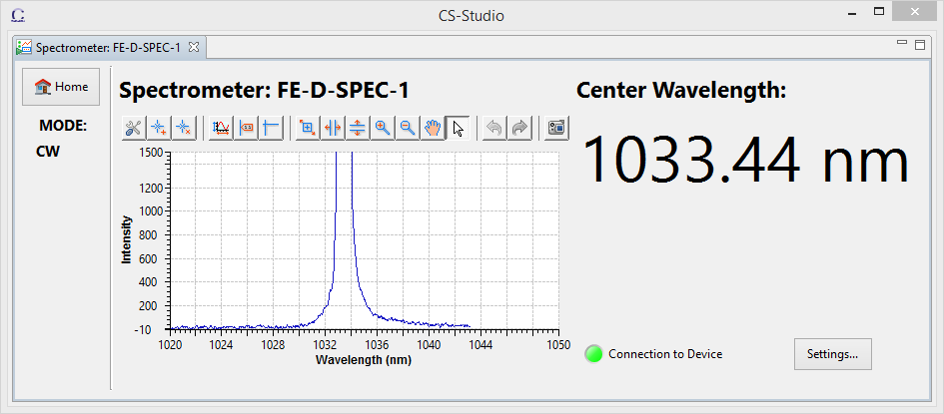

Slide 16
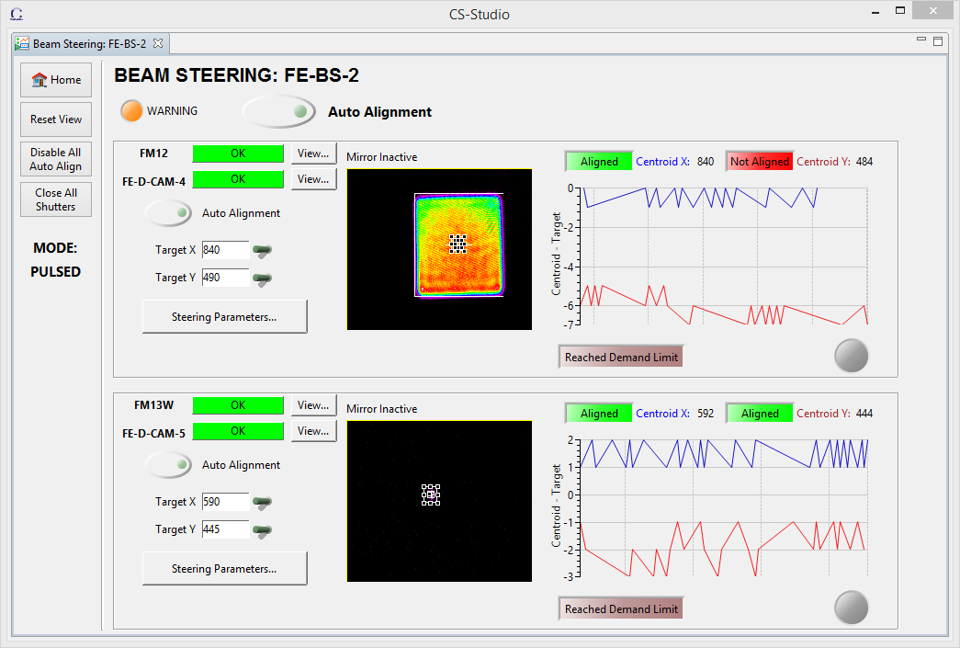
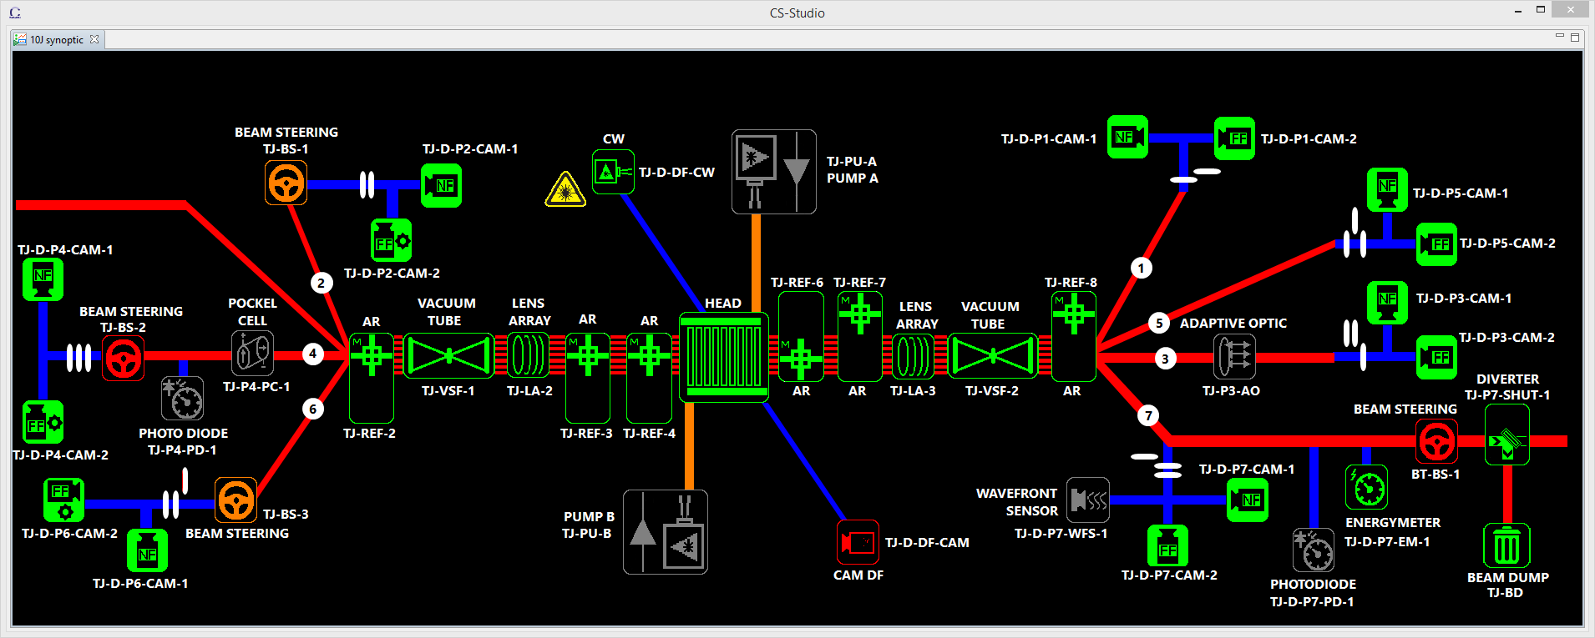
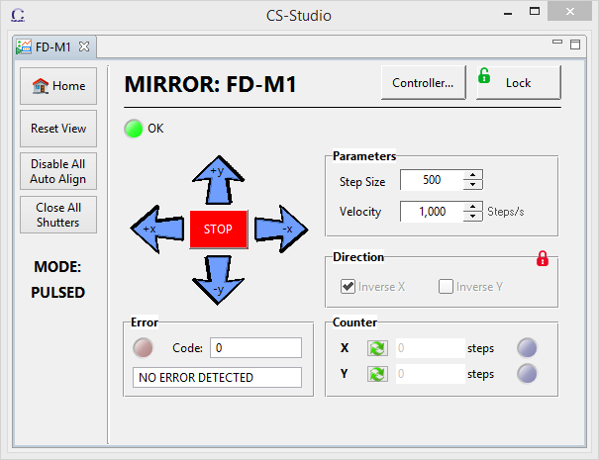

Slide 18
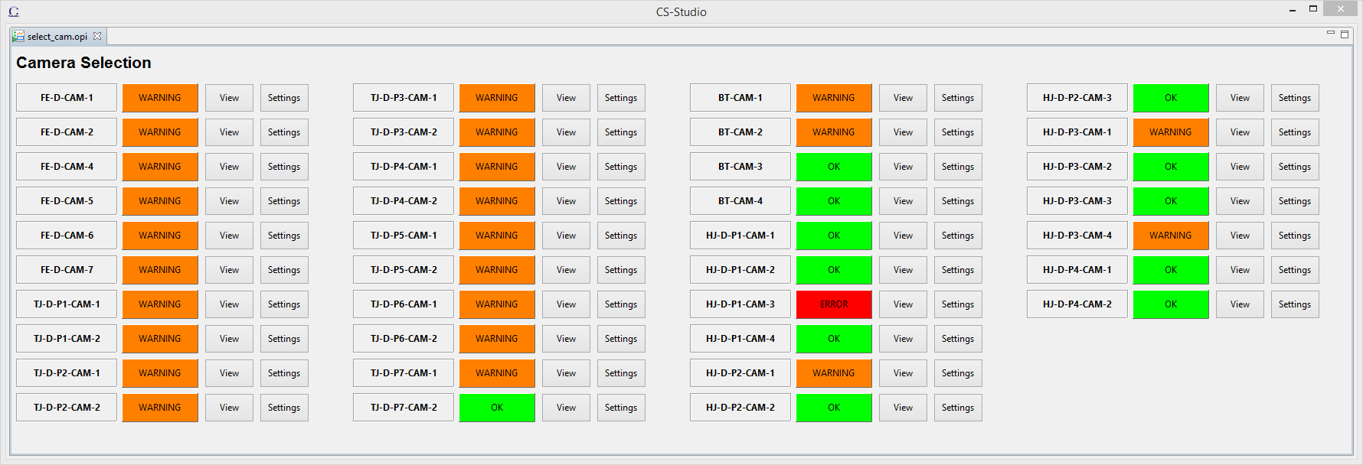
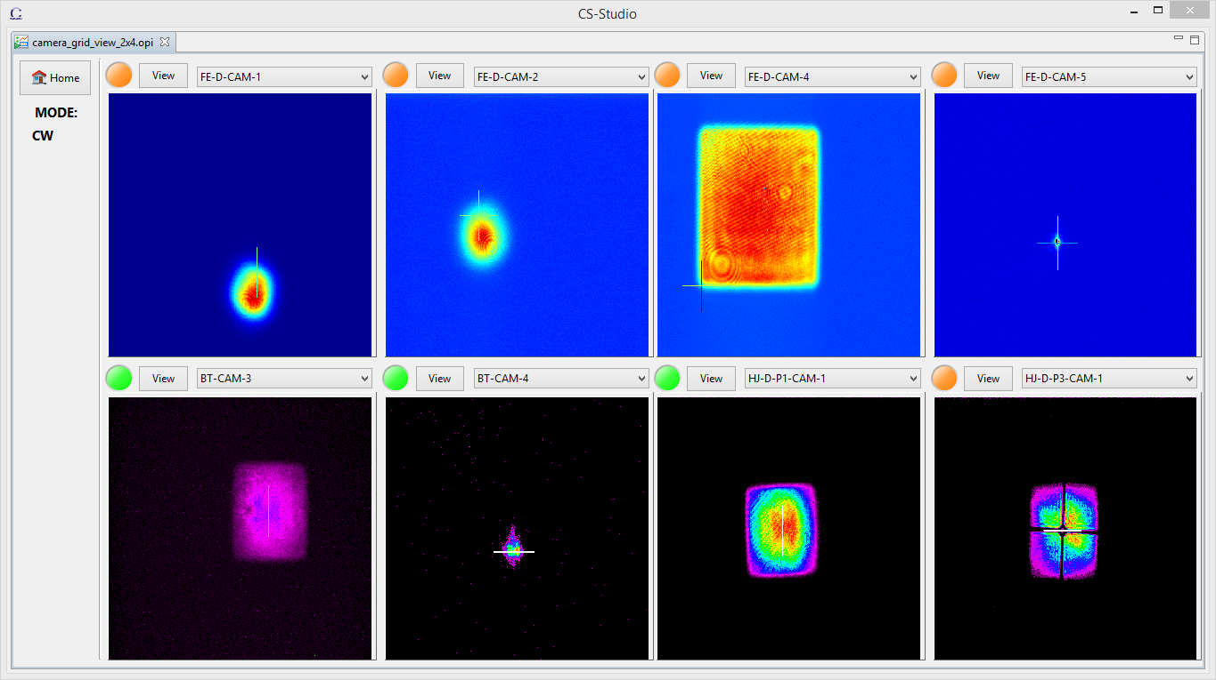

Slide 19
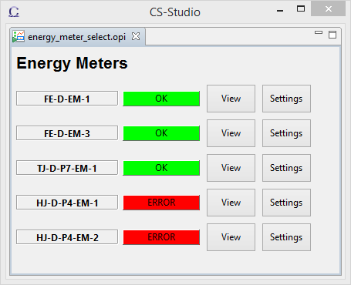
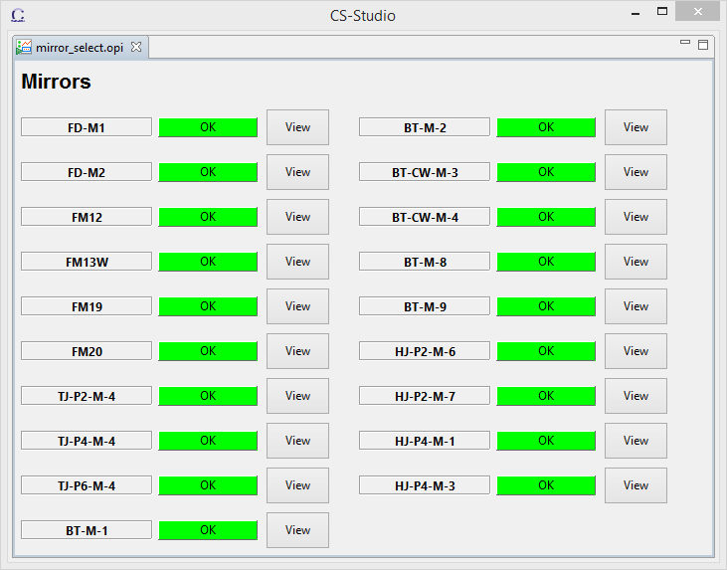
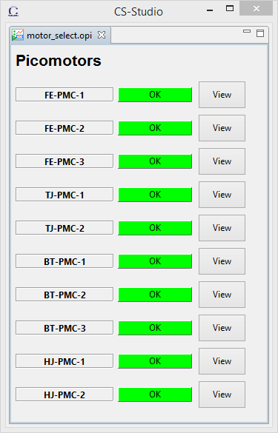



Notes:
All devices have status lights that we call “traffic lights”. Green means OK, no problems. Blinking amber is a warning, and red is obviously indicating an error that needs attention and/or intervention.

Slide 21
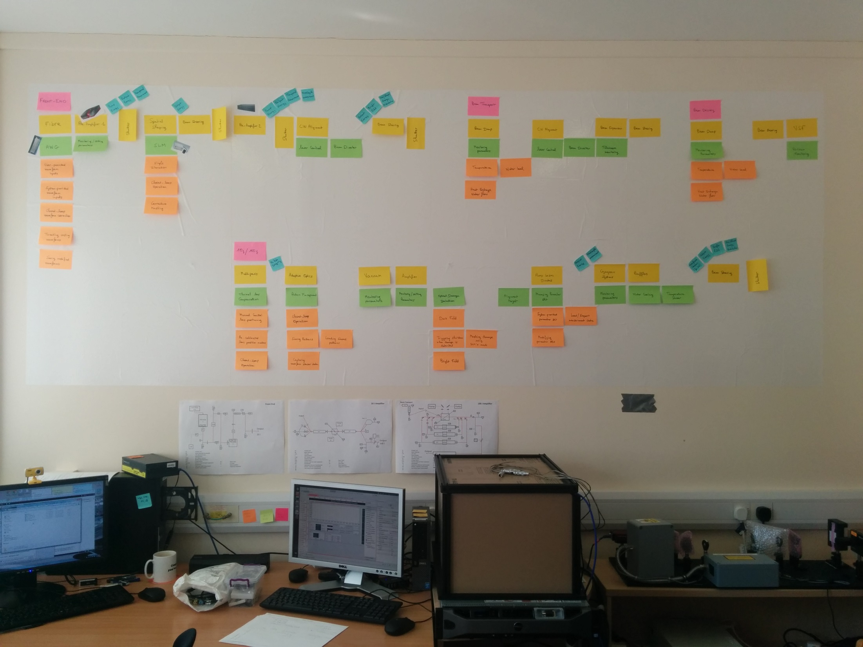

Slide 22
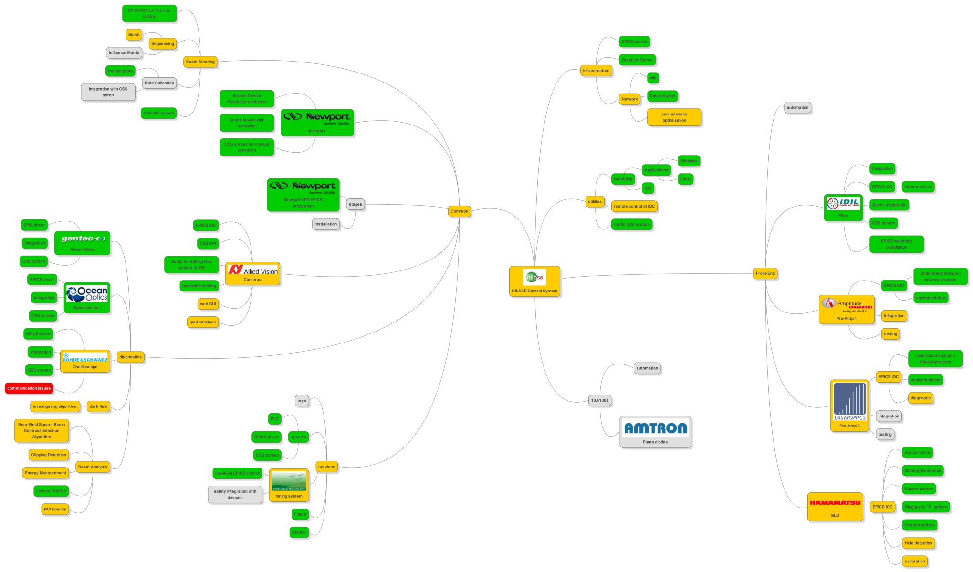

Slide 23
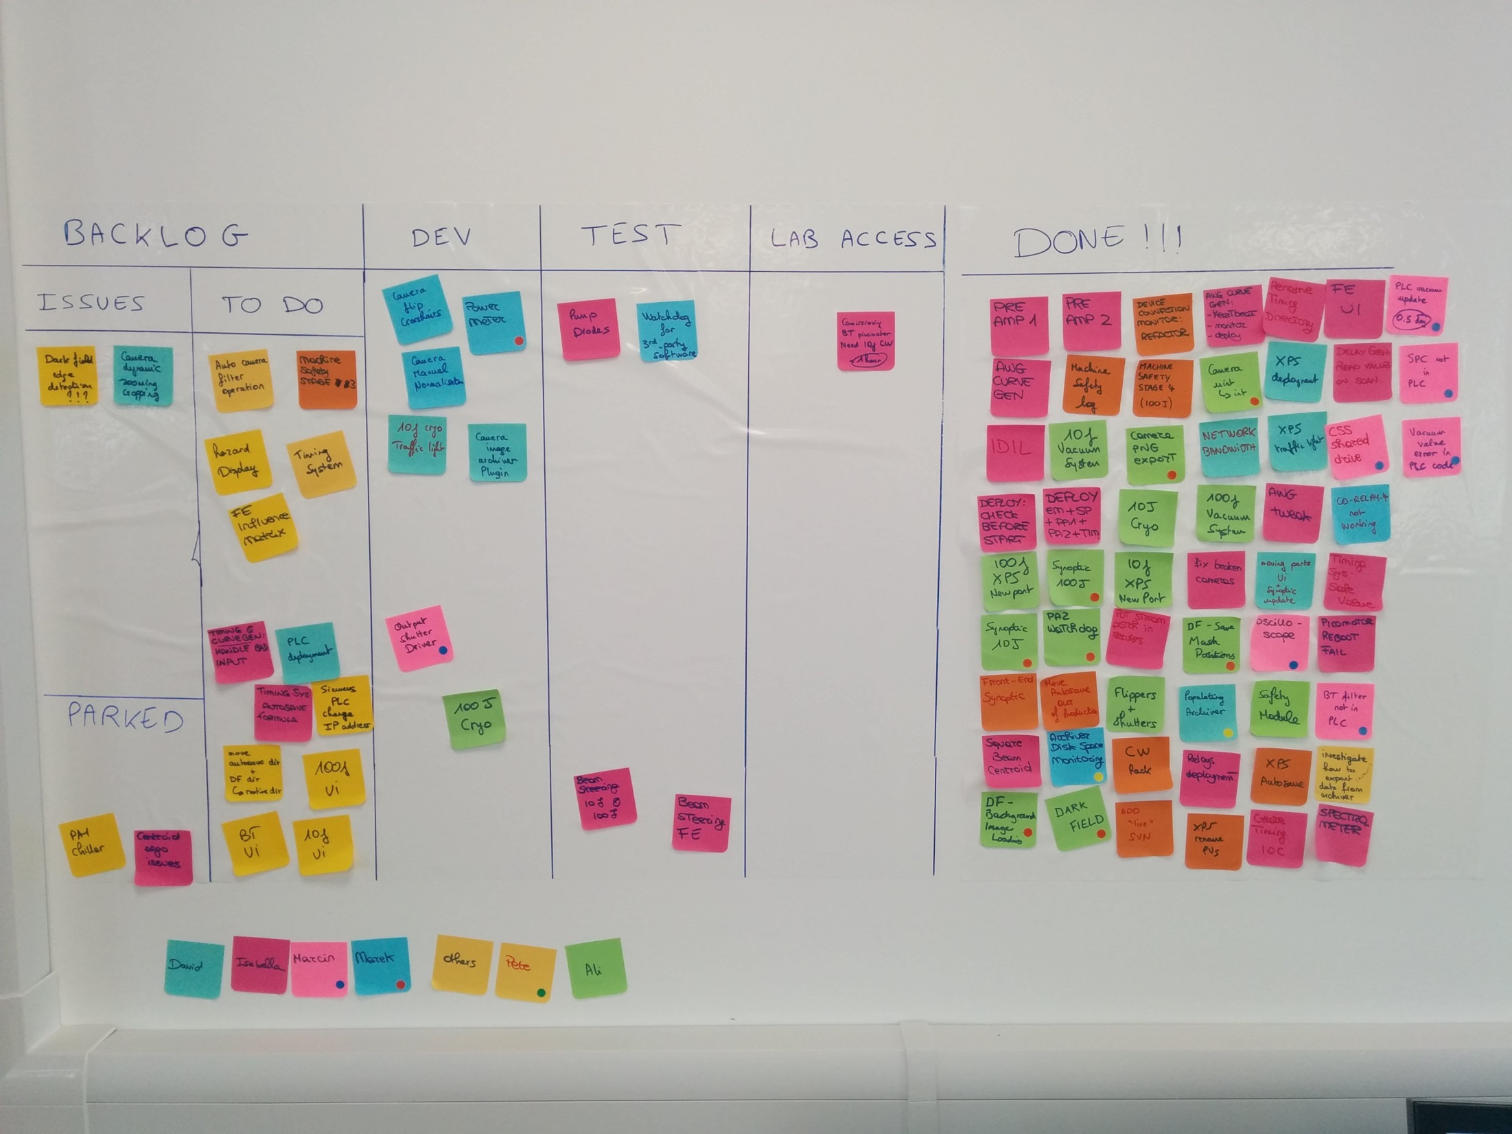

Slide 24

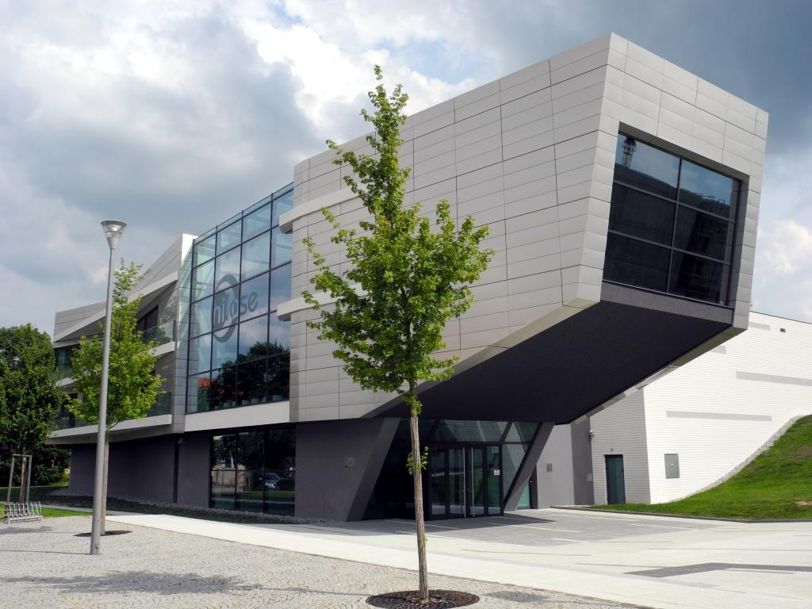

Notes:
To a facility called HiLASE.
They wanted a laser for their own research and the CLF was awarded the £10 million (!) contract to build it.

Slide 25
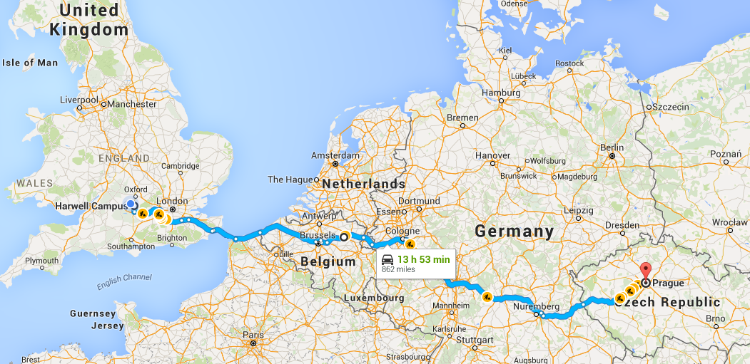

Slide 26
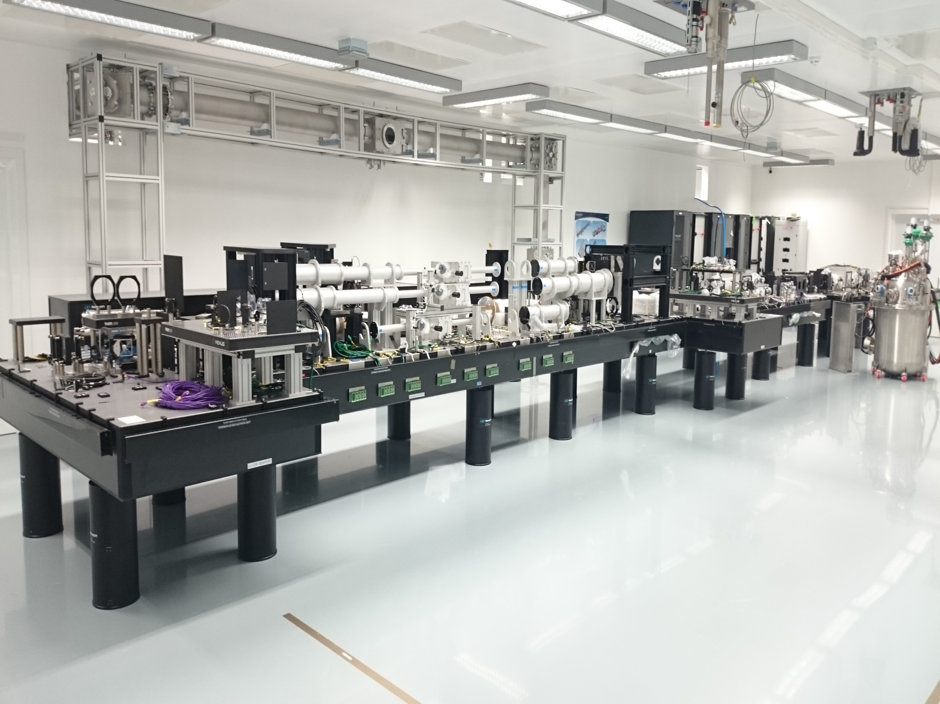

Slide 27


david.michel@tessella.com
?
david.michel@stfc.ac.uk

