Slide 1
EPICS Archiver Appliance Update
Presented by Murali Shankar on behalf of multiple
contributors from the EPICS collaboration

Slide 2
Goals
Scale to 1-2 millions PV’s
Fast data retrieval
Users add PV’s to archiver
Zero oversight
Flexible configurations on a per PV basis

Slide 3
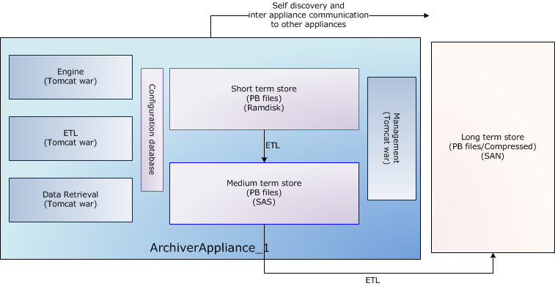
What’s in an appliance?
Components
Storage

Slide 4

Scale by clustering appliances
Apache
with
mod_proxy_balancer
Clients

Slide 5
Status at SLAC
Facility | Production | PV | Storage | Appliances in cluster
TestFAC | 3.5 years | 37K | 1GB/day | 1
FACET | 2 years | 34K | 1GB/day | 1
LCLS (electron) | 2 year | 178K | 19GB/day Currently 18TB in LTS | 3
LCLS (photon) | 0.5 years | 257K | 3GB/day | 1

Slide 6
Status at BNL
66K PVs
20K events/sec
95GB/day
In production for about 1.5 years

Slide 7
Status at NSCL/FRIB
NSCL has two appliances
  However, these are configured for failover
93K PVs
2GB/day
FRIB has one appliance but just starting out.

Slide 8
Status at HZB
118 PVs
118 events/sec.
66 GB/day
Test deployment
  May also add fast BPM data 200PVs @150Hz/6GB/day

Slide 9
Status at PSI
Been in production for more than a year
Use it for “fast” PV’s

Slide 10
Status at FHI
In production for about a year
  2K PVs
  600 events/sec
  1GB/day
Have two appliances in a cluster
  Each appliance is on a different EPICS VLAN.
  StrongBox as the LTS

Slide 11
Other deployments
Diamond
  Post evaluation; running thru their tests now.
Pohang - Evaluation
LNLS – In production for a while.
INFN-LNL – Testing; have two installations
  SPES – 7K PVs
  Cluster with 2 appliances writing to LTS on GlusterFS.

Slide 12
Retrieval times
%

Slide 13
Retrieval Mime Types

Slide 14
Issue - FRIB broadcast storm
One of the appliances was searching for PV’s at a high rate.
Rebooting did not seem to help
All the PV’s involved were from one IOC
IOC that was causing the issues had a bad gateway address.
Fixing the gateway address seems to have fixed this issue
  Still don’t know root cause
  We have some wireshark traces.
  IP routing configuration problems may result in false beacon anomalies that might cause CA clients to use unnecessary additional network bandwidth and server CPU load when searching for unresolved channels.

Slide 15
Issue - BNL Nanos
After starting, the status of appliance -> “Stopped – engine”
  But things seemed normal, we were storing and serving data.
  One of the IOC’s has TSE=-2 and was generating incorrect nanoseconds.
  Can’t really see this issue in caget etc – these utilities round up the incorrect nanos into the seconds.
  Simulate locally with an a subroutine record with TSE=-2.

Slide 16
Issues - ChannelArchiver import and thresholds
This was a something that we added to improve the overall speed of the ChannelArchiver import.
Limits number of “invalid” PV’s to a certain limit.
  Of course, we can configure this.
However, this puts a upper limit on the number of invalid PV’s you can submit to the archiver.
Various folks run into this
  SLAC photon
  SNS
Will probably change this somehow.

Slide 17
Issue - Maximum number of stores
FRIB added new readonly stores.
  But we had a config entry for the maximum number of stores in the system.
  ETL Exceptions if more stores than max
    Easily overlooked component
      Any exceptions here should be looked into.
    Otherwise, you run of space in your short-term-store
Removed this config entry
However, please do check for exceptions and FATAL statements in the log
Also monitor your stores for disk free space.

Slide 18
Other issues
Regression with adding fields to the archiver.
  The EPICS aliasing logic was getting in the way.
LNLS was having server crashes
  Marcio increased the memory for the JVM’s and this seems to have fixed it.
Jud (PSI) has intermittent problems with the the mgmt UI’s in the cluster.
  For now, we ignore the exceptions.
  Still need to get to the bottom of this.

Slide 19
New HTML5 Viewer
Developed by Igor Gaponenko (SLAC)
  Bundled as part of the appliance.
  Access using QuickChart
Uses JSON.
Support for scalars.
  Support for waveforms coming soon.
Performance is pretty good for a web based client.

Slide 20
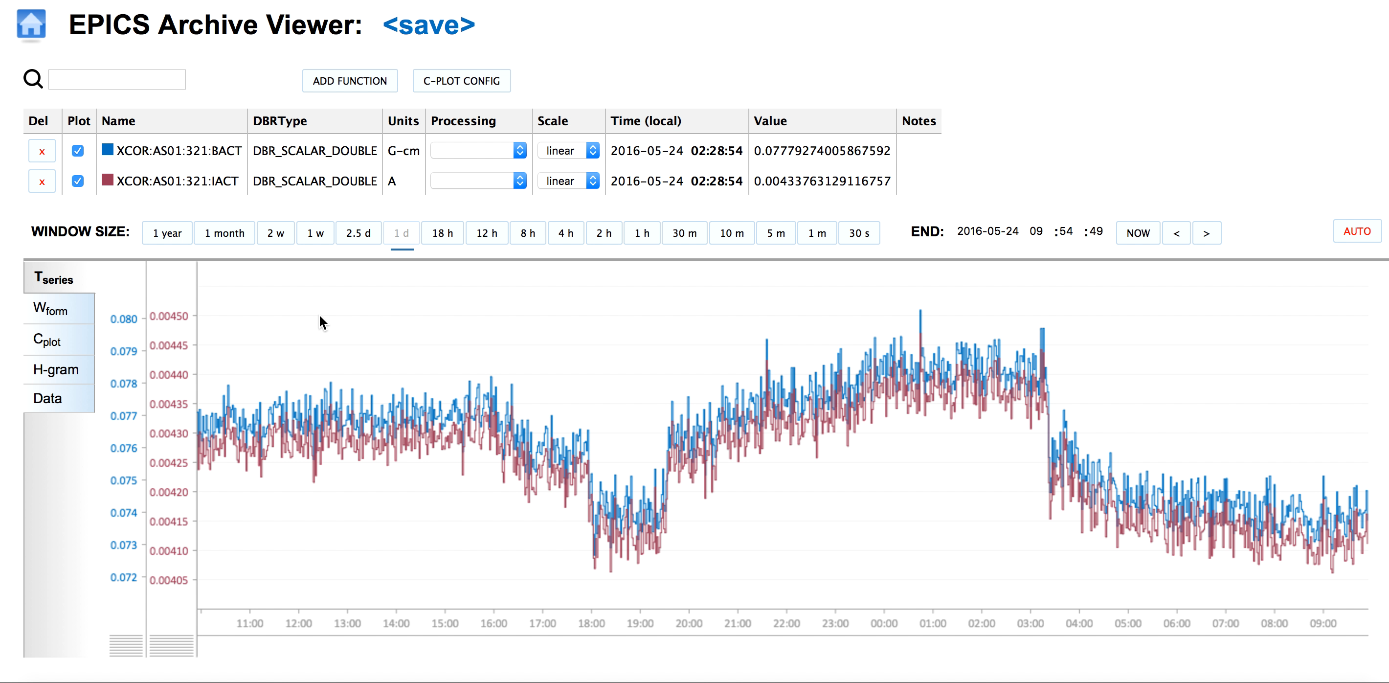
HTML5 Viewer

Slide 21
DBE_PROPERTIES
Support for DBE_PROPERTIES
  Since support for this is also in the gateway, can be used in most installations.
  For now, we have to set a boolean in the PVTypeInfo.
  Fields in the DBR_CTRL types are automatically obtained a monitor with a DBE_PROPERTIES mask.
  Of course, IOC’s need to be 3.15+.

Slide 22
Full support for V4 types.
Previously, we had largely tested V3 types thru PVAccess.
We now have a V4 service where we can surface other V4 types.
  Also, we now have pvDataBase in Java; yay!!
We should now be able to add any V4 type to the archiver and then view it using eget.
  And since we also have a V4 gateway, we should be able to include archive V4 types in a deployment.

Slide 23
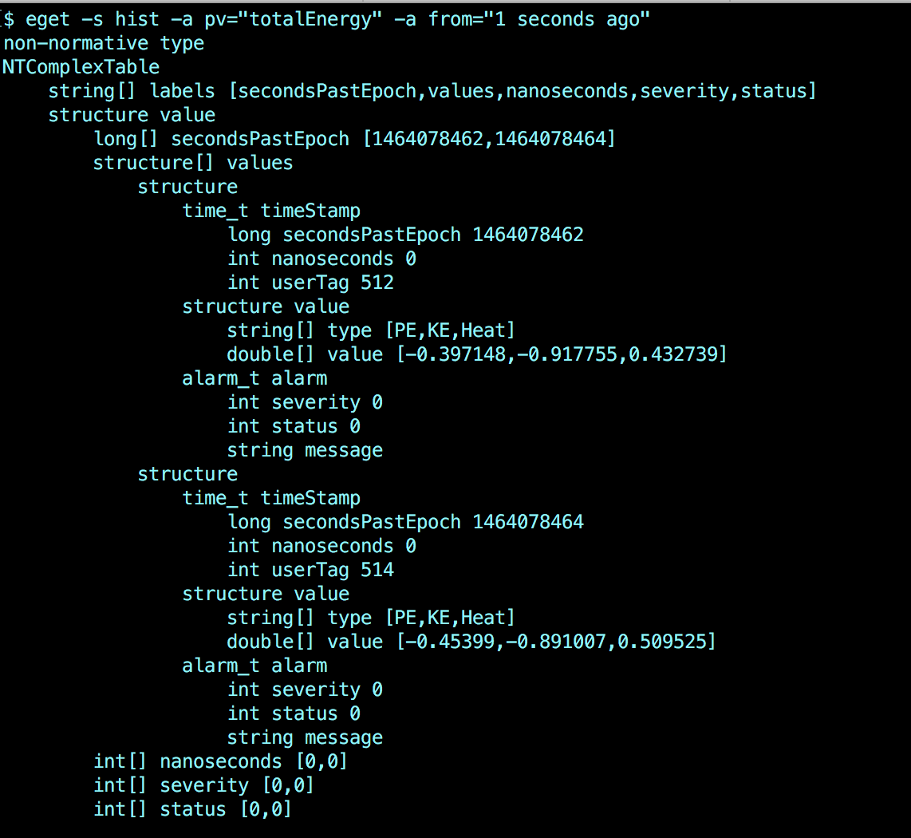
eget for complex type

Slide 24
Retrieval features
Michael Kenning (DLS) added the ability to get data from multiple PV’s in a single call.
  Support for this in the .raw and .json MIME-types.
Ability to transparently proxy other appliances
retiredPVTemplate – You can now “retire” a PV
  That is, have no notion of the PV in the archiver.
  Data can be placed into a store on an as needed basis (perhaps from tape).
  Use a PV as a template to indicate where the data is

Slide 25
Archive PV workflow
Bypass capacity planning – specify appliance as part of request or policy
  Let’s you have complex cluster configurations where the EPICS_CA_ADDR_LIST is not the same on all the appliances.
Specify control PV as part of policy
  Adam Egger (SLAC) is using this for a system to help operations when tuning the machine.
  Special PV signals when operators start tuning the machine.
  This PV turns on archiving of some signals at beam rate.
  The data from the tuning archiver is used to drive machine learning algorithms.

Slide 26
Deployment
Migrated to JDK 1.8
GitHub
  Completed the migration to GitHub.
  Viewer is a separate repo (included as a submodule)
    Please use git clone –recursive
  Docs are on bootstrap; will soon move the UI over.

Slide 27
Docker! Docker! Docker!
Deploy in a docker container.
  On my test machine, should be in production by the end of the year.
  Deploying in a docker container makes it transportable.
  Store configuration in Redis.
    MySQL is too heavy for a docker container.
  Seems to work
    Transparently moving members of a cluster will require some additional work.

Slide 28
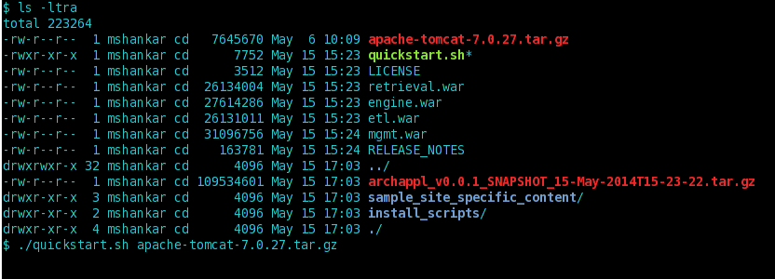
Quickstart/evaluate
Google “EPICS archiver appliance”
Download archiver appliance and tomcat
Run using
  ./quickstart.sh apache-tomcat-7.0.27.tar.gz

Slide 29
Questions
Thanks for listening

Slide 30
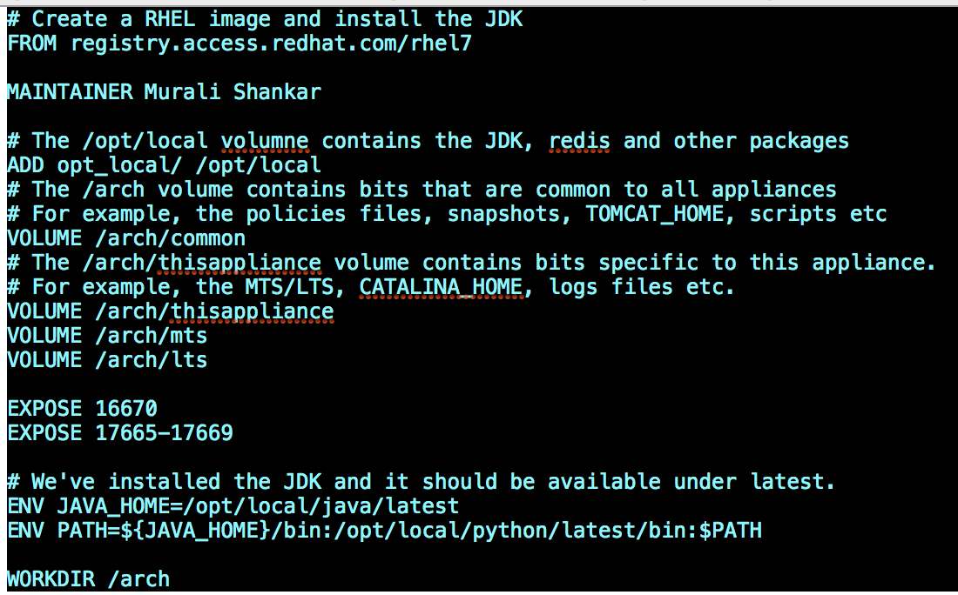
Dockerfile
Dockerfile is straightforward

Slide 31
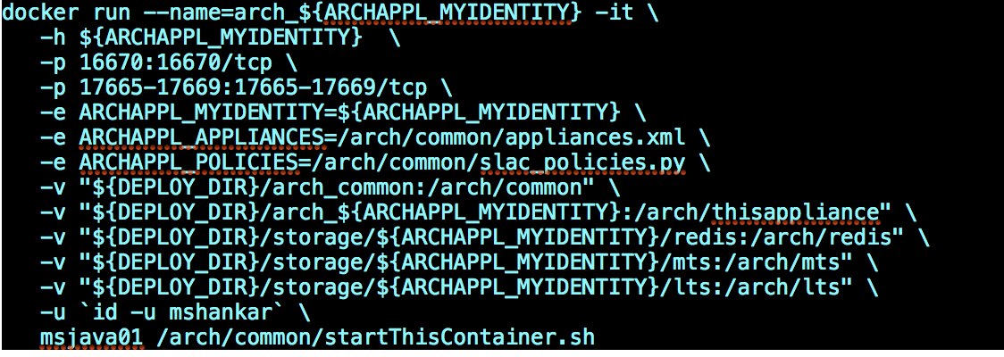
Docker run
When running, map the volumes/ports etc.

