Slide 1
ITER Packaging of the EPICS-based I&C Projects
D.Stepanov, L.Abadie, R.Lange, A.Zagar
ITER Organization
Cosylab

Slide 2
Objective
EPICS provides its own established build system, based on GNU make
Makefile-based approach allows for high level of flexibility, with regards to files location, dependency calculations, …
For ITER most of I&C applications will be developed off-site, with little-to-no control from the central team
Hence a natural wish that similar applications are built in a similar manner and packaged in a compatible way
Need strict control over delivered software, to make sure that no files have been forgotten or depend on local setup

Slide 3
ITER Approach to Packaging
From the very beginning ITER made decisions on packaging system:
Red Hat Linux as a base platform
RPM as a packaging tool, with YUM as a distribution mechanism
Build system is controlled by Apache Maven (clean, compile, …)
Maven is also used to automate frequent I&C tasks ( start / test / stop sequence). Control system-specific behavior of Maven is implemented with the ITER Maven plugin

Slide 4
ITER Assumptions About EPICS
Only one architecture (linux-x86_64)
Reuse the EPICS build system as much as possible
Provide EPICS / IOC specific commands as part of Maven environment
If Maven and EPICS project structures are respected, no specific additional instructions are required in pom.xml

Slide 5
I&C Project Structure
Software project structure adheres to Maven recommended structure. src/main/epics is allocated for EPICS projects
{unit_name}
├── pom.xml (project information)
├── doc/ (Directory for documentation)
└── src/ (Directory for source files)
├── main/ (Directory for source files of product)
│ ├── beast/ (CSS alarm configuration files)
│ ├── beauty/ (CSS archive configuration files)
│ ├── boy/ (CSS boy opi files)
│ ├── c++/ (C++ application sources)
│ ├── databrowser/ (databrowser files)
│ ├── epics/ (EPICS application sources)
│ ├── java/ (Java application/library sources)
│ ├── plc/ (PLC program sources)
│ ├── python/ (Python application/library sources)
│ ├── resource/ (application/library resources)
│ └── scan/ (CSS scan command files)
├── test/ (Directory for source files of test)
│ ├── ...
└── target/ (Build results)
├── ...

Slide 6
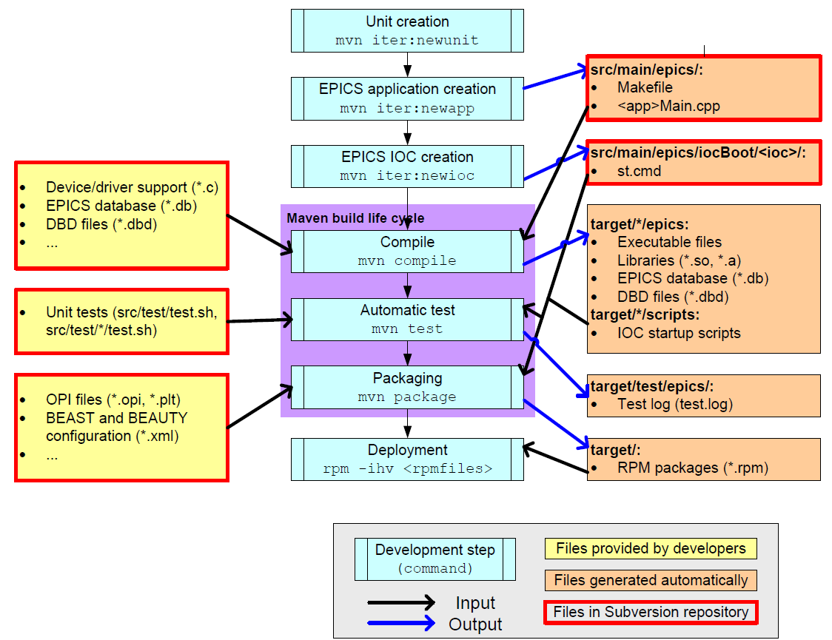
Maven Development Workflow

Slide 7
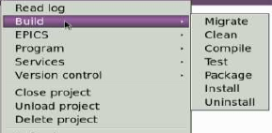
Standard Build Life Cycle Support
mvn clean
- cleanup the build tree
mvn compile
- compile the sources
mvn test
- do automated tests
mvn package
- perform packaging in RPMs
mvn install [-Drpm=*] [-Dremote=]
mvn uninstall [-Dremote=]
- install (possibly remotely)

Slide 8
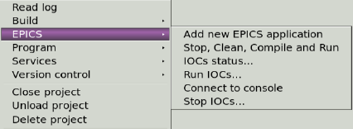
Maven Dev Commands for EPICS
mvn newapp -Dapp= [-Dtype=generic]
- create new EPICS application inside src/main/epics/
mvn newioc -Dioc= [-Dapp=] [-Dpriority=20] [-Drunlevels=345]
- create new IOC and assigns a given application to it
mvn reassign -Dapp= -Dioc=
- move the application from one IOC to another
mvn includeioc -Dioc=
mvn excludeioc -Dioc=
- add or remove existing IOC from packaging
mvn listapps
mvn listiocs
mvn listtypes
- info on the current project

Slide 9
Maven Runtime Commands for EPICS
mvn run [-Dioc=] [-Ddaemon=false] [-Dremote=]
- run IOCs
mvn stop [-Dioc=] [-Dremote=]
- stop IOCs
mvn status [-Dioc=] [-Dremote=]
- check if IOCs are running
mvn connect -Dioc= [-Dremote=]
- connect to the running IOC shell
Remote commands are done via ssh execution (hosts have to be registered in advance). Applications are supposed to be found in the same path (best is to mount the development folder via NFS)

Slide 10
Packaging Instructions for IOCs
pom.xml snippet:
<build>
<plugins>
<plugin>
<groupId>org.apache.maven.plugins</groupId>
<artifactId>maven-iter-plugin</artifactId>
<extensions>true</extensions>
<configuration>
<packaging>
<package name="TEST-S7-PSH0CORE-ioc">
<include type="ioc" name="TEST-S7-PSH0CORE" runlevels=“345" />
</package>
<package name="TEST-S7-PSH0PLC-ioc">
<include type="ioc" name="TEST-S7-PSH0PLC" runlevels=“345" />
</package>
<package name="TEST-S7-PSH0SYSM-ioc">
<include type="ioc" name="TEST-S7-PSH0SYSM" runlevels=“345" />
</package>
<package name="ioc">
<dependency version="current">%{codac_rpm_prefix}-${project.artifactId}-TEST-S7-PSH0CORE-ioc</dependency>
<dependency version="current">%{codac_rpm_prefix}-${project.artifactId}-TEST-S7-PSH0PLC-ioc</dependency>
<dependency version="current">%{codac_rpm_prefix}-${project.artifactId}-TEST-S7-PSH0SYSM-ioc</dependency>
<include type="script" scriptType="initd" file="plc-sample-iocs" />
</package>
</packaging>
</configuration>
</plugin>
</plugins>
</build>

Slide 11
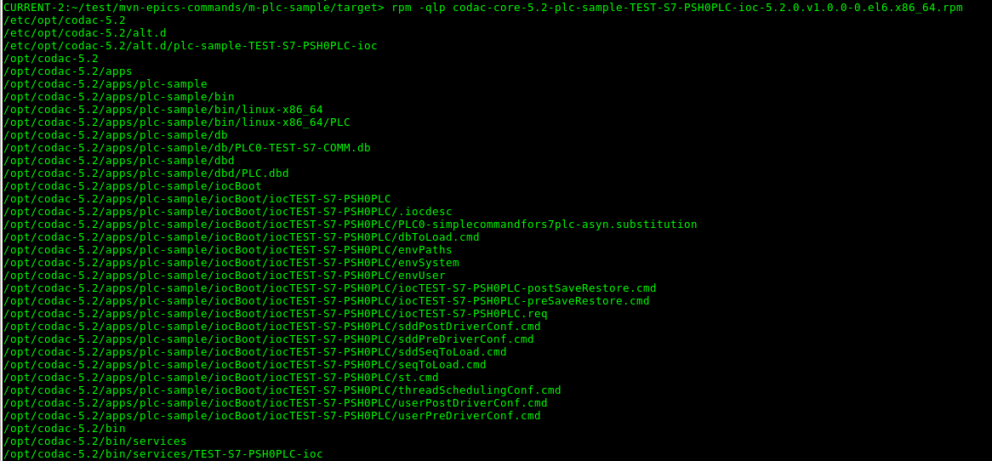
Content of an IOC Package
IOC binary
Database
IOC startup folder
System service script

Slide 12
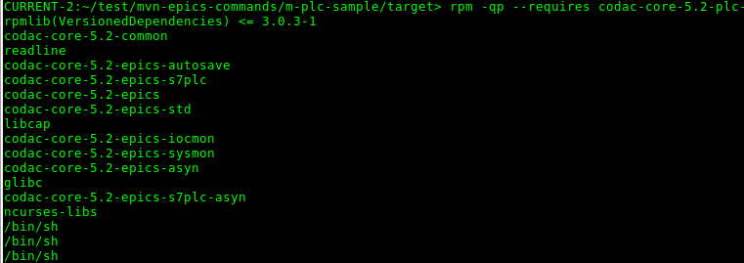
IOC Package Dependencies
IOC depends on major / minor version of CODAC. Maintenance versions are supposed to be binary compatible. Exact version dependency can be enforced
IOC packages have their own version, usually bound to the version of the I&C application served

Slide 13
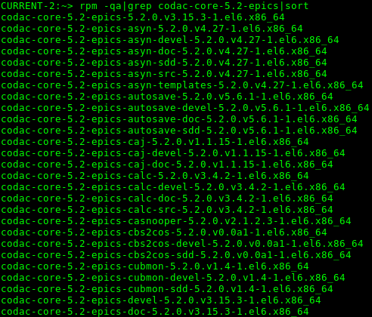
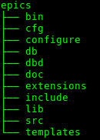
EPICS Base Packaging
ITER made a substantial effort to package EPICS itself in accordance with Red Hat Linux practices. This results in approx. 90 RPMs covering the following areas:
EPICS base
EPICS extensions and tools
EPICS device support modules
Whenever possible, runtime and devel packages are separated.
ITER-specific
EPICS packages
are clearly
separated too.

Slide 14
EPICS and CODAC profiles
It is possible to have several CODAC versions installed on one machine, hence, several EPICS versions too.
CODAC has profiles for different types of control system machines, which dictate which part of EPICS has to be installed
<meta name="ct">
<summary>CODAC Core System ${codac.version} CODAC Terminal</summary>
<provides codac="true">system-role</provides>
<!-- client/user applications -->
<requires codac="true">css</requires>
<requires codac="true">css-jms-send</requires>
<requires codac="true">css-opi</requires>
<requires codac="true">epics</requires>
<requires codac="true">python-cachannel</requires>
<requires codac="true">python-pyepics</requires>
<requires codac="true">system-tests</requires>
<requires codac="true">psps-fatsat-editor</requires>
</meta>
<meta name="pcf">
<summary>CODAC Core System ${codac.version} PCF Operation</summary>
<provides codac="true">system-role</provides>
...
<!-- epics modules -->
<requires codac="true">epics-irio</requires>
<requires codac="true">epics-mcoreutils</requires>
<requires codac="true">epics-nisync</requires>
<requires codac="true">epics-nisync-general-time</requires>
<requires codac="true">epics-pxi6259</requires>
<requires codac="true">epics-pxie6368</requires>
<requires codac="true">epics-pxi6528</requires>
<!-- libraries -->
<requires codac="true">irio</requires>
<requires codac="true">dan-daq</requires>
<requires codac="true">log-lib</requires>
...
</meta>

Slide 15
Conclusion
ITER has developed a Maven-based build kit which allows to seamlessly compile and package EPICS applications
Quick development / testing cycle without going through packaging is supported
RPM-based packaging of the EPICS base and EPICS tools is available
Thank you!

