Slide 1
MyRestore
Jlab’s Archiver-based Save, Restore & Compare System
Theo Larrieu
Analysis & High Level Applications Group
Jefferson Lab

Slide 2
Outline
Introduction
Implementation
Components
Process
Usage
Restore & Compare
“Saves”
Auto Restore
Restore Procedures
Overview
Examples
Status

Slide 3
Introduction - Features & Benefits
Centralizes saving PV values in the archiver
Eliminated redundant infrastructure to create and manage PVs in BURT files
Preserves all value changes
Allows restore to an arbitrary point in time.
Allows dynamic restore procedures
Utilizing external data sources.(e.g. the CEBAF Element Database or IOC signal.list files)
Automatic restore following an IOC reboot
Not just for IOCs
MyRestore also now backs machine configuration save & restore.

Slide 4
MyRestore Components
Mya Archiver
Archives PV history and provides Restore values.
MyRestore MySQL database
Stores Restore Procedure Definitions
MyRestore Web Application
Interface to the MyRestore MySQL Database
MyRestore & myRestoreGUI executables
Performs Restore Procedure
iocBootSpy
Performs Automatic IOC restoration

Slide 5
Mya Archiver
MySQL-based archiver developed at JLAB
In use since February 2007
Distributed Architecture
Currently Six (+1) hosts
Fallback archiver
All channels, 30 days history.
236,368 channels archived
~20,000 updates / second received
7,223 updates / second stored (dead bands)
~16GB/day
Can stream ~300,000 history updates / second to clients
~2 years of channel history currently available online.
Soon all data since 2008

Slide 6
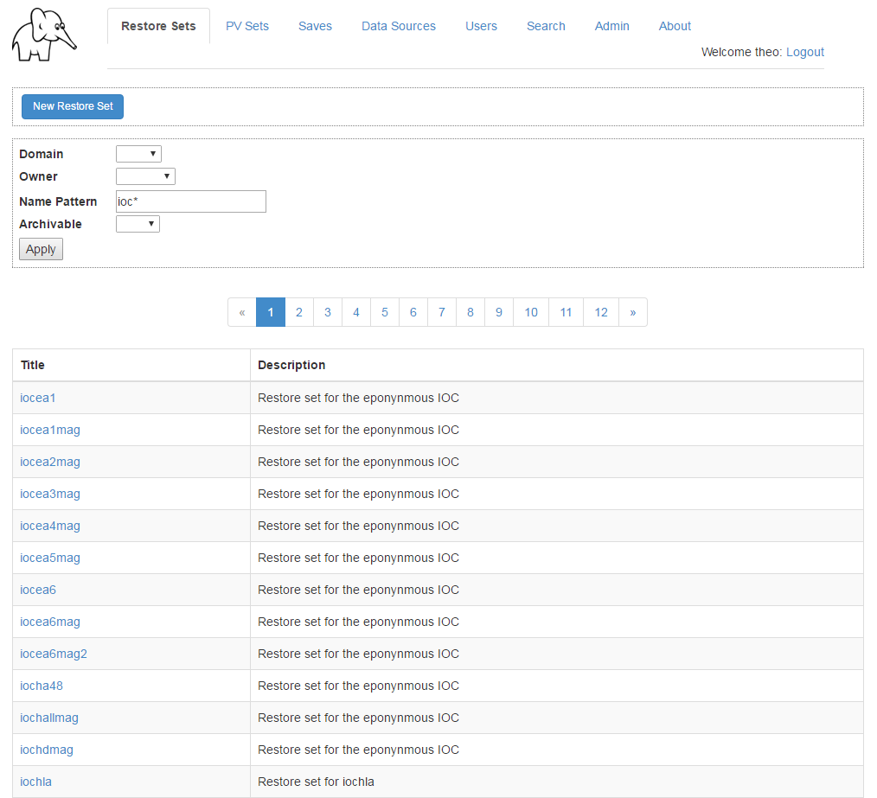
Web Server
Primary Interface to the MyRestore MySQL Database.
Allows users to view, create, edit Restore Procedures, Saves, and Data Source rules.
Exposes data to the myRestore command tools line via REST API

Slide 7
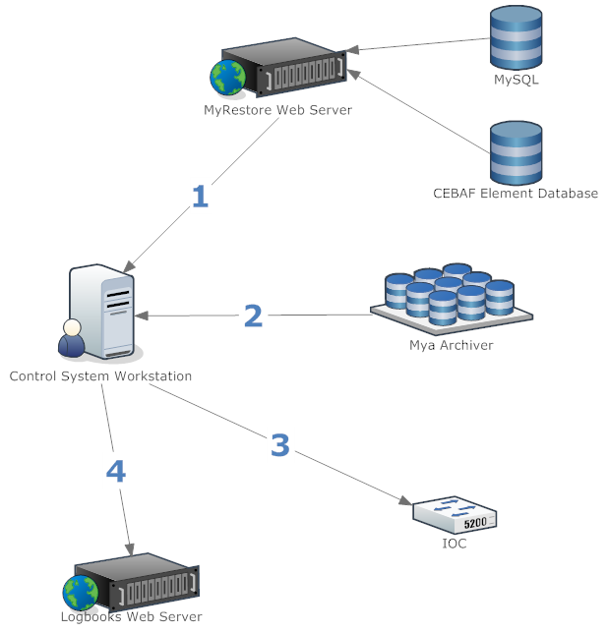
MyRestore Process
Client contacts the MyRestore web server to obtain Restore Procedure definition.
Client obtains values for each PV named in retrieved Restore Procedure from Mya Archiver.
Client writes the PV values to the IOC via Channel Access.
Client makes a logbook entry.
Notes:
Should rework the graphic to flip steps 1 and 3

Slide 8
Usage
The primary tool for using MyRestore is the myRestore executable.
myRestore capabilities include
Execute a Restore Procedure
Validate a Restore Procedure
Compare Historic vs. Current Values for PVs in a Restore Procedure
Create a BURT req file or snap file

Slide 9
IOC Restore Examples
Simple Case (Auto Timestamp)
myRestore –ioc –R ${IOC}
Specify Relative Timestamp
myRestore –ioc –R ${IOC} –t -1h
Specify Absolute Timestamp
myRestore –ioc –R ${IOC} –t “2016-04-30 16:00”
Strict Mode (abort on first failure)
myRestore –ioc –R ${IOC} –s
See All Options
myRestore –h ioc

Slide 10
About IOC Auto Timestamp
MyRestore queries Mya to find the most recent IOC disconnect time that was preceded by a "needs restored" transitioning to "NO“ where the time between those events was greater than 5 minutes.
Chooses the time 4 minutes before that IOC disconnect.
User can ask myRestore what timestamp it would choose:
myRestore –stamp –i ${IOC}
*
4 minutes
Restored
5+ minutes
Disconnect
Needs Restore
Needs Restore
Time
Notes:
In other words, finds the must recent disconnect time following at least 5 minutes of restored uptime.

Slide 11
Restore Set Validation
Checks:
PVs are being archived
PVs exist in EPICS
Executable paths exist and are executable
% myRestore -validate -R iocnl22rffcc1 -v
iocnl22rffcc1
Rf12Fcc
Pause step ok
Execution step ok
c100_rffcc: PVs:32 Errors:0 Warnings:0
Execution step ok
Execution step ok
Execution step ok
system: PVs:3 Errors:0 Warnings:0

Slide 12
Restore Set Comparison
Report on differences between current values and historic values at arbitrary timestamp.
% myRestore -compare -R iocnl22rffcc1 -t -90d -v
c100_rffcc (32):
R1M1TDOFF: 92.0709 -> 88.4729
R1M1RATN: 14.8889 -> 13.6111
R1M1PSifpw: 106.5 -> 59.7382
R1M1PSET: -22 -> -55.738
R1M1POFF: -124.81 -> -41.5979
R1M1GSET: 18.3 -> 17.4824
R1M1GLOS: 1.39072 -> 0.869257
R1M1DACMUX: 1024 -> 1027
R1M1CNTL1b: 4 -> 0
R1M1CNTL1: 4 -> 0
system (3):

Slide 13
IocBootSpy
Daemon process running on Linux.
Triggered by monitored <ioc>::ioc_sr.VALD connecting and being '1'.
Calls myRestore command line app to perform restore operation.
Executes in “strict” mode.

Slide 14
IOC “Saves”
A save is simply a named, annotated timestamp.
Largely unnecessary for IOCs, but available
Saves are versioned.
Repeated saves to the same name increment the version counter
iocnl22rffcc1-1
iocnl22rffcc1-2
When used in a restore context
Omit the version suffix to mean most recent version
Include the version suffix to specify a specific version
Saves can be made retroactively
Just specify the date & time instead of assuming now

Slide 15
Restore Procedures
PV Sets
Lists of PVs to restore (think BURT req files)
May require macro variables to be fulfilled at runtime
May reference data sources
Restore Sets
Multi-step restore procedures consisting of
PV Sets
Unix programs or scripts
Pauses
Prompts (not valid for auto-restore)
Nested Restore Sets
Supply values for macro variables required by the included steps

Slide 16
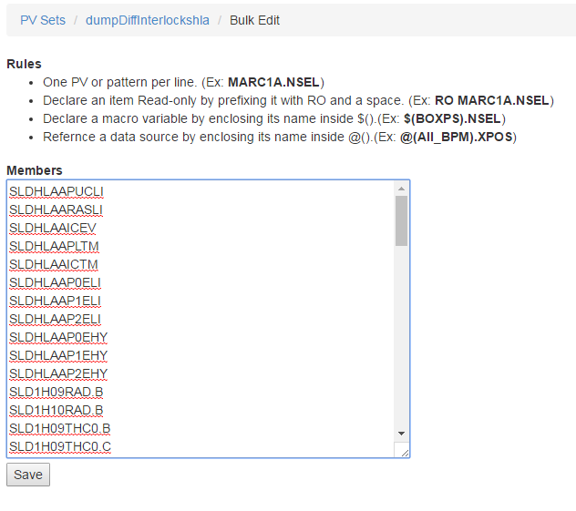
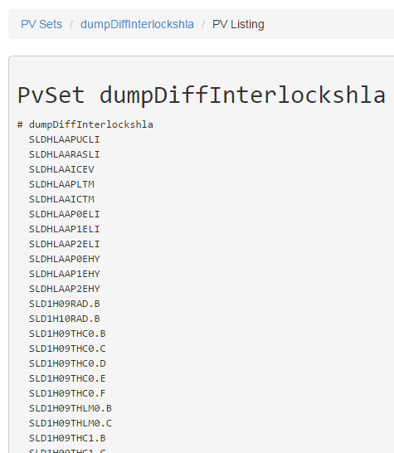
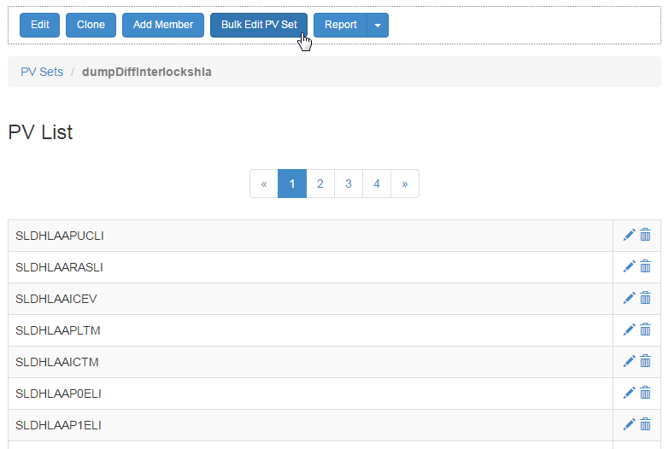
Restore Procedure - Static PV Set Example
BURT Req File “Cut-and-Paste”

Slide 17
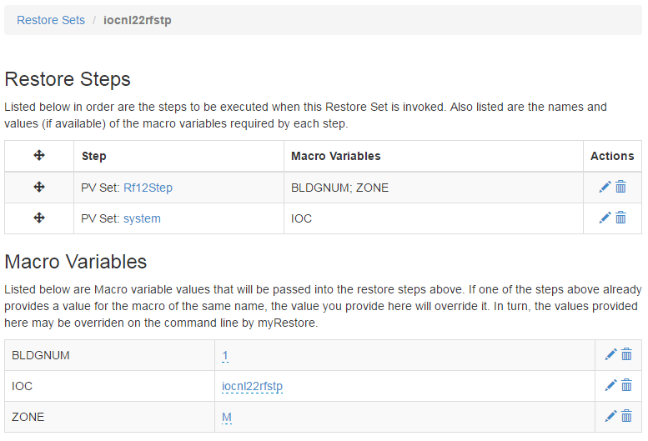
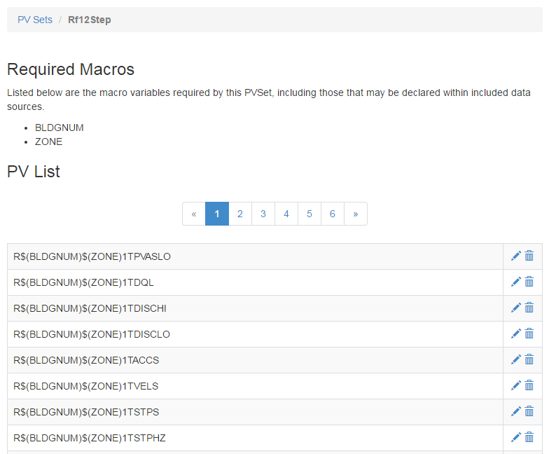
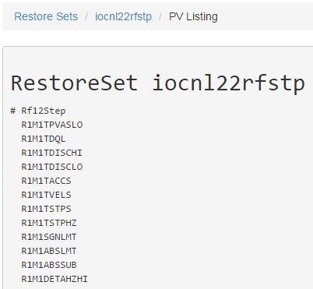
Restore Procedure– Variable Substitution Example

Slide 18
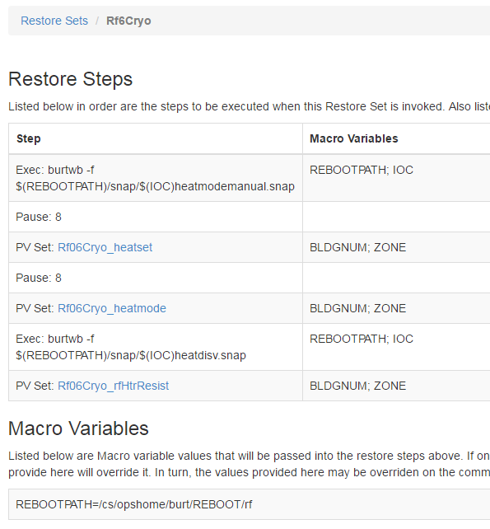
Restore Procedure – Multi-step Restore Set
Three different step types used here:
Executable (burtwb writes snap file with constants)
Pauses
PVSets
Intended for inclusion by another Restore Set that will provide values for the macro variables $(REBOOTPATH), $(IOC), $(BLDGNUM), $(ZONE)
Does provides a value for one required macro variable $(REBOOTPATH)

Slide 19
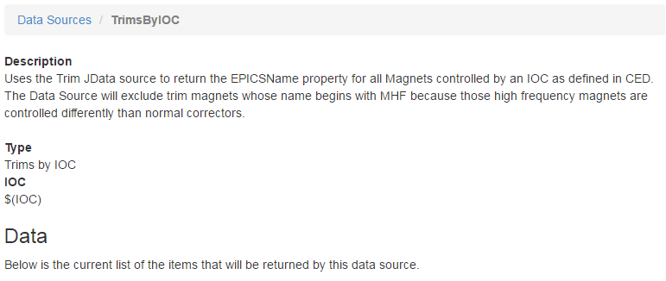
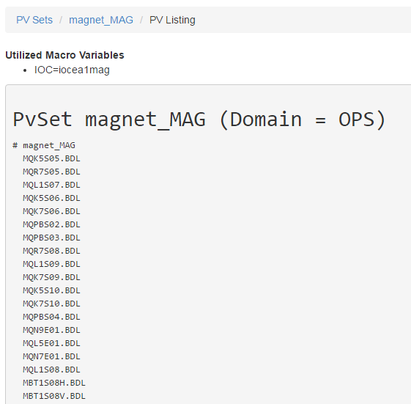
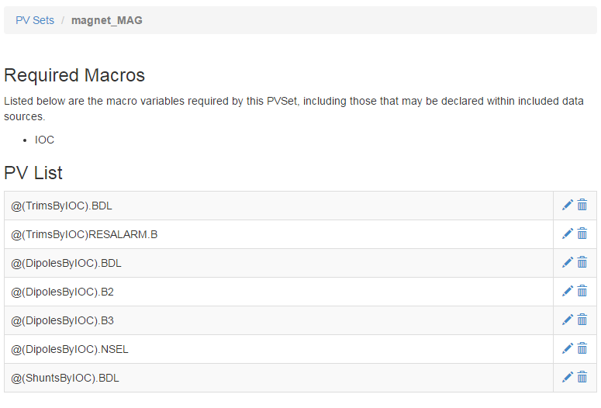
Restore Procedure – Data Source Example

Slide 20
About Data Sources
Simple Specification
A Class with a getData() method that returns an array of strings.
Three different interfaces currently available
CEBAF Element Database (CED)
JData ( JLAB On-the-fly EDM screen generator data sources)
signal.list (Regular expressions extract strings)
Nightly Report informs Mya Administrator if data source changes require new PVs to be archived.

Slide 21
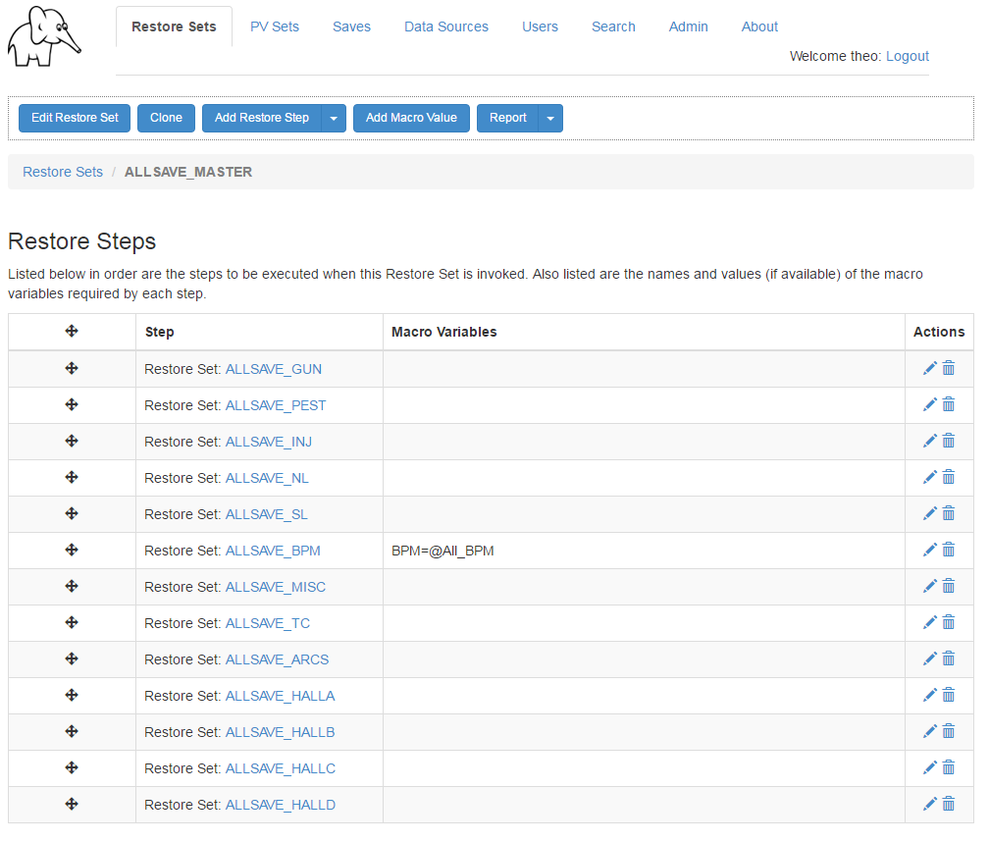
Restore Procedure – non-IOC Example
The Accelerator “Allsave” Master used to save and restore machine configuration is defined as a hierarchical Restore Procedure.

Slide 22
Current Status
Implemented on 210 (53%) of the 397 IOCs that are “Production/Available/OPS”
Primarily IOCs of the Magnet, RF, and SEE BPM systems.
Goal: Convert remainder during 2016 Summer Shutdown.
Has recorded 1426 successful restores to the electronic logbooks since August 2015.

Slide 23
The End
Thank you for your attention

Slide 24
Begin Extra Slides

Slide 25
Steps to Create an IOC Restore Set
Identify the apps on the IOC.
Create a new IOC Restore Set.
Add Restore Steps for each app.
Ensure values for all required macro variables.
Validate the Restore Set
Request that archiving begin.
Register the IOC in CED as MyRestore or MyRestoreAuto
Perform a test restore and/or reboot

Slide 26
Step 1 - Identify Apps on the IOC
% more Switch.OPS
# Begin OPS IOCs
# NOTE - be sure system application is last in the kindofs statement
case 313:
set kindofs = (system)
# set kindofs = (bunch fsd camacVer system)
breaksw
case 313a:
set kindofs = (system)
breaksw
case bcm:
set kindofs = (bcmVme system)
breaksw
case bd1:
set kindofs = ()
breaksw
case bpmhap1:
set kindofs = (HappexBpm system)
breaksw
case ea1:
set kindofs = (fsd bpm vac system)
breaksw
case ea1mag:
set kindofs = (magnet system)
breaksw
case ea2:
set kindofs = (fsd bpm blm vac system)
breaksw
case ea2mag:
set kindofs = (magnet system)
breaksw
For legacy IOCs one can examine
/cs/opshome/burt/REBOOT/scripts/src/switch.OPS

Slide 27
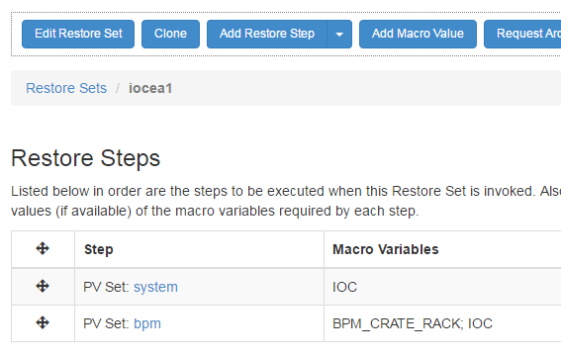
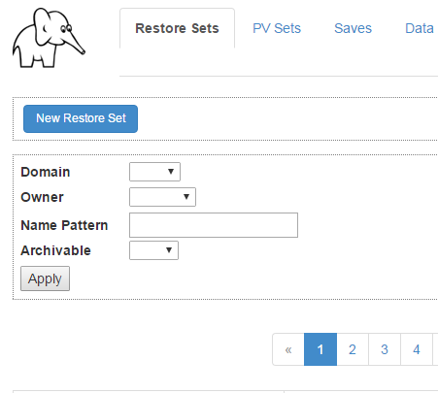
Step 2 - Create the IOC Restore Set
Option 1 – Clone from an existing similar IOC.
After cloning, the macro variable $(IOC) will automatically be updated to the new IOC name.
Option 2– Create a new Restore Set.
The “system” PV Set will automatically be linked to the new Restore Set.
The macro variable $(IOC) will automatically be assigned the IOC name as a variable.
Be sure to name the new Restore Procedure to match the IOC name!

Slide 28
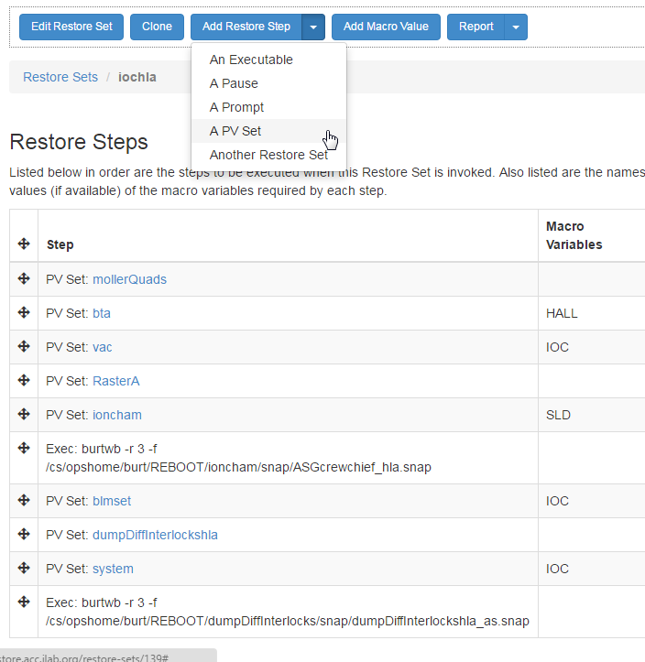
Step 3 - Add Restore Steps for each app
Restore Procedures named after the app they represent streamlines finding and adding them to the IOC.

Slide 29
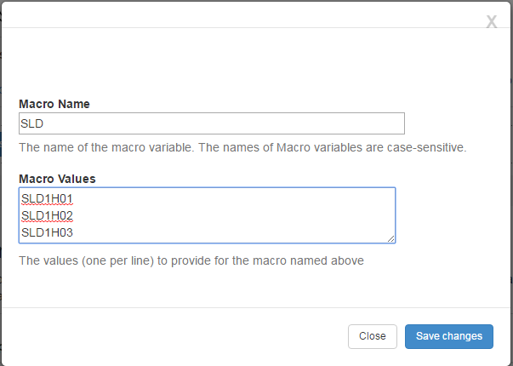
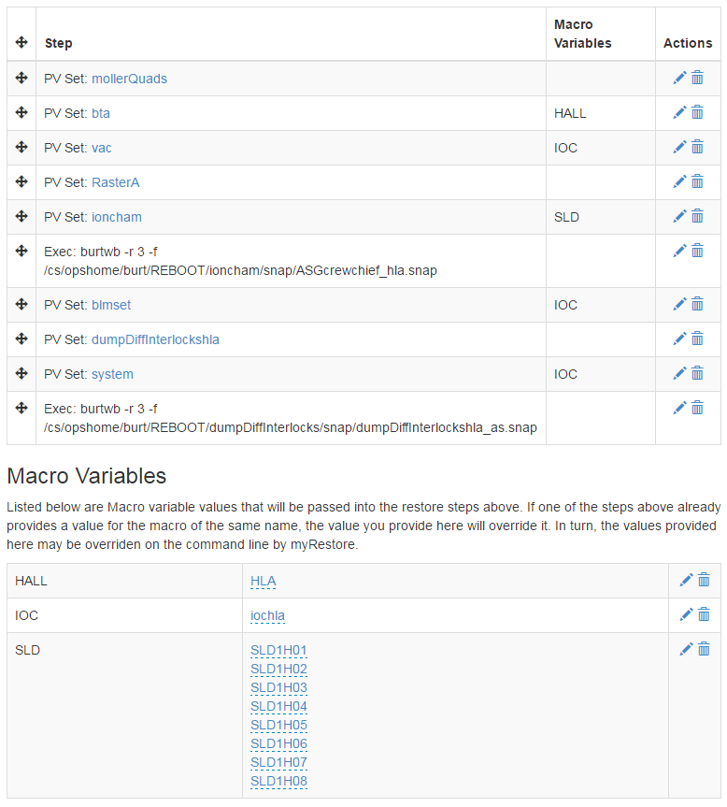
Step 4 – Ensure All Macro Variables have values
Here we can see values being provided for all three macro variables required by the steps in the prior section.
We can also see that the $(SLD) variable is being assigned multiple values.

Slide 30
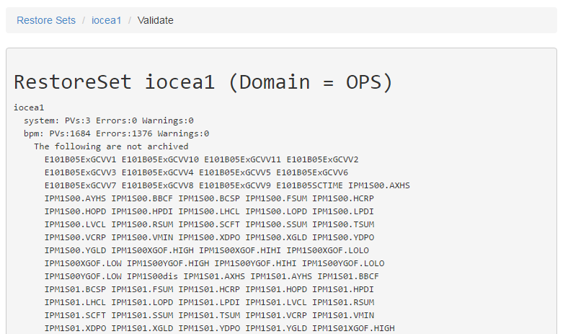
Step 5 – Validate the Restore Set
The only warnings you want to see in the validation report are PVs that are not archived.
Other errors should be fixed before proceeding.

Slide 31
Step 6 – Request Archiving
If archiving has never been initiated for a Restore Set, there will be a button on its web page labeled “Request Archiving”. Pressing this will send a request to the Mya Administrator.

Slide 32
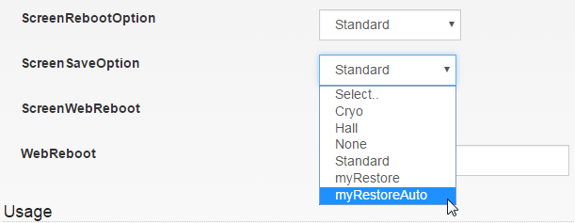
Step 7 – Update CED
Step 8 – Test
Set the ScreenSaveOption property:
MyRestore - Tells OTF screens to invoke the myRestoreGUI from IOC screen(s).
MyRestoreAuto – Also registers the IOC with iocBootSpy once merged to OPS.
Perform a test restore on the IOC.
The testing should include rebooting the IOC, especially if MyRestoreAuto.

Slide 33
CED Data Source
Ideal for keeping restore procedures in sync with CED
A stored CED query that returns a list of elements or a property thereof (Ex: EPICSName).
Transformations available
Uppercase
Lowercase
Exclude lists

Slide 34
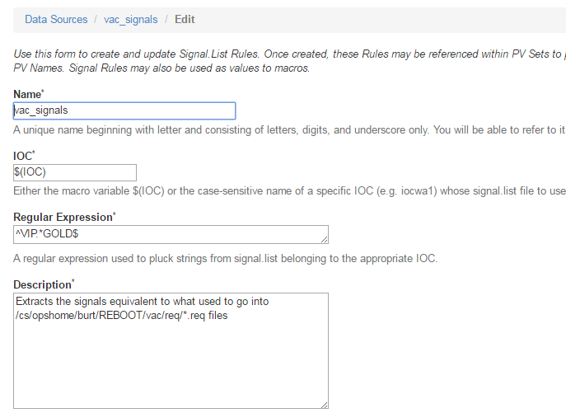
Signal.list Data Source
Use a regular expression to pull PVs from an IOC’s signal.list file.
Signal.list files are uploaded to myRestore database tables every night
/cs/op/iocs/myrestoreSignals.sh

Slide 35
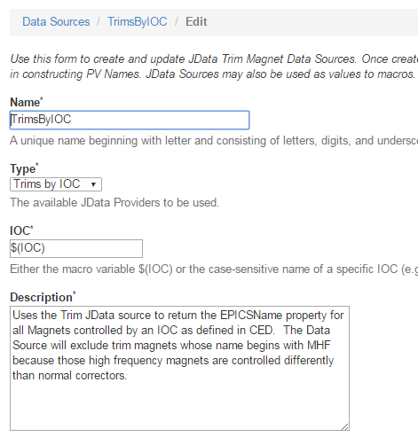
JData Data Source
Permits the use of an available OTF JData data source to provide an element list.
Currently Available:
Trims by IOC
Shunts by IOC
BPMs by IOC

Slide 36
Dynamic PV Set Example
$(BPM) macro variable is declared
Value(s) to be fulfilled at run time.
@(SEEMultiPassCrate) specifies a data source that will be used at run time.
Two PVs are prefixed with RO
Will be archived
Useful for comparisons
Will not be written during restore.

Slide 37
IOC Save Examples
Create with current timestamp and a description
myRestore –save –n ${IOC} –d “my description”
Create an IOC Save for a specific (past) timestamp
myRestore –save –n ${IOC} –t -1h –d “my description”
List saves for an IOC
myRestore –save –n ${IOC}
% myRestore -list -saves -n "iocse17-*" -v |
iocse17-12 2016-04-25 08:58:50
DEFAULT
francis
saveIOCS
iocse17-11 2016-04-25 05:27:56
DEFAULT
higgins
saveIOCS
iocse17-10 2016-03-10 05:55:39
DEFAULT
francis
saveIOCS

Slide 38
Restore Set Listing
List PVs
-b for BURT Format
% myRestore -pvs -R iocnl22rffcc1 -b
# c100_rffcc
R1M1CNFGA
R1M1CNFGC
R1M1CNFGD
R1M1CNTL1
R1M1CNTL1b
List PVs with values
-b for BURT Format
-t timestamp for values
% myRestore -pvs -R iocnl22rffcc1 -b -t -1d
--- Start Burt header
Time: Mon May 2 15:12:00 2016
Login ID: theo (Theodore Larrieu,,,)
Eff UID: 4280
Group ID: 106
Keywords:
Comments:
Type: Absolute
App: myRestore 2.6.1
Req File: c100_rffcc
--- End Burt header
R1M1CNFGA 1 0
R1M1CNFGC 1 0
R1M1CNFGD 1 0
R1M1CNTL1 1 4

