Slide 1
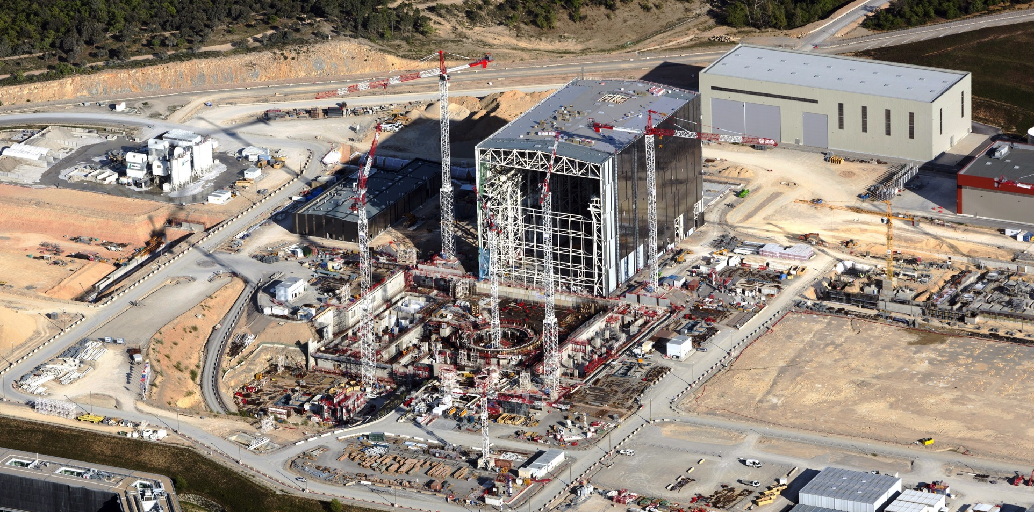
ITER and CODAC Status Update
Ralph Lange
ITER Organization – Central Team – Control System Division

Slide 2
Overall Status and Schedule
Project has been re-baselined, underpinned by a solid bottom-up resource loaded schedule giving a first plasma date of December 2025.
An extraordinary council meeting (late April) received the results of external validation.
Approval by ITER members is expected by the end of this year.

Slide 3
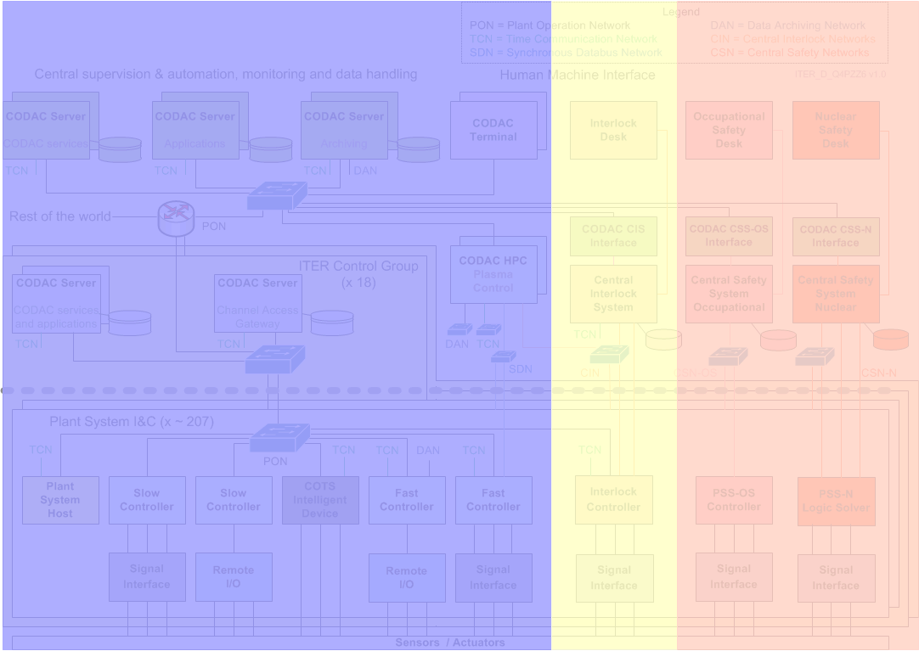
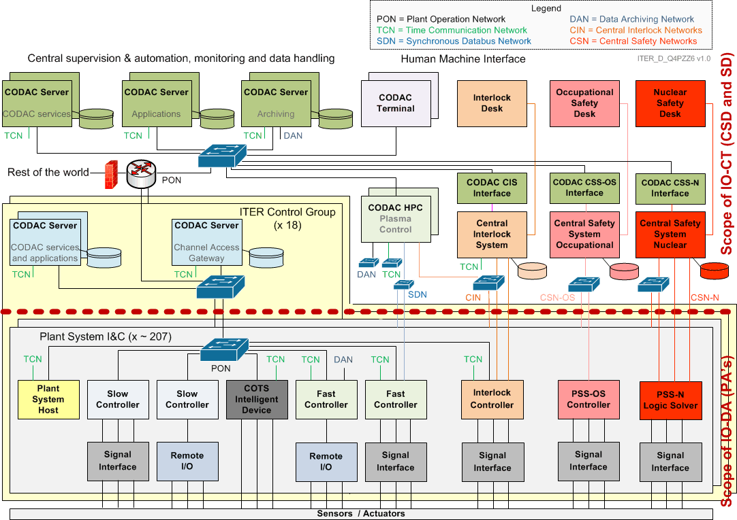
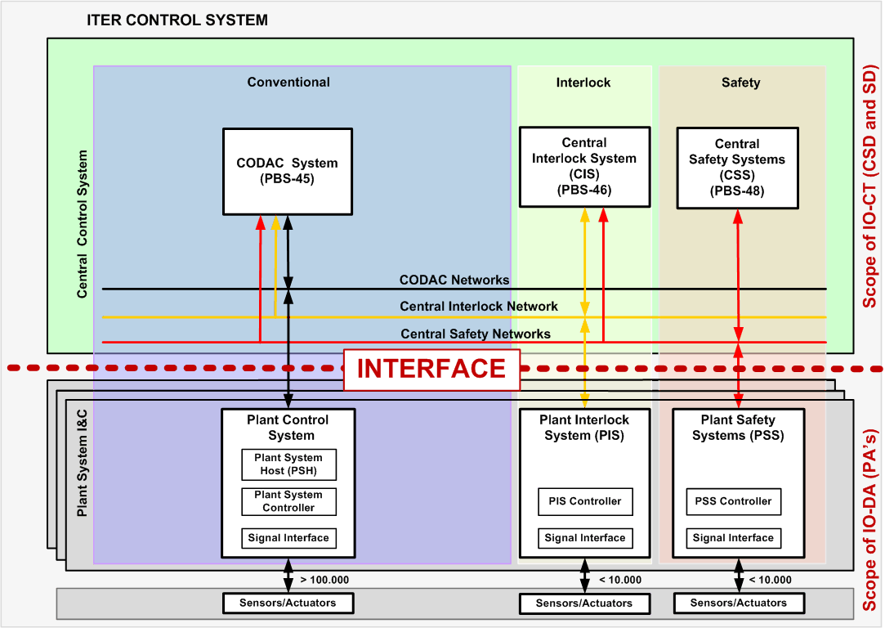
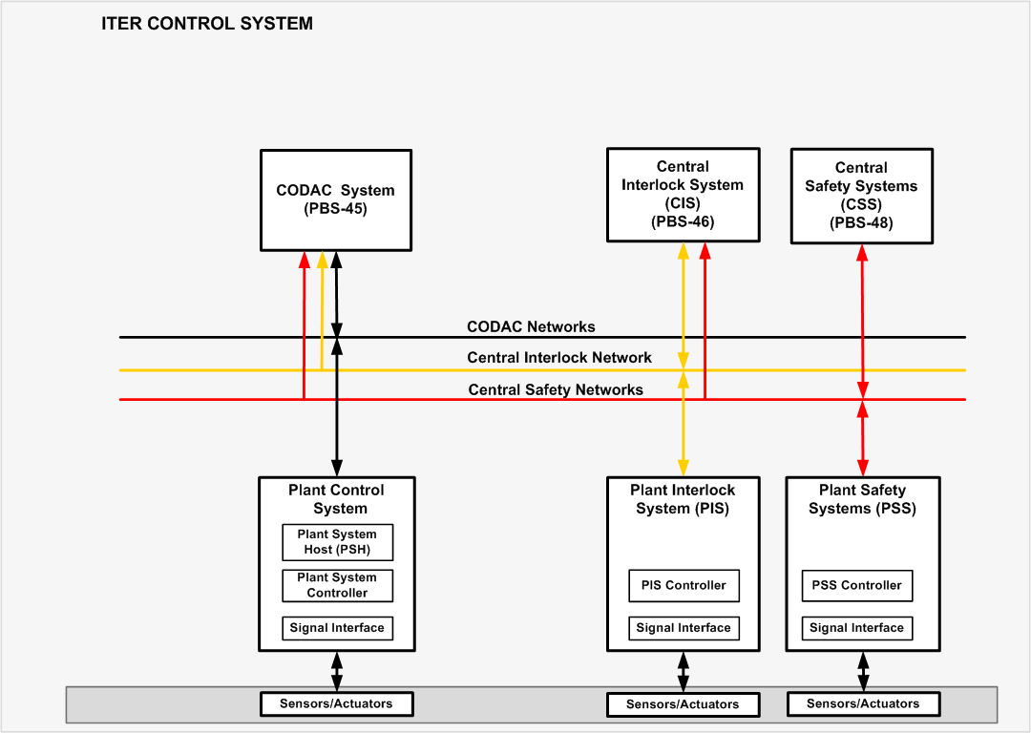
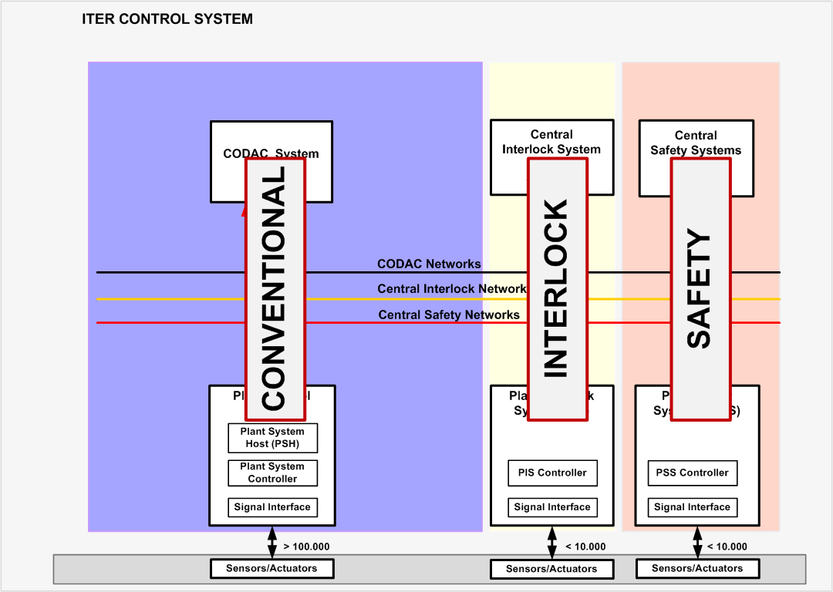
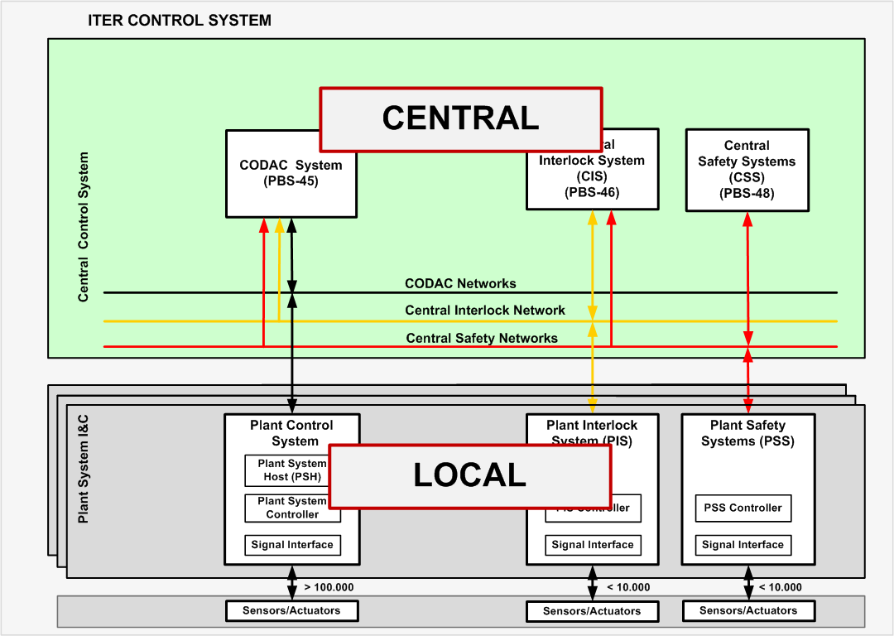
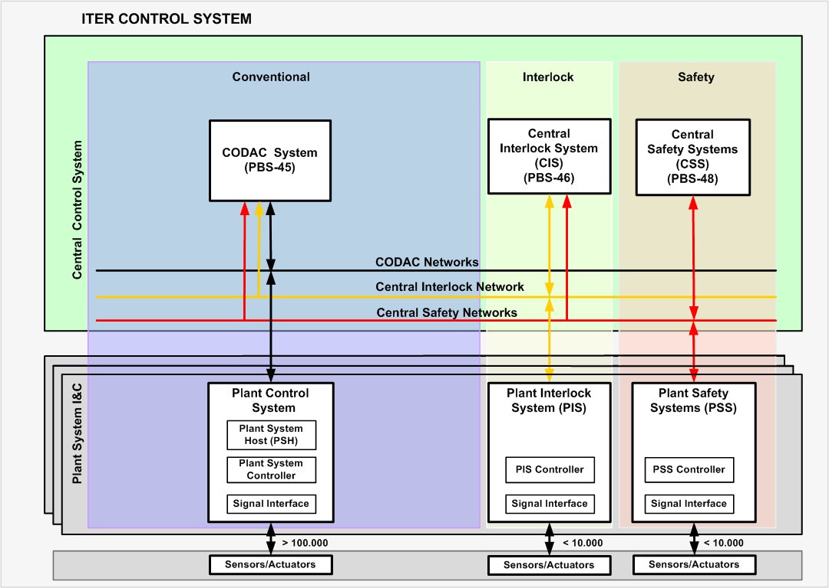
Scope and Architecture

Slide 4
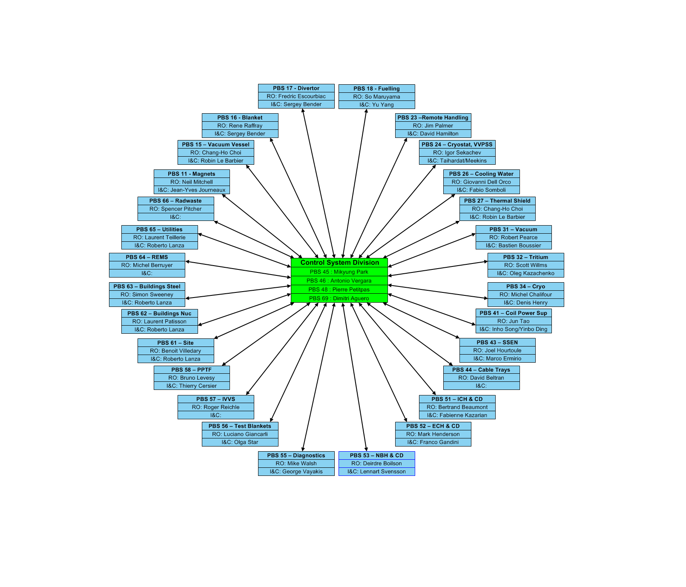
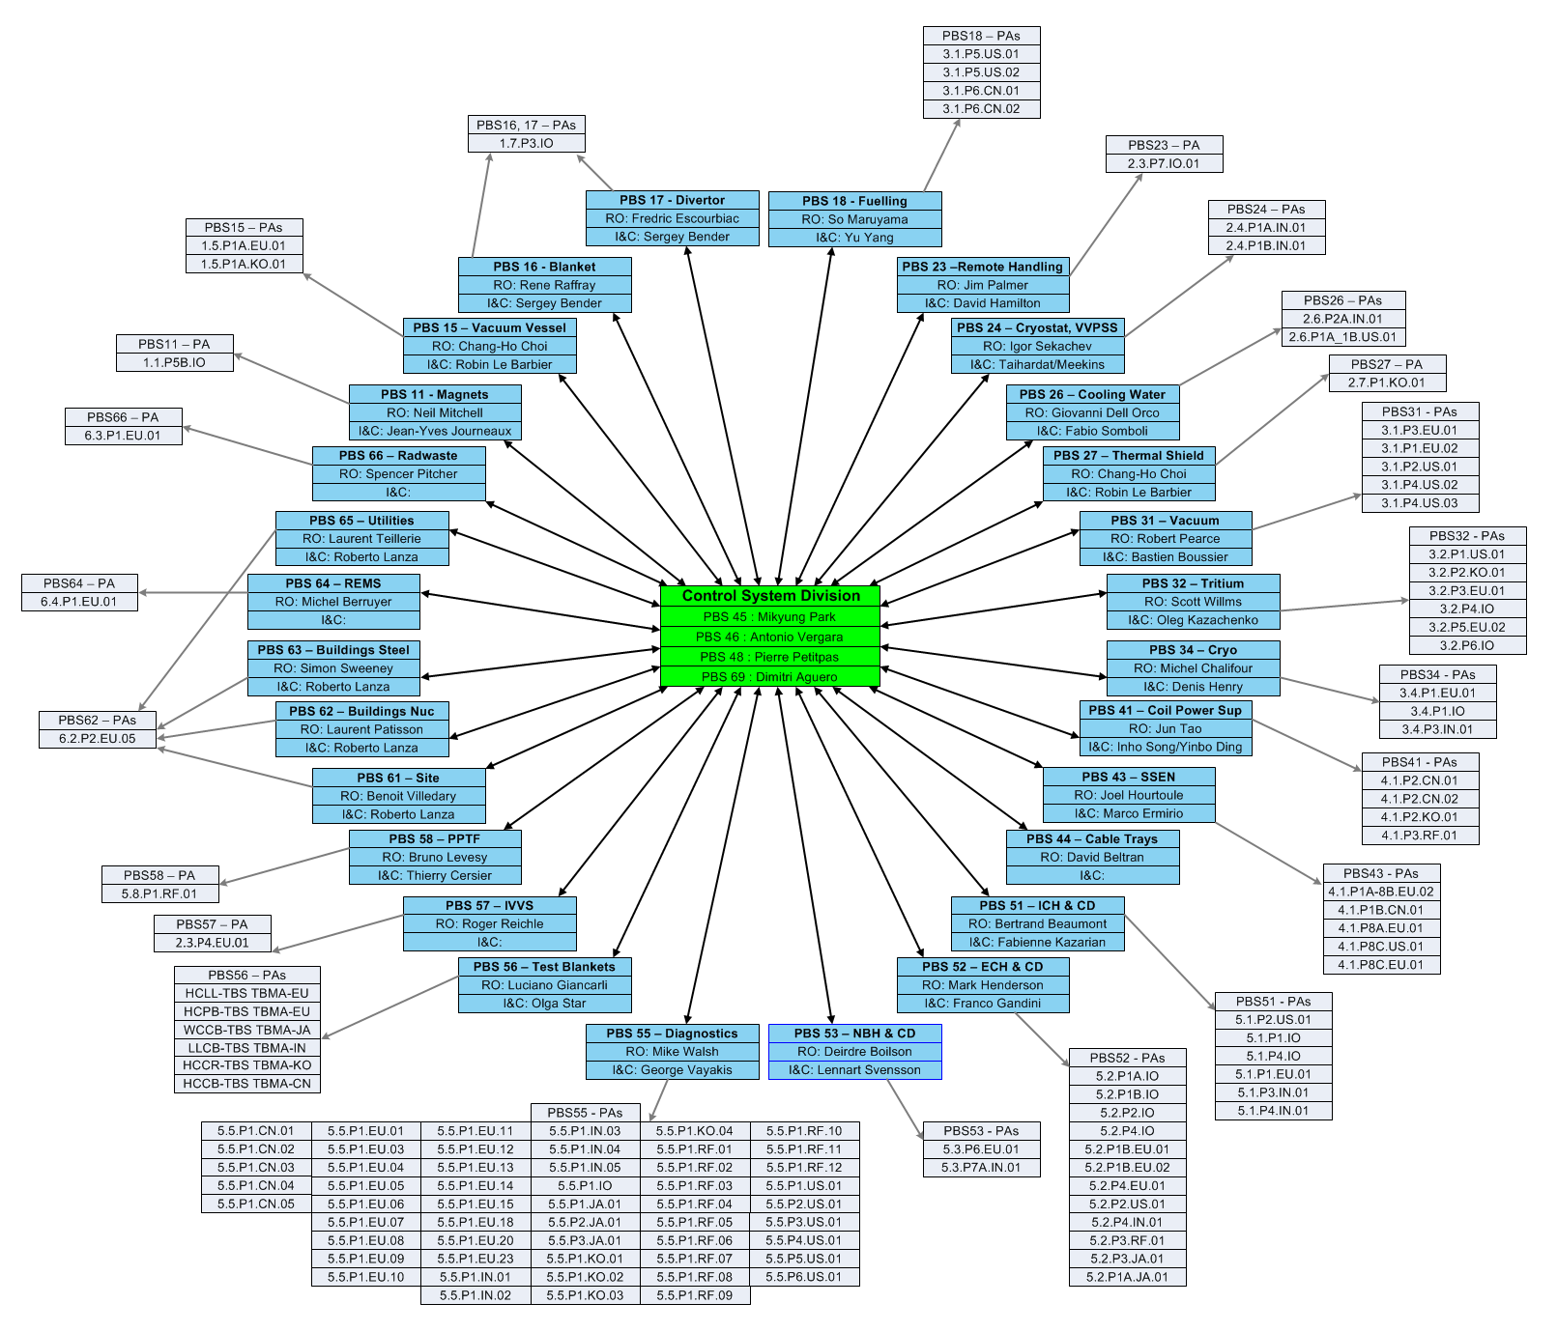
Interfaces
Interface and integrate 28 PBS I&C
supplied by 121 procurement arrangements

Slide 5
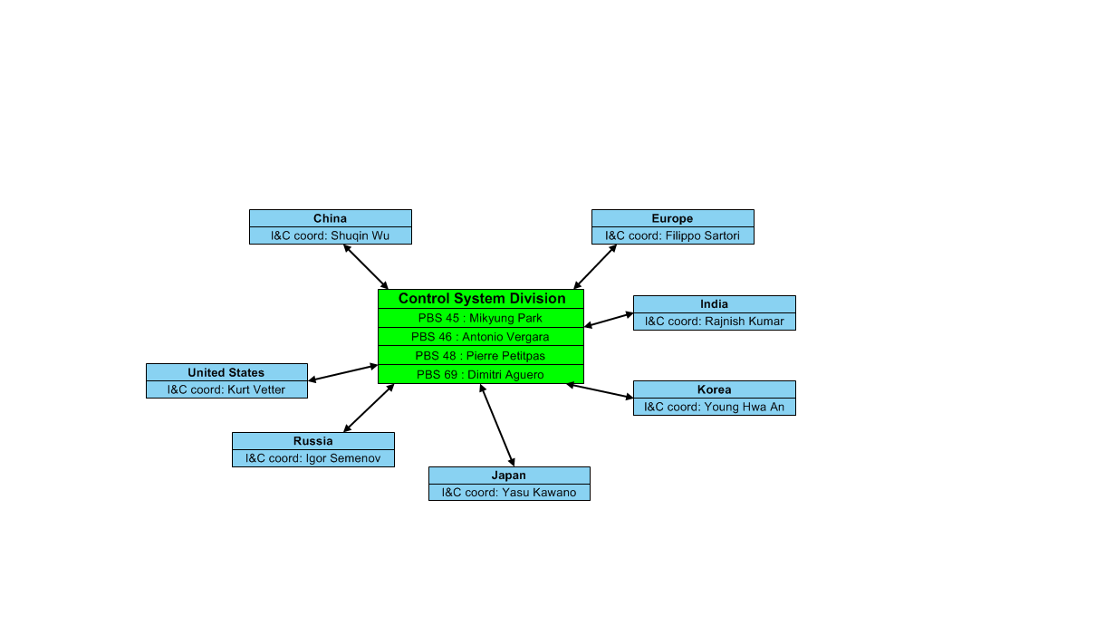
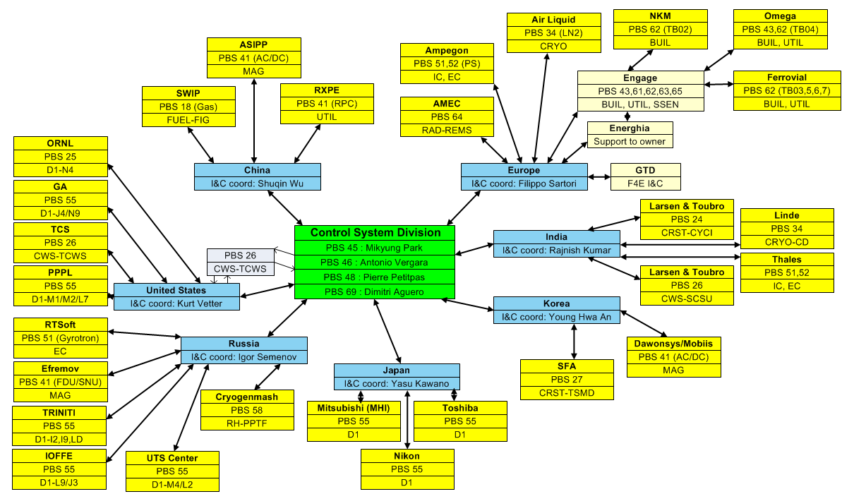
Interfaces
Interfaces to 7 DAs
and many suppliers (only subset shown)

Slide 6
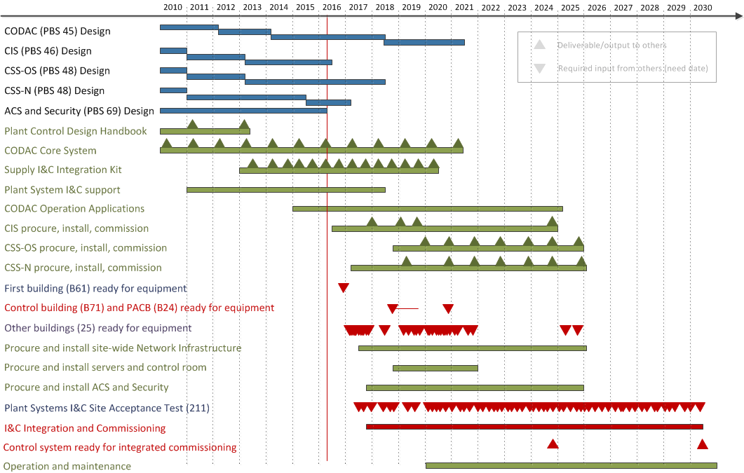
Overall Schedule

Slide 7
Overall Schedule
All central systems in final design phase. CODAC split in several sub FDR, the last related to plasma control.
No issues
Deliverables from central systems to plant systems to facilitate later integration
Deliverables from central systems to ITER facility
Network infrastructure, central systems and control rooms needs 28 buildings and service trenches
Control system needs to integrate 211 plant system I&C
Operation and maintenance of central systems starts 2020

Slide 8



CODAC Core System: Based on Open Source
OS: Red Hat Enterprise Linux (RHEL x86_64)
with MRG-R real-time extensions on fast controllers
  Infrastructure: EPICS, used in hundreds of projects world-wide: light sources, high energy physics, fusion (KSTAR, NSTX), telescopes
  CODAC services layer: Control System Studio used at many EPICS and other sites and including HMI, alarming, archiving etc.
  ITER specific software such as configuration (system description), state handling, drivers, networking, etc.
  → Talk by Denis Stepanov
  Fixed release cycle (minor release every year), extensive testing procedures

Slide 9
Current Activities
Division formed “Integration Team” to better support the upcoming integration phase
CODAC Core System release: 5.3 (2016B)
  RHEL 6.5
  EPICS Base 3.15.4
  EPICS V4 (evaluation)
New S7 communication driver
  → Talk by Jignesh Patel
EPICS Support for NI RIO (ASYN and NDS)
  → Talk by Mariano Ruiz (UPM)
New Support Framework Contracts (2016-2019)

Slide 10
What’s Next?
Develop and support of CODAC Core System
  switch from 6 month to yearly update cycle
  Migration to RHEL 7 in 2018
Focus on high level operation applications
Design real-time framework (fast control and diag)
Continue on Interlock and Safety
Start implementing network infrastructure
Engage with users (plant system I&C developers)
Prepare for upcoming FATs
Develop integration schedule and procedures

Slide 11
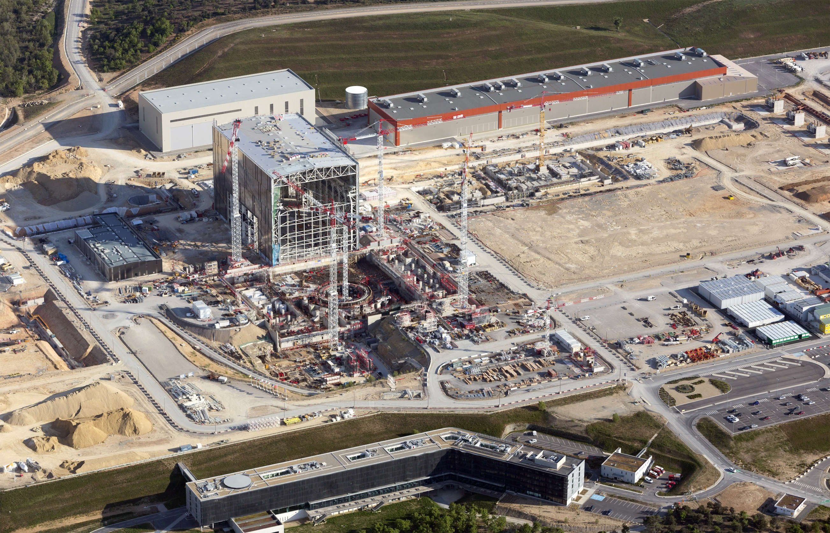
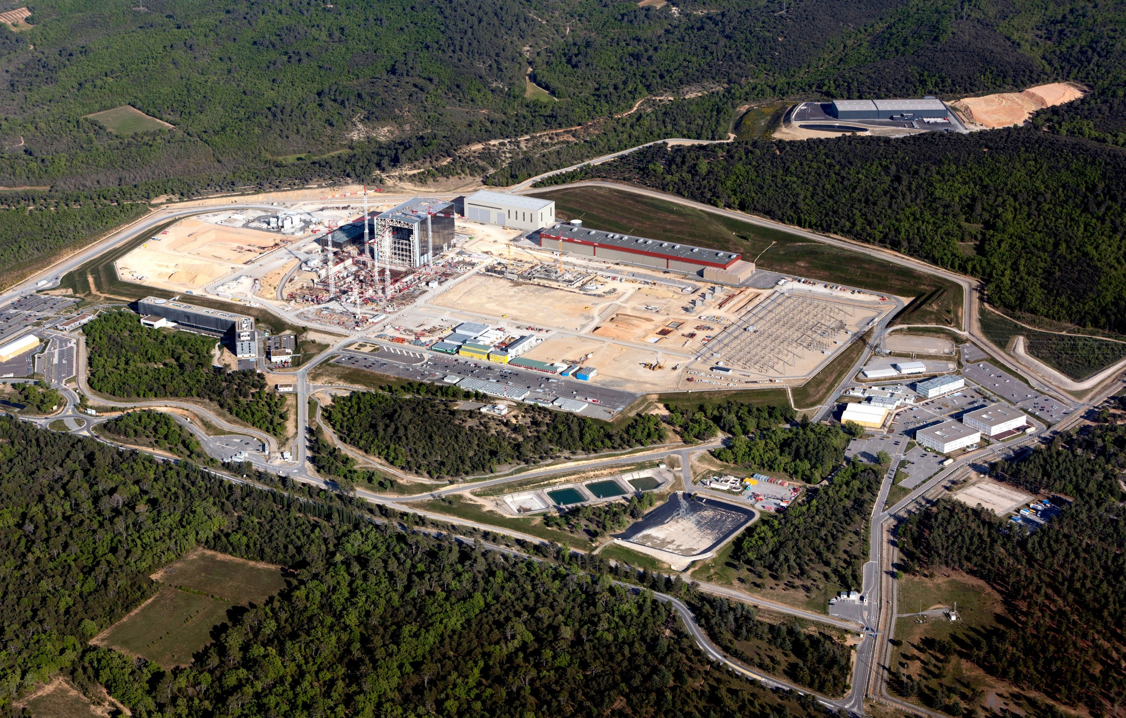
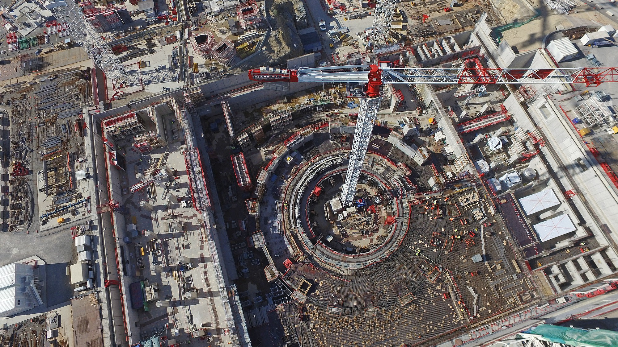
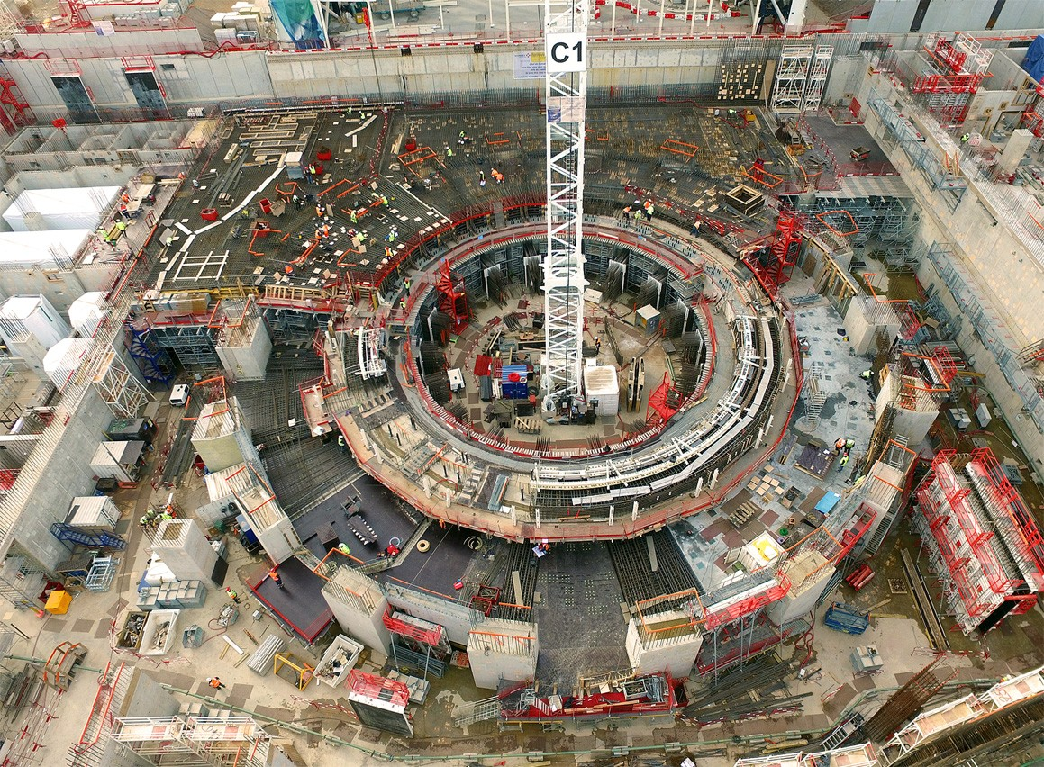
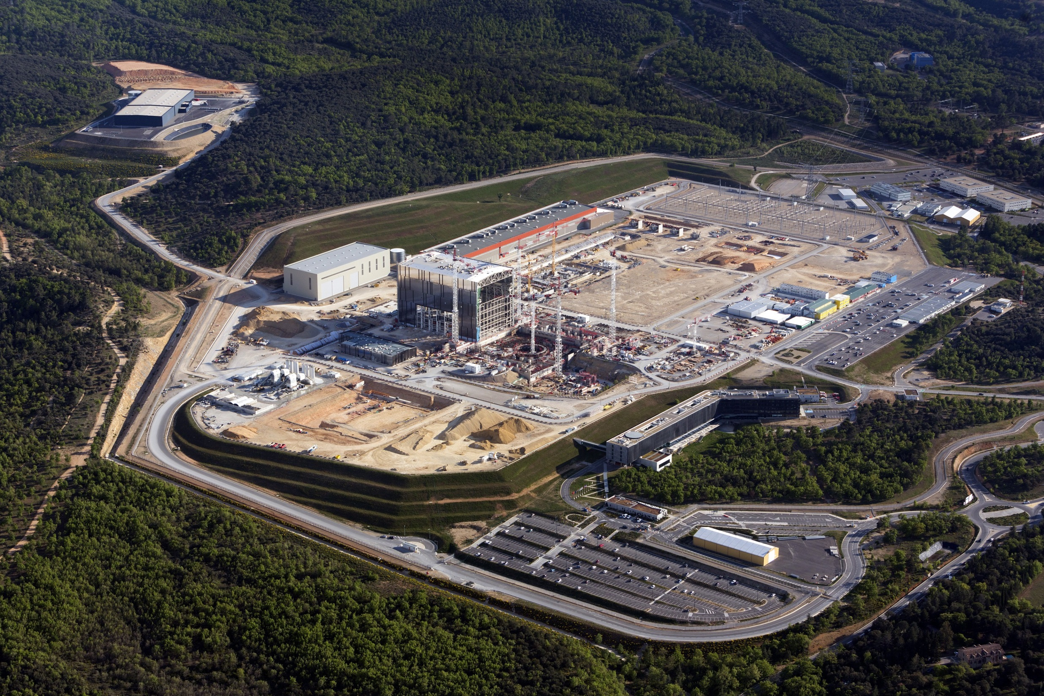
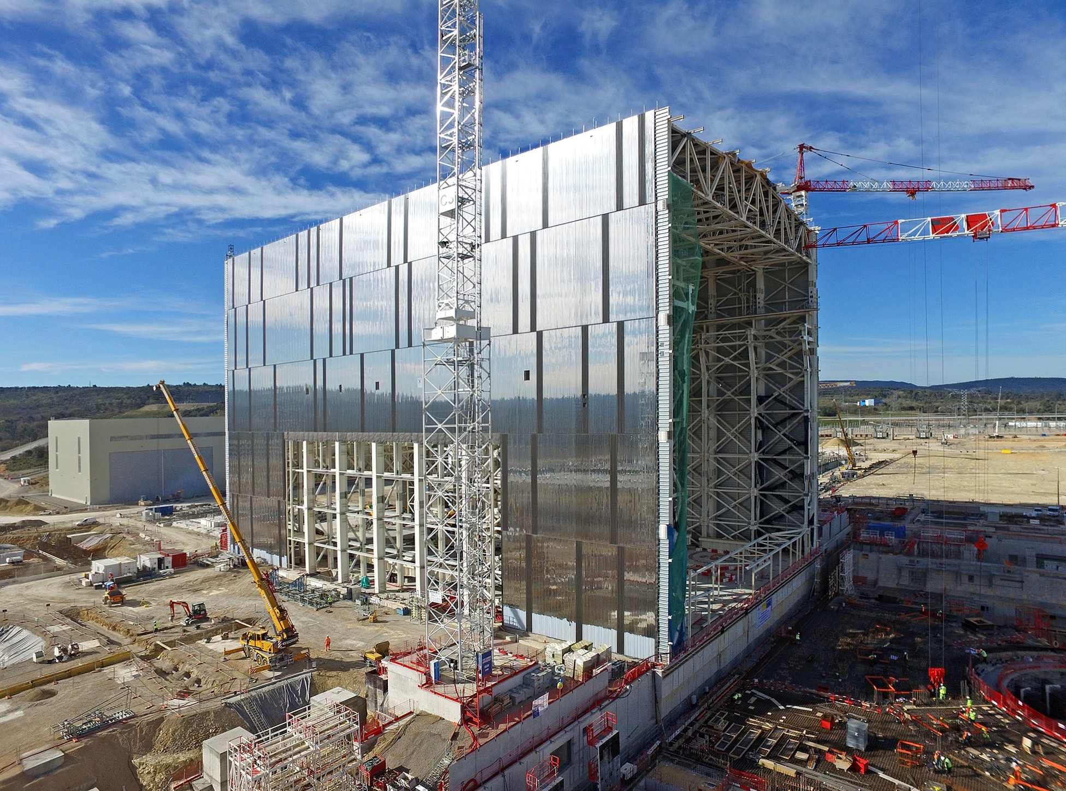
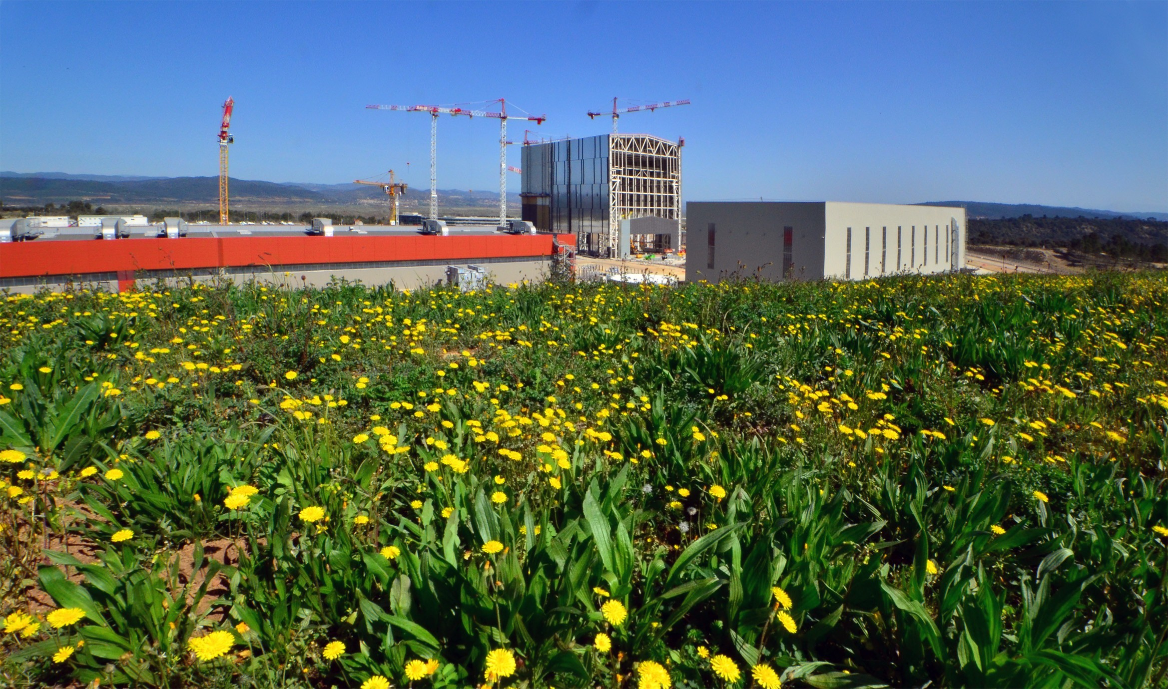
Thank you

