Slide 1
A WebSocket Microservice For EPICS
Matt Gibbs, SLAC National Accelerator Laboratory

Slide 2
Motivation
The web is a pretty enticing platform:
Nearly universal - works well on PCs, tablets, and phones.
Very large developer base
Real-time communication between the client and server is easy to do, and widely supported in browsers.
Graphics on the web is also quite strong - CSS, SVG, Canvas
There is a lot of potential here!

Slide 3
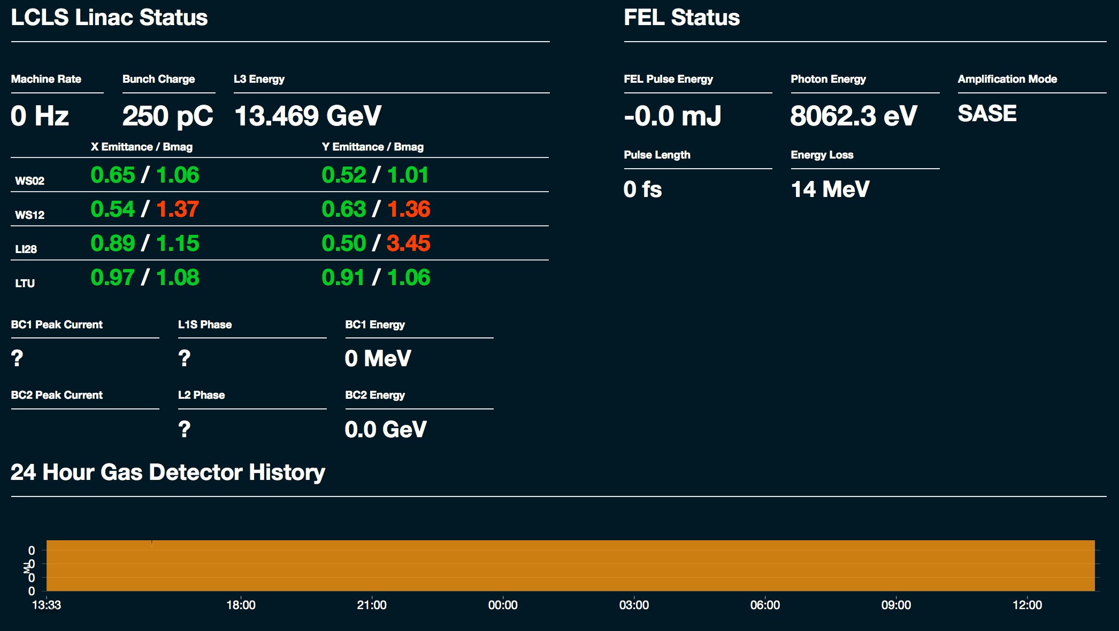
LCLS Status Display

Slide 4
pycaserver
pycaserver: monitor PVs via WebSockets
WebSockets let you establish a long-lived, two way, low overhead connection between a client and the server.
The client establishes a WebSocket connection to the server, then sends JSON messages to subscribe to PVs.
The server either establishes a new monitor on that PV, or re-uses a already monitor if one already exists.
Whenever the monitor’s callback fires, the server sends a JSON message with the new values to all subscribing clients.

Slide 5
Another Example: Web Striptool
Modified the Archive Appliance’s web viewer, turned it into a striptool

Slide 6
More about pycaserver
Written in Python, using the Bottle framework and a module called “gevent-websocket” to provide WebSockets support. PyEpics provides the interface to EPICS V3.
Pycaserver is really simple, less than 150 lines of code - three methods to handle WebSockets connections and messages, and four to handle Channel Access connections and callbacks.
Easy to modify and build a micro service for a custom purpose
https://bitbucket.org/noppo/gevent-websocket
http://bottlepy.org

Slide 7
EPICS V4 Support
Murali Shankar built a modified version to use as a web gateway for a EPICS V4 PV Access service
Uses the ‘pvaPy’ python module to make RPC calls
Implemented an HTTP API for SLAC’s V4 directory service, but would be easy to use for other services too.
@app.route('/eget/ds')
def eget():
'''
Get data from the ds and return as a JSON list
'''
print "Serving a DS request"
pvAccessRequestDef = dict([ (key, STRING) for key in request.query.keys() ])
pvAccessReq = PvObject({'query' : pvAccessRequestDef})
pvAccessReq.set({'query' : dict([ (key, request.query[key]) for key in request.query.keys() ])})
rpc = RpcClient('ds')
response = rpc.invoke(pvAccessReq)
return ujson.dumps(response.get()['value']['name'])

Slide 8
Archive Appliance Web Viewer
In the Archive Appliance Web Viewer, PVs are suggested via a web API call to our EPICS v4 directory service.

Slide 9
Experience
In use at SLAC for about a year
Used for a few different status displays
For our uses, it has been quite reliable
May start to see limitations of this approach if a service sees very large numbers of clients, or very large numbers of PV connections. (Typically, pycaserver less than 20 clients connected, and 100-200 PV connections)

Slide 10
Implementation
We run the server application on Gunicorn, a WSGI server for Python applications.
One Gunicorn instance per web service.
Gunicorn instances run behind an nginx reverse proxy server.

Slide 11
Conclusion
The web platform is powerful enough to build good interfaces.
Tools like Bottle and Gevent-Websockets make it easy to build web services to power these interfaces.
Easy to make EPICS V4 services available over HTTP
The code is on GitHub: https://github.com/slaclab/pycaserver

