Slide 1
PyQt Framework for EPICS GUI Applications
Matt Gibbs, SLAC

Slide 2
Outline
SLAC’s in-use tools for GUI applications
Introduction to Python Display Manager (PyDM)
Goals
Building a display
Writing an application
Architecture

Slide 3
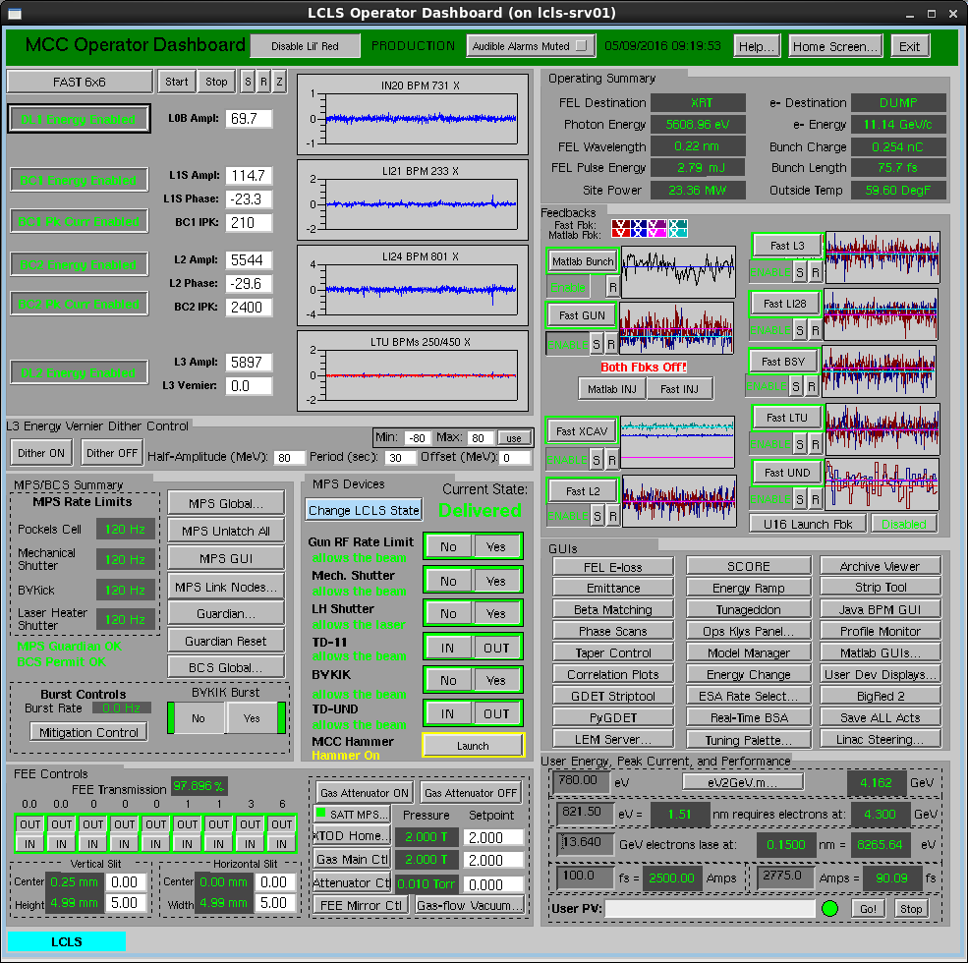
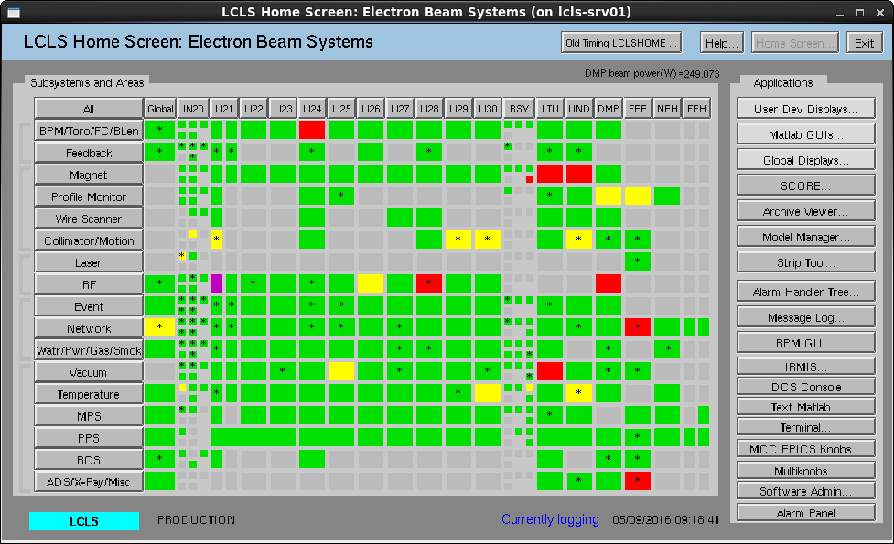
EDM at SLAC
We currently use EDM for most of the displays at SLAC
Making a display is drag-and-drop easy, non-developers can make new displays
Great performance, even with dozens of windows open, or hundreds of widgets updating at 30 Hz
5500 EDM files in production for LCLS

Slide 4
EDM Drawbacks
EDM is starting to show its age
Managing lots of windows is challenging
Crummy image widgets
Not very easy to add new widgets
Ugly font rendering
Very poor support for resizing a window
Font sizes aren’t adjustable
Relatively limited in what you can build with EDM - displays don’t have much internal state
No support for EPICS v4 in the future
…

Slide 5
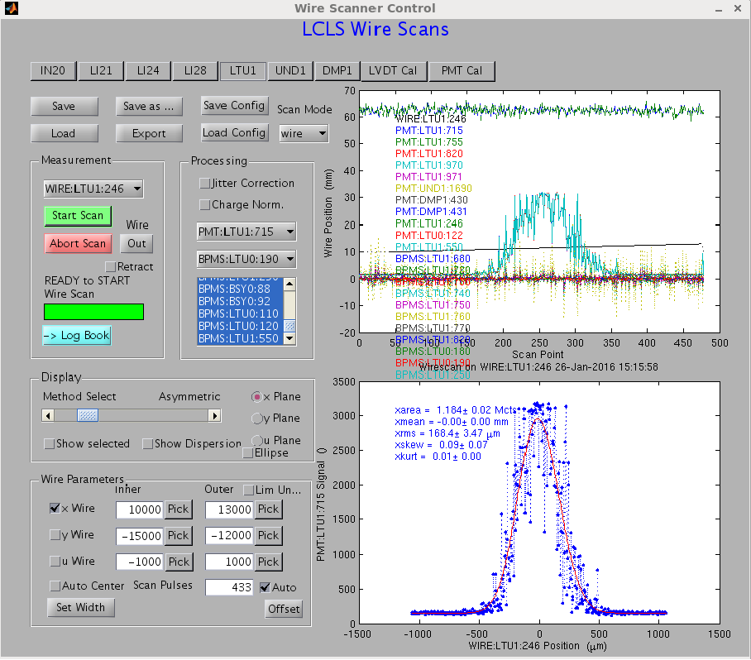
High Level Apps at SLAC
We use a huge number of high level apps, too - I counted about 100 LCLS high level apps.
Most of these are MATLAB or Python GUI applications written by operators or physicists, not full-time software developers.
Usually they are for a single task - scanning the phase of an RF station, measuring beam emittance, etc.

Slide 6
Drawbacks of Existing HLA Tools
MATLAB isn’t a great environment for GUI applications
Long start-up times for applications
Limited widget set
Ugly GUIs
Clunky GUI API
Python and PyQt
Better, but…
Always writing boilerplate code to do common things like updating a widget whenever a PV updates
App developers frequently end up re-inventing common widgets

Slide 7
Python Display Manager (PyDM)
Goal: Make a single framework that can be used to build simple, EDM-style screens, as well as more complicated high level applications.
Drag and drop UI creation
EPICS-aware widgets
Optional application logic in Python
Utilize existing modules to handle most of the graphics work, like plotting, and displaying images.

Slide 8
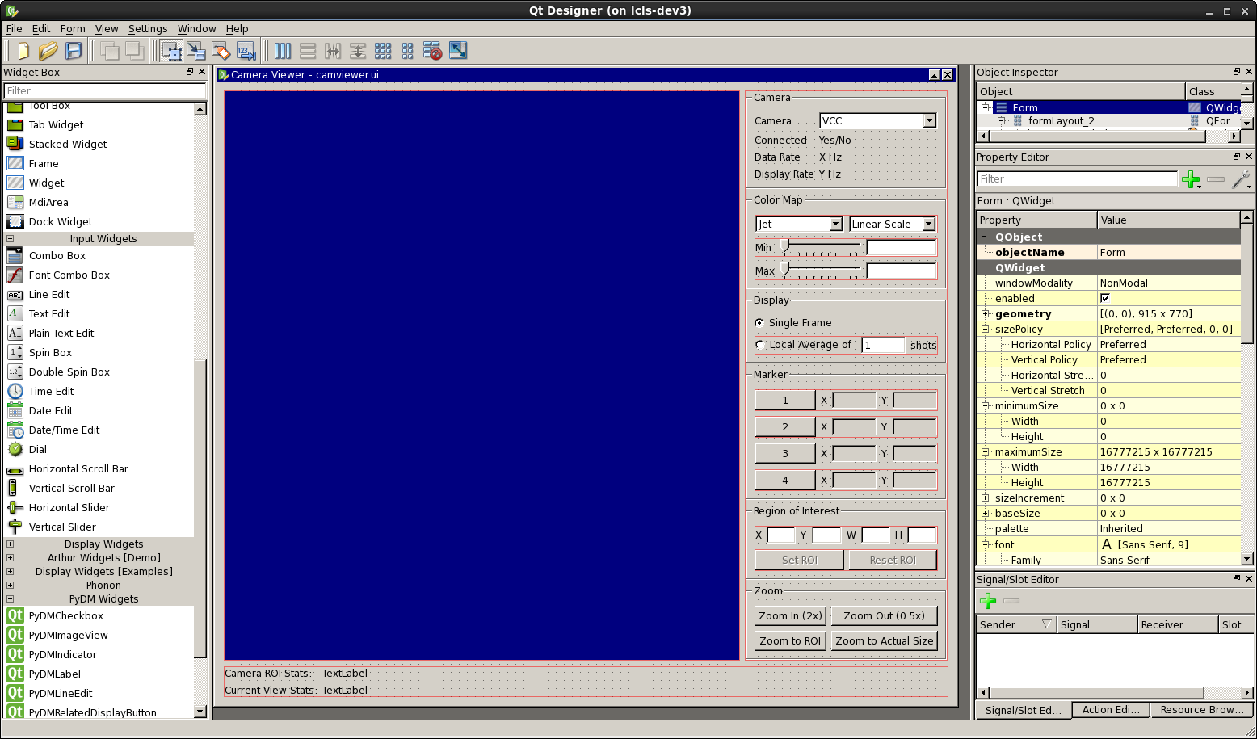
Building a User Interface
You can use Qt Designer to build an interface, or make it in code
Widgets have a “channel” property where you can specify a PV name to connect to
If you want to make an EDM-style panel, this is all you have to do - no need to write code

Slide 9
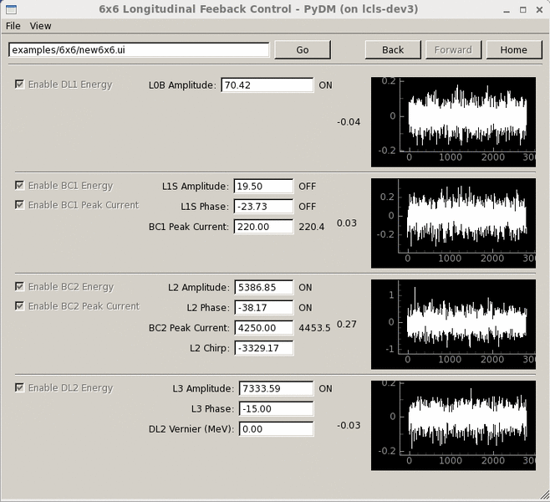
Example Display - LCLS Energy Feedback Control

Slide 10
Writing an Application
A ‘Display’ Python class is provided, you can subclass this to build a display with custom application logic. Display handles a lot of the PyQt boilerplate.
Displays can establish connections to PVs through the display manager, just like widgets.
You can either populate a Display’s UI via a Qt Designer .ui file, or with code.
Displays inherit from QWidget. You can do pretty much anything Qt will let you do.

Slide 11
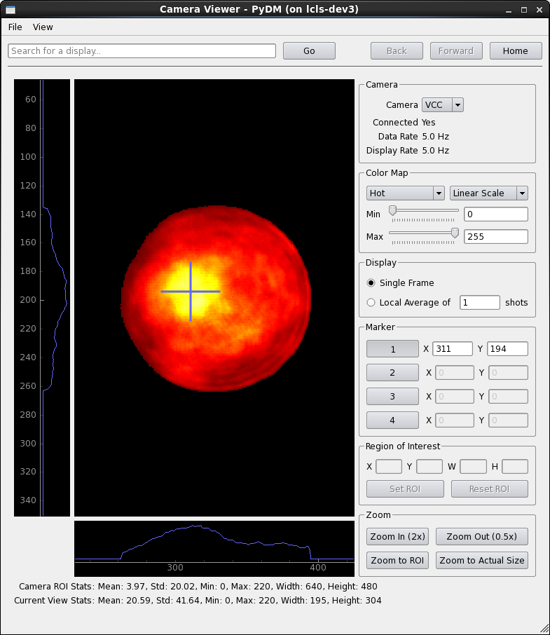
Example Application - Camera Viewer

Slide 12
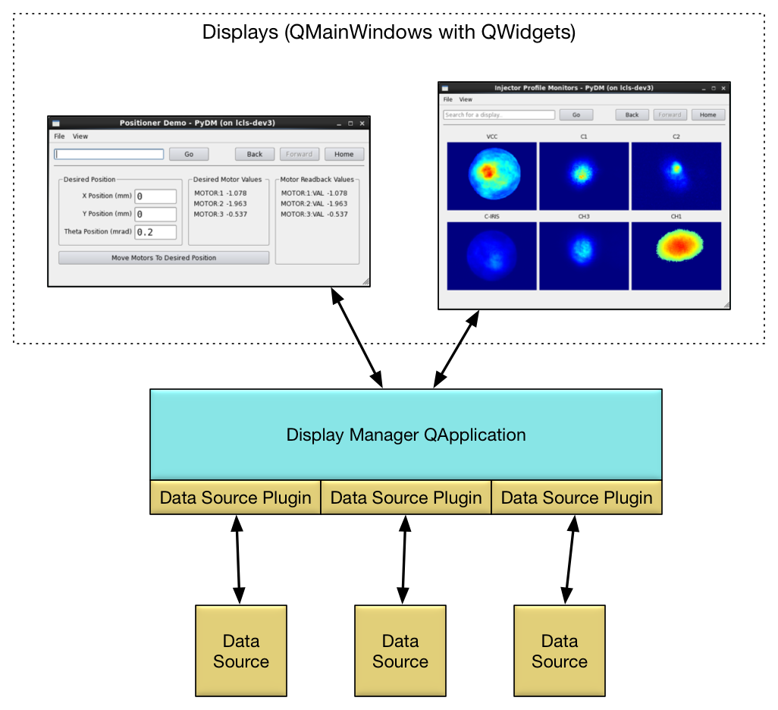
Architecture

Slide 13
Data Source Plugins
We want to support more than just Channel Access
You can write data source plugins to handle other sources of data.
Plugins implement a common interface to handle connections and send and receive signals to read/write data.
The ‘channel’ property on widgets specify a URI-like string.
ca://BPMS:LI24:801:X
archiver://MC00:ASTS:OUTSIDET?from=2012-09-27T08:00:00.000Z&to=2012-09-28T08:00:00.000Z
The display manager reads the url scheme (<scheme>://) and forwards the connection to the appropriate plugin.

Slide 14
Data Source Plugins, Continued
Channel Access Plugin
Currently uses PyEPICS
Needs to scale up to very heavy loads - some EDM screens, like our orbit display, use hundreds of BPM PVs updating at 30 Hz
PV Access Plugin is planned
Proposed URI syntax:
pva://pvname
pva://structurepv#field1&field2
pva://servicename?arg1=val1&arg2=val2#field

Slide 15
Display Manager Features
The display manager always displays a navigation bar at the top of each display.
Web-browser-like controls to move forward and back, or jump directly to a particular display by searching.
Related display buttons and the navigation bar support shift-click to open a display in a new window rather than using the existing window, like links in browsers.
Font size adjustable via Ctrl+ and Ctrl-

Slide 16
Future Work
Still early in development
Only a few of the most useful widgets have been implemented
Alarms are very rudimentary
Performance seems good so far, but we really haven’t attempted to push the limits with hundreds of PV connections or widgets.
Performance is an area where EDM really excels, our goal is to at least get close.

Slide 17
Source Code
Everything is available on GitHub: https://github.com/slaclab/pydm
Thanks!
mgibbs@slac.stanford.edu

