Slide 1

Advancements and Deployments of EPICS Version 4
Greg White, SLAC
for EPICS Version 4 working group
Presentation at EPICS 2016, Lund, Sweden
25-May 2016
Notes:
In this talk I will attempt to answer the two questions, “what facilities are in EPICS Version 4, and how are those facilities being used today by users?”
[TODO: Replace logo with one with no shadow]

Slide 2
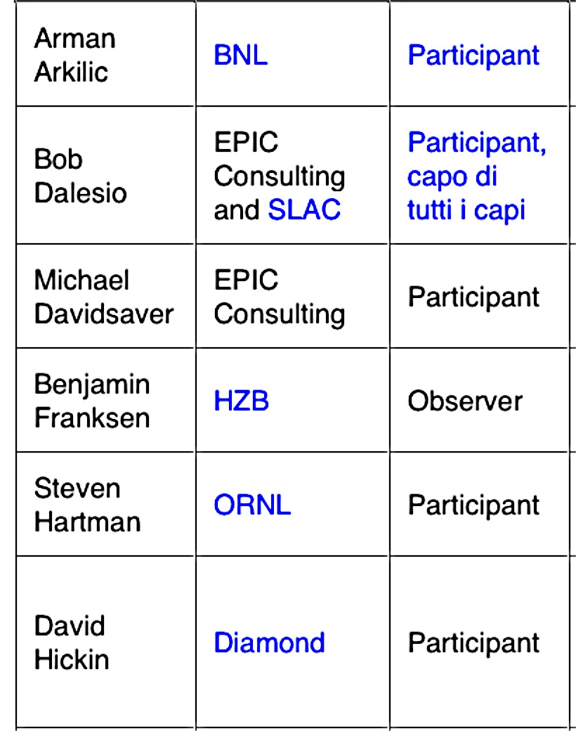
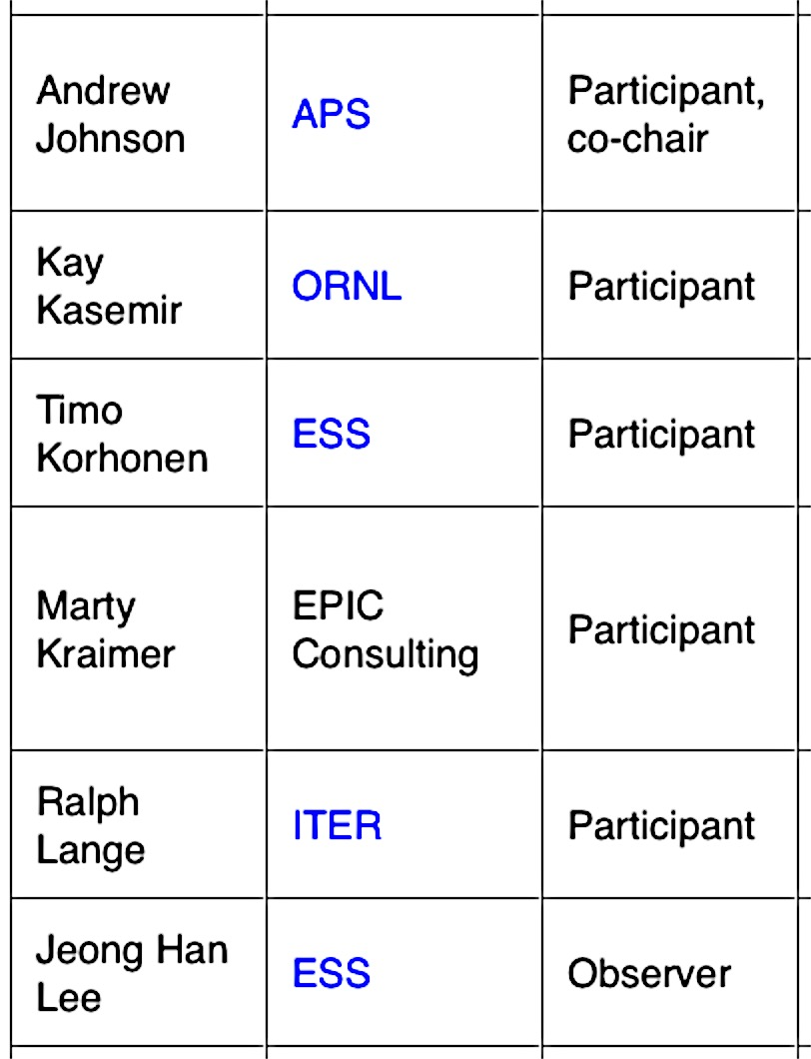
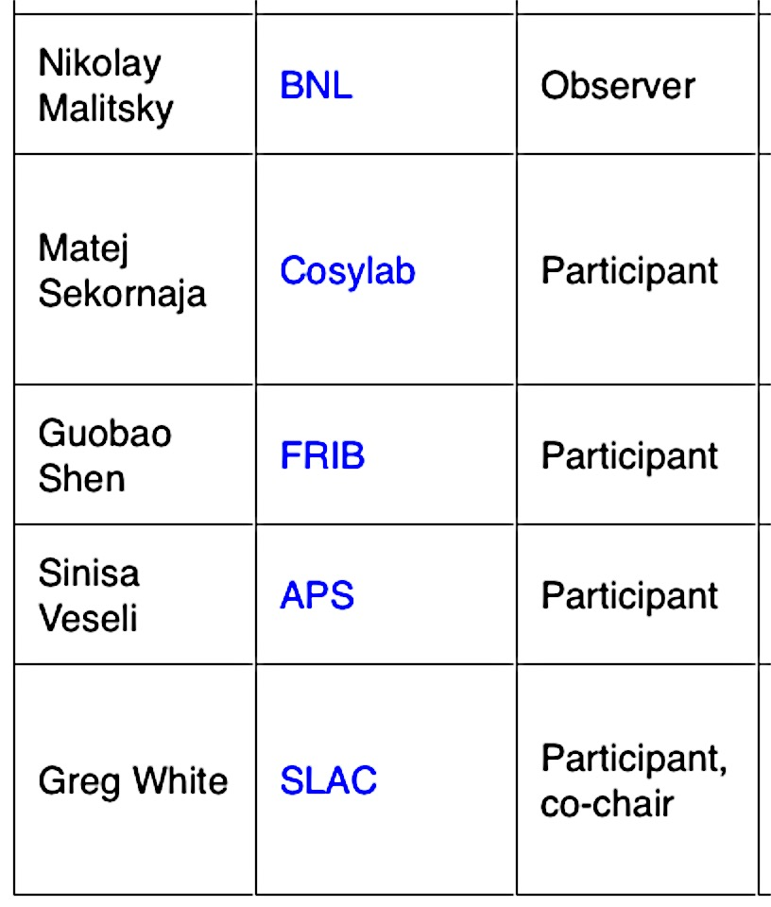
EPICS Version 4 Working Group
Introduction
GitHub (source code management) https://github.com/epics-base/
Sourceforge (documentation, admin, downloads) http://epics-pvdata.sourceforge.net
Notes:
The work presented is the collaborative effort of a number of people.

Slide 3
Talk Outline
Version 4 Additions to EPICS
Deployments
Developments underway
User Feedback & Recent Work

Slide 4
Talk Outline
Version 4 Additions to EPICS
Deployments
Developments underway
User Feedback & Recent Work

Slide 5
EPICS Version 4 in a Nutshell
Version 4 Additions to EPICS
New Protocol, “pvAccess”
Structured data
Introspection interface, “pvData”
Dynamic typing
Streaming
Standard Scientific Types
RPC and put/get
New smart database
Codec based transport
All APIs in C++ and Java
Python and Matlab
High Performance
High Reliability
$ eget -s XCOR:LI24:900:TWISS
non-normative type
structure
double energy 5.00512
double psix 37.7625
double alphax 13.6562
double betax -2.78671
double etax -0.00698294
double etaxp 0.00107115
double psiy 31.9488
double alphay 116.762
double betay 5.2592
double etay 0
double etayp 0
Figure: Example EPICS v4 pvAccess method “eget”,
getting PV whose value is a structure giving the
Courant-Snyder parameters at a corrector magnet.
This example is from the LCLS control system at SLAC.

Slide 6
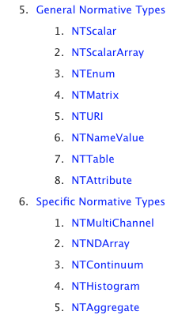
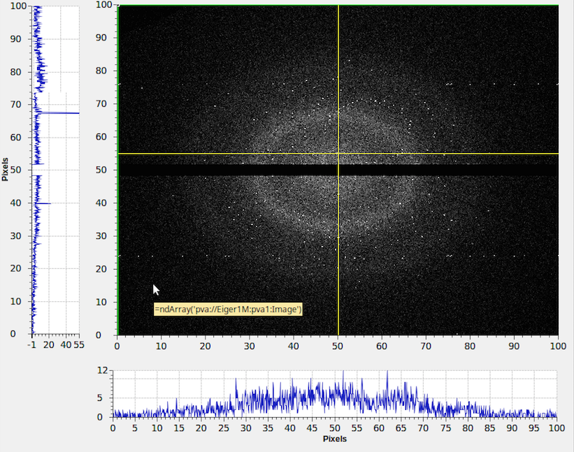
The EPICS V4 “Normative Types”
Version 4 Additions to EPICS
The Normative Types Spec defines a standard for commonly used data types,
http://epics-pvdata.sourceforge.net/alpha/normativeTypes/normativeTypes.html
$ eget -s XCOR:LI24:900:RMAT
0.0727485 0.0289316 0 0 0.0652488 0.00125391
0.0578214 0.0391775 0 0 -0.027185 -0.000192344
0 0 0.00943029 1.14291 0 0
0 0 -0.0013367 -0.0348832 0 0
-0.000370971 -0.000283933 0 0 -0.0182387 -0.000198345
0.10031 0.018722 0 0 -10.5721 -0.179568
$ eget pva://mccas0.slac.stanford.edu:39633/QUAD:LTU1:880:RMAT?type=design
$ eget -s LCLS:ELEMENTS
ELEMENT ELEMENT_TYPE EPICS_DEVICE_NAME S_DISPLAY OBSTRUCTION
CATHODE MAD CATH:IN20:111 2014.7 N
SOL1BK MAD SOLN:IN20:111 2014.7 N
CQ01 MAD QUAD:IN20:121 2014.9 N
SOL1 MAD SOLN:IN20:121 2014.9 N
XC00 MAD XCOR:IN20:121 2014.9 N
…
Figure: An extract of the Table of
Contents of the Normative Types
Specification document, together
with examples of 4 selected types
Notes:
The Normative Types Spec [1] defines a standard for data types commonly used in controls and
science. So servers know what to package and generic clients know how to interpret and display.
This slide shows an extract from the Table of Contents of the Normative Types specification (on the left), and on the right some examples from LCLS of the types in use. The top one is the response matrix of a given horizontal corrector.
Note the URI. In epics v4, the command line tools can take a URI, including arguments in the case of RPC PVs.
A very well used Normative Type is NTNDArray, which Diamond pioneered and BNL and SNS have used to great effect for experimental beamline detector data acquisition and fanout. Let’s hae a look at it in more detail

Slide 7
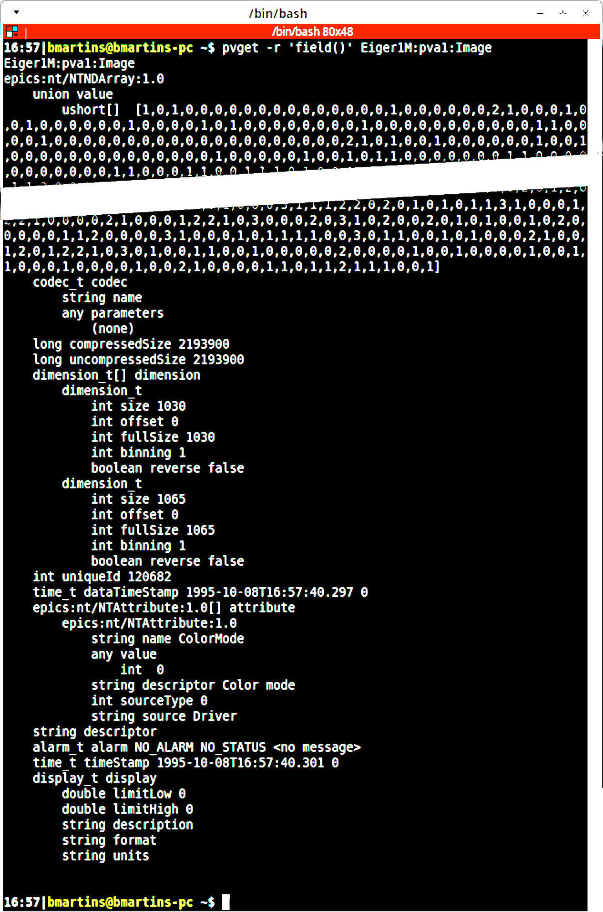
What does an EPICS V4 PV for structured data look like?
Version 4 Additions to EPICS
The pvAccess PV name
EPICS V4 data type identifier “NTNDArray”
A lot of data snipped
The image raw data
The image meta data; giving how to
interpret the data in the value field,
and other information.
Figure: A screenshot of the output of
the EPICS V4 “pvget” command,
showing data of a PV which encapsulates
all the data of an areaDetector NDArray in
in Normative Type NTNDArray. Example from B. Martin’s AD work at BNL.
Notes:
Let’s take the opportunity of describing NSLS-II use of V4 for beamline experiment data distribution, to show what a V4 “structured pv” actually looks like in the wild.
The example is real data from an Eiger detector.
It shows a single PV, “Eiger1M:pva1:Image”, which is of EPICS V4 Normative Type “NTNDArray.”
An EPICS V4 NTNDArray is designed to encapsulate the data of the areaDetector type NDArray.
Note the type-id at the top. That indicates to clients what structure to expect in what follows, and is a clue to clients about how to display. C.f. the following slide of CS-Studio showing this PV.
The pvget option –r ‘field()’ means “show me all the fields” not just the (default) value field.

Slide 8
EPICS Version 3 basic block diagram
Version 4 Additions to EPICS
EPICS in the nominal usage: An EPICS client communicates over Channel Access (CA) protocol to an Input/Output Controller (IOC) Channel Access server (module rSrv in an IOC)
Channel Access Client
Channel Access (CA) protocol
Input / Output Controller (IOC)
CA Server (rSrv)
IOC database
Device I/O
Notes:
Let’s turn briefly to look at the most basic architectures of EPICS V4, before we look at examples of their use.
In the first case, just to situate ourselves – and show how basic we’re talking here – this is the basic architecture of “EPICS Version 3.”

Slide 9
EPICS Version 4 is an extension of V3
Version 4 Additions to EPICS
V4 IOC == V3 IOC + pvAccess Server
Channel Access Client
pvAccess Client
CA
pvAccess
Use Case: Network efficient acquisition
of archived meta data
Presently, only 1 PV per pvAccess channel.
But plan is to get/monitor a group of PVs
through one pvAccess channel.
IOC
rSrv
pvaSrv
IOC database
Device I/O
Notes:
The simplest thing you can do with EPICS V4 – add the pvAccess server to an IOC.
So the first thing we see is that in EPICS V4, at core, the IOC remains the same. An EPICS Version 4 IOC is just an EPICS Version 3 IOC with a pvAccess Server added.
To be honest, there is not much advantage in using just this configuration for EPICS installations which are already heavily invested in EPICS Channel Access, since all your existing clients will be using Channel Access. For such places, the advantages of EPICS V4 will stem more from the basic architectures in the following 2 or 3 slides, and for new work.
But for new institutions, just now building your EPICS installation, you may consider this architecture.
ESS for instance, is going to be all pvAccess.
[ADD: pvaSrv example]

Slide 10
EPICS Version 4 includes CA
Version 4 Additions to EPICS
The pvAccess API includes Channel Access support, so one client lib does both
Channel Access Client
pvAccess Client
CA
pvAccess
CA
IOC
rSrv
pvaSrv
IOC database
Device I/O
Notes:
Just to add, the client side library of EPICS V4 includes support for Channel Access.
In fact, more generally, the pvAccess API includes a plugable architecture for “channel providers”, of which the pvAccess protocol and the Channel Access protocol are two.
[ADD example of getting CA data with pvAccess API – pvget –p ca]

Slide 11
EPICS Version 4 new database
Version 4 Additions to EPICS
A new smart database, “pvDatabase” can be used for data assembly and processing
Channel Access Client
pvAccess Client
CA
pvAccess
CA
Examples; the SNS and NSLS-II beamline
experiment high performance data acquisition and processing (later in talk)
IOC
rSrv
pvaSrv
pvDatabase
IOC database
Device I/O
Device drivers etc stay
only under IOC database
Notes:
Now things get interesting for new kinds of work made easier by EPICS Version 4.
V4 adds a new kind of front end processing database, the “pvDatabase”.
The device I/O, particularly the device driver layer, remains under the IOC Database.
This slide illustrates the architecture in which a pvDatabase is used inside an IOC. But a pvDatabase can be used standalone, at the host level of an EPICS version 4 controls network. At that level it might be used to aggretage data from a number of Channel Access PVs in subordinate IOCs, like to gather data from a number of beam diagnostics and deliver it all as one package.

Slide 12
EPICS Version 4 middleware support
Version 4 Additions to EPICS
RPC and Service Oriented Architecture (SOA)
Channel Access Client
pvAccess Client
CA
pvAccess
CA
Examples; the SLAC/ESS model and infrastructure system; BNL/FRIB configurations; and NSLS-II experiment data support (later in talk)
pvAccess Server
BYO back-end
datasource
IOC
rSrv
pvaSrv
pvDatabase
IOC database
Device I/O
Notes:
The last major architecture addition offered by EPICS Version 4, is to add the basis of service oriented architecture. The getRPC method of pvAccess allows a client to send arguments along with the PV. The arguments are then used for synchronous processing, and the results then returned.
Indeed, the same PV can be used both the monitor setup and in the RPC setup, allowing for one logical quantity to be acquired from either context – the result of a monitor of some system, or the result of a specific computation based on arguments. For instance, in an accelerator model, the PV for the beta function of a beampath may be continuously computed according to defaults – such as the default timing configuration, or it may be required to be computed from a specific timing configuration. The default case can be monitored, but the special case can be requested by RPC.
RPC is also very useful for connecting PVs to backend databases like MongoDB, mySql, Oracle etc. This is used at SLAC, ESS and NSLS-II.

Slide 13
Talk Outline
Version 4 Additions to EPICS
Deployments
Developments underway
User Feedback & Recent Work

Slide 14

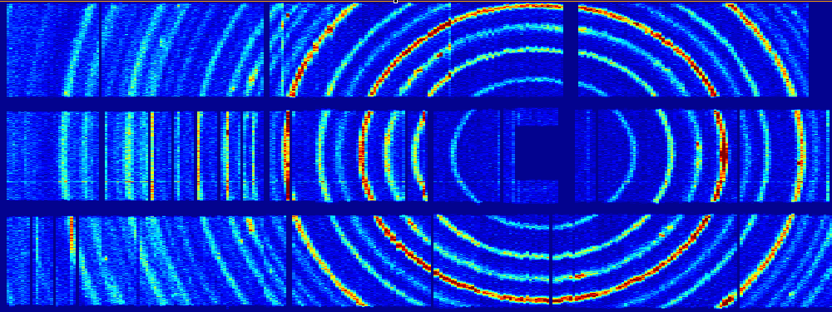
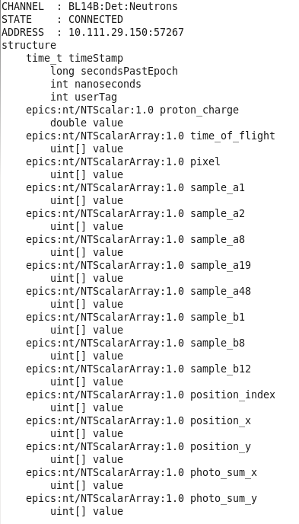
SNS uses EPICS V4 for high throughput event readout, of structured PV data.
ORNL SNS Deployment: Neutron event data aggregation and transport
Neutron Detector
CS-Studio
pvAccess streams event data at
80 Mbytes / sec
SNS SEQUOIA detector ray consisting of >800 ³He tubes covering a solid angle of 0.8 steradian
Diffraction rings of a powder sample at SEQUOIA, histogram generated by ADnED and displayed in CS-Studio
nED
ADnED
pvAccess Server
CA Server
pvDatabase
areaDetector data processing
Classic EPICS IOC
pvAccess Client
nED provides the driver interface to the detector electronics and streams experiment data using pvAccess
The V4 data structure includes an array of pixels and a corresponding array of times of flight for each recorded neutron event. Additional fields record accelerator pulse information and detector diagnostic information
ADnED, a pvAccess client, generates online histograms and counting statistics from the nED data stream and serves them using the CA protocol to clients including CS-Studio
Kay Kasemir, Steven Hartman, ORNL
Notes:
EPICS V4 is used at SNS in data acquisition and processing of Neutron scattering experiments.
80 Mbytes/s
The PV values are not single value, they’re complex, involving the event data itself, plus metadata such as time-of-flight, pulse information. Exactly as is pertinent to LCLS-II beamline experiments.
Neutron scattering can be used to help in the understanding of the structure and properties of materials; it is a technique complementary to x-ray scattering. Neutrons, with a neutral charge, are highly penetrating and are an effective probe for locating light atoms such as hydrogen.
nED provides the interface to the detector
nED streams experiment data using the V4 network protocol, pvAccess
ADnED, built on EPICS AreaDetector, is the V4 client
ADnED produces data histograms for online user display along with counting statistics for experiment control.
Presently the histogram and image data are still distributed as CA data.
Long term plan is to extend pvAccess to user client side, though that depends on pvAccess gateway and CSS-widget support
However, good that pvAccess areaDetector driver and plugin are about to be distributed with areaDetector (2-5)

Slide 15
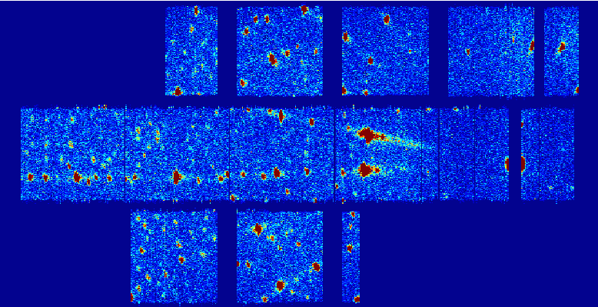
SNS’s use of EPICS V4 for transport of beamline neutron event data
ORNL SNS Deployment: Neutron event data aggregation and transport
SNS’ Conclusions:
Six beam lines currently using EPICS V4
Plans to extend to all experiment beam lines. Two more this summer.
Additionally, a pvaPy-based V4 client is used for detector calibration and diagnostics.
EPICS V4 meets performance requirements for all existing SNS instruments
Demonstrated at data rates of 10M events per second
Excellent reliability.
ADnED plot of a diffraction pattern from neutron scattering of a single-crystal sample at SNS CORELLI
Fragment of the SNS’ EPICS v4 structure used for streaming experiment data at the 60 Hz rate of the pulsed neutron source
Kay Kasemir, Steven Hartman, ORNL

Slide 16
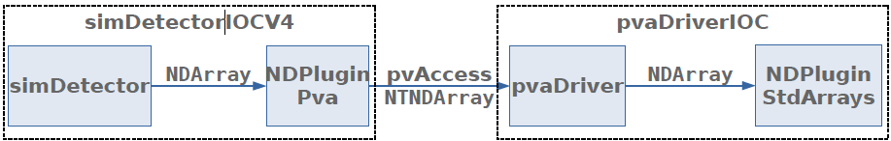
NSLS-II areaDetector EPICS V4 support
NSLS-II Deployment (1) – beamline image data transport and fanout
Problem: Modern detector rates
Eiger 1M: 1030x1065 @ 3 kHz
Eiger 4M: 2070x2167 @ 750 Hz
Eiger 9M: 3110x3269 @ 238 Hz
Eiger 16M: 4150x4371 @ 133 Hz
All these detector configurations saturate a 10 Gbps link
Other non-EPICS methods tried and failed (HTTP-chunking).
NSLS-II v4 Solution:
V4 server is an areaDetector plugin, NDPluginPva. V4 client is areaDetector driver.
Architecture tested with SimDetector datasource:
V4 server
V4 client
Bruno Martins, BNL (following work by James Rowland and Dave Hickin at Diamond)
Notes:
NSLS-II were very careful to zero-copy in population of NTNDArray from NDArray. However, it was found not to be possible to zero-copy in the extraction process at the client (NTNDArray to NDArray). However, it may be possible with modification of NDArray itself.

Slide 17
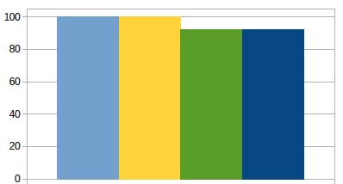
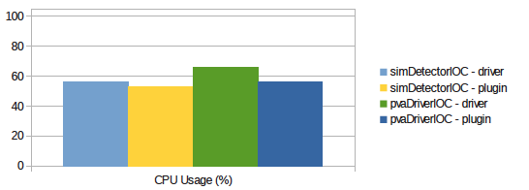
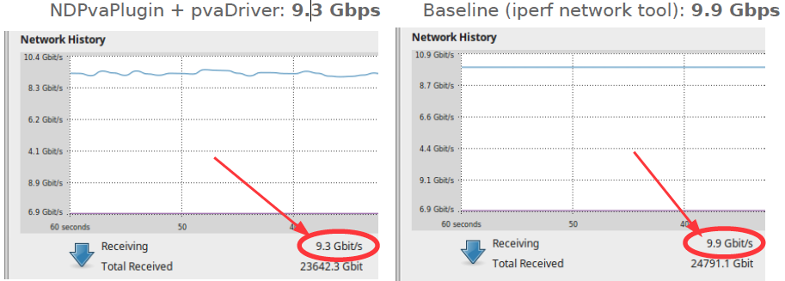
NSLS-II V4 areaDetector Performance Test
NSLS-II Deployment (1) – beamline image data transport and fanout
Test simDetecor datasource 5K x 5K @ 50Hz ~= 10 Gb/s over 10Gig Ethernet.
Non-blocking callbacks. AD ImageMode: Multiple. NumImages:10000
Test pipeline
stage
Frames through (%) (more is better)
CPU usage (less is better)
Transfer bandwidth: EPICS V4 & practical limit:
NSLS-II Conclusions:
EPICS V4 based areaDetector
pipeline has high throughput, few
frames lost, with no CPU
saturation. Network bandwidth
is close the practical maximum.
Bruno Martins, BNL (following work by James Rowland and Dave Hickin at Diamond)
Notes:
25M Bytes, 50 times a second = 10 Gbits.

Slide 18
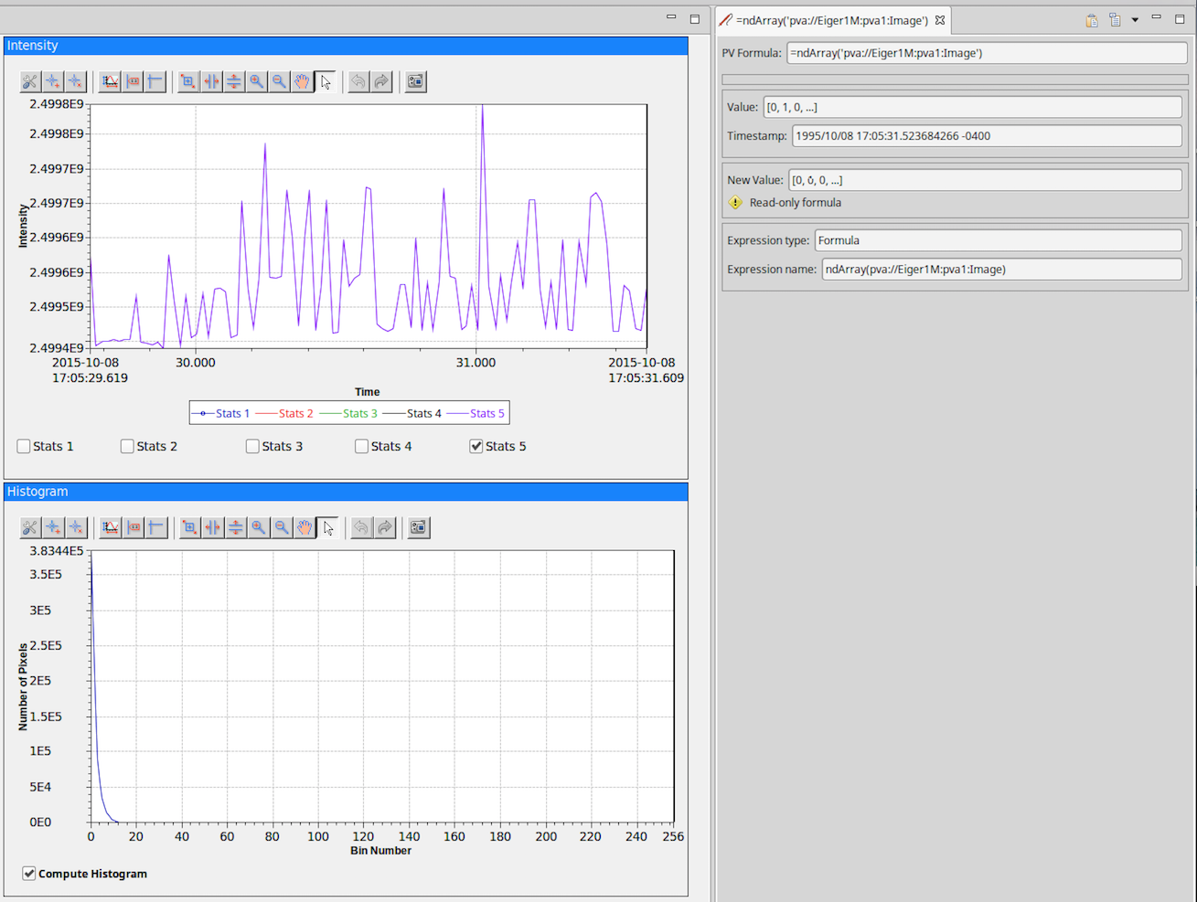
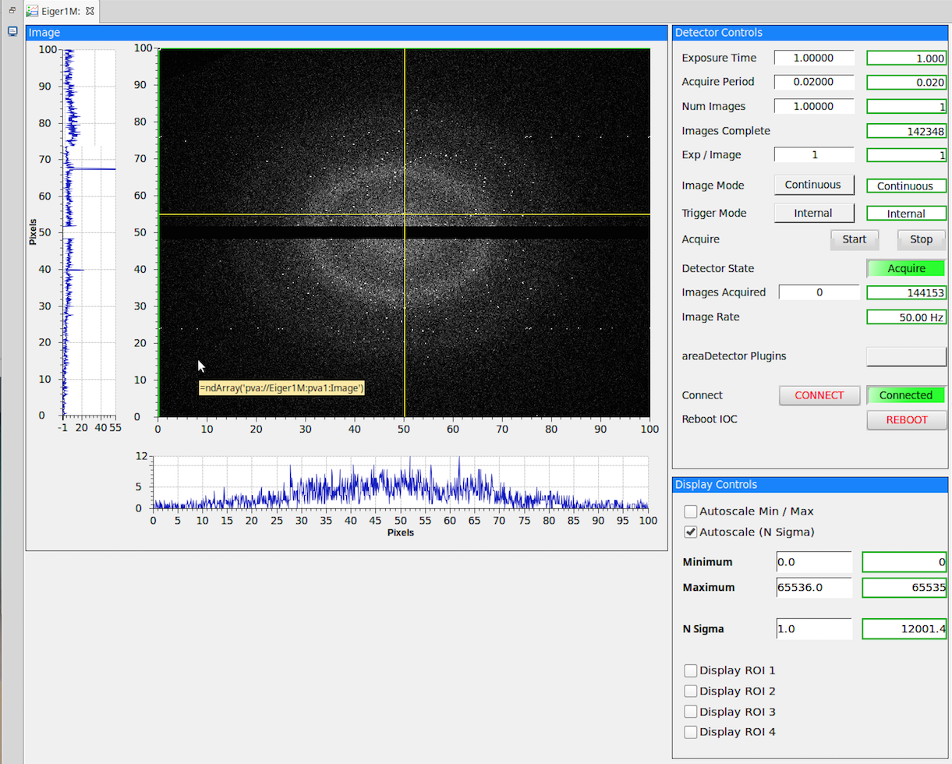
NSLS-II Deployment (1) – beamline image data transport and fanout
The V4 PV
“Eiger1M:pva1:Image”
of type NTNDArray
Figures: NSLS-II CS-Studio screenshots showing an EPICS V4 PV of the type for areaDetector images (NTNDArray) displayed using a CS-Studio “formula.”
Notes:
Like SNS, BNL NSLS-II uses CS-Studio as the OPI
But at NSLS-II the data transported are of the EPICS V4 normative types specifically intended for images from areaDetector, called NTNDArray.
The EPICS V4 Normative Types are handled in CS-Studio by CS-Studio formulas.

Slide 19
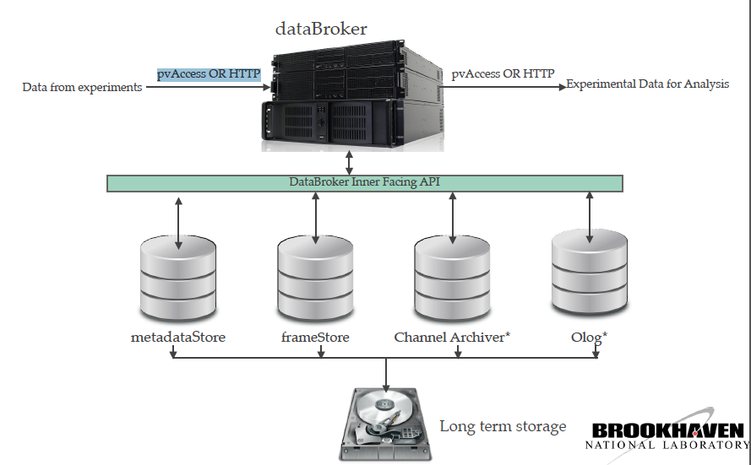
An EPICS V4 server might mediate all experiment data
NSLS-II Deployment (2): Beamline data management
“DataBroker” plan, giving access to all data, from all experiment data sources,
over pvAccess or HTTP.
Arman Arkilic BNL, Michael Davidsaver then at, BNL
Notes:
metaDataStore : records metadata of beamline experiments:
Such as run start and stop (examples in following slide), event description, event records.
Event description = many key-value pairs: hence Mongo DB, and EPICS V4 NTnameValue
frameStore i: a service that provides means to manage images and/or any
NDimensional data from experiments
ChannelArchiver : the familiar server to record signals from various hardware and provides means
to query time series data
Olog :” keeps track of a user’s experimental activity providing various APIs and web clients
dataBroker : provides write and read access to experimental
data frameworks underneath it. Acts as a glue for various underlying services
metadataStore

Slide 20
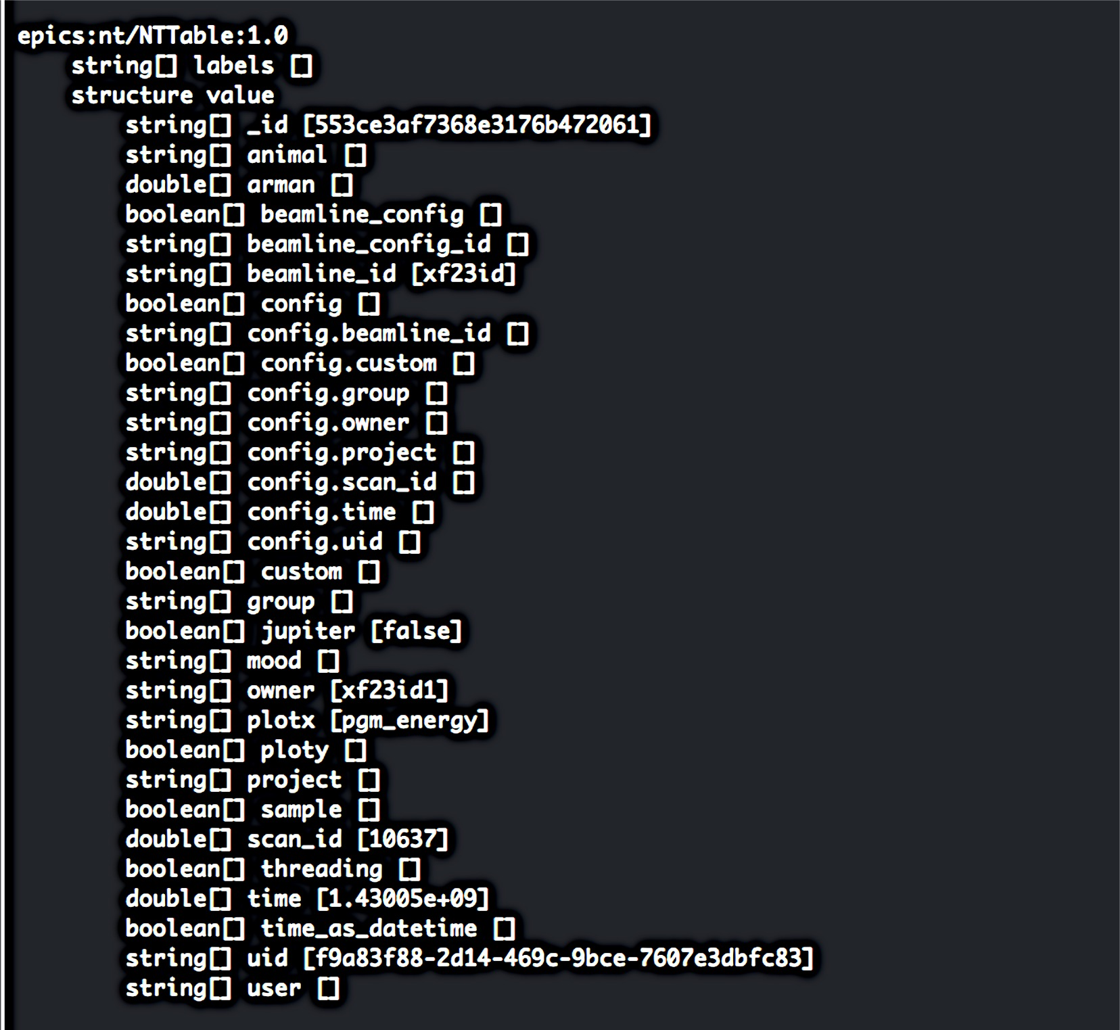
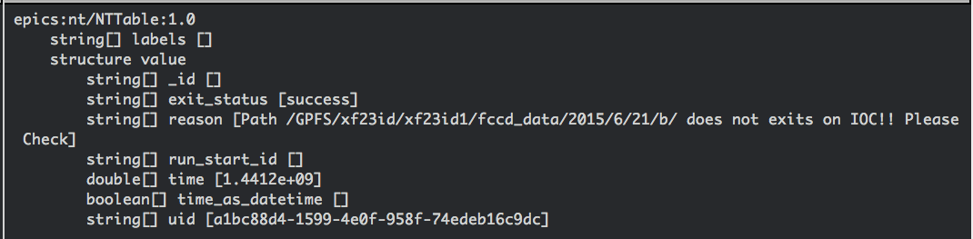
EPICS V4 Normative Type (NTTable) Examples from NSLS-II metaDataStore
NSLS-II Deployment (2): Beamline data management
NSLS-II beamline “run-start” metadata
NSLS-II beamline “run-stop” metadata
Figure: Beamline experiment meta-data expressed in EPICS V4 Normative Type NTTable, as returned by EPICS V4 service dataBroker from data in metaDataStore.
Arman Arkilic BNL, Michael Davidsaver then at, BNL
Notes:
The left-had-side shows meta data for the START of an experiment run.
The right hadn side shows meta data of the run STOP

Slide 21
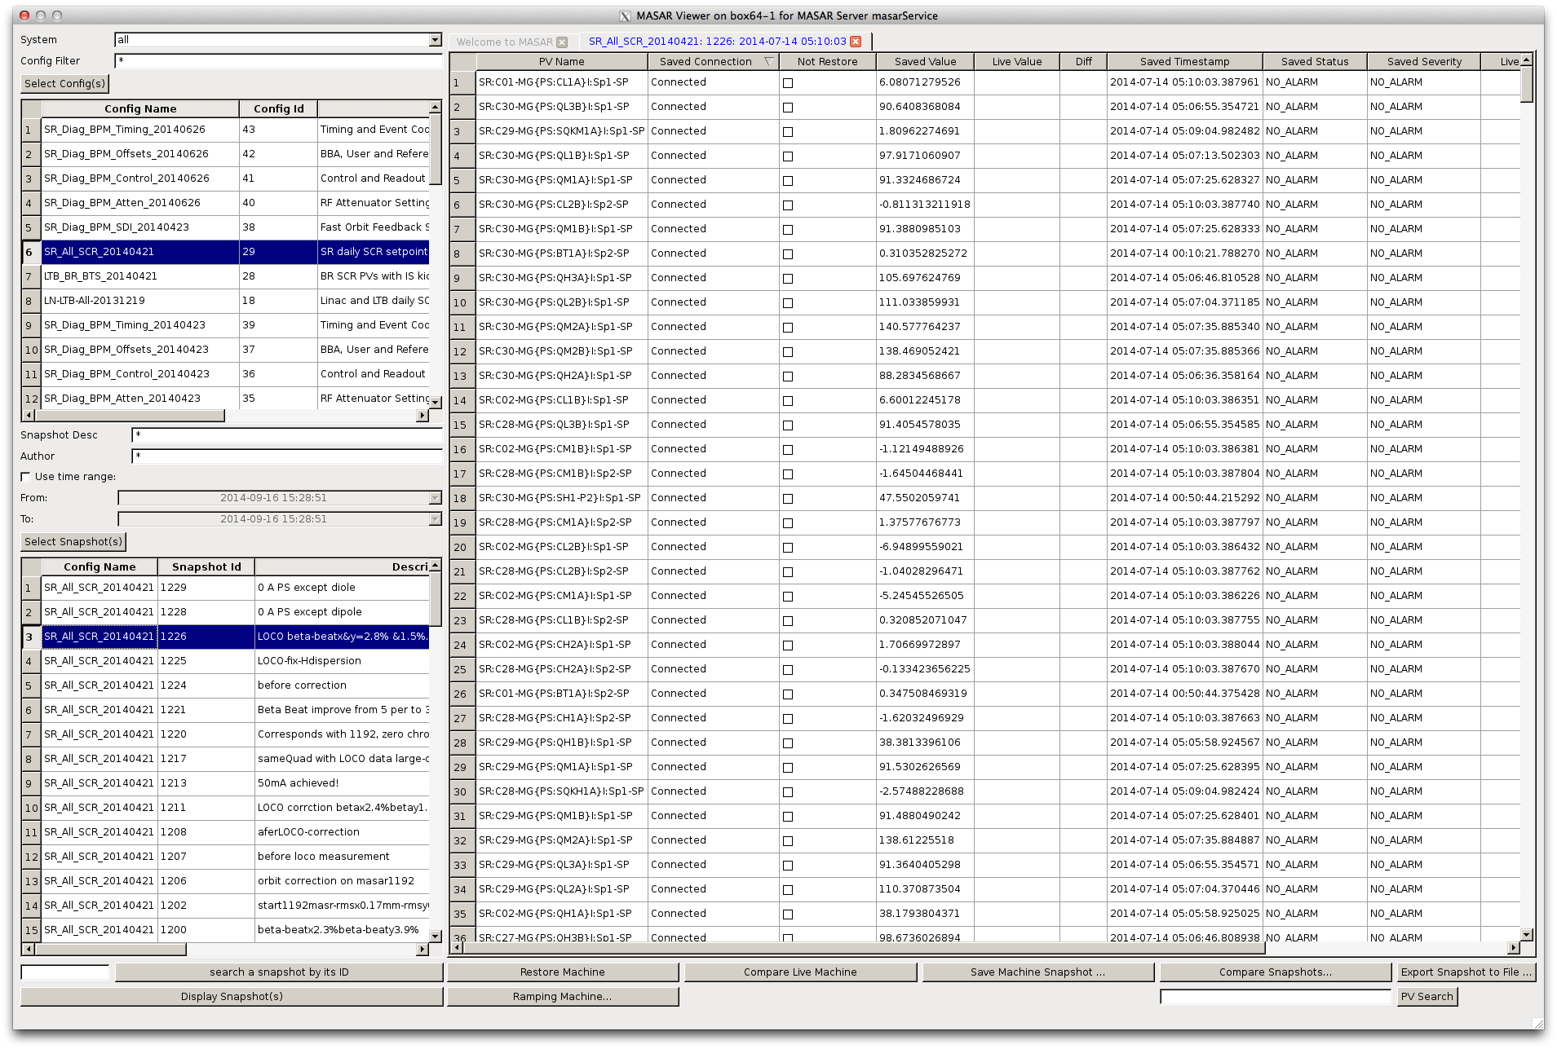
BNL and FRIB use EPICS V4 for PV configuration management
Deployments of EPICS Version 4: BNL’s CA PV Configurations save/restore system
The MASAR app (Machine Snapshot, Archiving, and Retrieval) allows a user to take snapshots of systems of CA PVs, save them in a database, view them, and restore them to IOCs
Whole machine configurations can be delivered to clients as a single set using EPICS V4.
Guobao Shen, FRIB

Slide 22
MASAR Architecture
Deployments of EPICS Version 4: BNL’s CA PV Configurations save/restore system
CS-Studio/BOY
Others
(Matlab)
PyQt
Scripting
Client
side
MASAR Client Python Library
pvAccess Client Library (Java)
pvAccess Client
pvAccess between server and client
pvAccess Server
MASAR Server (EPICS V4 Engine)
Sever
side
DSL-PY Module (C++ <->Python)
Gather/C++
PYMASAR (Python)
SQLite
Channel Access
MongoDB
IOC
IOC
IOC
Restore by CA
EPICS V4
Channel Access
Planned
Developing
Figure : MASAR server side delivers CA PV configurations using EPICS V4, to various client types.
Guobao Shen, FRIB

Slide 23
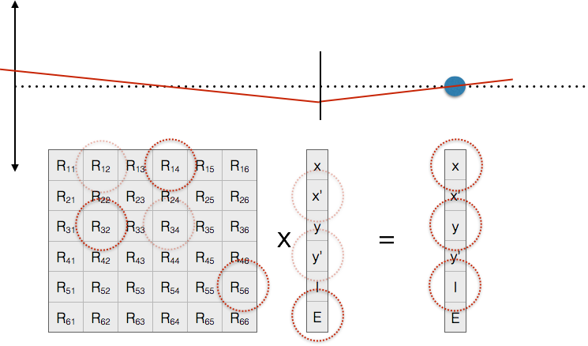
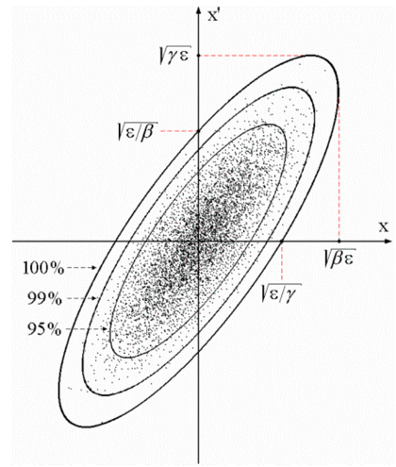
SLAC and ESS collaboration on EPICS V4 for beam dynamics modelling and infrastructure data
SLAC & ESS deployment: Modelling beam dynamics
“A”
“B”
Transverse
beam offset
(x or y)
Z
$ eget -s XCOR:IN20:491:RMAT -a b BPMS:IN20:525
0.669591 0.694604 0 0 -3.08532e-19 2.41325e-19
-0.570851 0.901275 0 0 -1.23627e-19 1.45491e-19
0 0 1.33379 0.966896 0 0
0 0 0.358415 1.00957 0 0
-2.29302e-24 8.92892e-20 0 0 1 1.20724e-05
1.00974e-28 0 0 0 0 1
From N. Delerue, Oxford Univ.
$ eget –s XCOR:LI24:900:TWISS
energy 5.00512
psix 37.7625
alphax 13.6562
betax -2.78671
etax -0.00698294
etaxp 0.00107115
psiy 31.9488
alphay 116.762
betay 5.2592
etay 0
etayp 0
z 2438.72
Figures: EPICS V4 modelling service giving orbit response matrices
and Twiss parameters for given devices. These are the basis of 90%
of emittance minimization applications – feedback, steering, bumps, etc
Greg White, Murali Shankar SLAC; Ivo List, ESS
Notes:
SLAC and ESS are collaborating on a system of EPICS Version 4 services that help accelerator physicists write commissioning applications.
The two examples in this slide show use of an EPICS service to compute the optics of accelerator lattice elements.
The Left Hand Side shows the response matrix computed between a corrector and a BPM. Two things to note:
1. The use of RPC sty;e argument – the name of the second device – given as an argument to the first.
2. That the response matrix self identified as the Normative Type NTMatrix, so eget (and any other client) knows to display it as a matrix
The Right Hand Side shows the acquisition of the Twiss – aka Courant-Snyder – paramters of a corrector.
Other PVs can also return the optics of the whole accelerator, returned as a very large table – in an NTTable.

Slide 24
SLAC and ESS collaboration on EPICS V4 for beam dynamics modelling and infrastructure data
SLAC & ESS deployment: Modelling beam dynamics
Directory Service (based on EPICS V4 channelFinder) examples:
# The names of PVs, by device name pattern:
$ eget -s ds -a name=XCOR:LI21:135:%
name
XCOR:LI21:135:ABORT
XCOR:LI21:135:ACCESS
XCOR:LI21:135:ALLFUNCGO
XCOR:LI21:135:BACT
XCOR:LI21:135:BACTFO
… (many rows snipped)
# Regular expression (restrict to sectors LI25-LI29)
$ eget -s ds -a regex='XCOR:LI2[5-9]:.*:BDES’
…
# Device names of the instruments in the laser heater
$ eget -s ds -a etype INST -a tag LSRHTR -a show dname
…
# A recent search for invalid data in corrector PVs
$ eget -tTs ds -a name %COR:LTU%:%:%DES | \
eget -p ca -f - | grep nan
XCOR:LTU1:558:BDES nan
XCOR:LTU1:558:IDES nan
…
Lattice example (from Oracle V4 service):
$ eget -s LCLS:ELEMENTS
ELEMENT ELEMENT_TYPE EPICS_DEVICE_NAME S_DISPLAY OBSTRUCTION
CATHODE MAD CATH:IN20:111 2014.7 N
SOL1BK MAD SOLN:IN20:111 2014.7 N
CQ01 MAD QUAD:IN20:121 2014.9 N
SOL1 MAD SOLN:IN20:121 2014.9 N
XC00 MAD XCOR:IN20:121 2014.9 N
... (many rows snipped)
Figure: Access to Oracle gives device infrastructure, magnet calibrations, drawing names, etc.
Will be used in LCLS-II for such things as cryogenic plant system hierarchy etc.
Greg White, Murali Shankar SLAC; Ivo List, ESS
Notes:
SLAC and ESS are collaborating on a system of EPICS Version 4 services that help accelerator physicists write commissioning applications.
The two examples in this slide show use of an EPICS service to compute the optics of accelerator lattice elements.
The Left Hand Side shows the response matrix computed between a corrector and a BPM. Two things to note:
1. The use of RPC sty;e argument – the name of the second device – given as an argument to the first.
2. That the response matrix self identified as the Normative Type NTMatrix, so eget (and any other client) knows to display it as a matrix
The Right Hand Side shows the acquisition of the Twiss – aka Courant-Snyder – paramters of a corrector.
Other PVs can also return the optics of the whole accelerator, returned as a very large table – in an NTTable.

Slide 25
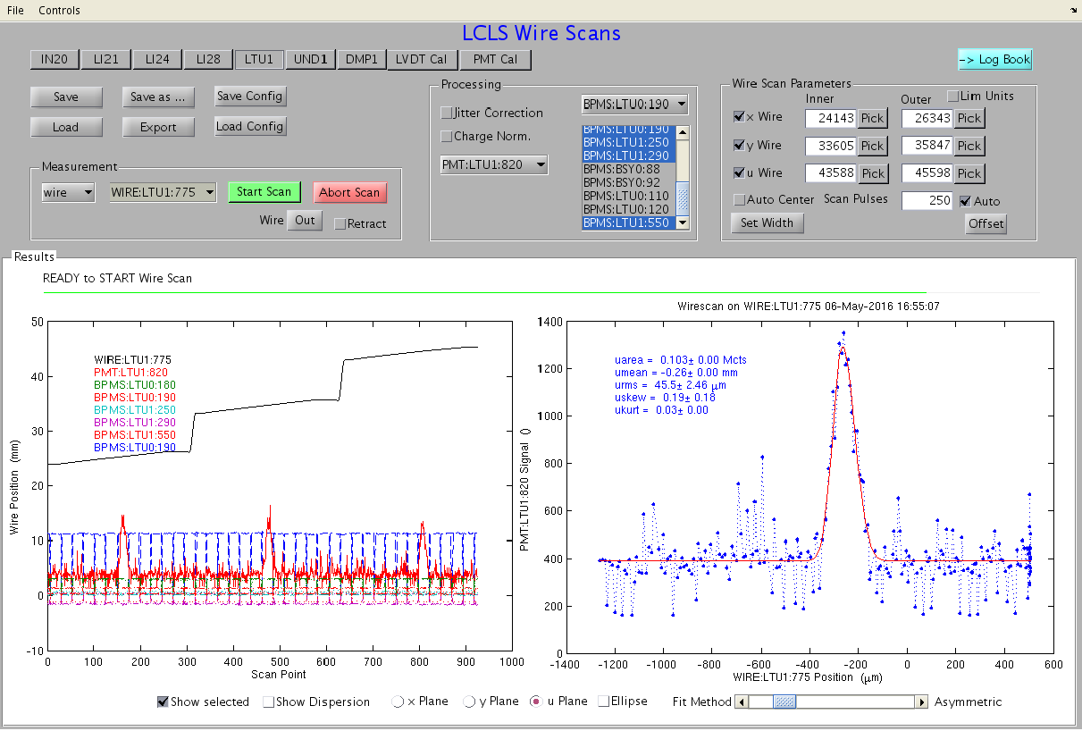
SLAC Wire Scanner example: uses DS and model
SLAC deployment: Modelling beam dynamics, device topology, archive data
Figure: Wire Scan and Emittance GUIs use EPICS V4 services to get relevant device names; Wire, BPMs,
Photo Multiplier Tubes, Quads, etc, and model transfer matrices between devices.
Greg White, Murali Shankar SLAC

Slide 26
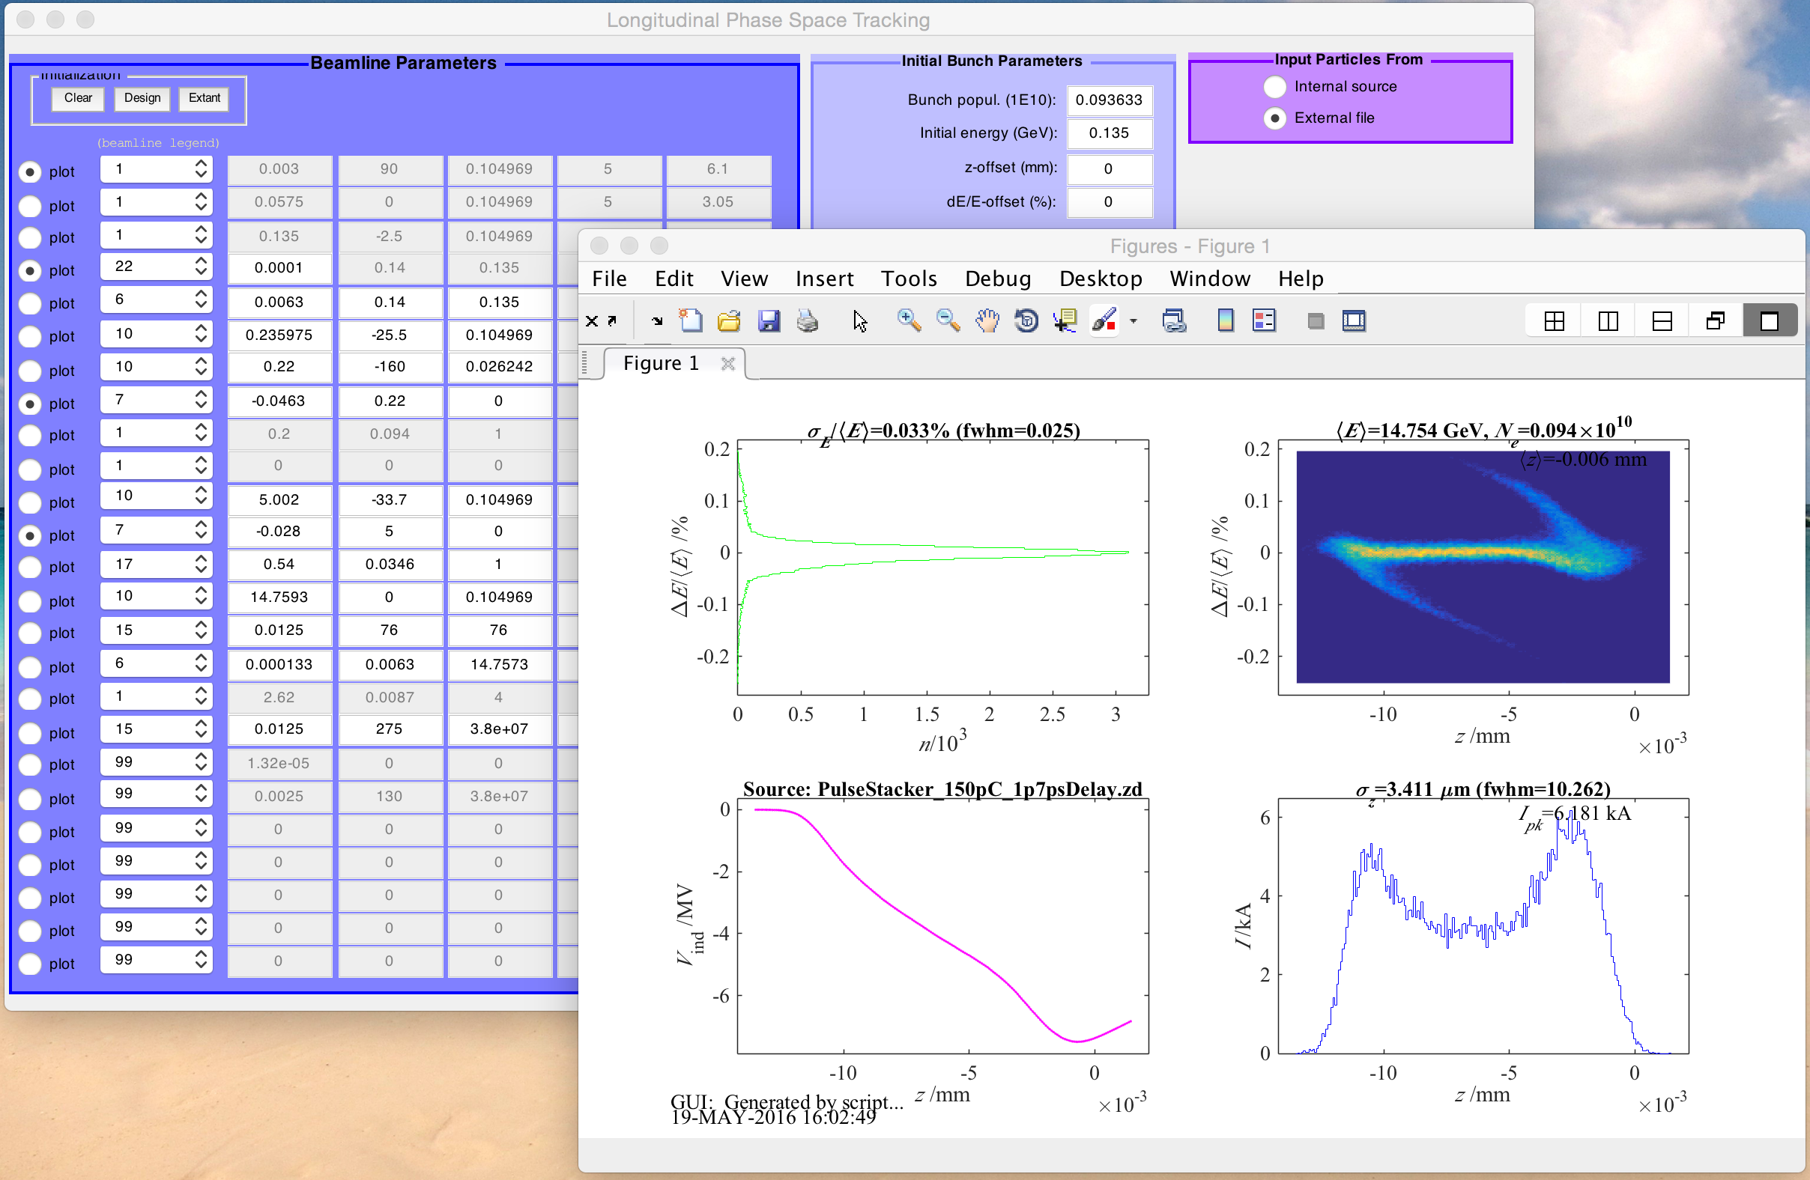
SLAC deployment: EPICS V4 API to CA used by longitudinal dynamics simulation
Figure: LiTrack longitudinal dynamics simulation uses EPICS V4’s Channel Access API
Greg White, Murali Shankar SLAC

Slide 27
Talk Outline
Version 4 Additions to EPICS
Deployments
Developments underway
User Feedback & Recent Work

Slide 28
FHI tested and planning to deploy V4 for STM data
EPICS V4 inside
“fast STM” control
VMEbus
X, Y, Z (const. height)
Highland V375, 4-channel arbitrary waveform generator, 15 MHz point step rate
X, Y (coarse STM)
struck SIS3316, 16 channel digitizer, 14bit, 250 MS/s per channel, 64 MSamples memory/ch
I/V, LockIn, other
MVME6100, PowerPC, 2GB, 2 Gbit/s Ethernet, 2 PMC-X
Ethernet, ca://, asyn
Ethernet, pva://
RTEMS 4.12
CA gateway
PVA gateway
CS-Studio
pvaPy, http/json
Archiver (v3)
appliance
NTNDArray
Archiver
appliance (v4)
Figure: EPICS V4 in high speed Scanning Tunneling
Microscopy of glass.
Heinz Junkes, Fritz-Haber-Institut Berlin

Slide 29
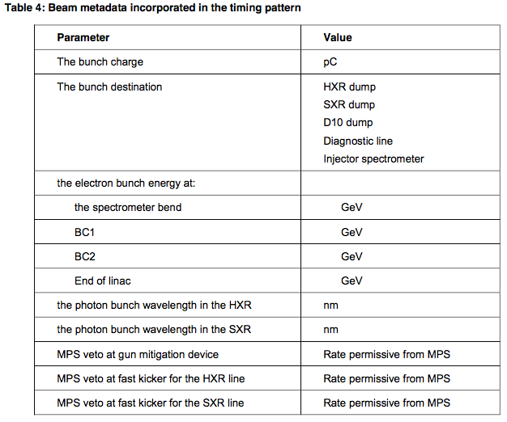
SLAC Beam Synchronous data to include Pulse & timing related metadata
Developments Planned or Under Way: LCLS-II and EPICS v4
All EPICS v4 data types include the facility to encode metadata, such
as Pulse ID, right in the data structure. That pulse-ID can index beam metadata.
Even a simple PV’s “value” will be a data structure:
E.g. A LCLS-II BPM’s X offset, say BPMS:LI03:403:X
Pulse-ID, indexing beam metadata:
NTScalar :=
structure
scalar_t value
string descriptor :opt
alarm_t alarm :opt
time_t timeStamp :opt
long secondsPastEpoch
int nanoseconds
int userTag
display_t display :opt
control_t control :opt

Slide 30
Potential LCLS-II Benefits from EPICS v4
LCLS-II and EPICS v4
Pulse-ID stamped in all BSA related data
X-ray Detector experiment data:
  Fast Streaming and pipeline processing (per BNL and SNS)
  Can store Beam Line Data (BLD) with detector data (per BNL Metadatastore)
Coordinated and combined BSA data across LCLS-I and LCLS-II control systems. E.g. eget orbit –a from cathode –a to HXR
Archiving complex data. E.g. archive pulse by pulse whole orbits
-> Jitter study, data mining, machine learning
Archived beam metadata ( charge, destination etc) labeled by pulse-Id.
Better links between offline computations and databases, to online control system. For instance:
  Feedback IOCs get R12s from the model
  Magnet IOCs get calibration and polynomials from Oralcle
At SLAC already have Optics, Oracle, Archive data, PV names directly from EPICS in V4. Much easier HLA programming
EPICS v4 interfaces in C++, python, Java and Matlab. Easy programming HLAs.

Slide 31
Talk Outline
Version 4 Additions to EPICS
Deployments
Developments underway
User Feedback & Recent Work

Slide 32
User Feedback – what’s good:
Conclusions
Performance is excellent
Reliability needs have been met or exceeded
Easy programming and scripting, once you’ve got started
Complex data and RPC enables one, simple, high performance, infrastructure across the whole controls and online scientific system. Utility of this effect previously overlooked, but in practice seen to be key
Normative Types enable systems of narrowly defined services to be applied generally to many experiment user problems
Streaming supports big online data processing. Beats tested alternatives in ease of use and performance.

Slide 33
User Feedback – what’s bad
Conclusions
It’s difficult to
get started!
New Developer’s Guide:
http://epics-pvdata.sourceforge.net/informative/developerGuide/developerGuide.html
We’ve started training.
Documentation reorganized for clarity.
Notes:
We have a new and complete developer’s guide. We have started training (Dave’s). We have overhauled the documentation so that the reference documentation specific to a given releave is easier to find.
I think it’s fair to say it’s now not difficult to get started, but isn’t trivial.
For the end user side, it’s really easy. V4 can give you all the data you need to do accelerator optimization, using a single simple API, if that data is made available.

Slide 34
User Feedback – what’s bad
Conclusions
We want one EPICS!
Not so easy. Different sites use different versions of base.
So, we now have V4 unbundled with base. Plus v4 bundled with base 3.15 and 3.16.
Andrew is planning when there will be one EPICS. Possibly about 3.16.3 -> 4.
Notes:
We have a new and complete developer’s guide. We have started training (Dave’s). We have overhauled the documentation so that the reference documentation specific to a given releave is easier to find.
I think it’s fair to say it’s now not difficult to get started, but isn’t trivial.
For the end user side, it’s really easy. V4 can give you all the data you need to do accelerator optimization, using a single simple API, if that data is made available.

Slide 35
Recent Additions to EPICS Version 4
Recent Work
Developer’s Guide. Training
Bundling EPICS base. One EPICS in progress
Pva gateway
V4 PVs serving collections of V3 records (new pvaSrv/QSRV)
High performance array management; enforced copy-on-write semantics and zero-copy. Used by HP areaDetector projects
Union data types
Bound and unbound arrays
Codec based transport, pvAccess can be replaced by zeroMQ for instance
Security plugin
Pipelining. Used by HP areaDetector. Dynamic TCP windowing
New Database, pvDatabase
Simplified APIs.
Easy to use wrappers for introspection interfaces of Normative Types

Slide 36
References
The EPICS V4 website (packaged downloads, documentation etc), http://epics-pvdata.sourceforge.net
EPICS V4 sourcecode repos, https://github.com/epics-base/
EPICS V4 EVALUATION FOR SNS NEUTRON DATA, K.U. Kasemir, G.S. Guyotte, M.R.Pearson, ORNL, Oak Ridge, TN37831, USA, contribution WEPGF105 of these proceedings
EPICS V4/areaDetector Integration, D. Hickin, Diamond, http://controls.diamond.ac.uk/downloads/other/files/areaDetectorOctober2014/EPICS%20V4%20areaDetector%20integration.pptx
areaDetector EPICSv4 modules, B. Martins, talk at spring 2015 EPICS Meeting (at Michigan State), https://indico.fnal.gov/contributionDisplay.py?contribId=81&s2essionId=11&confId=9718
areaDetector's ADCore on github, B. Martins, http://github.com/areaDetector/ADCore
NSLS-II Data Management Framework, A. Arkilic, talk at spring 2015 EPICS Meeting (at Michigan State), https://indico.fnal.gov/materialDisplay.py?contribId=80&sessionId=5&materialId=slides&confId=9718

