Slide 1
PV Monitor at the CLS
Rapid Scanning of EPICS PV’s Using Python
Gillian Black
Canadian Light Source
Notes:
Look at the audience

Slide 2


Synchrotrons Around the World
Canadian Light Source
Synchrotrons currently in operation
Synchrotrons under construction or in planning phase
Notes:
The only synchrotron in Canada

Slide 3

Saskatoon, Saskatchewan

Slide 4
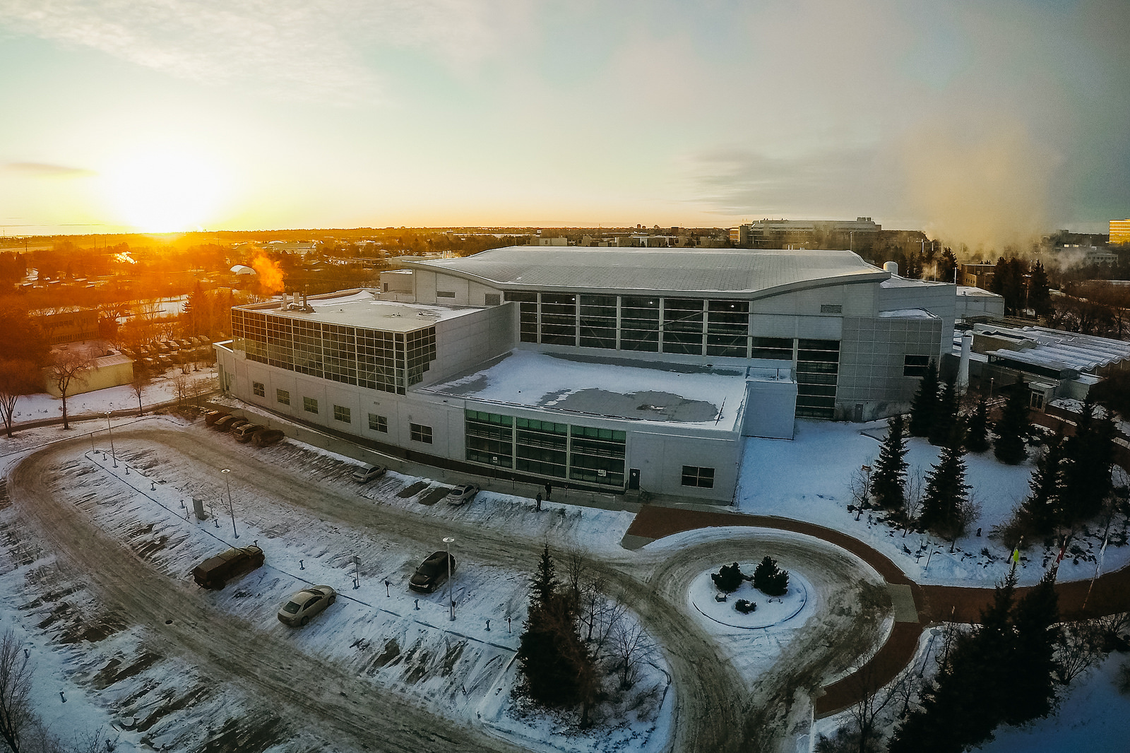

Slide 5
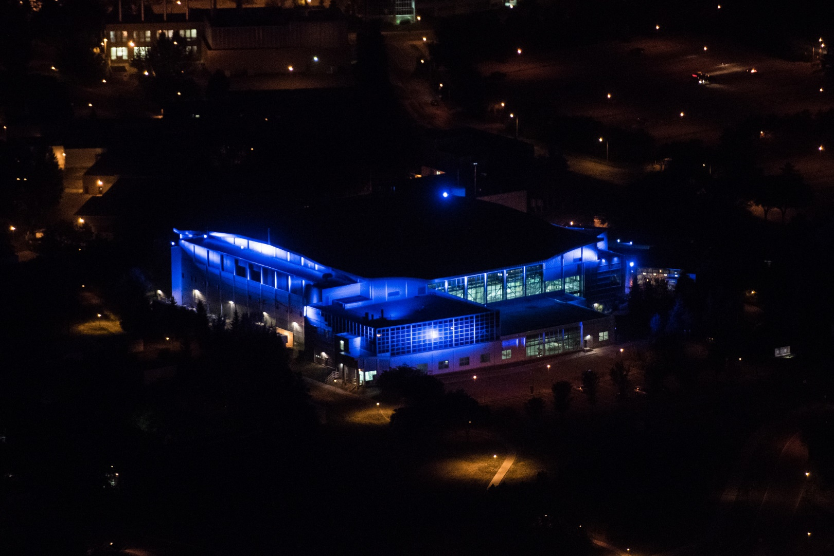
Notes:
If you can’t find us, just wait till night fall…

Slide 6
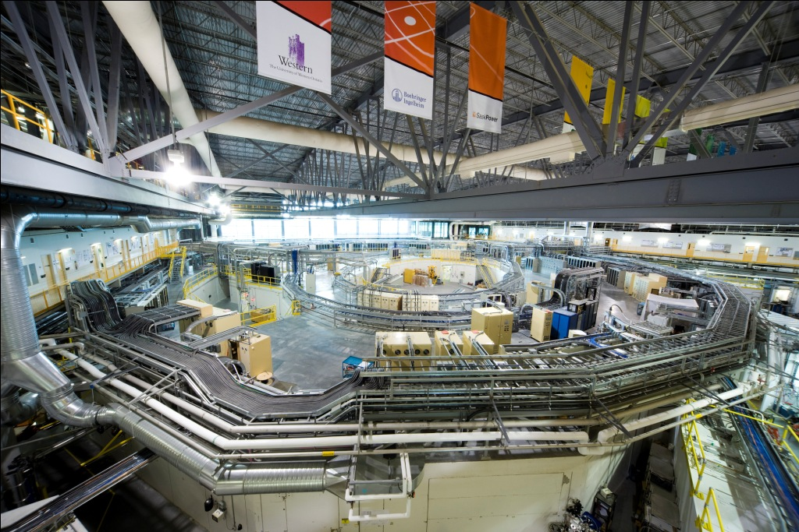
The Machine
22 beamlines
> 400 Physical IOCs
1000 EPICS applications
At least half a million PV’s
Notes:
2.9 GeV
76 meters in diameter
14 people in Controls and Instrumentation

Slide 7
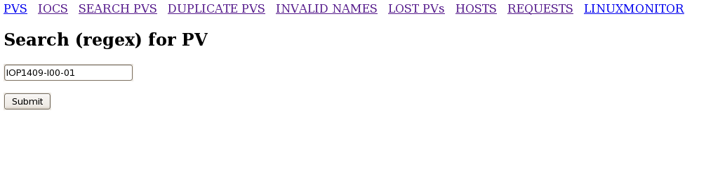
PV Monitor Web Interface
Notes:
One of our most common usages…

Slide 8
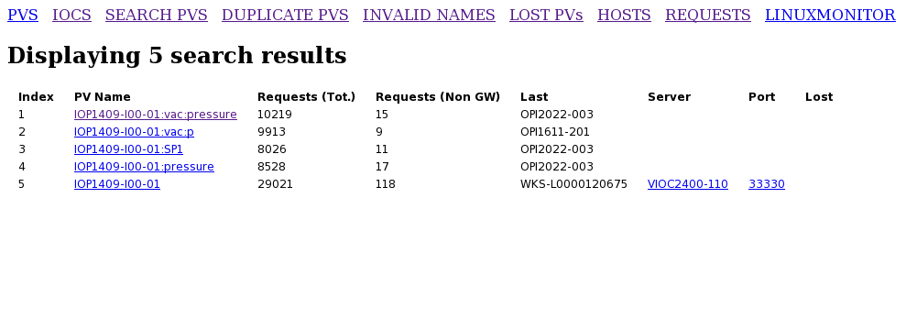
PV Monitor Web Interface

Slide 9

Notes:
So, what does the PV monitor look like?

Slide 10
PV Monitor in a Nutshell
Pure Python (no EPICS module)
Monitors CA_PROTO_SEARCH UDP packets
  Dynamically builds PV database
  Tracks which clients requesting PV
Polls PVs to determine location and status
Notes:
So, what is the PV monitor? Simply, we are watching UDP traffic to find out what PV’s are out there, and then cycling through those PV’s, polling, to find out where they are and to keep track of their history. What’s interesting about this is that what we are watching for are PV requests, that is, PVs that some other application, GUI or person actually finds interesting..
So what has that given us

Slide 11
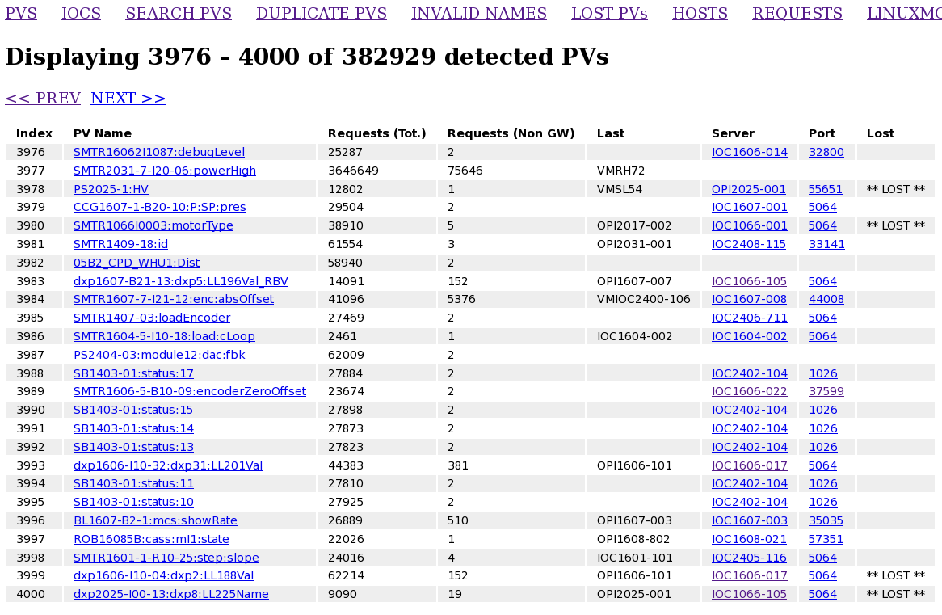
Notes:
Well so far, 382,000 unique PVs’
That of course is not all the PV’s in the system – just the ones requested by a GUI or another application somewhere. This list built up over a period of a few weeks.

Slide 12
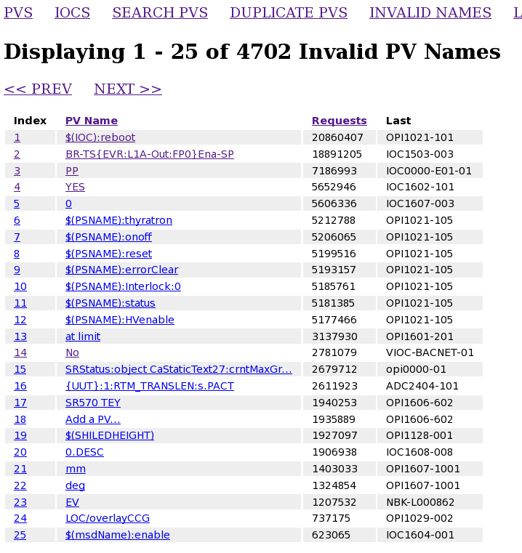
Notes:
An unexpected side effect of monitoring the requests, is that we see all the junk requests…

Slide 13
On the Polling Side…
Wanted fast polling
Wanted to reliably find multiple hosts

Slide 14
Fast Polling
pyCaGet()
caget
PV Monitor
PyEpics
EPICS Library
CA_PROTO_SEARCH
Notes:
We had a couple of major goals. Sniffing out PV requests turned out to be fairly straight forward. But trying to find the PV’s by doing cagets was just too slow particularly because of timing out waiting for lost PV’s. Also pyCaGet sometimes segfaults. Of course pyCaget is just basically using the epics library; we decided to bypass that library and do our own CA_PROTO_SEARCHes directly.
Of course polling adds to the traffic, but minutely.
So what has that given us?

Slide 15
PV Monitor Basics
Monitor the EPICS traffic
Over time this gives you a list of PV names – throw them in a database in RAM
Cycle through the database polling the PV’s by creating our own requests – now you sho
uld find out who is hosting the PV, if anyone
So far works on all versions of EPICS we are running, the latest being 3.12.14
Notes:
So, I am going back in time a bit here. Mike has been talking about the heartbeat, but since the heartbeat is in only about 5% of the apps, we are still So, we are monitoring traffic to find out what PV’s are out there, and then polling those PV’s to find out where they are and to keep track of their history. What’s interesting about this is that what we are seeing initially are the requests for PV’s.

Slide 16
Our Topology: One EPICS Gateway with 19 VLANS
CMCF
HXMA
BMIT
SGM/PGM
EPICS GATEWAY
BrockHouse
Mid IR
Far IR
Notes:
So, if you are going to look for PVS you have to be in a position to see them. In our topology, there is a gateway, which we use both as a concentrator to reduce traffic
And to allow some beamlines to implement access security.
So for us, to see all requests the PV Monitor has to sit on the Gateway machine.
Otherwise it could just sit on any machine, even a machine that doesn’t have EPICs installed

Slide 17
PV Names
Keep > n
PV Name
Requestors: [Port, IP], [Port, IP], [Port, IP]…
Hosts: [Port, IP], [Port, IP]…
PV Monitor
PV Finder
PV | Port | IP
CA_Proto_Searches
CA Responses
CA_Proto_Searches
Notes:
The PV name is part of the contents, the source of the request is from the packet envelope.
So now we have a queue of PV names, and a thread whose job it is to keep that table full.
Then we have another thread that is grabbing a few of these PV names at a time from the front of the queue, creating CA_PROTO_SEARCh packets of its own, one for each PV, and sending them out on every vlan, in parallel.
Replies come back on one socket.
Replies may be fewer than the number of PVs, of course, if the PV is not found, but they can also be more than the number of PVs, if for some erroneous reason the PV is multiply hosted, reliably find all the hosts.
Match them up with the requests using Channel ID
Throw those results in another queue
Separate thread updates main database
One more thing that the main thread of the PV monitor does, if it comes across a new PV, it sneaks it onto the front of the name queue.

Slide 18
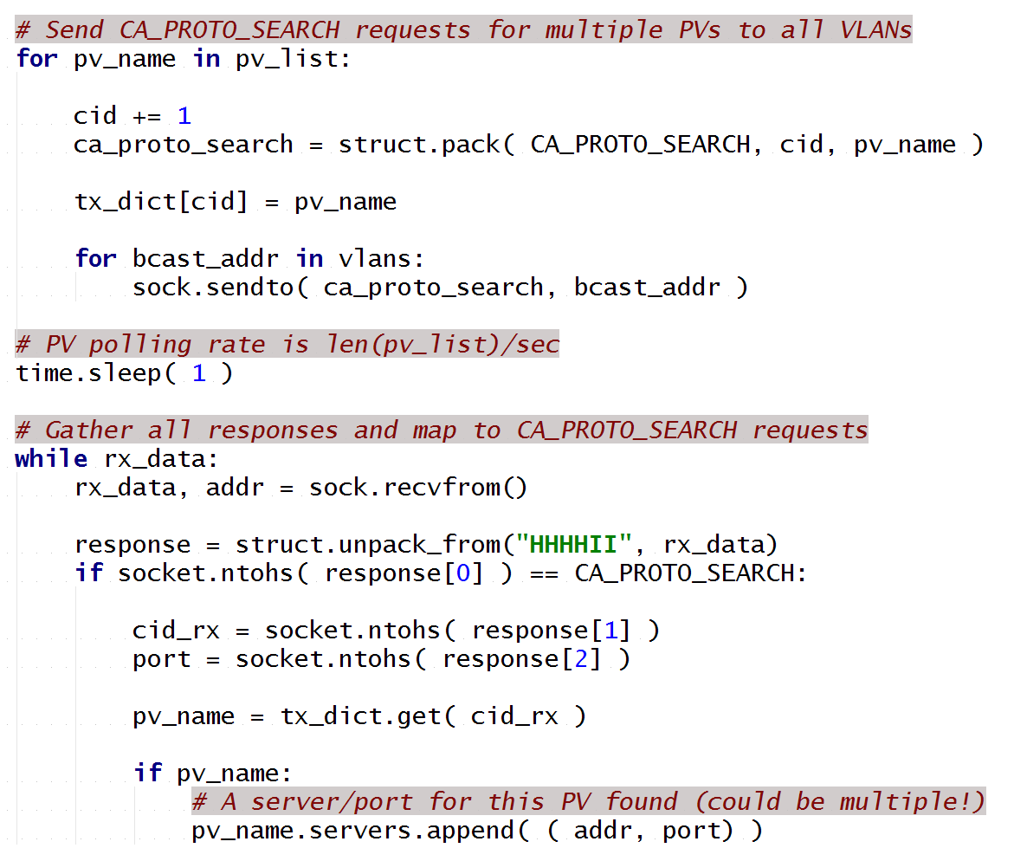
Notes:
A little bit of pseudo code
Channel IDs are used to match the requests with the responses. We create a packet per PV that we’ve grabbed from the queue, throw them each out on each vlan, then sleep for a second.
Then, checking for responses, if we find a matching channel ID, we add it to our dictionary of IP addresses and ports
So the polling rate is the number of PV’s we grab from the queue divided by the number of seconds we are waiting before checking for responses. In our case, at the moment, we are sending out 20 searches per second, so it takes about five hours to cycle through all the currently known PV’s.
Its as simple as this in pure python to implement this code.

Slide 19
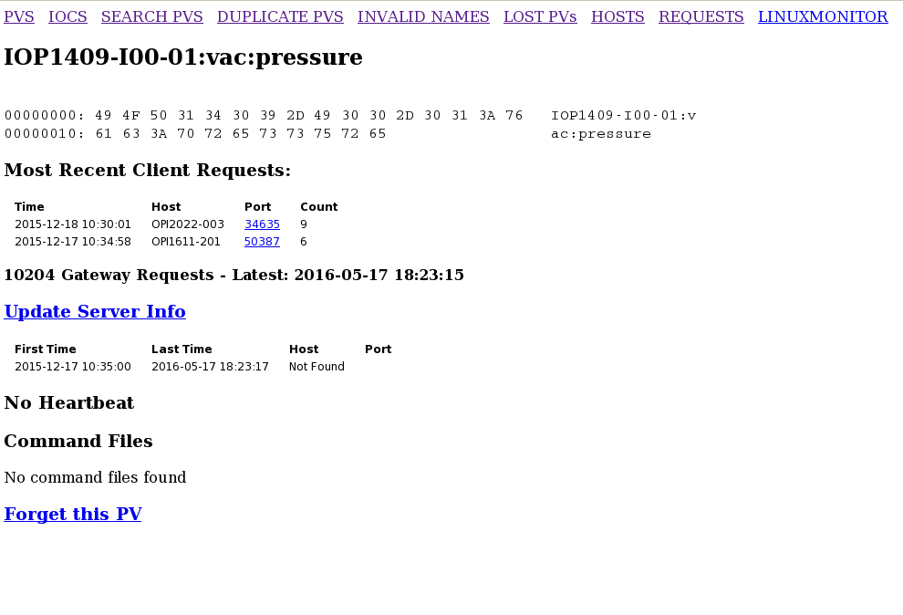

Slide 20
PV Monitor
Collects requests
Tells you which ones people or apps are looking for
Lets you keep track of bad requests, unanswered requests, total number of requests
Polling
Heartbeat
No action required by developers
Shows multiply served PV’s
No polling
Sees all PV’s in an app
Allows you to match the PV’s to the application

Slide 21
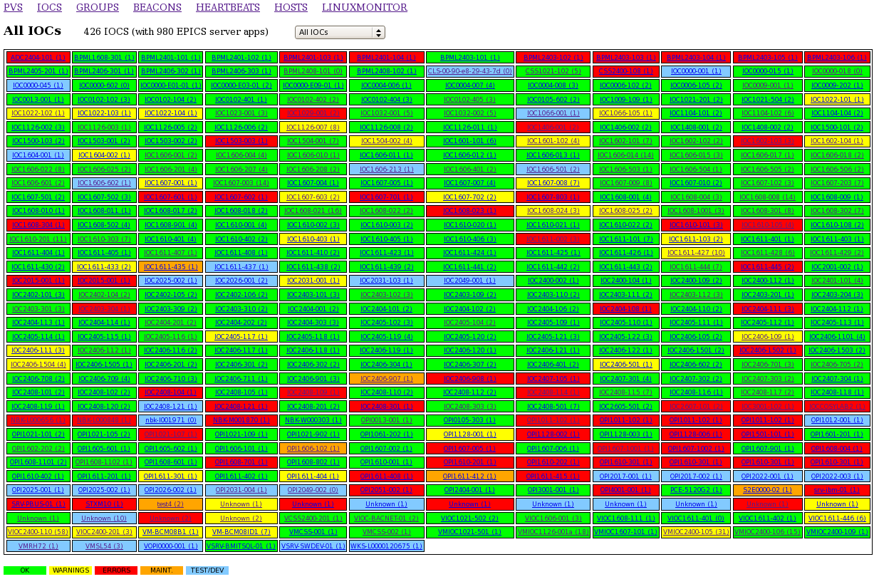

Slide 22
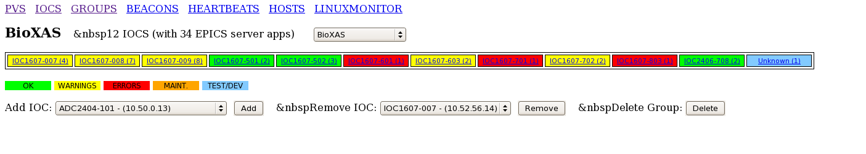

Slide 23
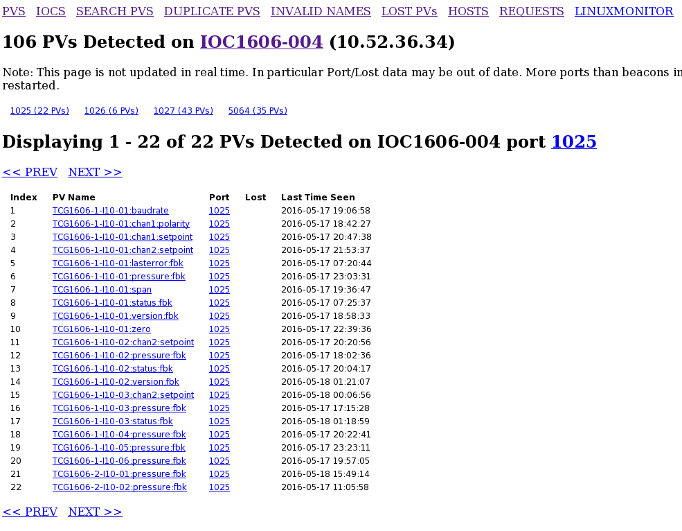

Slide 24
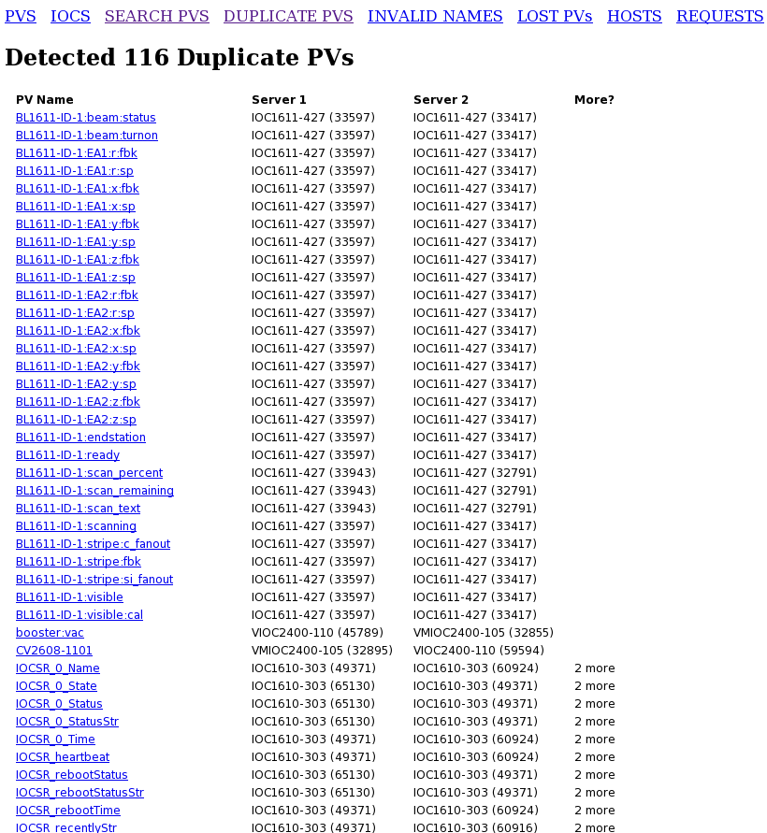

Slide 25
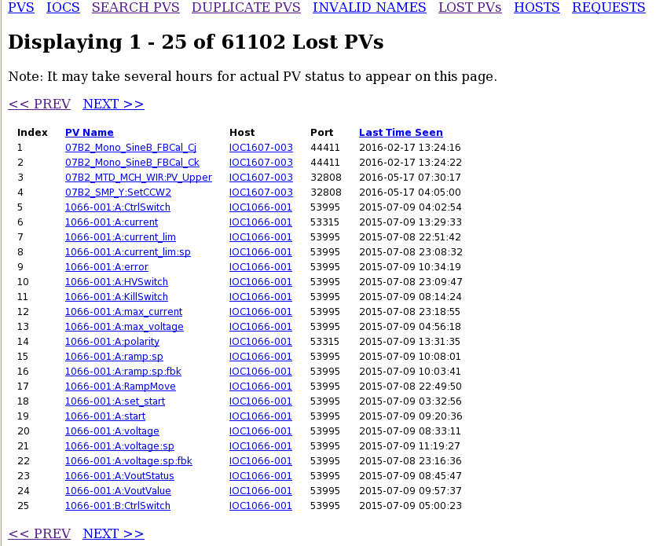

Slide 26
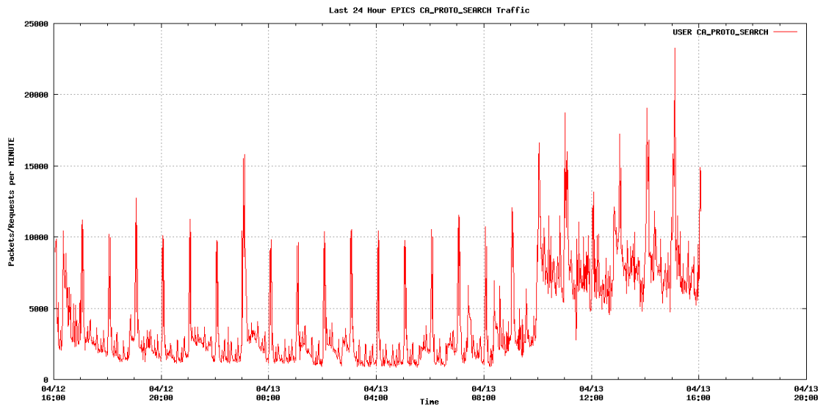
PV Requests over the Last 24 Hours

Slide 27
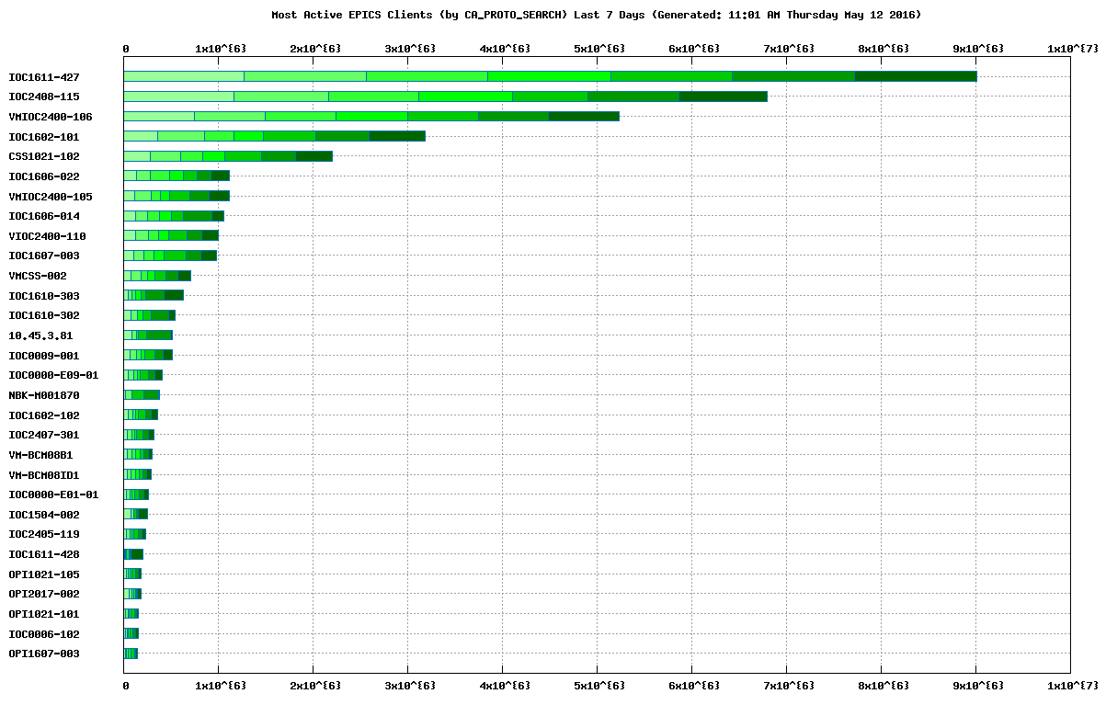

Slide 28
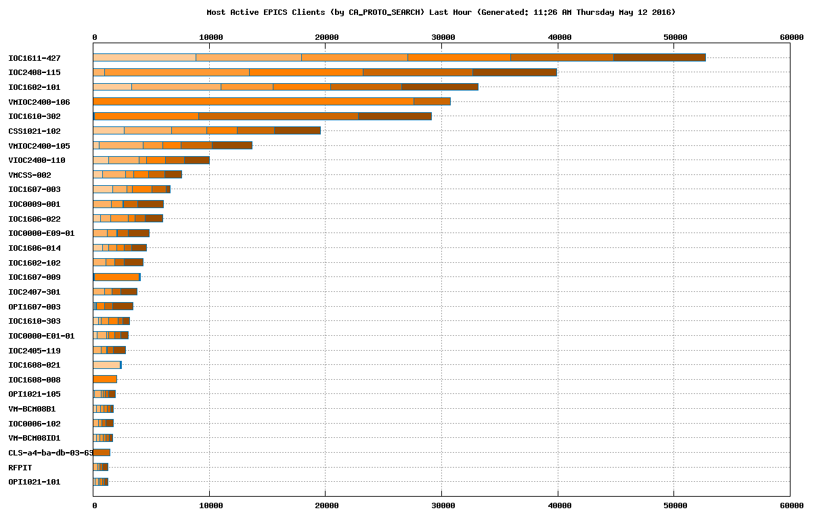

Slide 29
So how hard is this to set up really?

Slide 30
Configuration
# epicsgw-51-2
BCAST_ADDRESSES_EPICSGW_51_2 = [
'10.45.3.255',
'10.50.255.255',
'10.51.255.255',
'10.52.3.255',
'10.52.7.255',
'10.52.11.255',
'10.52.15.255',
'10.52.19.255',
'10.52.23.255',
'10.52.27.255',
'10.52.31.255',
'10.52.35.255',
'10.52.39.255',
'10.52.43.255',
'10.52.47.255',
'10.52.51.255',
'10.52.55.255',
'10.52.59.255',
'10.52.63.255',
'10.54.120.255',
'10.10.0.255',
]
Notes:
This is the only bit of configuration that’s needed – could probably automate this.
So far works on all versions of EPICS we are running, the latest being 3.12.14

Slide 31
Summary
Thank you for your attention.
Simple to set up
Runs independently of EPICs
Pure Python fast polling at a controllable rate
Reliably finds duplicate PVs
Runs anywhere on the network
Works on all the versions of EPICS that we have running – 3.14.12 is our most recent

Slide 32








Operating Funding Partners

Slide 33
Summary
Thank you for your attention.
Simple to set up
Runs independently of EPICs
Pure Python fast polling at a controllable rate
Reliably finds duplicate PVs
Runs anywhere on the network
Works on all the versions of EPICS that we have running – 3.14.12 is our most recent

