Slide 1
Introduction to Pilot TSS
Linda R. Coney
Group Leader – Target Safety and Controls
www.europeanspallationsource.se
February 15-16, 2016

Slide 2
Outline
TSS purpose and scope
Target Radiation Safety Hazard Analysis
TSS g Pilot TSS
Pilot TSS Concept
Conclusions

Slide 3
TSS – Purpose
The Target Safety System (TSS) is a safety classified, active monitoring and control system that shall:
Protect workers and public from exposure to unsafe levels of radiation and prevent the release of radioactive material beyond permissible limits
Bring the target station into a safe state in case of an abnormal event from the nuclear safety point of view

Slide 4
TSS Scope
Where does TSS fit within overall Target Safety Strategy?
Target Station Safety
Radiation Safety
Ionizing radiation
Activation
Contamination
Conventional Safety
High voltage
Chemical hazard
ODH
Cryogenics
Working at heights, ….
TSS
TSS is only involved with Radiation Safety
TSS is part of the Radiation Safety strategy
4

Slide 5
TSS Scope
Concerned with release of radioactive material
Tied to monitoring of system parameters – it is not an access control system
Requirements are based on the radiation safety hazard analysis evaluation for Target systems
Includes monolith & supporting systems, Active Cells, beam dump
Includes accelerator and instruments only to the extent that they jeopardize inventory in the Target station
Proton beam as aggressor to target wheel, Chopper failure as aggressor to monolith
Target Station Radiation Safety Hazard Analysis
Events/Accidents
H2 – H5
Normal Operations
All modes including beam to dump, beam to target, maintenance mode
TSS

Slide 6
Target Radiation Safety Hazard Analysis: Dose Limits
Protect workers and public from unsafe levels of radiation
Prevent the release of radioactive material beyond permissible levels
Defining consequence = dose to public and workers
These limits have been set by SSM (public) and ESS (workers)
ESS GSO FROM SSM
ESS Safety Objectives
Operating conditions Initiating event likelihood | Workers limit (effective dose) | Public limit (effective dose)
Normal operation - H1 | 10 mSv/year | 0,1 mSv/year
Incidents – H2 | 20 mSv/event | 0,1 mSv/event
Unexpected events – H3 | 50 mSv/event | 1 mSv/event
Design Basis Accident – H4 | 50 mSv/event | 20 mSv/event
Highly improbable events – H5 Ex : plane crashes, major earthquake |  | 100 mSv/event
6

Slide 7
Target Radiation Safety Hazard Analysis: Severity Matrices
Public
Severity (mSv) Probability | < 0.01 | 0.01-0.1 | 0.1-1 | 1-20 | 20-100 | >100
H1
H2
H3
H4
H5
Workers
Severity (mSv) Probability | 0-1 | 1-10 | 10-20 | 20-50 | 50-100 | >100
H1
H2
H3
H4
H5
H1 shaded out – indicates normal operation – limits per year
Normal operation limits and releases are handled separately from this analysis
H2 – H5 dose limits are per event
Limits for Public set by SSM
Limits for Workers set by ESS GSO (General Safety Objectives) except for H5 limit which we chose to equal that of the public because there was no limit stated
Unacceptable
Tolerable
Acceptable

Slide 8
TSS Context: Target Station Radiation Safety
Where does TSS fit within overall Target Radiation Safety Strategy?
TSS is part of our set of tools
Outcome of Radiation Safety Hazard Analysis for Target Station systems includes:
Identification of safety functions
Identification of safety SSCs (structures, systems, and components) and safety-related SSCs
Classification of SSCs

Slide 9
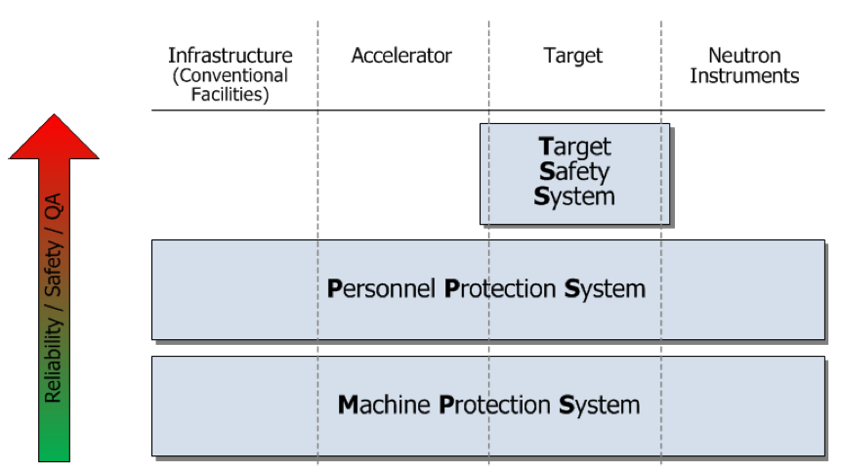
TSS Context: ESS Control Systems
TSS - Limit transfer of radioactive contamination to the public, workers, and environment
PSS - Suppress radiologic hazards by switching off the proton beam
Control access to restricted areas during operations
MPS – Protect investment from damage due to beam losses and malfunctioning equipment
Optimize integrated machine performance
Stop beam – Beam Interlock System
Personnel Safety System
TSS – Independent safety-qualified system
g Not tied into other ICS systems

Slide 10
TSS Development
Qualitative Hazard
Analysis
Accident Analysis
Dose Consequence
Identify Safety Functions
Allocate Safety Functions to TSS
Requirements for TSS
Design TSS
Process ongoing for the Target systems and TSS
Ideally sequential
End result
All safety functions identified
SSCs designed including complete TSS as part of the comprehensive safety strategy for Target station
However – Hazard Analysis is complex and time consuming

Slide 11
TSS g Pilot TSS
Hazard
Analysis
Other Accident Analyses
Dose Consequence
Identify Safety Functions
Allocate SaFs to TSS
Requirements for TSS
Design TSS
Awaiting completion of HA
Assume:
Dose Consequence
Safety Functions
Allocate SaFs to Pilot TSS
Requirements for Pilot TSS
Design Pilot TSS
Select Accident Scenario
HA
Merge to Create Complete TSS
Decision was made to move forward with the TSS design
Design Pilot TSS
Select accident scenarios from target wheel and helium cooling analysis
Until completion of Accident Analyses, the possibility remains that requirements on TSS will change

Slide 12
Pilot TSS Concept
Goals
Target Station shall operate safely, reliably, and with high availability
No mandate to maintain facility availability upon action by Pilot TSS
Target Station shall protect workers and the public from radiation exposure beyond allowable limits
Radioactive releases to the surrounding environment shall be prevented or, if this is not possible, controlled and mitigated
Pilot TSS shall bring the target into safe state in case of an abnormal event from nuclear radiation safety point of view
Defined as no beam on target for Pilot TSS accident scenarios

Slide 13
Pilot TSS Concept
Assume:
Dose Consequence
Identify Safety Functions
Allocate SaFs to Pilot TSS
Requirements for Pilot TSS
Design Pilot TSS
Select Accident Scenario
Assume Pilot TSS needs to:
Detect stopped wheel rotation
Detect loss of target He cooling
Shut down proton beam under these conditions
Define Pilot TSS safety functions (SaF)
Assume dose and identify severity – determine SaF classification & requirements for design
Design complete Pilot-TSS system to fulfil safety functions
Detection g decision g action (Logic, voting)
Trigger mechanisms, sensors, PLCs, actuators
Interfaces – Accelerator, Site Infrastructure, target wheel, PCool, ICS
Evaluate reliability, FMECA
TSS
Pilot TSS

Slide 14
Pilot TSS Concept
Architecture
Standalone active safety credited control and monitoring system
No dependency to other communication or control systems
Utilize its own dedicated sensors and actuators to bring target monolith to a safe state w/o relying on any external system
Includes physical separation, diversity and fail-safe criteria to such an extent that it can resist hazards that could impact Pilot TSS reliability
Interfaces
Target systems – monitor and evaluate process variables continuously, any sign of failure causes action to go to safe state
Accelerator – extract information related to operational modes to meet operational requirements
MCR – status available for monitoring to operations personnel

Slide 15
Pilot TSS Concept
Development standard
Pilot TSS will follow international standard IEC61511
Addresses safety-instrumented systems
Electrical/electronic/programmable electronic technology
Lifecycle and pragmatic quantification of risks and architecture provides valuable framework for safety engineering
Applies to all possible risks
Applying IEC61511 on systems-of-systems level and IEC61508 on the subsystem or components level
Licensing
Pilot TSS is important part of licensing process for the ESS
Subject to SSM conditions and legislations
Subject to local rules concerning risk and hazard management as defined by ES&H

Slide 16
Pilot PDR Presentations
Life-cycle process
TSS Document Map
Standard selection
ESS-0047208
Hazard analysis process
ESS-0041755
ESS classification
ESS-0016468
Jan Espen
Per
Monika
Mikael
Atefeh
Concept
ESS-0037596
Hazard analysis results overview
ESS-0050077
System requirements
ESS-0002776
Functions
ESS-0043617
Architecture & HW design
ESS-0045067
SW design
ESS-00xxxxx
Verification, commissioning and validation
ESS-0048372
Reliability Analysis
Identified safety controls ESS-0050185
Accidents reports ESS-0040075
ESS-0044348
ESS-0050081
He cooling variables ESS-0049507
ICD-R:s
ESS-0016380
ESS-0022915
ESS-0030063
ESS-0030068
ESS-0042356
ESS-0048755
FMECA
ESS-0047128

Slide 17
Conclusions
Pilot TSS is part of the overall Target Radiation Safety Strategy
Active control and monitoring system to protect the public and workers from release of radioactive material
Detect stopped wheel
Detect loss of target He cooling
Shut down power to proton beam under these conditions
Pilot TSS developed to enable design of TSS in parallel with continuation of Target Radiation Hazard Analysis
Follow IEC61511 lifecycle
Includes logic, sensors, PLC, actuators, interfaces
Analysis of reliability and failure modes
Much more information given in the rest of the PDR presentations

Slide 19
Target Radiation Safety Hazard Analysis: Severity Matrix – Public
Public
Severity (mSv) Probability | < 0.01 | 0.01-0.1 | 0.1-1 | 1-20 | 20-100 | >100
H1
H2
H3
H4
H5
H1 shaded out – indicates normal operation
Dose limits are per year
Normal operation limits and releases are handled separately from this analysis
H2 – H5 dose limits are per event
Limits set by SSM
Unacceptable
Tolerable
Acceptable

Slide 20
Target Radiation Safety Hazard Analysis: Severity Matrix – Workers
Workers
Severity (mSv) Probability | 0-1 | 1-10 | 10-20 | 20-50 | 50-100 | >100
H1
H2
H3
H4
H5
H1 shaded out – indicates normal operation – limits per year
Normal operation limits and releases are handled separately from this analysis
H2 – H5 dose limits are per event
Limits set by ESS GSO (General Safety Objectives) except for H5 limit which we chose to equal that of the public because there was no limit stated
Unacceptable
Tolerable
Acceptable

Slide 21
Target Station Radiation Safety Process
Systems/ Components
Design/define the systems and context
Qualitative Hazard Analysis
Risks - Events
Define (enveloping) events and frequency (H1-H5 probability)
Event Consequences
Calculate dose consequences of events (H1-H5 criteria)
Accident Analyses
Safety Function
Determine and categorize safety functions to prevent events (SaF)
Actions: (QA, Procedures) Analysis
Materials Manufacturing Installation
Inspection Testing
etc
Safety
Class
Determine safety classification of equipment (SIC)
ESS Classification Rules
Based on
standards
Code
Class
Choose classification in standards within the discipline

