Slide 1
Helium Cooling system:
Operating parameters,
Accident analyses
Per Nilsson
CFD Specialist
www.europeanspallationsource.se
15 February 2016

Slide 2
Outline
Accidents
Trigger parameters
Estimates from ESS-0049507

Slide 3
Accident Analysis
AA3:
Loss of Target wheel cooling during beam on target
AA4:
Leakage from Target Cooling circuit into monolith, Depressurization of Pcool
Notes:
- At least on of the bounding events from each of the major types determined by the hazard analysis that have the potential for an unacceptable risk level.
- Highest consequence among a group of similar events

Slide 4
AA3. Loss of target wheel cooling
Thermal stress and temperature increase in spallation material, cassettes and shroud
Shroud breaks and release He coolant into Monolith
Break NBW and/or PBW
ANALYSIS TO BE COMPLETED – No Final Dose Calc.
Target wheel is rotating
Criteria for safe shut down is 7 pulses on same sector ( ~ 18 s)
before exceeding level D criteria on shroud
(after 4 pulses/sector W temperature exceeds 700C)

Slide 5
AA4. Leakage from Target Cooling circuit into monolith (ESS-0044348)
Target vessel rupture
He leakage from target vessel, gradual increase of pressure in monolith vessel
Burst of PBW and/or NBW
ANALYSIS TO BE COMPLETED – No Final Dose Calc.

Slide 6
Choice of variables
Purpose:
Remove heat from target
Criterion:
Tungsten surface temperature < 700 °C
Requires:
Sufficiently cold and sufficiently high mass flow over target
➔ Inlet Temperature, Outlet flow, Pressure

Slide 7
Quantities
AA4 Leak from circuit
➔ Pressure
AA3 Loss of cooling (flow or secondary side water cooling)
Flow out (velocity easier than mass, but req. pressure)
Temperature in (out is only slowly affected by tungsten)
Notes:
Pressure is also important for oxygen control.
At small leaks, the pressure may be maintained by the pressure control system. Then the cooling function is maintained.
Mass flow out can be measured (Coriolis) but those are more complicated (contains calculations) than velocity meters.
Ensuring mass flow by velocity requires density, i.e. pressure and temperature.
Minimum pressure is triggered for.
Minimum temperature is ensured at inlet plus fixed added power. m=A*u*p/(RT)
Inlet temperature reacts faster and is easier to measure.

Slide 8
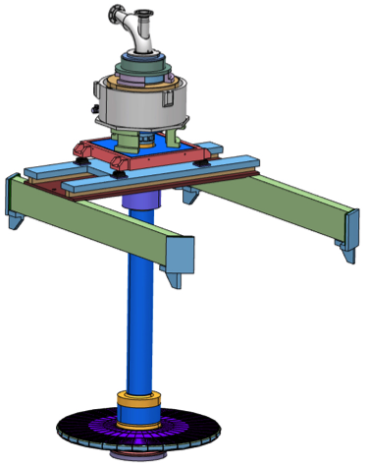
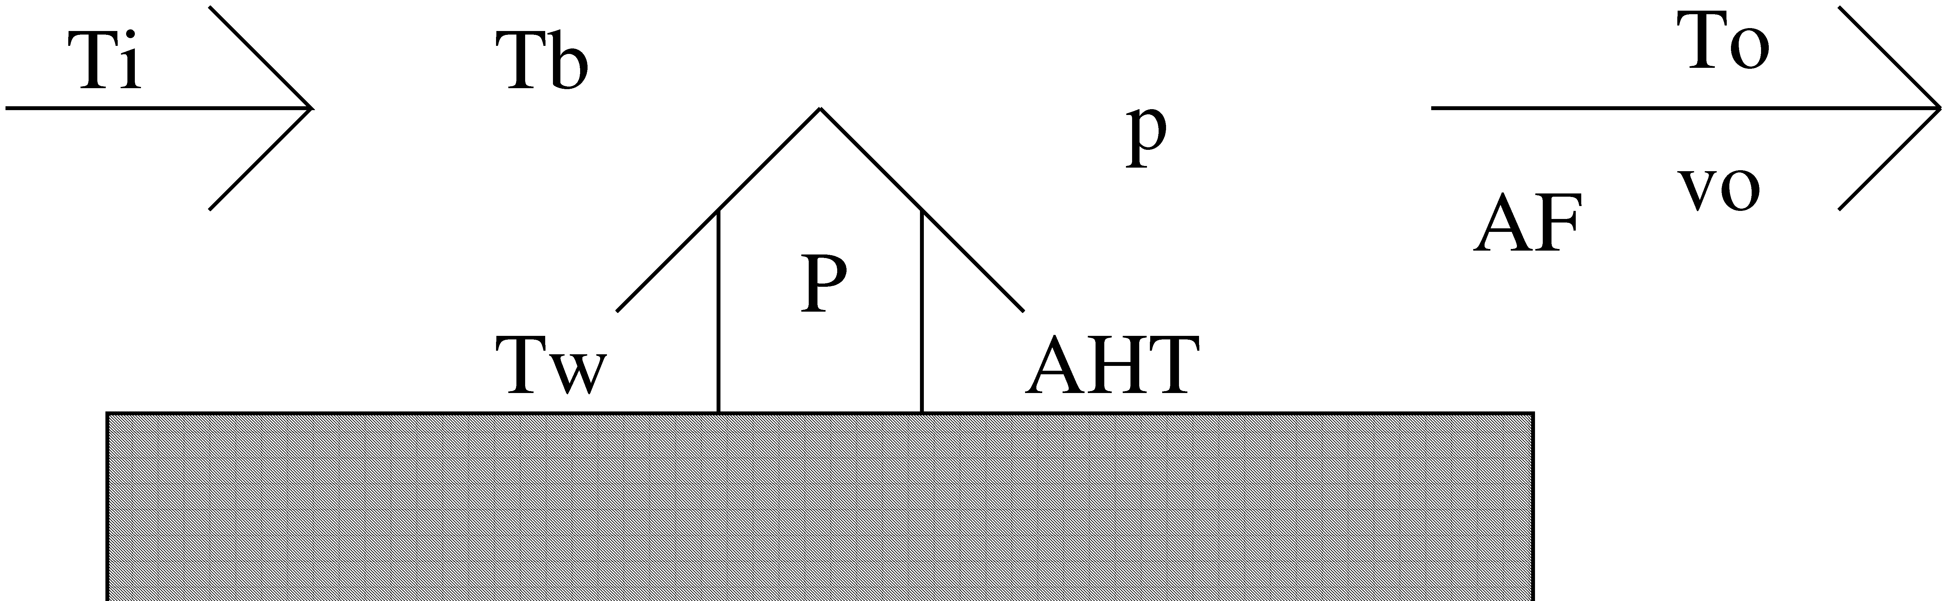
Lumped Model

Slide 9
Math
P = C_{p} * u_{o} * A_{F} * ρ_{o}(T_{o}, p) * ( T_{o} – T_{i} )
P = A_{HT} * α(T_{o}, p, u_{o}) * ( T_{w} – ( T_{o} + T_{i} )/2 )
C_{p}, A_{F}, A_{HT} Constant
α(Re, Pr, D, L) VDI Wärmeatlas
Vary p, T_{i} and u_{o} one at a time

Slide 10
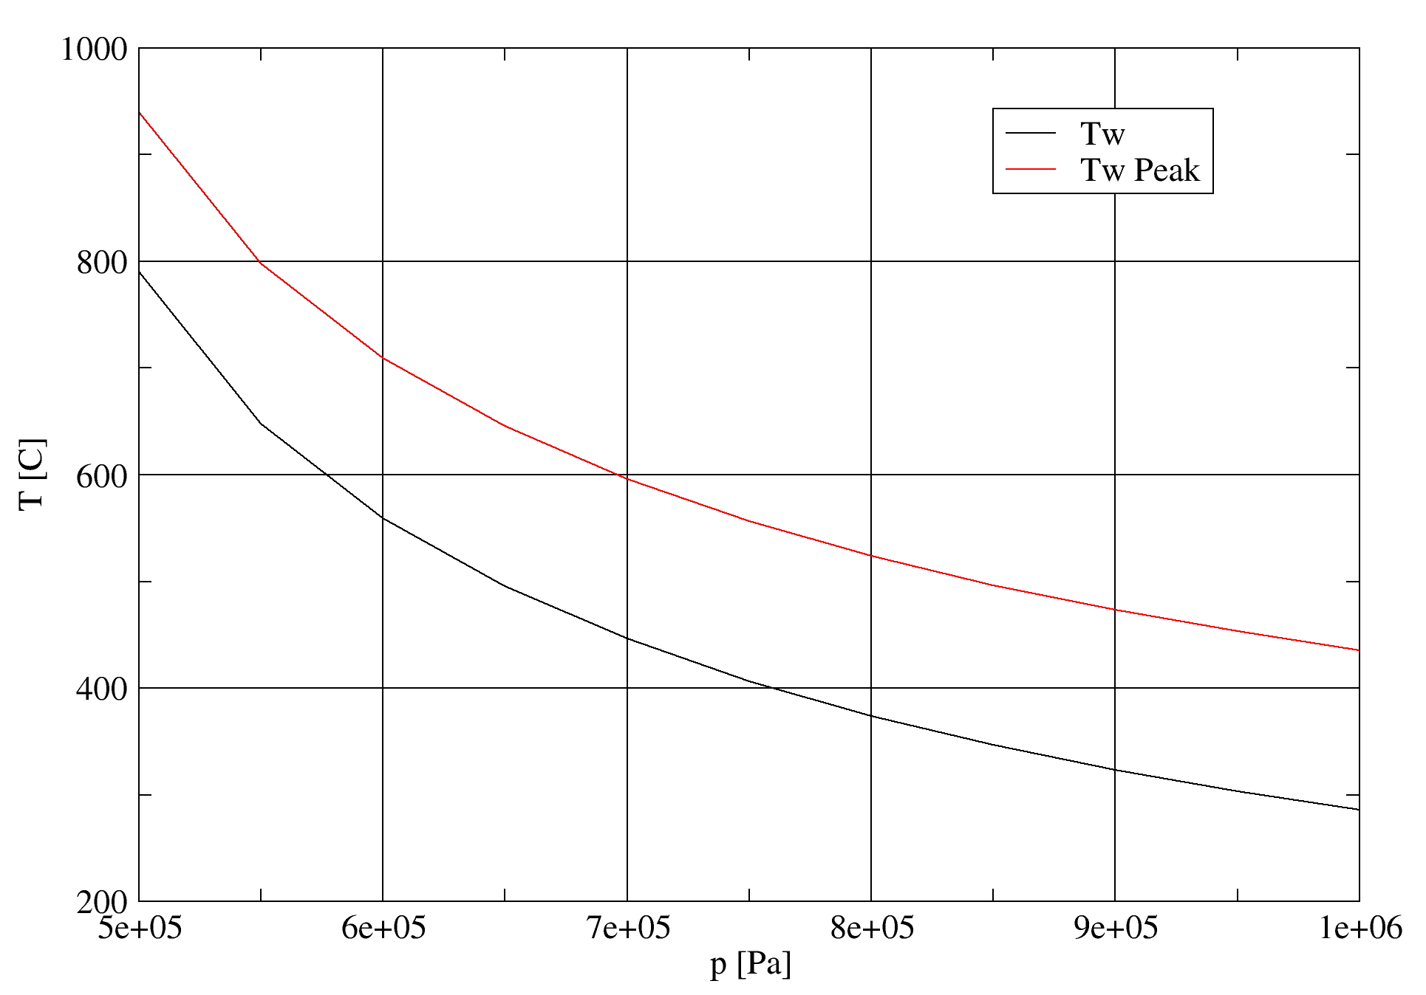
Pressure
~ 6.2 bar

Slide 11
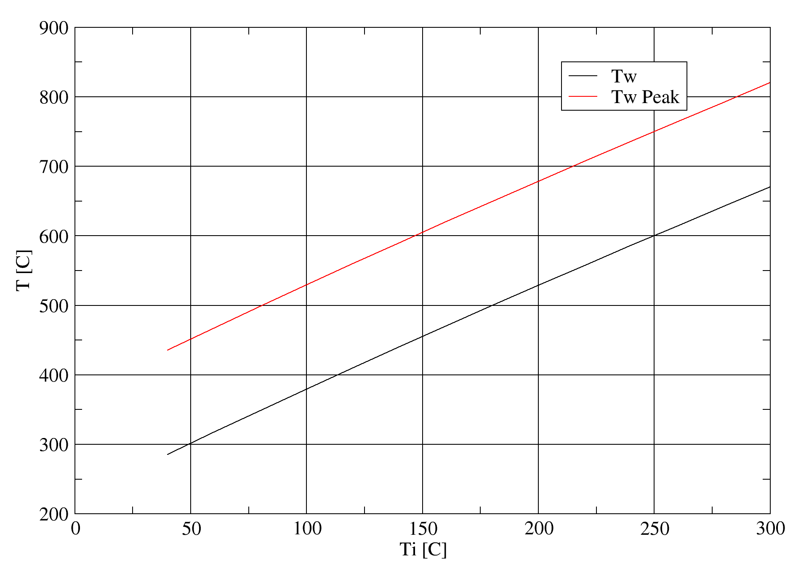
Inlet Temperature
~ 230 °C

Slide 12
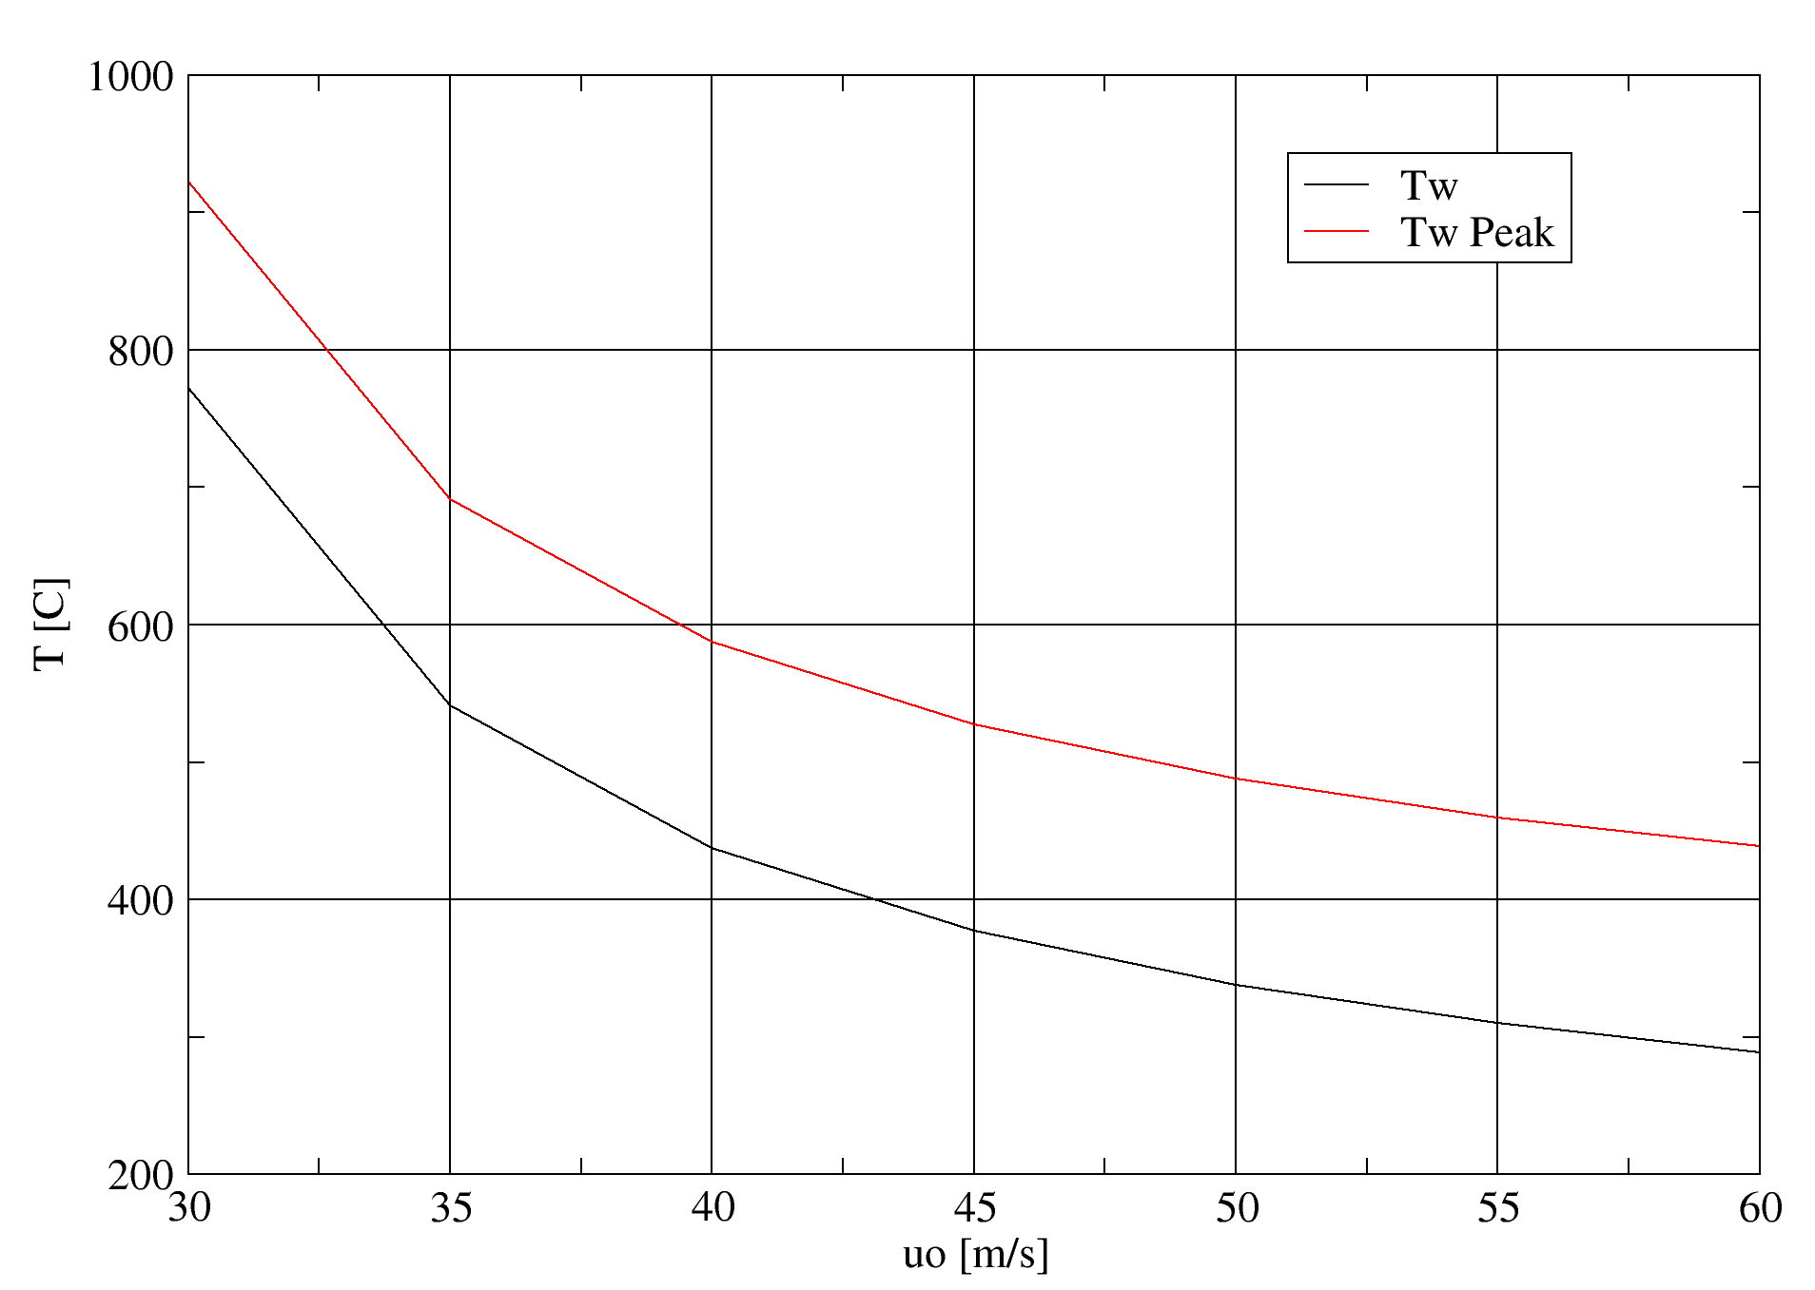
Outlet Velocity
~ 35 m/s

Slide 13
Time
3100 kg
3 MW
➔ 7 °C/s
From 440 °C to 700 °C takes about 35 s

Slide 14
Limitations and corrections to previous models
Changing only one variable at a time : Incorrect
Lumped, very simple model
CFD
System modeling
Notes:
- At least on of the bounding events from each of the major types determined by the hazard analysis that have the potential for an unacceptable risk level.
- Highest consequence among a group of similar events

Slide 15
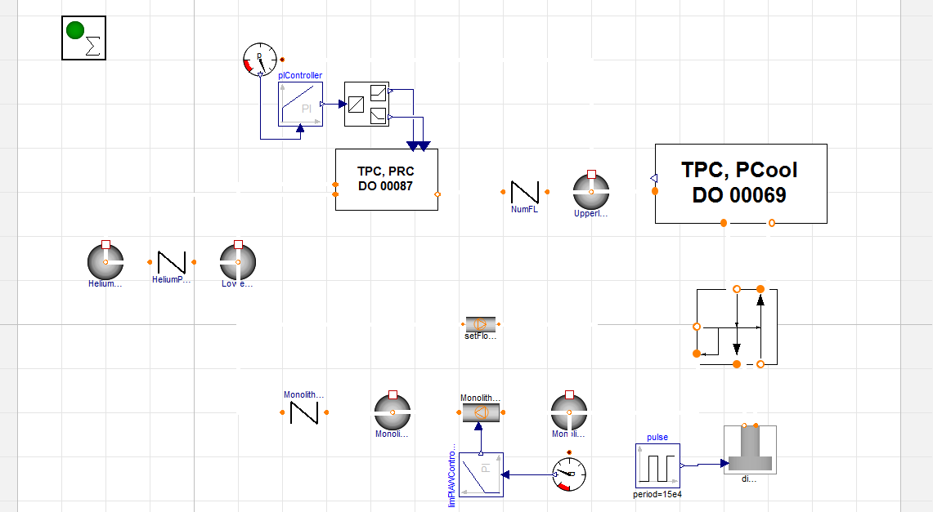
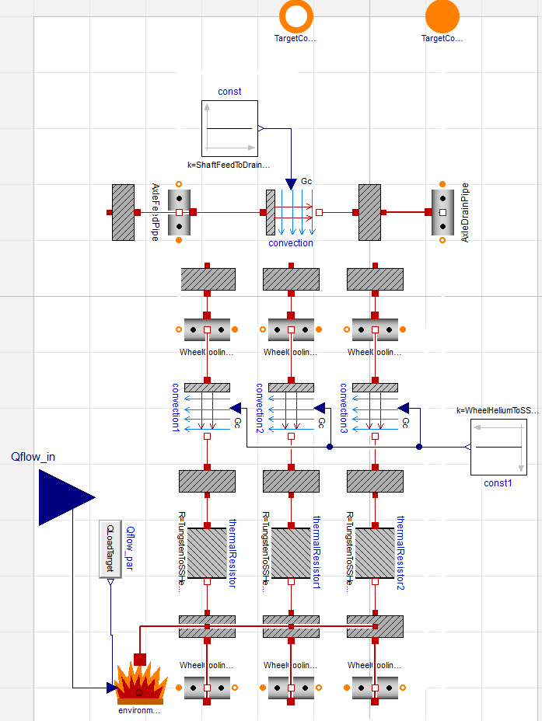
Modelica

Slide 16
Conclusion
Derived first estimates T_{in}, p, u_{out}, t
Further details required after Pilot TSS
Notes:
- At least on of the bounding events from each of the major types determined by the hazard analysis that have the potential for an unacceptable risk level.
- Highest consequence among a group of similar events

