Slide 1
Target Station Radioactive Hazard Analysis - Overview
Jan Espen Presteng
Safety Engineer – Target Control and Safety
www.europeanspallationsource.se
14 February 2016

Slide 2
Outline
Background and overview
Hazard Analysis procedure
Hazard analysis
Accident Scenario Analysis
Identified Active controls

Slide 3
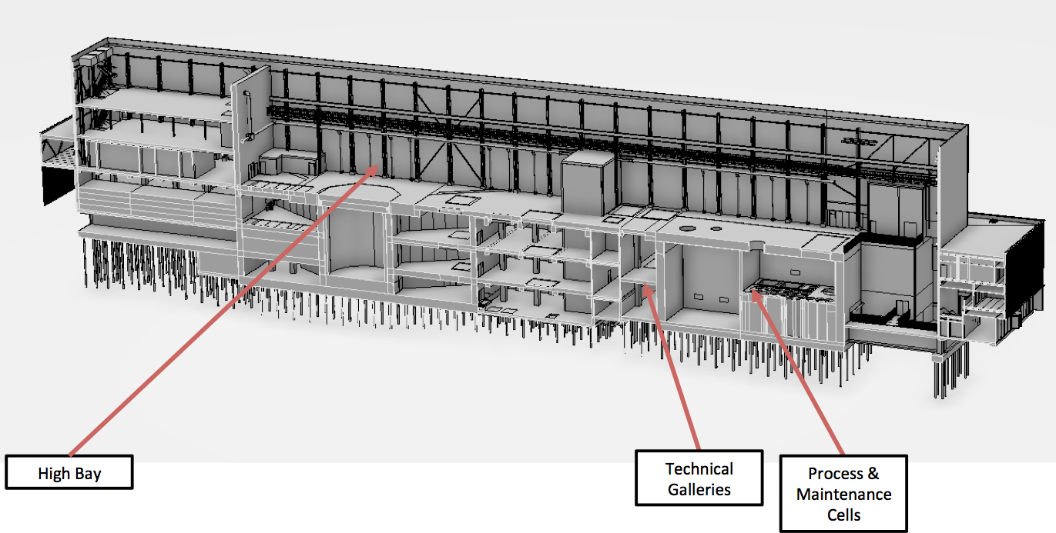
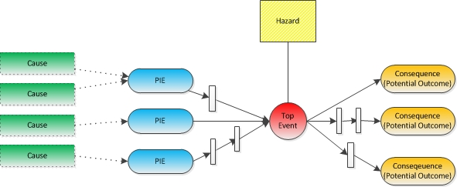
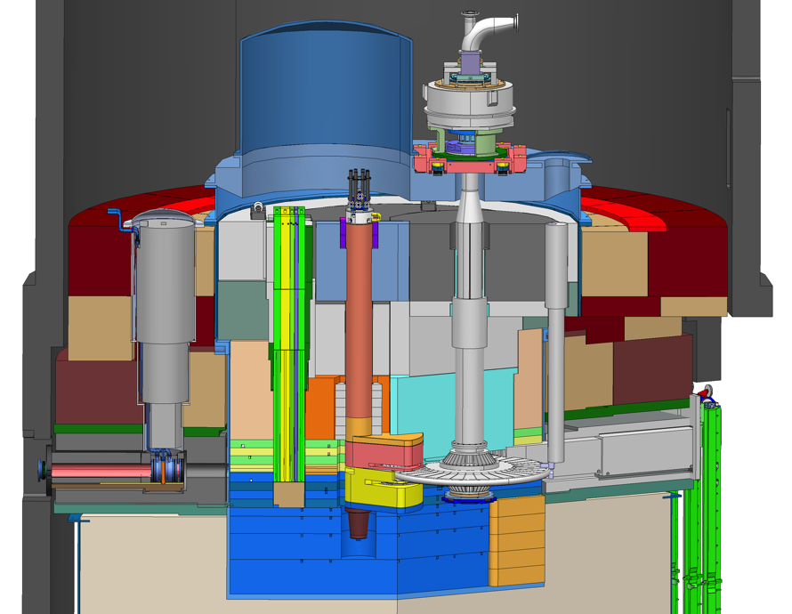
Background and overview
SSM;
Nuclear Authority
Design Facility
Hazard Analysis
Scenario Analyses
Safety Functions
Classification
Systems
Buildings
Operation
Events
(Severity
& Probability)
PIEs and Top
Enveloping
Unmitigated
Mitigated
Disciplines:
- Mechanical
- Ventilation
- Electrical
…
Physical evolution
Release Factors
Leaks, diffusion
Internal spread
External spread
Dose to public (SSM)
Severerity Probability | 0.01 -0.1 | 0.1 -1 | 1 -20 | 20 -100 | >100 mSv
H1 Normal
H2 Expected
H3 Unexpected
H4 Unlikely
H5 Very unlikely
Radiological impact
Inventory
Dose Factors

Slide 4
Hazard Analysis Procedure
Scope
  Applies to any system / subsystem / equipment / areas at Target Station that could have an accident with potential radiological impact to workers or the public.
  The hazard identification and analysis focuses on evaluating potential radiological accidents.
  Hazard analysis is a systematic process to identify, evaluate, and control potential hazards and accidents related to the Target Station.
Purpose
  Identify hazardous events associated with the facility processes, associated operations, work activities, and natural phenomena.
  Understand potential hazardous scenarios
  Define necessary mitigating measures – includes input to system design requirements and possible TSS actions

Slide 5
Hazard Analysis Procedure (qualitative)
Hazard Analysis procedure
  Define the system under analysis – include drawings, schematics, etc.
  Identify hazards
    Radioactivity, stored energy, explosion, impact (load drop)
  Identify initiating events and top events – circumstances that would evolve to an accident
  Describe consequences without risk reducing measures
  Estimate probability and severity g unmitigated risk ranking
  Define risk reducing measures
    Includes safety functions and associated triggers for active safety system
  Reassess severity g mitigated risk ranking
  Qualitative assessment based on expert engineering knowledge on similar systems

Slide 6
Systems and Hazard Analysis
Target Systems
Target Wheel and He Cooling
He Purification
Fluid Systems
Active Liquid Purification system
Primary Water Cooling Systems
Intermediate Water Cooling Systems
Intermediate Water Cooling for Water Systems
Contaminated Tanks
Gas Delay Tanks
Moderator Systems
Water Moderator
Reflector System
Cold Moderator
Target Moderator Cryoplant System
Target HVAC System
Monolith Systems
Monolith vessel incl. covers and penetrations, NBW, PBW
Shielding systems
Tuning Beam Dump
Remote Handling Systems

Slide 7
HA Target Wheel and He cooling (ESS-0037525) – Groups of events
Substantial leakage out from target & he-systems to rooms
Leakage between Primary Cooling and Intermediate cooling system
Small leakage out from target he-systems to rooms & stack
Leakage; out from target into monolith, no leakage to rooms
Leakage; out from rooms into monolith
Wheel stops or off synchronization
Decreased cooling efficiency in Pcool, no leakage to rooms
Abnormal helium flow between target helium cooling systems. no leakage to rooms
Increased heat deposition in target, no leakage to surrounding
Notes:
D. Failure mode. Target rotational sealing
All event groups will probably require function to monitor critical parameters and active control.

Slide 8
Hazard Analysis Procedure (quantitative)
Scoping calculations may be used for risk assessment
Accident Scenario Analysis
  Determining quantitatively probability for occurrence and consequence for top events
  Results are used to identify the need to designate safety function and class
  350 Top Events from HAs.
  Selection of events
    Enveloping events, at least on of the bounding events from each of the major types determined by the hazard analysis that have the potential for an unacceptable risk level

Slide 9
Accident Analysis
Target Wheel stop during beam on target
Beam Event: Focused and non-rastered beam on target
Loss of Target wheel cooling during beam on Target
Leakage from Target Cooling circuit into monolith
Clogged W channels, local overheating
Loss of He purification function
Water leakage from Intermediate Water System into Target He
Loss of confinement in Target He system – release into Utility rooms
LH2 leakage with explosion/LH2 leakage with local fire
Water leakage in monolith (highest contamination level)
Water leakage into connection cell and utility rooms
NBG/Chopper - missile effect on monolith system
Beam dump – high power beam when target in maintenance mode
Earthquake scenario Target/monolith
Operator inside maintenance cell when bi-fold door unintentionally opens
Operator inside confinement (process cell)
Operator inside confinement (maintenance cell)
Loss of dynamic confinement in Active Cell (Loss of HVAC)
Loss of confinement Active Cells process/maintenance – open doors
Fire in Active Cells
Earthquake in Active Cells

Slide 10
Accident Analysis
Pilot TSS related events
  AA1 – Target Wheel stopped during beam on target
  AA3 - Loss of Target wheel cooling during beam on target
  AA4 - Leakage from Target Cooling circuit into monolith, Depressurization of Pcool
Notes:
- At least on of the bounding events from each of the major types determined by the hazard analysis that have the potential for an unacceptable risk level.
- Highest consequence among a group of similar events

Slide 11
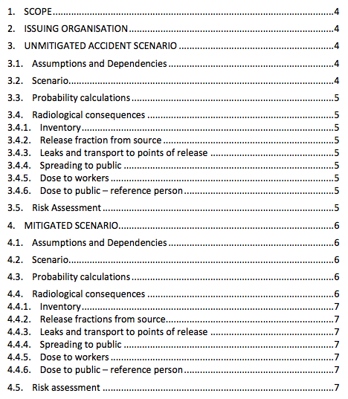
Accident Analysis template (ESS-0039961)

Slide 12
AA1. Wheel Stop with Beam (ESS-50081)
Beam on
Failure in the Drive system
Sync. With proton beam is lost
Target wheel rotation stop
Thermal stress and temperature increase in spallation material, cassettes and shroud
Shroud breaks and release He coolant into Monolith
Break NBW and/or PBW
ANALYSIS TO BE COMPLETED – No Final Dose Calc.
Criteria for safe shut down is 7 pulses ( ~ 0.49 s)
before exceeding level D criteria on shroud.
(after 4 pulses W temperature exceeds 700C)
Notes:
RCC-MRx

Slide 13
AA3. Loss of target wheel cooling
Thermal stress and temperature increase in spallation material, cassettes and shroud
Shroud breaks and release He coolant into Monolith
Break NBW and/or PBW
ANALYSIS TO BE COMPLETED – No Final Dose Calc.
Target wheel is rotating
Criteria for safe shut down is 7 pulses on same sector ( ~ 18 s)
before exceeding level D criteria on shroud
(after 4 pulses/sector W temperature exceeds 700C)

Slide 14
AA4. Leakage from Target Cooling circuit into monolith (ESS-0044348)
Target vessel rupture
He leakage from target vessel, gradual increase of pressure in monolith vessel
Burst of PBW and/or NBW
ANALYSIS TO BE COMPLETED – No Final Dose Calc.

Slide 15
Documentation
Radiological Hazard Analysis Process for the ESS Target Station (ESS-0049507)
Accident Analysis reports
Hazard analysis documentation overview
(ESS-0050077)
Hazard Analysis spread sheets

Slide 16
Potential Active safety functions identified (ESS-0050185)
1. Stop proton beam (TW)
2 . Stop proton beam (Loss of confinement MS)
3 . Isolate injection circuit (TW)
4. Restrict access to surrounding rooms (utility rooms) (TW/HP)
6. Mode of operation interlock (TW/PD)
7. Interlock: Not possible to enter maintenance mode before drain and fill mode (TW)
8. HE loop pressurized ´light´-signal in connection cell (TW)
9. Control of operational mode in relation with access control (TW)
11. Circuit isolation (WM)
12. Flush GLS tank (WM)
13. Ventilate H2 – degr. vacuum/pressure (CM)
21. Restrict access to triangular utility rooms during operation (AP/PD/CT)
23. Tritium sensor in triangular rooms (AP/PD/CT)
35. Monitoring and alarm system for loss of dynamic confinement
37. Stop air supply – pressure / confinement (HV)
39. Assure electric power supply (HV)
42. Interlock control of operator access in correct mode (AC)
43. Building operating system designed to prevent crashes (crane) (AC)
45. Gamma monitoring and sensors (AC)
48. Bypass ventilation (AC)
49. Close confinement; Adjustable dampers, shut off fans. (AC)
50. Interlock system; shielding cover in place, open hatch (AC)

Slide 17
Potential Active Safety function – TSS candidate?
1. Stop proton beam (TW)
2 . Stop proton beam (Loss of confinement) (MS)
3 . Isolate injection circuit (TW)
4. Restrict access to surrounding rooms (utility rooms) (TW/HP)
6. Mode of operation interlock (TW/PD)
7. Interlock: Not possible to enter maintenance mode before drain and fill mode (TW)
8. HE loop pressurized ´light´-signal in connection cell (TW)
9. Control of operational mode in relation with access control (TW)
11. Circuit isolation (WM)
12. Flush GLS tank (WM)
13. Ventilate H2 – degr. vacuum/pressure (CM)
21. Restrict access to triangular utility rooms during operation (AP/PD/CT)
23. Tritium sensor in triangular rooms (AP/PD/CT)
35. Monitoring and alarm system for loss of dynamic confinement (HV/AC)
37. Stop air supply – pressure / confinement (HV)
39. Assure electric power supply (HV)
42. Interlock control of operator access in correct mode (AC)
43. Building operating system designed to prevent crashes (crane) (AC)
45. Gamma monitoring and sensors (AC)
48. Bypass ventilation (AC)
49. Close confinement; Adjustable dampers, shut off fans. (AC)
50. Interlock system; shielding cover in place, open hatch (AC)

Slide 18
Conclusion
Qualitative analysis being finalized, complete analysis of maintenance aspect
Enveloping Accident Analyses identified
  Progress on Pilot-TSS related Accident Analysis
  Potential TSS-requirements from other Accident Analysis
Speed up and complete Accident Analysis
  quantitative assessment
  define safety functions
Assign safety functions to appropriate “safety system”
Notes:
- At least on of the bounding events from each of the major types determined by the hazard analysis that have the potential for an unacceptable risk level.
- Highest consequence among a group of similar events

