Slide 1
Pilot TSS system requirements
Mikael Olsson
Control engineer – Target control
www.europeanspallationsource.se
15 February 2016

Slide 2
ESS-0002776
Life-cycle process
Standard selection
ESS-0047208
Hazard analysis process
ESS-0041755
ESS classification
ESS-0016468
Concept
ESS-0037596
Hazard analysis results overview
ESS-0050077
System requirements
ESS-0002776
Functions
ESS-0043617
Architecture & HW design
ESS-0045067
SW design
ESS-00xxxxx
Verification, commissioning and validation
ESS-0048372
Identified safety controls ESS-0050185
Accidents reports ESS-0040075
ESS-0044348
ESS-0050081
He cooling variables ESS-0049507
ICD-R:s
ESS-0016380
ESS-0022915
ESS-0030063
ESS-0030068
ESS-0042356
ESS-0048755
FMECA
ESS-0047128

Slide 3
Outline
Hazard analysis / accident scenarios
ES&H requirements
ESS requirements
ESS classification
TSS overall safety function
TSS safety instrumented functions
TSS system requirements
TSS function specification

Slide 4
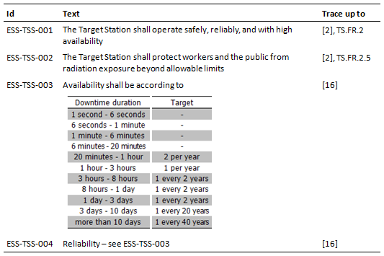
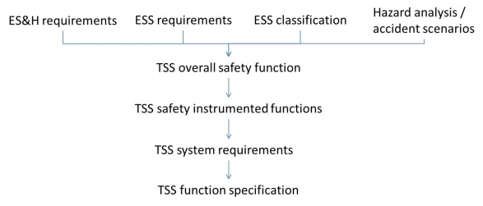
Top requirements - ESS
Extra: accelerator shall be allowed to produce and send proton beam to beam dump – even if target is not ready for beam Rationale:
commissioning and maintenance of accelerator
high availability of accelerator

Slide 5
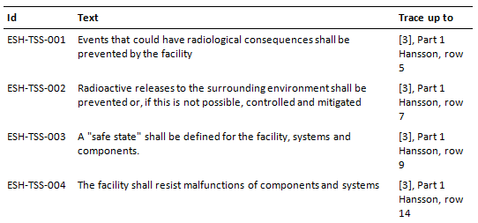
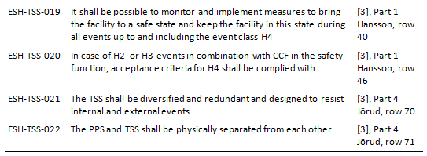
Top requirements –ES&H
Keywords
Prevention of events leading to radioactive releases
Usage of safety classes
Usage of “safe state”
Consider events up to and including event class H4
Resistance to malfunction
Single failures
Common cause failures
Design principles
Redundancy, diversity, physical separation

Slide 6
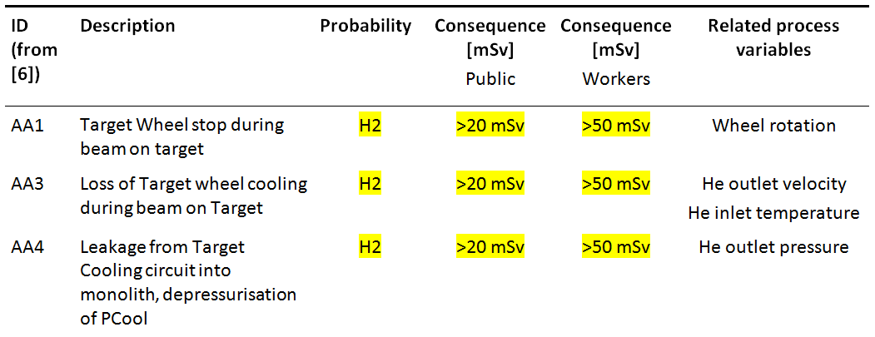
Accidents

Slide 7
ESS classification – need for safety function
Severity (mSv) Probability | < 0.01 | 0.01-0.1 | 0.1-1 | 1-20 | 20-100 | >100
H1
H2
H3
H4
H5
C3
C2
C1
C1
C2
C1
C1
C1
C1
C1

Slide 8
ESS classification – impact on TSS
“Proposal”

Slide 9
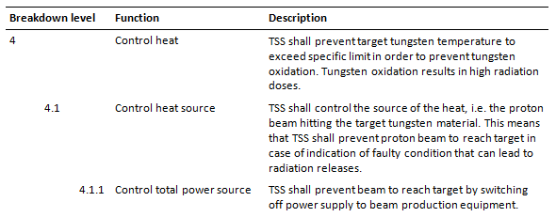
ESS classification - identification of TSS
TSS is identified as one of ESS safety functions
“Main radiation safety function”
“Detailed radiation safety function”
“Further detailed radiation safety function”

Slide 10
Overall safety function
Based on common hazard from AA1, AA3 and AA4 (likely TSS related consequences)
If >700 °C oxidation of tungsten becomes possible and more isotopes are released
Overall safety function | Normal operation | Req ID
TSS shall prevent target wheel tungsten temperature from exceeding 700 °C | 390 °C | TSS-TSS-100

Slide 11
Instrumentation of overall safety function
Process variable Accident | Outlet velocity | Outlet pressure | Inlet temperature | Target shaft rotational speed
Target Wheel stop during beam on target - AA1 |  |  |  | X
Loss of He cooling flow (blower fail) - AA3 | X
Loss of He cooling pressure (leakage) – AA4 |  | X
Loss of He cooling heat exchange – AA3 |  |  | X
TSS cannot measure tungsten temperature due to high radiation level inside monolith
Instead monitoring tungsten cooling conditions
4 process variables identified

Slide 12
Safety instrumented functions
Safety instrumented functions | Normal operation | Req ID
TSS shall prevent proton beam from reaching target if…
target He outlet velocity is < 35 m/s within 35 sec | 61 m/s | TSS-TSS-101
target He outlet pressure < 6.2 bar within 35 sec | 10 bar | TSS-TSS-102
target He inlet temperature > 230 °C within 35 sec | 40 °C | TSS-TSS-103
target shaft rotational speed < 11.6 rpm within 210 ms | 23.3 rpm | TSS-TSS-104
Target wheel stops instantaneously. 4:th pulse on same sector gives >700 °C.
Within 3 pulses after stop = 3*70 ms = 210 ms

Slide 13
Target wheel stops – time constraint
Scenario | Tungsten T [°C] | Time [ms]
p⁺1 hits sector | 390 -> 490
Rotation stops |  | 0
p⁺2 hits same sector | 590 | 70
p⁺3 hits same sector | 690 | 140
p⁺4 hits same sector | 790 | 210
X
p⁺1
p⁺2
p⁺3
p⁺4

Slide 14
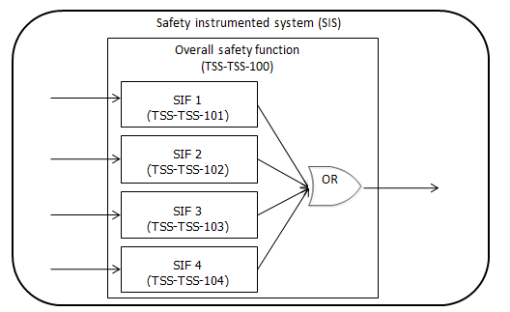
Safety system – overall function – instrumented functions

Slide 15
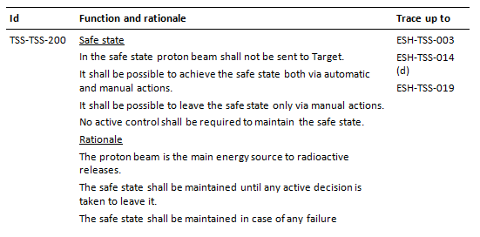
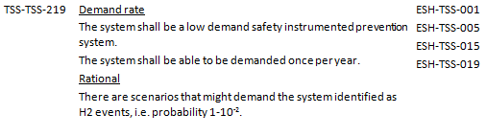
System requirements
Requirement content (extracted from 61511)
Safe state
Modes of operation
Start-up and restart
System input and output
Manual shutdown
Failure modes and responses
Common cause failures
Single failures
Max allowable spurious rate
Operator interfaces
Proof test interval
Mean time to repair
Security
Environmental design for equipment
Tools for periodic test and replacement
Demand rate

Slide 16
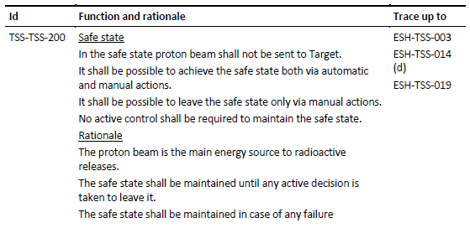
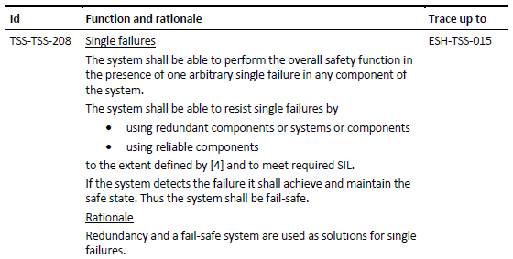
System requirements - examples

Slide 17
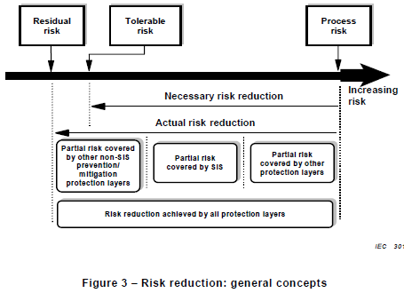
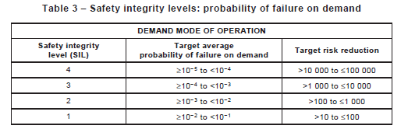
IEC 61511 and SIL
Risk level including TSS
Probability for demand of TSS
Identified during hazard analysis
Safety classified design, passive safety functions etc.
TSS reliability = probability of failure on demand
SIL

Slide 18
ESS-0043617
Life-cycle process
Standard selection
ESS-0047208
Hazard analysis process
ESS-0041755
ESS classification
ESS-0016468
Concept
ESS-0037596
Hazard analysis results overview
ESS-0050077
System requirements
ESS-0002776
Functions
ESS-0043617
Architecture & HW design
ESS-0045067
SW design
ESS-00xxxxx
Verification, commissioning and validation
ESS-0048372
Identified safety controls ESS-0050185
Accidents reports ESS-0040075
ESS-0044348
ESS-0050081
He cooling variables ESS-0049507
ICD-R:s
ESS-0016380
ESS-0022915
ESS-0030063
ESS-0030068
ESS-0042356
ESS-0048755
FMECA
ESS-0047128

Slide 19
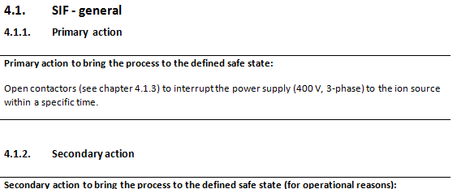
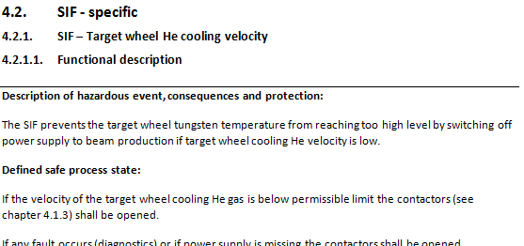
Functions
Function content (extracted from 61511)
Functional description
Primary action
Fail safe process input and output
Final elements
Trip limit and response time
Muting/bypass (beam to dump)
Activate/deactivate
Reset/restart
Spurious trips and reset failures
BPCS and other system interfaces
Proof test intervals
Protection from environmental conditions and accidents
Consequential hazards
Demand rate and safety integrity
HMI

Slide 20
Conclusions
Requirement structure
ES&H interpretation of SSM requirements
Overall safety function based on likely accidents with assumptions (Pilot TSS)
Prepared for changes (TSS)
Further details during detail design

Slide 21
Break

Slide 22
Design challenges
H2 events with consequences >20 mSv
>20 mSv is only allowed for H5 events
TSS to decrease probability H2 (>10⁻²) -> H5 (<10⁻⁶)
Corresponds to <10⁻⁴ which is SIL4
Layers of protection = count on process control and machine protection to decrease demand rate for TSS?
Target wheel stops instantaneously
TSS must act within 210 ms (3 pulses) to prevent 700 °C
Safety control equipment generally slow due to internal diagnostic functions
Can target wheel stop within one sector?
Is 700 °C the critical temperature?

Slide 23
Questions
Who is defining requirements on TSS for single failure and common cause failures?
SSM definitions
ES&H interpretations/requirements
Solution by SE (ESS classification - ESS-0016468)
Safe state - what is required to leave safe state?
Due to spurious trip
Due to real trip

