Slide 1

TSS Standard & Classification
Dr. Monika Reif, Sven Stefan Krauss
Zürcher Hochschule für angewandte Wissenschaften (ZHAW), Switzerland

Slide 2
Agenda
1. Standard Selection
1.1 Introduction
1.2 Standards compared
1.3 Comparison of several concepts of these standards
1.4 Conclusion: Standard selection
2. Hazard and risk assessment
2.1 Introduction
2.2 Mapping of ESS guidelines to IEC61511
2.3 Example for hazard and risk assessment
2.4 Conclusion: Mapping

Slide 3
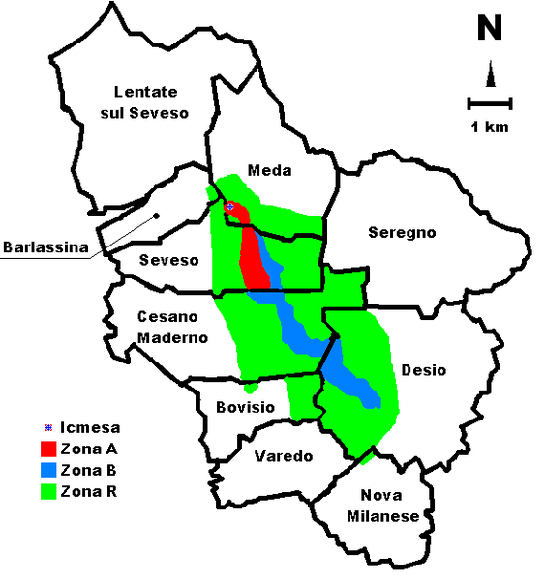
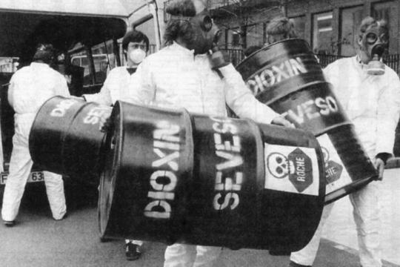
1.1 Introduction
Chemical accident in Seveso, Italy 1976:
Release of dioxin with catastrophic impact for human and environment
Decree of several directives and standards (IEC61508 series)
Reference : Wikipedia.com, Welt.de

Slide 4
1.1 Introduction
Standards IEC61508 series
Nuclear power plants
IEC61513
Process industry
IEC61511
Railway
EN 5012x
IEC 61508
Medical
IEC 60601
Automotive
ISO26262
power drive systems
IEC 61800
Machinery
IEC 62061

Slide 5
1.2 Standards compared
Nuclear Power Plants IEC
Development of system according to IEC61513
Several standards referenced for certain parts of development or facility
IEC60671
Nuclear power plants – Instrumentation and control systems important to safety – Surveillance testing
Categorization: IEC 61226
Systems IEC61513
Software | Hardware
Category A: IEC60880 | IEC60987
Categories B and C: IEC62138
IEC60709
Nuclear power plants – Instrumentation and control systems important to safety – Separation
IEC60780
Nuclear power plants – Electrical equipment of the safety system – Qualification
IEC62340
Nuclear power plants – Instrumentation and control systems important to safety – Requirements for coping with common cause failure (CCF)
IEC61500
Nuclear power plants – Instrumentation and control important to safety – Data
communication in systems performing category A functions
etc.

Slide 6
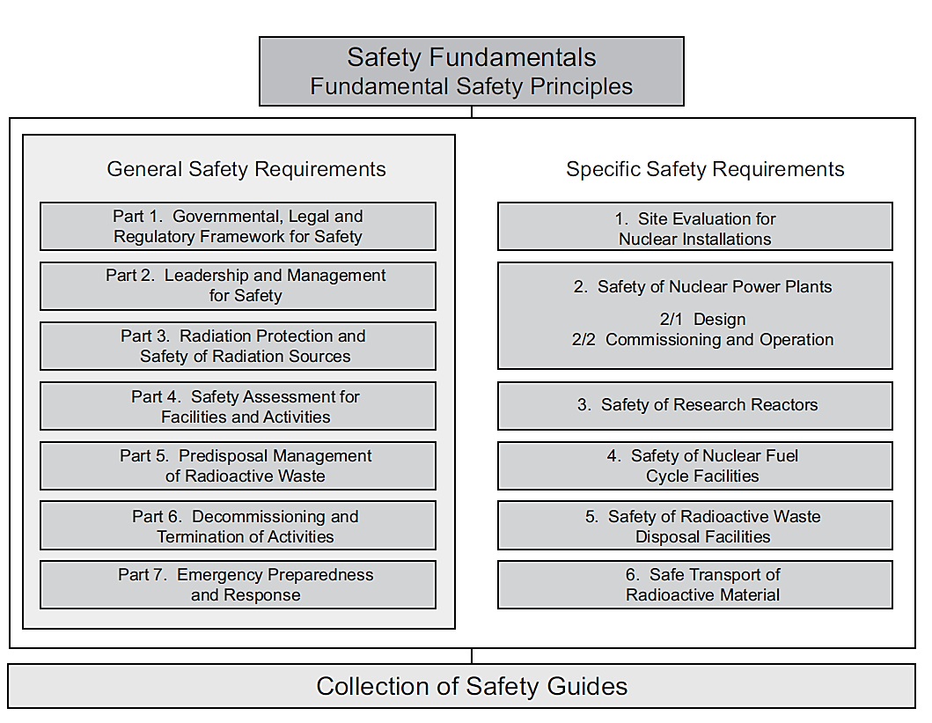
1.2 Standards compared
Nuclear Power Plants IAEA
Reference: IAEA SSR-2/1: Safety of: Nuclear Power Plants: Design

Slide 7
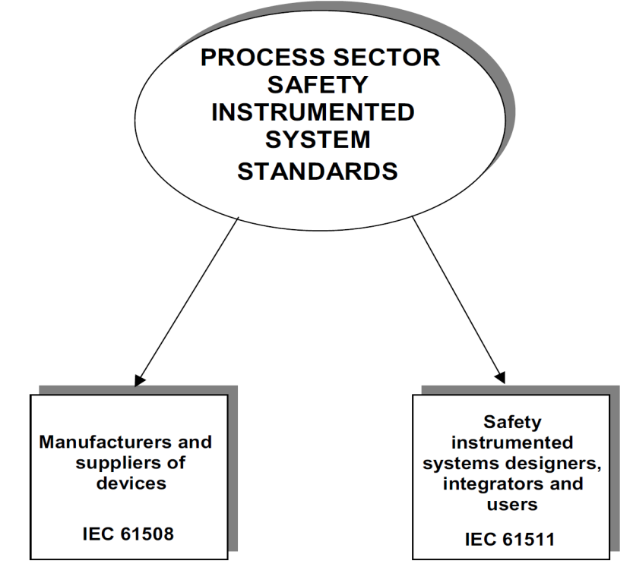
1.2 Standards compared
Process sector standard
Part 1: | Framework, definitions, system, hardware and software requirements
Part 2: | Guidelines for the application of IEC 61511-1
Part 3: | Guidance for the determination of the required safety integrity levels
Development of system
according to IEC61511
Development of devices (SW/HW)
according to IEC61508
Requirements cover complete lifecycle to prevent and control:
Systematic HW or SW failures: by process, methods, procedures
Random HW failures: by process, methods, procedures, compliance proofed among others by a PSA
Reference: IEC61511-1

Slide 8
1.2 Standards compared further standards and orders
DOE O 420.2C, Subject: Safety of Accelerator Facilities
defines the safety programs of a comnplete accelerator facility:
an approved accelerator safety envelope (ASE)
a safety assessment document (SAD)
clearly defined roles and responsibilities for accelerator activities
an unreviewed safety issue (USI) process
an accelerator readiness review (ARR) program that ensures facilities are adequately prepared for safe commissioning and/or operations
a current listing/inventory of accelerators …
Order applies to whole facility
E/E/PE-systems relevant to safety as part of credited controls
Requirement within this safety lifecycle for E/E/PE defined in a generic way (referred to IEC61511 for one credited control)

Slide 9
1.3 Standard comparison
Scope
IEC61513:
I&C of new nuclear power plants as well as to I&C up-grading or back-fitting of existing plants
IAEA SSR-2/1:
land based stationary nuclear power plants with water cooled reactors designed for electricity generation or for other heat production applications
IAEA SSG-37 :
design and operation of instrumentation and control systems for research reactors
IEC61511:
specification, design, installation, operation and maintenance of a safety instrumented system, so that it can be confidently entrusted to place and/or maintain the process in a safe state

Slide 10
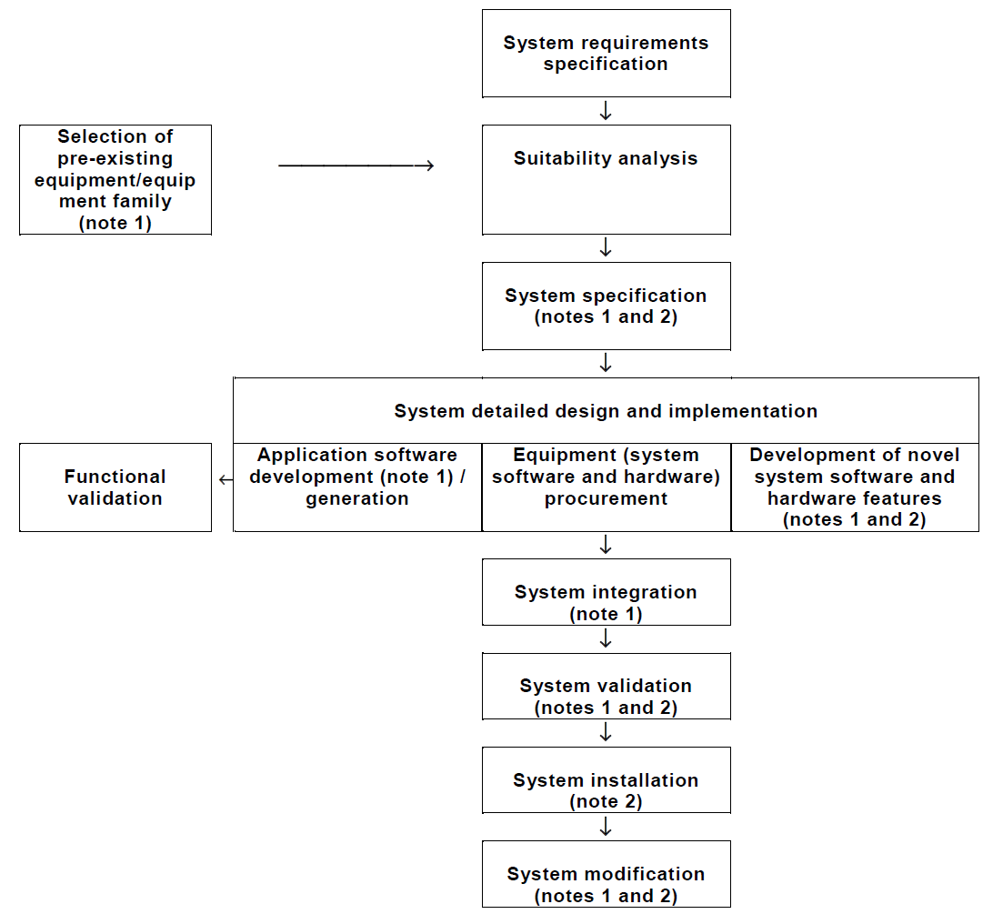
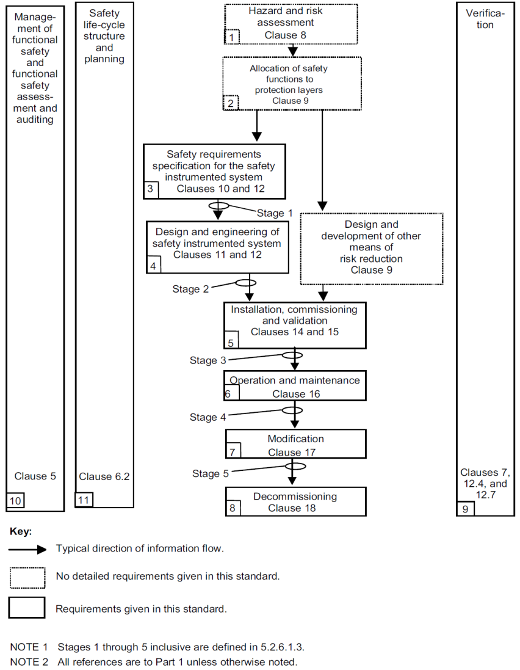
1.3 Standard comparison
Safety lifecycle
IEC61513: Nuclear Power Plants IEC61511: Process industry

Slide 11
1.3 Standard comparison
Importance to safety (Cat or SIL)
IEC61226: Nuclear Power Plants
Procedure:
Defining design basis accidents (DBA) and the resulting design base events (DBE)
Functions are categorized in terms of their role with respect to these DBEs:
Cat. A: direct role in maintenance of safety
Cat. B: complementary role to Cat. A
Cat. C: auxiliary or indirect role.
rather deterministic way for classification

Slide 12
1.3 Standard comparison
Importance to safety (Cat or SIL)
IAEA SSG-30: Safety Classification of Structures, Systems and Components in Nuclear Power Plants
Functions credited in the safety assessment | Severity of the consequences if the function is not performed
 | High | Medium | Low
Functions to reach a controlled state after anticipated operational occurrences | Cat. 1 | Cat. 2 | Cat. 3
Functions to reach a controlled state after design basis accidents | Cat. 1 | Cat. 2 | Cat. 3
Functions to reach and maintain a safe state | Cat. 2 | Cat. 3 | Cat. 3
Functions for the mitigation of consequences of design extension conditions | Cat. 2 or 3 | n/a | n/a

Slide 13
1.3 Standard comparison
Importance to safety (Cat or SIL)
Residual Risk
Tolerable Risk
Risk which is accepted in a given context based on the current values of society.
Process
risk
Risk existing for the specified hazardous events for the process, the basic process control system and associated human factor issues
Risk remaining after protective measures have been taken.
Risk
Necessary Risk Reduction
Actual Risk Reduction
Risk = Frequency for a specified consequence
Partial risk covered by other non-SIS prevention/ mitigation
protection layers
Partial risk
covered by SIS,
e.g. TSS
Partial risk
covered by other
protection layers
SIS = Safety instrumented system
Risk reduction achieved by all protection layers
Reference: IEC61511-3

Slide 14
1.3 Standard comparison
Importance to safety (Cat or SIL)
IEC61511: Process industry
Safety integrity level (SIL) relative level of risk-reduction provided by a safety function:
SIL 4 the most dependable and SIL 1 the least
Methods used to assign a SIL:
Risk matrices
Risk graphs
Layers of protection analysis (LOPA)
rather probabilistic way for classification

Slide 15
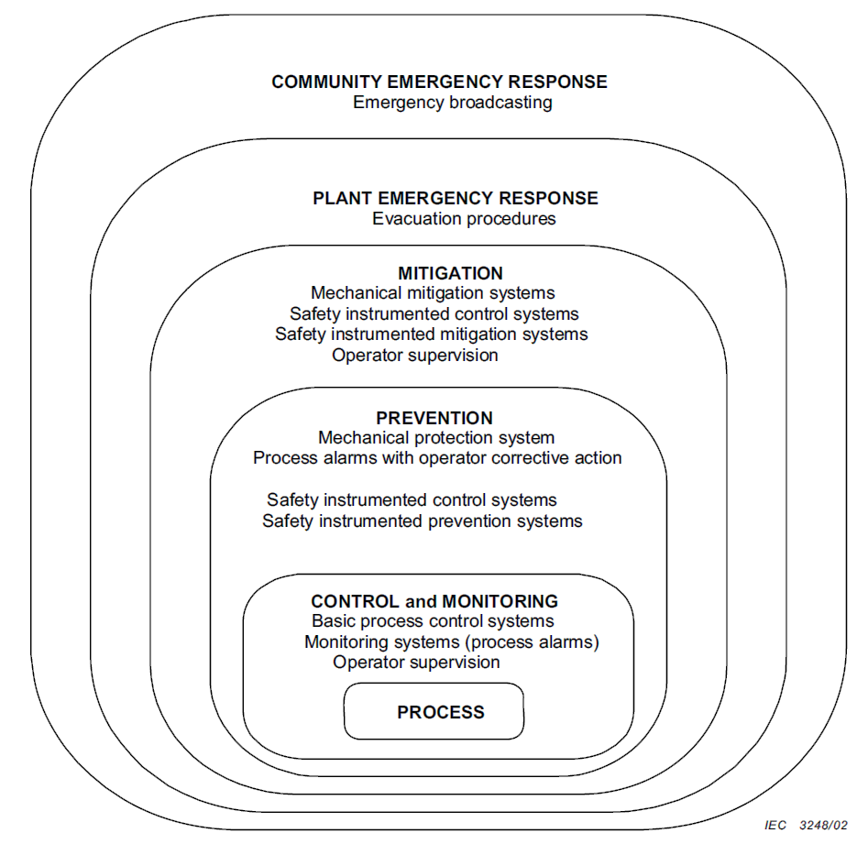
1.3 Standard comparison
Defence in depth or protection layers
      IAEA SSR-2/1
      IEC61511
Protecting people and the environment, emergency preparedness
Prevention of accident progression, mitigation of consequences
Control of accidents within the design basis
Control of abnormal operation and detection of failures
Prevention of abnormal operation and failures

Slide 16
1.3 Standard comparison
CCF, single failure criterion, diversity
IEC61513 or IAEA SSR-2/1 or IAEA SSG-37
Single failure criterion: deterministic approach to ensuring that a minimal redundancy of a system or of a group of equipment items is obtained.
Redundancy : to achieve system reliability goals and/or conformity with the single failure criterion. (independence needed)
Diversity: principle of monitoring different parameters, using different technologies, different logic or algorithms, or different means of actuation. (defence against common cause failures)

Slide 17
1.3 Standard comparison
CCF, single failure criterion, diversity
IEC61511
Requirements for preventing common cause, common mode and dependent failures (clause 9.5)
Minimum hardware fault tolerance equivalent to single failure criterion and redundancy requirements (independence needed)
very good diagnostics
SIL3

Slide 18
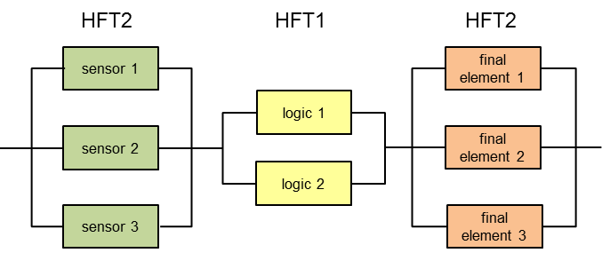
1.3 Standard comparison
CCF, single failure criterion, diversity
Example for a system structure compliying with SIL3 of IEC61511
Common causes have to be considered for identical components and also for complete system, e.g. common cause analysis

Slide 19
1.3 Standard comparison
Extreme conditions
IAEA:
IAEA NS-G-1.11: Protection against Internal Hazards other than Fires and Explosions in the Design of Nuclear Power Plants
IAEA NS-G-1.5: External Events Excluding Earthquakes in the Design of Nuclear Power Plants
IAEA NS-G-1.6: Seismic Design and Qualification for Nuclear Power Plant
IAEA NS-G-1.7: Protection Against Internal Fires and Explosions in the Design of Nuclear Power Plants
IEC61511: consider
the extremes of all environmental conditions that are likely: temperature, humidity, contaminants, grounding, electromagnetic interference/ radiofrequency interference (EMI/RFI), shock/vibration, electrostatic discharge, electrical area classification, flooding, lightning, and other related factors;
major accident event, e.g., time required for a valve to remain operational in the event of a fire.

Slide 20
1.4 Conclusion
Advantages and disadvantages
Advantages of showing compliance with IEC61511:
Compared to IEC61513 or IAEA SSR-2/1 or IAEA SSG-37:
ESS is not a nuclear power plant or a nuclear research reactor
ESS produces neutrons in a process that involves certain hazards
IEC61511 requires analyzing the specific hazards of the system regarded
Radiation hazards and other hazards could be treated according to one standard
Standardized components (HW/SW) certified according to IEC61508 could be used
Compared to IEC61508:
IEC61508 is a generic standard
IEC61511 is adapted to big process facilities with hazards that might be comparable to those of TS

Slide 21
1.4 Conclusion
Advantages and disadvantages
Advantages of showing compliance with IEC61511:
Compared to DOE O 420.2C?
The safety life cycle for physical credited controls according to DOE O 420.2C is rather generic, equal or higher standards are admitted.
In the associated guide it is referred to IEC61511 for one credited control (access control)
IEC61511 is an international standard
Disadvantages of applying IEC61511:
authorities have to be convinced to follow approach
strict safety lifecycle showing compliance to requirements of IEC61511 has to be followed (other standards need compliance with requirements)

Slide 22
1.4 Conclusion
IEC61511 is applicable for SIS of large facilities of process industry to maintain the process in a safe state and ESS produces neutrons in a process that involves certain hazards
IEC61511 covers comparable concepts compared to nuclear power plant or nuclear research reactor standards
IEC61511 poses several requirements throughout the complete safety lifecycle that have to be complied with if decided to follow IEC61511, but all other standards require also a systematic process
IEC61511 covers all possible hazards not only radiation hazards
IEC61511 as well as IEC61513 aim for the necessary risk reduction

Slide 23
Agenda
1. Standard Selection
1.1 Introduction
1.2 Standards compared
1.3 Comparison of several concepts of these standards
1.4 Conclusion: Standard selection
2. Hazard and risk assessment
2.1 Introduction
2.2 Mapping of ESS guidelines to IEC61511
2.3 Example for hazard and risk assessment
2.4 Conclusion: Mapping

Slide 24
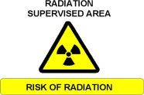





2.1 Introduction
Hazards
Ionising radiation hazards:
  Prompt
    Beam Induced
    Equipment induced (i.e. X rays in cavities)
  Residual
  Contamination
Cryogenic hazards (direct exposure - burns, ODH)
Electrical hazards
Magnetic field hazards
Laser hazards
Motion hazards
Gas hazards (Explosion, ODH)
Reference: Personnel Safety Systems at ESS, 2016-02-01

Slide 25
2.1 Introduction
Hazard and risk assessment
first step of safety life-cycle
Reference: IEC61511-1

Slide 26
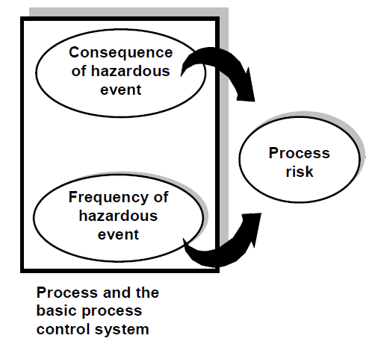
2.1 Introduction
Hazard and risk assessment
Reference: IEC61511-3

Slide 27
2.1 Introduction
Hazard and risk assessment
IEC61511-3
Several methods for evaluation of necessary risk reduction:
Risk matrices
Risk graphs
Layers of protection analysis (LOPA)
Risk graph suggested based on existing hazard and risk assessment

Slide 28
2.2 Mapping: ESS guidelines to IEC61511
ESS: Severity Matrix – Public
Severity (mSv) Probability | 0.01-0.1 | 0.1-1 | 1-20 | 20-100 | >100
Normal operation - H1
Incidents – H2 F > 10⁻² per year
Unexpected events - H3 10⁻⁴ < F < 10⁻² per year
Design Basis Accident – H4 10⁻⁶ < F < 10⁻⁴ per year
Highly improbable events – H5 10⁻⁷ < F < 10⁻⁶ per year
Green = acceptable
Yellow = tolerable
Red = unacceptable
Reference: ESS-Severity Matrices Public Workers Nov2015

Slide 29
2.2 Mapping: ESS guidelines to IEC61511
ESS: Severity Matrix – Workers
Severity (mSv) Probability | 1-10 | 10-20 | 20-50 | 50-100 | >100
Normal operation - H1
Incidents – H2 F > 10⁻² per year
Unexpected events - H3 10⁻⁴ < F < 10⁻² per year
Design Basis Accident – H4 10⁻⁶ < F < 10⁻⁴ per year
Highly improbable events – H5 10⁻⁷ < F < 10⁻⁶ per year
Green = acceptable
Yellow = tolerable
Red = unacceptable
Reference: ESS-Severity Matrices Public Workers Nov2015

Slide 30
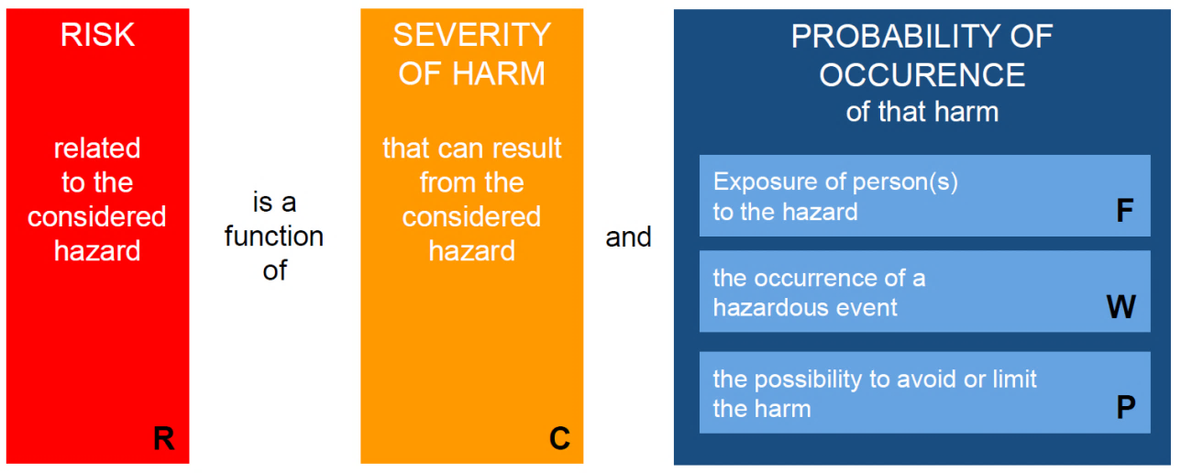
2.2 Mapping: ESS guidelines to IEC61511
IEC61511: Parameters of risk graph

Slide 31
2.2 Mapping: ESS guidelines to IEC61511
IEC61511: Parameters of risk graph
Consequence (C)
CA Light injury to persons
CB Serious permanent injury to one or more persons; death of one person
CC Death of several persons
CD Catastrophic effect, (very) many people killed
Occupancy (F)
F1 Rare to more frequent exposure in the hazardous zone
F2 Frequent to permanent exposure in the hazardous zone
Possibility of avoiding the hazardous event (P)
P1 Possible under certain conditions
P2 Almost impossible
Demand rate (W)
W1 very slight probability for the unwanted occurrences, e.g. < 0.1 D/a
W2 slight probability for the unwanted occurrences 0.1D/a < W < 1D/a
W3 relatively high probability for the unwanted occurrences 1D/a < W < 10D/a

Slide 32
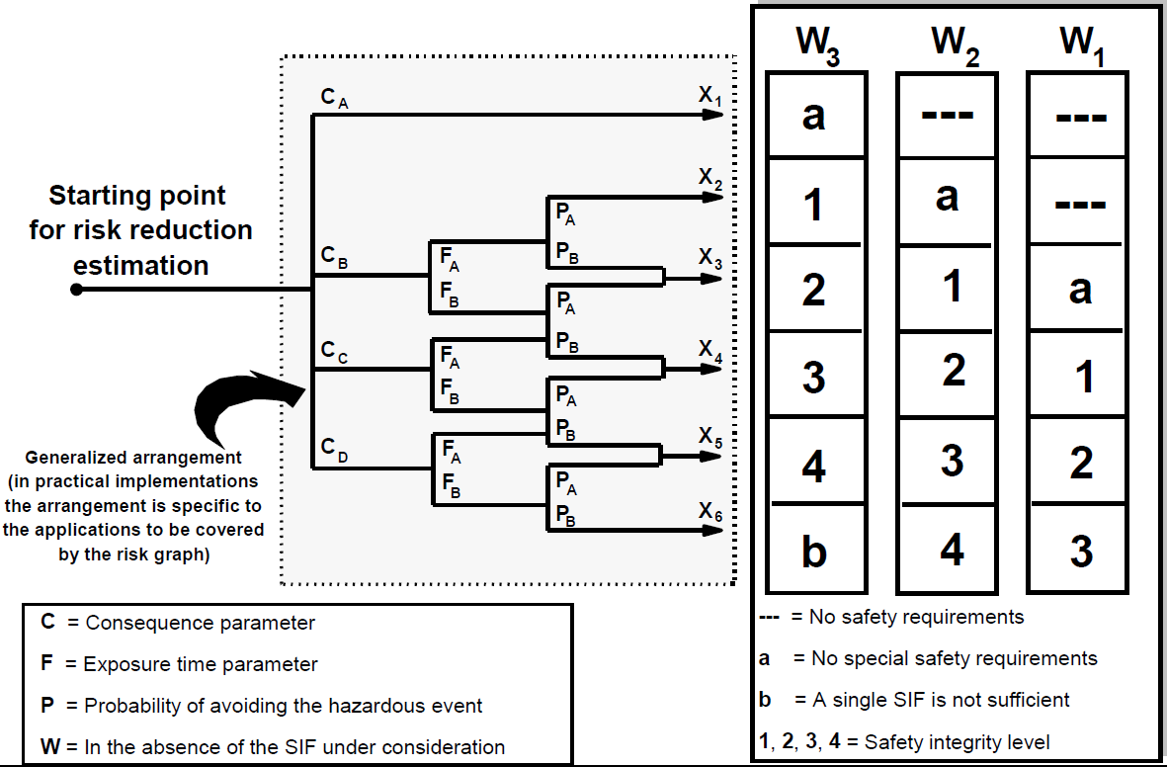
2.2 Mapping: ESS guidelines to IEC61511
IEC61511: Evaluation of SIL
Reference: IEC61511-3

Slide 33
2.2 Mapping: ESS guidelines to IEC61511
Mapping: severity to consequences
Severity level | radiation | cryogenics | chemicals | fire | others (if necessary)
CD |  | Catastrophic effect, (very) many people killed
CC | Radiological consequences for the public > H4 (20 mSv) Radiological consequences for workers > H4 (50 mSv) | Death of several persons
CB | Radiological consequences for public > H3 (1 mSv) Radiological consequences for workers > H2 (20 mSv) | Serious permanent injury to one or more persons; death of one person
CA | Radiological consequences for the public > H2 (0.1 mSv) Radiological consequences for workers > 10 mSv | Light injury to persons

Slide 34
2.2 Mapping: ESS guidelines to IEC61511
Mapping: event class to demand rate #1
Event class | Explanation | Demand rate | Explanation taken from calibrated risk graph
H5 | Highly improbable events 10⁻⁷ < F < 10⁻⁶ per year | W1 | less than 0.1 D per year
H4 | Design basis accidents 10⁻⁶ < F < 10⁻⁴ per year
H3 | Unanticipated events 10⁻⁴ < F < 10⁻² per year | W2 | 0.1 D up till 1 D per year
H2 | Anticipated events F > 10⁻² per year | W3 | 1 D up till 10 D per year
H1 | Normal operation

Slide 35
2.2 Mapping: ESS guidelines to IEC61511
Mapping: event class to demand rate #2
Event class | Explanation | Demand rate | Explanation taken from calibrated risk graph
H5 | Highly improbable events 10⁻⁷ < F < 10⁻⁶ per year | W1 | less than 0.1 D per year
H4 | Design basis accidents 10⁻⁶ < F < 10⁻⁴ per year
H3 | Unanticipated events 10⁻⁴ < F < 10⁻² per year
H2 | Anticipated events F > 10⁻² per year | W2 | 0.1 D up till 1 D per year
H1 | Normal operation | W3 | 1 D up till 10 D per year
less conservative, but still more conservative than existing risk matrix at ESS

Slide 36
2.2 Mapping: ESS guidelines to IEC61511
Mapping: Occupancy and avoidance
Two other parameters to be added in hazard and risk assessment:
Occupancy (F)
Possibility of avoiding the hazardous event (P)
not mapped directly

Slide 37
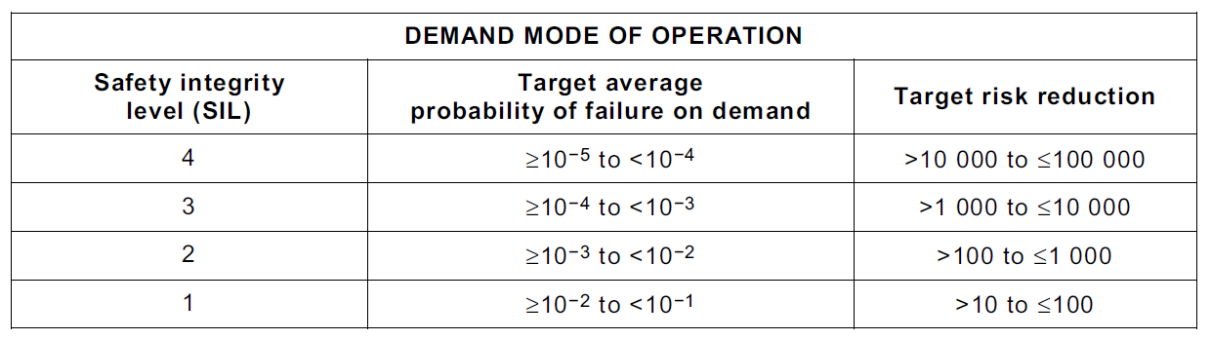
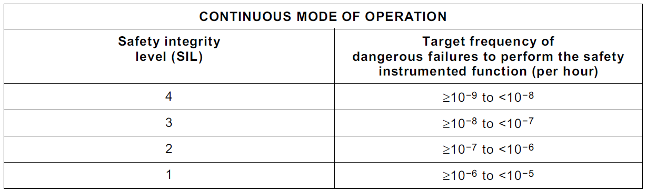
2.2 Mapping: ESS guidelines to IEC61511
Probabilistic requirements IEC61511
Target risk reduction: demand mode
Target frequency of dangerous failures: continuous mode
Probability
Normal operation - H1
Incidents – H2 F > 10⁻² per year
Unexpected events - H3 10⁻⁴ < F < 10⁻² per year
Design Basis Accident – H4 10⁻⁶ < F < 10⁻⁴ per year
Highly improbable events – H5 10⁻⁷ < F < 10⁻⁶ per year
Reference: ESS-Severity Matrices Public Workers Nov2015

Slide 38
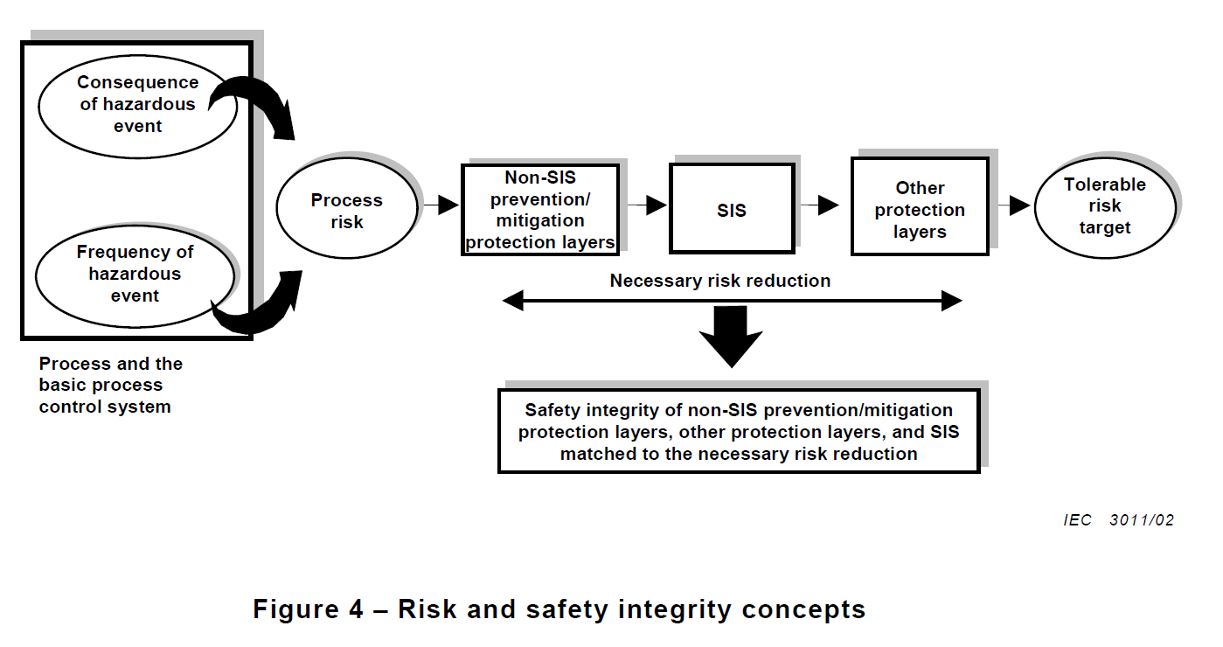
2.3 Exemplary hazard and risk assessment
Necessary risk reduction

Slide 39
2.3 Exemplary hazard and risk assessment
ESS: without prevention or mitigation

Slide 40
2.3 Exemplary hazard and risk assessment
IEC61511: without prevention or mitigation

Slide 41
2.3 Exemplary hazard and risk assessment
Prevention or mitigation measures

Slide 42
2.3 Exemplary hazard and risk assessment
Prevention or mitigation measures
Community Emergency Response
Emergency broadcasting and community evacuation procedures
Firefighting procedures for community rescue units
Radioactive decontamination procedures for community rescue units
Plant Emergency Response
Evacuation procedures
Firefighting procedures
Radioactive decontamination procedures
Mitigation
Mechanical protection system: Size of tungsten target to sustain afterheating, ...
Building structure
Safety instrumented control system: proton beam shut down via TSS
Prevention
Mechanical protection system: Size of tungsten target to sustain overheating
Safety instrumented control system: n/a
Safety instrumented prevention system: n/a
Control and Monitoring
Basic process control system
Target wheel rotation
Active cooling of the target material, etc.
Monitoring systems (process alarms), e.g. shut down via MPS
Operator supervision
IEC61511:
Instrumented systems (not safety systems) are allowed to reduce necessary risk reduction by not more than 10
Process

Slide 43
2.3 Exemplary hazard and risk assessment
Necessary risk reduction

Slide 44
2.3 Exemplary hazard and risk assessment
ESS: with prevention or mitigation
TSS included

Slide 45
2.3 Exemplary hazard and risk assessment
IEC61511: with prevention or mitigation
TSS excluded
reduced by two level. e.g. due to BPCS, mechanical layout, etc.
reduced by one level. e.g. due to building structure
reduced by one level. e.g. due to BPCS, mechanical layout, etc.

Slide 46
2.4 Conclusion
Risk and category/SIL mapping
Mapping of ESS guidelines and IEC61511 is possible (mapping is conservative therefore admissable)
Different measures might reduce different parameters, e.g.:
Access control: number of persons affected (C) or occupancy (F)
Building structure: number of persons affected (C)
Isolation of injection circuit: consequences (C)
Alarms and emergency procedures: avoidance (P)
Size and structure of target: demand rate (W)
Hazard analysis and risk assessment according to IEC61511 could be applied to all possible hazards
Measures taken into account have to be addressed to other systems or components in form of traceable requirements (requirements management)

Slide 47
2.4 Conclusion
Traceability
Hazard and risk assessment
Operation and maintenance
8
1
Decom-missioning
6
Allocation of safety functions to protection layers
Overall installation, commissioning, validation
2
Safety require-ments for SIS
SIS installation, commissioning, validation
3
5
Safety lifecycle structure and planning
11
4
4
Management of functional safety, assessment and audit
Design and engineering of SIS
System integration
verification or validation
10
Verification
9
safety lifecycle IEC61511-1
HW/SW requirements
HW acc. tests/ SW acc. tests
no.
Implementation
Hardware
Software
Modification
7

Slide 48
Backup
Failsafe ion source switchoff
Example for a system structure compliying with SIL3 of IEC61511
Common causes have to be considered for identical components and also for complete system, e.g. common cause analysis

Slide 49
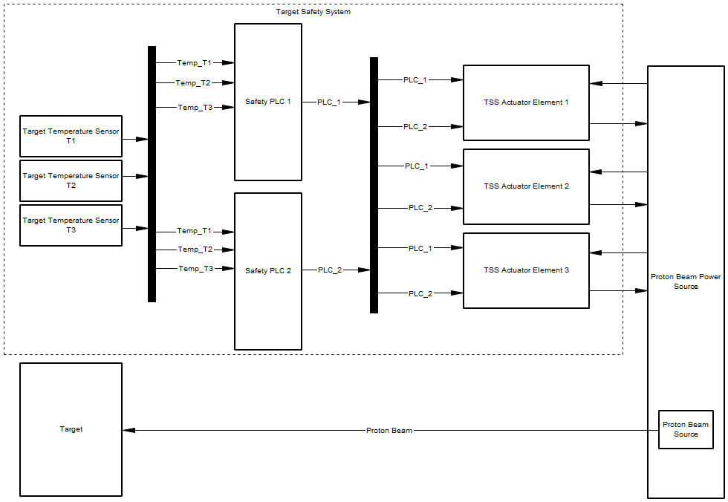
Backup
Failsafe ion source switchoff

Slide 50
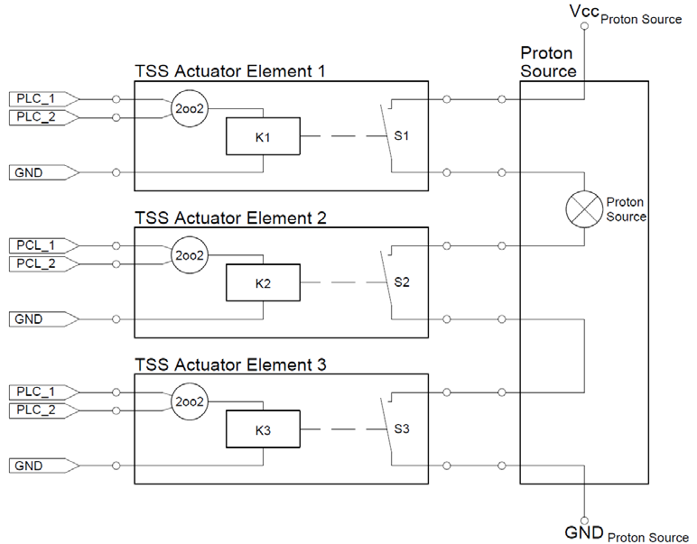
Backup
Failsafe ion source switchoff
Failsafe
structure
diagnostics such as:
force-actuated contacts
cross check
etc.

