Slide 1
Pilot TSS Interfaces
Atefeh Sadeghzadeh
Control Engineer – Target Control
www.europeanspallationsource.se
15 February 2016

Slide 2
Outline
TSS Interfaces
Target Wheel drive and shaft
PCool
EPICS and MCR
Machine Protection – Beam Interlock System
Site Infrastructure
Accelerator

Slide 3
ICD-Rs for all interfaces
Life-cycle process
Standard selection
ESS-0047208
Hazard analysis process
ESS-0041755
ESS classification
ESS-0016468
Concept
ESS-0037596
Hazard analysis results overview
ESS-0050077
System requirements
ESS-0002776
Functions
ESS-0043617
Architecture & HW design
ESS-0045067
SW design
ESS-00xxxxx
Verification, commissioning and validation
ESS-0048372
Identified safety controls ESS-0050185
Accidents reports ESS-0040075
ESS-0044348
ESS-0050081
He cooling variables ESS-0049507
ICD-R:s
ESS-0016380
ESS-0022915
ESS-0030063
ESS-0030068
ESS-0042356
ESS-0048755
FMECA
ESS-0047128

Slide 4
Physical Interfaces
TSS
SI (ESS-0030063)
Ion source
ACC (ESS-0030068)
RFQ
MP (ESS-0048755)
Bending magnet
EPICS (ESS-0042356)
Target
Target He cooling (ESS-0016380)
Target wheel, drive and shaft (ESS-0022915)

Slide 5
Target Wheel drive and shaft: Thresholds
Safety instrumented functions | Normal operation
TSS shall prevent proton beam from reaching target if…
target shaft rotational speed < 11.6 rpm | 23.3 rpm

Slide 6
Target Wheel drive and shaft: TSS space allocation
TWDS shall provide position and space for accurate measurement of motor current, either separately or at the variable frequency drive. 300 mm is reserved.
TWDS shall provide position and space for accurate measurement of rotor rotational speed.
Notes:
360 notches+ extra resolver
Radiation is dominated by fast neutron irradiation (> 0,1 MeV) with a flux 10^5 n / cm2 / s)

Slide 7
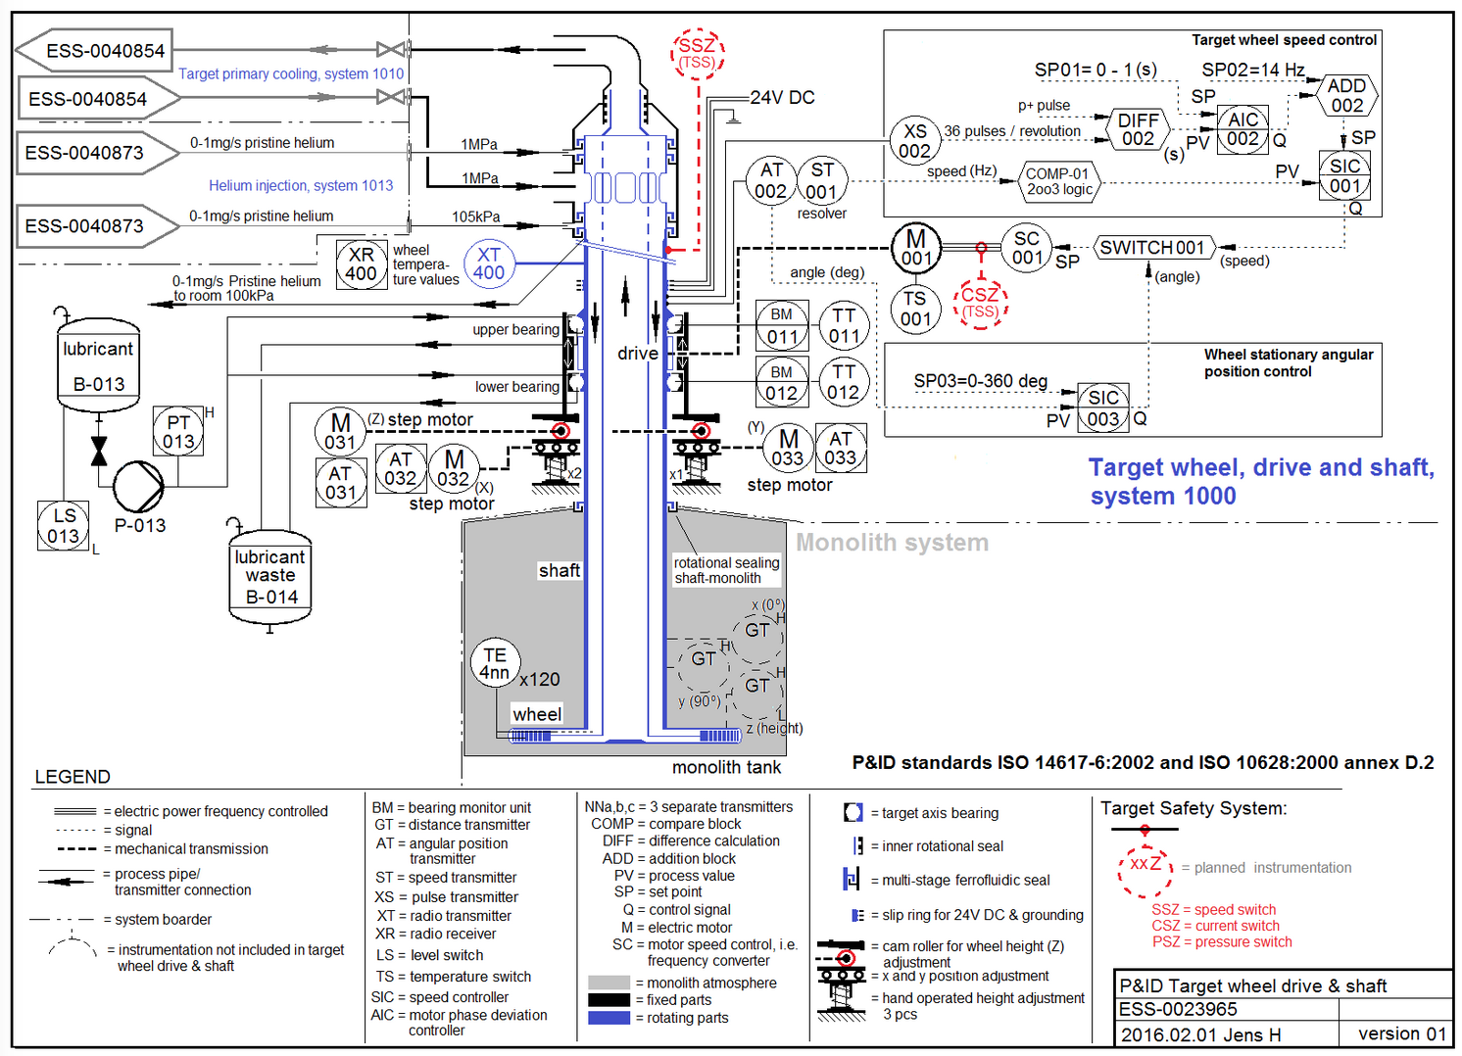
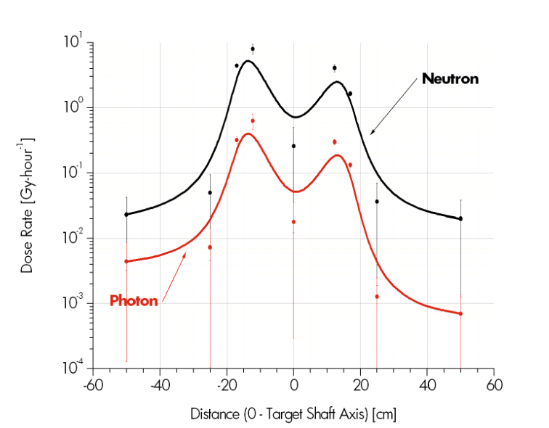
Target Wheel drive and shaft - P&ID

Slide 8
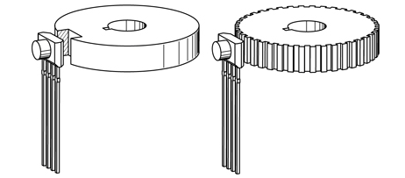
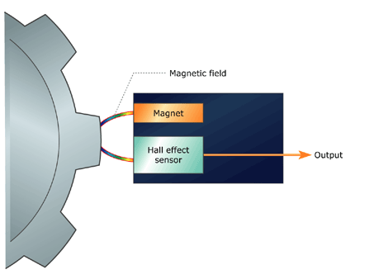
Target Wheel drive and shaft: Hall effect sensor

Slide 9
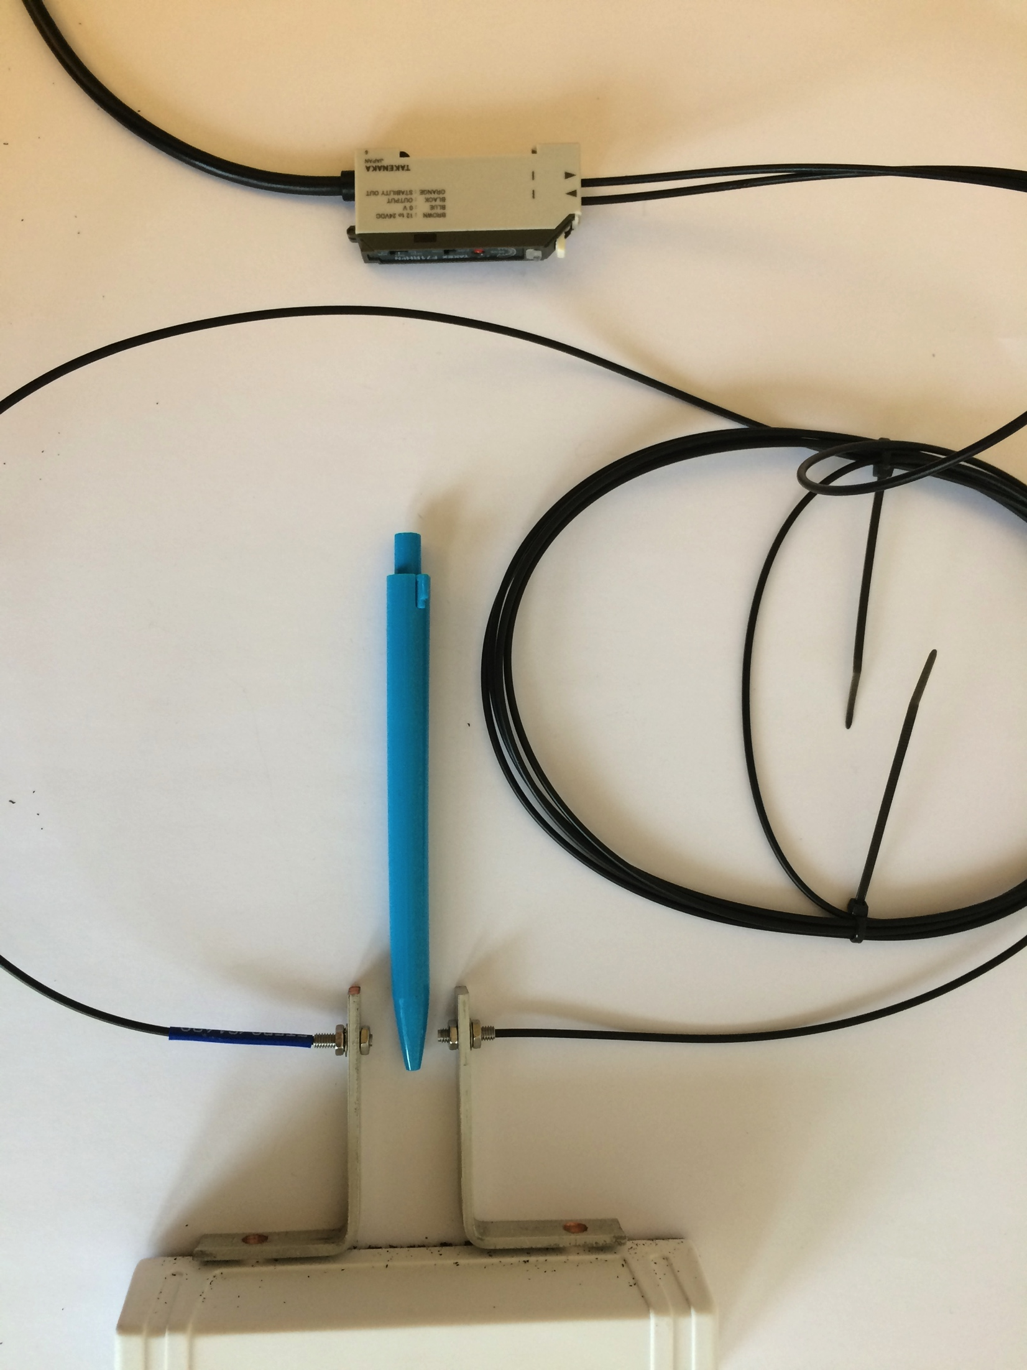
Target Wheel drive and shaft: Optic sensor + radiation hard optical fiber

Slide 10
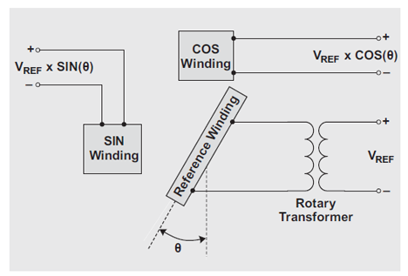
Target Wheel drive and shaft: Resolver (alternative)
A resolver is a type of rotary electrical transformer used for measuring degrees of rotation
Notes:
The resolver (in this case, a transmitter unit), is made up of three distinct coil windings: the reference, the sine (SIN), and the cosine (COS). The reference winding is the primary winding that, through a transformer known as the rotary transformer, is excited by an AC voltage applied to the primary side of the transformer. Since the rotary transformer then passes the voltage off to the secondary side of the transformer, no brushes or rings are needed. This increases the overall reliability and robustness of the resolver.
The reference winding is mounted on the motor shaft. As the motor spins, the voltage output from the SIN and COS windings change according to the shaft position. The SIN and COS windings are mounted 90° from each other in relation to the shaft. As the reference winding spins, the angle of difference between the reference and SIN/COS windings change, represented as the theta rotation angle or θ in Figure 1. The voltages induced upon the SIN and COS windings are equivalent to the reference voltage multiplied by the SIN winding and COS winding of angle theta.
The induced output voltage waveforms are shown in Figure 2. They show the normalized voltage-output signals from the SIN and COS windings, divided by the reference voltage. Traditional reference voltages are anywhere in the 1- to 26-V range, and the output frequency range is 800 Hz to 5 kHz.1

Slide 11
PCool - Thresholds
Function | Normal operation
TSS shall achieve safe state if…
… target He cooling outlet velocity < 35 m/s | 60 m/s
… target He cooling outlet pressure < 6.2 bar | 10 bar
… target He cooling inlet temperature > 230 °C | 40 °C

Slide 12
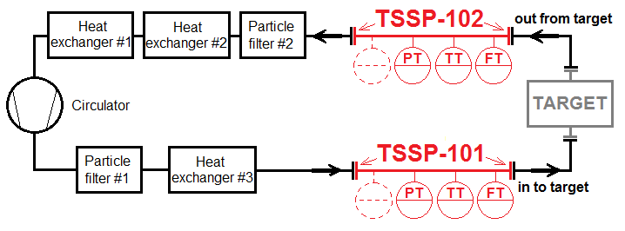
Pcool: Space allocation
2 pieces of aligned pipe flanges in stainless steel* DN250, PN16, max temp 150°C, operational pressure 10 bar, Flow rate max 3.0 kg/s. Maximum leakage rate 10mg/h. Distance between flanges sealing surfaces 1.000m.
2 pieces of aligned pipe flanges in stainless steel* DN300, PN16, max temp 300°C, operational pressure 10 bar, Flow rate max 3.0 kg/s. Maximum leakage rate 10mg/h. Distance between flanges sealing surfaces 1.000m.

Slide 13
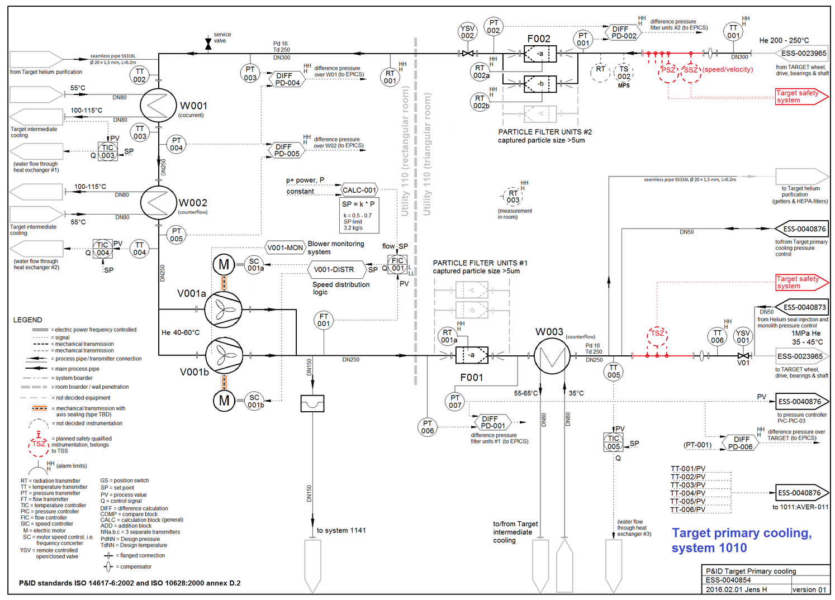
PCool - P&ID

Slide 14
PCool – Instruments specifications
 | Pressure Sensor | Temperature Sensor | Velocity Sensor
Range | 5-10 bar | 0-200 C | 30-60 m/s
Media | Gas He | Gas He | Gas He
Accuracy | +/- 0.1 bar | +/- 1 C | +/-0.1 m/s
Radiation level in media | 8e10 Bq | 8e10 Bq | 8e10 Bq
Humidity in the room (max) | 90% | 90% | 90%
Temperature of Media | Up to 300 C | Up to 250 C | Up to 300 C
Electrical interface | Switch (contactor) | Switch (contactor) | Switch (contactor)
Allowed pressure drop | N/A | N/A | Less than 1Kpa (0.01 bar)
Pipe dimension | DN300 | DN250 | DN300
Frequency of dangerous failures (per hour) | >10⁻⁸ to <10⁻⁷ | >10⁻⁸ to <10⁻⁷ | >10⁻⁸ to <10⁻⁷

Slide 15
EPICS and MCR
Space for one TSS normal size rack is reserved so that TSS will locate the mode operation system in the MCR in order to change TSS operation mode
ICS shall archive and display relevant data in MCR with sampling time of once per minute
TSS connection to the ICS shall be one-way direction electrical communication using isolation devices
Notes:
Isolation amplifiers provide electrical isolation and an electrical safety barrier.  They protect the patients from leakage currents.  They break the ohmic continuity of electrical signals between input and output.  Isolated power supplies are provided for both the input and output stages.  Used to amplify low level signals.

Slide 16
Machine Protection-BIS
Digital signal from TSS to the BIS indicating readiness of the TSS for beam operation [BEAM PERMIT OK] or indicating the stop of beam operation [BEAM PERMIT NOK]
The BEAM PERMIT SIGNAL, which is sent from TSS towards BIS shall be based on a hardwired connection (no software based signal).
TSS will use isolation devices

Slide 17
Site Infrastructure
TSS rooms
Size, location, fire protection, access authorization, Power supply
Cable routes to/from (see Design presentation: MO)
TSS rooms, Utility room, High energy bream transport (HEBT), Front end building (FEB), MPS location, Main control room
Discussions ongoing about responsibilities for cable routes
TSS responsible for defining routes and CF responsible for wall penetrations, TSS responsible for cable installations, Coordination important

Slide 18
Accelerator
The accelerator division shall stop beam production in less than 1 ms after the 400 V power circuit is interrupted
Space allocation in FEB for (see Design presentation: MO)
two physically separated racks with TSS control equipment
two physically separated cabinets for TSS safety contactors
Cable routes
Space allocation in Klystron gallery for
Cable routes
Space allocation in HEBT for
Monitoring equipment at the bending magnets
Power supply

Slide 19
Conclusions
We have identified Pilot TSS interfaces
We made good progress in defining some of them
As future works we should define interfaces to the RFQ and bending magnets

