Slide 1
Pilot TSS architecture and hardware design
Mikael Olsson
Control engineer – Target control
www.europeanspallationsource.se
15 February 2016

Slide 2
ESS-0045067
Life-cycle process
Standard selection
ESS-0047208
Hazard analysis process
ESS-0041755
ESS classification
ESS-0016468
Concept
ESS-0037596
Hazard analysis results overview
ESS-0050077
System requirements
ESS-0002776
Functions
ESS-0043617
Architecture & HW design
ESS-0045067
SW design
ESS-00xxxxx
Verification, commissioning and validation
ESS-0048372
Identified safety controls ESS-0050185
Accidents reports ESS-0040075
ESS-0044348
ESS-0050081
He cooling variables ESS-0049507
ICD-R:s
ESS-0016380
ESS-0022915
ESS-0030063
ESS-0030068
ESS-0042356
ESS-0048755
FMECA
ESS-0047128

Slide 3
Outline
System and functions
Architecture and layout
Performance

Slide 4
System and functions

Slide 5
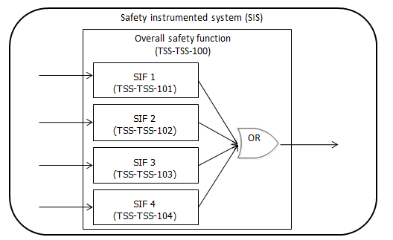
System and functions
Overall safety function
TSS shall achieve safe state if target wheel tungsten temperature > 700 °C
Safety instrumented functions
TSS shall prevent proton beam from reaching target if…
target He outlet velocity is < 35 m/s within 35 sec
target He outlet pressure < 6.2 bar within 35 sec
target He inlet temperature > 230 °C within 35 sec
target shaft rotational speed < 11.6 rpm within 210 ms

Slide 6
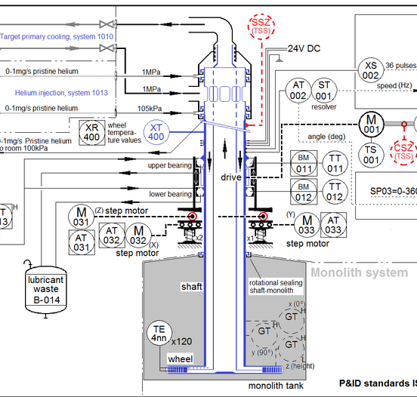
Safety instrumented functions - inputs
Process variable Scenario | He outlet velocity | He outlet pressure | He inlet temperature | Target shaft rotational speed
Target Wheel stop during beam on target - AA1 |  |  |  | X
Loss of He cooling flow (blower fail) - AA3 | X
Loss of He cooling pressure (leakage) – AA4 |  | X
Loss of He cooling heat exchange – AA3 |  |  | X
PSZ
SSZ
TSZ

Slide 7
Safety instrumented functions - output
Purpose = achieve safe state
Ion source
Contactors stop allowing power to the Ion source
Contactors dedicated to TSS
RFQ as a remaining potential redundant solution
Both closed = allow power
Any open = no power
High voltage electrical power generation
(75 kV)
Conventional electrical power (400 V)
High voltage isolation
Ion source high voltage area
Control
Coils
Magnetron
TSS control

Slide 8
Safety instrumented functions - principal
Read
(sensors)
Evaluate
(logic solvers)
Act
(final elements)
Target wheel He cooling outlet velocity
< 35 m/s
Target wheel He cooling outlet pressure
< 6.2 bar
If inside all limits
Close contactors at the ion source
Target wheel He cooling inlet temperature
> 230 °C
If any limit exceeded
Open contactors at the ion source SAFE STATE
Target wheel shaft rotational speed
< 11.6 rpm
If sensor connection lost
Diagnostic
If communication lost
Fail safe
If control HW failure
If power lost

Slide 9
Bending magnet impact
Requirement from accelerator:
“accelerator shall be allowed to produce and send proton beam to beam dump – even if target is not ready for beam”
Solution
Monitor bending magnets status
If both bending magnets are grounded (beam to dump) -> allow beam

Slide 10
System performance – bending magnet
Read
(sensors)
Evaluate
(logic solvers)
Act
(final elements)
If beam to Target
If beam to Dump
Target wheel He cooling outlet velocity
< 35 m/s
No evaluation of sensors
Target wheel He cooling outlet pressure
< 6.2 bar
If inside all limits
Close contactors at the ion source
Target wheel He cooling inlet temperature
> 230 °C
If any limit exceeded
Open contactors at the ion source SAFE STATE
Target wheel shaft rotational speed
< 11.6 rpm
If beam to dump:
No evaluation of sensors
If sensor connection lost
Diagnostic
If communication lost
Fail safe
If control HW failure
If power lost

Slide 11
Architecture

Slide 12
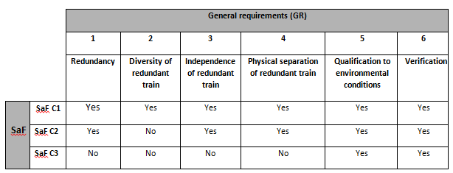
Architecture constraints
HW safety integrity (61511, SIL 3)
Redundancy (single failure)
Reliability
TSS is classified as C1
Redundancy (single failure)
Diversity (CCF)
Physical separation (CCF)
Response time < 210 ms

Slide 13
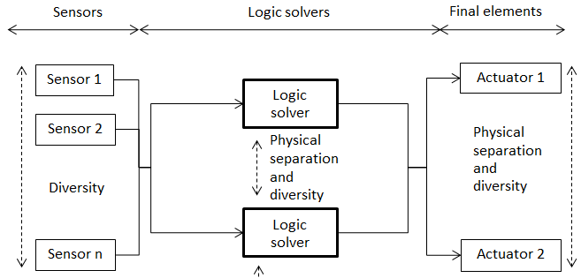
Architecture – overview

Slide 14
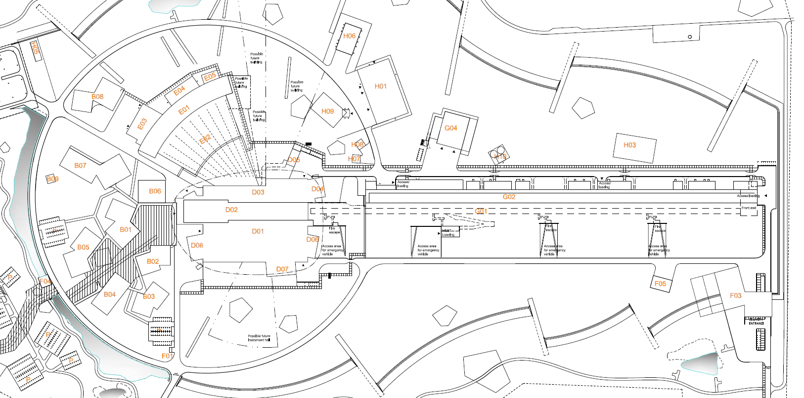
Layout - overview
Common area for monitoring of process variables
Separate area for control equipment for the two trains
Common area for actuators to stop proton beam
Common area for monitoring bending magnet status
Separate cable routes for the two trains

Slide 15
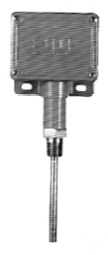
Sensors - architecture
Pressure sensors
TSS train 1
TSS train 2

Slide 16
Sensor - alternatives
2 sensors (1oo2 voting)
3 sensors (2oo3 voting)
(+) Less complexity
(+) Less configuration and maintenance
(-) Negative impact on availability
(+) Increased availability by 2oo3 voting
(-) More complex
(-) More configuration and maintenance

Slide 17
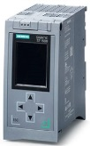
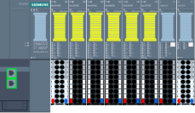
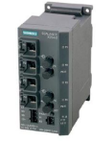
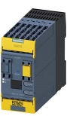
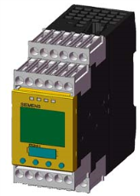
Logic solver - architecture
F-PLC
ET200SP station
ET200SP station
Actuator 1
Sensors
Switch
Switch
Switch
F-Relay
Actuator 2

Slide 18
Logic solver – alternatives
PLC in both trains
PLC and relay
Relay in both trains
(+) Less cables
(-) Hard to state diversity
(+) Diversity for logic and cables
(+) meet advisory requests for relay solution
(-) more cables
Relay must be in TSS room #2 due to distance (max 1000 m)
(-) Hard to state diversity
(-) No option for diverse cables (fiber + copper)
(-) Long distance from TSS room #1 to FEB
(-) more cables

Slide 19
Logic solver – relay alternatives
Simple relay (3SK1)
Middle relay (3SK2)
Advanced relay (MSS)
No SW configuration needed
(-) not flexible to expand
(-) response time increasing when expanding by adding relays
(-) less diagnostic
Minor SW configuration needed
(+) up to 20 inputs
(+) response time constant
(+) more diagnostic
(+) Built-in HMI (small, not configurable)
Minor SW configuration needed
(+) Can be further programmed = simple PLC
(+) up to 50 inputs
(-) More advanced than needed

Slide 20
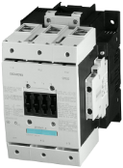
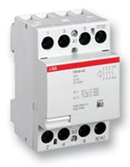
Final elements architecture
TSS train 1
TSS train 2
3-phase 400 V
Ion source

Slide 21
Final elements – alternatives
Only ion source
Ion source + RFQ
More options
(+) Safe, robust, simple
(+) Diversity by two different contactors
(-) Hard to resist CCF in case of external event (fire)
(+) Safe, robust, simple
(+) Diversity and physical separation
(+) Reduced effect by CCF in case of external event
(-) Potential damage of RFQ – might require delayed signal
(-) slow

Slide 22
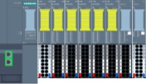
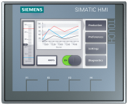
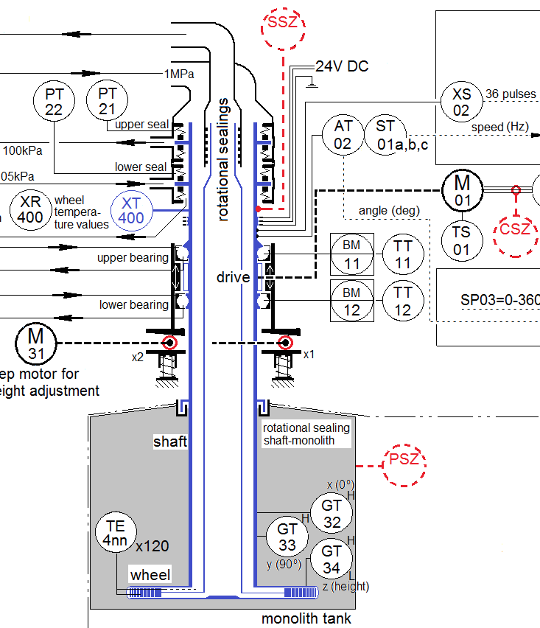
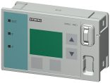
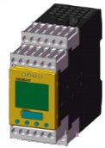
Architecture ans components
Utility room
TSS room 1
Front end building
x2
ET200SP station
F-PLC
HMI
ET200SP station
x2
x2
x2
Ion source
Switch
PSZ
SSZ
TSZ
ET200SP station
HEBT (bending magnets)
HMI
400 V
F-Relay
TSS room 2

Slide 23
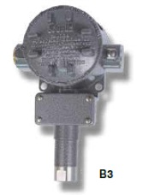
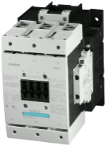
Layout of components - ESS

Slide 24
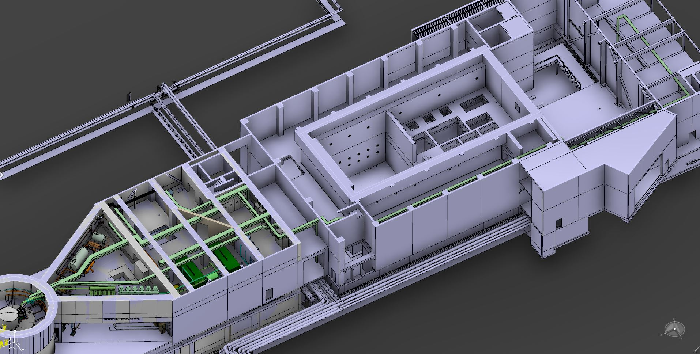
Cable routes - Target

Slide 25
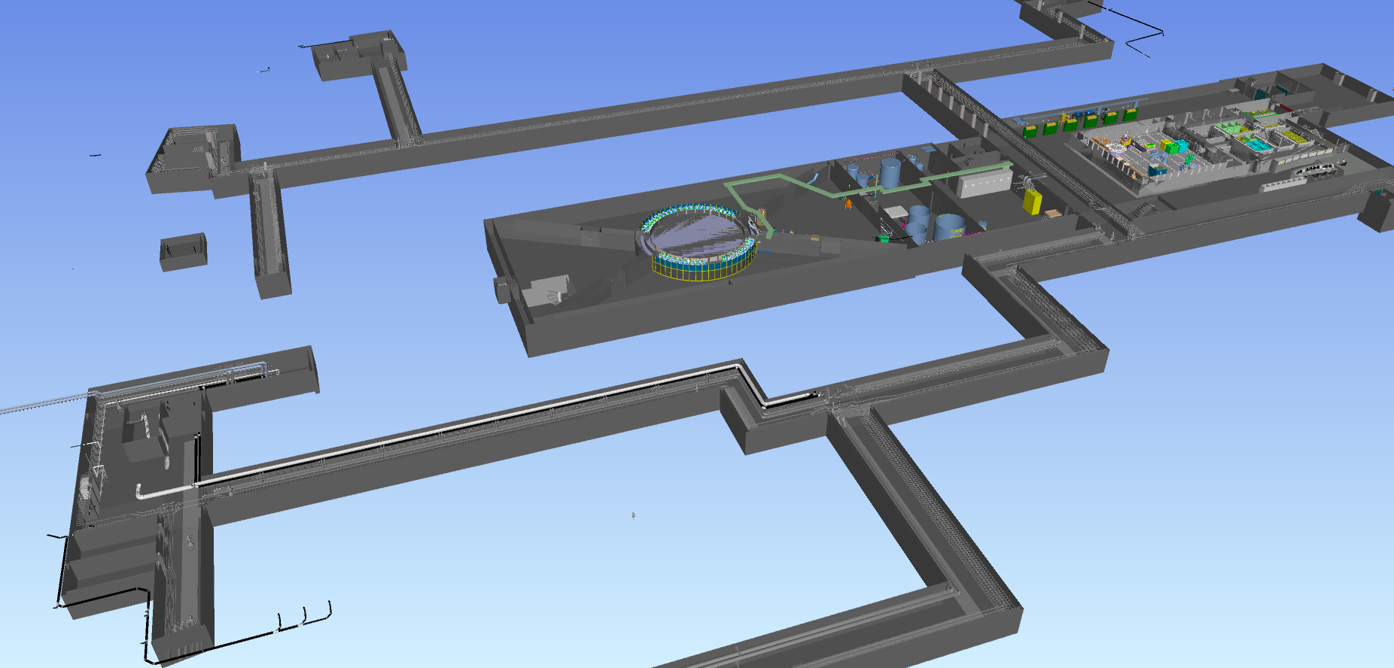
Cable routes - Target

Slide 26
Cable routes - Target to FEB
Copper cable
Through klystron gallery
Fiber cable
Outside and underground

Slide 27
Cable routes Target to FEB – alternatives
Accelerator tunnel
Klystron gallery
Outside underground
(+) accessible
(+) short distance
(-) radiated area
(-) not suitable for fiber cables
(-) area with a lot of maintenance
(+) non radiated areas
(+) short distance
(+) accessible
(-) area with a lot of maintenance
(+) non radiated areas
(+) suitable for fiber cable
(+) minor maintenance
(-) long distance
(-) not accessible

Slide 28
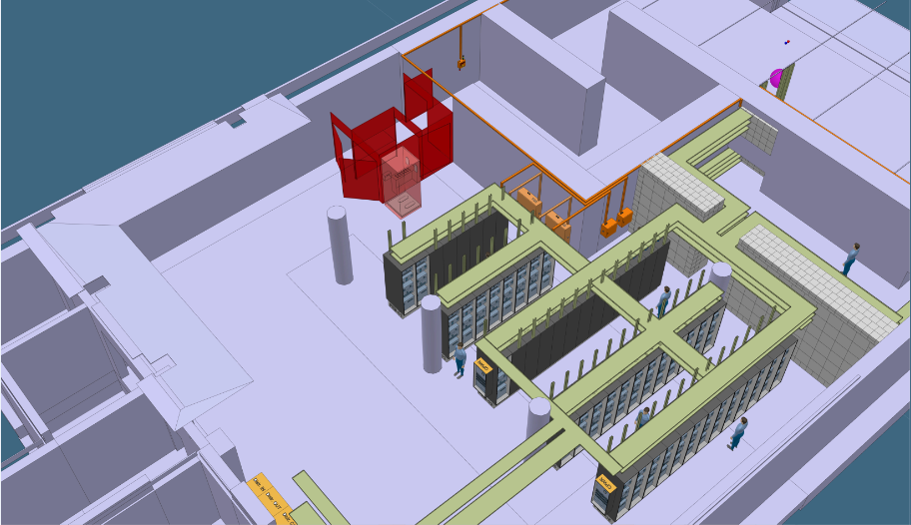
FEB space allocation
High voltage electrical power generation
(75 kV)
Conventional electrical power (400 V )
High voltage isolation
TSS control
Ion source high voltage area
Control
Coils
Magnetron
p+

Slide 29
Performance

Slide 30
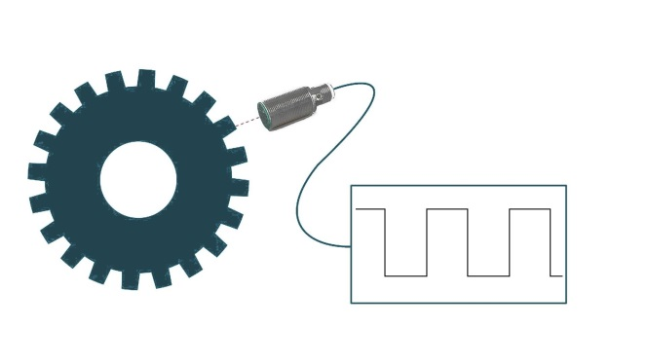
System performance - sensors
He velocity, pressure and temperature (switches)
Shaft rotational speed (pulse signal)
10 V
P < 6.2 bar
v < 35 m/s Stop beam
T > 230 °C
Gives immediate indication when process variable outside limit
0 V
Needs processing before decision if process variable outside limit
10 V
< 11.6 rpm -> Stop beam
0 V
<--- Time consuming --->
Safe processing even more time consuming…

Slide 31
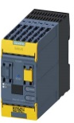
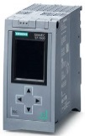
System performance - response time
Hard to achieve < 210 ms for shaft rotational speed
Contactors assumed 100 ms
 | TSS train 1 (Relay) | TSS train 2 (PLC) | Comment
Velocity, pressure and temperature | ~180 ms | < 200 ms | Contactor most critical
Rotational speed | ~270 ms | TBD | Process of pulsed signal most critical Speed monitoring F-relays are generally slow F-PLC cannot process pulsed signal Need extra components (relay, redundant “normal” PLC, etc)
+ ?

Slide 32
Conclusions
Two train system – diverse and physically separated
Sensors and contactors shared by the two trains
Ion source
Difficult to fulfill 210 ms for rotational speed

Slide 33
Thank you!

Slide 34
If time allows…

Slide 35
FMECA
Single failure OK
CCF
Faulty manual setting of sensors limit (proof test required after sensor maintained)
Faulty specification gives faulty behavior in both trains (project management to follow activities in 61511 to minimize this risk)
External events (fire)
Utility room: sensors damaged and locked in “OK” position
FEB: contactors damaged and locked in “OK” position

Slide 36
Challenges and questions
Challenges
Safety instruments in radiated areas
Response times (210 ms)
Questions
Bending magnets monitoring only – or do we need to control?

Slide 37
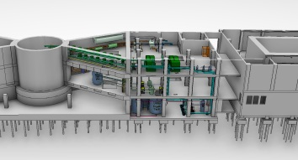
Extra

