Slide 1
Pilot TSS Reliability
Atefeh Sadeghzadeh
Control Engineer – Target Control
www.europeanspallationsource.se
15 February 2016

Slide 2
Outline
Background
Pilot TSS SIL calculation
Conclusions and future works

Slide 3
Background – Safety and Reliability
Nothing is more important than safety for the TSS.
Reliability is
a key component of safety; the more reliable device, the safer critical process.
the probability that an item will perform a required function, under stated conditions, for a stated period of time. An item is highly reliable if it works for a long time without failing
Notes:
The foundation for any modern safety system, then, is to reduce risk to an acceptable or tolerable level.

Slide 4
Background - Layered Protection
No single safety measure can eliminate risk
Safety exists in protective layers: a sequence of mechanical devices, process controls, shutdown systems
If one protection layer fails, successive layers will be available to take the process to a safe state.
If one of the protection layers is a safety instrumented function (SIF), the risk reduction allocated to it determines it’s safety integrity level (SIL).
Notes:
A way to indicate the tolerable failure rate of particular safety function. It is defined as four discrete levels of safety (1-4).
Requirements for hardware fault tolerance (architectural constraints)
SIF probability of failure

Slide 5
Background – Risk reduction
2 kinds of safety actions: TSS deals with prevention
Severity
SIS
Prevention
Risk
S
Mitigation
unacceptable risk
Risk
acceptable risk
P
Probability

Slide 6
Background - Continuous or on demand?
TSS is an “on demand system”
Affects the reliability calculations
Definitions extracted from 61511:

Slide 7
Background – SIL and PFD
The risk reduction allocated to a safety function is determined by it’s Safety Integrity Level (SIL)
The effectiveness of a safety function is described in terms of “the probability it will fail to perform its required function when it is called upon to do so.” This is its Probability of Failure on Demand (PFD).
From 61511:
Notes:
In the case of safety instrumented functions operating in the demand mode of operation, the target failure measure should be expressed in terms of the average probability of failure to perform its design function on demand, as determined by the safety integrity level of the safety instrumented function
When a Hazards Analysis determines that a SIS is required, the level of risk reduction afforded by the SIS and the target SIL have to be assigned. The effectiveness of a SIS is described in terms of “the probability it will fail to perform its required function when it is called upon to do so.” This is its Probability of Failure on Demand (PFD). The average PFD (PFDavg) is used for SIL evaluation.

Slide 8
Background - SIS structure
Sensor subsystem
Sensor 1
Logic subsystem
Sensor 1
Final element
Sensor 1
Logic Solver
Actuator 1
Sensor 2
Actuator 2
.
.
.
.
.
.
Sensor X
Actuator X
PFD _{total} = PFD _{S} + PFD _{L} + PFD _{FE}
Notes:
instrumented system used to implement one or more safety instrumented functions. An SIS is composed of any combination of sensor (s), logic solver (s), and final element (s)

Slide 9
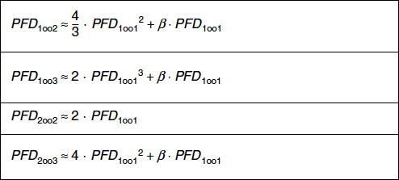
Background - General procedure for determining the PFD (VDE 2180)
PFD _{total} = PFD _{S} + PFD _{L}+ PFD _{FE}

Slide 10
Background - β
For Pilot TSS considered to be 20% (conservative)
Notes:
β, defines the number of undetected passive faults with a common cause that will influence all channels at the same time in redundant SIS.

Slide 11
Pilot TSS SIL calculation: PFDs
Element | PFDavg | SIL
Sensor | 2,2e-3 | SIL 2
DI | 2,0e-5 | SIL 3
DO | 2,0e-5 | SIL 3
CPU | 2,0e-5 | SIL 3
Relay | 2,0e-5 | SIL 3
Actuator | 2,4e-3 | SIL 2
β | 20%

Slide 12
Pilot TSS SIL calculation: train 1
Sensor 1
F-DI 1
F-DO1
Act. 1
CCF
CCF
F-CPU
CCF
CCF
Sensor 2
F-DI 2
F-DO2
Act. 2
4,46E-04
2,80E-05
4,88E-04
PFD _{sys}= 9,62E-04

Slide 13
Pilot TSS SIL calculation: train 2
Sensor 1
Act. 1
CCF
Relay
CCF
Sensor 2
Act. 2
4,46E-04
2,0E-05
4,88E-04
PFD _{sys}= 9,54E-04

Slide 14
Pilot TSS SIL calculation: 1oo2
Sensor 1
DI 1
DO1
Act. 1
CCF
CCF
CPU
CCF
CCF
CCF
Sensor 2
DI 2
DO2
Act. 2
Relay
4,46E-04
4,4E-06
4,88E-04
PFD sys_{(1oo2)}= 9,39E-04

Slide 15
Pilot TSS SIL calculation: 1oo3 (sensor)
Sensor 1
DI 1
DO1
Act. 1
CCF
CCF
CPU
CCF
CCF
CCF
Sensor 2
DI 2
DO2
Act. 2
DI 3
Sensor 3
Relay
4,40E-04
2,80E-05
4,88E-04
PFDsys(1002)(3 sensor) 9,32E-04

Slide 16
Pilot TSS SIL calculation: β= 5%
PFDsensor(1oo2) 1,16E-04
PFDlogic (1oo1)(safety PLC) 2,20E-05
PFDlogic(1oo2)(safety PLC and relay) 1,10E-06
PFDfinal element 1,28E-04
PFDsys 2,45E-04

Slide 17
Pilot TSS SIL calculation: PFDs (second example)
Element | PFDavg | SIL
Sensor | 2.5e-4 | SIL 3
DI | 2.0e-5 | SIL 3
DO | 2.0e-5 | SIL 3
CPU | 2.0e-5 | SIL 3
Relay | 2.0e-5 | SIL 3
Actuator | 2.5e-4 | SIL 3
β | 5%

Slide 18
Pilot TSS SIL calculation: β= 5% (second example)
PFDsensor(1oo2) 1,77E-05
PFDlogic (1oo1)(safety PLC) 2,20E-05
PFDlogic(1oo2)(safety PLC and relay) 1,10E-06
PFDfinal element 1,26E-05
PFDsys 3,13E-05

Slide 19
Pilot TSS SIL calculation: with Reliasoft (second example)
PFD sys_{(1oo2)} = 2,80E-05 (β = 5%)
first cut sets:
Set 1 ( 1 block ) ( 0,000017 ) : CCF sensor
Set 2 ( 1 block ) ( 0,000010 ) : CCF Actuator
Set 3 ( 1 block ) ( 0,000001 ) : CCF Logic

Slide 20
Pilot TSS SIL calculation: Comparison
Example 1
PFD_sys(train 1) (β = 20%) 9,62E-04
PFD_sys(train 2) (β = 20%) 9,54E-04
PFD_sys(1oo2) (β = 20%) 9,39E-04
PFD_sys(1oo2) (β = 20%) (1oo3 sensors) 9,32E-04
PFD_sys(1oo2) (β = 5%) 2,45E-04
Example 2
PFD_sys(1oo2) (β = 5%) 3,13E-05
PFD_sys(1oo2) (β = 5%) Reliasoft 2,80E-05

Slide 21
Conclusions and future works
We can achieve target SIL
Adding multiple sensors beyond 2 will not gain reliability
Using diverse elements (sensor/actuator), can decrease the CCF effect that has high impact in total reliability
Simplified calculation is reasonably accurate
We will do calculation with IEC 61511 formula

Slide 22
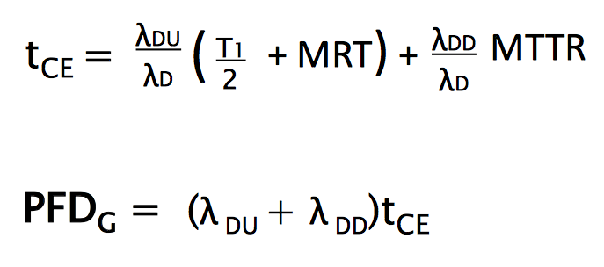
Back-up - PFDavg (IEC61511)
1oo1
1oo2

Slide 23
Back-up

