Slide 1
Safety & Standards
Technical Board – December 2012
Christine Darve
European Spallation Source - Accelerator Division
Lund, Date

Slide 2
Headline
Motivation
Stakeholders
e-nav: “Standards and Norms applicable for ESS”
E-Share: ESS Web interface using NEXT Community

Slide 3
Motivation
Provide guidance to complete engineering design
Empower collaborations and strengthen the ESS
Access to the approved and official ESS “Norms and Standards”
Standardize the ESS engineering philosophy
Communicate a ESS unique safety policy and practices
Benefit from other institute expertise in terms of ES&H policies
Sharing consistent and coherent safety engineering practices
Complement the ESS public web-site by possible co-development
Complement to CHESS
e-nav
E-SHare

Slide 4
Stakeholders
ESS group members (technical and legal members)
ESS/Accelerator Work-package members
Quality Assurance management
Collaborating Institutes
Industrial partners
Governing institutions
Publics
Proposed tools
“e-nav” - limited access: Database-like
→ Developed in collaboration with ESS Safety and Health Environment Division and ESS X-functional working group.
“E-SHare” - staged access: NEXT community
→ Developed in collaboration with ESS communication department, CERN and FNAL

Slide 5
“Standards and Norms applicable for ESS” using
e-nav

Slide 6
Content
4700 documents + 200 extra
35 kEuro / year (7 euro/doc)
Radiation protection standards
ICRP standards, International Commission on Radiological Protection
IAEA standards, International Atomic Energy Agency
Euratom council directives, European Atomic Energy Community
Engineering standards
SIS standards, Swedish standards institute
CEN standards, European Committee for standardization
ISO standards, International Organization for standardization

Slide 7
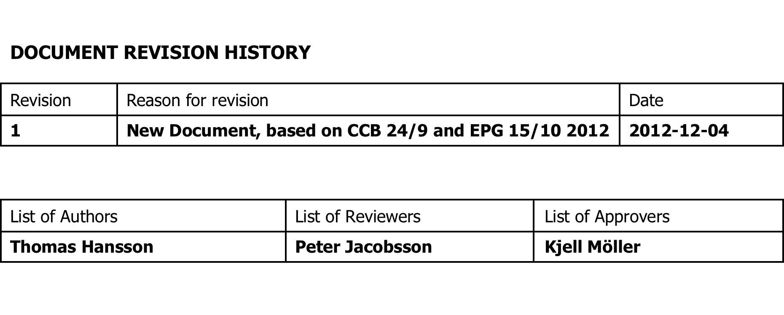
“Standards and Norms applicable for ESS”
→ Sep. 13th, 2012: “Recommendation” to the EPG by Thomas Hansson
→ October 5th , 2012: Approved by EPG
→ December 12, 2012:“Operating Procedure” to the EPG
Document Number ESS-0001515
Date 2012-12-04
This document defines which standards to use for the design and construction of the European Spallation Source, ESS. It is based on reference and approved by CCB 24/9 and EPG 15/10, 2012.

Slide 8
“Standards and Norms applicable for ESS”
The decision has been prepared by the X-functional team “Standards & Norms”, consisting of the following members;
Thomas Hansson, ESS Licensing
Christine Darve, ESS Accelerator department
Atafeh Sadeghzadeh, ESS Target department
Karin Svedin, ESS Conventional facilities
Pascal Sabbagh, ESS Target department
Iain Sutton, ESS Instrument department
Mikael Puls, ESS Design office

Slide 9
“Standards and Norms applicable for ESS”
The Swedish Radiation Safety Authority regards ESS as a non-nuclear facility, but still some requirements and standards from the nuclear industry will be applied.
ISO-CEN-SIS standards are to be fulfilled when designing and constructing ESS
Deviation to be handled by X-functional team “Standards & Norms”
Committee chair: Thomas Hansson
Database remain active, in order to deal with occasions when a proposed design or construction isn’t able to fulfil a given standard.
The system engineer should then present the deviation to the X-functional team “Standards & Norms”, who will review the specific case.
The X-functional team will decide if the deviation is justified and acceptable. Otherwise the system engineer has to change the proposed design and construction of the system.
These deviations may be presented to CCB.

Slide 10
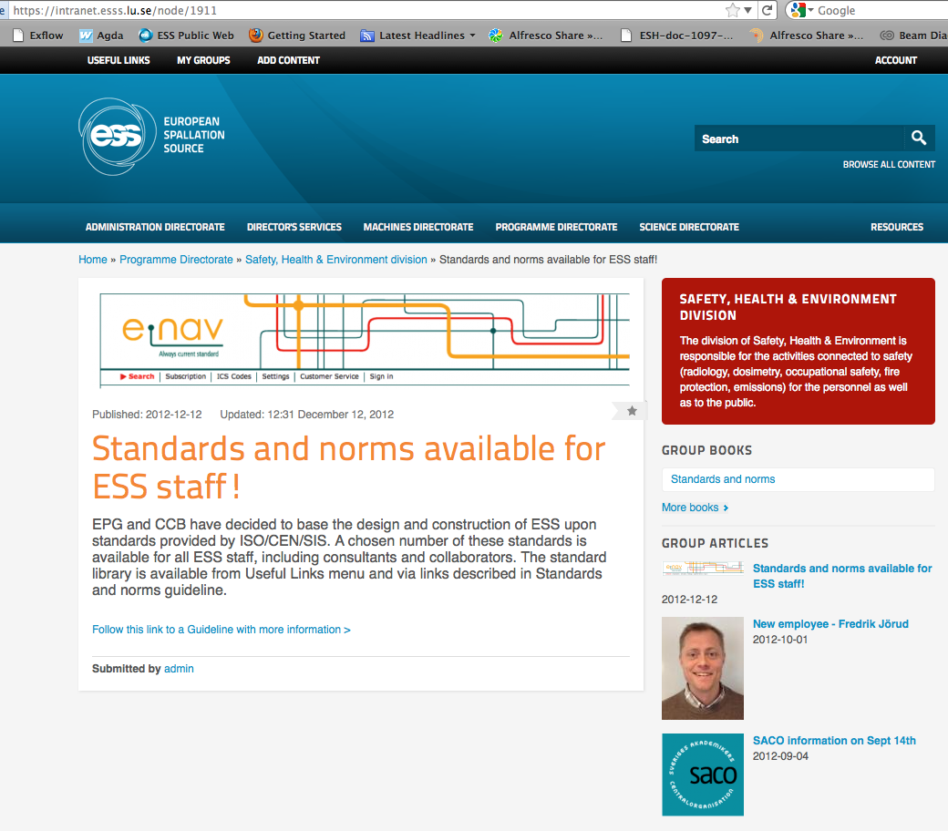
Using e-nav [see ESS intranet]
https://enav.esss.lu.se/DesktopDefault.aspx?tabname=ICS-Koder

Slide 11
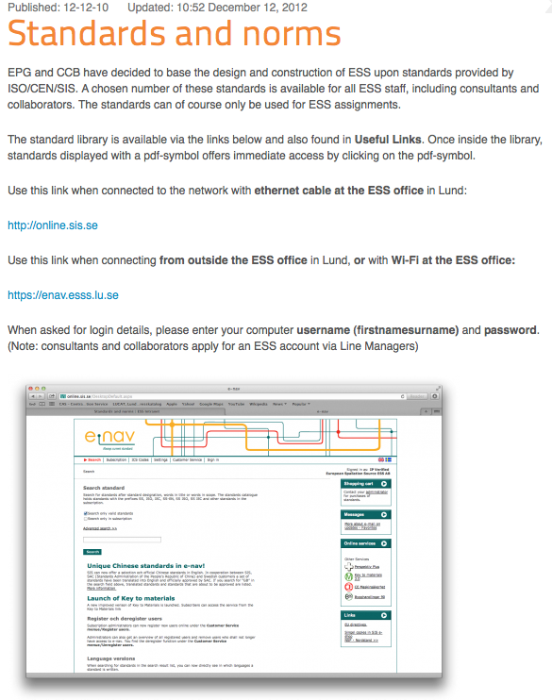
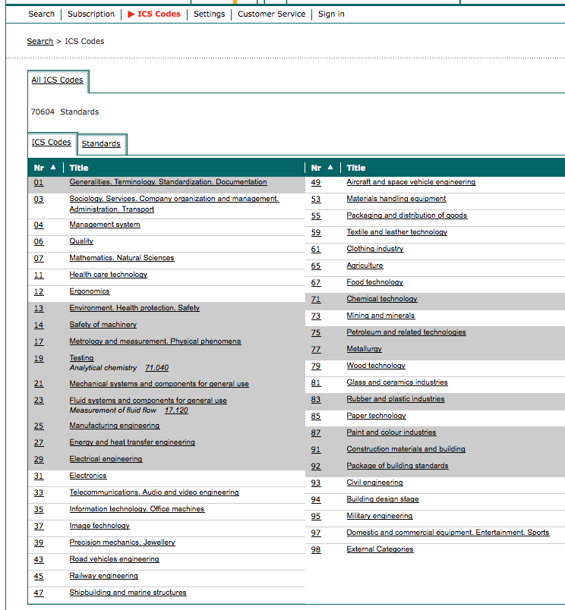

Slide 12
ESS Web interface using NEXT Community
E-SHare

Slide 13
E-Share: Web interface
Content of the Web-based site
Safety procedures (RP, ODH, electrical hazard, etc.. )
Safety training (LOTO, ODH, electrical safety, etc..)
Access to safety manuals
Lessons learned, etc..
Tools for development : NEXT Community
(Public, Project members area, incl. Developer admin, safety responsible)
example:
Users Needs:
Design engineers
Goals/what :
Want to access to ESS engineering guidance for pressure safety vessel
Value:
To complete the design of a cryomodule

Slide 14
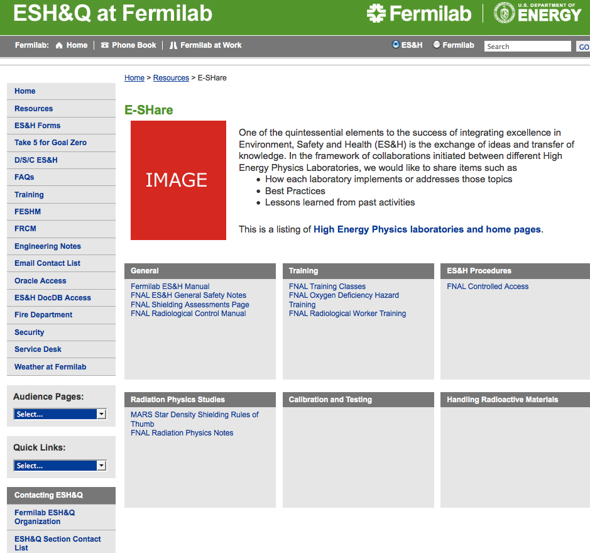
Earlier development FNAL - CERN
By Nancy Grossmann
FNAL ES&H Director

Slide 15
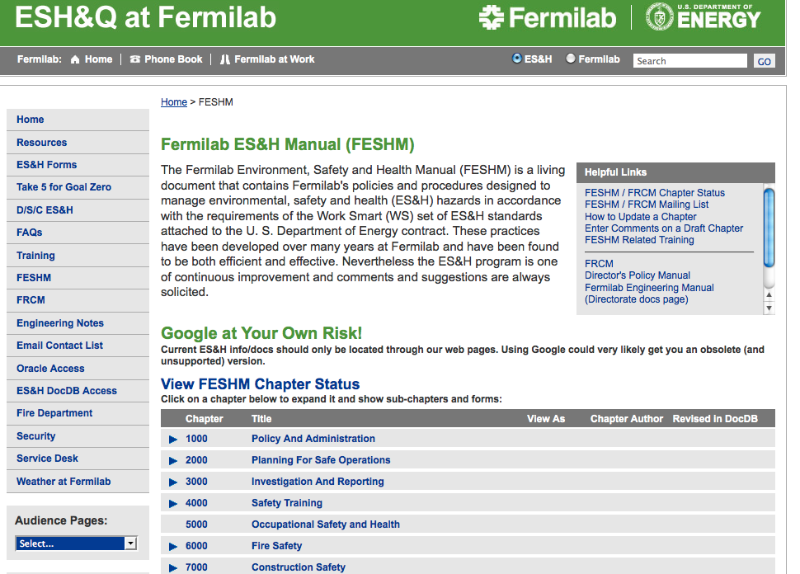

Slide 16

There is such thing as a free lounge !
2012-12-12
Christine Darve, ESS
Karl McFaul, ESS - Project Leader, NEXT Community

Slide 17
NEXT Community
A Collaboration Platform for Science & Innovation
In 2012, ESS, Region Skåne & Participating Partners co-developed the first code base for the NEXT Community platform
User Designed Applications
Open Source Software Platform
Scalable & Secure Infrastructure
Karl McFaul
www.nextcommunity.org

Slide 18
NEXT Community : Key Benefits
NEXT Community offers you a digital workspace with smart tools and valuable resources to help advancing projects.
Empowered by the world-leading Open Source platform of Drupal.
Operated by enthusiastic “intrapreneurs” at ESS, Region Skåne & Lund University.
We can develop cheaper with our use of open source
We can develop faster than proprietary alternatives with our agile methodology
We can develop with better user orientation since NEXT Community is co-developed together with its users as an open innovation project.
We operate as a non-profit organization where members can influence.
We share a network of expertise within Science, Innovation and Communication
Karl McFaul

Slide 19

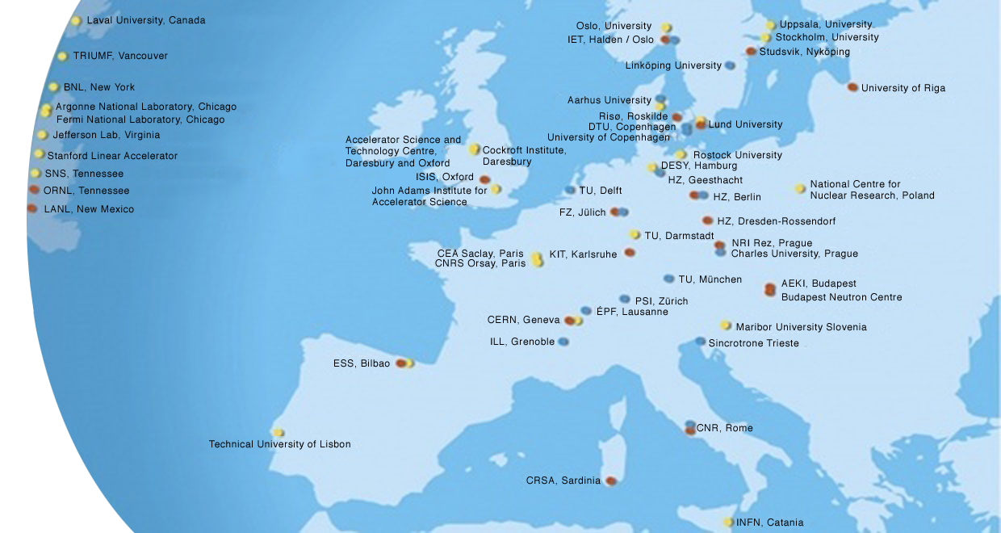
ESS : Existing Partner Labs
Potential Members of NEXT Community ?

Slide 20
Example : E-SHare
ESS
Fermilab
CERN
Daily need: Share public data with other regional actors
Iterate further on public investments from external sources
Regional project work on international attractiveness / ease of use - ESS mission: Provide “the machine” - The Region’s mission: Job creation - Attract competence and investments

Slide 21
NEXT Community : Delivered 2012
- Budget: 32.000 €
- Configuration of Drupal core platform
- 5 “apps” for sharing Open Data with Faceted Search
- First partners aboard
NEXT Community : Scope 2013
- Develop 35 planned apps & features (ESS / CERN / Fermilab = 8 items)
- Improve overall design and functionality
- Total Budget need for development: ≈ 120.000 € (The ESS / CERN / Fermilab items cost ≈ 25%)
Karl McFaul

Slide 22
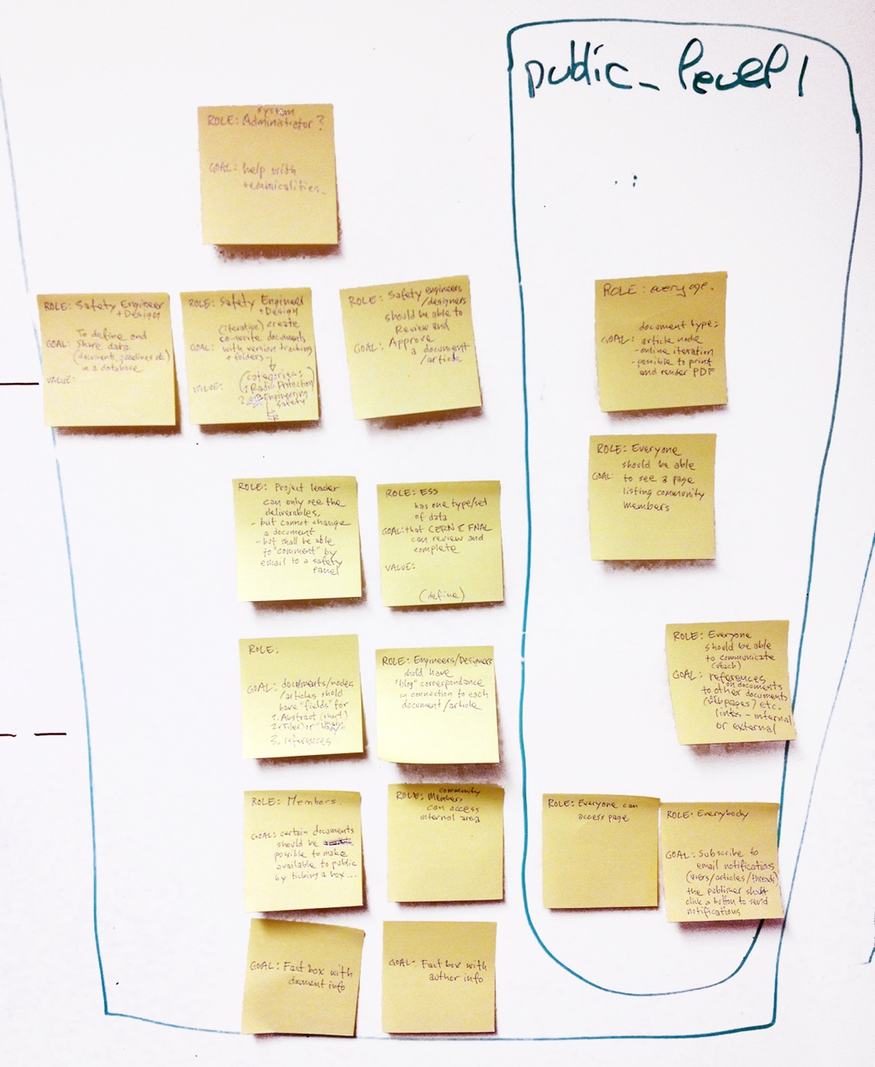
project zone
public zone
ESS / CERN / FNAL
Items (faximile)
Contribute to our Backlog for the development of NEXT Community !
Karl McFaul

Slide 23
“User Needs” collected from all current stakeholders during workshops Autumn 2012
(ESS / CERN / FNAL items are marked with a blue label)
Karl McFaul

Slide 24

Functionality Needs (overall)
DESIGN
WHO: as a user
WHAT: I want a clear, pedagogic and visually attractive design of NEXT Community
VALUE: so that I don’t get information overload
Database
STATISTICS
STATISTICS
SEARCH
WHO: as user
WHAT: I want to see related material on posts in the DB that other users have been interested in
VALUE: so that I can learn through others
WHO: as an administrator
WHAT: I want users to fill in a questionnaire when registering an account in NEXT Community
VALUE: so that we can get valuable statistics about our users
WHO: as a user
WHAT: I want to expand types of search parametres in the Facetted Search function
VALUE: so that users can use facetted search in the creative process of finding solutions for innovation
FOLLOW
WHO: as a web site visitor
WHAT: I want the front site to have boxes with syndicated flows of innovation news from the community.
VALUE: so that I can feel the vibe, discover new opportunities, events and insights!
SHARE
SEARCH
WHO: as a user
WHAT: I want to have open data syndicated into NEXT Communty (API) from external resources
VALUE: so that I can get valuable information which is not uploaded into the database (events, feeds, statistics)
WHO: as a user
WHAT: I want to search function to index the text inside documents files
VALUE: so that I can search for information in uploaded files
FOLLOW
WHO: as a user
WHAT: I want to share certain projects / posts / link lists on the public front end for non-members.
VALUE: so that I can reach people who are not signed into NEXT Community.
ESS / CERN / FNAL
Karl McFaul
NEXT Community 2013

Slide 25
Functionality Needs (public zone)
BUSINESS
DESIGN
RESEARCH
PEOPLE
WHO: as an entrepreneur
WHAT: I want a catalogue where companies promotes business needs
VALUE: so that I can find new business opportunities sourced directly from the market
WHO: as a user
WHAT: I want a browsing functionality in NEXT Community
VALUE: so that I can inform myself and engage in what’s going on
WHO: as a researcher
WHAT: I want a library in NEXT Community to share research publications with “open access”
VALUE: so that anyone can review and use the outcome of research
WHO: as a user
WHAT: I want to have ego-metrics shown next to my stuff around the system and on my profile
VALUE: so that I can market myself
Inn Demand:
www.teknopol.se/demand
DOCUMENTS
PEOPLE
PEOPLE
WHO: as an entrepreneur
WHAT: I want a functionality displaying market needs (sourcing from DB stats)
VALUE: so that I can see the regional need for an idea or sulution (engaging the public)
WHO: as a user
WHAT: I want functionality for versioning / date stamp / approval on documents, files, articles
VALUE: so that users can trace versions.
WHO: as a user
WHAT: I want a page + box
where I can see members registered in NEXT Community
VALUE: so that users get overview and can connect
WHO: as an administrator
WHAT: I want a box / functionality with gamification
VALUE: that stimulates users to share, interact and complete their profile etc.
ESS / CERN / FNAL
ESS / CERN / FNAL
Karl McFaul
NEXT Community 2013

Slide 26
Functionality Needs (public zone)
COMPETITIONS
STATISTICS
STATISTICS
DOCUMENTS
WHO: as an innovator
WHAT: I want NEXT Community to have a page / event called Innovation Hack
VALUE: where users are stimulated to remix idéas, products and methods for innovation
WHO: as a user
WHAT: I want to have buttons and counters for “like” on material and on bookmarks
VALUE: so that I can see whats popular
WHO: as a user
WHAT: I want to have a box with simple diagrammes showing statistics on material and users in the community
VALUE: so that I can see trends
WHO: as a user
WHAT: I want to have buttons and functionality for rendering articles into nice PDF’s for printing. Article posts should have fields for “short abstract”, and “references”, “author & document info”
VALUE: so that I can work with research and science.
ESS / CERN / FNAL
BUSINESS
INNOVATION
SPONSOR
DOCUMENTS
WHO: as a member
WHAT: I want to have a page for marketing my company / project /services / producs / collaborations
VALUE: so that I can attract business relations / customers
WHO: as a member
WHAT: I want to be able to share corporate innovation projects that haven’t proceeded, and make them available as open innovation projects
VALUE: so that I can attract external competence to develop them
WHO: as a user
WHAT: I want to have a crowdsourced fundraising functionality for projects, similar to Kickstarter
VALUE: so that I can attract capital to my project
WHO: as a user
WHAT: I want to be able to co-write articles (like a Wiki)
VALUE: so that I can co-develop material with other project members.
ESS / CERN / FNAL
Karl McFaul
NEXT Community 2013

Slide 27
Functionality Needs (project zone)
BUSINESS
PROJECTS
FOLLOW
DISCUSS
WHO: as an investor
WHAT: I want an App in NEXT Community showing 1-minute movie pitches sorted by date / category / type
VALUE: so that I can find new projects and start-ups to invest in
WHO: as a user
WHAT: I want a functionality with a closed “project area” in NEXT Community
VALUE: so that users can develop work in teams
WHO: as a user
WHAT: I want to be able to select to subscribe and get notifications (by email) when various users posts are being published categories I follow.
VALUE: so that I can follow the subjects I’m interested in (the author should decide if / when to notify members ?)
WHO: as a user
WHAT: I want to be able to discuss in a forum with the possibility to define categories and topics.
VALUE: so that users can discuss and browse topics
ESS / CERN / FNAL
ESS / CERN / FNAL
DOCUMENTS
SHARE
DISCUSS
PEOPLE
WHO: as a user
WHAT: I want a functionality which displays folder structures for document libraries
VALUE: so that users can map information and search in this traditional way
WHO: as a user
WHAT: I want a functionality to transfer files like Sprend
VALUE: so that users can correspond larger files easily
WHO: as a user
WHAT: I want box with a live chat feed (FaceBook like)
VALUE: so that users can correspond live
WHO: as a user
WHAT: I want an App in NEXT Community visualising sociogrammes of members from statistics relating to business, interests, user relations etc.
VALUE: so that I can find the right team for a project
ESS / CERN / FNAL
Karl McFaul
NEXT Community 2013

