Slide 1
Preliminary pressure vessel code requirements
Technical Board – December 2012
Christine Darve
European Spallation Source - Accelerator Division
Lund, Date

Slide 2
Headline
  European Directive 97/23/EC (PED)
  Preliminary ESS pressure vessel code requirements based on study modeled existing experience
  Example: Paulo Azevedo (CERN-TE/MSC) work

Slide 3
  European Directive 97/23/EC (PED)
Relationship between this European Standard and the Essential Requirements of EC Directive 97/23/EC (PED)
  This European Standard has been prepared under a mandate given to CEN by the European Commission and the European Free Trade Association to provide a means of conforming to Essential Requirements of the EC Directive 97/23/EC (PED).
ESS engineering standards (see “Safety & Standards” talk)
SIS standards, Swedish standards institute
CEN standards, European Committee for standardization (incl. PED)
ISO standards, International Organization for standardization

Slide 4
ESS Pressure system compliance
  Goal: to comply with European directives and regulations using a series of codes describing necessary procedures to follow.
  ESS has established the use of “Norms and Standards” to be used in the design of the ESS components (accelerator, target, instrument).
  ESS is developing a web-based manual (E-Share) to provide guidance to the engineering design, fabrication, installation and operation of the accelerator components.
  → pertain to the design and operation of cryogenic systems

Slide 5
Essential safety requirements
Conformity Assessment procedure
PED - harmonized standards
EN 13445 (old CODAP)
EN 13458 (cryogenic vessels)
Construction
Engineering design report (Risk Analysis)
Manufacturing
Inspection/controls (Project Engineer)
Installation
Prevention:
training
Operational procedure
Protection
Emergency procedures
Safety relief, CE marking

Slide 6
Pressure vessel codes
Reference based on Paulo Azevedo ‘s SPL study:
EN ISO 4126: Safety devices for protection against excessive pressure (parts 1,6, and 7)
• EN 13648: Cryogenic vessels – Safety devices for protection against excessive pressure (part 3)
• EN 13458: Cryogenic vessels – Static vacuum-insulated vessels (part 2)
• Lehmann and Zahn; “Safety aspects for LHe cryostats and LHe transport containers” (1978)
• Cavallari et al; “Pressure protection against vacuum failures on the cryostats for LEP SC cavities” (1989)
• Boeckmann et al; “Experimental tests of fault conditions during the cryogenic operation of a XFEL prototype cryomodule”
• CERN Safety Commission; “Safety instruction IS 47: The use of cryogenics fluids”; CERN EDMS doc. 335812

Slide 7
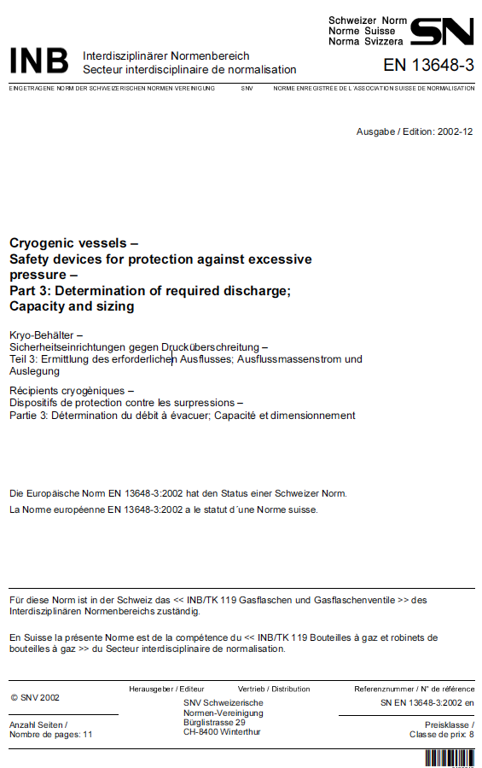
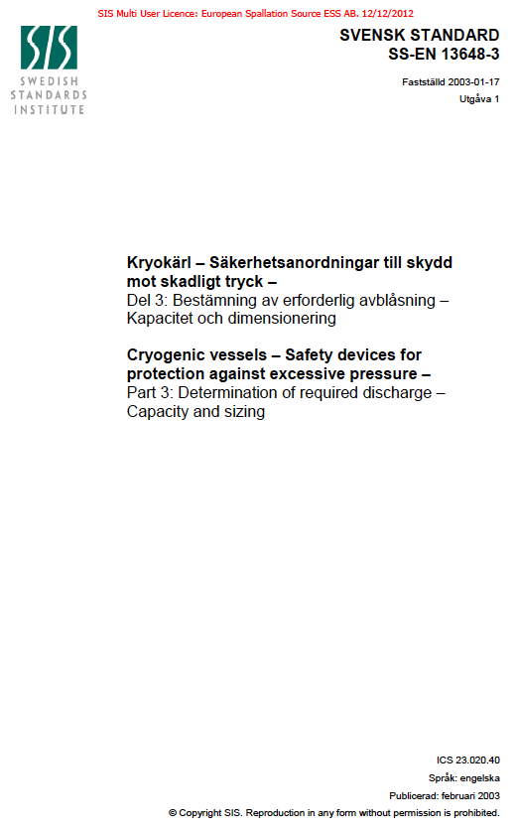
Example

Slide 8
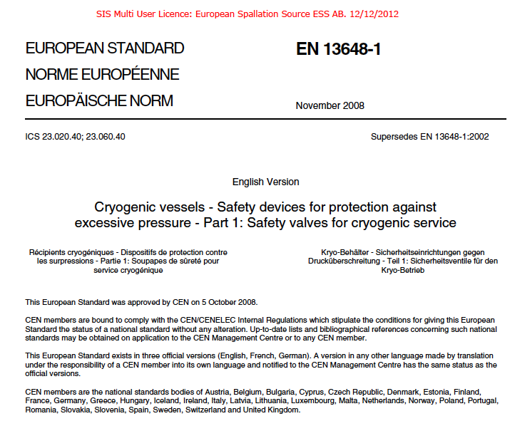
Example

Slide 9
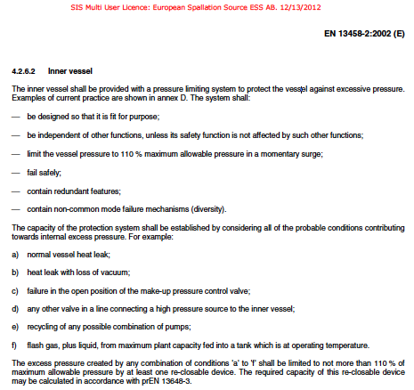
Example

Slide 10
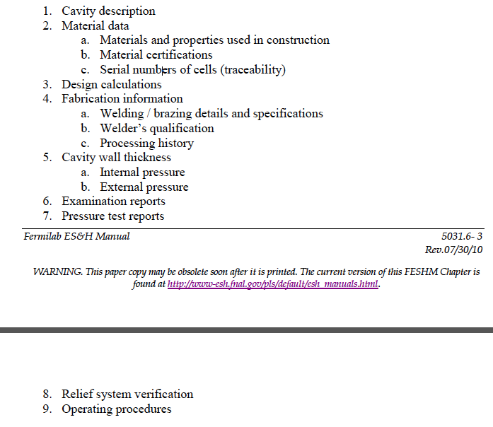
Example by FNAL : Engineering Note
Example

Slide 11
Safety analysis to be completed by CEA and IPNO for the cold linac cryomodules
Example of
safety report:
“Cryogenic Safety Analysis
ILCTA - MDB Vacuum System“
Table of Contents
Category: Page Number:
1.0 – System Design Documents
1.1 – System Description 3-4
1.2 – Flow Schematic (Reduced Size for Reference) 5
1.3 – Component – Valve – Instrumentation List (App.1) 6
1.4 – Operating Control Loops and Interlock Systems (App.3) 6
2.0 – System Operating Documents
2.1 – Operating Procedures 6-7
2.2 – Commissioning phase 7
2.3 – Qualification and Training Requirements 7
3.0 – Safety Analysis Documents
3.1 – FMEA (App.4) 8
3.2 – What If Analysis (App.5) 8
3.3 – Hazard Analysis 8
3.4 – Other ES&H Sections Compliance (App.6) 8
4.0 – Engineering Documents
4.1 – Relief System Calculations 9-17
4.2 – Material Stress Calculations 18-26
5.0. Appendices
Example

Slide 12
Pressure vessel code to apply to the ESS cold linac cryomodules

Slide 13
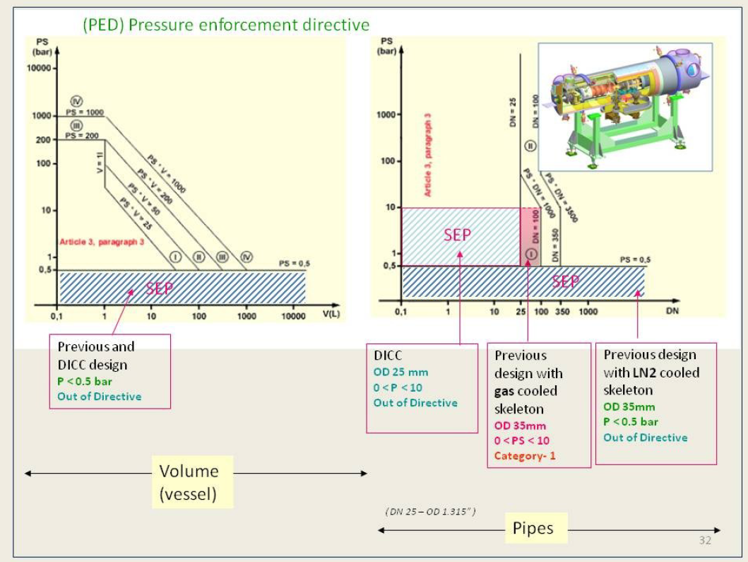
Example of application of Pressure Equipment Directive
Example

Slide 14
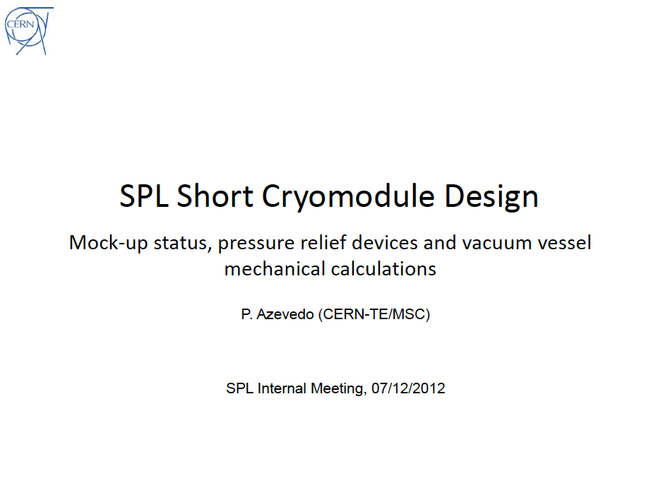
Example

Slide 15
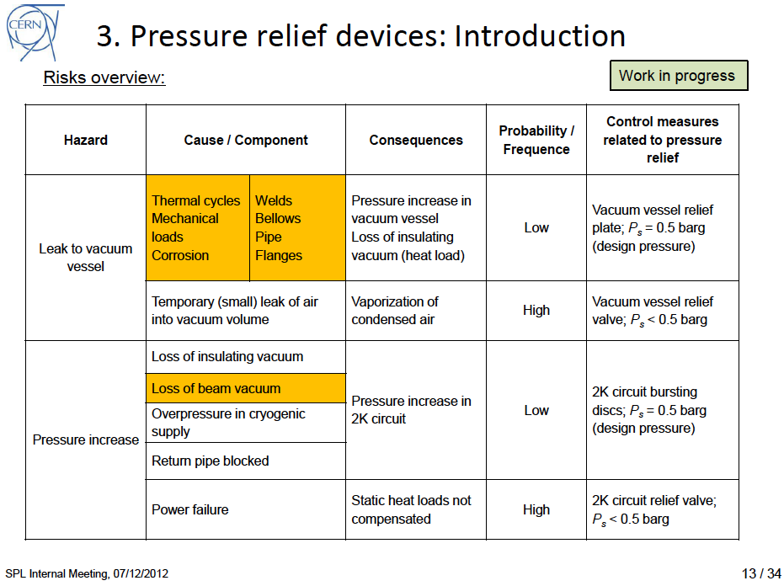
Example

Slide 16
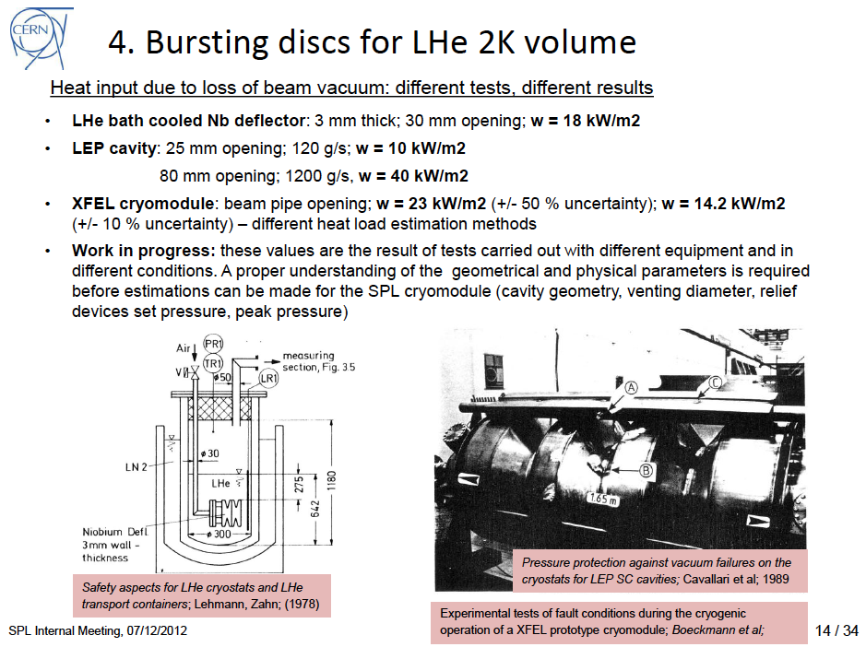
Example

Slide 17
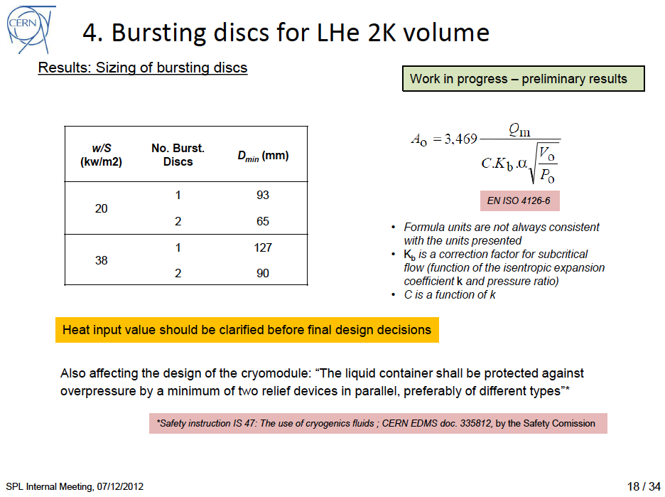
Example

Slide 18
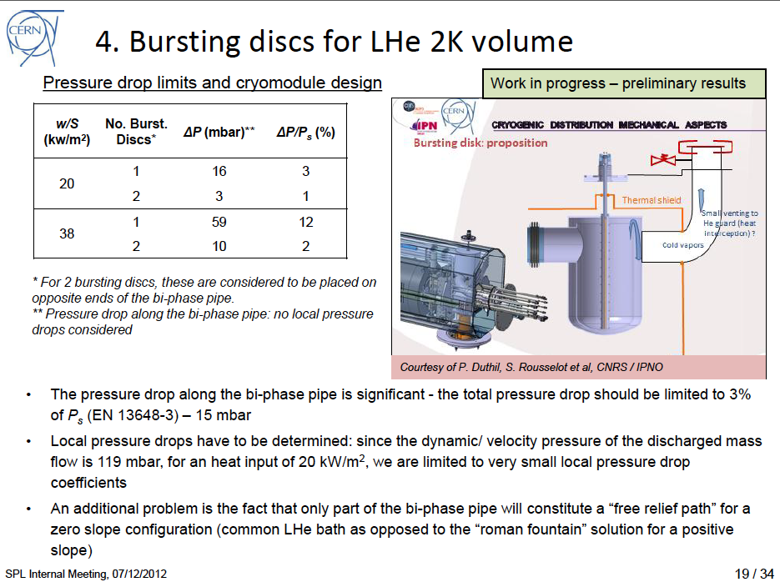
Example

Slide 19
Conclusion
Principles:
Comply with the formality of safety procedure
Similar to SPL approach (example)
On-going:
CEA/IPNO Safety analysis for a staged venting of the cryomodules
MCI if cavities to be replaced - Risk analysis in progress
Open questions:
Define the heat load deposited for un-insulated vacuum vessel
Proper selection of the temperature for the relieving scenario

