Slide 1
TIK-4.3 Irradiation Module
In-Kind Partner Team
R. Senesi [1,2], G. Gorini [3,4], F. Masi [1], G. Scionti [3], C. Vasi [2]
[1] Università degli Studi di Roma Tor Vergata ; [2] CNR-IPCF;
[3] Università degli Studi di Milano Bicocca; [4] CNR-IFP
ESS Team
Y. Lee, L. Zanini, R. Linander, M. Kickulies, D. Lyngh
www.europeanspallationsource.se
March 16th, 2015 Fourth Target Technical Board meeting

Slide 2
Outline
Highlights
Near-term plans
Risks and issues
Concluding remarks

Slide 3
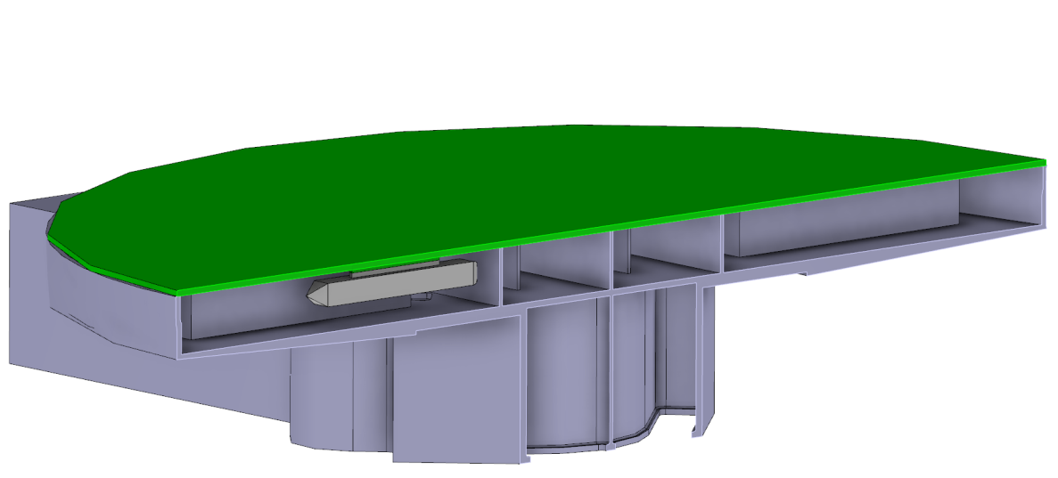
Highlights of work since last meeting December 2015
IM will be located inside the BOTTOM premoderator
Referring to the Target Coordinate system (TCS) the centre of the capsule is located in (x=13,5; y=145; z=-92).

Slide 4
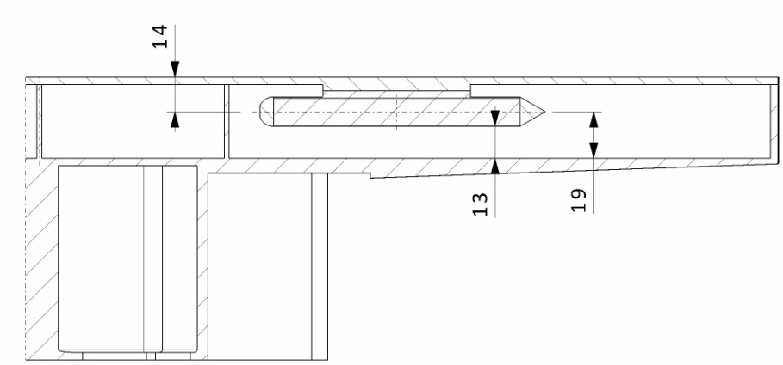
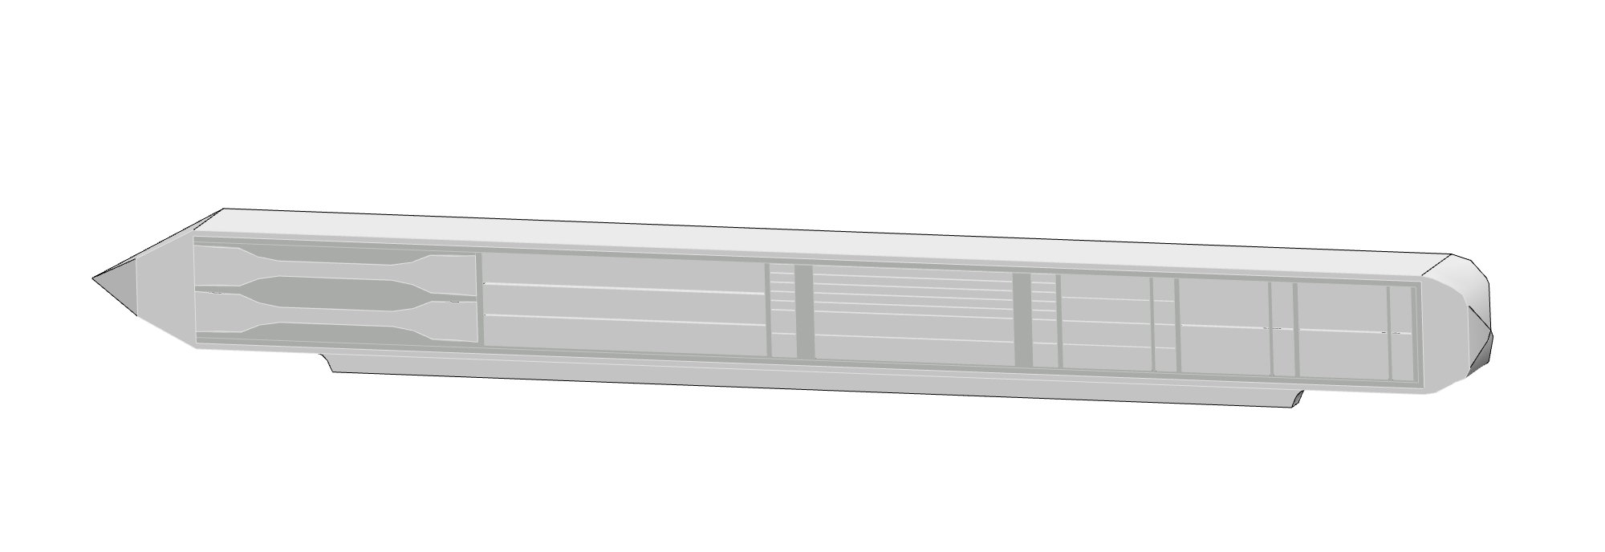
Highlights of work since last meeting December 2015
Mechanical design
Aluminium module, torpedo shaped
Miniature samples (SS 316L)
module
mini-samples
Capsule, samples, aluminium foil, helium, appendix, realized in two parts (welded in the middle)

Slide 5
Highlights of work since last meeting December 2015
Mechanical design- Main dimensions
Three parts: two halves and the hemispherical plug. After the samples packaging, the two halves will be welded and the plug will close the module. An aluminium foil separates the layers of samples one from another. Wall thickness 0.5 mm

Slide 6
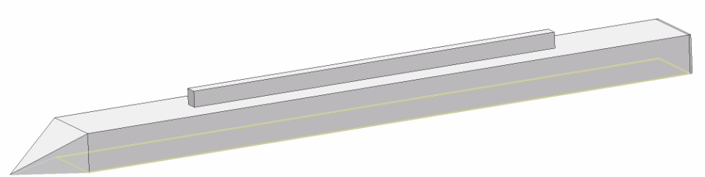
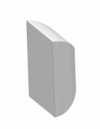
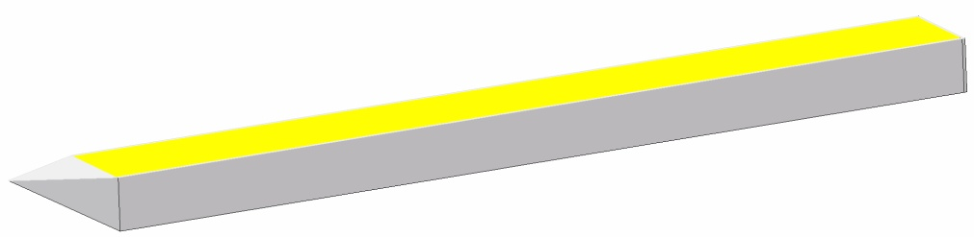
Highlights of work since last meeting December 2015
Mechanical design- Main dimensions
The module will be welded, through an appendix on the upper half, to the cover plate of the thermal moderator.
Hemisperical plug
Appendix

Slide 7
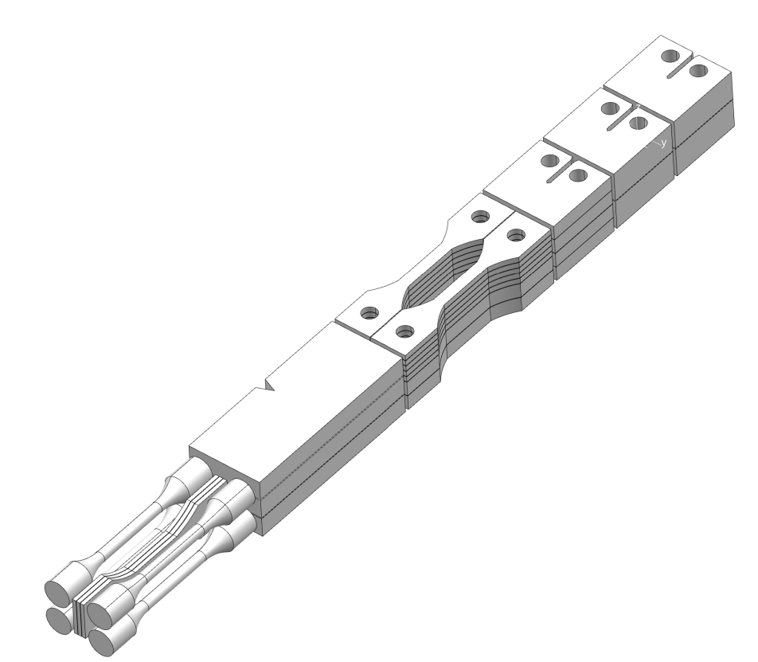
Highlights of work since last meeting December 2015
Mini-samples as part of the TIK
The mini-samples will be made by SS 316L. They will be manufactured cutting a 1 mm thick steel layer, using EDM (Electro Discharge Machining).
The shape and the dimension are being defined; EDM guarantees the required accuracy (0.01 mm) and the required surface roughness (20 micron).

Slide 8
Highlights of work since last meeting December 2015
Documentation prepared –under revision
SDD- requirements for the Irradiation Module
SDD- solutions for the Irradiation Module
ICD-R: Irradiation Module - Moderator Reflector Systems- interface requirements between the Irradiation Module and the Moderator Reflector Plugs

Slide 9
Near Term Plans (next 3 months)
Neutronics calculations (by Neutronics group by April 15th)
Complete SDD, ICD requirements and solutions
Manufacturing test
Complete risk register and analysis
Sign Technical Annex by May 2016

Slide 10
Risks and Issues
Interface with Remote Handling-manteinance mode of the IM
Interface with Moderator TiK- CFD analysis by Juelich with inputs from Irradiation Module TIK

