Slide 1

Backgrounds, n &c.
Remarks for discussion at SNS
14 December 2012
John M. Carpenter
IPNS, Argonne National Laboratory
and
SNS, Oak Ridge National Laboratory

Slide 2
Prompt neutrons in the beam

Slide 3
Delayed neutrons in the beam
Delayed neutrons emerge continuously on the interpulse time scale. Delayed-neutron spectra in the low-energy range are the same as prompt-neutron spectra, but because they originate from fission product decay or gamma,n reactions, (for example, in Be and D₂O) the spectra do not contain energies above about 2 MeV: no high-energy neutrons.

Slide 4
Skyshine
High-energy neutrons from several sources scatter and slow down in the air and building structures, traveling tens of meters and decaying after an initiating pulse in milliseconds (a signature feature). They rain down from above.
Remember that cosmic-ray-generated neutrons are always with us. The thermal neutron flux at the earth’s surface is about 10⁻⁴~10⁻³ n/cm²-sec, which varies with barometric pressure as exp(-0.083 P_{cm Hg}).

Slide 5
Groundshine
Fast neutrons in the skyshine and fast neutrons traveling underground emerge beyond the main source from below.

Slide 6
Where from?
Primarily from the target itself.
Otherwise, anywhere that high energy protons strike: Proton-transport losses in the linac, between the linac and the ring, at the stripper beam dump, at the extraction dump, ring-to-target transport, proton beam windows.
All these are supposedly well shielded. But … , and may be suspect sources.

Slide 7
Then what?
Slow neutrons are easy to stop.
Capture gamma rays from collimators and beam scrapers—Cd, Gd, Fe, Boron, and hydrogenous materials, are mainly a personnel radiation hazard, but can produce background in neutron detectors:
Cd, Gd, Fe: shower of gammas up to MeV
Boron: 478-keV gammas
Hydrogen: 2.2-MeV gammas
⁶Li₂CO₃: no gammas but a few fast n’s from

Slide 8
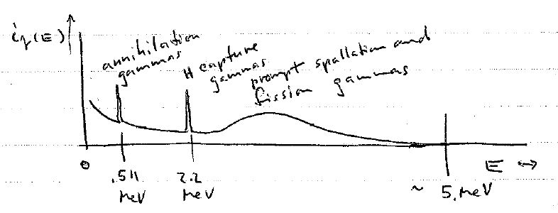
Gamma rays in the beam

Slide 9
Fast-neutron scattering
Fast neutrons scattered from beamline devices, T_{o} choppers, choppers in general, filters, monochromator crystals, windows, collimators, beam stops, beam scrapers—Cd, Gd, Fe, Al, Boron, and hydrogenous materials, can be a personnel radiation hazard and a source of detector background.

Slide 10
Guides
Fast neutrons escape from neutron guides, especially, curved guides. Similarly, epi-cutoff neutrons escape from neutron funnels.

Slide 11
Shielding
Capture gamma rays from shielding materials—
Fe, Boron, Hydrogenous materials contribute to personnel background and suggest a layered approach to shielding design. Include outer layer of Pb?

Slide 12
Machinery and piping
Coolant water exposed to fast neutrons
activates , which activity circulates
with the water and decays .
The exceptionally hard gamma rays produce a shower of secondaries. In D₂O, the gamma ray produces fast neutrons . Gamma-sensitive detectors register the gamma rays, and in the case of D₂O, the neutrons can affect neutron detectors. Both fast neutrons and gamma rays contribute to personnel radiation dose near water-system components.

Slide 13
At IPNS
Skyshine at synchrotron-injection time
Source: unrecognized lack of shielding of 50-MeV proton transport line (50 MeV protons make neutrons)
Beamline hot spots outside shielding at collimating apertures
Gamma rays from water-cooling system boxes above main shield
Cadmium is rarely an effective shield
materialB₄C shielding (“Crispy mix”) inside flight paths should be mounted with dry side toward detectors
We got away with rather small beamstops
Air scattering contaminates SANS and reflectometer data

