Slide 1
Finding and reducing a background feature at HYSPEC
Barry Winn, Mark Hagen,
M. Graves-Brook, RAD, ISDD
Thursday, August 9, 2012, 1 PM
Rm C-250

Slide 2
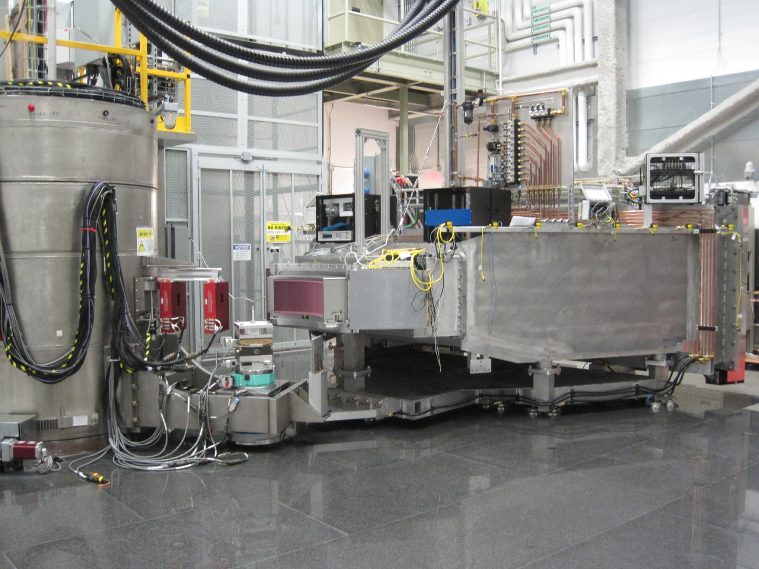
HYSPEC’s sensitive detector array
20 8-packs of
1.2 m long
LPSD’s, 25 mm
Dia tubes
detectors
~4.5 m
From sample,
So sum over
All detector
Pixels
(no spatial
Variation seen)
Surrounded by
A cadmium
‘box’

Slide 3
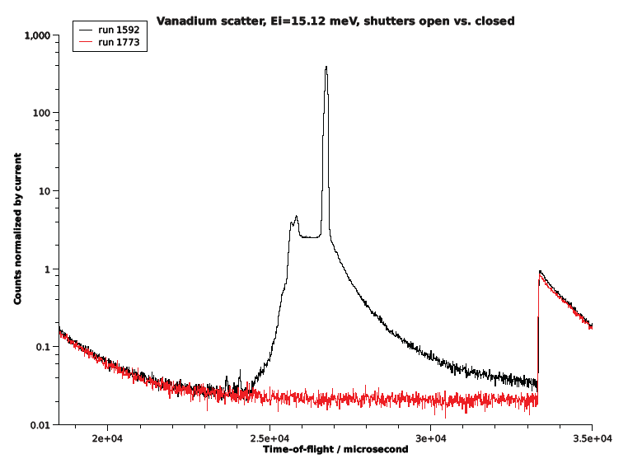
HYSPEC data summed over all detectors
Elastic scattering
from Vanadium
Inelastic feature from
Vanadium
Spallation
Event every
16.7 ms
(1/60 Hz)
Background tail ends about 3.5 ms beyond spallation event

Slide 4
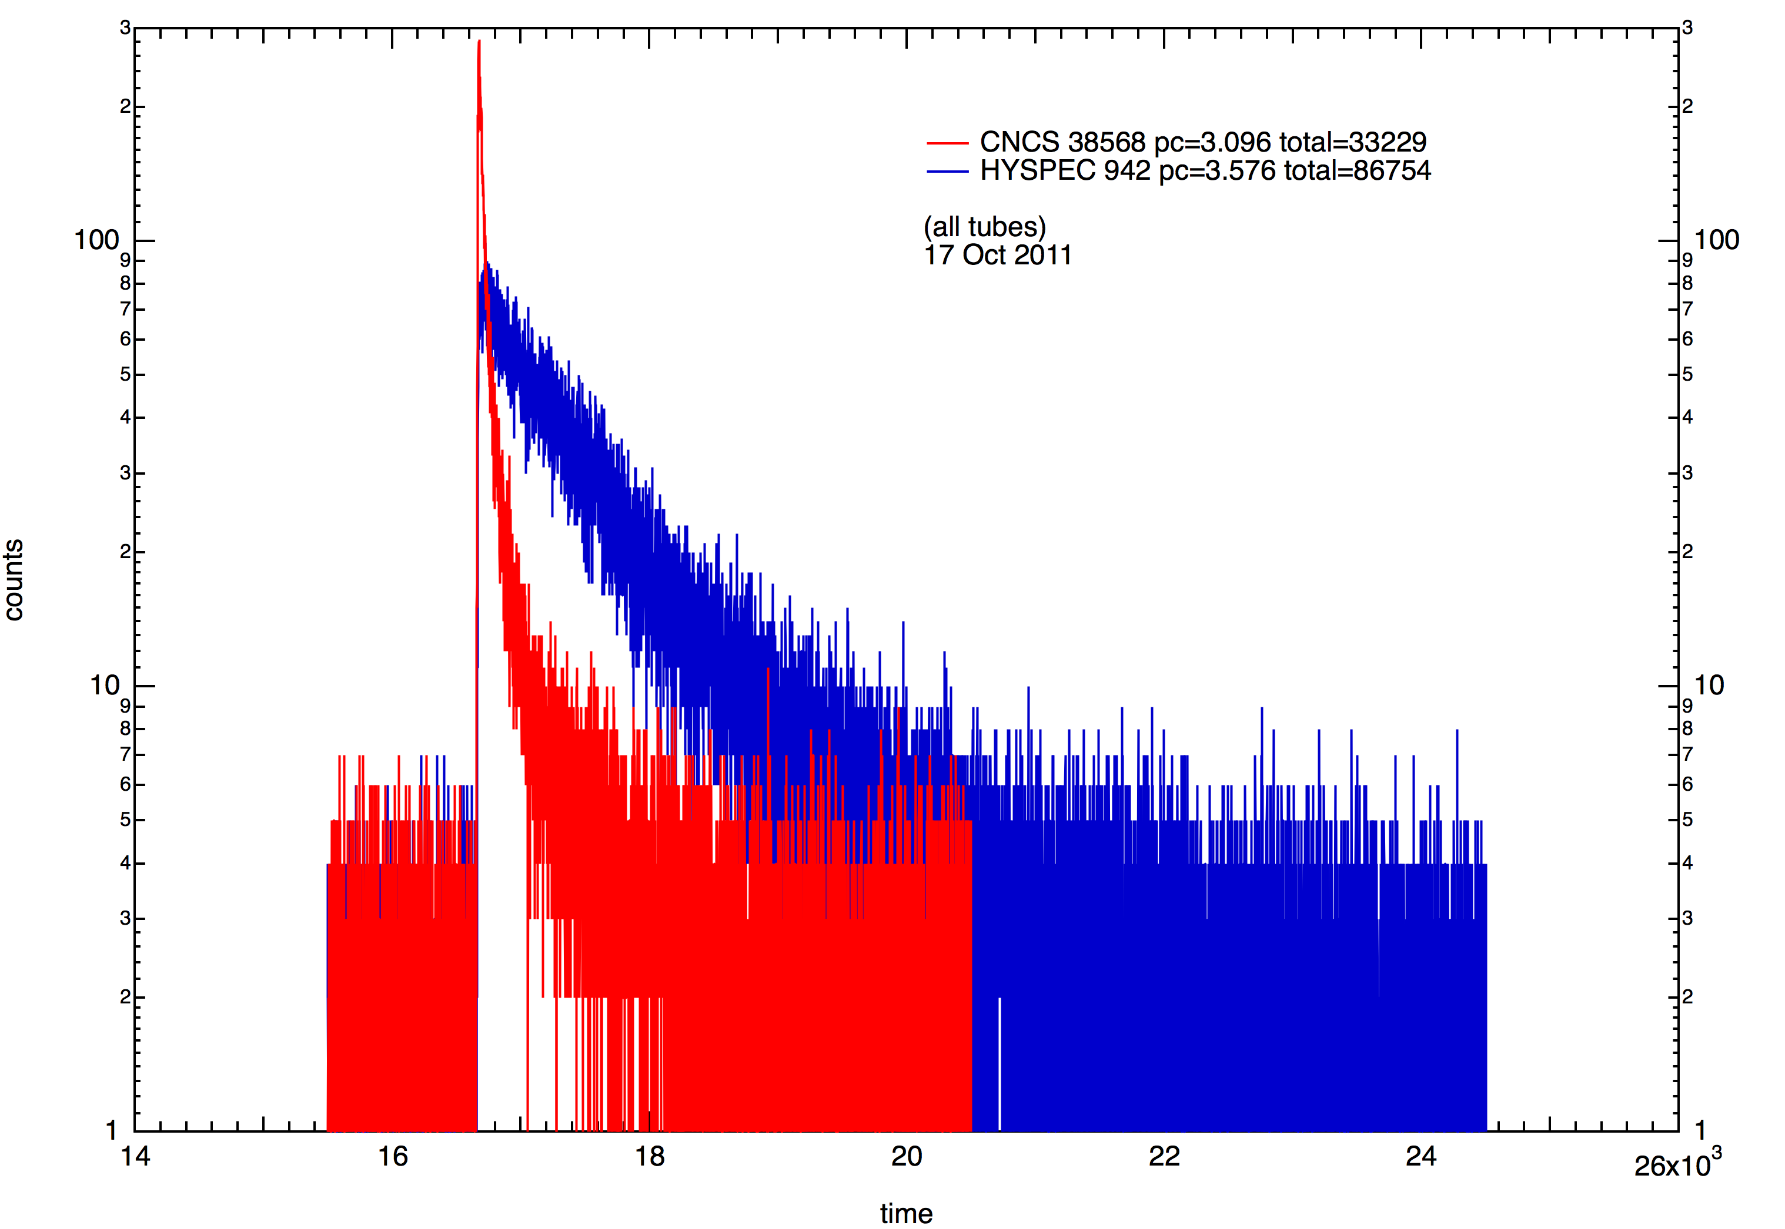
HYSPEC vs. CNCS

Slide 5
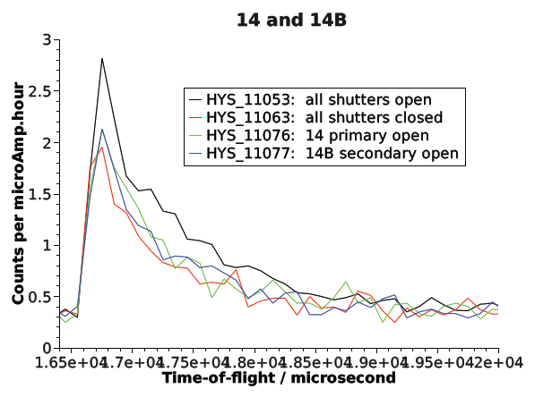
T0 chopper and curved guide do a good job of stopping this feature from coming down the 14B ‘tube’

Slide 6
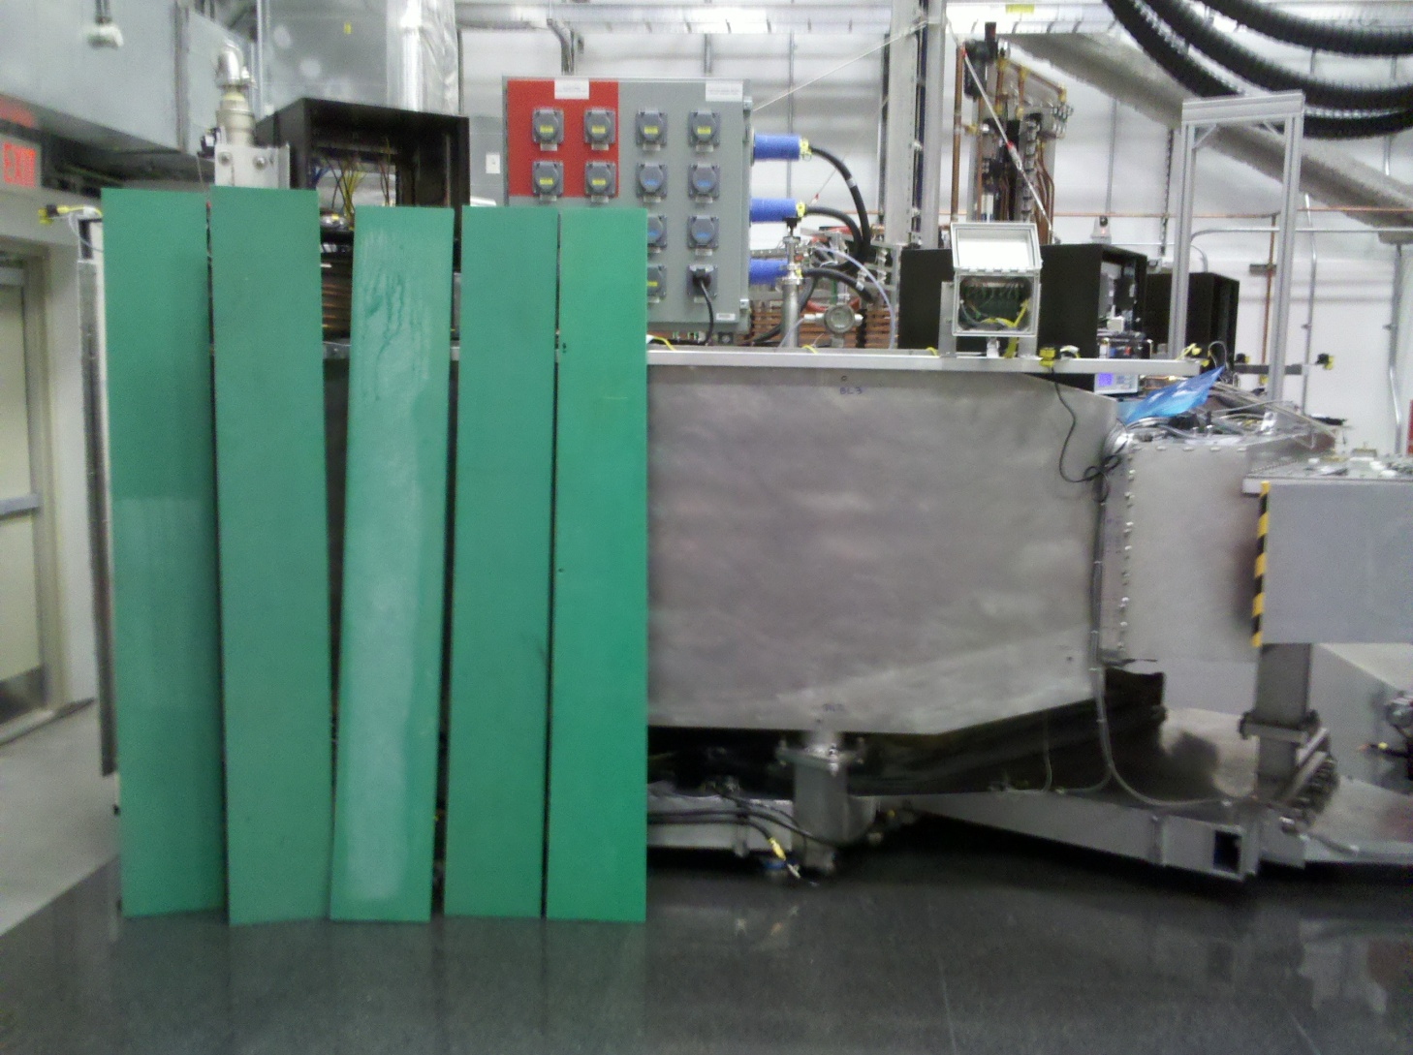
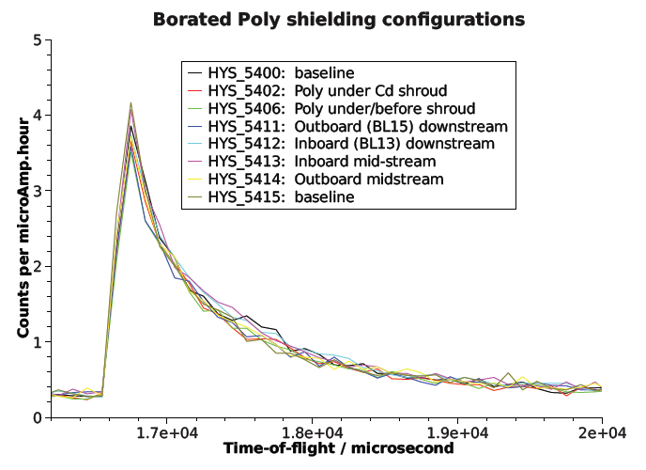
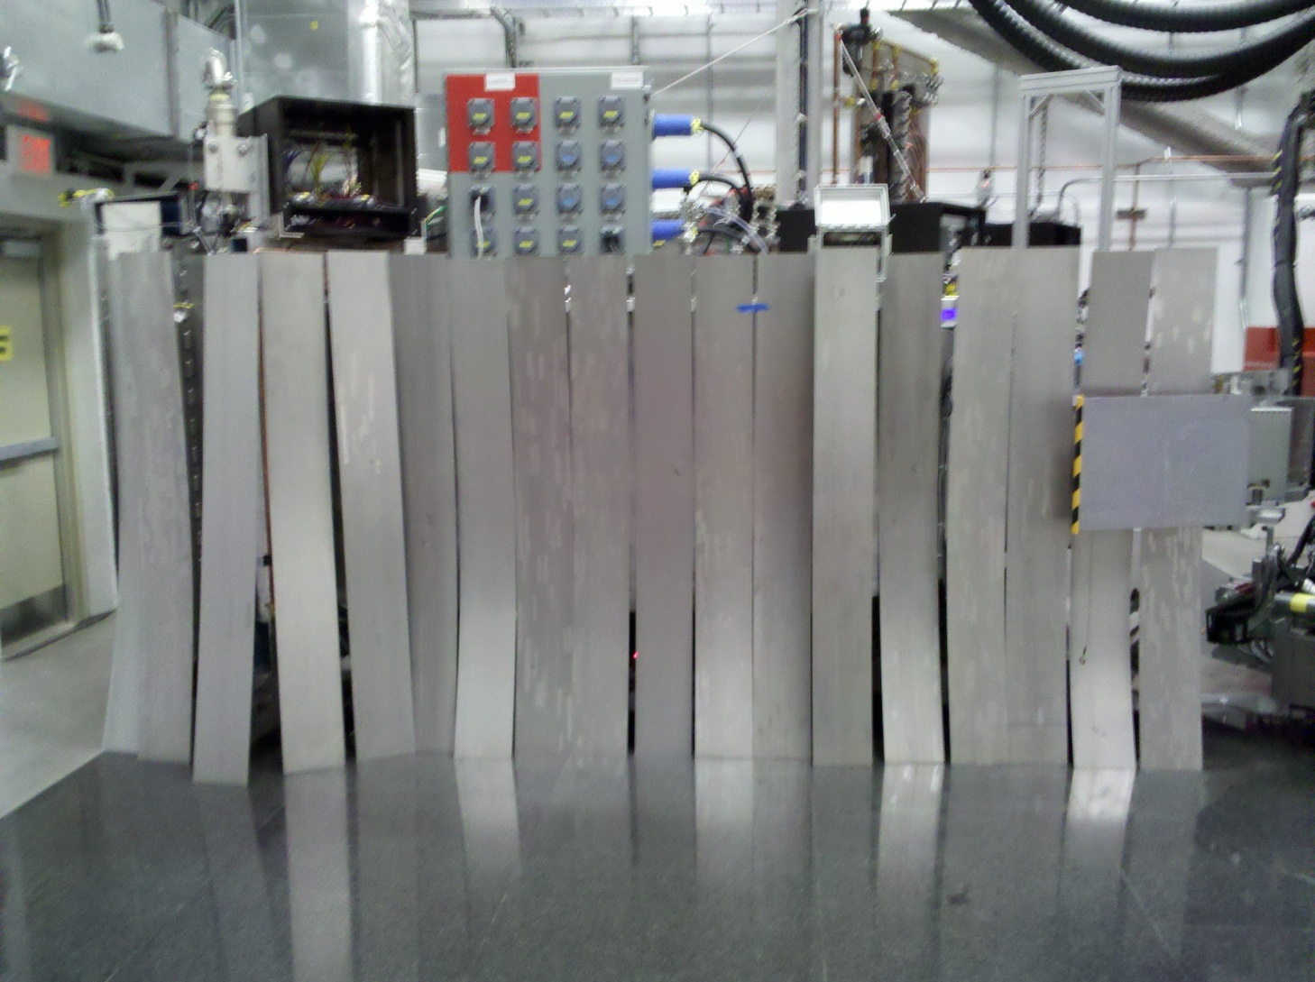
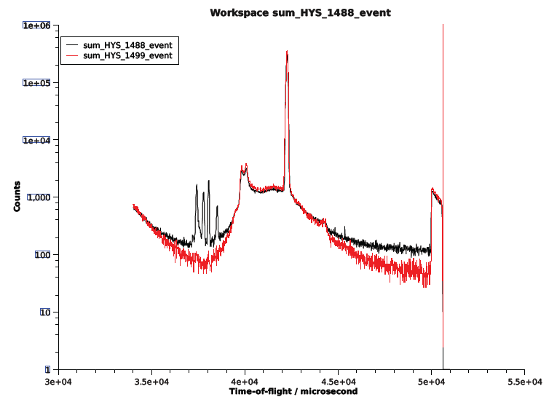
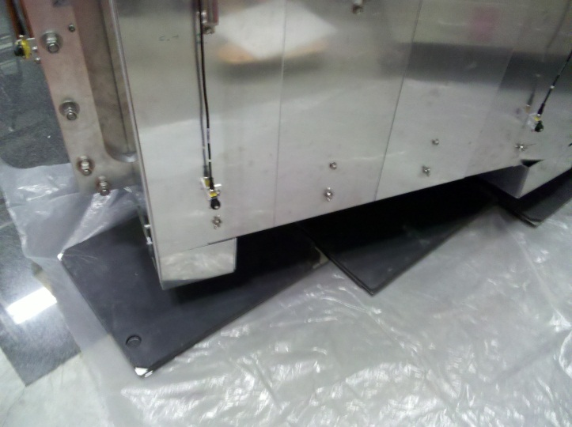
Tests confirm it’s not easy to eliminate at our detectors
Detector Configuration
  Threshold
  Gain/Bias
  MaxADC
  DiscWidth
Shielding at Detector Vessel

Slide 7
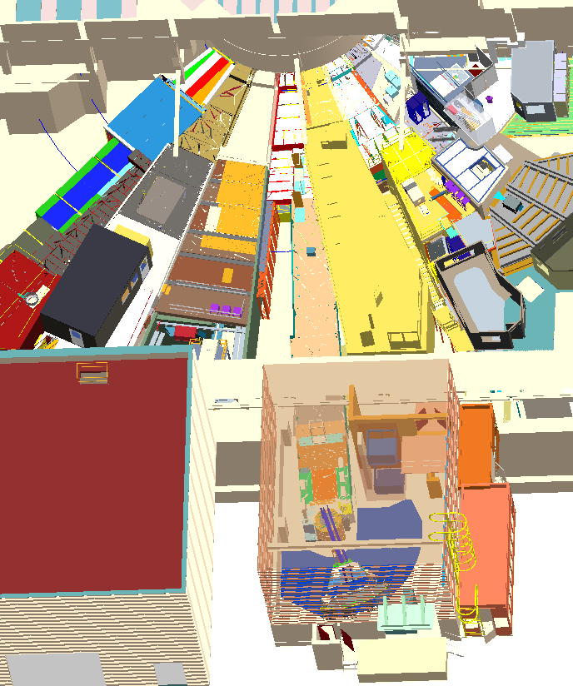
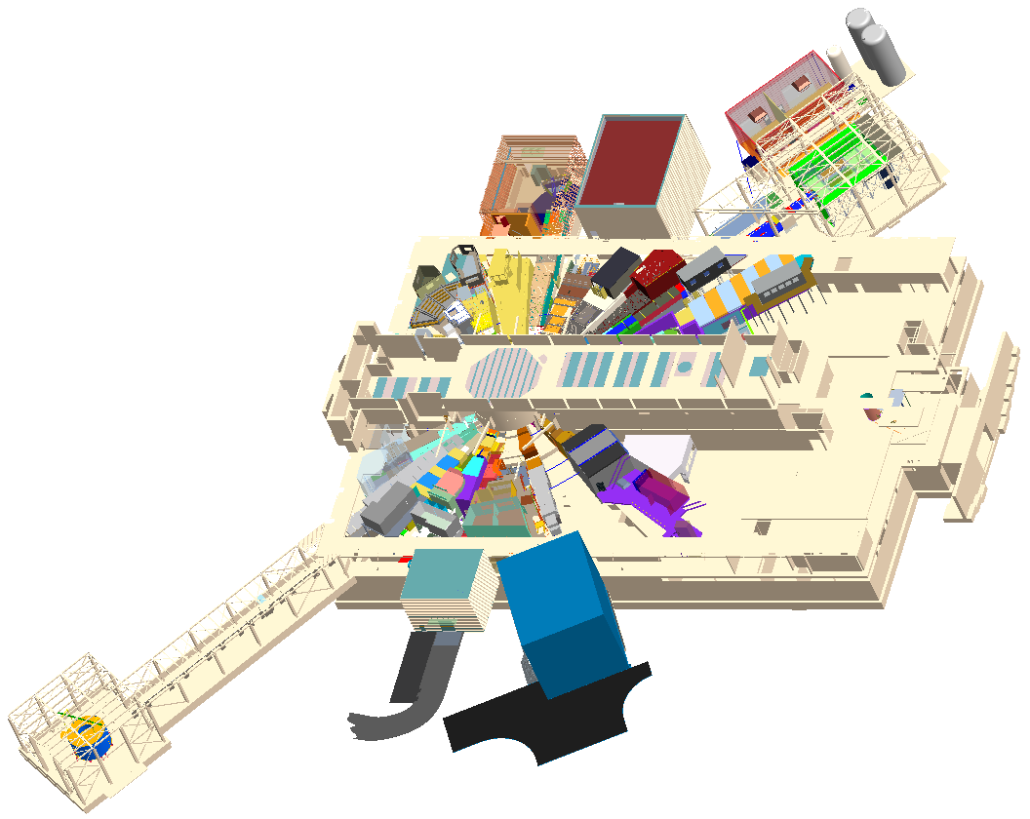
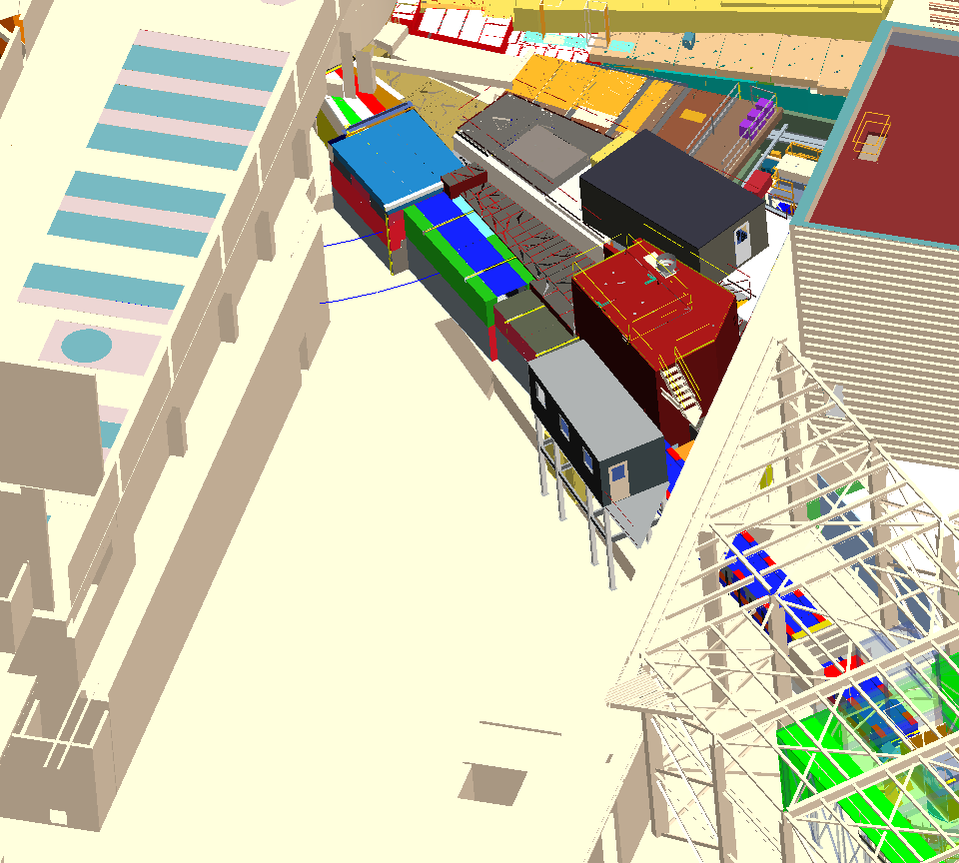
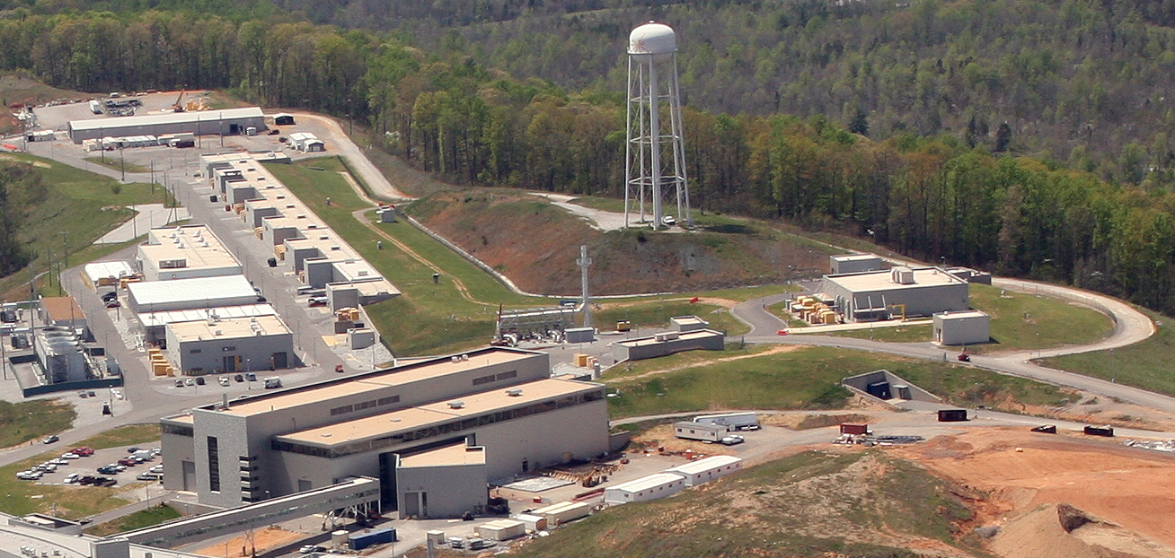
HYSPEC
HYSPEC
Region above end of
Proton beam is beacon
Of fast neutrons
Former source
Of 70% background
feature
Proton beam dump off collection ring
Was found innocent
HYSPEC

Slide 8
Timeline, Fall 2011
Date | Action
30-Aug-11 | Prompt pulse first observed on HYSPEC
6-Sep-11 | Initial shutter tests with BL 15: no effect
3-Nov-11 | Gamma background at sample position observed on detectors; removed with threshold and bias settings
8-Nov-11 | Proton Beam Dump Test: no effect
25-Nov-11 | Shadowing observed as difference in counts between two detector vessel angles
28-Nov-11 | Primary 11 closing reduces flux by 70%
30-Nov-11 | Not primary 12
1-Dec-11 | Not primary 18
2-Dec-11 | Not primary 17
2-Dec-11 | Sequoia 8-pack portable testing begins
9-Dec-11 | Not primary 13
7-Dec-11 | Yellow block shield testing atop BL 11 begins (3 stages)
8-Dec-11 | Clear supression observed with portable 8-pack and HYSPEC array
5-Jan-12 | Neutronics calculations suggest scatter from BL 11a choppers into BL10 cavity
8-Feb-12 | Yellow blocks added based on neutronics calculations
12-Feb-12 | Spring startup: 70% gone but the rest still there

Slide 9
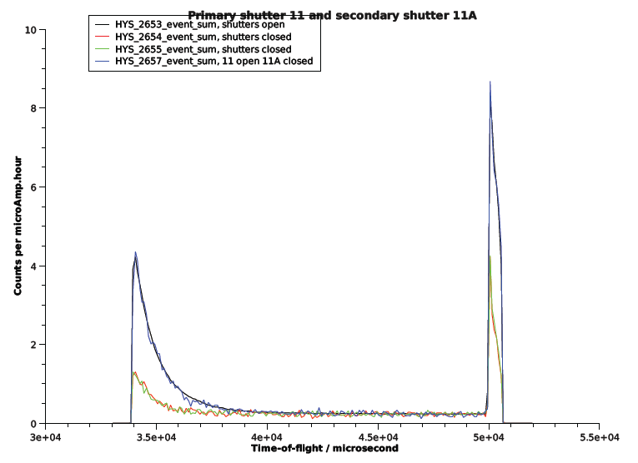
Date | Run | Charge | Time | Counts | Comments
28-Nov-11 | 2653 |  |  |  | primary shutter 11 open, secondary shutter 11A open
28-Nov-11 | 2654 | 138.8 |  | 8743 | primary shutter 11 closed, secondary shutter 11A closed
28-Nov-11 | 2655 | 138.8 |  | 8902 | primary shutter 11 closed, secondary shutter 11A closed
28-Nov-11 | 2657 | 138.8 |  | 17336 | primary shutter 11 open, secondary shutter 11A closed

Slide 10
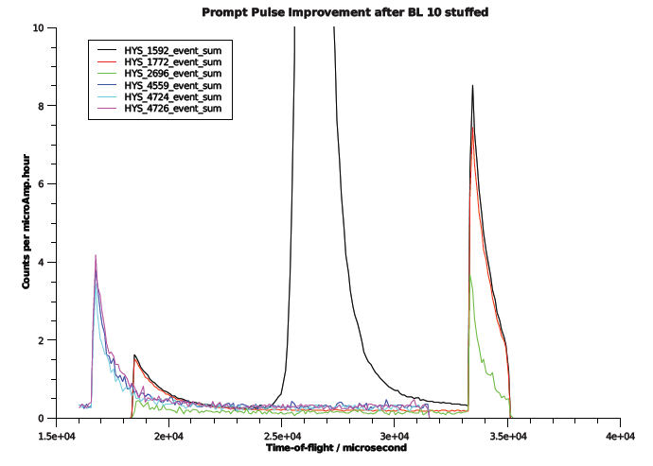
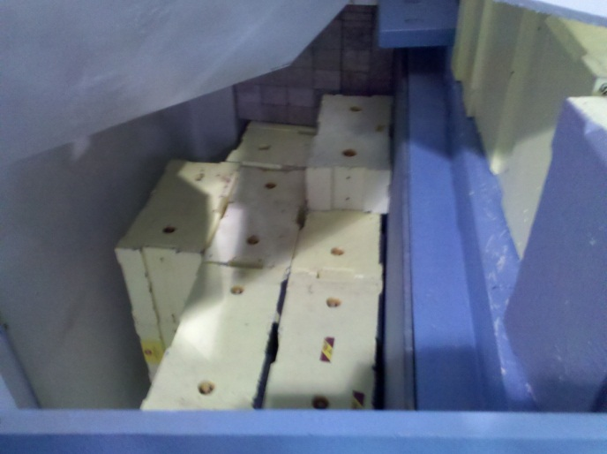
Before
Now
Wrap-around

Slide 11
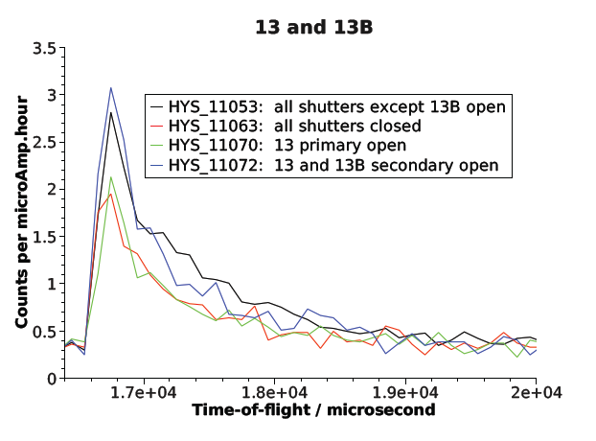

Slide 12
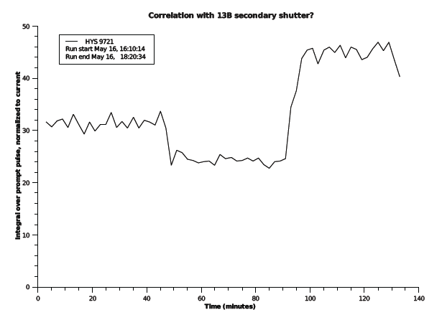
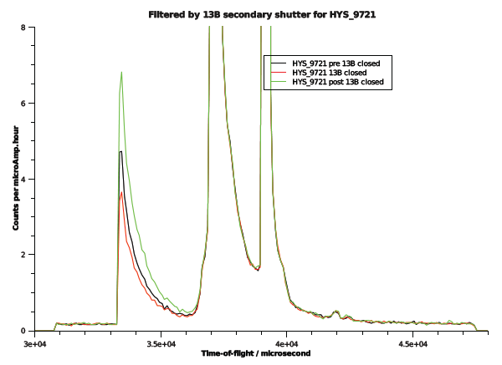
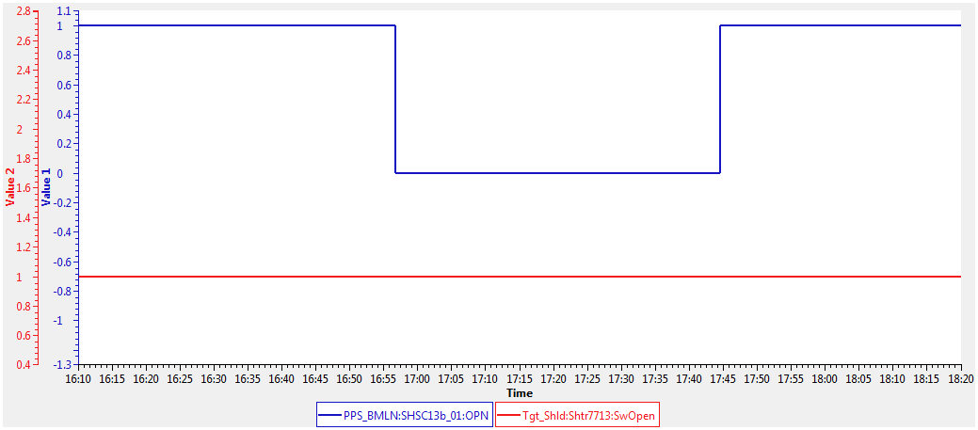
Time correlation with 13B’s secondary shutter?
Step size / time resolution is 2 minutes for ‘clock’ progression of prompt pulse., using filter_by_time algorithm
16:58 and 17:42 are times for drop and rise on run. In CSS, secondary shutter for 13B closes at 4:56 and opens at 5:44 PM.
H2 vs. Cl is reason for higher signal after reopening

Slide 13
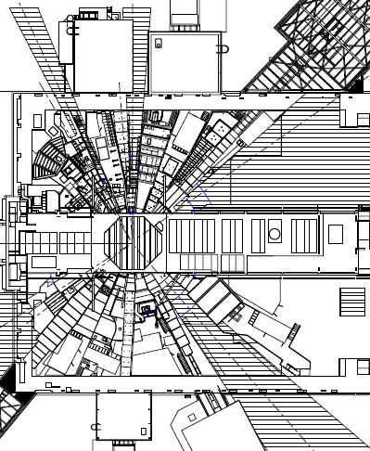
0.65
0.47
mrem/hr
0.52
2.8
1.7
2
16
15
7.2
10.2
24.3
117.8
37.7
2-1100

Slide 14
What next?
General and shutter closed contribution
  New Target, new background?
  Detector settings: we’ll try again
  Gradual time development on Tuesday afternoons: open to suggestions
  More mapping with LPSD
BL 13B secondary shutter
  Clock dependence kills any ‘empty can’ background subtraction approach
  Initial test of extra yellow blocks not so good
  Need another location, or higher blocks

Slide 15
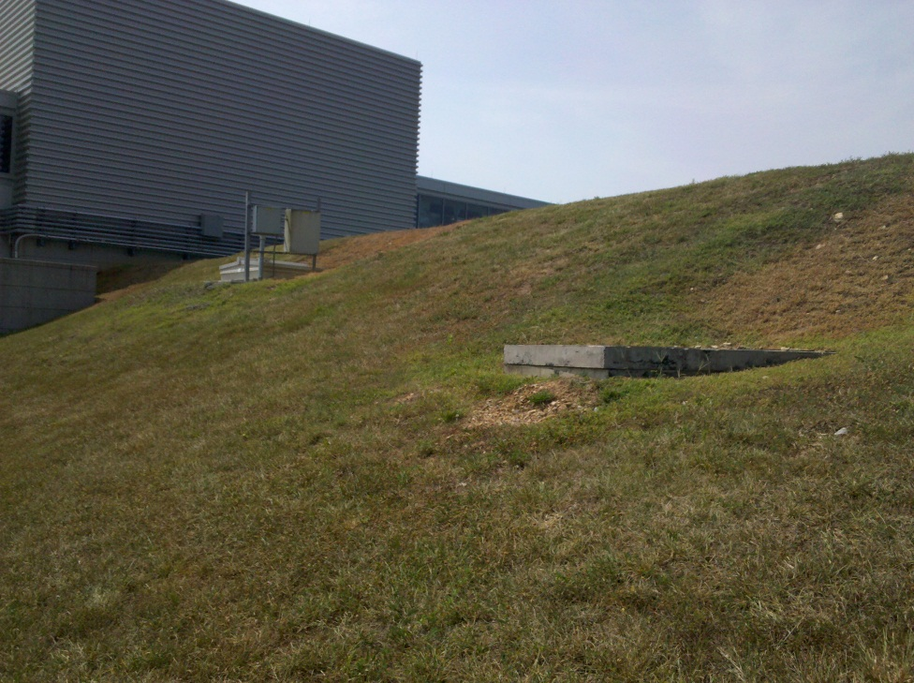
BL 11 shutter
  Lowest contribution, so least concerned
  may need more shield blocks somewhere
  difficult to measure with LPSD on cart to determine where best to shield

Slide 16
It takes a village
RAD
RCT’s & Don Gregory
  J. Treen, D. Craft, M. McAvoy, J. Eubanks, F. Barrera, D. Smith, R. Davis, P. Gonzalez
Accelerator Group
  C. Peters, J. Galambos
Target Group & Ray S.
  J. Denison, R. Armstrong
Instrument Support Group
  D. Engle et. al.
DAS
  L. Clonts
ISDD
Neutronics Group
  F. Gallmeyer, E. Iverson
Engineering: Operating Instruments
  M. Harvey, T. Roseberry, P. Rosenblad
Detectors
  L. Funk
Commissioning Support
  K. Herwig

Slide 17
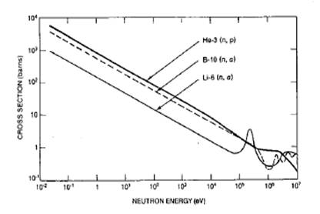
3He tube sensitivity
Cd transmission

Slide 18
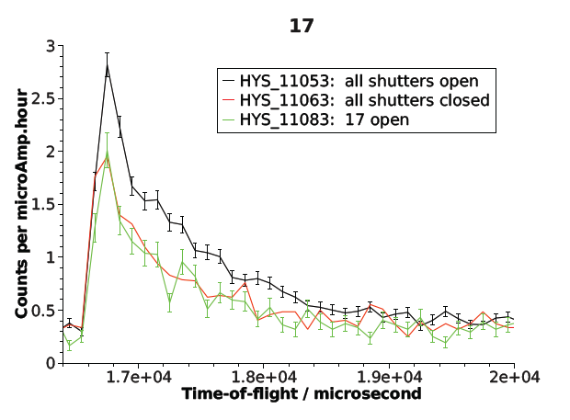
Statistics check:
30 min runs Monday vs.
10 min runs Tuesday
Sum over 100 us (0.1 ms) bins

Slide 19
Why it’s bad: Fast neutrons easily ‘lap’ neutrons we use for scattering
Affects ~3.5 ms of 16.7 ms frame
Background moves as we change Ei
  ARCS & SEQUOIA don’t care because they work in first frame
Temporary strategy: preferred Ei’s for energy loss or energy gain

Slide 21
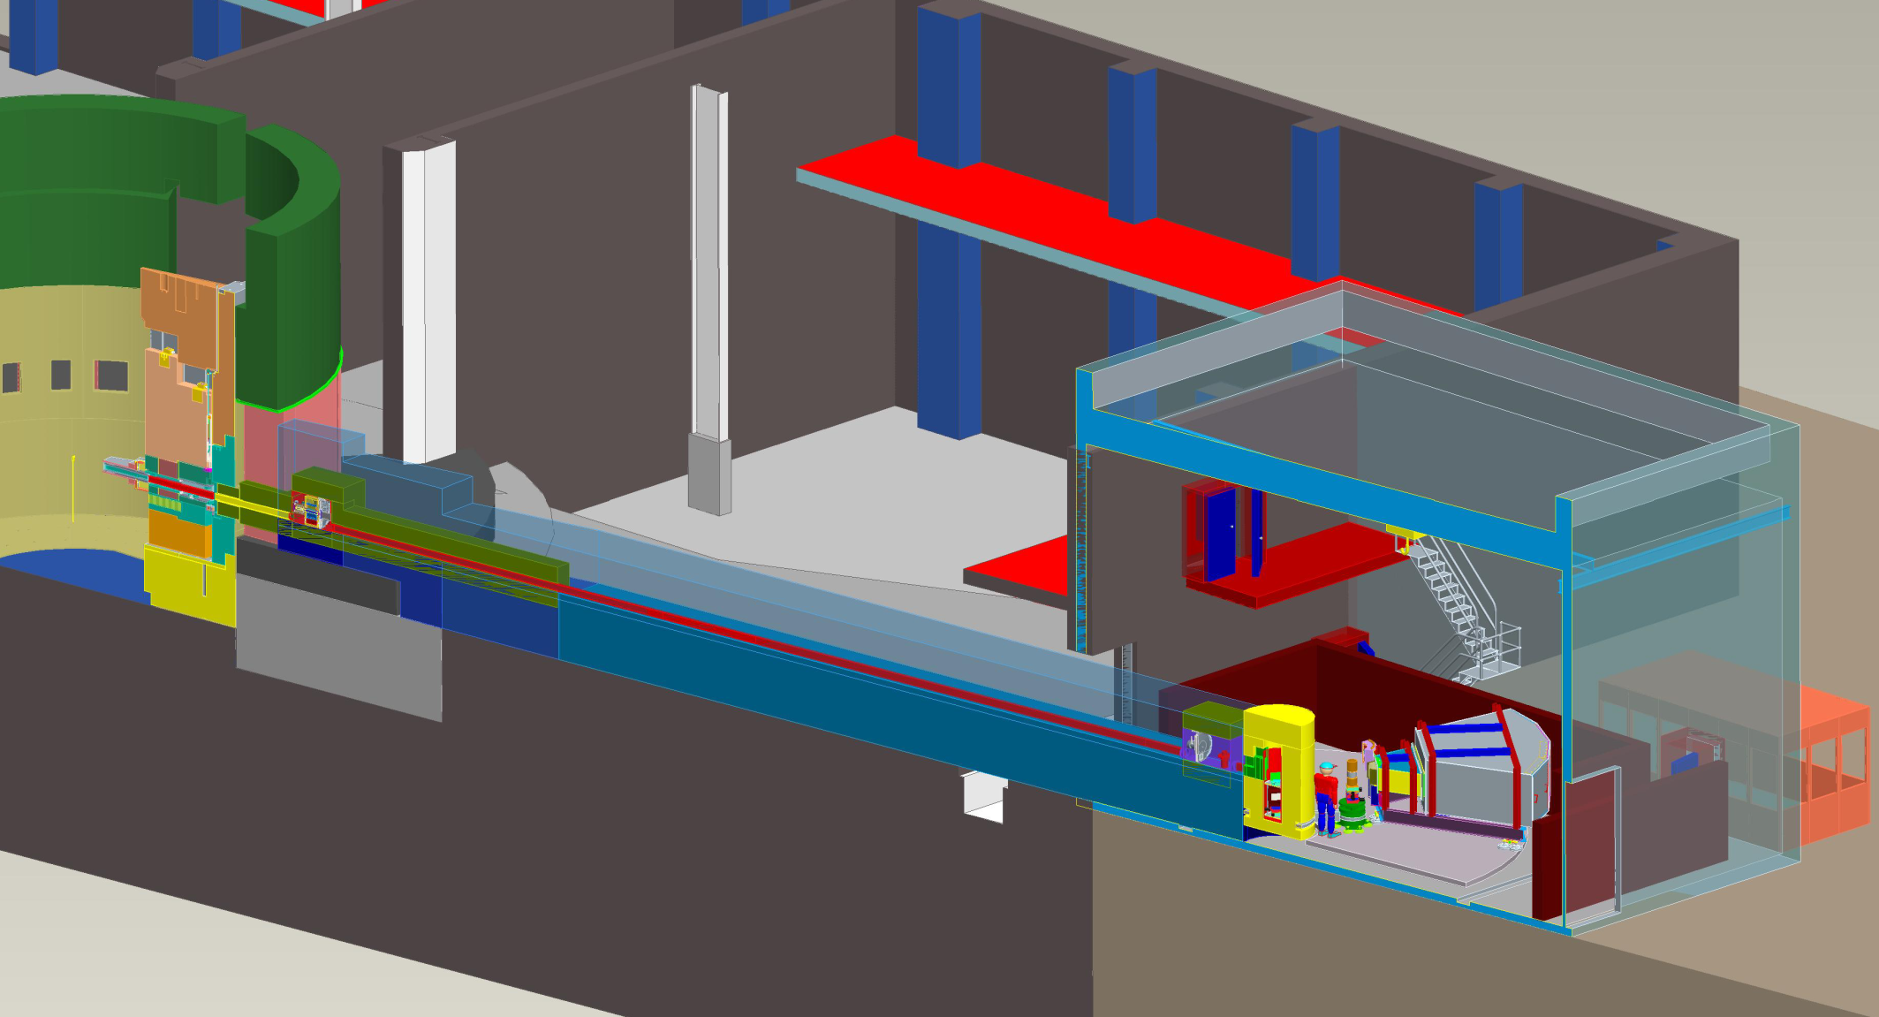
Shielding against fast neutrons at HYSPEC
Drum shield has heavy concrete, stainless steel and lead shielding,
T0 chopper stops high-E neutrons
Only sheet metal just above red concrete shielding
14A beamstop and filler blocks
1.5 mm thick Cd box surrounds LPSD’s
Curved Guide
(well shielded)
avoids
line-of-sight & stops high-E neutrons
10’ high 1’ deep regular concrete wall at lower part of 8714 AND about stairwell may thermalize more than shield
~3’ thick concrete underneath

Slide 22
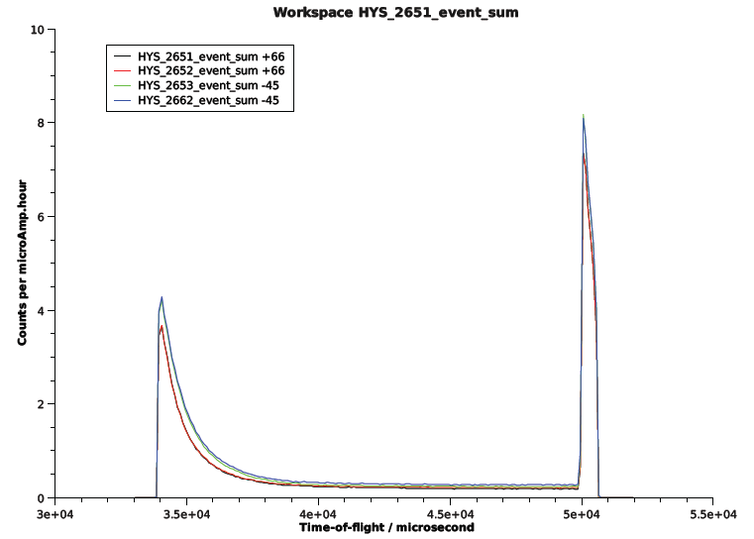
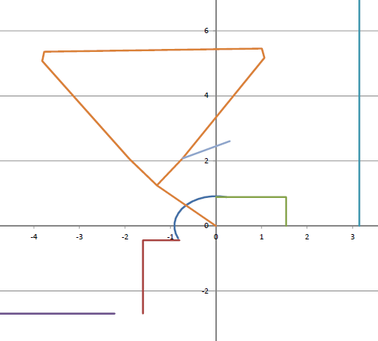
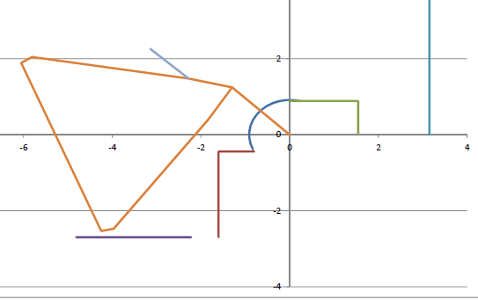
Shadowing

Slide 23
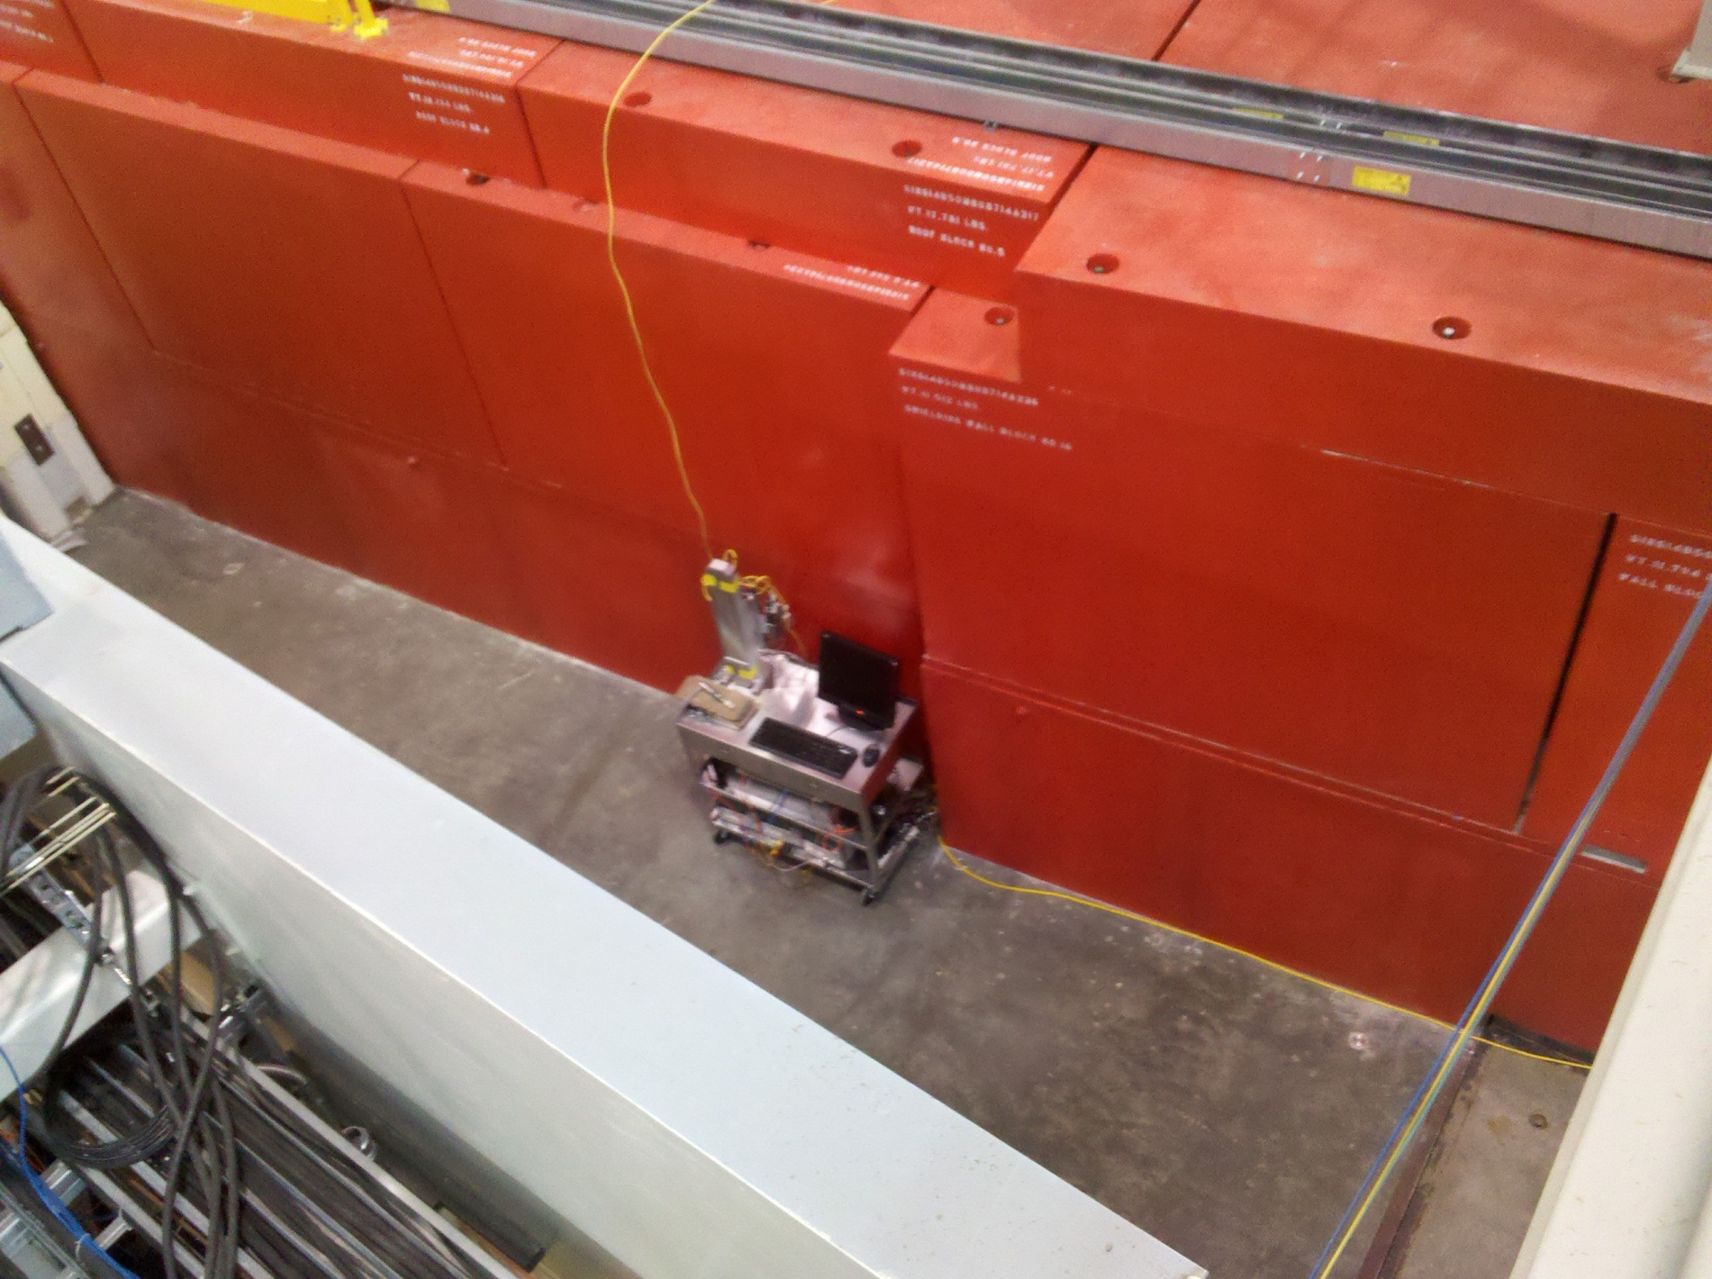
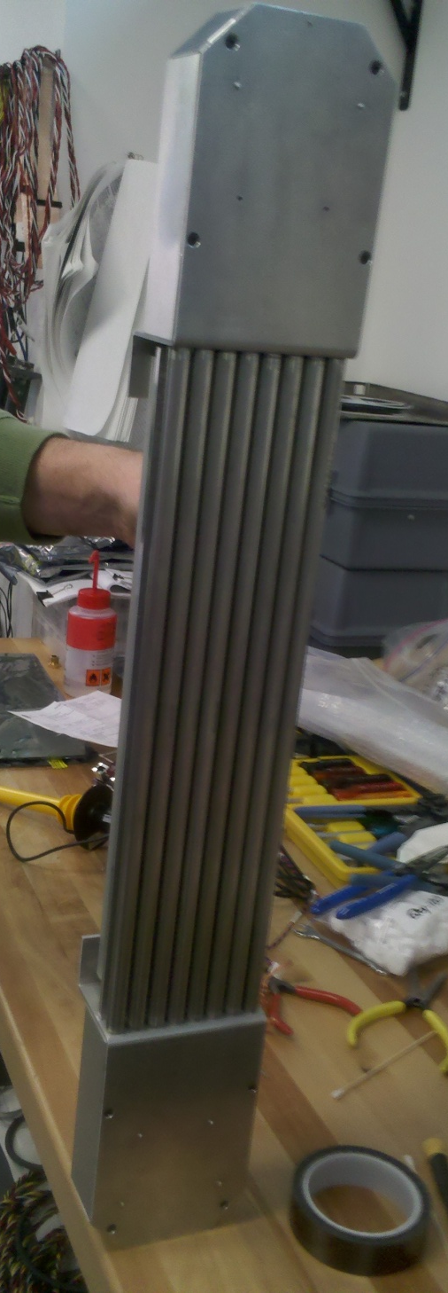
Use portable 8-pack to map prompt pulse background in Target building and experiment room
Effectively a mini-instrument, with TOF
Recording capability
3He tubes like HYSPEC’s (similar pressure
But smaller diameter and length)
Mostly portable; rides on a cart which isn’t all
That easy to move around (one LCD terminal
Down…). Prefer much more mobile, like atop
BL 10 crevice
Use partial shielding to
-characterize observed spectra
-observe some directionality

Slide 24
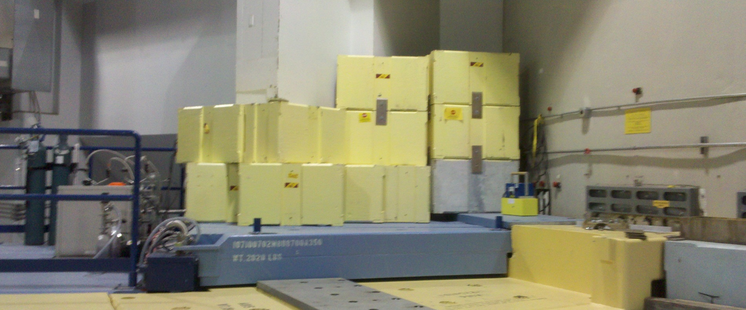
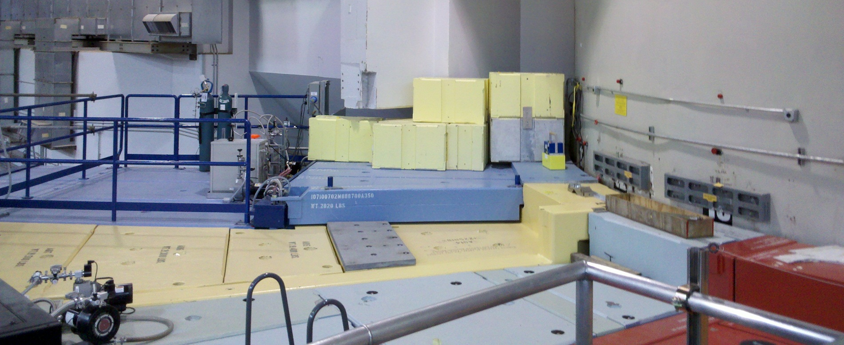

Critical part of test: adding temporary shielding (bulky; requires rigging support) to confirm directionality
+
Portable detector array

Slide 25
Lessons:
0.25 mrem/hr time averaged dose goal may not be enough for pulsed background
Initial, temporary configuration implications
  Concrete primary shutter at 11 may be too weak
  Thin walls between beamlines near monolith too thin
Mapping facility with time-dependent detector
Rapid shielding tests
Easy access to primary shutter status archives on all beamlines
  (spring-discover secondary shutters can also be important)

Slide 26
Timeline, spring 2012
Date | Action
16-Mar-12 | New dedicated IPNS portable detector array
15-Feb-12 | BL 11 primary shutter test: minimal effect now (Mar 20 too)
26-Mar-12 | BL 18 primary shutter test: no effect
17-Feb-12 | Shielding tests at detector vessel (and 23rd, 24th)
21-Feb-12 | Tuesday startup, no prompt pulse initially. Gradual growth from heatup or other correlation
29-Feb-12 | Proton beam steering tests on target (and March 1)
2-Apr-12 | More detector settings optimizing, hoping to reduce relative sensitivity to prompt pulse. Also April 25, May 5, May 16
29-Mar-12 | Lead blanket tests at Jim's Crack: no effect at HYSPEC (April 2, also)
3-Apr-12 | Measurements at Jim's Crack begin; high countrates observed
24-Apr-12 | Heavy concrete brick shielding Test at Jim's Crack: no effect
2-May-12 | Secondary shutters archived in EPICS
30-May-12 | Correlation with 13B shutter observed for 20% of background feature
18-Jun-12 | Shielding Test for 13B: no effect
18-Jun-12 | Coordinated AP shutter test at end of cycle: most remains when all shutters closed
9-Aug-12 | Shutdown: this talk
 | Fall cycle: ?

Slide 27
Where
  Shutter tests suggest that the bulk is NOT in instrument beamlines anymore
When
  Abrupt changes suggest shutters
  Gradual changes suggest something developing
    Changes in proton beam? Vacuum changing increasing scattering?
    Changes (thermal expansion) in what’s blocking the proton beam?
    Changes in shield configuration for fast neutrons?

Slide 28
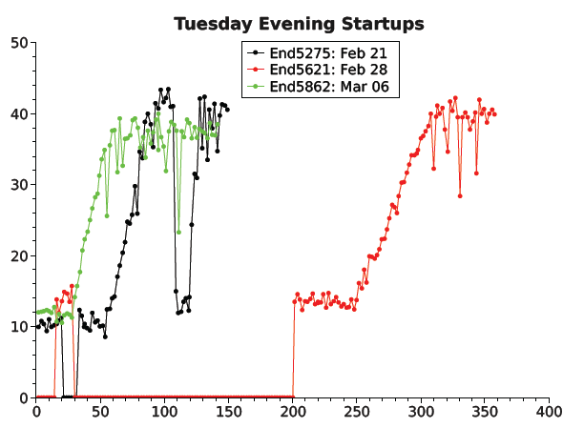
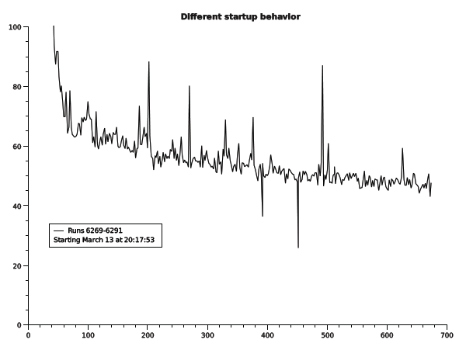
Gradual growth led to some steering tests on proton beam, but nothing conclusive (baseline varied by same amount as steering changes…)

Slide 29
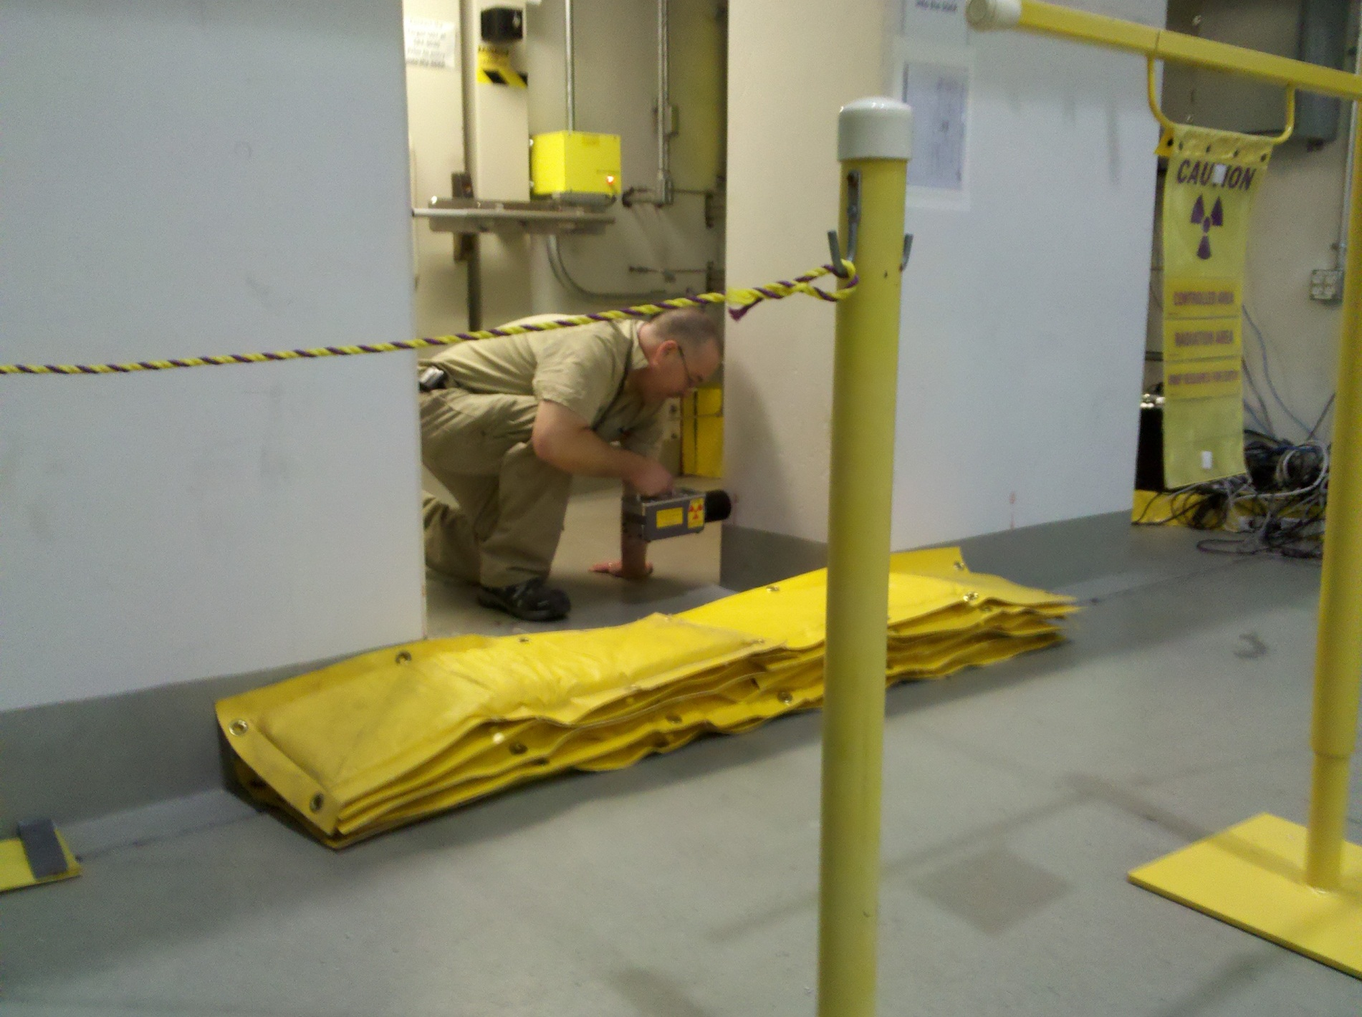
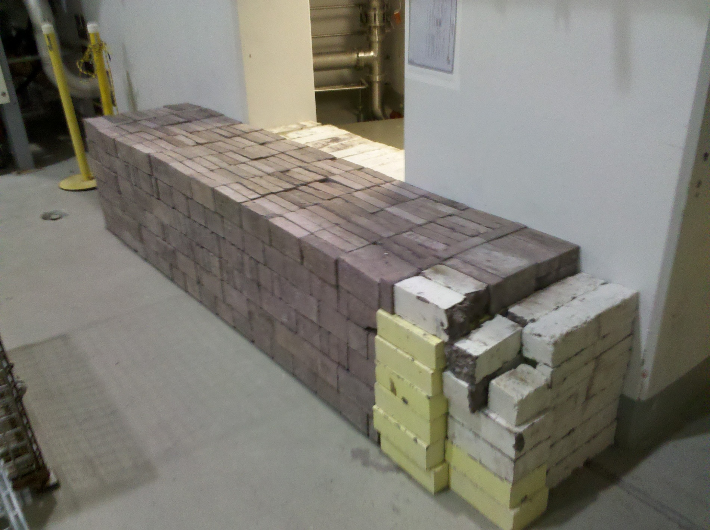
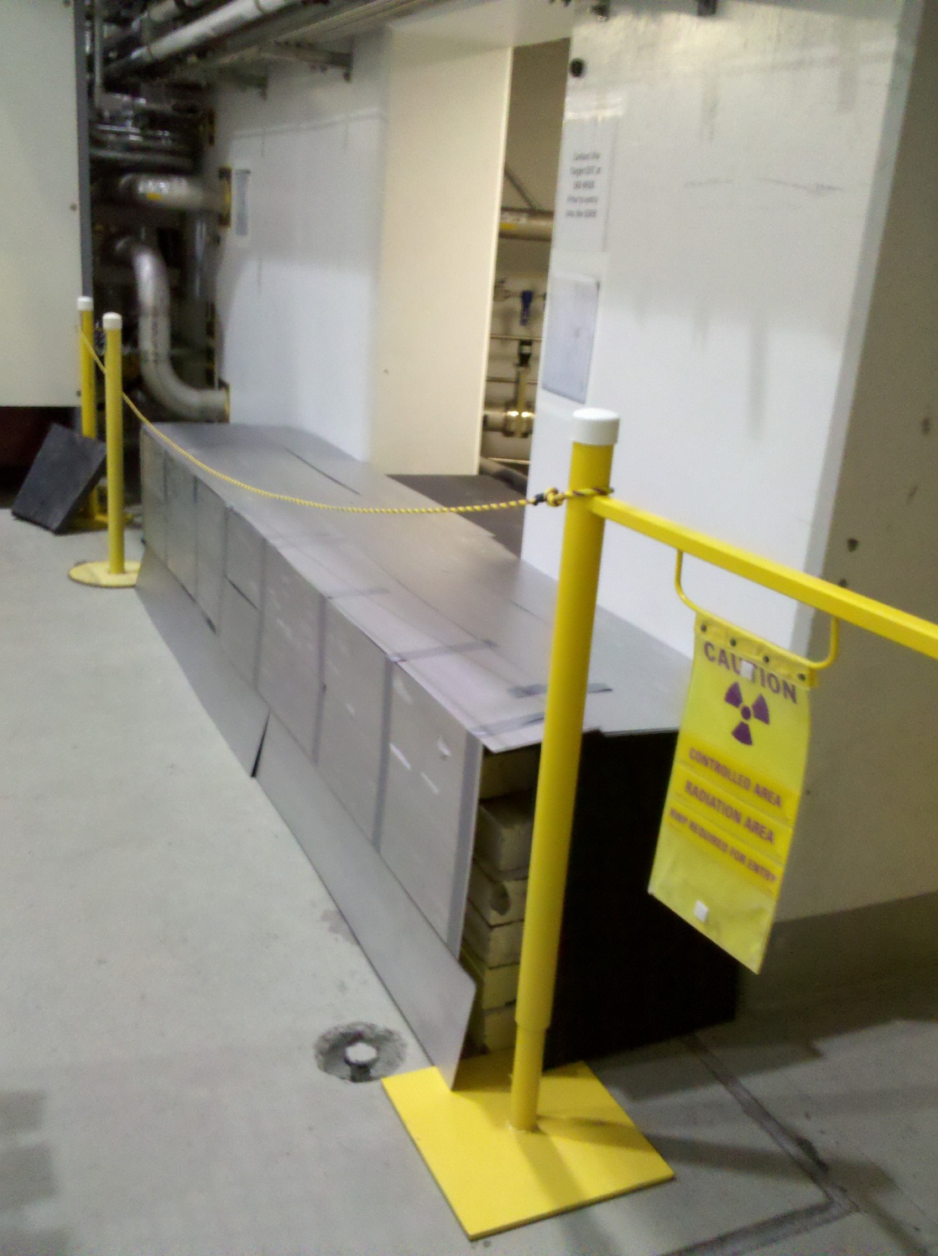
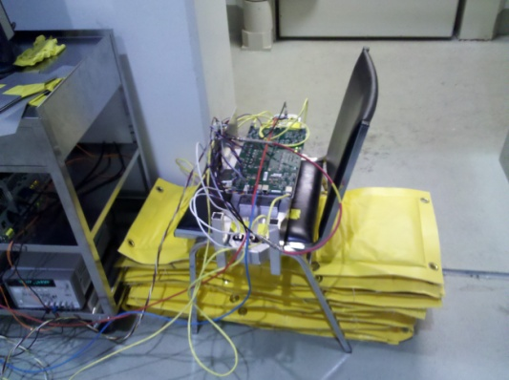
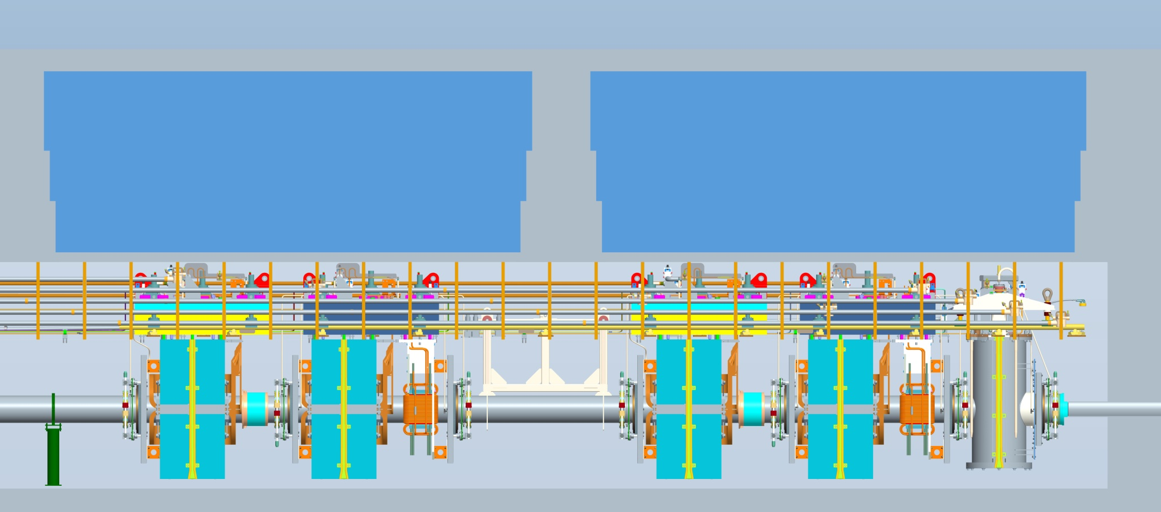
Tried above end of proton beam:
High radiation level in foyer of shutter control room

Slide 30
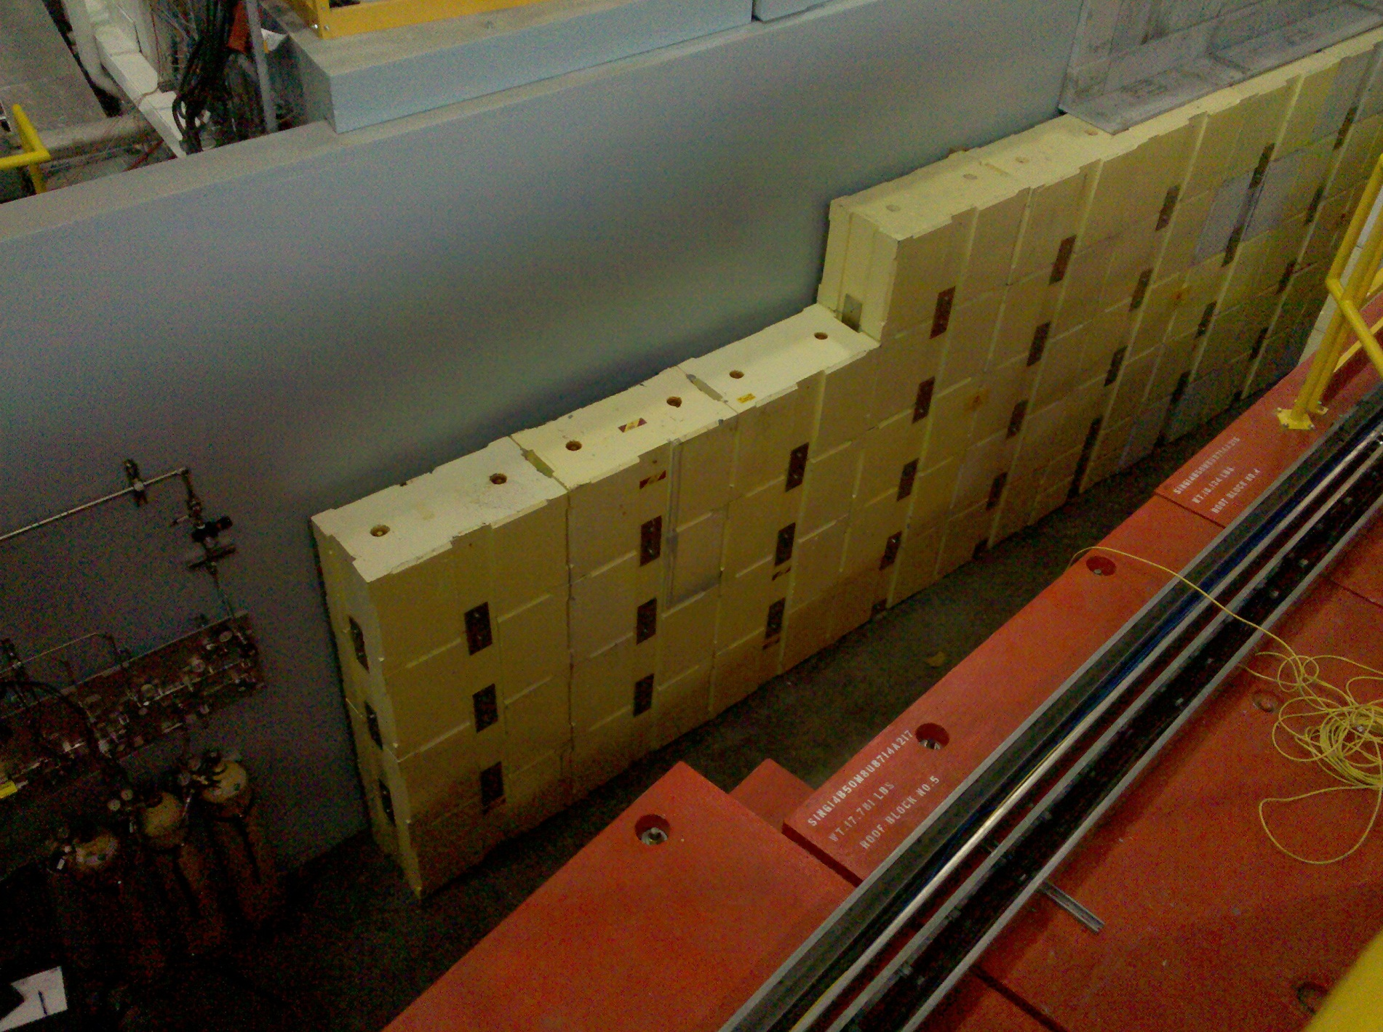
Other correlations observed in May
# | Time | PPS_BMLN:SHSC13b_01:OPN | Value | Severity | Run | Shift time | Diff time
5/16/2012 | 13:11:46 | - | MAJOR | STATE_ALARM | 9719 | 13:13:02 | 0:01:16
5/16/2012 | 13:29:22 | OPEN | OK | OK |  | 13:31:02 | 0:01:40
5/19/2012 | 3:27:03 | - | MAJOR | STATE_ALARM | 9871 | 3:28:38 | 0:01:35
5/19/2012 | 3:55:27 | OPEN | OK | OK | 9872 | 3:57:12 | 0:01:45
5/24/2012 | 10:51:24 | - | MAJOR | STATE_ALARM | 10020 | 10:53:15 | 0:01:51
5/24/2012 | 10:55:52 | OPEN | OK | OK |  | 10:59:15 | 0:03:23
5/25/2012 | 8:58:40 | - | MAJOR | STATE_ALARM | 10055 | 9:00:41 | 0:02:01
5/25/2012 | 9:25:28 | OPEN | OK | OK |  | 9:28:41 | 0:03:13
5/25/2012 | 9:34:21 | OPEN | OK | OK | 10056 | 9:36:48 | 0:02:27
5/25/2012 | 9:37:24 | - | MAJOR | STATE_ALARM |  | 9:38:48 | 0:01:24
5/25/2012 | 9:40:18 | OPEN | OK | OK |  | 9:42:48 | 0:02:30
5/25/2012 | 9:43:10 | - | MAJOR | STATE_ALARM |  | 9:44:48 | 0:01:38
5/27/2012 | 0:34:45 | - | MAJOR | STATE_ALARM | 10122 | 0:36:35 | 0:01:50
5/27/2012 | 2:15:13 | OPEN | OK | OK | 10126 | 2:17:25 | 0:02:12
5/27/2012 | 12:32:46 | - | MAJOR | STATE_ALARM | 10146 | 12:36:13 | 0:03:27
5/27/2012 | 12:49:47 | OPEN | OK | OK | 10147 | 12:52:16 | 0:02:29
5/31/2012 | 4:31:54 | - | MAJOR | STATE_ALARM | 10262 | 4:34:28 | 0:02:34
5/31/2012 | 4:49:54 | OPEN | OK | OK |  | 4:52:28 | 0:02:34
5/31/2012 | 8:07:11 | OPEN | OK | OK | 10265 | 8:09:05 | 0:01:54

Slide 31

Concerned about shielding at the top not going high enough to block transmission through BL10 heavy concrete temporary insert & stacked grey blocks

