Slide 1
High-energy background at the Cold Neutron Chopper Spectrometer at the SNS
Georg Ehlers
Quantum Condensed Matter Division
Oak Ridge National Laboratory

Slide 2
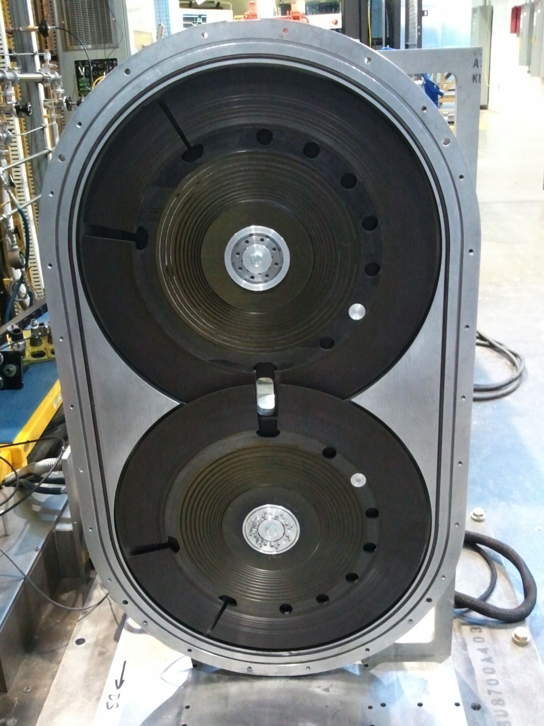
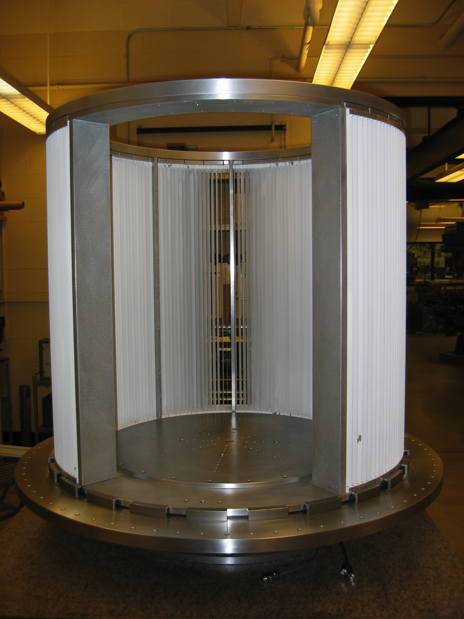
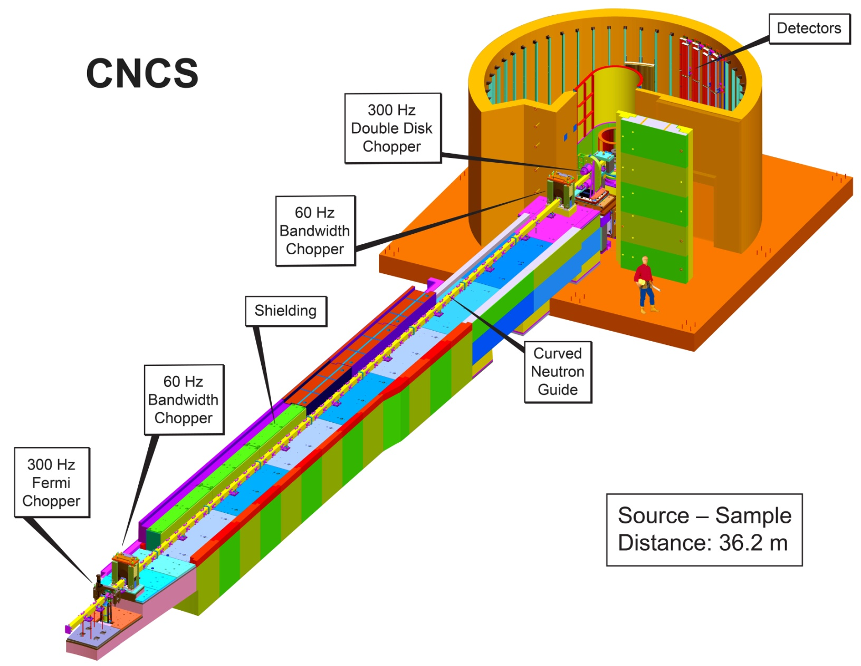
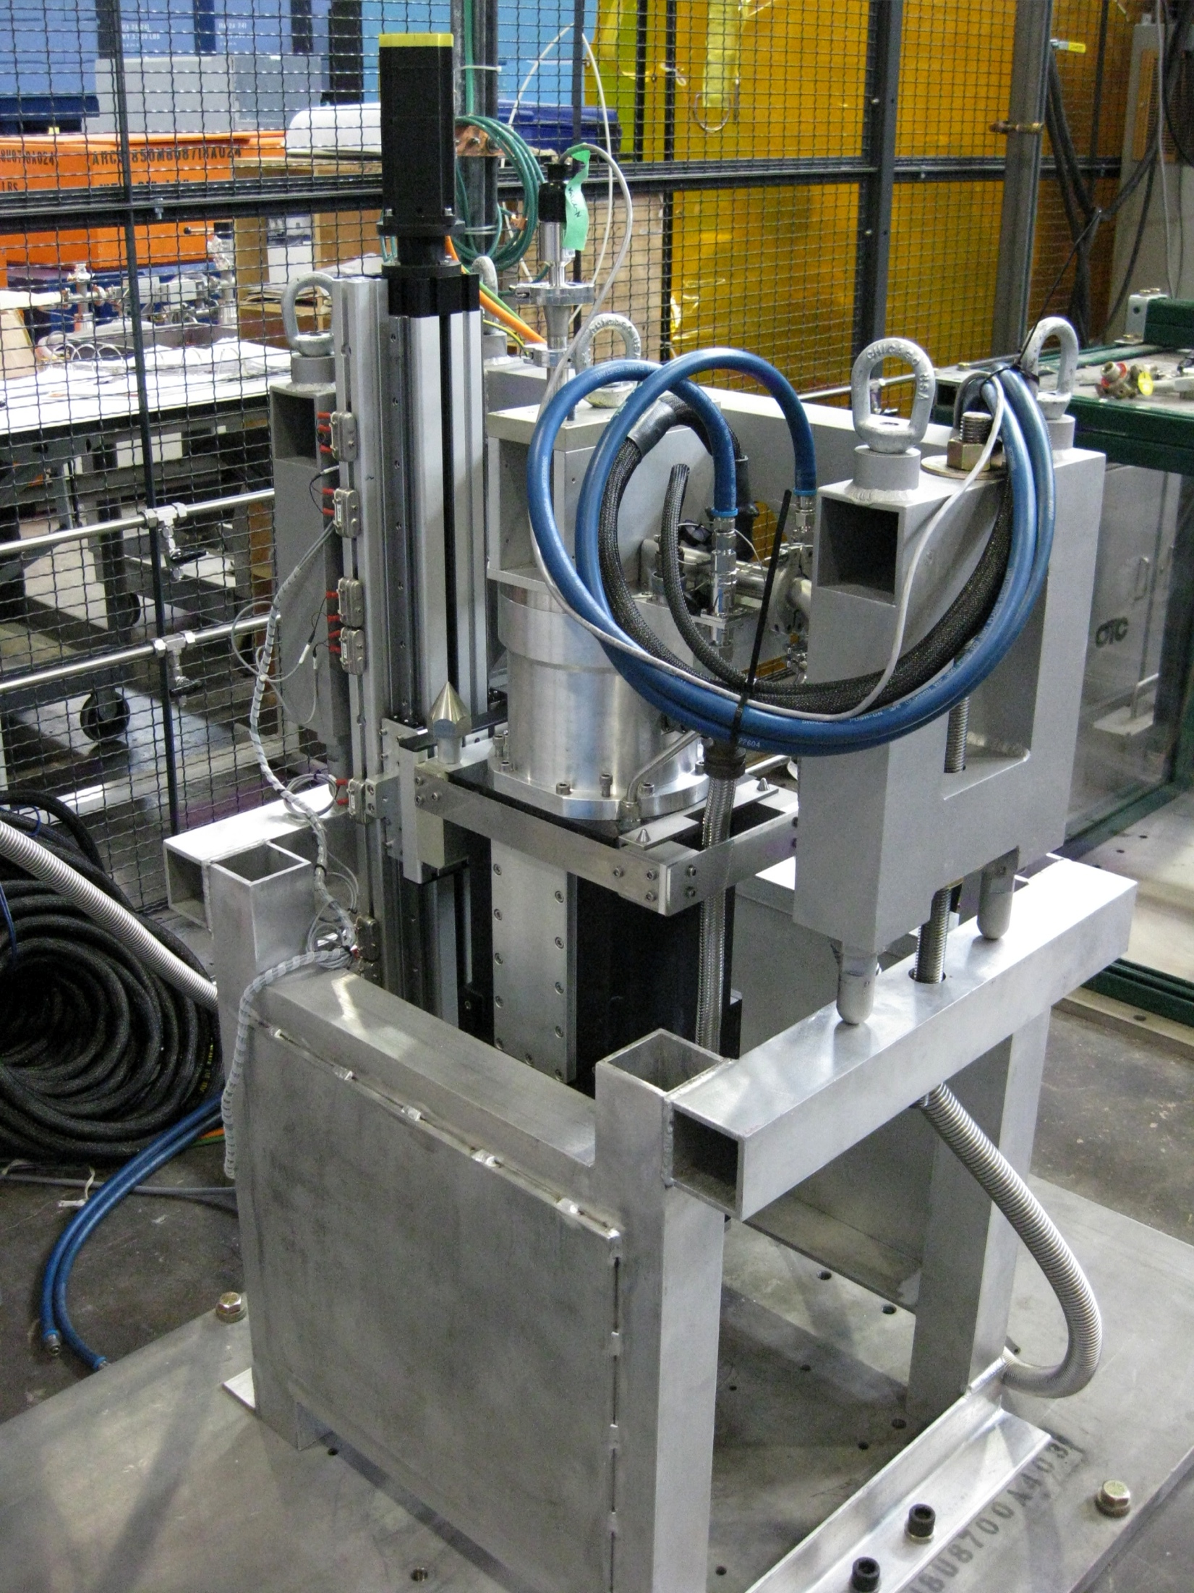
CNCS – overview
Construction of CNCS was funded by DOE grant DE-FG02-01ER45912
Notes:
This is for reference.

Slide 3
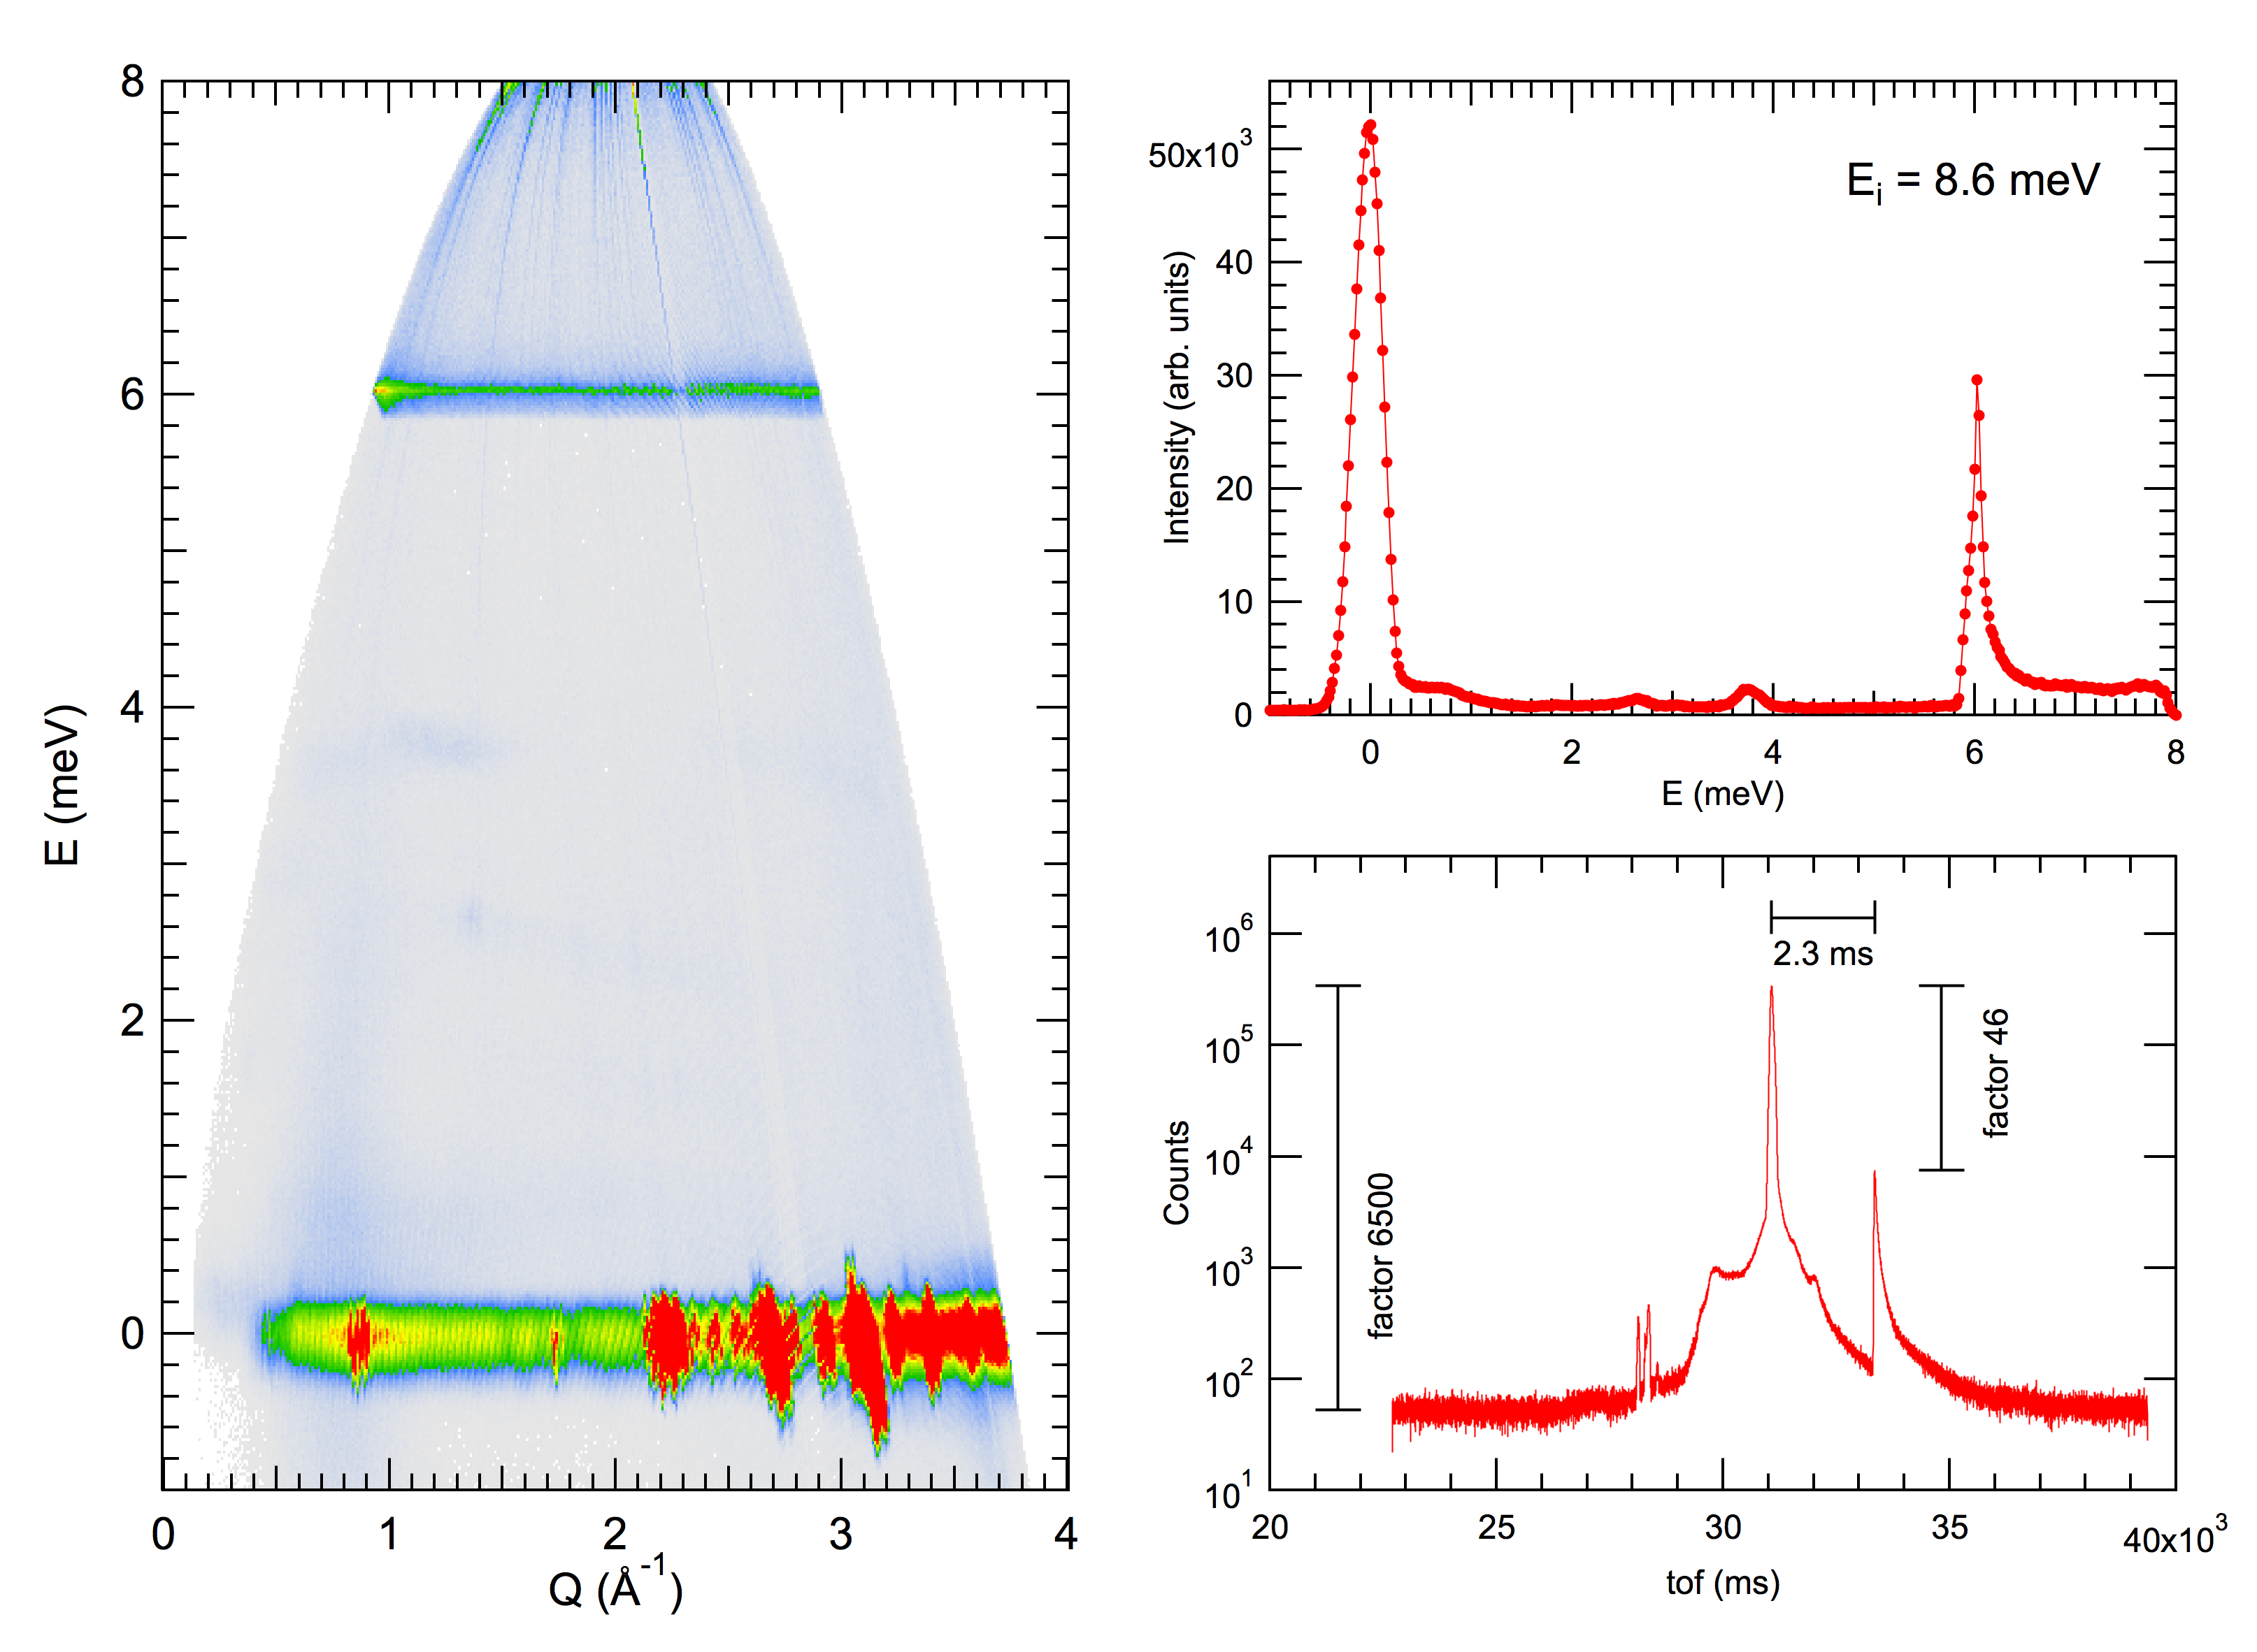
Uncorrected data from a randomly chosen user experiment

Slide 4
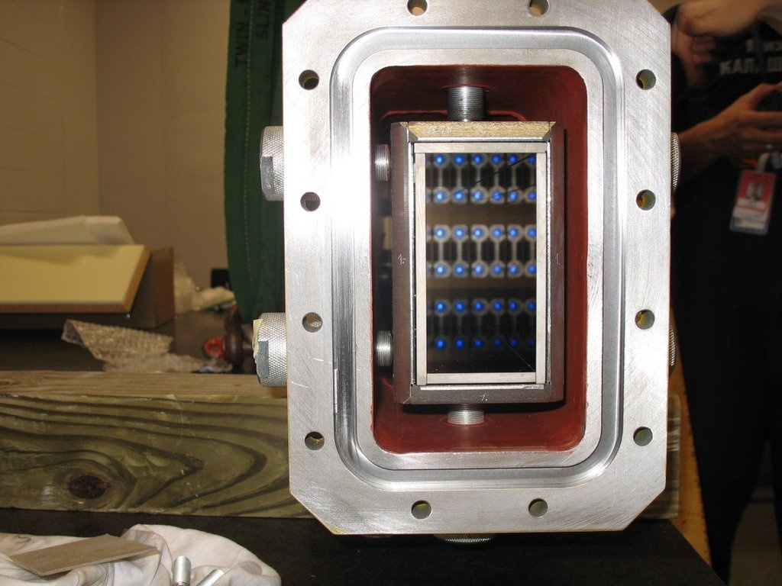
Guide/housing cross section
Significant gap alongside the guide inside vacuum housing.
Need a T₀-chopper.
Going out of line of sight for thermal neutrons is not sufficient.
You have to go out of line of sight with the shielding.

Slide 5
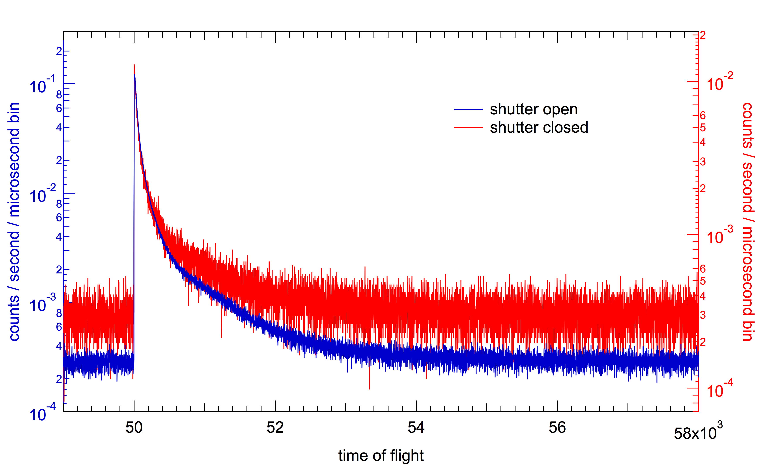
Most recent measurement (2012)

Slide 6
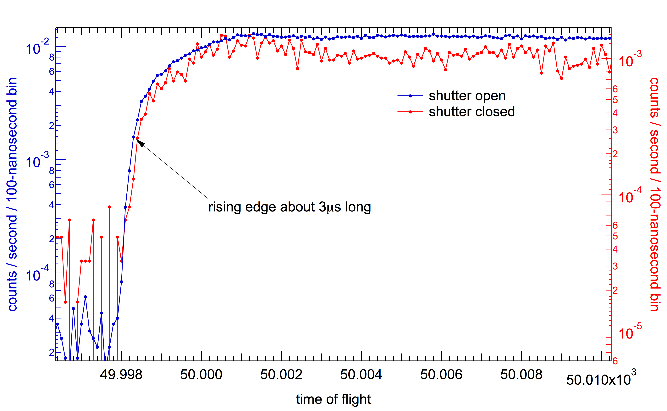
Most recent measurement (2012)

Slide 7
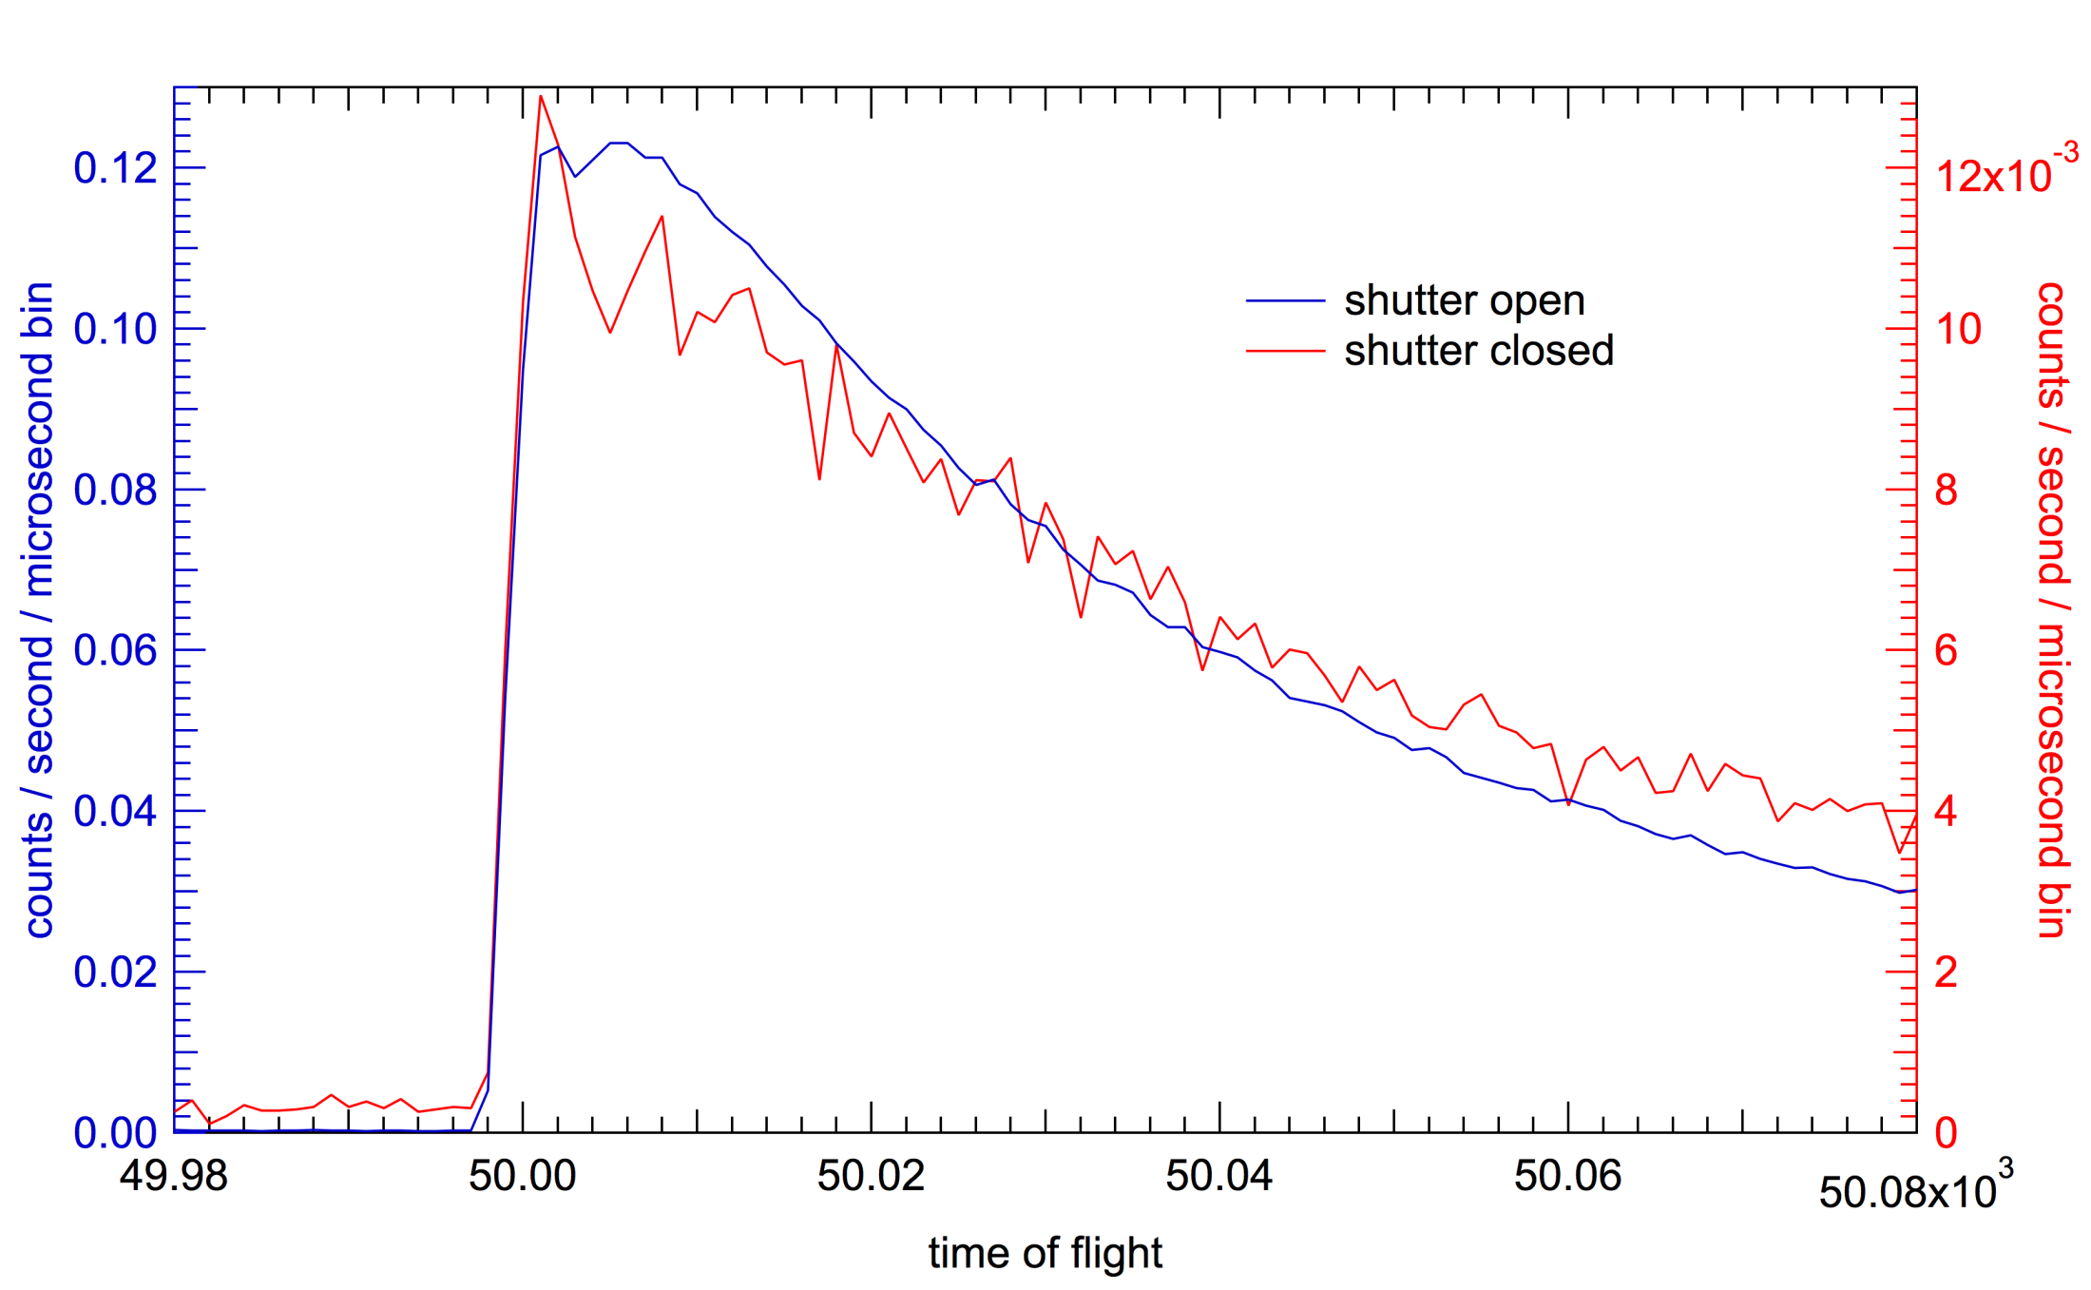
Most recent measurement (2012)

Slide 8
Observations
Both runs were with a proton beam intensity on target of 1 As in ≈1000 seconds, no sample environment in the beam.
Total intensity above electronic and other background (counts per minute per meter of tube):
Shutter open 0.93
Shutter closed 0.14
Most of the background comes streaming down the guide or in its vicinity. However, the “shutter closed” situation reveals a strong secondary source term with very little difference in apparent level of neutron moderation.
The rising edge can be resolved within the timing resolution of the measurement (100 ns).
Intensity is homogeneous across the detector array (20 m²).

