Slide 1
SNS Facility Background Measurements
L. Funk did all the real work

Slide 2
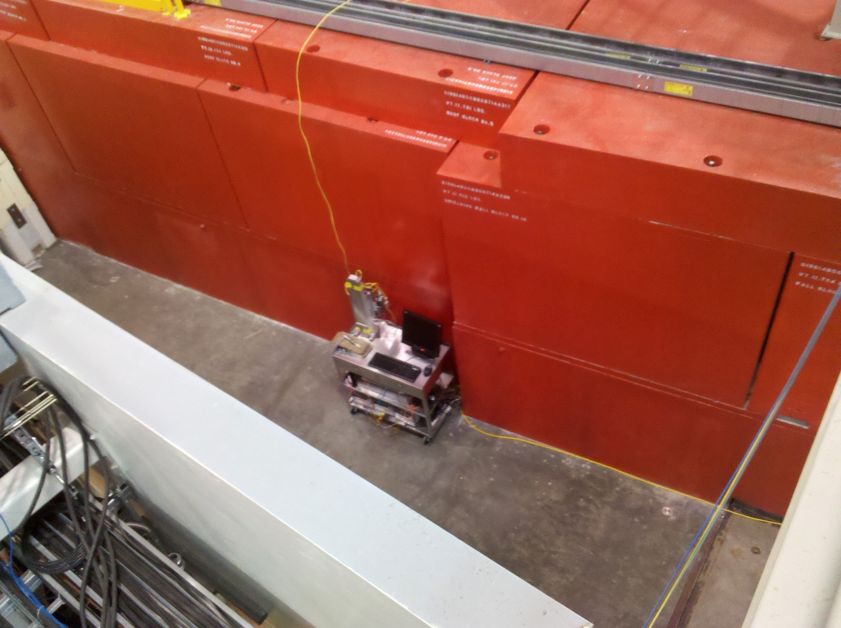
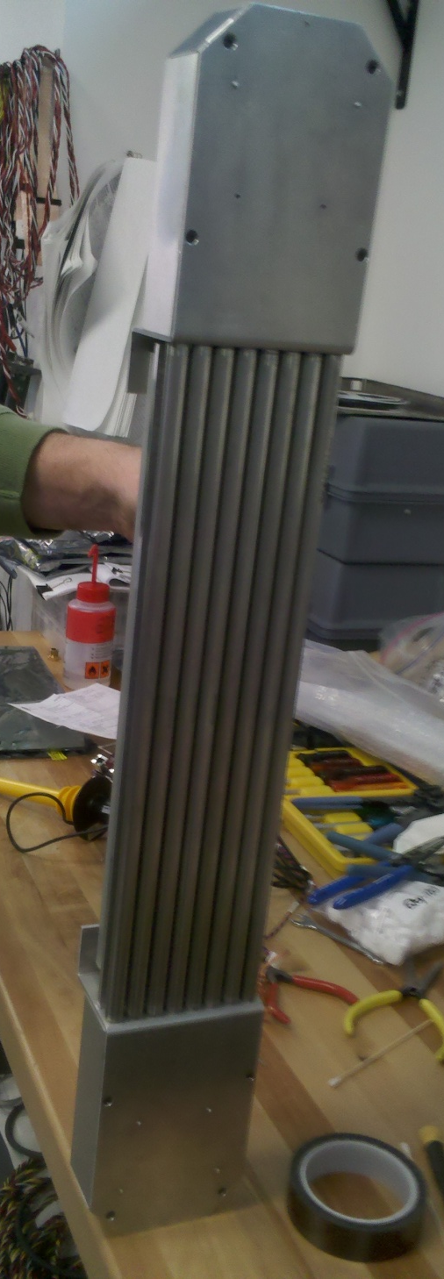
Use portable 8-pack to map prompt pulse background in Target building and experiment room
Effectively a mini-instrument, with TOF
Recording capability
3He tubes like HYSPEC’s (similar pressure
But smaller diameter and length)
Mostly portable; rides on a cart which isn’t all
That easy to move around (one LCD terminal
Down…). Prefer much more mobile, like atop
BL 10 crevice
Use partial shielding to
-characterize observed spectra
-observe some directionality

Slide 3
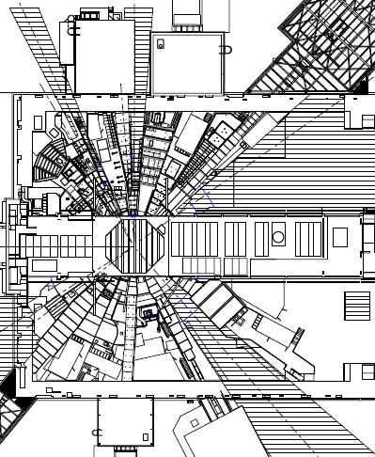
Sequoia short full 8-pack count rate (ct/s), raw
2.55
1.53
1.86
1.97
1.87
5.26
8.46
11.9
3.1
3.19
6.2
7.14
19.4
0.78
0.98
0.88
6.95
0.42
25.9
132.7
102
14.2
341.5
32.0
21.9
3.46
15.2
9.92
2.21
Before extra shielding
After extra shielding
BL-11 Primary Shutter Closed
Mezzanine
Level

Slide 4
0.65
0.47
New LPSD.
Spring 2012
mrem/hr
0.52
2.8
1.7
2
16
15
7.2
10.2
24.3
117.8
37.7
2-1100

Slide 5
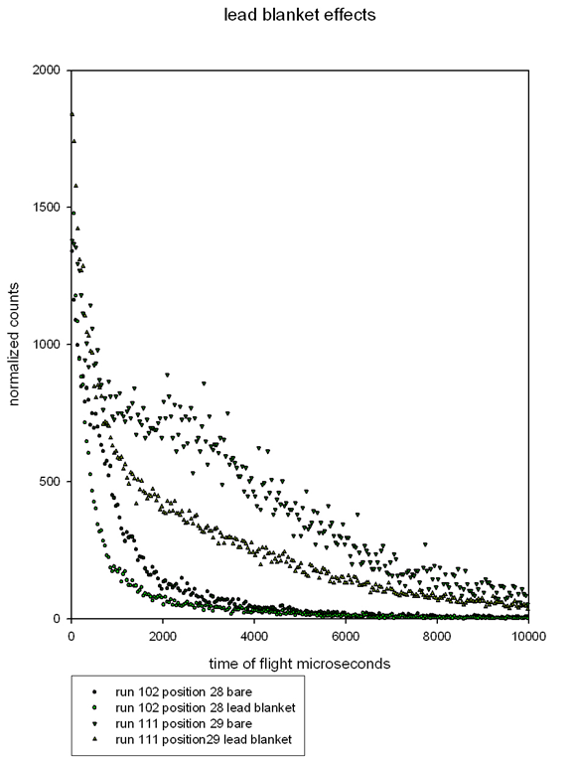
Effects of position and shielding: overall counts and tail shape

Slide 6
Shielding variations
B-10 loaded aluminum 1 mm thick
Cadmium 1.5 mm thick
1 gallon of water
Lead
Maxus plate 1 cm thick
Regular density concrete
Heavy concrete brick
Some potential to estimate distance to moderated source

Slide 7
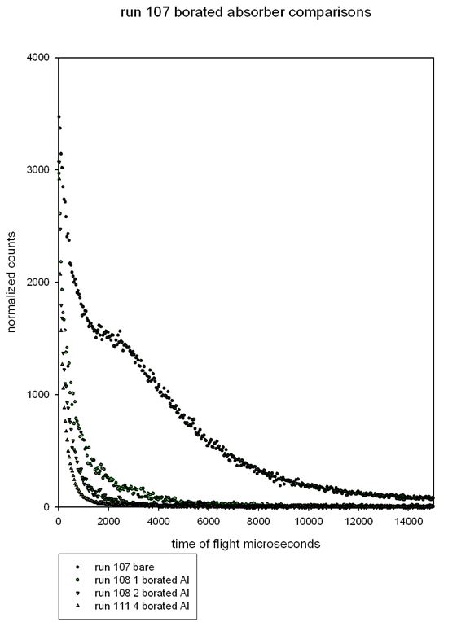
vary thickness of B-10 aluminum

Slide 8
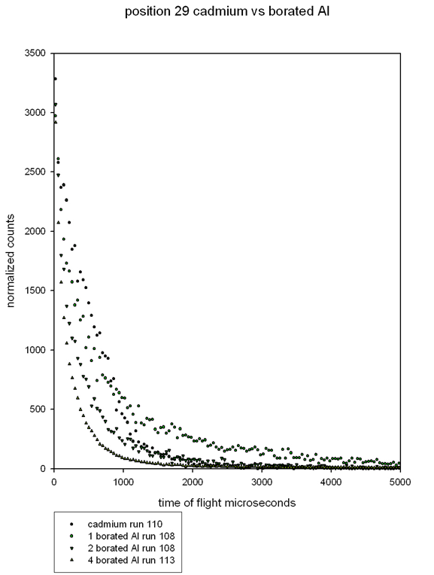
Cadmium vs. Boron

Slide 9
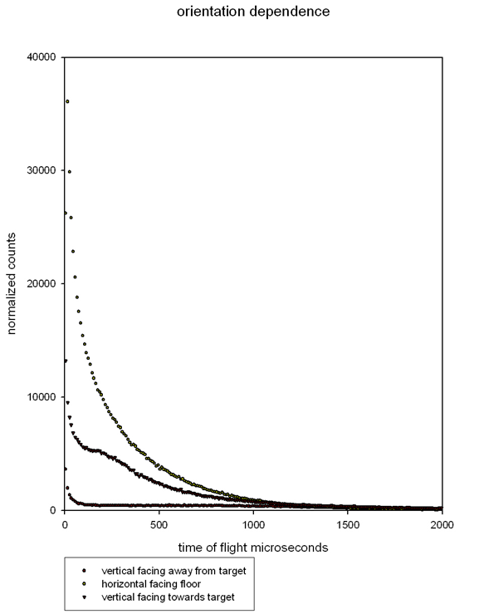
Limited directionality measurements
(shielding behind portable LPSD)

