Slide 1
Comparison of different materials for shielding
Fe, Cu, W, Al, C
Nataliia Cherkashyna, ESS

Slide 2
General idea
GEANT4
10. 000 n →
2 GeV
Size:
2m x 2m x Z
Z:
from 0.2m to 3m

Slide 3

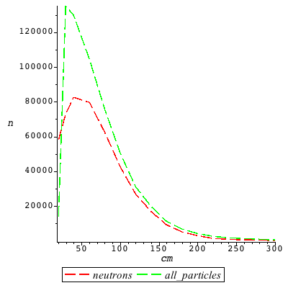
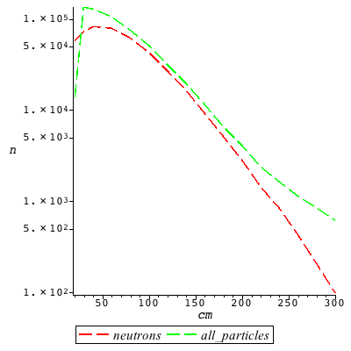
Iron
1m→
neutron, gamma, proton, anti_nu_mu, nu_e, nu_mu,
e+, pi-, e-, pi+, anti_nu_e, kaon0, mu-
2m→
neutron, nu_e, gamma,
e-,proton
3m→
nu_e,nu_mu,anti_nu_mu, neutron, gamma

Slide 4

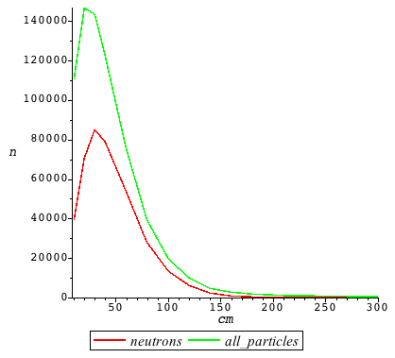
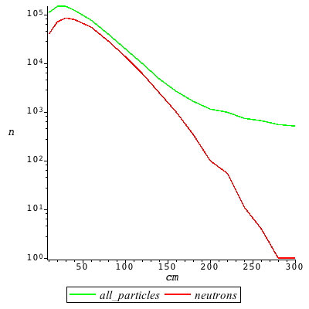
Copper
1m→
neutron, gamma, e-, nu_e, nu_mu, anti_nu_mu, proton, pi+, pi-, e+, anti_nu_e

Slide 5

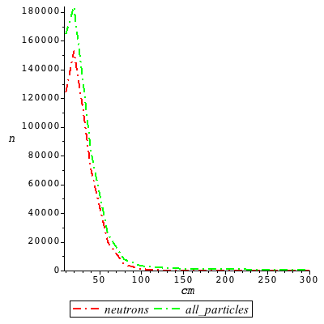
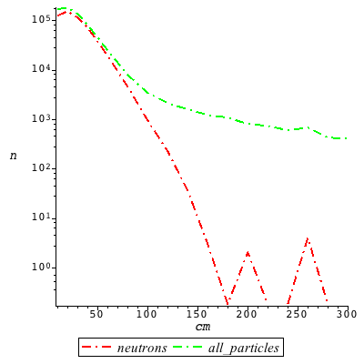
Tungsten
0.8m→
anti_nu_mu, neutron, nu_mu, nu_e, proton, gamma, pi-, e-, anti_nu_e, pi+

Slide 6

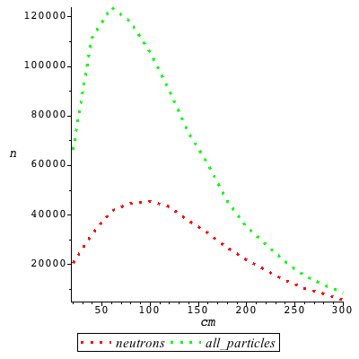
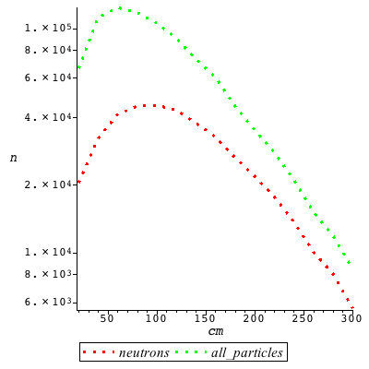
Aluminum
3m→
neutron, nu_mu, gamma, anti_nu_mu, e-, e+, nu_e, pi-, proton, pi+, anti_nu_e

Slide 7

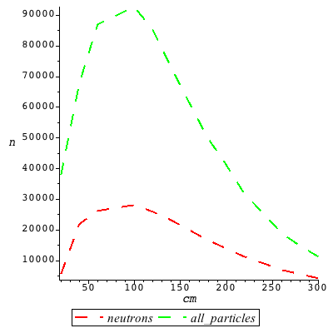
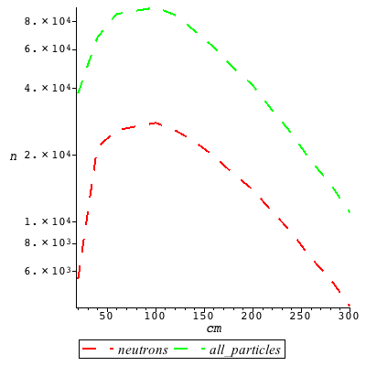
Graphite (C)
3m→
gamma, neutron, nu_mu, nu_e, anti_nu_mu, proton, e-, e+, pi-, pi+, anti_nu_e, mu-

Slide 8
Z₁ = 3m Fe + 1m Cu + 0.4m W
10. 000 n →
Z₁ →
77 particles: nu_e, nu_mu, anti_nu_mu
Z₂ = 2.5m Fe + 0.7m Cu + 0.3m W
10. 000 n →
Z₂ →
139 particles: nu_e, nu_mu, anti_nu_mu
Z₃ = 2m Fe + 0.7m Cu + 0.3m W
10. 000 n →
Z₃ →
189 particles:
nu_mu, nu_e, anti_nu_mu, anti_nu_e, gamma
Z₄ = 2m C + 0.7m Cu + 0.3m W
10. 000 n →
Z₄ →
910 particles: anti_nu_mu, nu_e, nu_mu, neutron, gamma, anti_nu_e
Z₅ = 3m C + 0.7m Cu + 0.3m W
10. 000 n →
Z₄ →
433 particles: anti_nu_mu, nu_e, nu_mu, anti_nu_e, neutron, gamma

Slide 9
Comparison
Material & width | Neutrons survived | Particles survived
Fe, 3m | 98 (~1%) | 614
Cu, 3m | ~1 (0.01%) | 512
W, 2.4m | ~0 | 606
Al, 3m | 5644 (~56%) | 8456
C, 3m | 4186 (~42%) | 11053
Z₁, 4.4m 3m Fe + 1m Cu + 0.4m W | ~0 | 77
Z₂, 3.5m 2.5 m Fe + 0.7 m Cu + 0.3m W | ~0 | 139
Z₃, 3m 2m Fe + 0.7m Cu + 0.3m W | ~0 | 189
Z₄, 3m 2m C + 0.7m Cu + 0.3m W | 217 (~2%) | 910
Z₅, 4m 3m C + 0.7m Cu + 0.3m W | 22 (~0.2%) | 433

Slide 10
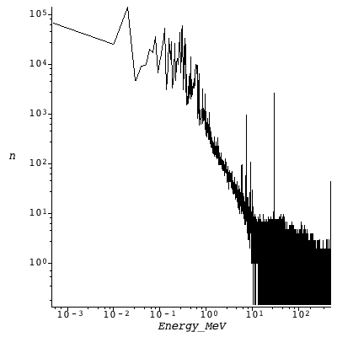
Energy spectra
10⁶ n →
1m³ Fe
500 MeV

Slide 11
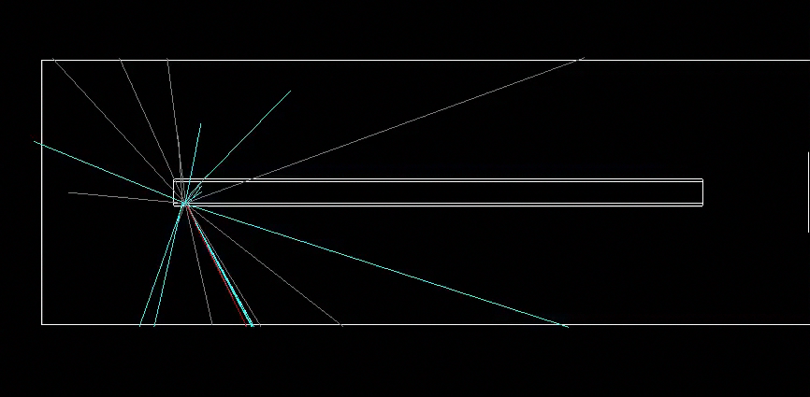
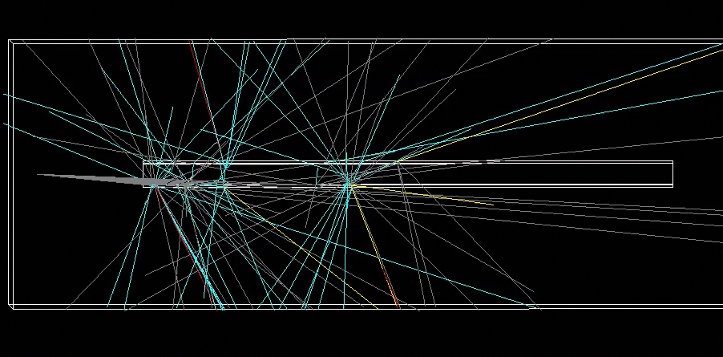
2.5 GeV neutrons
1 n
2m tube of iron
10 n
2m tube of iron

Slide 12
Preliminary conclusions
Iron is the material that can stop certain amount of particles,
but it doesn’t block neutrons as effectively as alternatives;
copper is better in comparison with iron;
tungsten blocks almost all kinds of particles;
Aluminum and graphite are less effective than iron,
despite having attractive nuclear physics parameters at high energies
Combinations of first 3 materials (Fe, Cu, W)
are more effective for shielding due to stopping power
and because of the energy windows in iron

Slide 13
Thanks for your attention!

