Slide 1
In-Kind Contributions Opportunities
Marie-Louise Ainalem
2 June 2016
Riga, Latvia
www.europeanspallationsource.se

Slide 2
Contents
IKC definition and general principles
In-Kind Management process overview
Material available on-line
Example of ESS Member country: Estonia

Slide 3


2025
ESS construction complete
2014
Construction work starts on the site
2023
ESS starts
user program
2009
Decision: ESS will be built in Lund
2019
First neutrons on instruments
2012
ESS Design Update phase complete
2003
First European design effort of ESS completed

Slide 4
ESS In-kind Contributions (IKC) Definition
What: A non-cash contribution in labor or material to ESS.
Why:
ESS is a greenfield project – we need the knowledge, capacity and contributions of Europe’s best experts.
Large RI’s today require cooperation due to scale - allowing more work to be completed in parallel
How:
Technical components for the facility (also personnel needed to perform the testing, installation and/or integration)
R&D work (also personnel needed to perform the work)
Personnel made available for specific tasks during the construction phase
Other products and services relevant for the completion of the facility

Slide 5
ESS In-kind Goals
Construction cost: € 1,84 Billion
In-kind: € 747.5 Million
€ 510 M
40.5%
€ 350 M
75%
65%
€ 155 M
€ 73 M
65%
50%
Controls
Target
Instruments (NSS)
Accelerator

Slide 6
ESS In-kind contributions – General principles
Potential in-kind contributions are defined by the ESS Programme Plan
Values based on ESS Cost Book
Each contract to follow the approved template + technical annex
The delivering party is responsible for the contribution (technical, financial)
In-Kind Review Committee to evaluate all IKC agreement proposals
ESS Council to approve all in-kind contracts
Based on final evaluation the Member Country gets accredited the value of the In-Kind Contribution

Slide 7
The ESS Collaboration Framework
ESS Project
In-kind Partner
Industrial Partner
Industrial Liaison Officers
In-kind Review Committee
Funding Agency
ESS Council

Slide 8
ESS In-kind Criteria
Public Institutes/ universities
Partner selection criteria
Eligible partners
Partnership of public & private organizations
Technical capabilities and capacities
Management and human resources
Procurement capabilities
Historical track record and references
Quality/Risk management
Availability of funding
Acceptance of ESS Schedule and Cost book value
Relevance to project requirements

Slide 9
ESS In-kind contributions – EOI Process
May 2013
Call for EOI sent out
Target mailing, website publishing, conferences/events
Active solicitation period
Period of meetings and communications with potential partners to encourage participation and answer questions
Ongoing
EOI Evaluation started
Prioritization based on schedule, need, relevance
TDR
Cost Book
Competence
Relevance
In-Kind framework rules
On-going process
New calls as WPs mature
Over 1000 responses from 205 organizations received

Slide 10

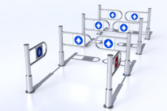
ESS In-kind contributions – In-Kind process
PHASE 1
PHASE 2
PHASE 3
ESS Programme Plan
WPs/WU 1
WPs/WU 2
WPs/WU 3
WPs/WU 4
EOI
response
ESS + Potential party discussion
Contract proposal
IKC frame contract + technical annex
Design, Production
Delivery
(Integration commissioning, acceptance test)
IKRC + Council approval
Transfer of ownership
IKRC recommendation + Council approval
ESS + Partner follow up and review
ESS + Partner final acceptance
IKC value crediting to member country

Slide 11
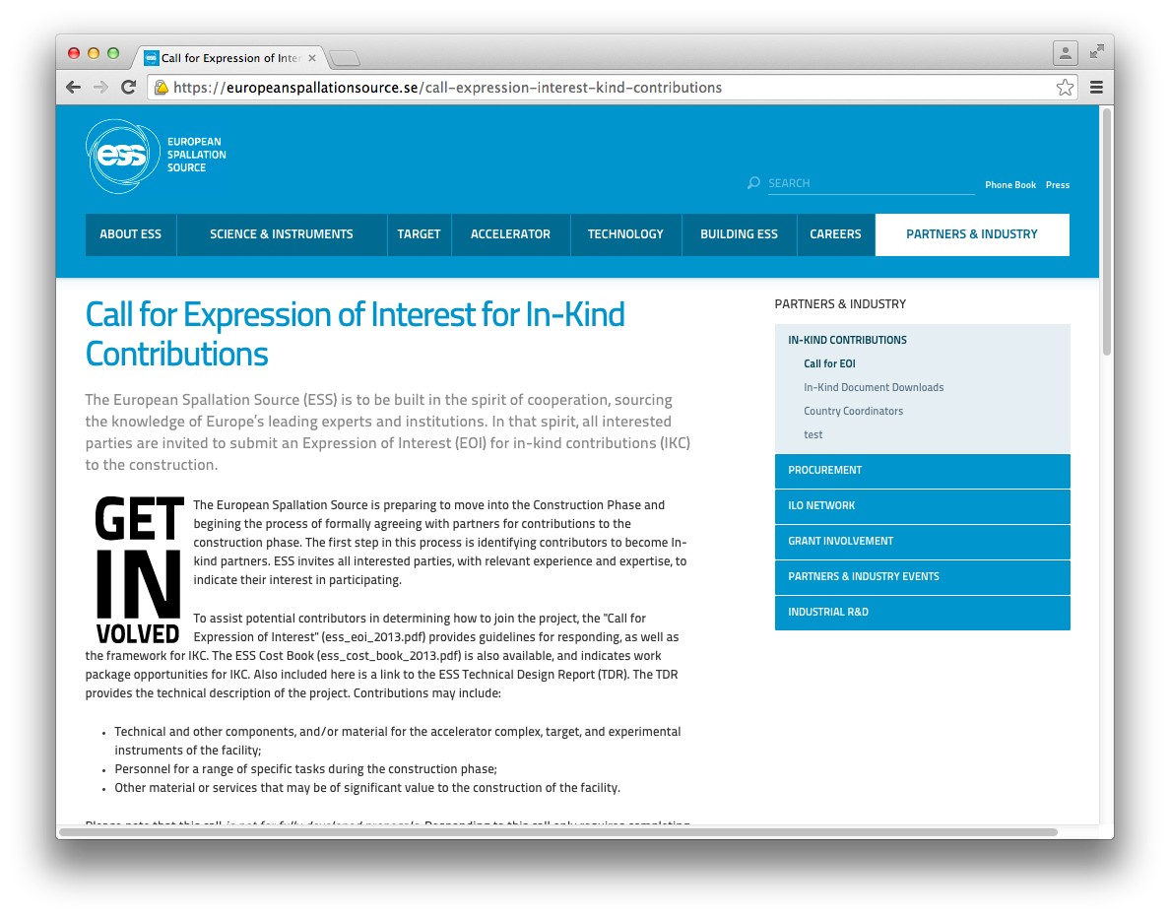
What Is The Best Way For Potential Partners To “Get Involved”?
http://esss.se
Partners & Industry
In-Kind Contributions
Call for EOI
Application Form
TDR
Cost Book: description, scope, schedule

Slide 12
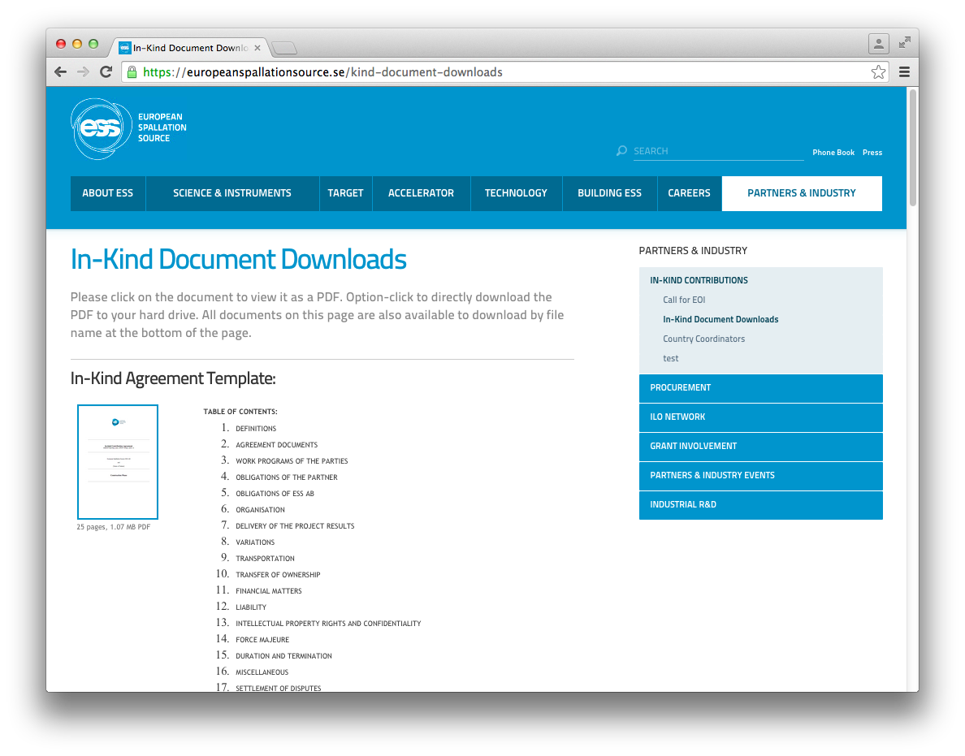
IKC Agreement documents online
http://esss.se
Partners & Industry
In-Kind Contributions
In-Kind Document Downloads
Main agreement
Technical Annex template
ESS processes

Slide 13

Example of Founding Member Country: Estonia
  Total planned commitment: 4.61 MEur (0.25%)
  cash: 1.4 MEur (30%)
  In-kind: 3.2 MEur (70%)
Estonian partner | ESS project | WP description | Value (kEur)
Tartu University | NSS | Radiological Materials Glove Boxes for Neutron Experiments | 70
Tartu University | NSS | Set-Up for Laser-Neutron Pump-Probe Experiments | 196
Tallinn Tech Uni | ICS | Implementation of an EtherCAT slave contribution | 564
Tallinn Tech Uni | Acc | Design, Development and Experimental Evaluation of the High Voltage Power Converter Module for IOT Modulator | 50
Tallinn Tech Uni | ICS | Complete Cyber security plan | 194
Tartu University | NSS | Laser pump probe follow project | 100
Tartu University | NSS | Gas handling systems | 400
Total |  |  | 1574

Slide 14
Estonia - ESS
Estonia is funding its involvement in ESS using EU structural f funds
  Priority: Improving the competitiveness of Estonian R&D activities through the research programmes and modernisation of higher education and R&D institutions
Financing available from the Structural Funds or the European financing are allocated in Estonia via three funds:
  European Regional Development Fund
  European Social Fund
  Cohesion Fund
In 2014-2020 budget period, in total, 3.5 billion euros will be channelled to Estonia from the EU Structural Funds
Since Estonia became a member of the European Union in 2004, thousands of projects all over Estonia have been implemented with the support allocated to the country.

Slide 15
Final thoughts
Much of ESS will be built by ‘in-kind’ partners all over Europe
In-kind Contributions (IKC) are schedule critical – it will define the critical path for the ESS construction project
Good Progress on technical definition and Technical Annexes with In-Kind Partners.
Some Projects and Countries are already achieving their IKC goals.
The ESS perspective is that the IKC relationship is not a supplier/customer relationship – it is an equal partnership with specific roles
We are working for best value for ESS while keeping in mind IKC objectives of the members
15

Slide 16

Thank you for your attention
Please contact:
Marie-Louise Ainalem
Tel: +46 721 79 20 74
marie-louise.ainalem@esss.se
www.esss.se

