Slide 1
Perspectives in Biological Physics
INSTITUTE OF PHYSICAL ENERGETICS
INSTITUTE OF SOLID STATE PHYSICS
Dr. Phys. Leonid Rusevich
ESS Latvian Partner Day, Riga, 2.06.2016

Slide 2
INSTITUTE OF PHYSICAL ENERGETICS
INSTITUTE OF SOLID STATE PHYSICS
A few our results in field of biophysics
QENS experiment for studying protein (WSCP) dynamics
Neutron Dynamics Data Bank for biological macromolecules
Molecular flexibility and dynamics are essential for biological function of proteins

Slide 3

INSTITUTE OF PHYSICAL ENERGETICS
INSTITUTE OF SOLID STATE PHYSICS
Collaboration in the study of protein dynamics in selected photosynthetic processes by neutron scattering
Reduction, analysis and interpretation of experimental data
QENS Experiment
ToF spectrometer FOCUS at the Paul-Scherrer institute, Switzerland
λ = 5 Å, ΔE = 0.123 meV, Q = 0.33 ÷ 2.25 Å⁻¹ ,
T = 20K ÷ 300K.
J.Pieper, Professor of Biophysics of Tartu University
Sample: Protein (WSCP) was diluted in a buffer solution (300 mM Imidazole, 20 mM NaP and D₂O).
Data reduction and fitting: DAVE software package
We have scattering data from Vanadium, Empty Can, Buffer and Sample (WSCP + Buffer). Careful separation of contributions of buffer and protein is required !!!

Slide 4
INSTITUTE OF PHYSICAL ENERGETICS
INSTITUTE OF SOLID STATE PHYSICS
T=260K
QENS spectra (summed over all values of Q) at 260K and 300K.

Slide 5
INSTITUTE OF PHYSICAL ENERGETICS
INSTITUTE OF SOLID STATE PHYSICS
Model for diffusion in a sphere.
EISF
Q [Å⁻¹]
Q-dependences of EISF for protein at different temperatures.
EISF contains information about the geometry of localized motions. R is the radius of the sphere and p represents the immobile fraction of hydrogen atoms for a given resolution function.

Slide 6
INSTITUTE OF PHYSICAL ENERGETICS
INSTITUTE OF SOLID STATE PHYSICS
Internal WSCP dynamics
D_{i} = (3.4±0.4)∙10^{‑5} cm²/s
τ = 1.2±0.2 ps
Jump-diffusion model for Q > 1 Å⁻¹ .
Dependence of HWHM_{i} as function of Q² for internal protein dynamic at 300K.

Slide 7
INSTITUTE OF PHYSICAL ENERGETICS
INSTITUTE OF SOLID STATE PHYSICS
Global WSCP diffusion
The slope of the linear fit determinates the coefficient of global diffusion.
D_{g} contains a component of both translational and rotational diffusion of protein [1].
D_{g} = (9.4±0.6)∙10^{‑7} cm²/s
Dependence of HWHM_{g} as function of Q² for global protein diffusion at 300K.
[1] Perez et al. Biophys. J.,
77, 454, 1999.

Slide 8
INSTITUTE OF PHYSICAL ENERGETICS
INSTITUTE OF SOLID STATE PHYSICS
QENS Experiment
Conclusions
We fulfiled careful separation of buffer and protein contributions to total scattering.
At room temperature WSCP dynamics can be reasonably modelled by two types of motion: i) internal protein dynamics and ii) global diffusion of the whole WSCP molecule.
Numerical values, obtained for the radius of the sphere R and the diffusion coefficients look reasonably and are comparable with values obtained other authors and by other methods.
These results are interesting both to neutron and biophysical communities. Results were presented and published e.g.:
Conference QENS 2014/WINS 2014, Oral Contributions. May 2014, Autrans, France.
L. Rusevich, J. Embs, I. Bektas, H. Paulsen, G. Renger, J. Pieper. Protein and solvent dynamics of the water-soluble chlorophyll-binding protein (WSCP). — EPJ Web of Conferences 83, 02016 (2015).

Slide 9
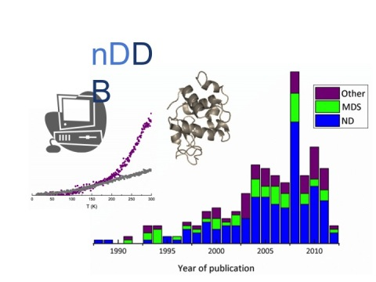


INSTITUTE OF PHYSICAL ENERGETICS
INSTITUTE OF SOLID STATE PHYSICS
nDDB project
Mark Johnson
Head of Computing for Science (CS) group
ILL UK Associate Director and Head of Science Division (from 1.10.2016)
Joseph Zaccai
Senior Fellow for Biology ILL, Directeur de Recherche CNRS
In September 2011 Joe Zaccai invited me to take part on setting up a data bank for neutron scattering results on biological molecule dynamics and fulfil the first step - collection and organising the neutron publications in this field.

Slide 10
INSTITUTE OF PHYSICAL ENERGETICS
INSTITUTE OF SOLID STATE PHYSICS
nDDB project
The aim of setting up the nDDB is to make the neutron data on biological systems widely available, to expose and give easy access to a body of experimental data for the scientific community.
Searching in PubMed and Web of Science data bases with the key terms “Neutron scattering” AND “Protein dynamics”. Search was performed for the time period between 1988 and July 2012.
More than 300 articles in refereed journals relate to neutron scattering studies of biological macromolecular dynamics were collected in our data base.
In future, we hope, the authors will deposit their data into this data bank (not only information about papers, but real experimental data and results of MDS).

Slide 11
INSTITUTE OF PHYSICAL ENERGETICS
INSTITUTE OF SOLID STATE PHYSICS
nDDB project
The papers were classified into four types:
ND (Neutron Data – neutron experiment), MDS (MD Simulation), Review, Methods.
Next information was included into data bank:
year and journal of publication
neutron measurement type (elastic, inelastic, quasielastic)
neutron facility
sample state (powder, solution, membranes)
external parameter (temperature, pressure, hydration)
system of study
etc...
a few special items more were included for MDS papers.
The database allowed us to perform a detailed statistical analysis of publications.

Slide 12
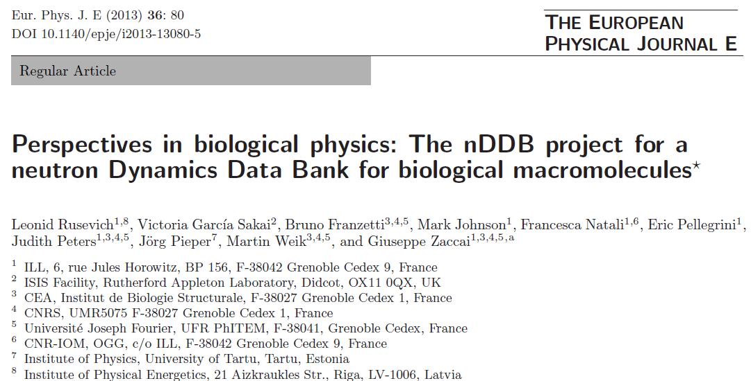
INSTITUTE OF PHYSICAL ENERGETICS
INSTITUTE OF SOLID STATE PHYSICS
nDDB project
Project will be continued…

Slide 13
INSTITUTE OF PHYSICAL ENERGETICS
INSTITUTE OF SOLID STATE PHYSICS
Conclusion
Information to reflection…
Searching in Web of Science (period: 2010 - 2016, address: Latvia)
Keywords
Number of publications
Neutron scattering 11 (9)
Neutron scattering & protein 4
Protein 564
Protein & NMR 15
There are authors from Latvian Institute of Organic Synthesis in 12 papers (from 15), from Latvian Biomedical Research and Study Centre – in 5 papers…
NMR Spectroscopy is alternative and complementary technique to neutron scattering and can yield dynamical information…

Slide 14
Thank You for Your Attention!
INSTITUTE OF PHYSICAL ENERGETICS
INSTITUTE OF SOLID STATE PHYSICS

