Slide 1
Safety Requirements
M. Hartl
e

Slide 2
Radiological Safety / Swedish Authorities (SSM)
ESS is the first spallation source in Sweden!
ESS applies to SSM for permits to construct and operate ESS
NOSG
ESS/SSM
It is ESS’s job to prove to the Swedish authorities that the rest risk of our operation is lower than the one tolerated by society.
It is your job to prove to the Neutron Optics and Shielding Group (NOSG) that your shielding is according to the ESS requirements
It is ESS’s and NOSG’s job to keep you informed of the requirements with regard to shielding

Slide 3
Why do we need to shield against radiation?
Damage to the human body and to the environment
Damage to the equipment
Damage to experimental data (noise level of the data)
Shield for
prompt radiation (=“pulse” from the target)
residual radiation (=activation of components)
Damage to the human body and to the environment
Damage to the equipment
Damage to experimental data (noise level of the data)
Shield for
prompt radiation (=“pulse” from the target)
residual radiation (=activation of components)

Slide 4
ZONING in the experimental hall – one supervised zone
Experimental
Cave -
Closed
Shutter
sample
beamline
Shielding with active
Personal Safety System (PSS)
Experimental
Cave –
Open
Shutter
sample
beamline

Slide 5
Allowable doses in the supervised zone
supervised zone:
SSM
supervised zone: ESS
6 mSv/y (H1+H2)
6 mSv/y (H1)
≤ 2mSv/y (H2)
AND worker will not be allowed in supervised zone when dose of
3.5 mSv is reached
≥ 1/year
1 to 10⁻² /year
6 mSv/y : 2000 h (work time) = 3 μSv
=> design for 1.5 μSv on outside of shielding (safety factor:2, ESS-0019931, Shield Design Procedure)

Slide 6
Shielding design considerations
Design shielding for “supervised zone” to 1.5 μSv
BUT remember:
Sample environment (e.g. pool equipment) and samples can be/become active as well
=> this counts toward the total dose to the worker! e.g. if part of the dose budget is spent on handling an activated sample, less is available for “background radiation level” in experimental hall/on instrument.
Misalignment of components (H2) might lead to increase scattering of neutrons and activation of components
=> needs to be considered in shielding (limit: < 2mSv/event)
changes to shielding will be reviewed no matter how small

Slide 7
ESS RULES for shielding – procedure/calculations
ESS Procedure for designing shielding for safety (ESS-0019931), ESS Procedure for activation calculations (ESS-0051491) & shielding design coordinator (SDC, ESS-0011057, G. Muhrer). NO NEGOTIATIONS about procedures!!!
Calculations:
(A) “Textbook” (safety factor: 3)
(B) Calculation Codes (safety factor: 2)
Particle transport codes (Publically released version of MCNP(X), FLUKA, MARS)
Activation/Burn-up codes to be used (Publically released version of Cinder, FISPACT, ACAB, Fluka and MARS-DeTra)
Cross-secion libraries (ENDF 7 (6,5,4,..) if available; other libraries based on approval by the Shielding Design Coordinator
Flux do dose conversation factors (ESS-0019931)

Slide 8
ESS Shielding procedure (ESS-0019931)
Shielding expert (instrument team): calculations, document the work, submit document, input files and output files for approval to NOSG
=> ESS-0052625 (NOSG phase 2 guidelines for designing instrument shielding for radiation safety) for details
Peer review by shielding expert (NOSG will determine expert, suggestions welcome) -> ESS, CHESS
If calculations/document are acceptable: approval by “customer” (=instrument), Shield Design Coordinator (ESS), ESH member (Environmental, Safety& Health, ESS)

Slide 9
NOSG requirements ESS-0052625
Detailed Engineering Design Phase (phase 2): ensure that
the experimental halls can be operated as supervised areas (ESS-0001786 “Definition of Supervised and Controlled Radiation Areas, ESS-0051603 “NSS zoning document”)
that the overall ESS dose limits for the public are not exceeded (ESS-0000004 “General Safety Objectives for ESS”)
normal operation (H1) and likely accidents (H2) are assessed
EXAMPLES
H1: - Full beam hitting the beamstop
- Full beam scattering of a worst-case sample.
H2: - Misaligned sample environment equipment
- Sheet of cadmium in sample location

Slide 10
NOSG requirements for the “bunker”/experimental cave
Bunker requirements (ESS-0052649):
absorber on components in bunker (air & component activation)
Modification in bunker need to be approved by NOSG (shielding procedure)
Feedthroughs through walls/ceiling need to be approved
Experimental cave shielding requirements
Experimental cave = supervised zone when no prompt beam is present : make sure radiation levels are those of a supervised zone (e.g. shutters? extra shielding?)
Remember Instrument specific sample environment!
Worst case activated sample (NOSG can help with ideas)
Detectors?

Slide 11
THANKS

Slide 13
ZONING: Swedish law (public and supervised areas)
Supervised areas: An area shall be declared as supervised if at least one of the following conditions applies:
The expected annual dose during normal operations and likely accidents to the
full body: 1 - 6 mSv.
lens or eye: 15 - 45 mSv
hands, feet, ankles or skin: 50 - 150 mSv
Removable surface contamination is not significant from a radiological point of view (< 40 KBq/m² for β,γ or < 4 KBq/m² for α).
Controlled areas: An area shall be declared as controlled if at least one of the following conditions applies:
The expected annual dose during normal operations and likely accidents to the
full body: > 6 mSv.
lens or eye: > 45 mSv
hands, feet, ankles or skin: >150 mSv.
The removable surface contamination exceeds 40 KBq/m² for β,γ or 4 KBq/m² for α.
EXPERIMENTAL HALL
INSTRUMENT

Slide 14
Protecting people: Current ESS dose budgets

Slide 15
Protecting people: Radiation zoning at ESS

Slide 16
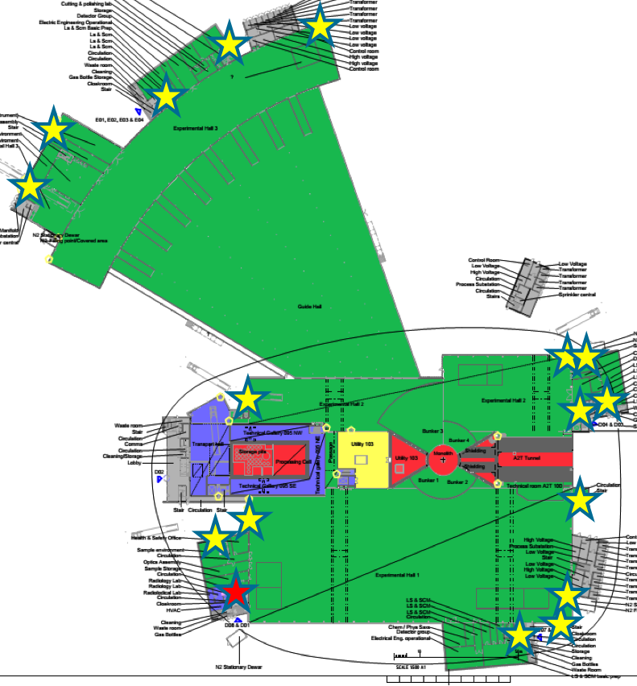
Zoning and Safety Functions
Experimental halls, workshops and labs are single supervised zone (portal monitor , access ctrl.) containing several controlled zones, e.g.
Radioactive Materials Lab.
sample area in experimental cave
beamline
Experimental
Cave -
Closed
Shutter
sample
beamline
Instrument safety: design rules, safety review, shielding integrity (PSS), periodic checks
Operational safety: access to instr. cave (PSS)

Slide 17
Protecting people: Swedish law (Controlled areas)
Passive safety (one time cost at the beginning of the project)
Active safety features (continues maintenance cost)
Administrative controls (seems cheap, but high rest risk => large overhead for operation)

Slide 18
Protecting people: Allowable doses at ESS (GSO)
≥ 1/year
BUT: 2mSv/y due to ALARA
1 to 10⁻² /year
10⁻² to 10⁻⁴/year
10⁻⁴ to 10⁻⁶/year
< 10⁻⁴ /year

