Slide 1
Neutron optics and shielding options for BEER
J. Šaroun
Nuclear Physics Institute of the CAS, Řež
Beamline for European Material Engineering Research
Nuclear Physics Institute
Czech Academy of Sciences

Slide 2
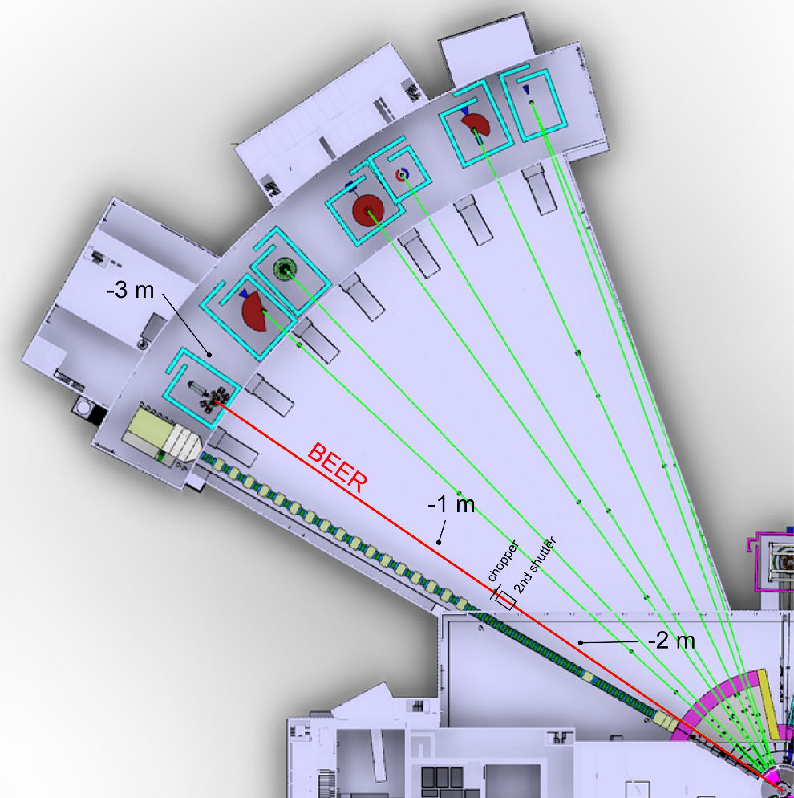
BEER – ToF diffractometer for material engineering
Scientific requirements
1. In-situ & in-operando experiments with large SE
fast data collection (< 1s) = high intensity
medium gauge volume (~ 0.2 cm³)
${Δd}/{d≳0.5\%,d>0.7 Å}$
microstructure evolution: SANS
2. Residual strain mapping
small gauge volume (> 1 mm³)
${Δd}/{d= 0.1 \% .. 0.5\%}$, $d≅1 .. 2.5 Å$
high flux (beam modulation method)
Bragg edge imaging ($λ≅2 .. 5 Å$)
Situation plan with floor levels
Beam requirements
bi-spectral extraction, λ = 1 .. 8 Å
adjustable beam size: 0.5x0.5 to 10x10 mm²
adjustable Δλ/λ resolution, 0.07 .. 0.8 %
adjustable divergence, 1 x 1 .. 10 x 30 mrad²
S/N > 3 for diffraction
background < 1 n/s @ SANS detector

Slide 3
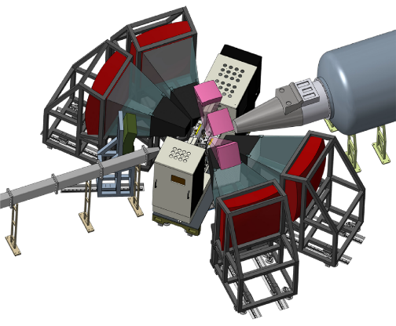
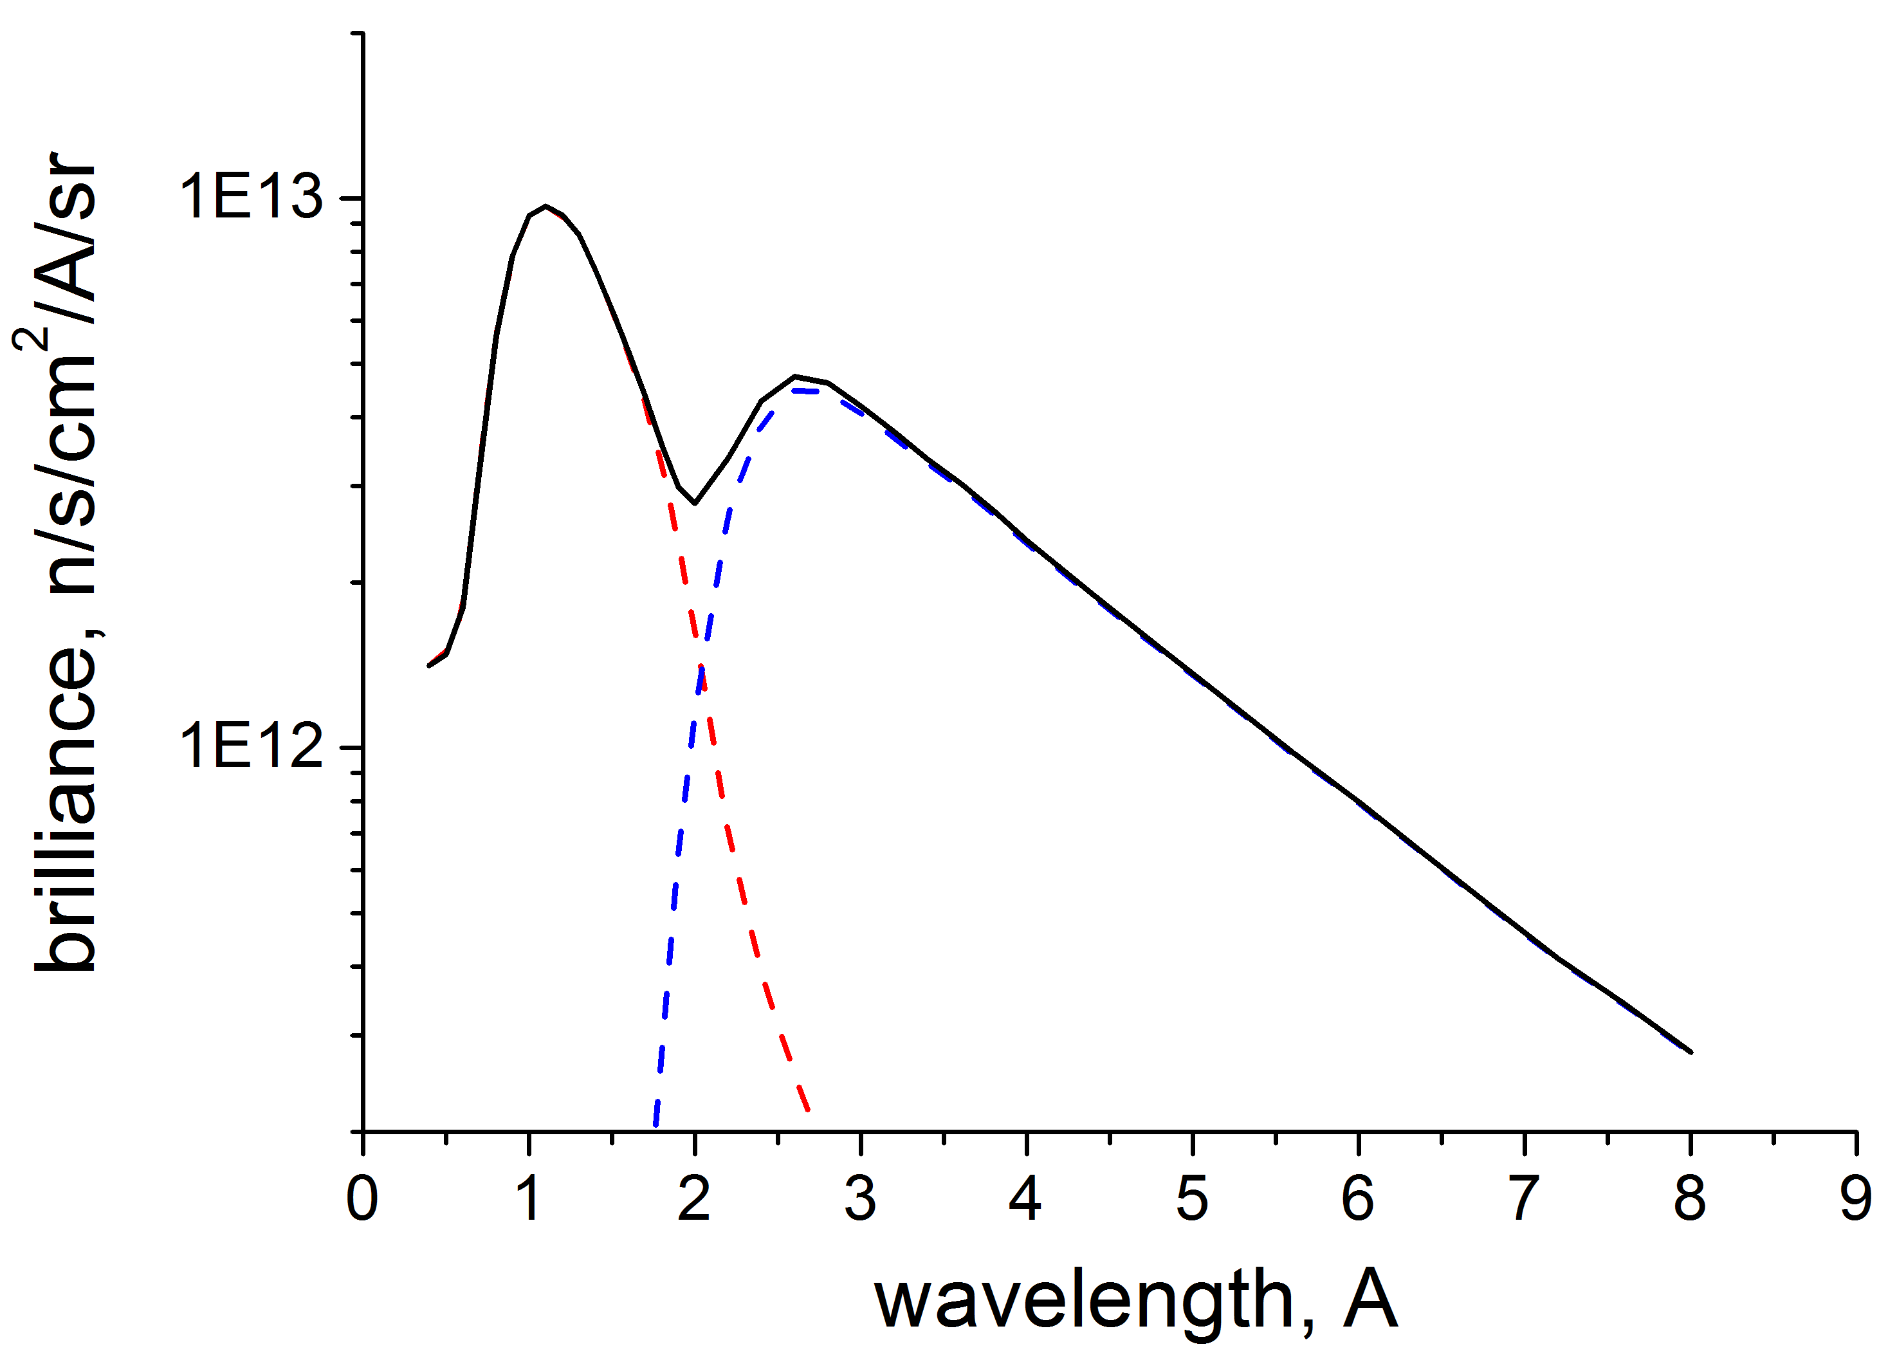
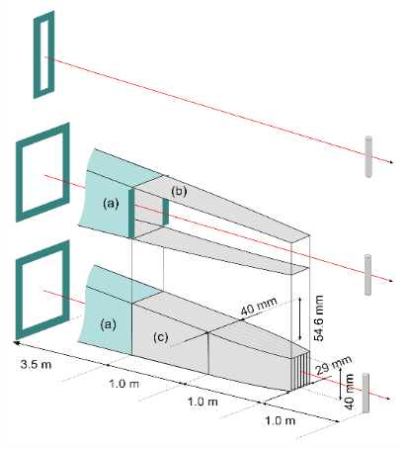
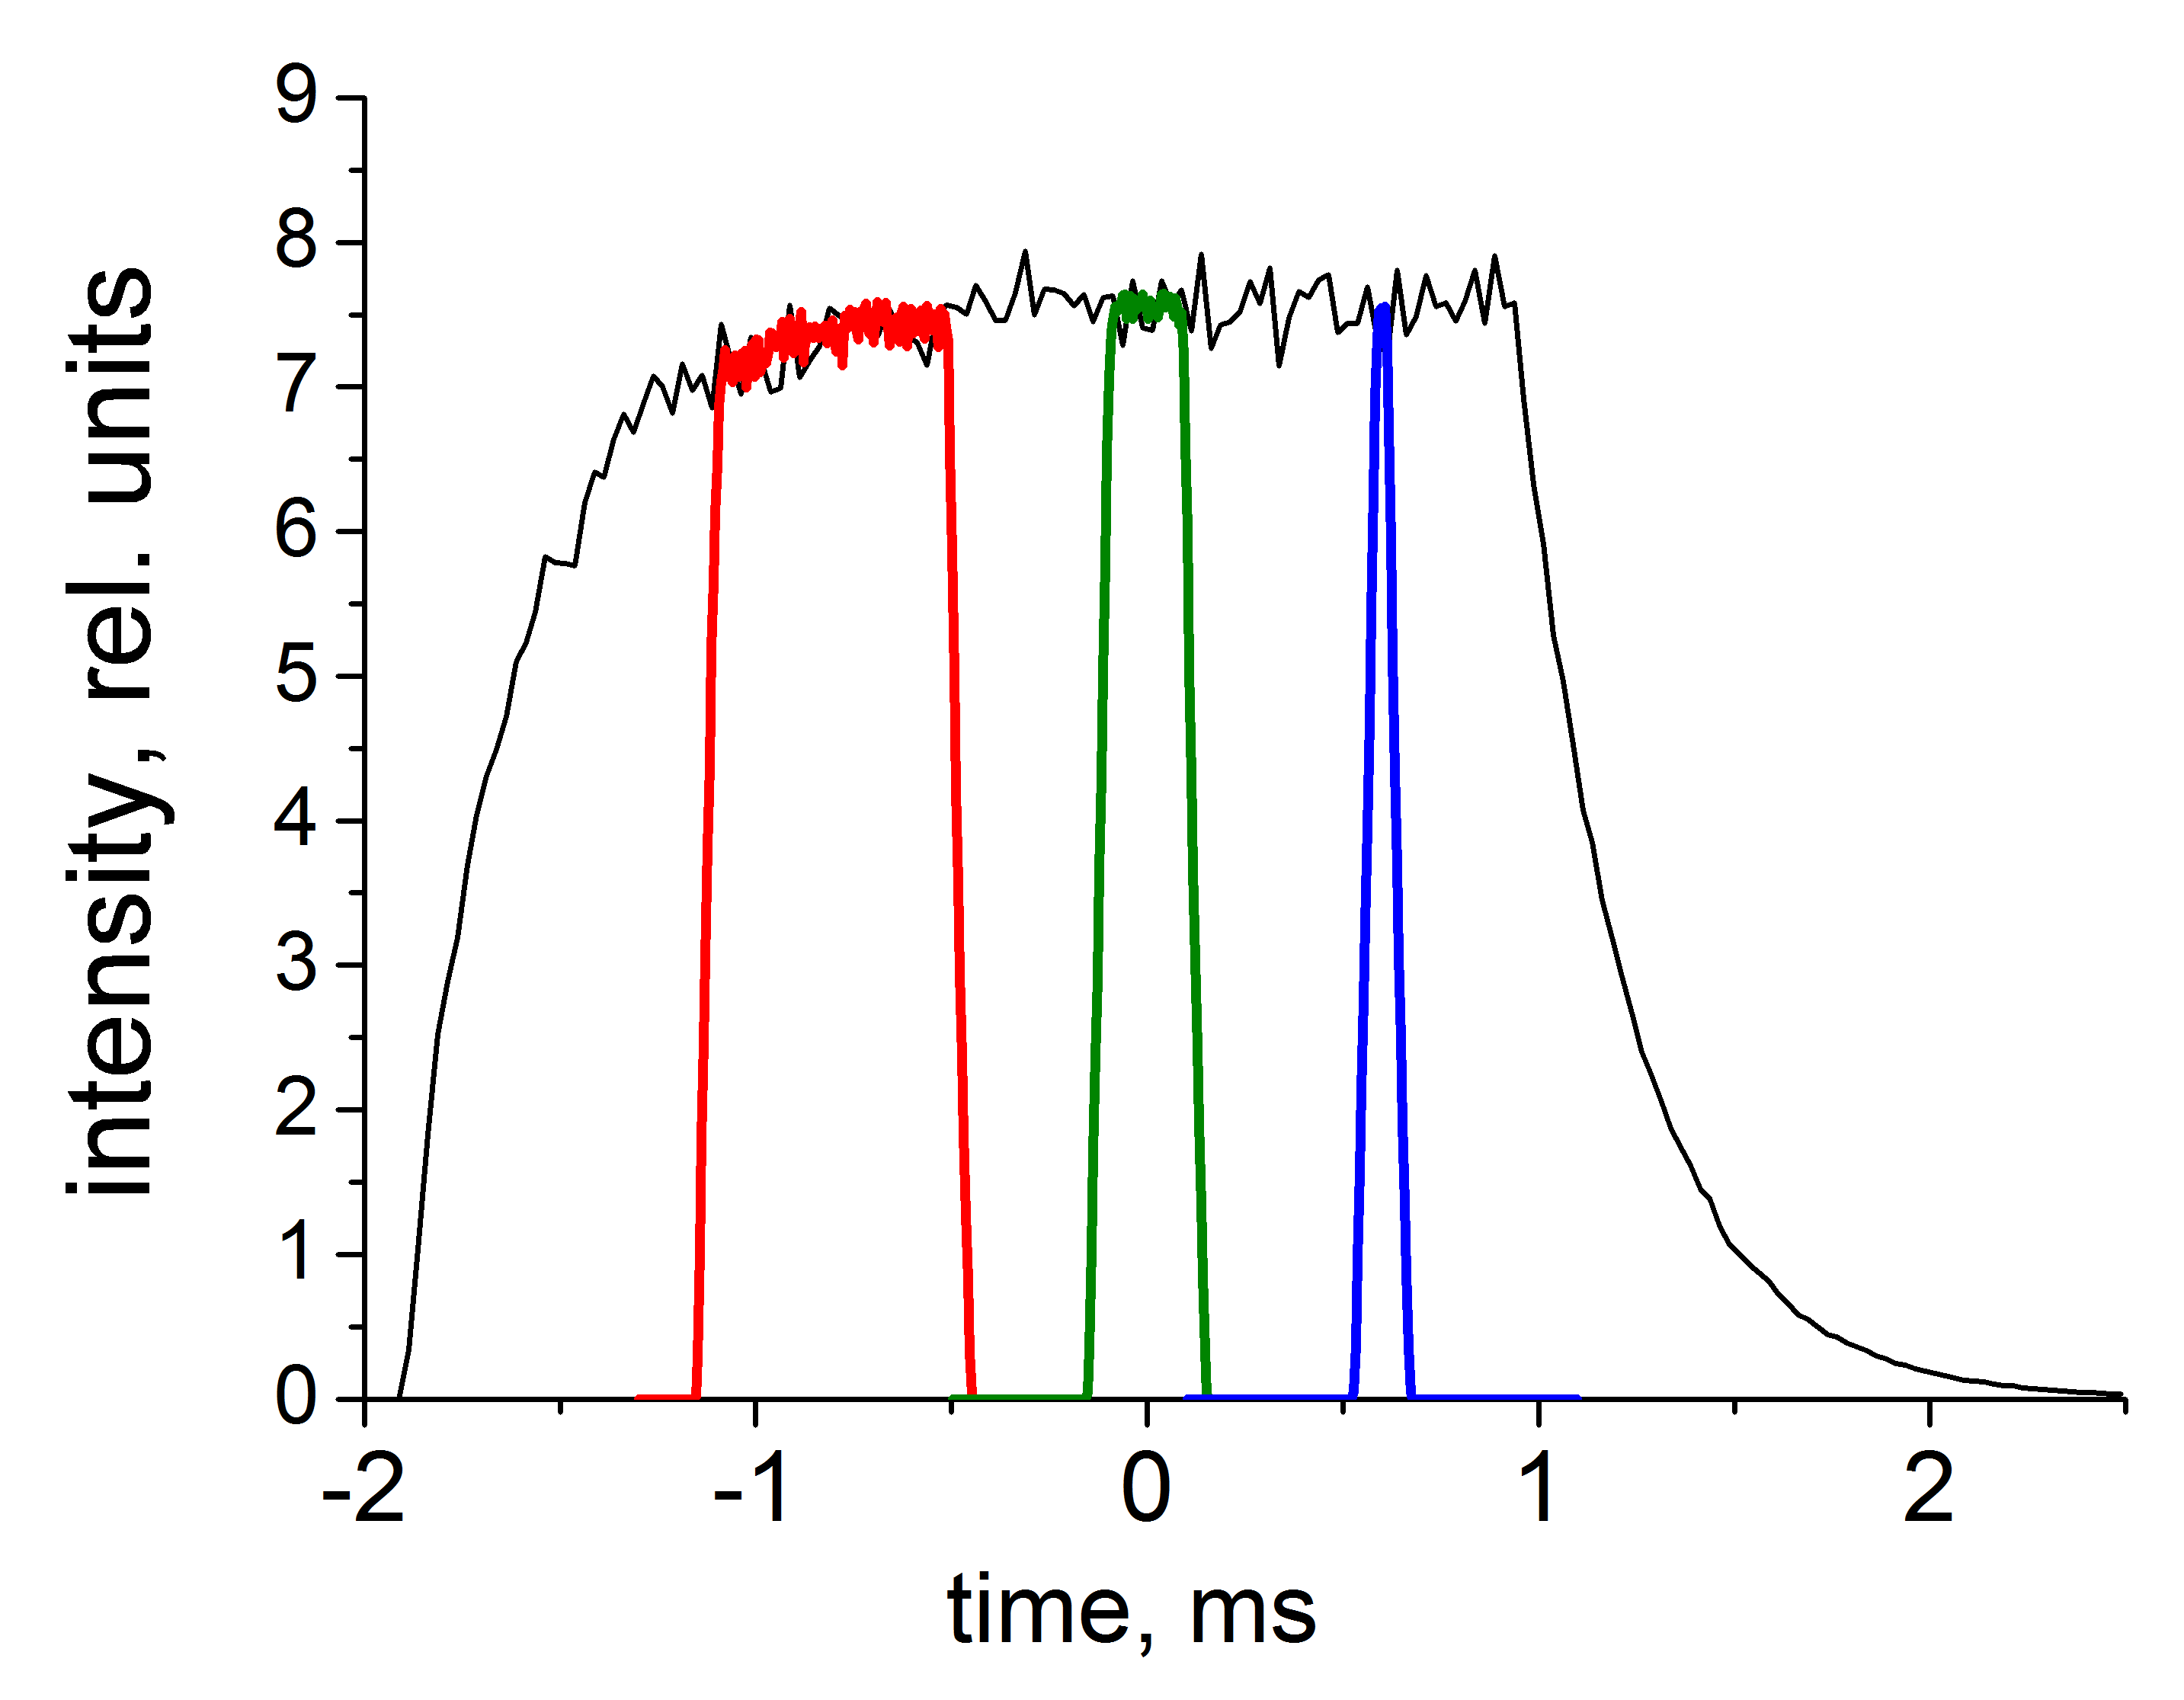
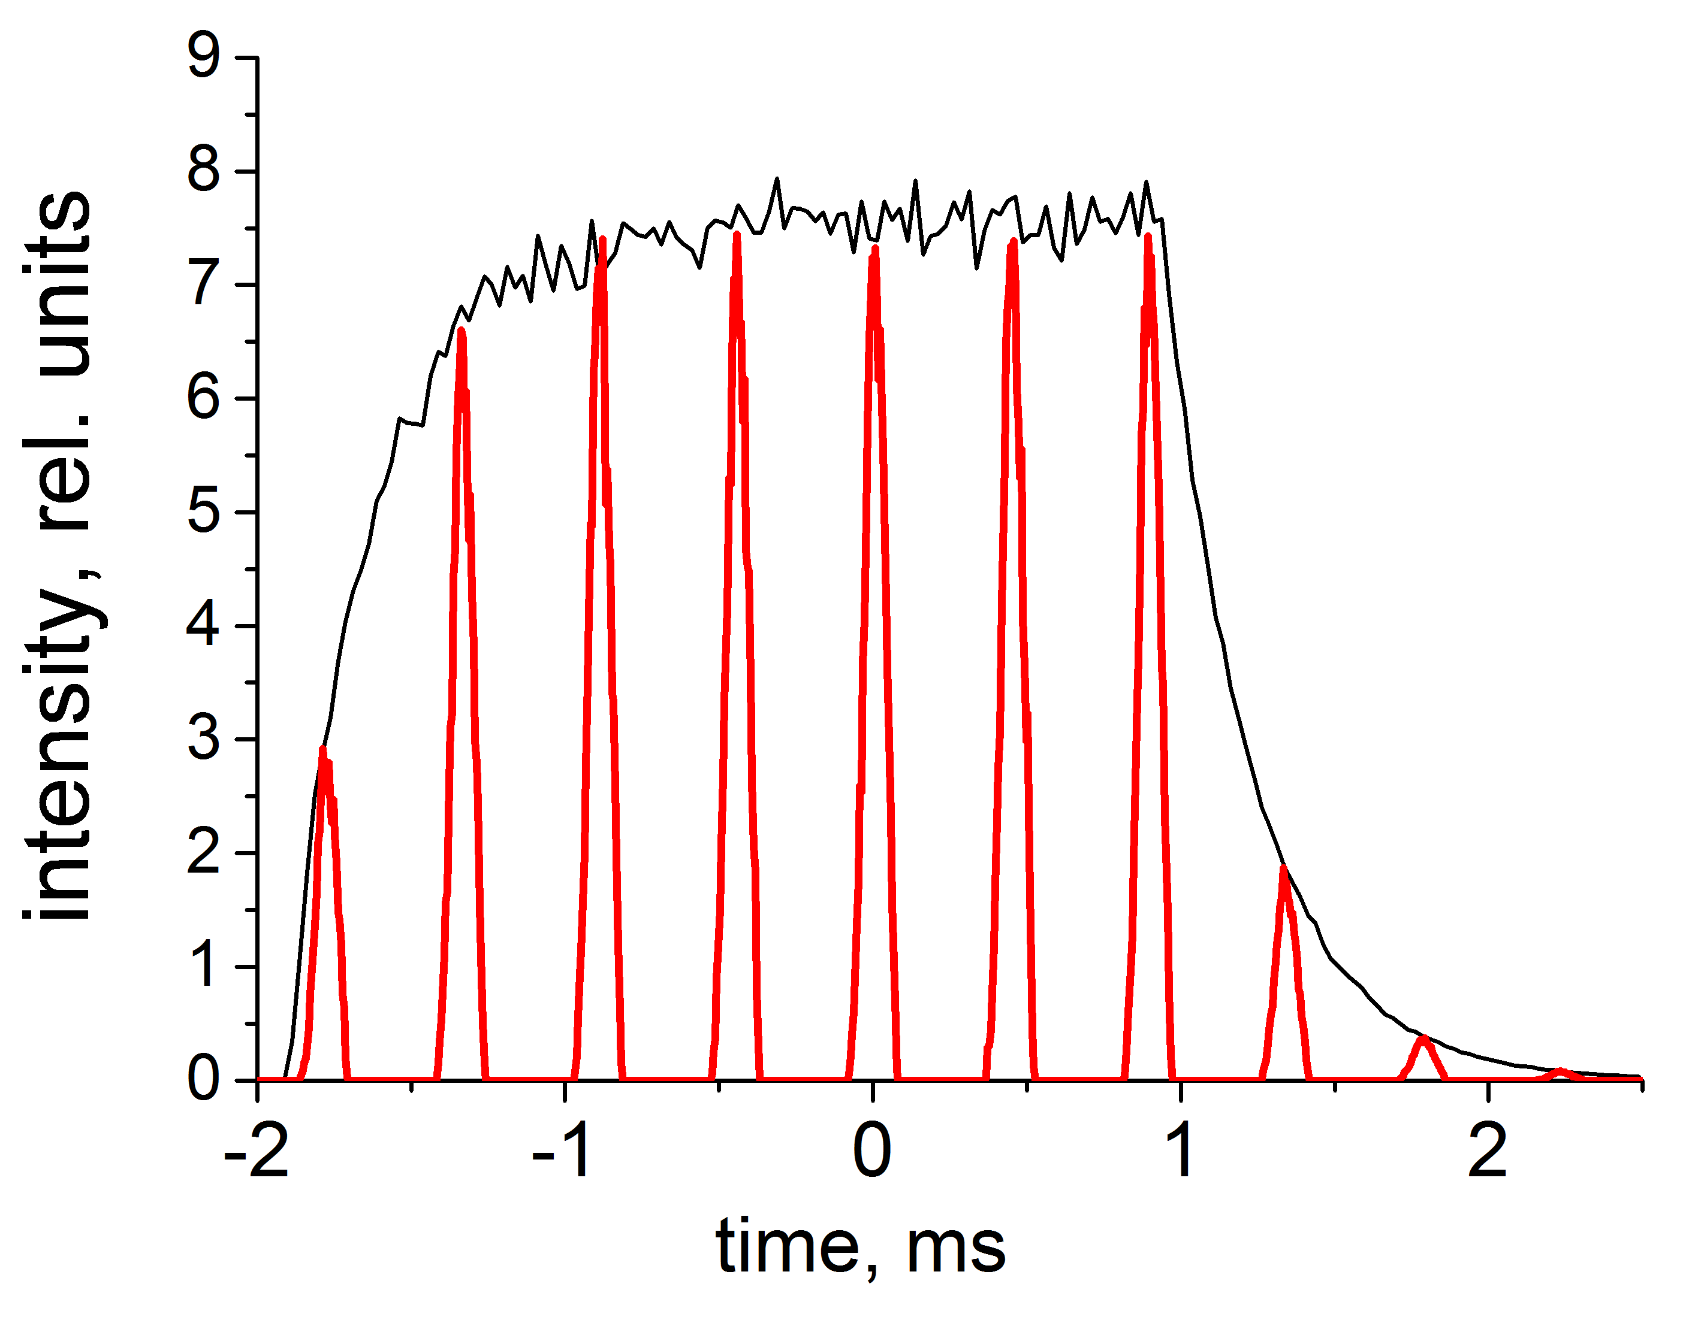
BEER – Materials Engineering Diffractometer
Beamline overview
Beamline for European materials Engineering Research
bi-spectral extraction optics
detector banks
+
sample environment
length 159 m
divergence
chopper system for wide range of resolutions
exchangeable
beam-shaping optics
pulse shaping
pulse modulation

Slide 4
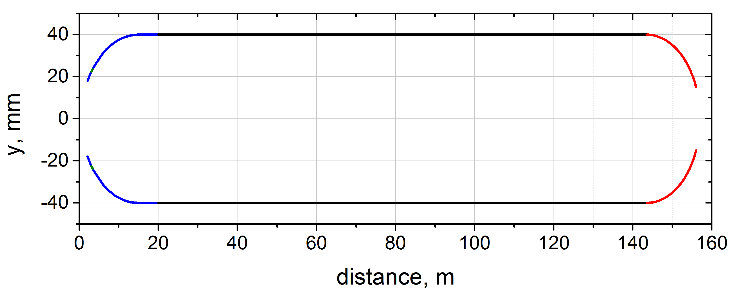
Neutron optics – vertical guide profile
All guide sections follow the same ballistic vertical profile.
m=2.5
z, mm
m=4 to 2.5
m=2.5 to 5
Focused at the top moderator ( 3cm). The bottom moderator gives ~ 20 % lower flux at the sample.
The profile results from numerical optimization and subsequent trade-off between cost and performance.
Vertical divergence at the sample ~ 30 mrad.

Slide 5
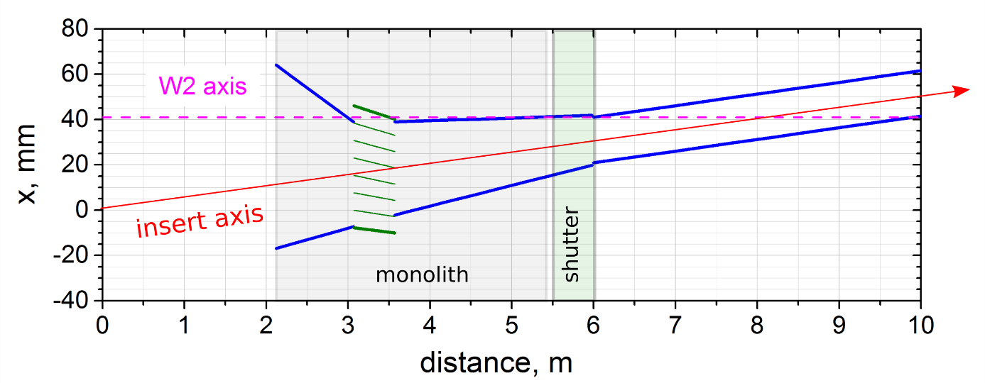
Neutron optics - monolith insert
Focusing at the thermal moderator:
beam axis angle: + 0.295 deg
beam axis shift: -30 mm at the entry -10 mm at the shutter
bi-spectral extraction
Si blades, m=4, t=0.5 mm
y, mm
m=4
beam axis
m=4
narrow beam section with choppers
m=0 ?
Horizontal guide profile with the monolith insert.
2.12 m

Slide 6
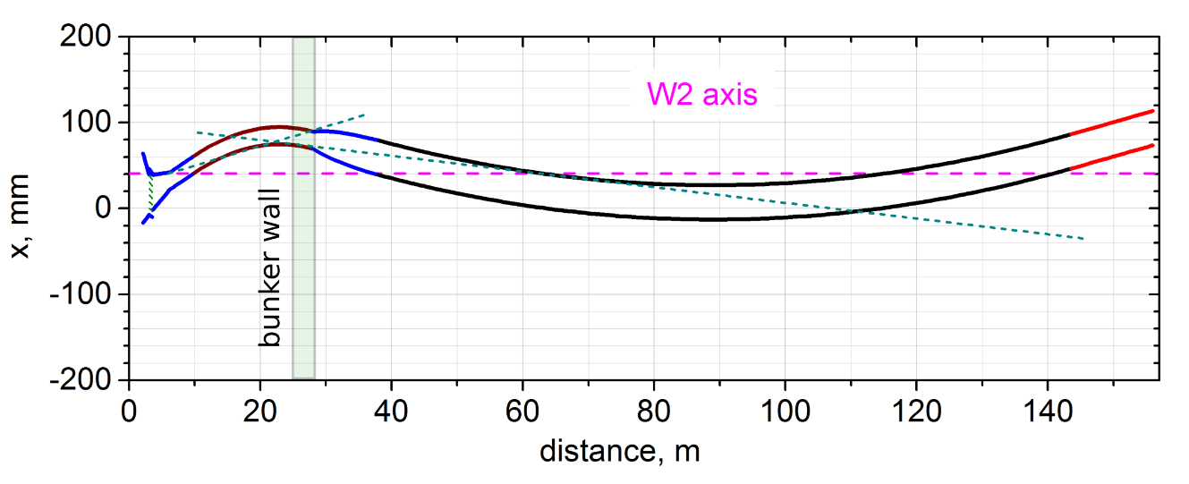
Neutron optics – horizontal guide profile
Option 1 (preferred)
DLS closed twice outside the bunker (dashed cyan lines).
The curved guide starts in the bunker (at 20 m):
width = 4 cm
length = 123.5 m
R = -16 km
beam expansion, w= 2 cm -> 4 cm, length=10 m
Option 2
DLS closed once inside the bunker, 2nd closure is outside (dashed cyan lines).
Guide 1:
width = 2 cm
length = 18 m
R = -2.5 km
Guide 2:
width = 4 cm
length = 105.5 m
R = 25 km

Slide 7
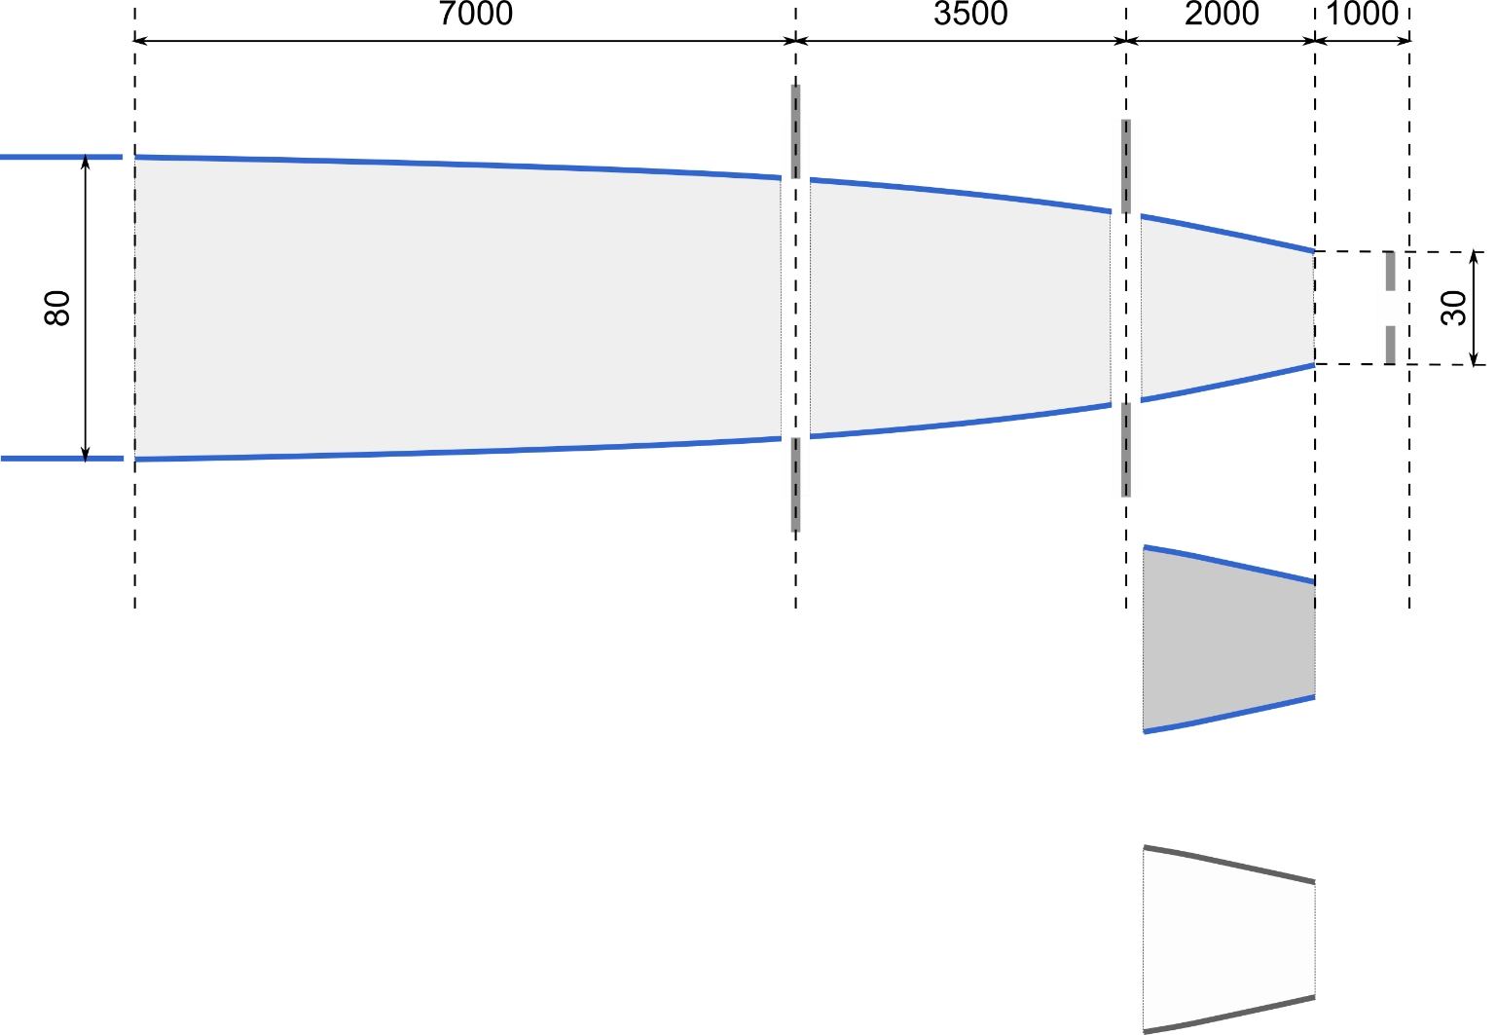
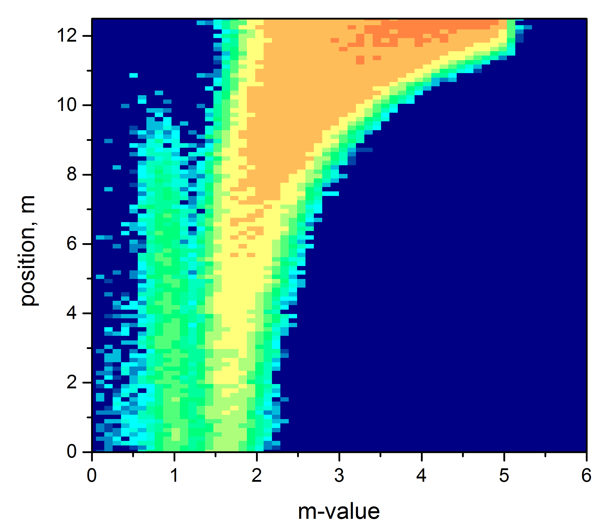
Neutron optics – vertically focusing guide
sample axis
S1
S2
S3
bounce statistics for 1A
Beam shaping optics:
vertically focusing guide with exchangeable end section
2 adjustable divergence slits (S1, S2)
adjustable slit S3 for gauge volume definition, variable distance
guide exchanger
wall
absorbing side walls
m-value

Slide 8
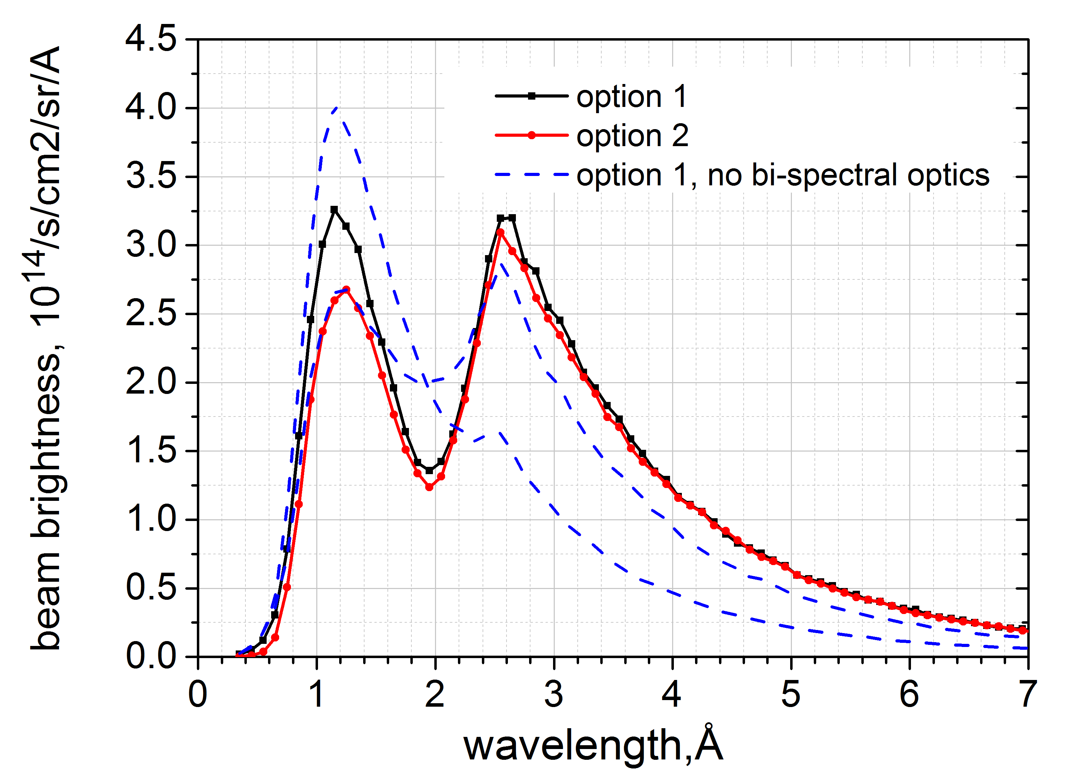
Neutron optics – performance
Beam brightness at the sample
Option 2 yields less thermal neutrons (as expected)
dashed curves: beam axis focused near the moderators boundary

Slide 9
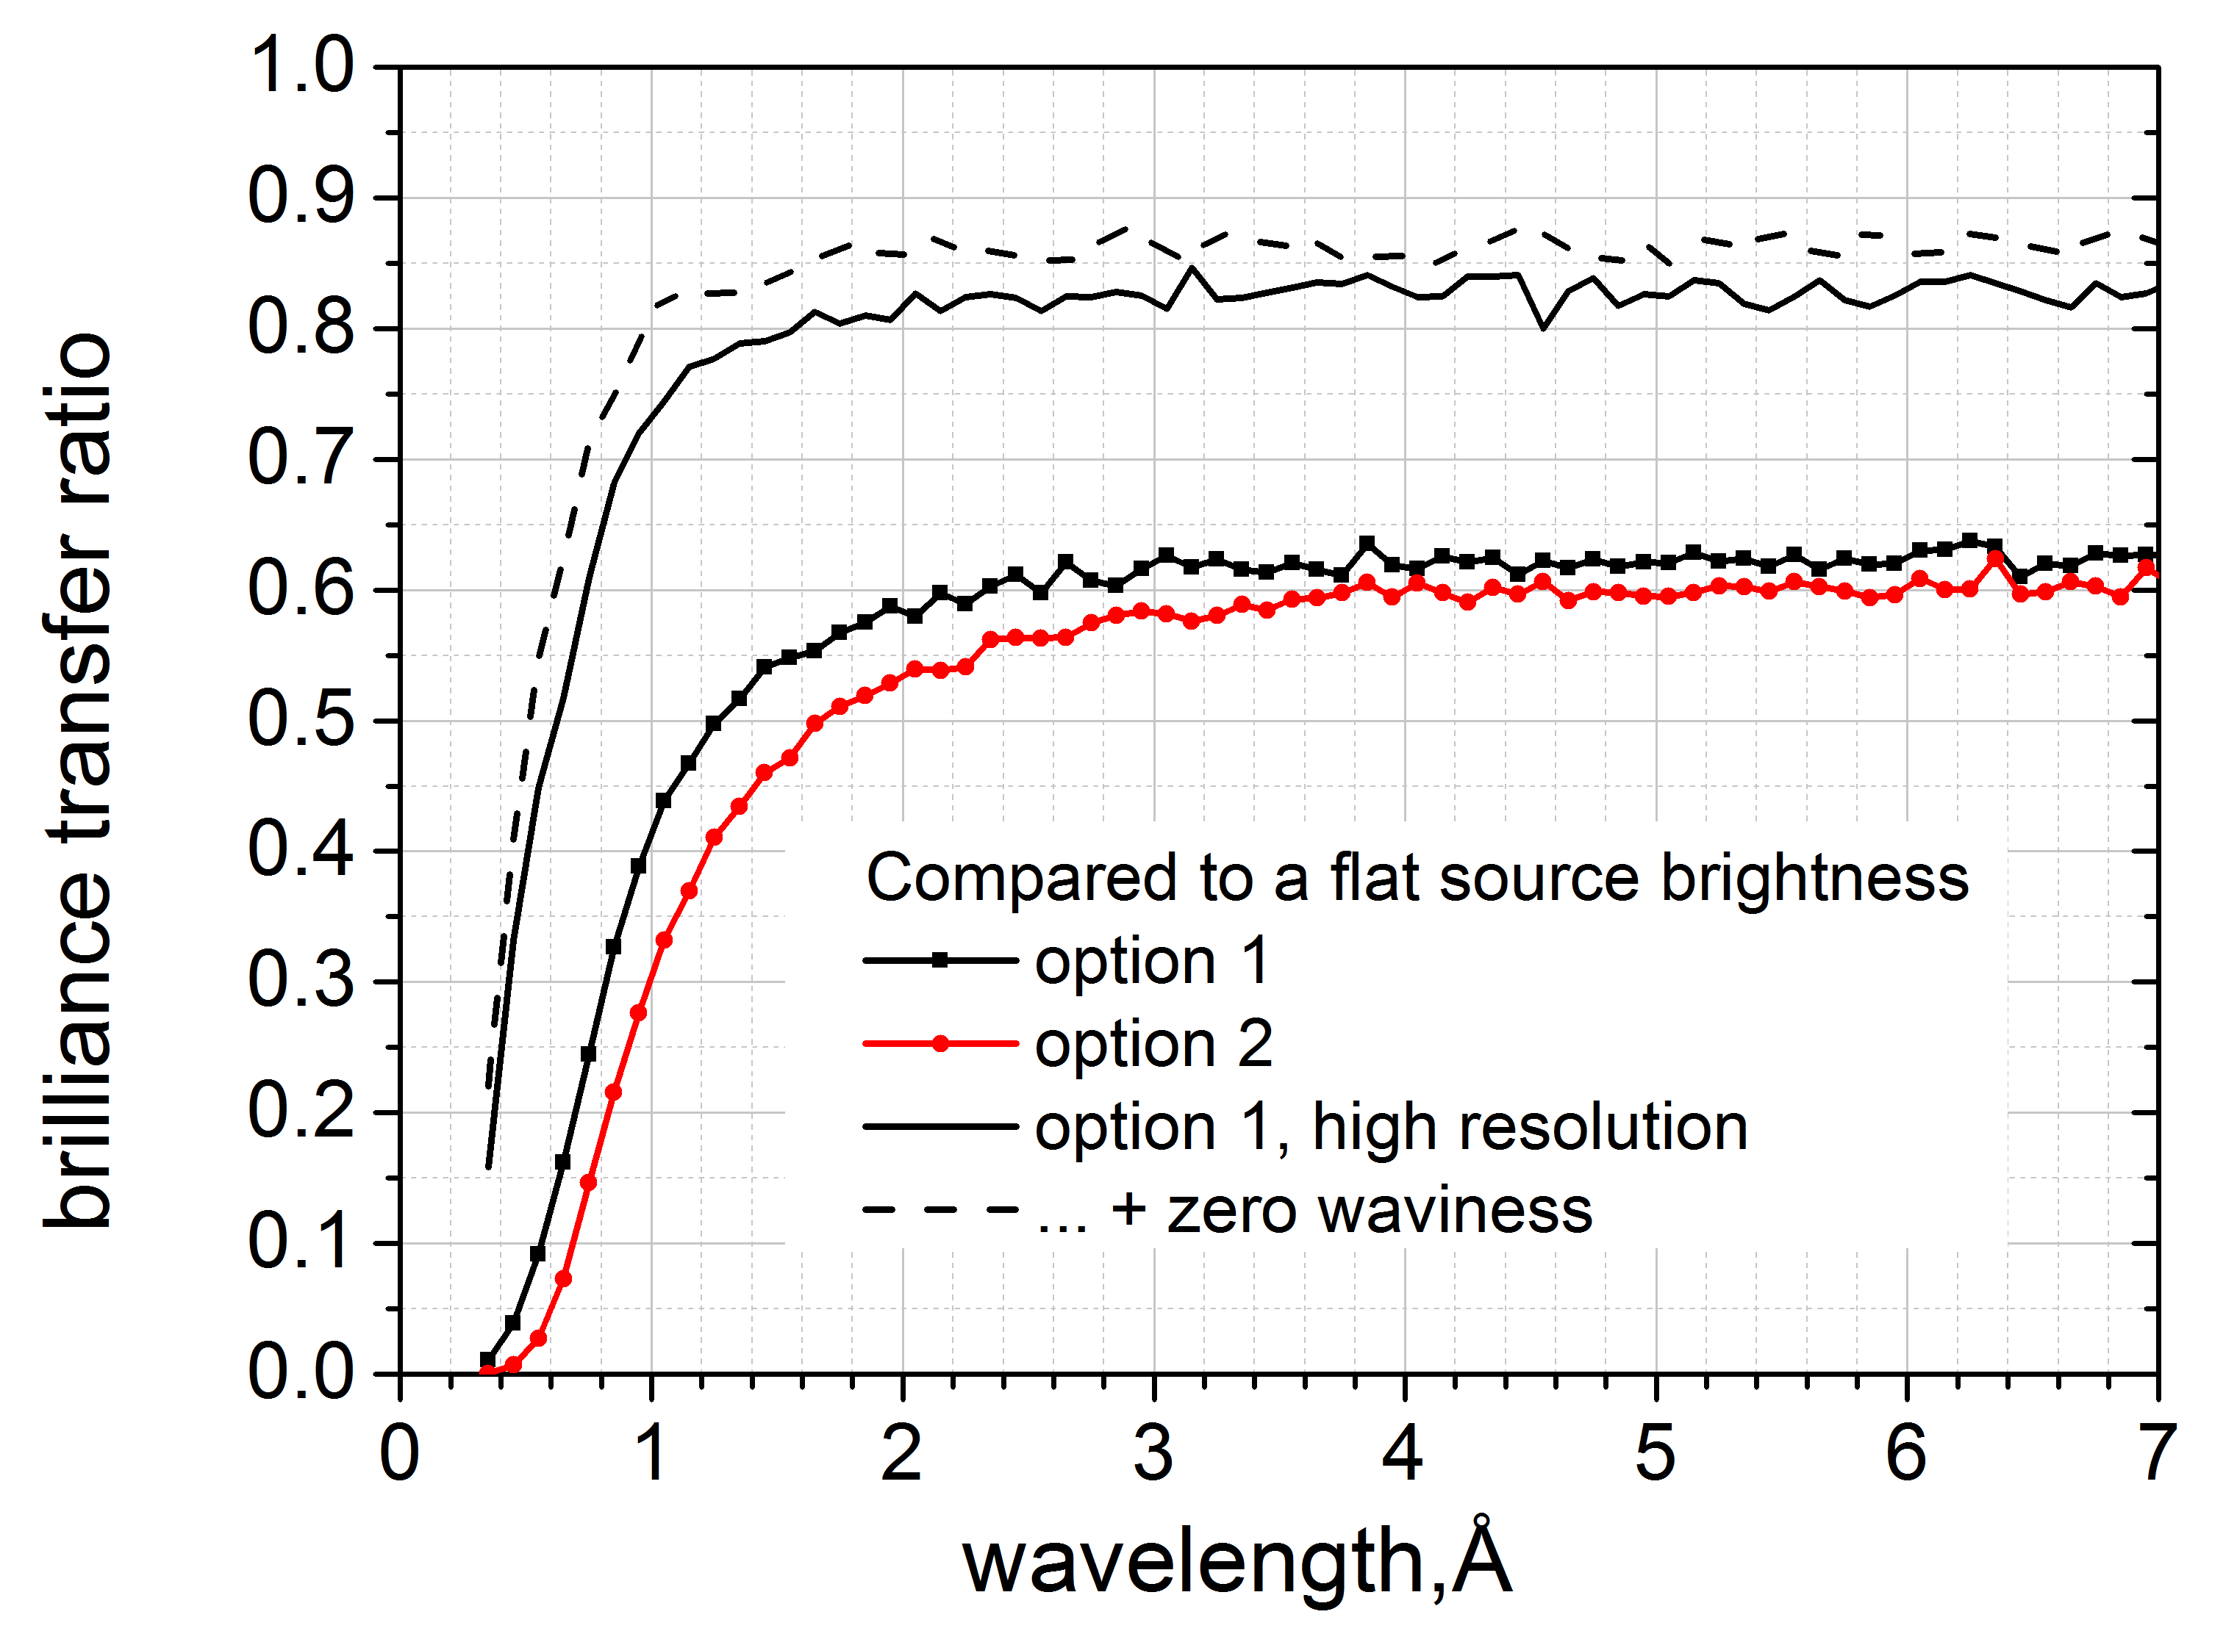
Neutron optics – performance
Brilliance transfer ratio
ΔΩ = 2x2 mrad²
ΔΩ = 5x30 mrad²

Slide 10
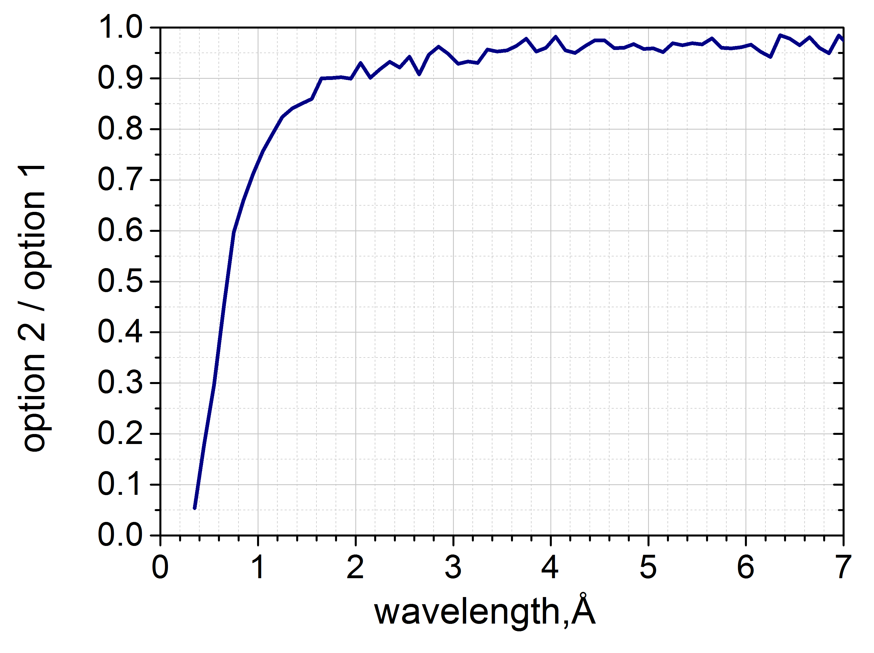
Neutron optics – performance
Beam brightness at the sample, option 2 / option 1
Option 2:
gives by 10 % to 25 % less intensity in the most important wavelength range of 1 to 2 Å

Slide 11
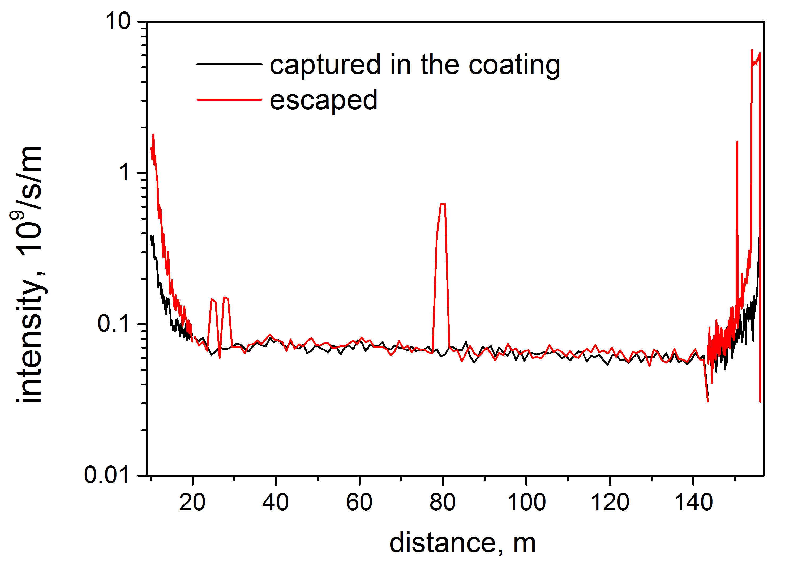
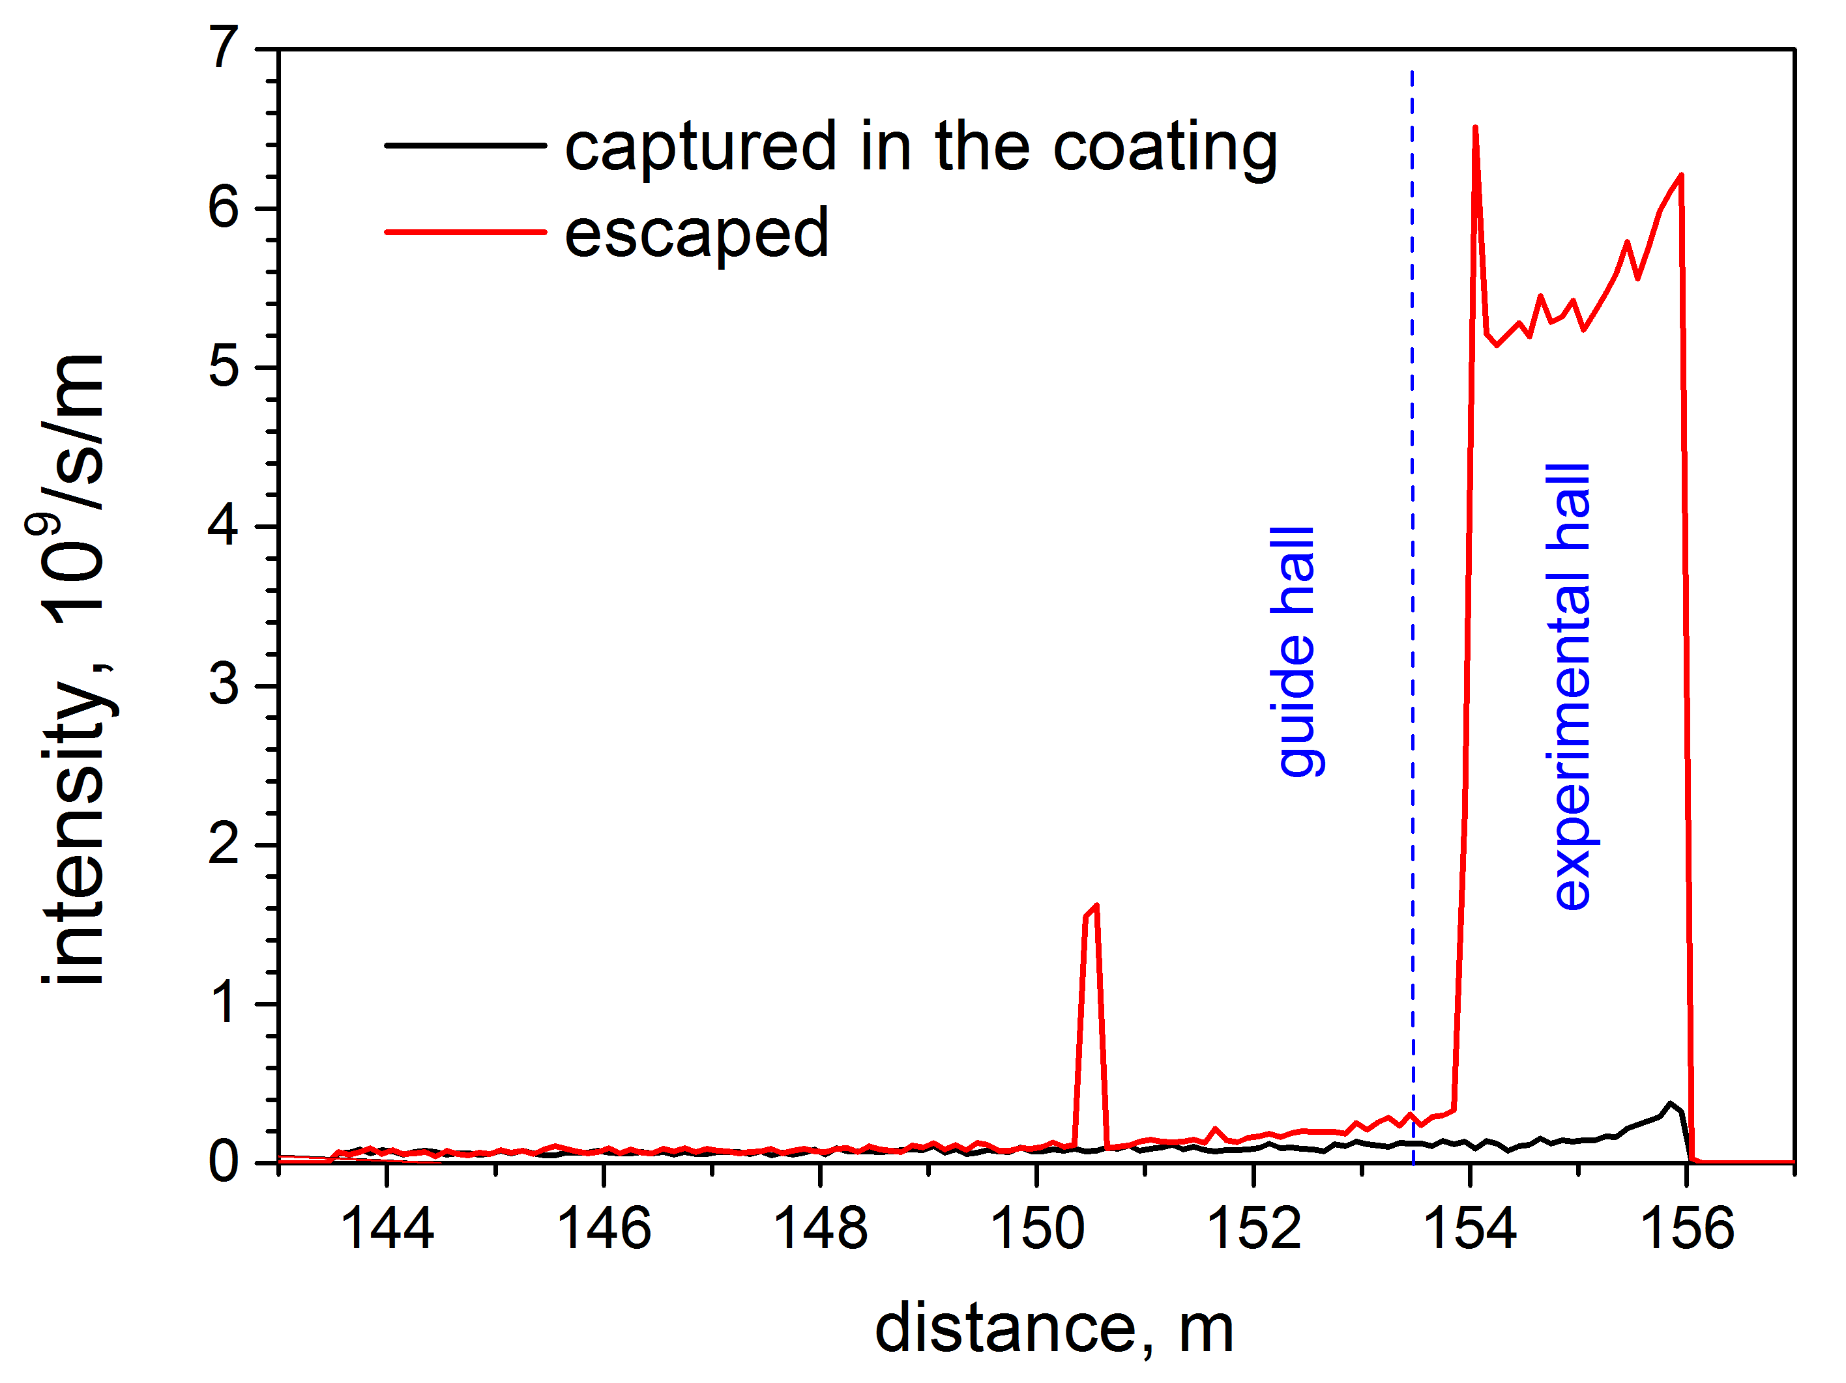
Simulation of neutron escape intensity
SIMRES v. 6.3.4
Monitoring of neutron events in the guide coating
a) capture in the NiTi coating => conversion to γ
b) scattering or transmission => escaped neutrons
To be used for the assessment of the focusing guide shielding …

Slide 12
Neutron optics – transported neutron flux and intensity
Example for Option 1, full pulse (choppers stopped)
Estimation of thermal neutron flux and integrated intensity at various places along the beamline (ray-tracing simulation)
position | x [m] | flux [10⁹/s/cm²] | integral [10¹⁰ / s]
sample | 157 | 6.1 | 4.6
slit 2 | 154 | 2.6 | 5.5
slit 1 | 150.5 | 2.0 | 5.6
2nd shutter | 78 | 1.9 | 6.3
bunker wall | 28 | 2.1 | 6.9
monolith wall | 6 | 11.4 | 15.7
At least 10 x lower values are expected during normal operation

Slide 13
Options for guide shielding
Option 1
Option 2

Slide 14
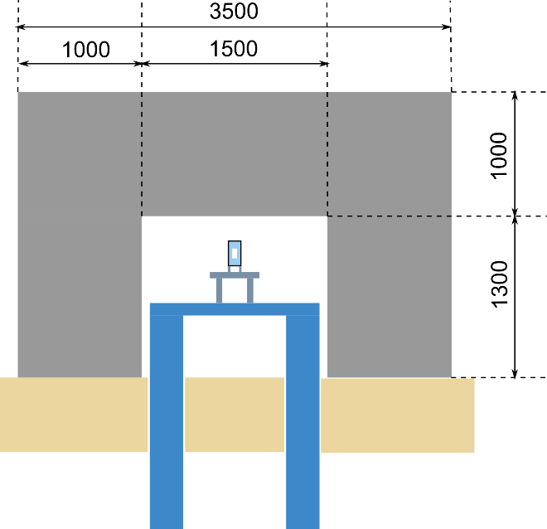
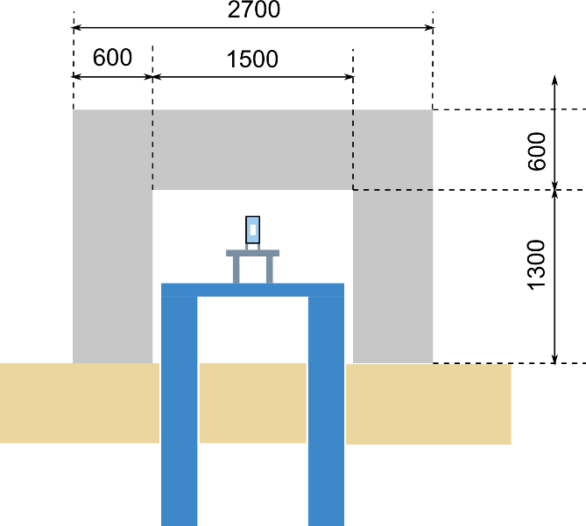
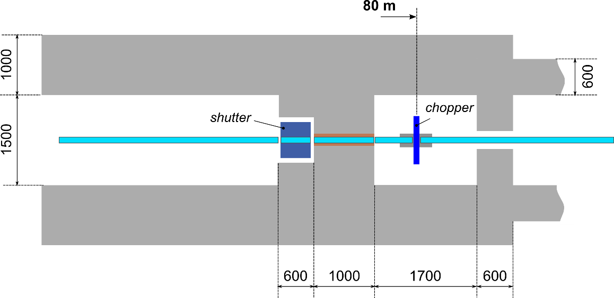
Options for guide shielding
Proposal for the 1st iteration
Before DLS
After DLS
hd concrete
std. concrete
Shutter and chopper cave (option 1)

Slide 15
Thank you for your attention

