Slide 1




T-REX
A bispectral chopper spectrometer for
magnetism, materials science and soft matter
Wide E_{i} Spectrum
Polarization Analysis
Flexibility
Versatility
Notes:
There is a common misconception that magnetism, material science and soft matter all have different requirements for investigations using Inelastic Neutron Scattering. As a consequence, it’s commonly believed that one machine cannot serve different communities, because any application requests different capabilities and features.
But in reality, they are very similar, instead.
People tend to assume that the optimization of a machine for a specific application, would led to compromise the performance for other applications.
Our work indicates that no compromise is necessary.
And this brings us on to the subject of exploring the requirements for the various applications.

Slide 2
Science driven Instrument Requirements
Incident Energy Range: 2 meV - 160 meV
Elastic energy resolution (FWHM) 1% - 3% at 2 meV
3% - 6% at 100 meV
Time resolution (FWHM): 10µs
Q range: 0.01 Å⁻¹ – 15 Å⁻¹
Q resolution (FWHM): 0.05 Å⁻¹ at 80 meV
tailored to needs
Minimum 2ϑ_{S}: 1°
Beam size: 10mmx30mm
Beam profile: flat
S/N crucial
Polarization Analysis users option from 1st day

Slide 3
NO&S Requirements
Wavelength transport: 0.7Å – 6.5 Å
suppression: others
Collimation lambda dependent from +/- 0.25° to +/-1° improvable +/- 0.25°, +/-0.5°
profile smooth
Beam size 10mm x 30mm
profile flat
Choppers integration
S/N maximum
Notes:
Detectors are only one part of the scattering characterization system, which is called traditionally secondary instrument or spectrometer.
Other functional components are: vessel, shielding, vacuum system. Previous STAP advised the instrument team to investigate the impact on S/N ratio of a collimator, which is a this stage only an option under consideration. Neutron Detectors consist of conversion devices, support structure, electronics, interfaces.

Slide 4
Beam Characterization System Layout
Removable extraction
Curved guide
+T0
Clash with Construction pillar
50m??

Slide 5
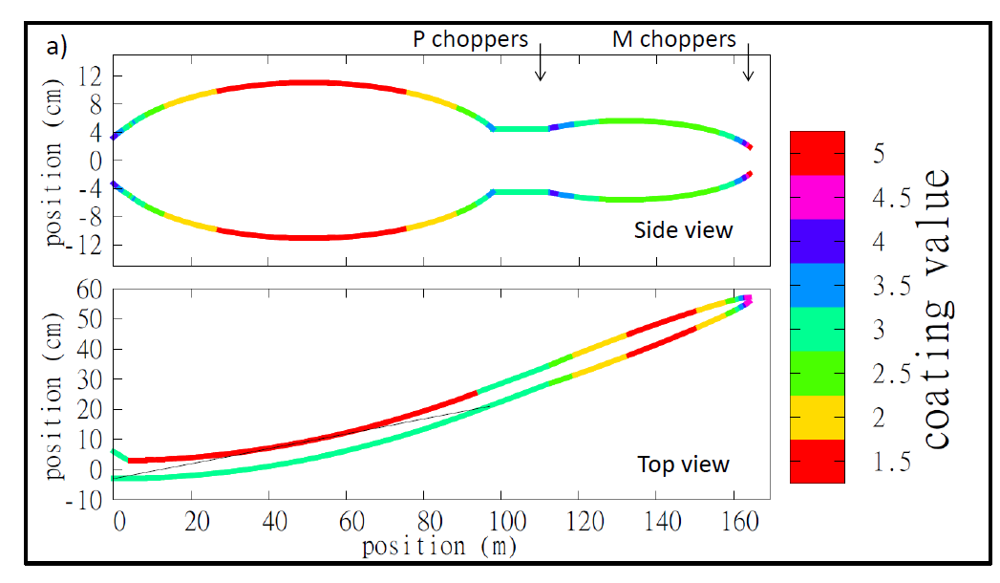
Guide Layout T-REX
W7

Slide 6
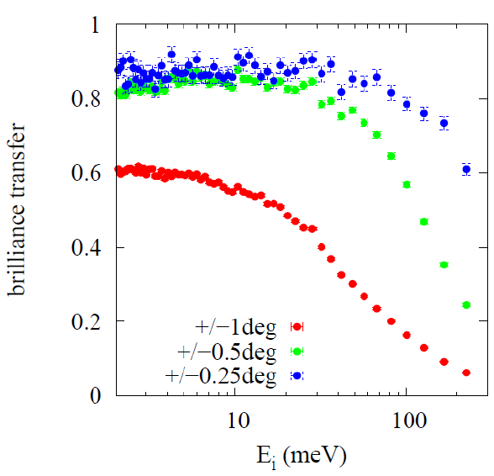
Excellent Performance
10 mm x 30mm

Slide 7
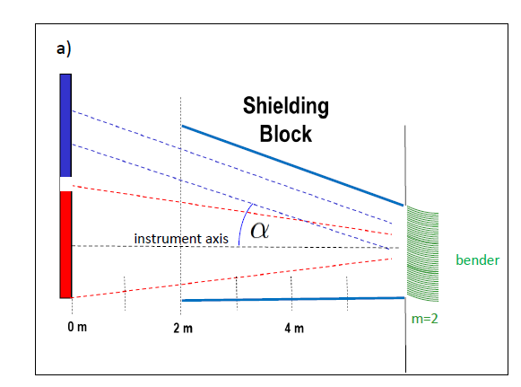
Bender Layout T-REX
L = 50mm
R = 3.7 m
m = 2
150 µm Si
+ Polarizer option

Slide 8
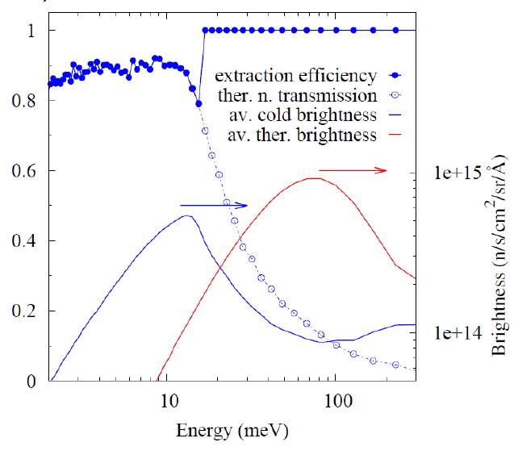
85% of cold flux

Slide 9
Shielding
proposal ’15:
2.5 m³/m x 5k€ / m³ x 140 m = 1800 k €
No concept so far
P1 IK Resources allocated for
preliminary engineering design
Detail ?
?
Proposal ‘15:
2 M€ guide cost
4.4M€ including vac
~ 30%
budget
category

