Slide 1
Air activation studies from dark current emitted at Super Conducting Radio Frequency Cavities
Mario Santana✝, J. Blaha, L. H. Nicolas, H.Tran, J. C. Liu (SLAC > RPD)
msantana@slac.stanford.edu.

Slide 2
Outline
Motivation
SCRF Introduction: Hard X-Ray FEL, LCLS-II beam-lines; Field emission
Methodology: Track3P assumptions, Soft Coupling FLUKA-Track3P, FLUKA settings
Simulations: Effects of EM fields, effects of QUAD fields
Results: Reference study; halo collimators, Ratio CM/halo_collimators
Future outlook: Energy upgrades and measurements
Summary
4th Int. Workshop on Accelerator Radiation Induced Activation, May 22-24, 2017, Lund, Sweden

Slide 3
Motivation
Most current or projected major accelerators have a superconducting electron (XFEL, SLAC, JLAB) or proton linac (ESS,…).
Apertures at the Linac cryomodules are typically large
→ most beam losses happen at well shielding collimation / bunch compression sections
Thus, ‘Losses’ at the cold linac are mainly from field emission, typically 1-10 nA, i.e. 0.1-1.0 W can escape each end of a cryomodule and be eventually swept out by quadrupoles
Do we then have to care about air activation at the ‘cold’ Linac? Can we let the cold Linac have free ventilation? What happens if the gradient is increased to reach higher beam energies?
4th Int. Workshop on Accelerator Radiation Induced Activation, May 22-24, 2017, Lund, Sweden

Slide 4
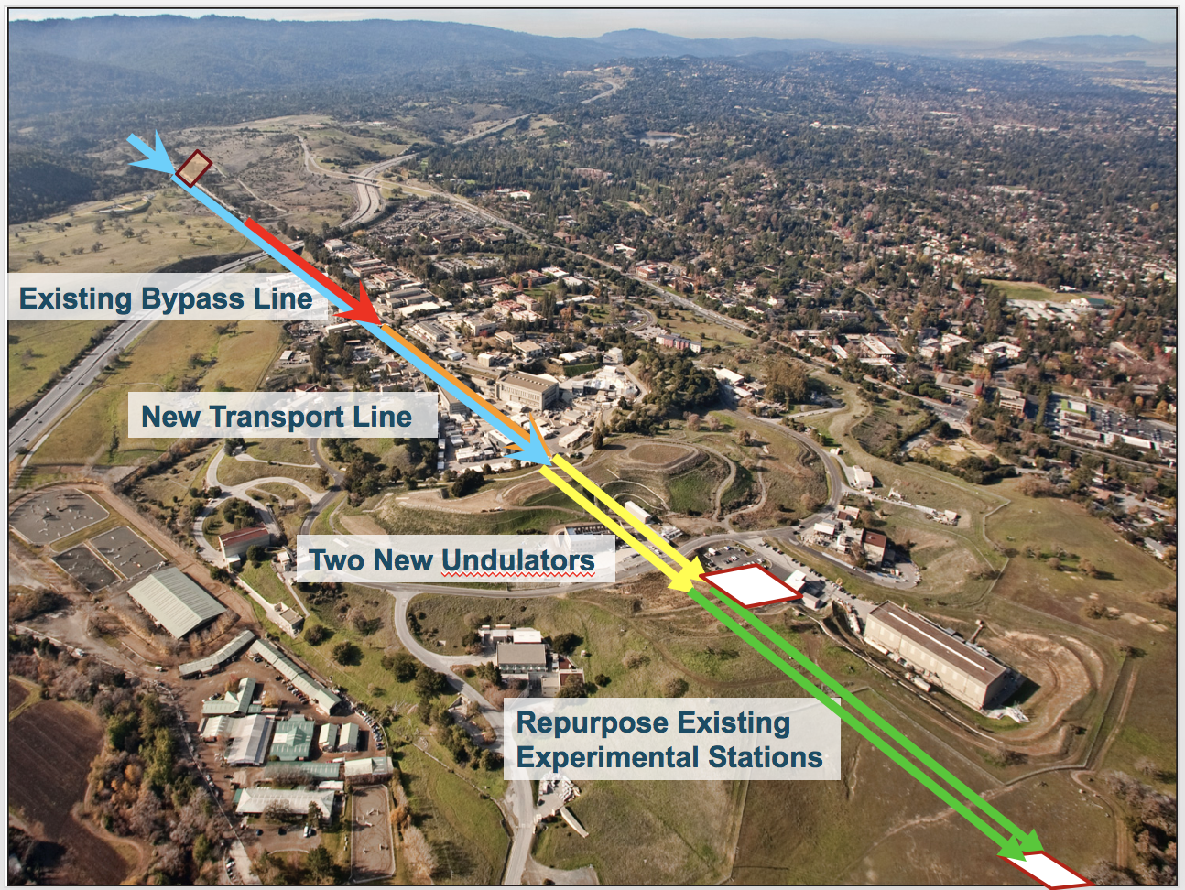
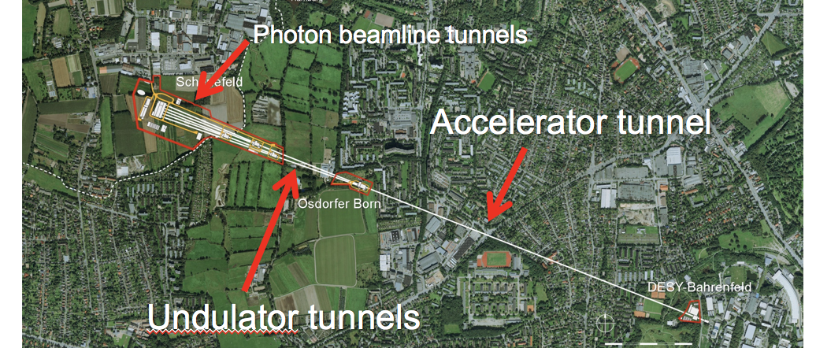
SCRF Introduction – hard X-ray facilities
35 cryomodules to be installed in LCLS-II
From W. Clement, DESY
96 cryomodules at XFEL
4th Int. Workshop on Accelerator Radiation Induced Activation, May 22-24, 2017, Lund, Sweden

Slide 5
SCRF Introduction - LCLS-II beam-lines
L0
ϕ =varies
V₀=100 MV
I_{pk}=12 A
σ_{z}=1.02 mm
L1
ϕ = −12.7°
V₀=211 MV
I_{pk} = 12 A
σ_{z}=1.02 mm
L2
ϕ = −21°
V₀=1446 MV
I_{pk}=80 A
σ_{z}=0.15 mm
L3
ϕ =0
V₀=2206 MV
I_{pk}=1.0 kA
σ_{z}=9.0 μm
Lf
ϕ =±34
V₀=202 MV
I_{pk}=1.0 kA
σ_{z}=9.0 μm
BC3
E=4.0 GeV
R₅₆=0
σ_{δ}=0.13 %
HL
ϕ = −150°
V₀=64.7 MV
CM01
CM02,03
3.9 GHz
CM04
CM15
CM16
CM33
CM34,35
LH
E=100 MeV
R₅₆=-14.5 mm
σ_{δ}=0.05 %
BC1
E=250 MeV
R₅₆=-55 mm
σ_{δ}=1.6 %
BC2
E=1600 MeV
R₅₆=-37 mm
σ_{δ}=0.38 %
BYP/LTU
E=4.0 GeV
R₅₆≈0.2 mm
σ_{δ}≈0.014%
> 2.5-km
GUN
750 keV
100-pC machine layout: April 24, 2014; v21 ASTRA run
4th Int. Workshop on Accelerator Radiation Induced Activation, May 22-24, 2017, Lund, Sweden

Slide 6
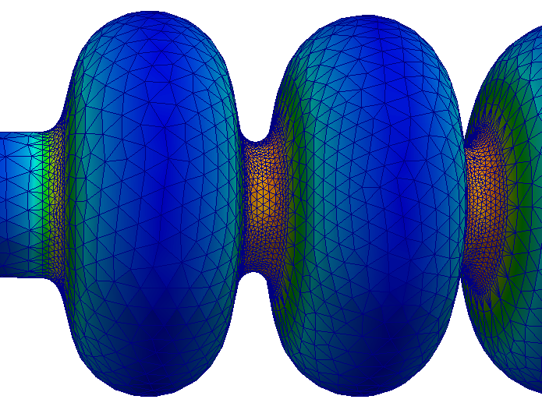
Field emission
Field-emission & tracking
Santana et al, Int. J. Mod. Phys. Conf. Ser. 2016.44
Electrons are extracted from the cavity surface and accelerated by the RF fields until they are lost or intercepted
Track3P + SLAC RF fields used to simulate the emission and RF transport inside the cavities
FLUKA used to transport particles between cryomodules (including quads) and in matter
Soft coupling, i.e. up to 8 x 2 data transfer between Track3P & FLUKA to simulate impact of field emitted electrons through +/- 8 cryomodules
Impact files read by FLUKA for radiation transport and activation
4th Int. Workshop on Accelerator Radiation Induced Activation, May 22-24, 2017, Lund, Sweden

Slide 7
Track3P features & assumptions (1/3)
Field Level: 16 MV/m
Work Function φ: 4.2
Local field Enhancement factor: 120
Field emission and transport within the EM fields of the cryomodules computed by Track3P particle tracking code on finite elements
Curved elements to match boundaries
Parallel implementation
RF fields imported from SLAC finite elements field solvers: Omega3P (resonant mode), S3P (resonant wave), T3P (transient RF excitation)
Computes dark current evolution
4th Int. Workshop on Accelerator Radiation Induced Activation, May 22-24, 2017, Lund, Sweden
From Z. Li & L. Ge

Slide 8
Track3P features & assumptions (2/3)
Model: 1 cryomodule
8 cavities with 9 cells: 10.959 m
Quadrupoles not included
Mesh
Locally refined in iris region
Convergence study: Two sets mesh
Coarse: 303k curved tetrahedral elements
Denser: 1.45M curved tetrahedral elements
Fields
Pi mode
Frequency = 1.2999669e+09
From Z. Li & L. Ge
4th Int. Workshop on Accelerator Radiation Induced Activation, May 22-24, 2017, Lund, Sweden

Slide 9
Track3P features & assumptions (3/3)
From Z. Li & L. Ge
Implementation for LCLS-II:
Initial particles emitted on one quarter & on 1st RF cycle
Total Tracking time 60 cycles
No Secondary emission, multipacting not activated (but could be)
Field emission generated by each cryomodule and exiting each of its ends set at 10 nA (=upper acceptance level), not due to single emitter, but rather to smooth distribution of emitters
4th Int. Workshop on Accelerator Radiation Induced Activation, May 22-24, 2017, Lund, Sweden

Slide 10
FLUKA settings – physics options
Photo-nuclear interactions activated (TBD, test effect of electronuclear contributions) and biased
EMF cutoff at 10 GeV (slightly too high…)
Photo-muon reactions activated and biased
‘Peanut’ hadronic generator up to top energy
Heavy fragment evaporation
Coalescence
4th Int. Workshop on Accelerator Radiation Induced Activation, May 22-24, 2017, Lund, Sweden

Slide 11
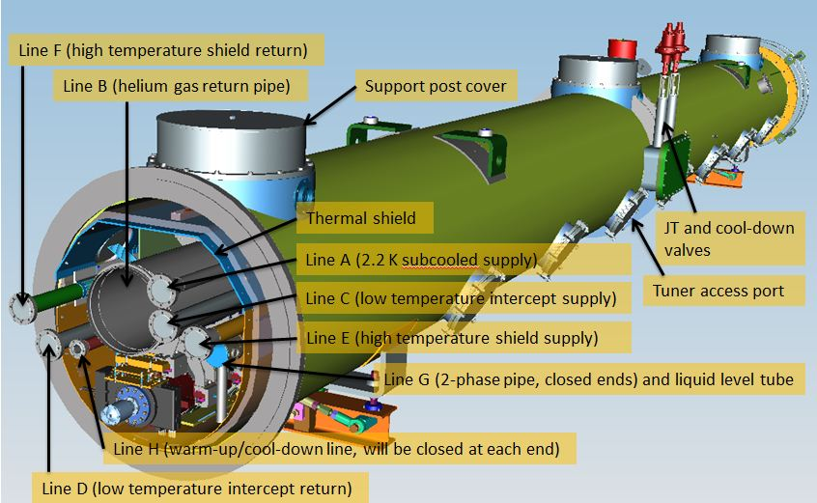
FLUKA settings – geometry implementation (1/2)
From Mark Ross, SLAC
CM Design 1.04.05 (Fermilab)
4th Int. Workshop on Accelerator Radiation Induced Activation, May 22-24, 2017, Lund, Sweden

Slide 12
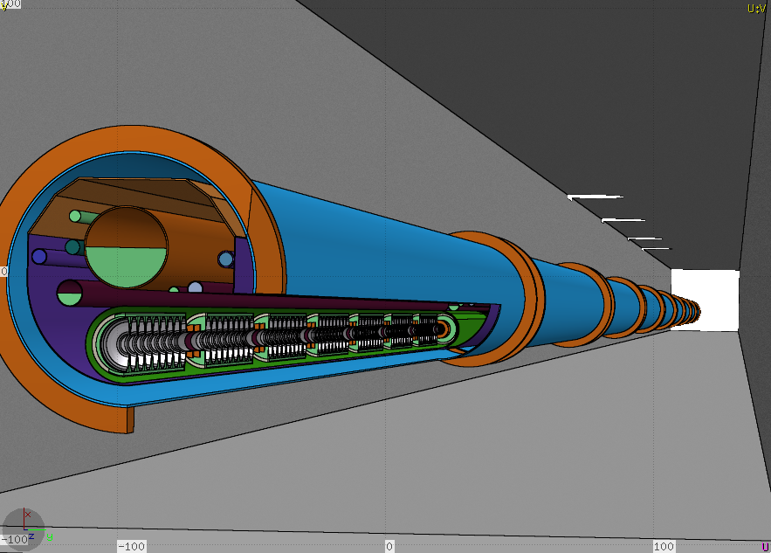
FLUKA settings – geometry implementation (2/2)
quadrupole
8 Cavities with nine cells each
4th Int. Workshop on Accelerator Radiation Induced Activation, May 22-24, 2017, Lund, Sweden

Slide 13
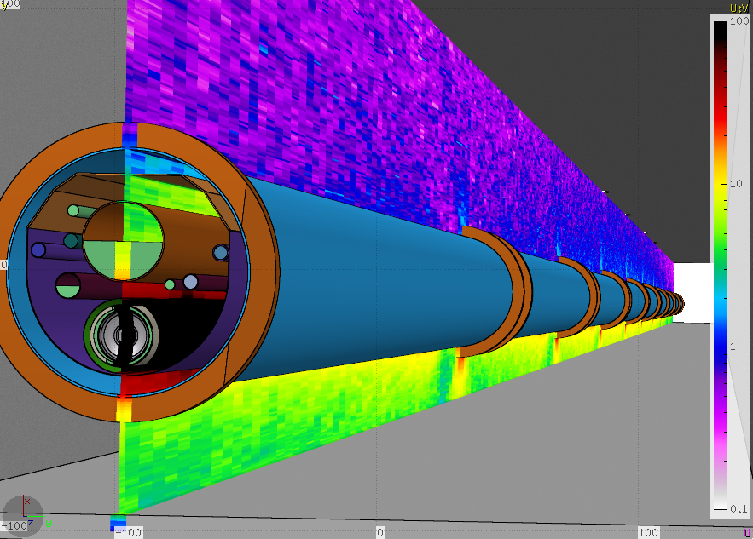
FLUKA settings – geometry implementation (2/2)
4th Int. Workshop on Accelerator Radiation Induced Activation, May 22-24, 2017, Lund, Sweden

Slide 14
‘Soft coupling’ Track3P ←→ FLUKA: impact maps (1/2)
Generation of n^{th} order impact files: FLUKA here is used to transport field-emitted electrons in the vacuum between cryomodules, sending events back to Track3P, which was modified to start from such conditions instead of emission events
Track3P
Generation of field-emitted electrons
Track electrons within RF field to collision with walls or extraction at either end of the 8-cavity string
2n+1 impact files: original cryomodule, ±1 cryo, …, ±n cryo
FLUKA
Read impact file & transport escaping electrons to next/previous cryomodule through quadrupoles
Auxiliary data files
Transform coordinates to original cryomodule & print position, velocity, energy, weight & RF cycle.
4th Int. Workshop on Accelerator Radiation Induced Activation, May 22-24, 2017, Lund, Sweden

Slide 15
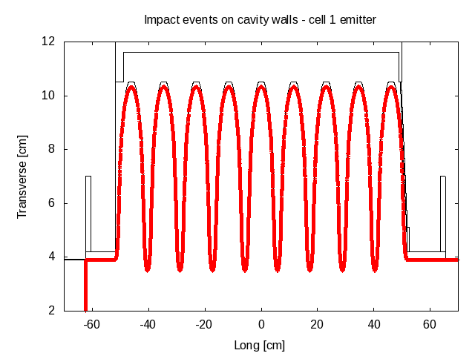
‘Soft coupling’ Track3P ←→ FLUKA: impact maps (2/2)
Preprocess impact data: change units, transform axis & position
Select impact event randomly according to statistical weight
Randomize transverse coordinates (position & direction) to full 2π as impact data covers only 1/4th
Auto-adjust impact to boundary surface to avoid mis-match between TRACK3P and FLUKA surface of the cavities
Set detector to count current of primaries exiting its birth cryomodule. This will be used to renormalize all results
4th Int. Workshop on Accelerator Radiation Induced Activation, May 22-24, 2017, Lund, Sweden

Slide 16
‘Soft coupling’ Track3P ←→ FLUKA: transport
Read 2n+1 files, with n determined in FLUKA input (source card)
Select file (=step number) randomly according to relative likelihood & select event within. Latch primary (FLUKA variable SPAREK(2,…))
e.g. step=-2
-1
0
+2
…
-3
-2
+1
+3
Convolute previously selected birth cryomodule with step number to obtain ‘collision’ cryomodule and discard if outside the geometry
e.g. CM5-2 = 3
…
1
2
3
4
5
6
7
Kill primary particle (not showers) if it reaches another RF zone, as such events are already included in step±1 impact file
4th Int. Workshop on Accelerator Radiation Induced Activation, May 22-24, 2017, Lund, Sweden

Slide 17
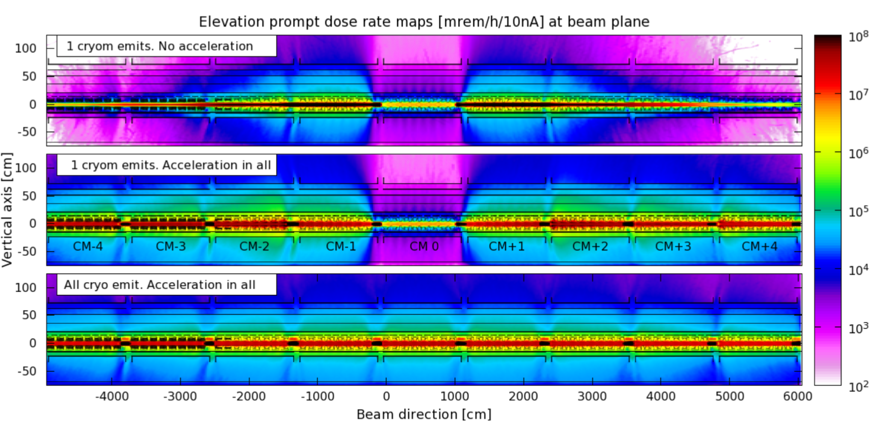
SCRF FE simulations – Effect of EM fields
Now, all other cryomodules are also powered (but don’t emit): what happens to FE from the central cryomodule?
Now, if all cryomodules emit electrons (and of course, they are all powered, and synced) what is the radiation profile?
4th Int. Workshop on Accelerator Radiation Induced Activation, May 22-24, 2017, Lund, Sweden

Slide 18
SCRF FE simulations – Effect of EM fields
Now, if all other cryomodules are also powered (but don’t emit): what happens to FE from the central cryomodule?
Now, if all cryomodules emit electrons (and of course, they are all powered, and synced) what is the radiation profile?
4th Int. Workshop on Accelerator Radiation Induced Activation, May 22-24, 2017, Lund, Sweden

Slide 19
SCRF FE simulations – Effect of EM fields
Now, if all cryomodules emit electrons (and of course, they are all powered, and synced) what is the radiation profile?
4th Int. Workshop on Accelerator Radiation Induced Activation, May 22-24, 2017, Lund, Sweden

Slide 20
SCRF FE simulations – Effect of EM fields
Now, if all cryomodules emit electrons (and of course, they are all powered, and synced) what is the radiation profile?
4th Int. Workshop on Accelerator Radiation Induced Activation, May 22-24, 2017, Lund, Sweden

Slide 21
SCRF FE simulations – Effect of EM fields
4th Int. Workshop on Accelerator Radiation Induced Activation, May 22-24, 2017, Lund, Sweden

Slide 22
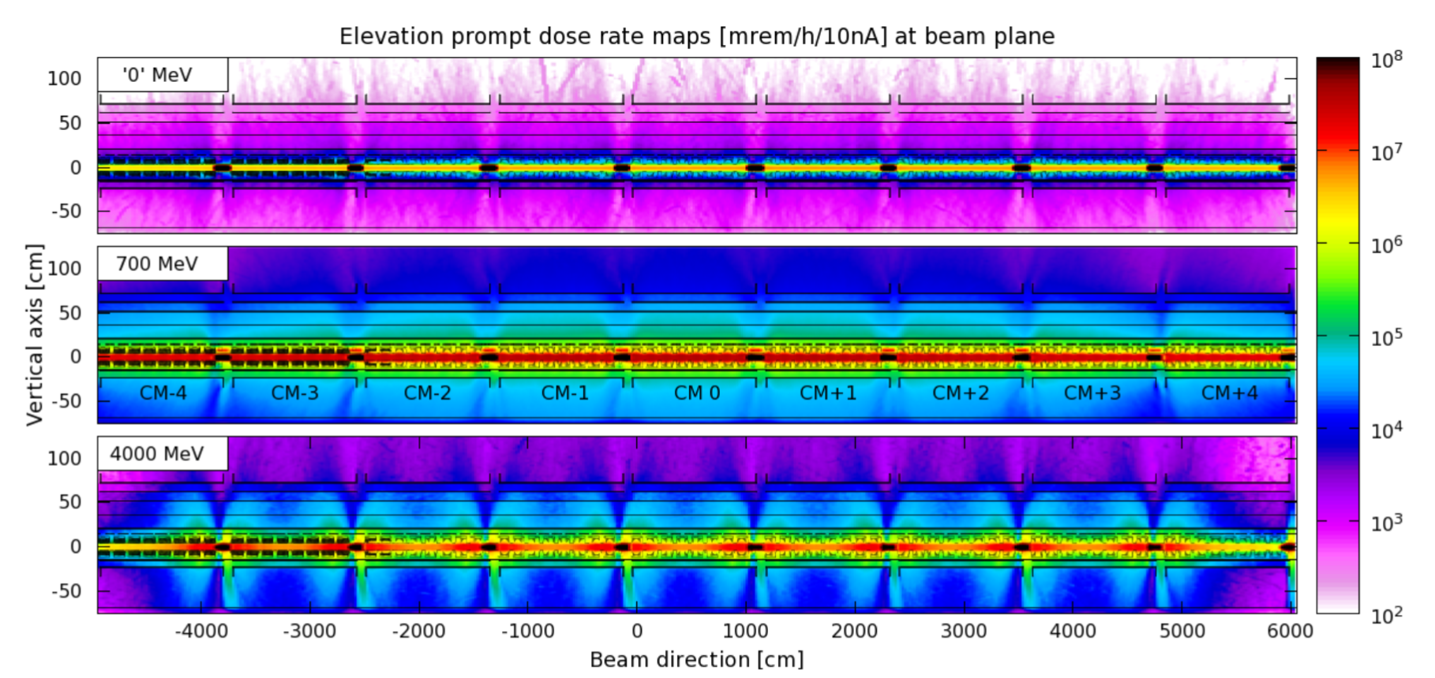
SCRF FE simulations – Effect of QUAD fields
Low quad gradient increases transmission up/downstream → translates the problem to other areas
Mid quad strength maximizes radiation at the cryomodules
4th Int. Workshop on Accelerator Radiation Induced Activation, May 22-24, 2017, Lund, Sweden

Slide 23
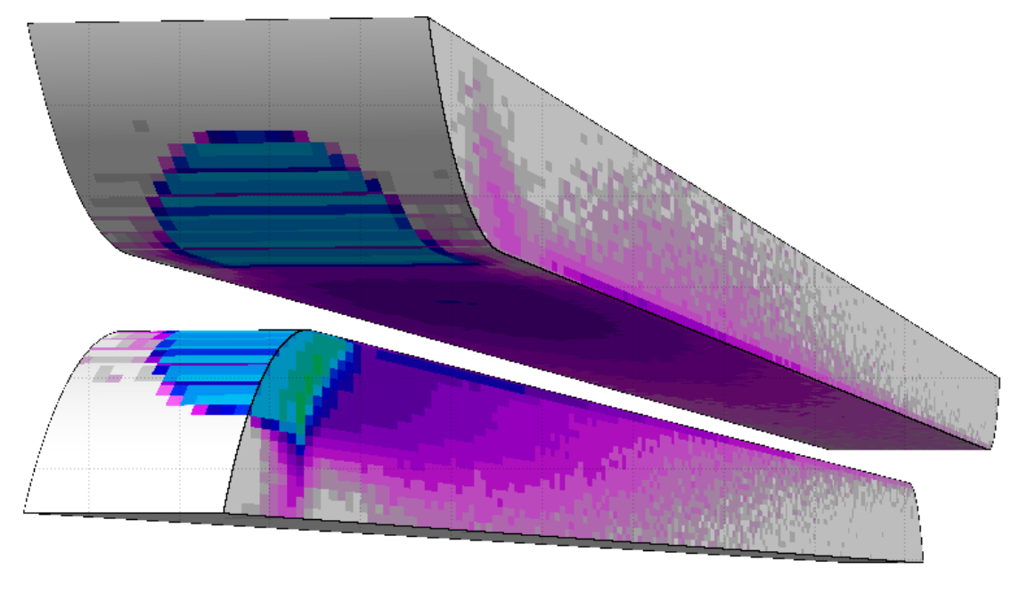
Reference study – air activation in warm sections (1/2)
Air activation was calculated for a simplified approach of beam halo losses in collimators → collapsed jaws into a single piece → cylindrical tungsten target
15 X₀
Total losses on warm linac (=collimators) = 310 W based on beam transport estimates
Collimators with > 10 W have local shielding
4th Int. Workshop on Accelerator Radiation Induced Activation, May 22-24, 2017, Lund, Sweden

Slide 24
Reference study – air activation in warm sections (2/2)
 | Linac Collimators | BSY | 2 EBDs
<Power> [kW] | 0.31 | 90 | 50
Dose [mrem/y] | ~0.8E-03 | 1.1E-03 | 3.2E-04
From J. Blaha, L. Nicolas and H. Tran
→ Only one daily air exchange permitted
Dose from air activation in collimators is almost as important as that from all high power dumps combined (shielding effect)
Will some tens of nA of ~50 MeV field emission contribute significantly?
Field emission raw data was divided by collimator data to obtain relative importance. This was done in three sections representing L1, L2 and L3…
4th Int. Workshop on Accelerator Radiation Induced Activation, May 22-24, 2017, Lund, Sweden

Slide 25
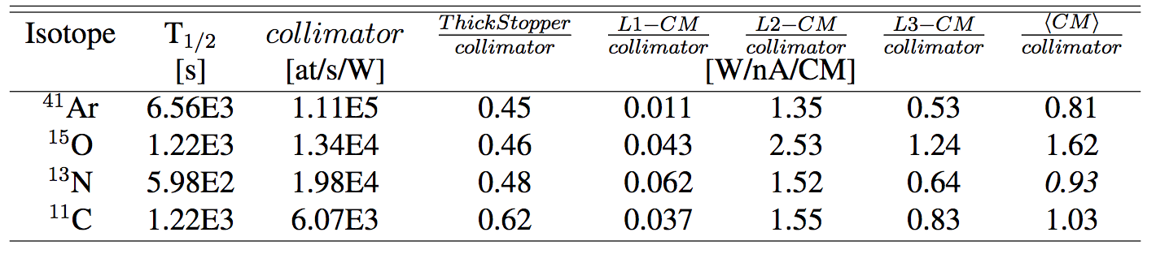
SCRF FE simulations – Results for air activation (1/2)
Isotope generation in air by each cryomodule relative to that in an LCLS-II halo collimator
Thus, 35 CM @ 10 [nA]
⩸ 0.81·35·10 = 284 W on halo collimators for ⁴¹Ar production, 567 W for ¹⁵O, 325 W for ¹³N, and 360 W for ¹¹C.
These numbers are similar to the 310 W maximum integrated loss on collimators that is expected for 1.2 MW operation.
→ RP requirement of less than one air exchange per day applies also to the cold sections
4th Int. Workshop on Accelerator Radiation Induced Activation, May 22-24, 2017, Lund, Sweden

Slide 26
SCRF FE simulations – Results for air activation (2/2)
Why is this happening?
About 94% of field emission is not captured → 10 nA only represents a small fraction of all the generated field emission, the rest is lost at the cavities
The cavities are thin Nb targets, with apparent thickness as small as ~2.7 mm
A fraction of the captured field emission gets accelerated → it picks up more more
Can this get worse…?
4th Int. Workshop on Accelerator Radiation Induced Activation, May 22-24, 2017, Lund, Sweden

Slide 27
SCRF FE simulations – HE upgrade considerations
High energy upgrades (to ~8 GeV) contemplate increasing…
… the number of cryomodules → more air activation,
… the beam energy → more FE power → more air activation
… the gradient of cryomodules to ~19.3 MeV/m → The higher gradient could increase FE production by an order of magnitude.
Thus estimates at 10 [nA/CM] should not be looked as too conservative.
4th Int. Workshop on Accelerator Radiation Induced Activation, May 22-24, 2017, Lund, Sweden

Slide 28
Future outlook – measurements at XFEL?
In collaboration with N. Tesch, A. Leuchner, J. Brahlard, N. Walker (DESY)
Possible measurements at XFEL – precise instrumentation – known ‘bad’ cavity – similar conditions to LCLSII – FLUKA model has been generated
4th Int. Workshop on Accelerator Radiation Induced Activation, May 22-24, 2017, Lund, Sweden

Slide 29
Summary
A model to compute air activation from SCRF field emission has been established.
The model with accurate description of LCLS-II/XFEL cavities ’soft-couples’ FLUKA and Track3P
Air activation from cryomodules at 10 nA/m is comparable to that of 310 W on collimators and similar to 90 kW on a shielding dump, thus same ventilation restrictions should apply to cold sections as to the rest of the machine
Future works may include measurements at XFEL, ‘hard-coupling’ Track3P-FLUKA (‘a la Sixtrack’), electronuclear reactions and lower EMF thresholds
4th Int. Workshop on Accelerator Radiation Induced Activation, May 22-24, 2017, Lund, Sweden

Slide 30
End

