Slide 1
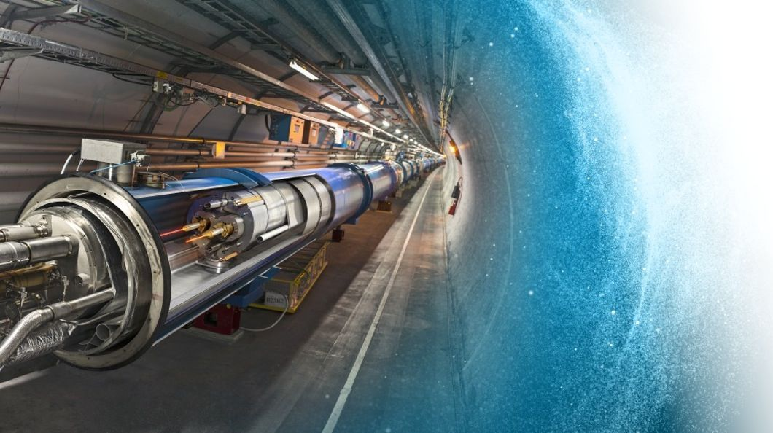

ActiWiz 3 – an overview of the latest developments and their application
Chris Theis and Helmut Vincke
CERN
ARIA 2017
ESS, Lund

Slide 2
Contents
Introduction to ActiWiz and its applications
ActiWiz 3 overview – evolution and new features
Examples

Slide 3
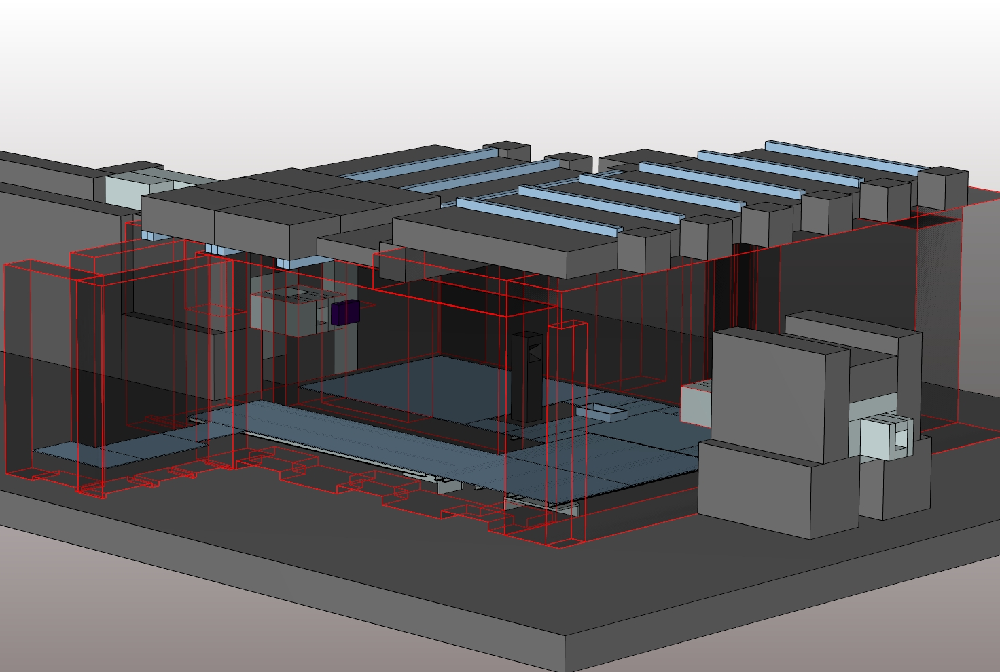
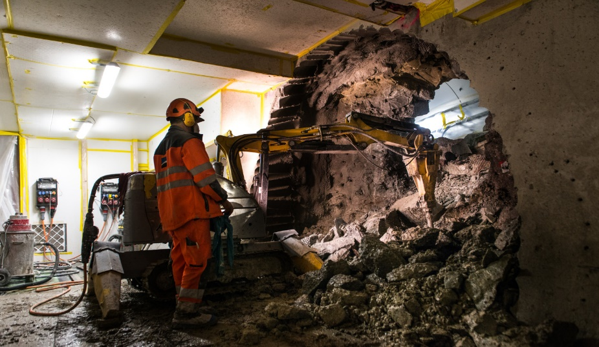

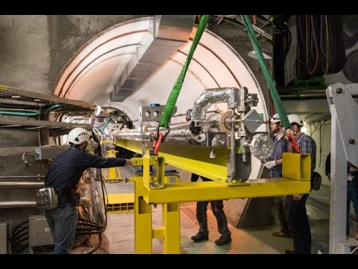
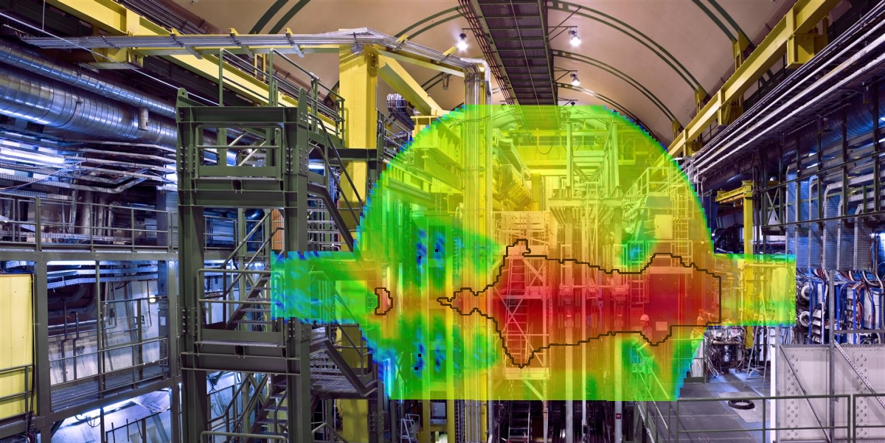
Nuclear facility
Design
Activated material & future waste
Construction
Today we have to build the tools to meet tomorrow’s challenges
Dismantling
Operation

Slide 4
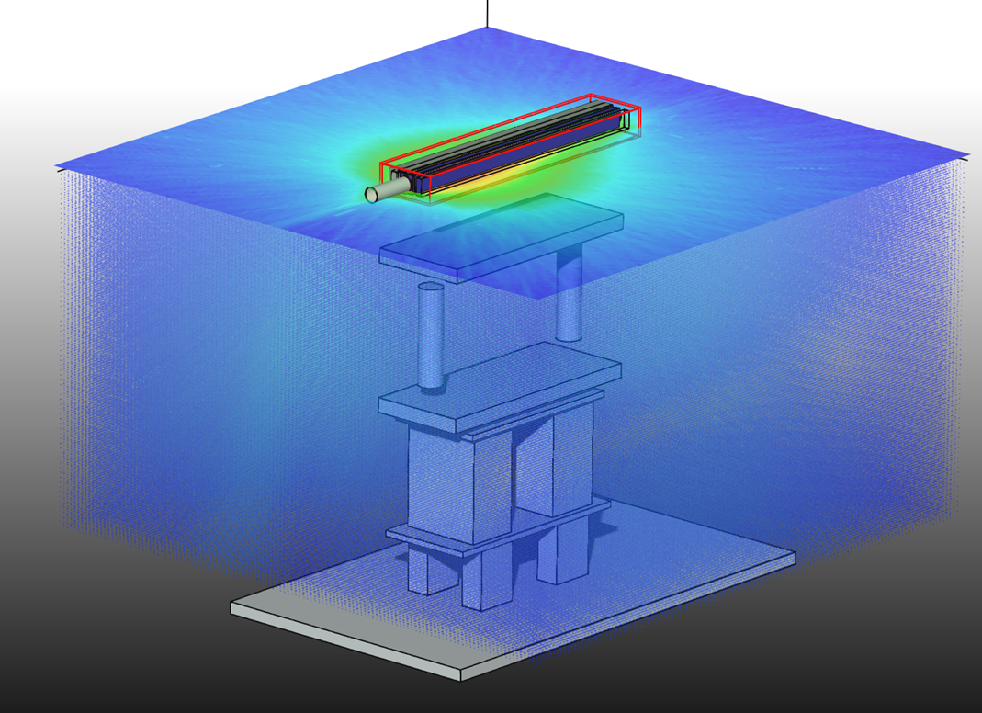
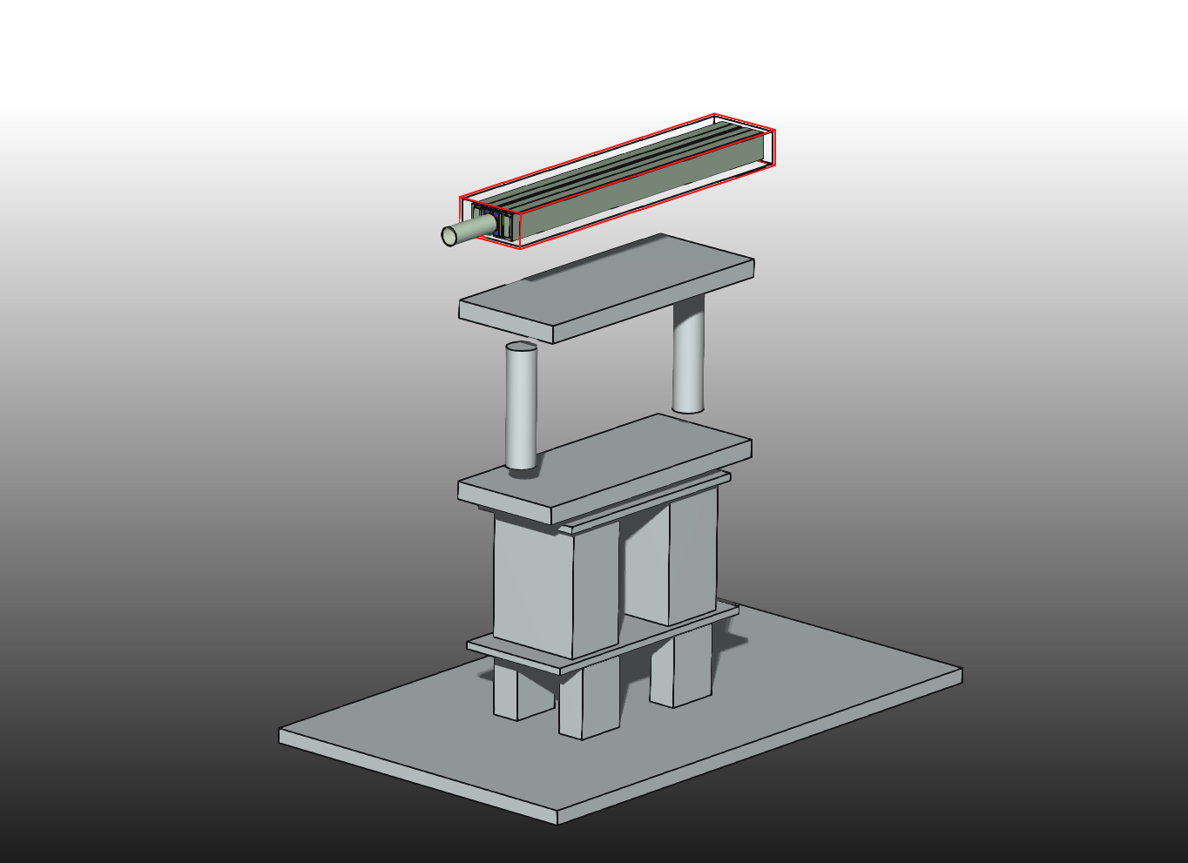
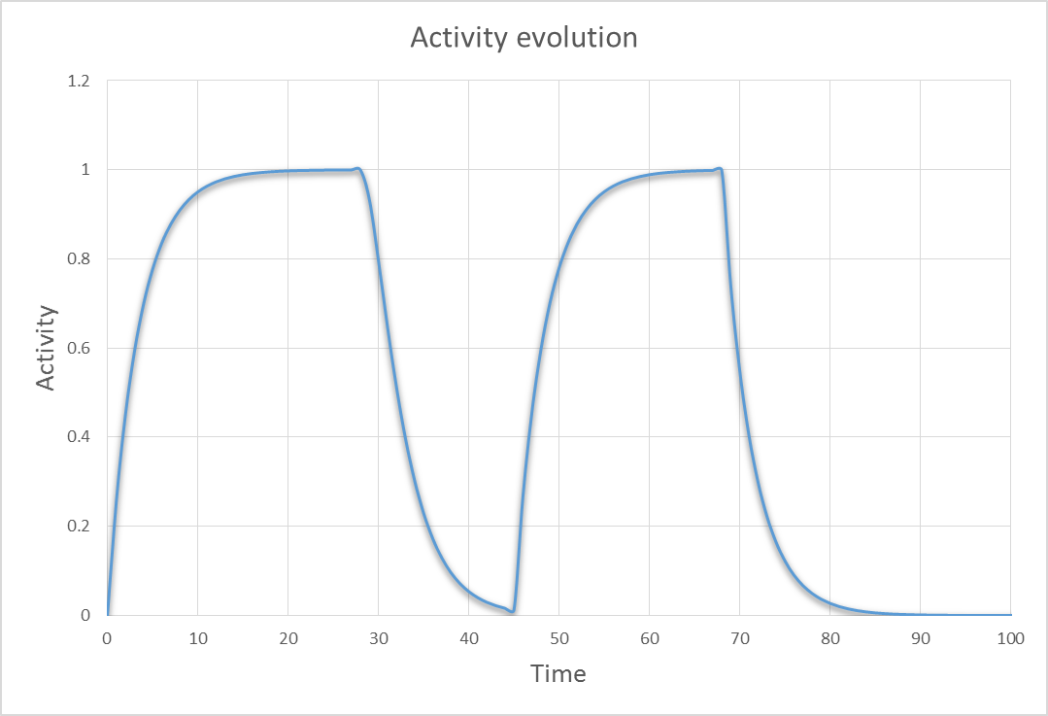
Material activation
secondary particles
beam
Cool-down
Operation

Slide 5
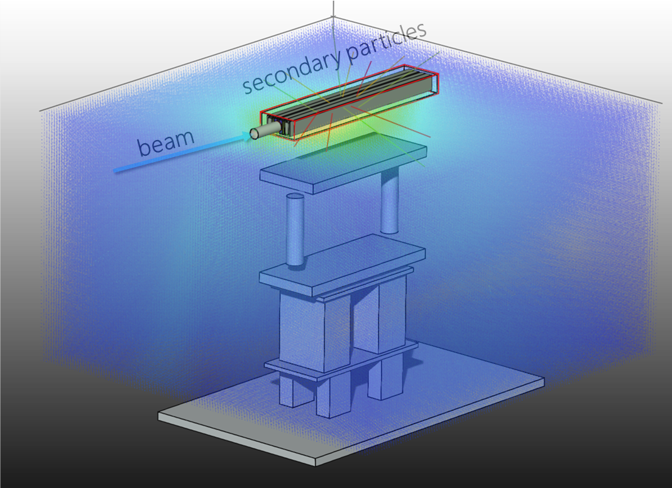
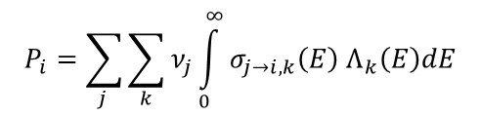
Isotope production
Total production rate of radio-nuclide P_{i}
based on particle fluence Λ
$$P_{i}=\sum_{j }{\sum_{k}{ν_{j}\int_{0}^{∞}{σ_{j→i,k}\left(E\right) Λ_{k}\left(E\right)dE}}}$$
Build-up & decay
decay
build-up
Nuclide inventory

Slide 6

Calculation method
Monte Carlo
Pros:
Yields fluence + activation at the same time
Takes geometry into account → spatial distribution
Cons:
Long calculation times & statistics can be difficult (e.g. thin coating layers)
Requires additional analysis tools to treat raw data
ActiWiz does not intend to replace but to complement general purpose Monte Carlo codes
with respect to radiological characterization
Deterministic
Pros:
Very fast & high statistical significance
Analysis tools fully integrated
Cons:
Requires fluence spectra information
No information on spatial distribution

Slide 7
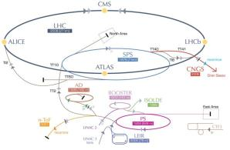
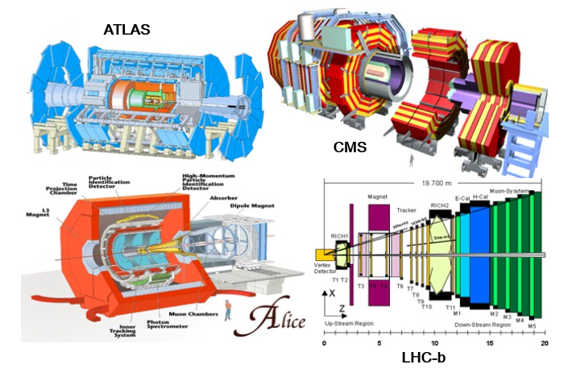
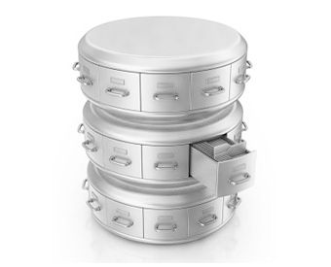
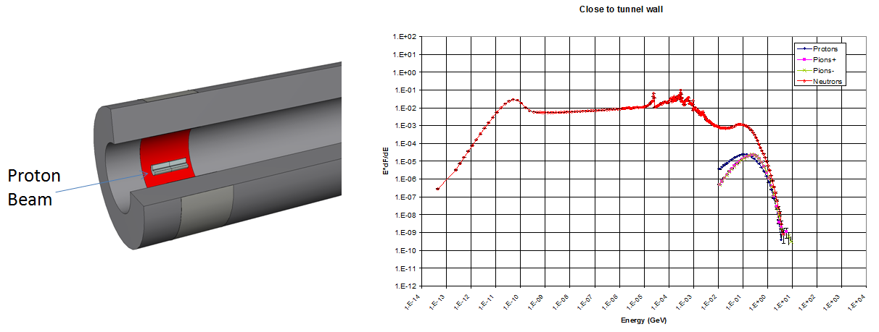



ActiWiz 3 overview
built-in radiation fields
external radiation fields
CERN accelerators & LHC experiments
Radiation environment files
User defined compound material composition
(85 different chemical elements)
Arbitrary irradiation & cool-down patterns
(high complexity with thousands of subsequent differing beam on/off patterns possible, calculation done with 512 bits floating point precision)

Slide 8

Nuclide inventory analysis
Nuclide inventory
Radiotoxicity
(EU, CH, US, A, Japan, IAEA limits)
γ emission spectra
dominating isotopes
isotope production sources
shielding
alpha/beta
analysis
temporal evolution of dominating isotopes
inverse temporal extrapolation of hazard
Green = ActiWiz 2
Blue = added in ActiWiz 3

Slide 9


Analysis & reporting – some more specific examples
which the software delivers out-of-the-box…..

Slide 10
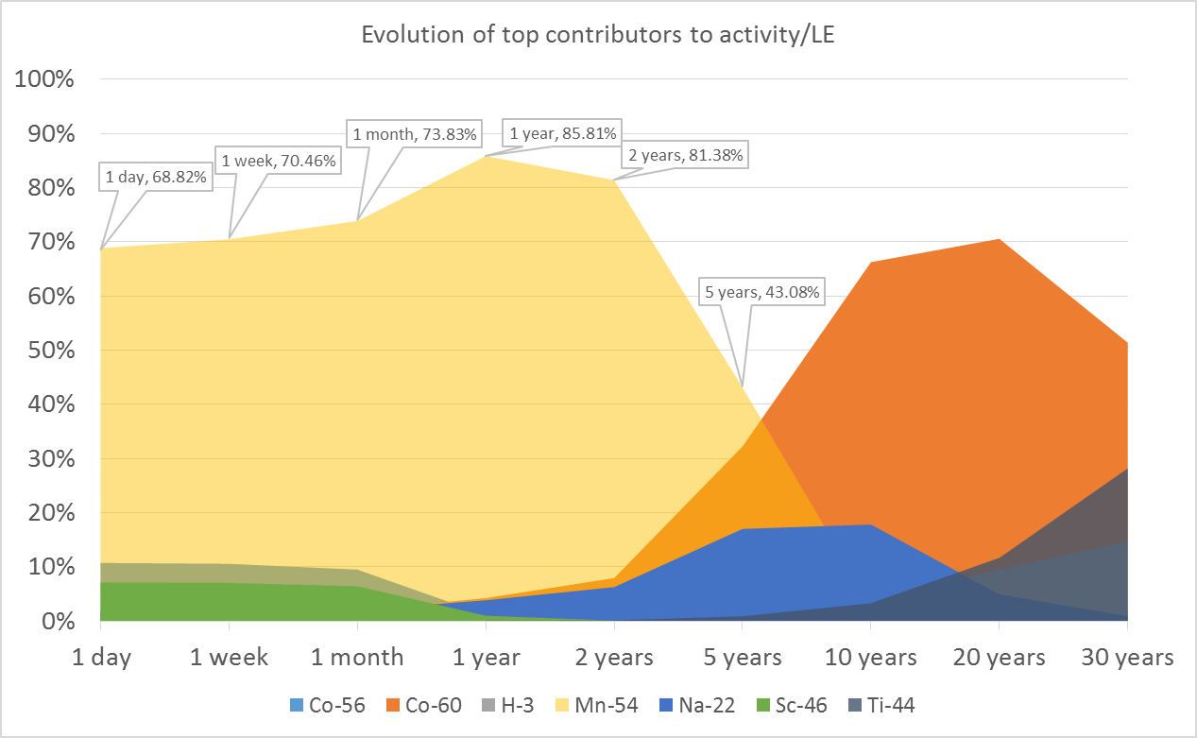
Analysis & reporting
Which isotopes are dominant at what time?
Example: radiotoxicity of
stainless steel in SPS accelerator
Allows for planning of measurements/gamma spec at the “right time”, as long as
there is still a usable gamma signal

Slide 11
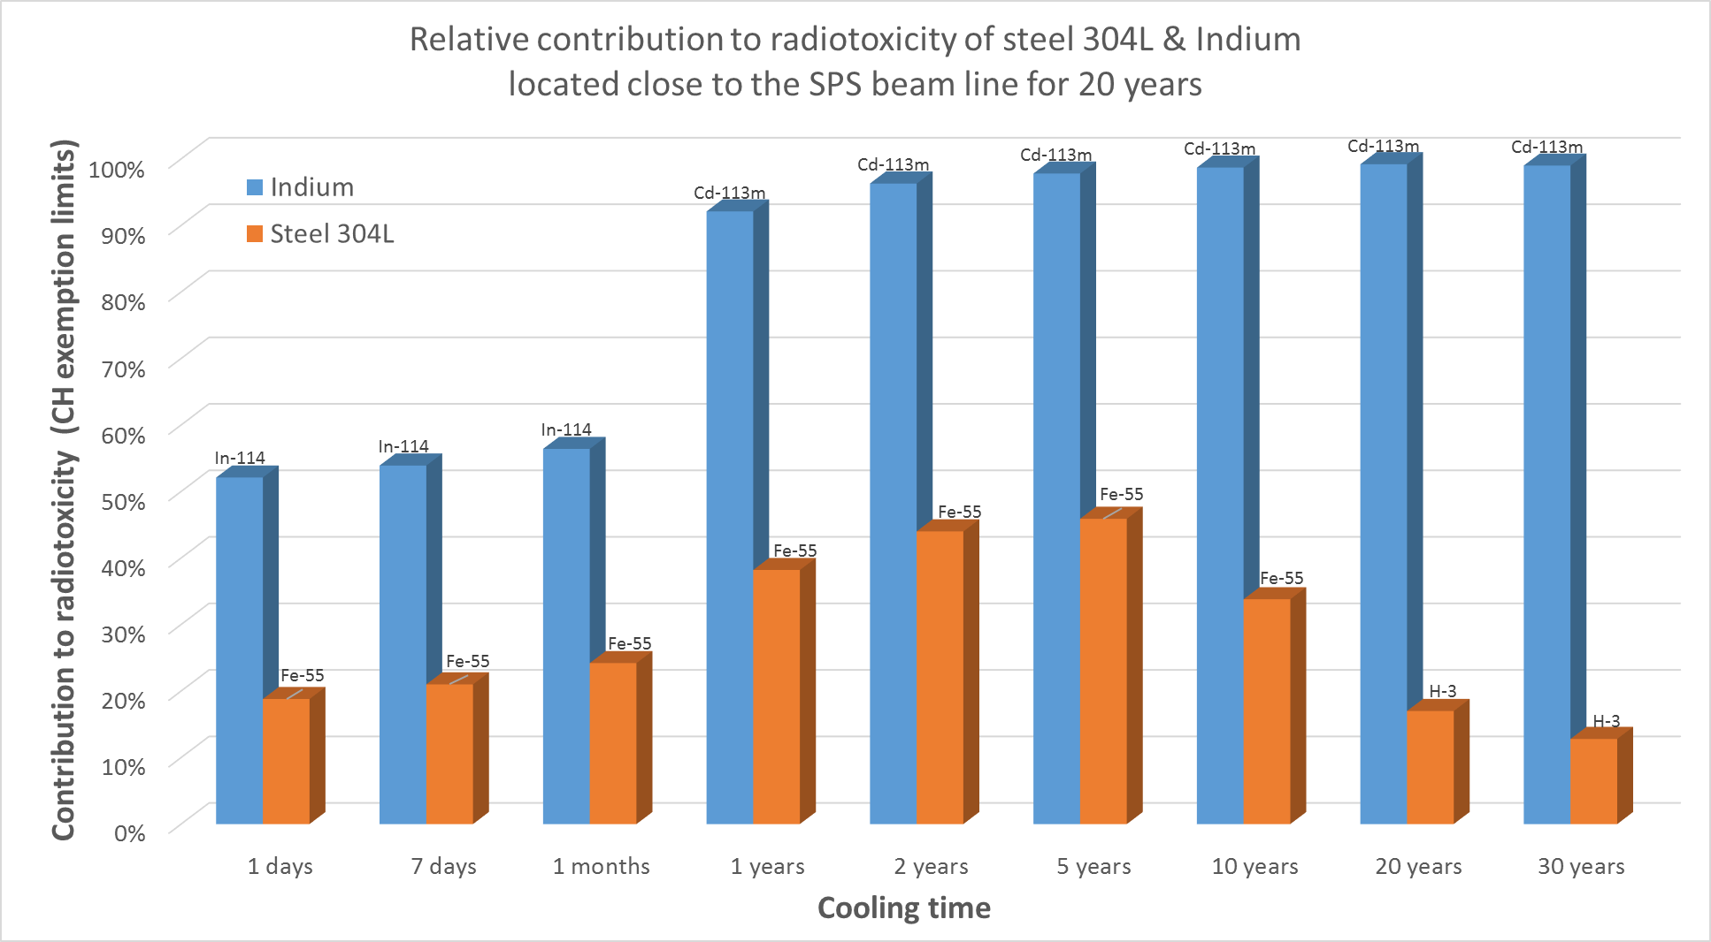
Analysis & reporting
What is the contribution of alpha/beta emitters to the total radiotoxicity?
Additional table with more details is generated as well

Slide 12
A more complex case of an exemplary
study – LEP super conducting cavities

Slide 13
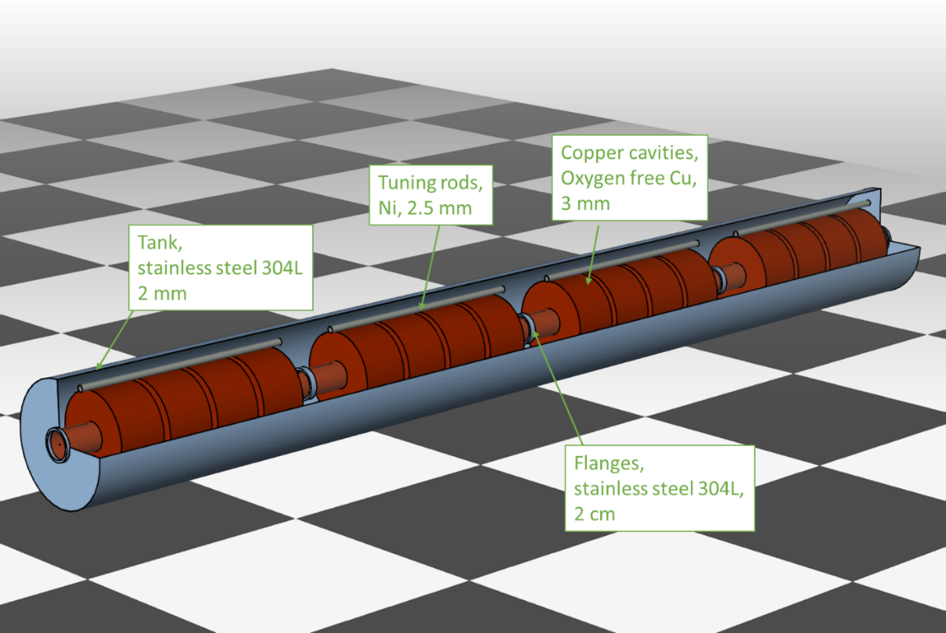
Example - super conducting cavities
C. Theis & H. Vincke, The LEP superconducting
cavities - a practical example of how to use
ActiWiz 3 for radiological characterization,
CERN-RP-2016-170-REPORTS-TN,
EDMS 1719831, (2016)
Super conducting Cu cavities with a thin Niobium coating
Does the Nb layer pose a problem w.r.t. material clearance?
Can we quantify that its radiotoxicity is negligible?

Slide 14
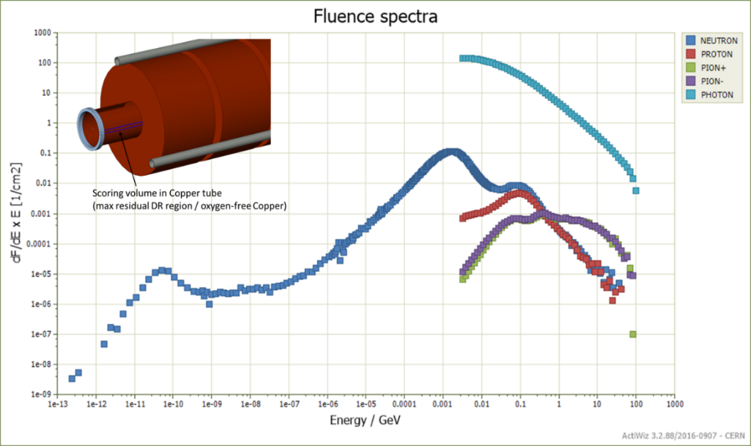
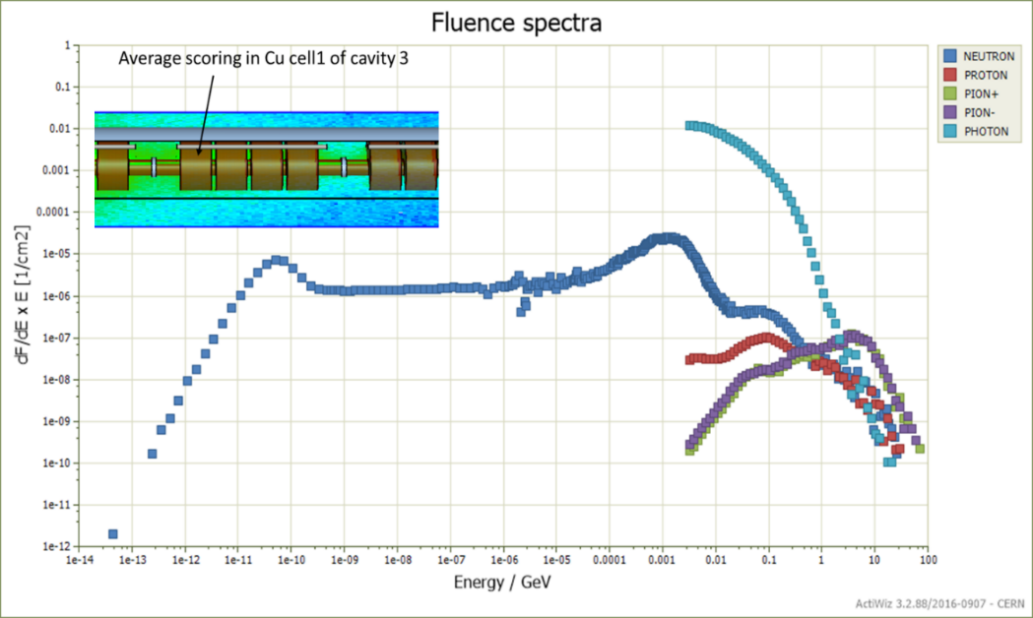
Calculation of particle fluence
1.) FLUKA: Calculation of particle fluence spectra at different positions
(direct impact of 100 GeV/c electrons & dark current calculations)
2.) ActiWiz: transformation of spectra into radiation environment data
3.) ActiWiz: definition of material + irradiation/cooling pattern
4.) ActiWiz: calculation of nuclide inventory

Slide 15
Radiotoxicity analysis
Position | Radiotoxicity ratio of Copper vs. Niobium
 | CERN design clearance limit | LE – Swiss clearance limit | LL – Swiss clearance limits 2018
Beam impact | 14 | 7 | 13
Downstream | 3 | 3 | 3
The radiotoxicity of the Copper will always overshadow the Niobium

Slide 16
Isotope – origin analysis
What are the dominating isotopes & from which element do they
originate?
Example: stainless steel used for flanges and the tank
Flange | Rel. contribution to the radiotoxicity | Source
Co-60 | 45% | COBALT : 3.96%, IRON : 0.01%, NICKEL : 96.03%
Fe-55 | 28% | COBALT : 0.01%, IRON : 98.09%, MANGANESE : 0.01%, NICKEL : 1.89%
Tank | Rel. contribution to the radiotoxicity | Source
Co-60 | 91% | COBALT : 94.55%, NICKEL : 5.45%
Fe-55 | 9% | IRON : 99.63%, NICKEL : 0.37%
Co content in steel often unknown as it is an impurity, but Ni content is well known
Clearance via dose rate measurement and scaling to simulated activity is
feasible for flanges, but not for tank unless detailed chem. composition is known

Slide 17
Summary
ActiWiz 3 is a completely new generation based on lessons learnt
from AW 2
Internal radiation fields extended by 42 locations from
LHC experiments
Arbitrary external radiation fields are supported → fluence spectra
Added new chemical elements to define compounds
(now 85 available)
Nuclear data library is based on JEFF 3.1.1 for neutrons < 20 MeV
and FLUKA (2011.2c) for neutrons > 20 MeV + all other particles
up to 100 TeV
Lots of out-of-the-box reports provided, tailored to radiological
characterization problems

Slide 18

chris.theis at cern.ch & helmut.vincke at cern.ch

Slide 19
Backup slides

Slide 20

Built-in vs. external radiation fields
Built-in radiation fields:
  available to the user via pre-defined drop down boxes
External radiation fields:
  can be loaded “on-the-fly” from radiation environment files
  these files can be created via a CERN internal tool chain and provided to
  collaborating partners for end-use
requires fluence spectra of neutrons, protons, charged pions and
(optionally) photons

Slide 21
Analysis & reporting
Various different hazards can be determined for a calculated nuclide inventory:
  radiotoxicity based on clearance limits (Swiss, IAEA, CERN-design, US, Japan, …)
  Swiss authorization limit (LA)
  ambient dose equivalent H*(10)
  effective inhalation dose
  effective ingestion dose
  French IRAS (waste criticality) level
  …
* 1.) beam intensity: 1 p/s, irradiation: 6.3072E+08 s (20 years), cooling: 1200 s (20 minutes)
*
* Selected hazard factor: Waste clearance (Swiss LE limits, StSV 4/4/2000)
************************************************************************************************************* T O P C O N T R I B U T O R S
Top contributors (> 5%) to total sum of activity/limit = 7.33E-07 +/- 0.01%:
Total activity: 1.46E-05 Bq/g +/- 0.02%
*************************************************************************************************************Ca-45 51% t1/2 = 1.40832e+07 s [Source: CALCIUM : 99.98%, TITANIUM : 0.02%, ]
Na-24 22% t1/2 = 53845.2 s [Source: ALUMINUM : 1.25%, MAGNESIUM : 1.50%, SODIUM : 96.01%,…]
Na-22 6% t1/2 = 8.21427e+07 s [Source: ALUMINUM : 7.45%, MAGNESIUM : 20.71%, SILICON : 55.74%,…]

Slide 22

Analysis & reporting
J
Which chemical constituents are critical?

Slide 23
Analysis & reporting
component criticality analysis:
“which chemical element contributes in which proportion to LE, LA, H*(10), etc.”
***********************************************************************************************************
C O M P O N E N T C R I T I C A L I T Y A N A L Y S I S
***********************************************************************************************************
Compound: "inconel-0.25-Co", density 8.19 g/cm3
The following table shows how much each component of the compound material contributes
to the selected hazard quantity: H*(10) level
COBALT : 95.11% (weight fraction: 0.25%)
NICKEL : 3.45% (weight fraction: 53%)
TANTALUM : 0.59% (weight fraction: 0.01%)
IRON : 0.42% (weight fraction: 18.4%)
NIOBIUM : 0.21% (weight fraction: 5.2%)
CHROMIUM : 0.15% (weight fraction: 18.3%)

Slide 24
Analysis & reporting
J
What is the contribution of alpha/beta emitters to the total radiotoxicity?

Slide 25
Analysis & reporting
Example: ARMCO iron used for yokes (20 y irradiation @ SPS, 20 y of cool-down)
**************************************************************************************************************
(Q U A S I) - P U R E A L P H A & B E T A E M I T T E R S
**************************************************************************************************************
Selected hazard factor: IAEA clearance limits - Safety Standards RS-G-1.7 (2004)
Id rel. contribution to hazard t1/2 [s] decay info
--------------------------------------------------------------------------------------------------------------
H-3 67.5% 3.89097e+08 [ 100% beta-, ]
C-14 2.3% 1.79874e+11 [ 100% beta-, ]
Cl-36 0.251% 9.49863e+12 [ 1.9% beta+, 98.1% beta-, ]
Mn-53 0.00868% 1.16129e+14 [ 100% beta+, ]
Fe-55 3.63% 8.63082e+07 [ 100% beta+, ]
...
--------------------------------------------------------------------------------------------------------------
Total contribution to hazard = 73.7%, which equals = 1.198378E-06 Bq/unit (93.5% of total activity)
--------------------------------------------------------------------------------------------------------------
The following chemical elements contributed to the hazard with 73.7% via (quasi) pure alpha/beta emitters:
CARBON - 0.0117% (weight fraction: 0.0025%)
IRON - 73.5% (weight fraction: 99.7%)
MANGANESE - 0.202% (weight fraction: 0.235%)
PHOSPHORUS - 0.0139% (weight fraction: 0.0115%)
SILICON - 0.00366% (weight fraction: 0.0035%)
SULFUR - 0.0078% (weight fraction: 0.00901%)

Slide 26
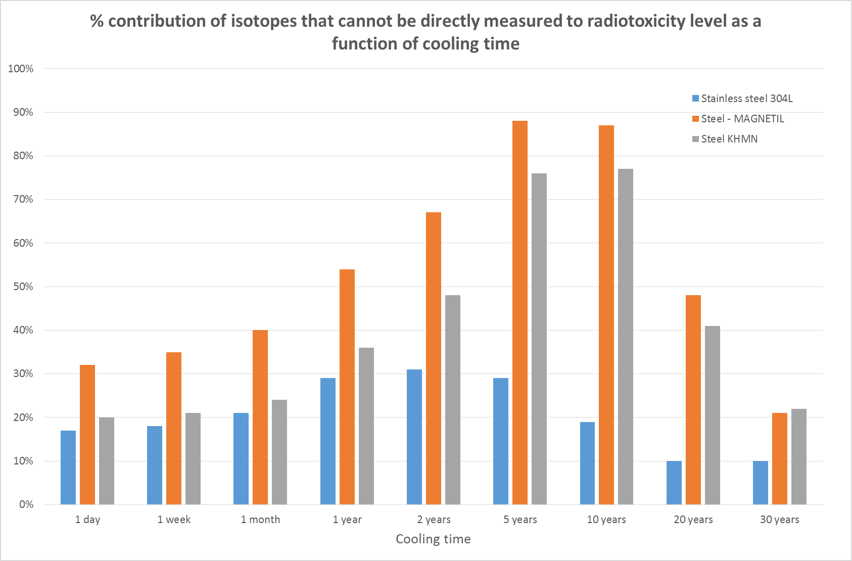
Analysis & reporting

Slide 27
Analysis & reporting
J
How long do I have to wait for the residual dose rate to drop by X?

Slide 28
Nuclide inventory extrapolation
Typical questions:
“how long do I have to wait to reduce the H*(10) by a factor of X?”
“how much longer would I have to wait if I used the new LL values for clearance instead of the current LE clearance values”?
…
Trivial for single isotopes but full inventories are considerably more complicated
→ requires to solve the following equation for the time t efficiently(!):
$$\left( \sum_{i=1}^{M}{\sum_{i\underset{→}{yields}l}{\frac{λ_{l}N_{i}^{0}}{{LL}_{l}}\prod_{j=1}^{l−1}{λ_{j,j+1}}\sum_{k=1}^{l}{\frac{e^{−λ_{k}t}}{\prod_{\begin{aligned}p=1 \\ p≠k\end{aligned}}^{l}{(λ_{p}−λ_{k})}}}}}\right)−\sum_{i=1}^{M}{\frac{λ_{i}N_{i}^{0}}{{LE}_{i}}}=0 with nuclide concentration N\left(t=0\right)=N0$$
ActiWiz 3 will provide this capability including full consideration of the temporal
evolution of the nuclide inventory

Slide 29
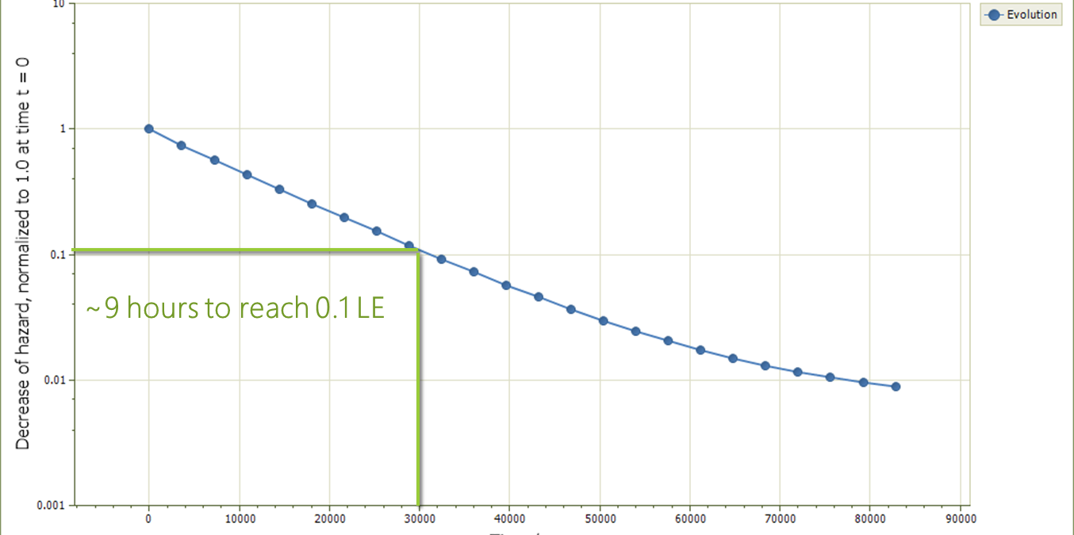
Analysis & reporting
For example: Stainless steel (304L) support irradiated in the PS. How long do I have to wait
to reduce my dose rate by a factor of 10?
Selected hazard: H*(10) level
Current hazard: 5.99E-014, requested decrease: 0.1
Decreased hazard: 5.74E-015
after: 30878 s +/- 4.245% (= 8 hours, 2077 seconds)
Calculation time: 1.688 s

Slide 30
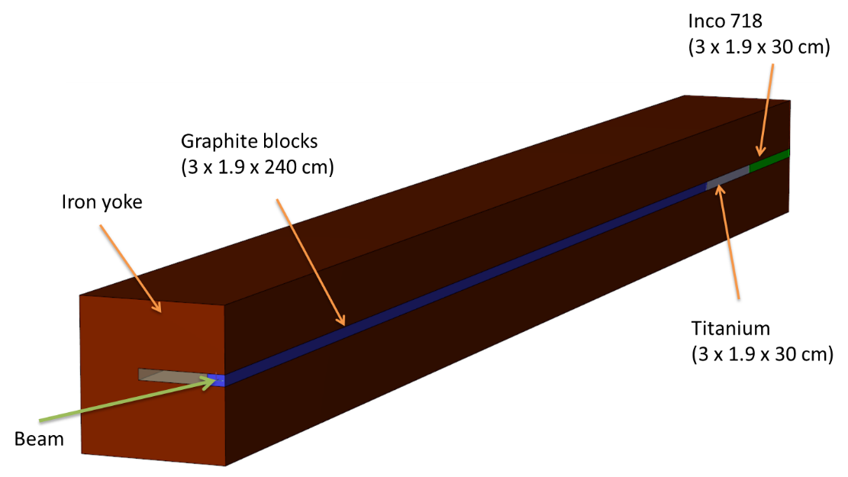
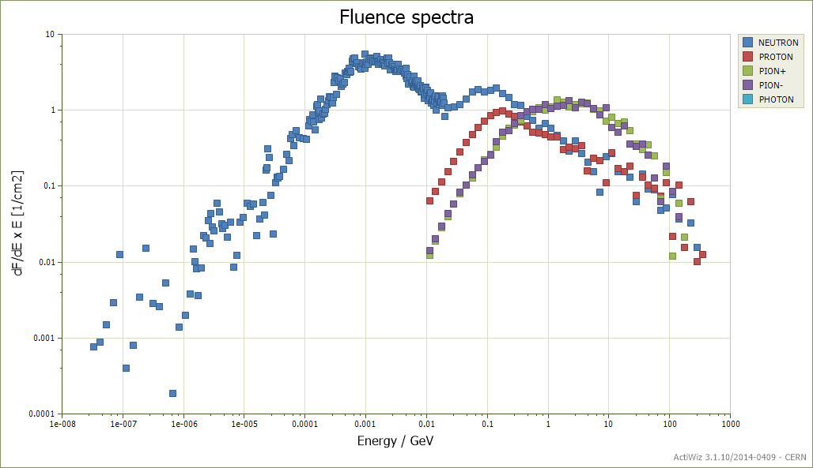
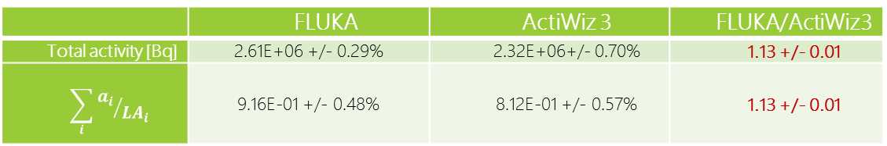
Comparison with FLUKA
Beam protection device TPSG
Track-length spectra in Inco 718
 | FLUKA | ActiWiz 3 | FLUKA/ActiWiz3
Total activity [Bq] | 2.61E+06 +/- 0.29% | 2.32E+06+/- 0.70% | 1.13 +/- 0.01
$$\sum_{i}{{a_{i}}/{{LA}_{i}}}$$ | 9.16E-01 +/- 0.48% | 8.12E-01 +/- 0.57% | 1.13 +/- 0.01
Comparison per isotope: max. 35% difference for those isotopes which make up 95% of the LA

Slide 31
Brief feature summary
Supports 85 different chemical elements as compound constituents
High energy reactions based on FLUKA, low energy neutron reactions based on
JEFF 3.1.1
Creation of metastable states by low E neutrons based on evaluated data (JEFF)
Decay engine limits numerical problems due to 170 digits accuracy (512 bits)

Slide 32
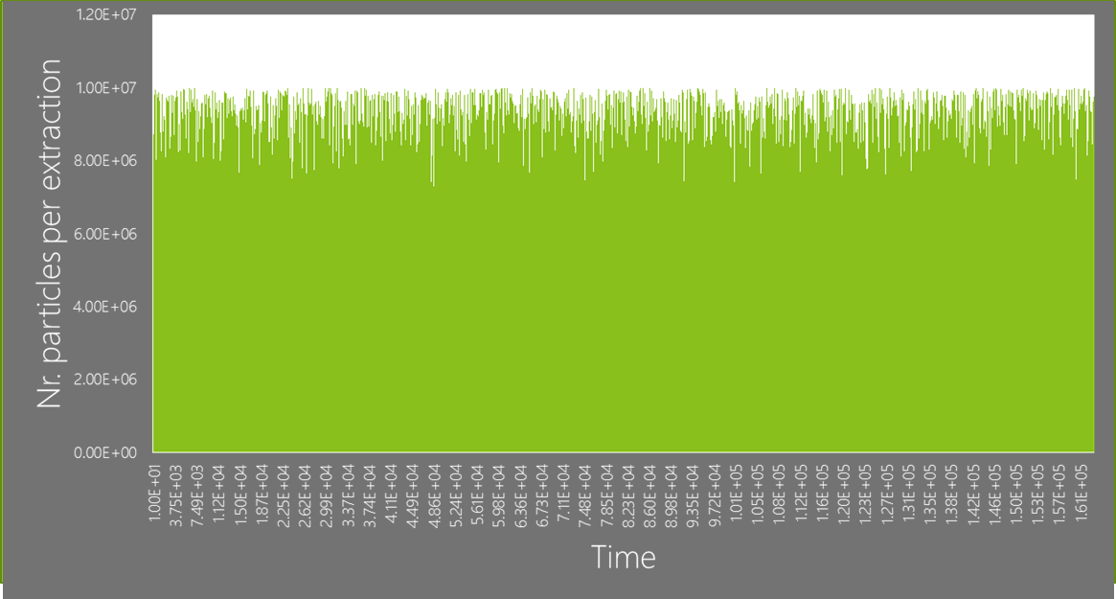
Brief feature summary
Multi-layer caching system for performance optimization of build-up & decay calculation
- calculation of the nuclide inventory of stainless steel for 55600 consecutive, different beam extractions (SPS case) in ~1.5 minutes with a precision of 170 significant digits
- 1 full year of SPS operation (>612.000 consecutive extractions) in ~15 minutes
Now supports also loading of external radiation fields via rad. environment files

Slide 33

Build-up & decay engine
fully analytical solution without approximations, including also treatment of buildup
allows for pairing irradiation & cooldown calculation in one step + modelling of complex irradiation/cooling patterns
normalized partial solutions can be stored and reused in a 2-level cache → considerable speed-up in ActiWiz 3
numerical issues treated by arbitrary precision arithmetics implemented with 512 bits significand ~ 170 digits

Slide 34
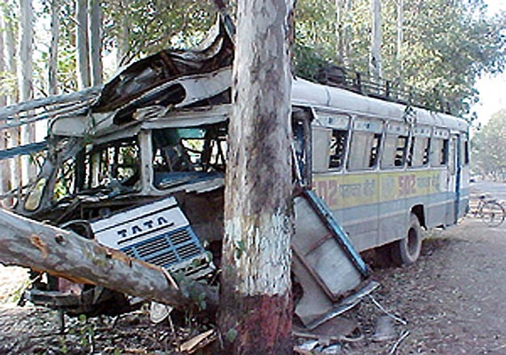
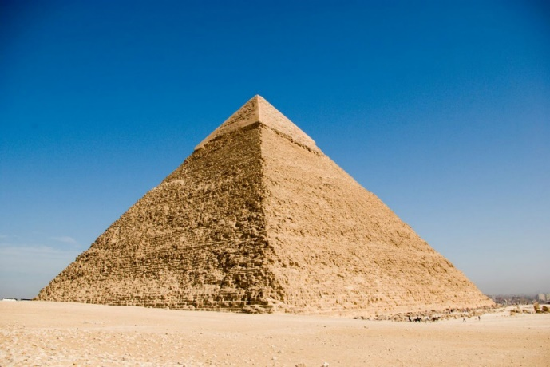
Quality assurance
Validation of simulation codes is crucial to avoid
“wrecking the car”
Thorough QA requires a multi-layer approach within
which several levels of discrepancy are acceptable

Slide 35
Quality assurance
Accepted discrepancy
(if origin is understood!)
Unit
tests
Algorithm
x-checks
Physics results
x-checks
none
Concealed bugs in the algorithms are too willingly blamed
on different physics models (especially if the discrepancy is
not fully understood)
1‰
can be > 10%

Slide 36

Quality assurance
Following “agile methodology” with “extreme programming model”
Full core functionality has been implemented independently using different
approaches and algorithms
 | ActiWiz 3 Creator | ActiWiz 3 Core – F2003 used for x-checks
Programming language | C++11 (Microsoft) | FORTRAN 2003 (Intel)
Platform | Windows - 32 bit/64 bit | Windows – 32 bit
Floating point architecture | Arbitrary precision arithmetic 512 bits accuracy | Proprietary hybrid routines using double precision (64 bits) and 256 bits
Execution mode | parallel algorithms | sequential algorithms
Results of 1160250 test cases agree within a accuracy level better than 0.1 %
The origin of the small discrepancies is well understood.

