Slide 2
Radiological characterization of very-low-level radioactive waste at CERN
M. Magistris, R. Froeschl, F. La Torre, C. Theis, L. Ulrici, N. Walter, B. Zaffora

Slide 3
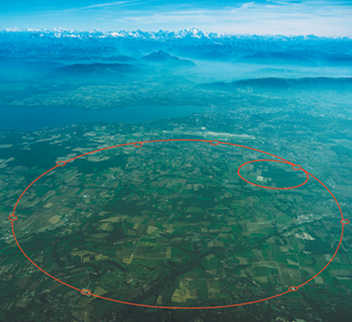
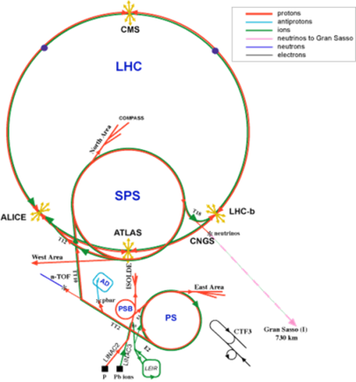

Introduction
The CERN accelerator complex
Founded in 1954, the CERN laboratory sits astride the Franco-Swiss border near Geneva.
The accelerator complex is a succession of machines that accelerate particles to increasingly higher energies. In the LHC – the last element in this chain – particle beams are accelerated up to 6.5 TeV per beam.

Slide 4
Introduction
Radioactive waste at CERN
In high-energy particle accelerators, beam particles can interact with gas molecules and accelerator components, and lead to material activation.
The radiological characterization of radioactive waste is a requirement for its disposal in the national final repositories.
This presentation will focus on the characterization of very-low-level waste (VLLW), including loose metallic waste (steel, copper and aluminium), cables and magnets., which represent >80% of stored radioactive waste at CERN.
All calculations were performed with the analytical code ActiWiz (see presentation by Chris Theis in this conference)

Slide 5
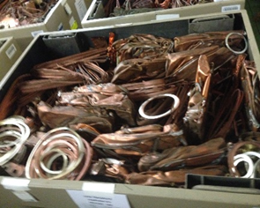
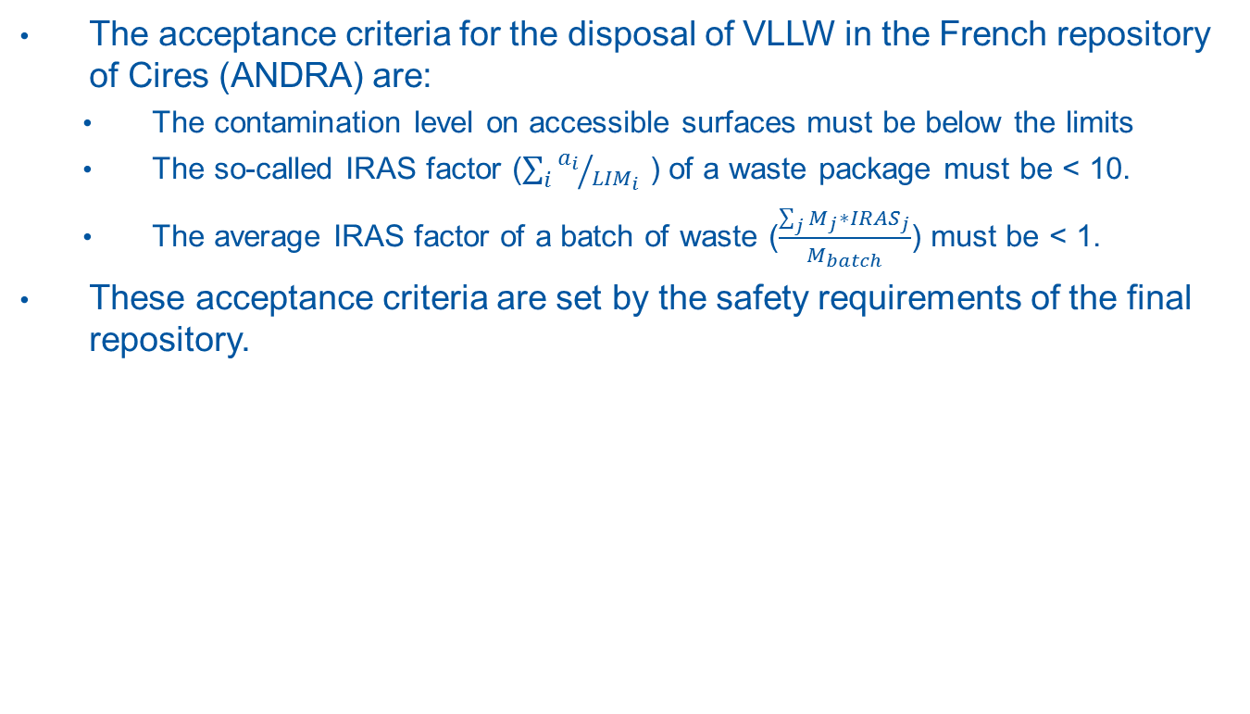
Radiological characterization
Acceptance criteria for VLLW (very-low-level waste)
The acceptance criteria for the disposal of VLLW in the French repository of Cires (ANDRA) are:
  The contamination level on accessible surfaces must be below the limits
  The so-called IRAS factor ($\sum_{i}{{a_{i}}/{{LIM}_{i}}}$ ) of a waste package must be < 10.
  The average IRAS factor of a batch of waste ($\frac{\sum_{j}{M_{j}∗{IRAS}_{j}}}{M_{batch}}$) must be < 1.
These acceptance criteria are set by the safety requirements of the final repository.
Example of waste package with pieces of copper

Slide 6
Radiological characterization
General methodology at CERN
In the general case, the characterization of waste at CERN is performed as follows:
Define a batch of homogeneous waste, e.g. 100 tons of cables
Use ActiWiz to identify the radionuclide inventory, i.e. radionuclides which can have an activity above the declaration limit defined by ANDRA
Evaluate the specific activity depending on the nuclide:
  Easy-to-measure nuclides: in-situ gamma spectrometry or dose-rate measurements on the waste packages
  Difficult-to-measure nuclides:
    Sampling followed by gamma-spectrometry and radiochemical analysis
    Use of experimental scaling factors (activity ratios) or mean activity
  Impossible-to-measure nuclides:
    Use of analytical scaling factors
Calculate the IRAS factor for each waste package

Slide 7
Radiological characterization
Examples of waste families
  Loose metallic waste
  Cables
  Magnets

Slide 8
Loose metallic waste
General description
In 2016, over 1’000 m³ of metallic waste that had been activated over the last 40 years, were temporarily stored at CERN and required radiological characterization
This waste is a mixture of aluminium, steel and copper pieces with different geometry and radiological history
Prior to disposal in the national repository, the metallic waste is sorted per type of material, treated for volume reduction and packaged in 1.3 m³ or 2.7 m³ waste packages
Waste package (1.3 m³) with pieces of stainless steel

Slide 9
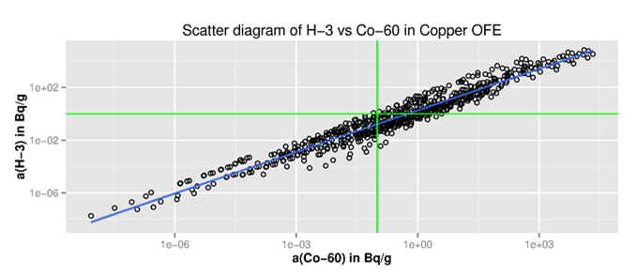
Loose metallic waste
Radionuclide inventory and scaling factors
We studied with ActiWiz > 10’000 activation scenarios for a set of possible material compositions, in order to identify the radionuclide inventory and the expected scaling factors.
The dominant radionuclides are H-3, Co-60, Na-22, Ti-44 and Fe-55.
The calculations suggest that the activity of different radionuclides can be correlated.
The activity ratios can vary by a factor of 100 depending on the activation scenarios. The analytical scaling factor (SF) is the geometric average of these possible activity ratios.
Example: activity ratios calculated with ActiWiz over 1’100 different scenarios for 1 W beam losses

Slide 10
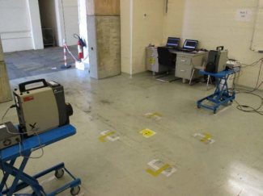
Loose metallic waste
Characterization procedure
Identify a batch of ~100 tons of waste
Collect samples per type of material (non-probabilistic sampling)
Measure samples by gamma-spectrometry (key nuclides: Na-22, Ti-44 and Co-60) and radiochemical analysis (difficult-to-measure nuclides: H-3, Fe-55 and Ni-63)
Estimate experimental scaling factors (e.g., activity of H-3 vs Co-60) or mean activity values
Treat and package waste into 1.3 m³ containers
Perform in-situ gamma spectrometry on the waste packages
The activity is evaluated as follows:
Easy-to-measure nuclides: in-situ gamma spectrometry
Difficult-to-measure nuclides: experimental scaling factors or mean activity values
Impossible-to-measure nuclides: analytical scaling factors
Station for in-situ gamma spectrometry

Slide 11
Cables
General description
There are about 300 different types of cables, which were classified into 5 families (coaxial, signal and power cables, with Al or Cu wires)
In 2016, over 1’000 m³ of radioactive cables were temporarily stored at CERN and required radiological characterization
These cables can contain PVC (with possible presence of Cl-36) and traces of lead
The five different families of cables
Temporary storage of radioactive cables

Slide 12
Cables
Radionuclide inventory and scaling factors
The radionuclide inventory was defined by studying > 1’000 possible activation scenarios with ActiWiz, including:
  The materials phtalate, PVC, Al, Cu and steel
  Irradiation position: close to the tunnel wall of behind concrete shielding
  Proton bean with energy from 1.4 GeV to 7 TeV
  Irradiation time from 10 to 40 years
  Waiting time from 6 months to 40 years
The analytical scaling factors were calculated as geometric average over the scenarios of interest
The dominant radionuclides are H-3, Na-22, Cl-36 and Co-60
Geometric average of possible specific activities, given the activity aw of one scenario with beam energy Es

Slide 13
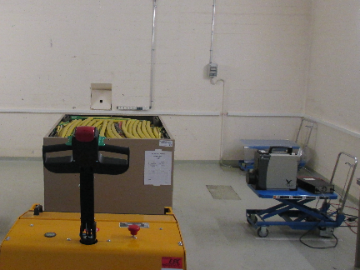
Cables
Characterization procedure
Identify a batch of ~100 tons of cables
Collect compound samples per family of cables (non-probabilistic sampling)
Measure samples by gamma-spectrometry (key nuclides: Na-22 and Co-60) and radiochemical analysis (difficult-to-measure nuclides: H-3, Cl-36 and Ni-63)
Estimate experimental scaling factors (e.g., activity of Cl-36 vs Co-60) or mean activity values
Treat and package waste into 1.3 m³ containers
Perform in-situ gamma spectrometry on the waste packages
Measurement of a waste package with in-situ gamma spectrometry

Slide 14
Magnets
General description
In 2017 there are > 500 magnets which are currently stored at CERN and require radiological characterization
These magnets are made of copper coils, an iron yoke and a supporting steel structure
The mass can vary from 1 to 30 tons, and the length can reach 6 metres
The characterization is challenging because of the presence of a mixture metals, and because of constraints on handling, in-situ gamma spectrometry and destructive analyses.
Example of magnets which are temporarily stored at CERN

Slide 15
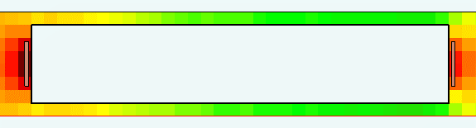

Magnets
Radionuclide inventory and transfer function
The radionuclide inventory was defined by studying > 300 possible activation scenarios with ActiWiz, including:
  The materials copper (for the magnet coil), iron (magnet yoke) and steel (supporting structure)
  Different irradiation and waiting times (from 3 to 40 years)
  Proton beam losses with energy 1.4 GeV to 7 TeV
The activity of the dominant gamma emitters (Ti-44, Mn-54 and Co-60) is evaluated from dose-rate measurements with a conversion function
Map of expected dose-rate (uSv/h) in contact with a magnet coil, as simulated with the Monte Carlo code Fluka. Top cross-sectional view of the coil.

Slide 16
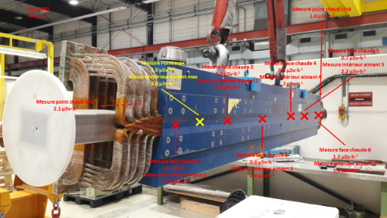
Magnets
Characterization procedure
The dose-rate is measured in contact with well-defined points of the magnet, and an average dose-rate is calculated
The specific activity of each radionuclide is evaluated via a global transfer function
 | Global conversion factors (Bq/g)/(µSv/h)
Waiting time | 3 to 10 years | 10-20 years | 20-40 years
H-3 | 21.6 | 33.3 | 32.7
C-14 | 0.003 | 0.01 | 0.02
Na-22 | 0.08 | 0.02 | 0.001
Cl-36 | 4.50E-04 | 0.001 | 0.003
Ar-39 | 0.5 | 1.2 | 2.7
Ca-41 | 0.001 | 0.002 | 0.004
Ti-44 | 0.4 | 0.9 | 1.8
Mn-54 | 0.6 | 0.002 | n.a.
Fe-55 | 48.6 | 14.1 | 0.7
Co-60 | 1.3 | 1 | 0.3
Ni-63 | 1.3 | 3.1 | 6.3
Ag-108m | 0.003 | 8.20E-03 | 0.02
Dose-rate cartography of a magnet to be characterized

Slide 17
Conclusions 1/2
The methods developed at CERN were used to characterize over
1’000 m³ of loose metallic waste and 600 m³ of cables, which have been disposed of as Very-low-level waste in France
The method for the characterization of magnets was successfully tested on a few representative cases. It will be used systematically as from 2018.
 | Dose rate | Ti-44 (Bq/g) |  | Co-60 (Bq/g)
 | (µSv/h) | Exp. | Pred. | Exp. | Pred.
Point 1 | 0.20 | 0.11 | 0.19 | 0.12 | 0.21
Point 2 | 0.19 | 0.18 | 0.18 | 0.19 | 0.20
Point 3 | 0.17 | 0.05 | 0.16 | 0.08 | 0.18
Point 4 | 0.22 | 0.09 | 0.21 | 0.23 | 0.23
Mean | 0.20 | 0.11 | 0.19 | 0.15 | 0.20
Characterization of a test magnet. Comparison of predicted values of activity with results from in-situ gamma spectrometry.

Slide 18
Conclusions 2/2
It is important to involve the national Authorities at an early stage in the conception of a new characterization methodology
Quality assurance is fundamental for radiological characterization and should include detailed work instructions and regular quality controls
Traceability of waste items, packages and data is a key element in waste characterization

