Slide 1

Activation assessment of the soil around the ESS accelerator tunnel
Igor Rakhno¹, Nikolai Mokhov¹, Igor Tropin¹
Daniela Ene²
¹Fermi National Accelerator Laboratory, Batavia, Illinois, USA
² European Spallation Source, Lund, Sweden
4th Int. Workshop on Accelerator Radiation Induced Activation
May 22-24, 2017

Slide 2
Outline
Introduction
MARS15 with DeTra option
Geometry model of the ESS facility
Input data: Soil composition and model of operational beam loss
Results of calculations
Measured and calculated induced activity: examples of verification
Conclusions

Slide 3
Introduction
The ESS accelerator is planned to be operating for 40 years at an average beam power of 5 MW.
A detailed analysis is needed to predict residual activity of the soil and water outside the accelerator tunnel.
This study focuses on distributions of activity of radionuclides produced in the soil around the ESS accelerator tunnel wall for 1 and 40 years of normal operation for a given operational scenario.
Only the contribution from the beam losses in the linac is considered here.
The distributions of radionuclides are provided in 30 spatial bins – 3 longitudinal x 10 transverse – for further migration analysis by a dedicated expert group.
Total residual activity of the accelerator tunnel itself is calculated as well.
Description of computer codes used and examples of measurement vs calculation verifications are presented as well.

Slide 4
MARS15 code with DeTra option (1)
MARS15 is a general purpose Monte Carlo code for modeling particle and nuclei interactions with matter and transport in magnetic field in realistic accelerator 3D structures.
The energy span covers many decades: from a multi-TeV region down to the thermal region for neutrons and to 1 keV for other particles.
MARS15 has a 40+ years history and for the last ~25 years is developed and maintained at Fermilab. Numerous users worldwide.
DeTra module is implemented as a part of MARS15, it is invoked separately after MARS itself generated nuclide production rates.
DeTra has a ~20 years history and was developed by P. Aarnio (Helsinki University/CERN) for the LHC/CMS. Decay and Transmutation. Library NUDAT 2.6.

Slide 5
MARS15 code with DeTra option (2)
For the ESS applications, T_{p} ≤ 2 GeV, the following data libraries/collision models are used:
  TENDL-2015 library below 100 MeV (adjustable) for protons, light ions and gammas
  Mix-and match around 100 MeV between TENDL and CEM
  Exclusive modeling with CEM for energies between 100 and 300 MeV
  Mix-and-match between CEM and LAQGSM between 300 and 500 MeV
  Exclusive modeling with LAQGSM above 500 MeV
Neutron interactions below 14 MeV are modeled using ENDF/B libraries.

Slide 6
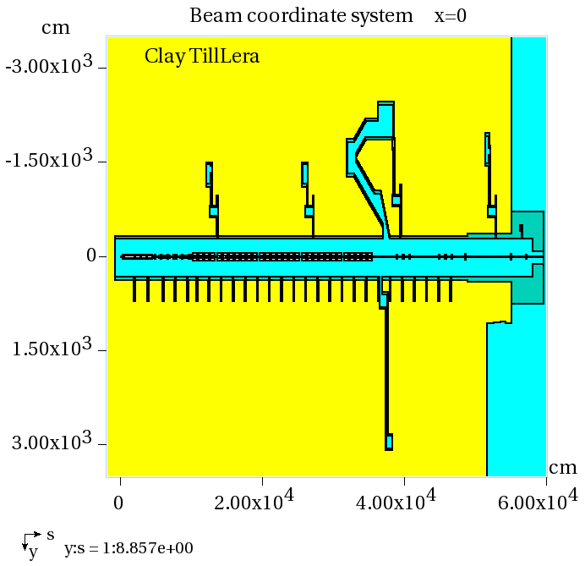
Geometry Model of the ESS facility (1)
MARS15 computational model was developed in 2015 and updated thereafter in 2016 during a collaboration with ESS.
Plan view
Plan view

Slide 7
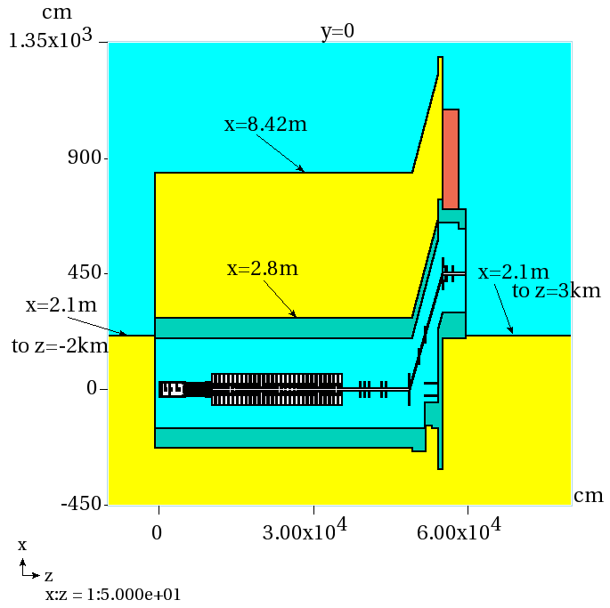
Geometry Model of the ESS facility (2)
Realistic heterogeneous 3D structures, both accelerator components and tunnel. The soil berm above the accelerator tunnel has a noticeable slope.
Elevation view

Slide 8
Soil composition and model of operational beam loss (1)
A 50%-50% composition corresponding to deep and shallow soil samples taken at ESS site was used in our calculations.
The well-known “1 W/m” average homogeneous beam loss rate, applicable for high energy accelerators, was considered as a design criterion and an upper limit during normal operations.
This value of 1 W/m was derived from the hands-on maintenance conditions and was adopted at ESS.

Slide 9
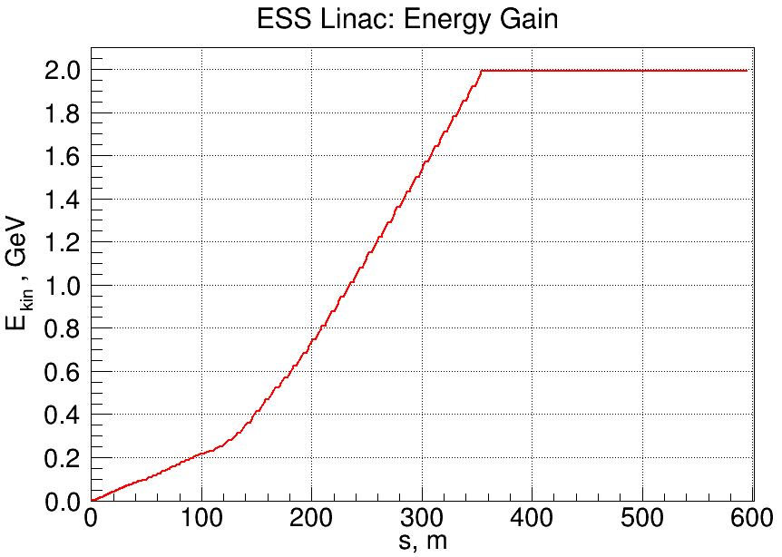
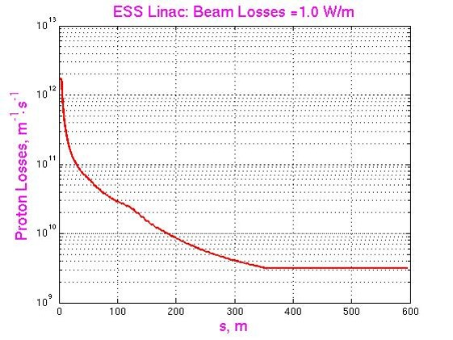
Soil composition and model of operational beam loss (2)

Slide 10
Results of calculations (1)
The radionuclide production is scored in transverse bins in the soil immediately outside the concrete tunnel structures.
The first five bins are 20-cm thick each, while the bins 6 thru 10 are 100-cm thick each.
In addition, the linac length was divided into three regions:
  The low-beta region, 0 ≤ Z < 176 m (T_{p} ≤ 571 MeV)
  The region 176 ≤ Z < 490.56 m (571 MeV < T_{p} ≤ 1991 MeV)
  “Dog-leg” region, 490.56 ≤ Z < 580.5 m (T_{p} = 1991 MeV)
The various colors shown in the bins on next Figures are used for technical reasons to specify volumes for scoring radionuclide production.

Slide 11
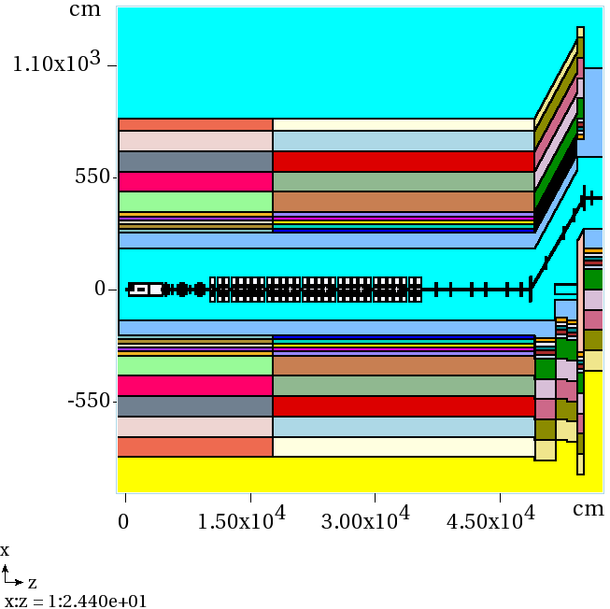
Results of calculations (2)

Slide 12
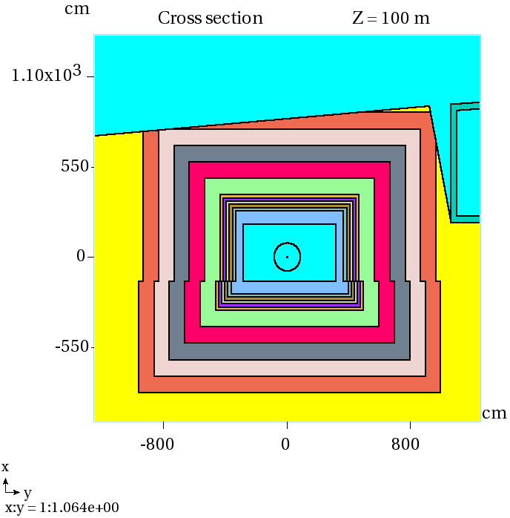
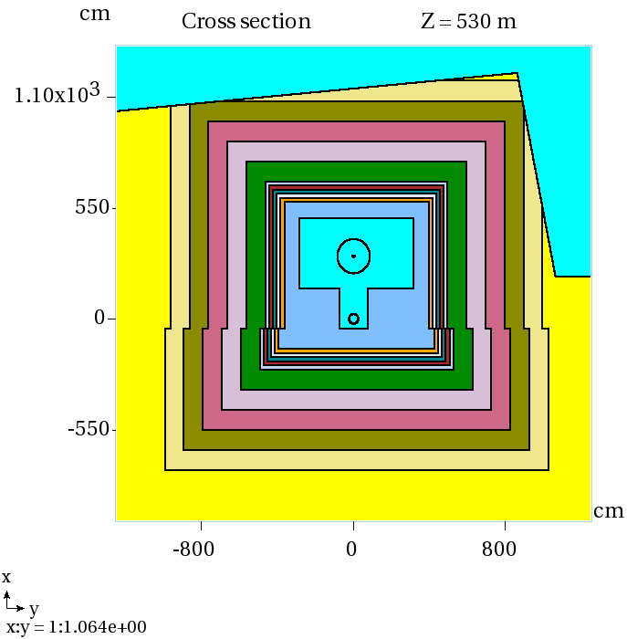
Results of calculations (3)

Slide 13
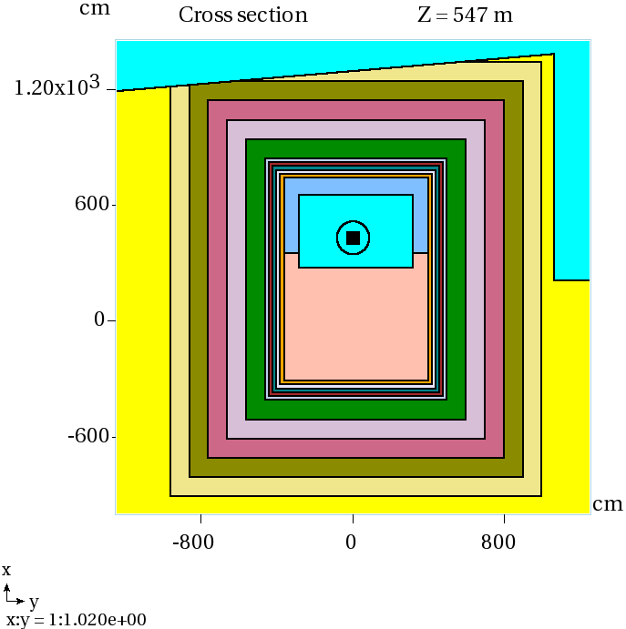
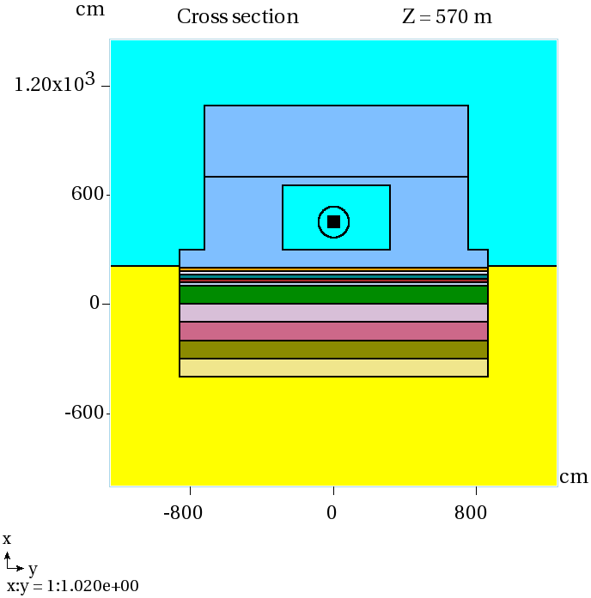
Results of calculations (4)

Slide 14
Results of calculations (5)
The list of eleven most important radionuclides for groundwater activation was compiled using studies by Thomas and Stevenson: ³H, ⁷Be, ²²Na, ²⁴Na, ³²P, ³⁵S, ⁴⁵Ca, ⁴⁶Sc, ⁵⁴Mn, ⁵⁵Fe, ⁶⁵Zn.
⁶⁵Zn represents produced nuclides with the lowest activity, and corresponding calculated statistical uncertainty, 1σ, is approximately 8%. For the remaining produced nuclides on the list, the values of 1σ are in between 1 and 8%.

Slide 15
Results of calculations (6)
Longitudinal distribution of total activity (Bq) of radionuclides produced in the 6-m thick soil layer around the ESS tunnel wall immediately after 1 year of operation (no decay)
Produced Nuclide | 0<Z<176m 176m<Z<490.56m 490.56m<Z<580.5m Total
³H | 5.147E+7 1.097E+9 1.367E+8 1.285E+9
⁷Be | 2.065E+8 6.340E+9 7.936E+8 7.340E+9
²²Na | 3.957E+7 8.740E+8 1.083E+8 1.022E+9
²⁴Na | 4.395E+9 4.105E+10 4.633E+9 5.008E+10
³²P | 1.041E+8 1.345E+9 1.591E+8 1.608E+9
³⁵S | 2.357E+7 4.215E+8 5.252E+7 4.976E+8
⁴⁵Ca | 1.325E+6 2.934E+7 3.297E+6 3.396E+7
⁴⁶Sc | 8.464E+7 7.575E+8 8.544E+7 9.276E+8
⁵⁴Mn | 4.269E+7 7.631E+8 9.397E+7 8.998E+8
⁵⁵Fe | 3.242E+7 5.521E+8 6.853E+7 6.531E+8
⁶⁵Zn | 0 1.069E+6 1.401E+5 1.209E+6

Slide 16
Results of calculations (7)
Activity of radionuclides (Bq) produced in the layers of soil ‒ 1-m thick and 6-m thick ‒ around the ESS tunnel wall immediately after 1 year and 40 years of operation (no decay) (in other words – at shut-down)
Produced Nuclide | Period of operation (year) 1 40 Layer thickness (m) Layer thickness (m) 1 6 1 6
³H | 1.157E+9 1.285E+9 1.892E+10 2.101E+10
⁷Be | 6.631E+9 7.340E+9 6.688E+9 7.404E+9
²²Na | 9.188E+8 1.022E+9 3.930E+9 4.371E+9
²⁴Na | 4.635E+10 5.008E+10 4.635E+10 5.008E+10
³²P | 1.469E+9 1.608E+9 1.470E+9 1.609E+9
³⁵S | 4.482E+8 4.976E+8 4.746E+8 5.268E+8
⁴⁵Ca | 3.053E+7 3.396E+7 3.870E+7 4.305E+7
⁴⁶Sc | 8.595E+8 9.276E+8 9.036E+8 9.752E+8
⁵⁴Mn | 8.088E+8 8.998E+8 1.457E+9 1.620E+9
⁵⁵Fe | 5.883E+8 6.531E+8 2.630E+9 2.919E+9
⁶⁵Zn | 1.093E+6 1.209E+6 1.693E+6 1.873E+6

Slide 17

Results of calculations (8)
Activity (Bq) of top ten radionuclides in all the soil bins after 40 years of operation given at shut down (left) and after 30 years of cooling (right)
Produced Activity Radionuclide | Produced Activity Radionuclide
¹⁵O 1.076E+11 | ³H 3.994E+9
²⁸Al 1.035E+11 | ³⁹Ar 4.722E+7
²⁴Na 5.140E+10 | ¹⁴C 4.159E+7
³H 2.157E+10 | ⁴¹Ca 1.907E+7
²⁷Si 1.356E+10 | ⁶⁰Co 1.102E+7
¹³N 1.213E+10 | ⁴⁴Sc 4.059E+6
⁵⁶Mn 1.120E+10 | ⁴⁴Ti 4.059E+6
¹⁴O 8.259E+9 | ²²Na 1.525E+6
⁷Be 7.599E+9 | ⁵⁵Fe 1.511E+6
¹¹C 7.168E+9 | ¹³³Ba 1.425E+6

Slide 18
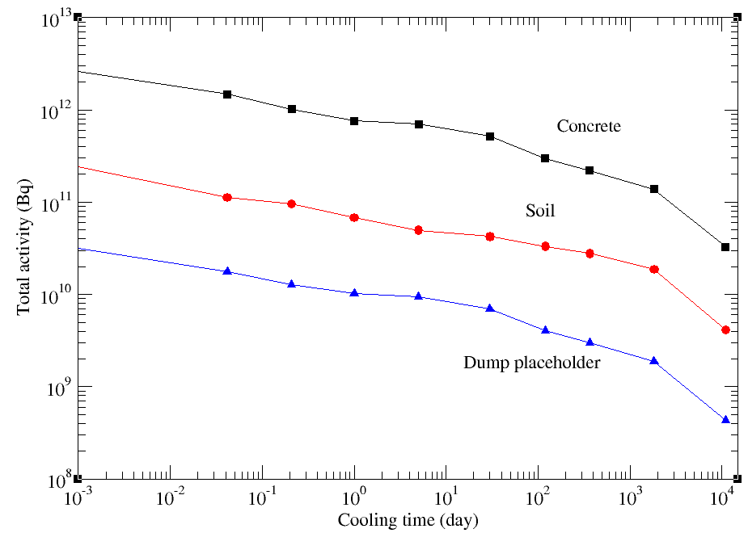
Results of calculations (9)

Slide 19
Examples of verification (1) Simple case
Measured residual activity induced by U ions with energy of 500 MeV/u in Cu target (GSI), Proc. of EPAC 2006, Edinburgh, Scotland, TUPLS141.
Results of MARS calculation were added to the figure from this paper.
Well defined beam. Cylindrical target was assembled of copper disks and the activation foils were inserted between the disks.
Specific residual activity of cobalt isotopes generated and stopped in a copper target.
On average, agreement between MARS prediction and measurement is ~30% or better.

Slide 20
Examples of verification (2) Simple case

Slide 21
Examples of verification (3) More complicated case
Measured residual activity of several samples (Al, steel, and Cu foils) in the collimation region of Main Injector at Fermilab with 8-GeV primary proton beam (Bruce Brown).
Calibration of the amount of lost protons with three different methods reveals a significant uncertainty: a factor of approximately 1.5 between the average number of lost protons and the extremes → significant systematic uncertainty.
Complicated irradiation profile (technical issue).
Material composition of steel samples is not well known → potentially significant uncertainty.

Slide 22
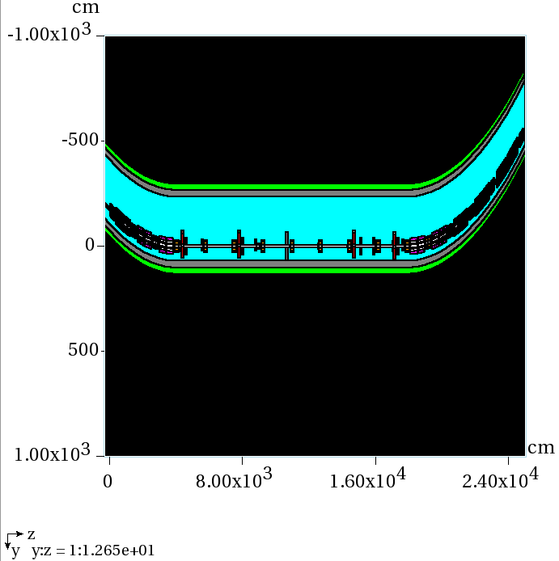
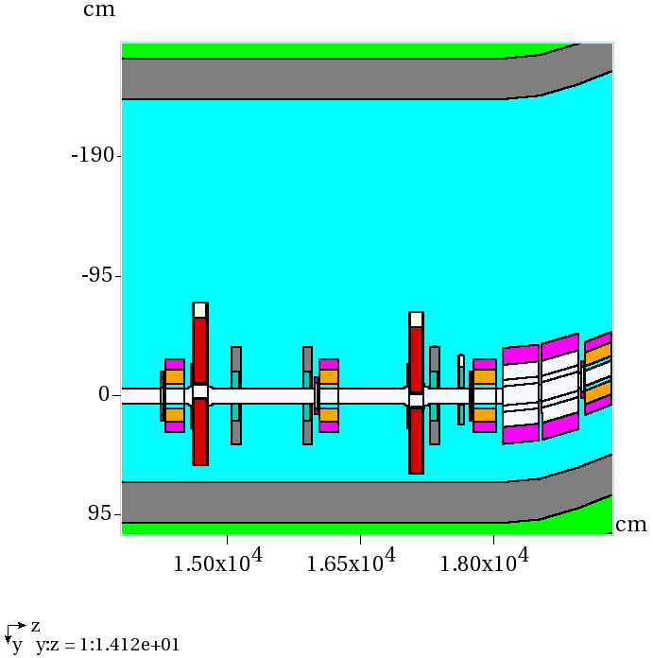
Examples of verification (4) More complicated case
Fermilab Main Injector

Slide 23
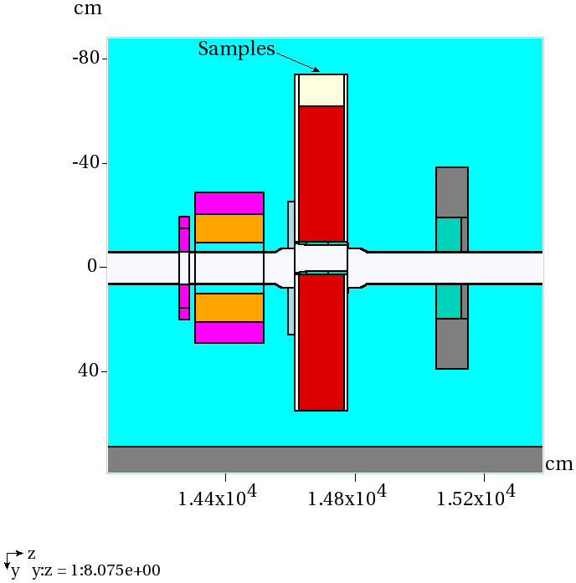
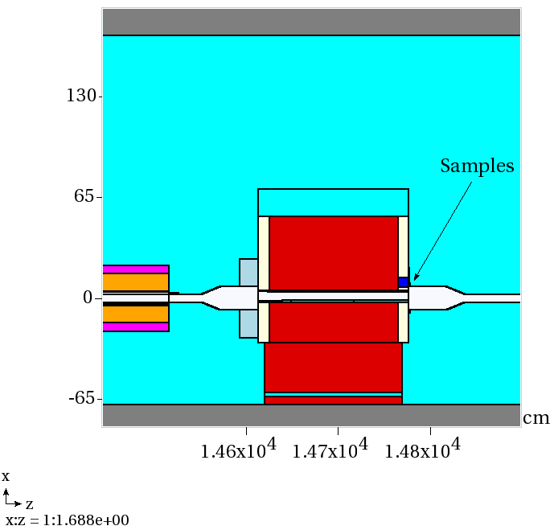
Examples of verification (5) More complicated case
Plan view Elevation view
Shielded location
Unshielded location

Slide 24
Examples of verification (6) More complicated case
Steel foil Unshielded location Copper foil
Radionuclide | Measured activity (pCi/g) | Calculated activity (pCi/g) | C/E
⁴²K | 1510±520 | 954 | 0.63
⁴⁸Cr | 863±112 | 1757 | 2.04
⁵¹Cr | 10700±2000 | 4930 | 0.46
⁵²Fe | 904±159 | 443 | 0.49
⁴³K | 1240±170 | 636 | 0.51
⁵²Mn | 12600±1100 | 11535 | 0.92
⁵⁴Mn | 2200±380 | 762 | 0.35
²⁴Na | 944±155 | 161 | 0.17
⁴⁶Sc | 463±103 | 213 | 0.46
⁴⁷Sc | 3080±480 | 1592 | 0.52
⁴⁸Sc | 702±129 | 1182 | 1.68
⁴⁴Ti/⁴⁴Sc | 7680±1200 | 4955 | 0.65
⁴⁸V | 4430±510 | 2717 | 0.61
Radionuclide | Measured activity (pCi/g) | Calculated activity (pCi/g) | C/E
⁵⁵Co | 1510±290 | 2410 | 1.60
⁵⁶Co | 642±145 | 228 | 0.36
⁵⁷Co | 537±197 | 289 | 0.54
⁵⁸Co | 3310±540 | 1566 | 0.47
⁶¹Cu | 47800±5000 | 25850 | 0.54
⁴³K | 800±204 | 279 | 0.35
⁵²Mn | 2490±240 | 1757 | 0.71
⁵⁶Mn | 5400±720 | 1780 | 0.33
⁵⁷Ni | 1270±250 | 1250 | 0.98
⁴⁷Sc | 501±201 | 323 | 0.64
⁴⁸Sc | 413±82 | 576 | 1.39
⁴⁴Ti/⁴⁴Sc | 1470±280 | 1179 | 0.80
⁴⁸V | 519±107 | 568 | 1.09

Slide 25
Examples of verification (7) More complicated case
Aluminum foil Shielded location Steel foil
Radionuclide | Measured activity (pCi/g) | Calculated activity (pCi/g) | C/E
²²Na | 45.8±11.8 | 41.7 | 0.91
²⁴Na | 1270±210 | 1102 | 0.87
Radionuclide | Measured activity (pCi/g) | Calculated activity (pCi/g) | C/E
⁵⁶Co | 22.5±4.3 | 71.6 | 3.18
⁵¹Cr | 1870±290 | 4020 | 2.15
⁵²Mn | 439±40 | 1608 | 3.66
⁵⁴Mn | 639±97 | 1600 | 2.50
⁴⁶Sc | 58.3±7.7 | 133.5 | 2.29
⁴⁷Sc | 44.9±11.6 | 75.3 | 1.68
⁴⁸V | 358±39 | 1228 | 3.43

Slide 26
Conclusions
Distributions of radionuclides produced in the soil outside the ESS accelerator tunnel wall were calculated for a realistic operational scenario.
The distributions are for subsequent analysis of radionuclide migration by a dedicated group of experts.
For most of the studied radionuclides, agreement between predicted and measured residual activation is within a factor of two or better. There is number of radionuclides that reveal a worse agreement ‒ a factor from two to four.

Slide 27
Acknowledgements
The work was supported by a CRADA agreement FRA-2016-0058 between Fermi Research Alliance, LLC and European Spallation Source ERIC.

