Slide 1

Present status of accelerator decommissioning project in Japan
ARIA 2017/05/22-25 Lund
High Energy Accelerator Research Organization
Kazuyoshi MASUMOTO

Slide 2
In Japan, the clearance system which contains (1) the clearance level and (2) the control procedures for the radioisotope handling facilities and accelerator facilities was provided.
In this regulation, the definition and the handling rules for activated materials were also defined. This system is very difficult, expensive and time consuming for small facilities to perform.

Slide 3
Number of accelerators in Japan (as of March 31, 2015)
Category | Total | Hospitals &Clinics | Educational Institutions | Reseach Institutions | Private Companies | Other Organizations
Total | 1,595 | 1,180 | 66 | 165 | 147 | 37
(%) | 100% | 74 | 4.1 | 10.3 | 9.2 | 2.3
Cyclotrons | 212(13.3) | 143 | 4 | 23 | 39 | 3
Synchrotrons | 40(2.5) | 9 | 3 | 23 | 4 | 1
Synchrocyclotrons | - | - | - | - | - | -
Linear Accelerators | 1,202(75.4) | 1024 | 25 | 55 | 65 | 33
Betatrons | 3(0.2) | - | 1 | 2 | - | -
Van de Graaff Accelerators | 38(2.4) | - | 14 | 23 | 1 | -
Cockcroft-Walton Accelerators | 73(4.6) | - | 16 | 27 | 30 | -
Transformer-type Accelerators | 17(1.1) | - | - | 9 | 8 | -
Microtrons | 9(0.6) | 4 | 3 | 2 | - | -
Plasma Generators | 1(0.1) | - | - | 1 | - | -

Slide 4
How to keep the medical use.
-> Activated area should be defined for the decommissioning work in hospitals. But, it is very difficult to do in hospitals.
Then, we performed the neutron monitoring using activation detector, TLD, CR-39 in hospitals.
Calculation of activation has been also done by the coupling use of Monte Calro methods and Dchain-SP.

Slide 5
Electron Accelerators in Hospitals
Purcased year
Survey results of 2008
Exchange rate is about 10 years interval.
!00 mashines were exchanged per 1 year in Japan.
Notes:
This is the answerer from hospitals in 2008. It was found that exchange rate is 10 years interval.
!00 mashines were exchanged per 1 year.

Slide 6
X-ray maximum energy
Survey results of 2008
Energy (MeV)

Slide 7
Neutron measurement
Dose
  TLD；UD-813PQ4
  Track detector : CR-39
  conversion to fluence
Neutron fluence
  Au-foils (20μm in thickness)
  + covered with and without
  Cd-foils(0.5mm in thickness)

Slide 8
Varian Clinac iX (15 MeV)
135
0
Dose monitoring of neutrons
X-ray beam -> 0 dgree
Neutrons -> isometric
90
45

Slide 9
Comparison C/E
E decreased more rapidly than C (MCNP)
C/E<2
Bolt(SUS304) of floor
Co-60: 0.016 Bq/g
10y、400hr/y operation
C=0.029Bq/g
(C/E=1.8)
Dose (μSv/h)
Distance (cm)
Neutron dose (15MeV, 0-degree)

Slide 10
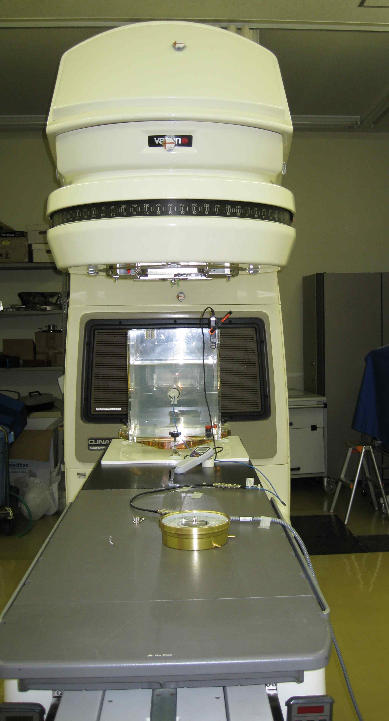
Neutron monitoring at 18 MeV
Varian Clinac 2300 C/D 18MeV
1 min. irradiation
Run-1:electron(without target)
Run-2:Ｘ-ray（window:40cm×40cm）
Run-3:Ｘ-ray（with Multi lleef）
Run-4:Ｘ-ray（with steel filter）
Run-5:Ｘ-ray（with Pb filter）
Run-6:Ｘ-ray（window :0.5cm×0.5cm）
Beam exit
Phantom water

Slide 11
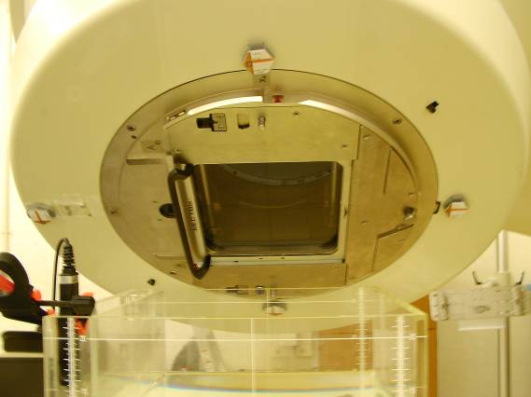
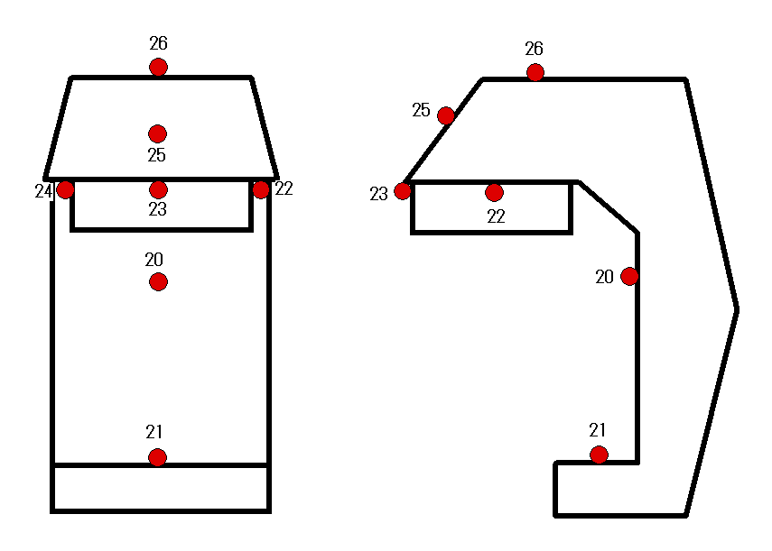
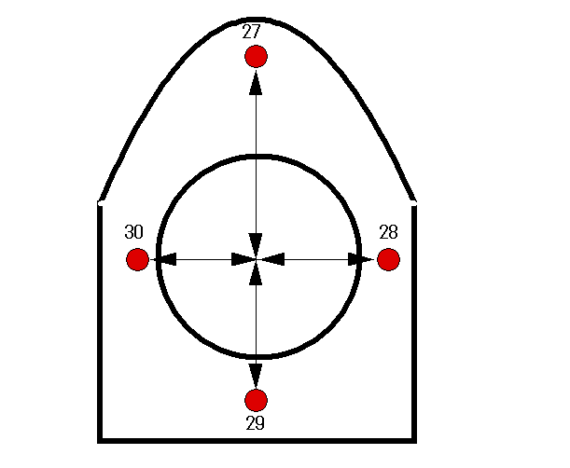
Measurement position
28
27
29
30
Front viw
Side viw
Head beneath

Slide 12
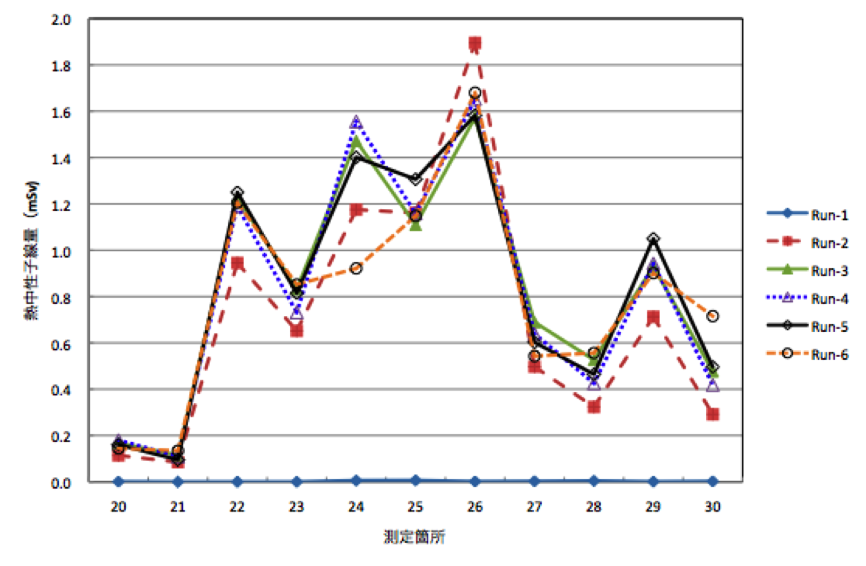
Thermal neutron
← Head parts →
High fluence at No. 22, 24 and 26
Electron irradiation -> No neutros

Slide 13
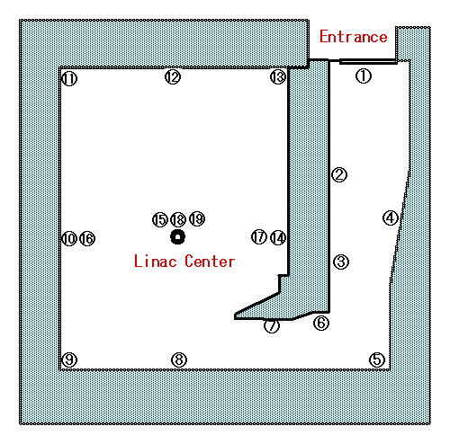
Neutron distribution
Au、TLD、CR-39 were set for 1d.
Total operation time=11.1min

Slide 14
Thermal neutron distribution
Irradiation room
0.95 m hight
cm⁻²s⁻¹
Maze
ceiling
floor

Slide 15
Our results
X-ray energy(MeV) | Neutron flux
6 | ND
10 | Thermal:1X10³cm⁻²s⁻¹、Epithermal:1X10²cm⁻²s⁻¹ Thermal 10⁶ cm⁻² (d)、10 ¹⁰ cm⁻² (10y)
15 | Thermal:2X10⁴cm⁻²s⁻¹、Epithermal:2X10³cm⁻²s⁻¹ Thermal 10⁷⁻⁸cm⁻²(d)、10 ¹¹ cm⁻²(10y)
18 | Thermal:5X10⁴cm⁻²s⁻¹、Epithermal:4X10³cm⁻²s⁻¹ Thermal 10⁸ cm⁻(d) 、10 ¹¹ cm⁻²(10y)

Slide 16
Activated area assigned by NSA
6 MeV :No activation
10 MeV or less : target and collimators
15 MeV or less : target, collimators and shielding materials
Non activated region -> Surroundings and Building

Slide 17
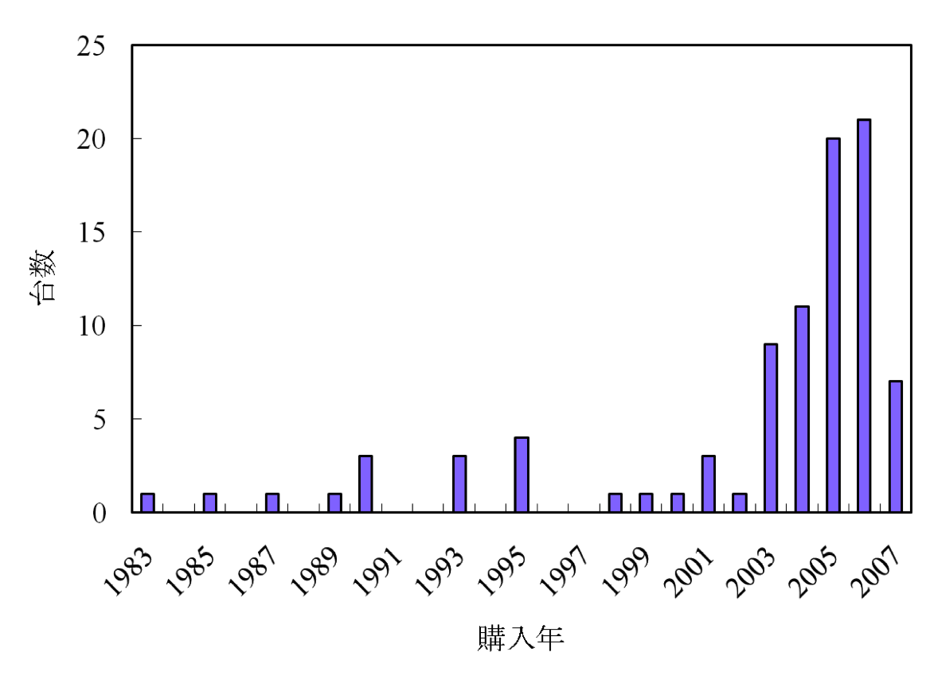
PET cyclotron
Peak: 2005
After 2007, delively system was prevailed.
Now, decommisiong case was increased.
Number
Purchsed Year

Slide 18
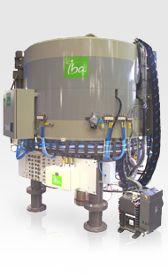
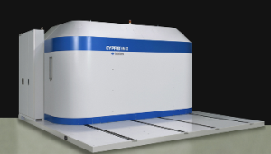
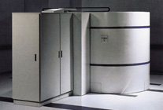
Cyclotron
(a) Proton
(b) H^{- I} ion
without self-shield
Self-shield

Slide 19
RI production and reaction
Produced RI | Reaction | Site number
¹⁸F | ¹⁸O(p,n)¹⁸F ²⁰Ne（d,α）¹⁸F ¹⁸O(p,n)¹⁸F, ²⁰Ne(d,α)¹⁸F両方 | 82 1 4
¹¹C | ¹⁴N(p, α)¹¹C | 29
¹⁵O | ¹⁴N(d,n)¹⁵O ¹⁵N(p,n)¹⁵O | 17 5
¹³N | ¹⁶O(p,α)¹³N | 15
Others | ⁶⁴Ni(p,n)⁶⁴Cu | 1
¹⁸F is major RI
¹¹C(33%)、¹⁵O(25%)、¹³N(17%)

Slide 20
Source of neutrons of PET-cyclotron
Neutrons are mainly produced by the ¹⁸O(p,n)¹⁸F reaction.
Neutron yield from the ¹⁴N(p,α)¹¹C reaction was 8.9% of ¹⁸F-production
Therefore, neutron fluence is mainly dependent on the produced amount of ¹⁸F.

Slide 21
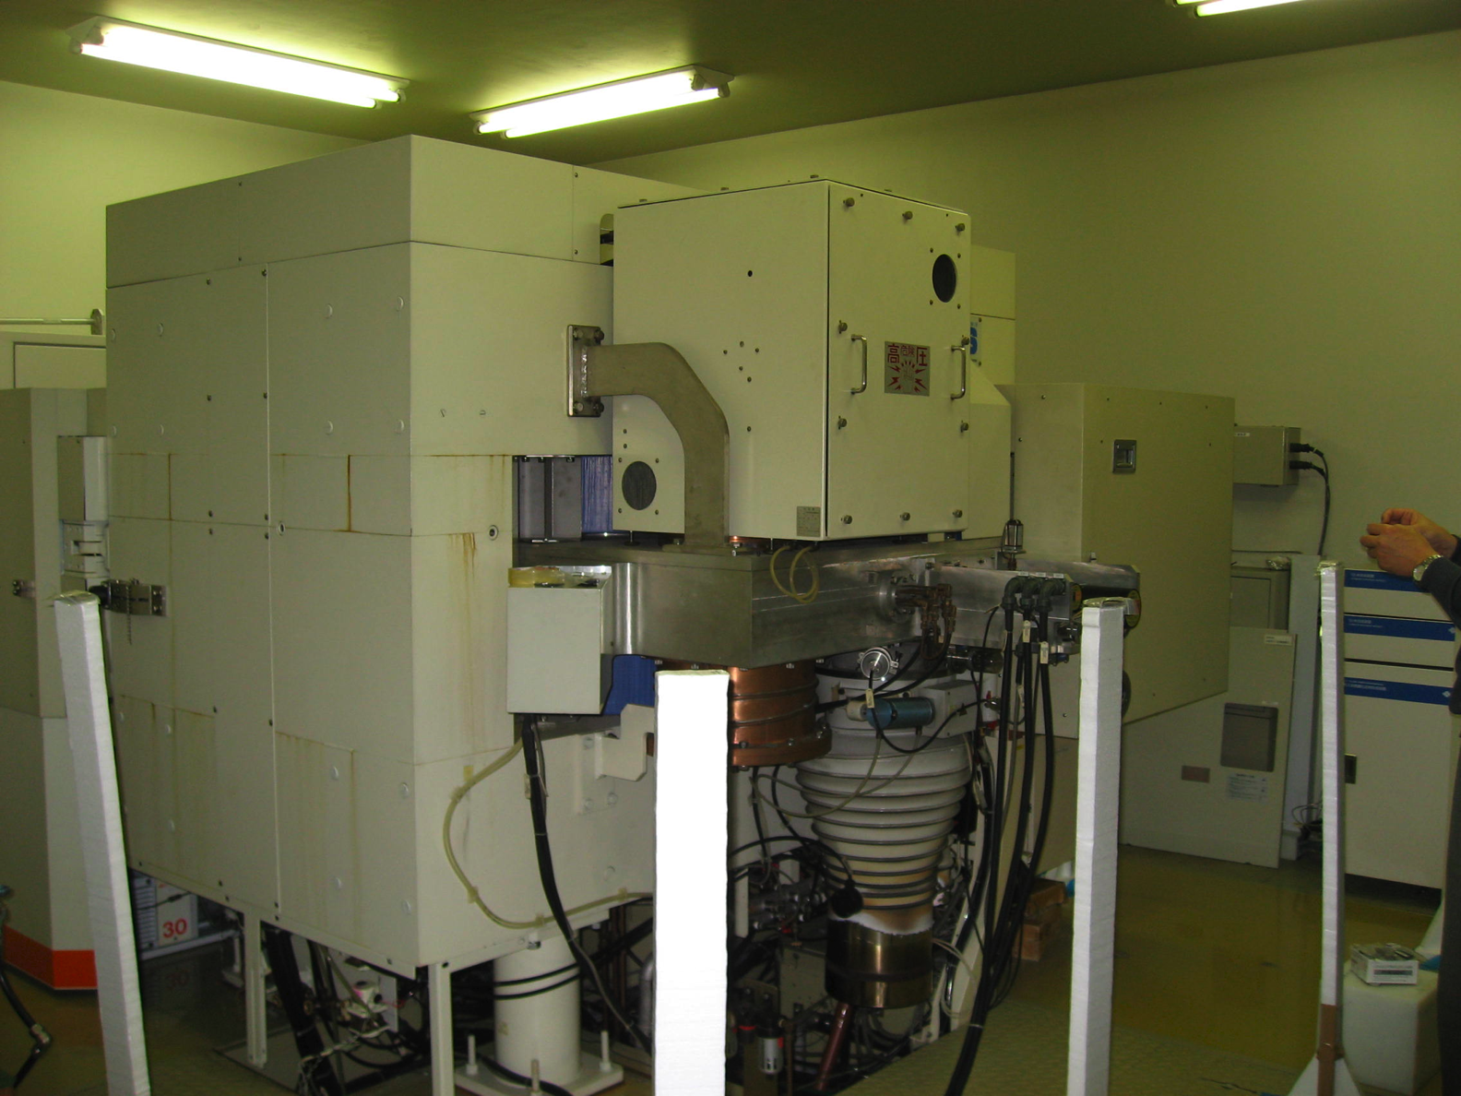
Measurement of neutron fluence
Target:water（O-18）
Production：F-18
H⁻ ion ,18MeV
Current：21μA
Irradiation：63min
SHI HM-18

Slide 22
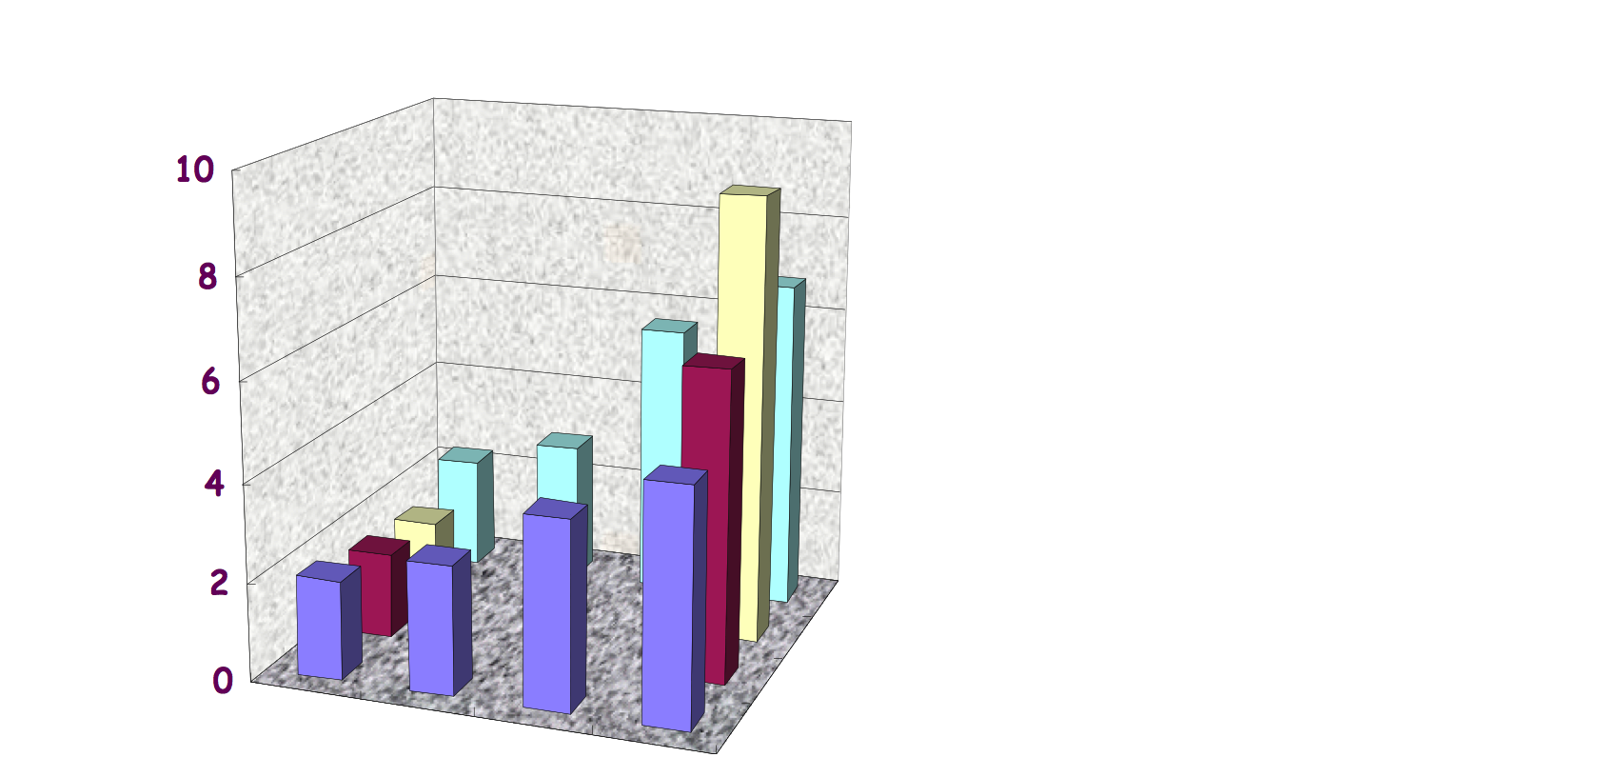
Neutron distribution
Near target：10⁶ cm⁻²s⁻¹
Opposite side：2×10⁵ cm⁻²s⁻¹
Inside the target box：10⁷ cm⁻²s⁻¹
Bolt(Brass,Cu:Zn=65:35) was sampled from the wall near the target
Averaged neutron flux of operation
Cu-64 : 4.5×10⁵ cm⁻²s⁻¹ (2days)
Zn-65 : 6.3×10⁵ cm⁻²s⁻¹(2years)
cm⁻²s⁻¹×10⁵

Slide 23
Results
Near target: 10⁷cm⁻²s⁻¹
Inside the vault: 10⁵⁻⁶ cm⁻²s⁻¹
Estimation of induced activity in concrete
  Co :10ppm
  Operation:500h/year
  Neutron flux= 4.6×10⁵
Specific activity of Co-60 became 0.1Bq/g.

Slide 24
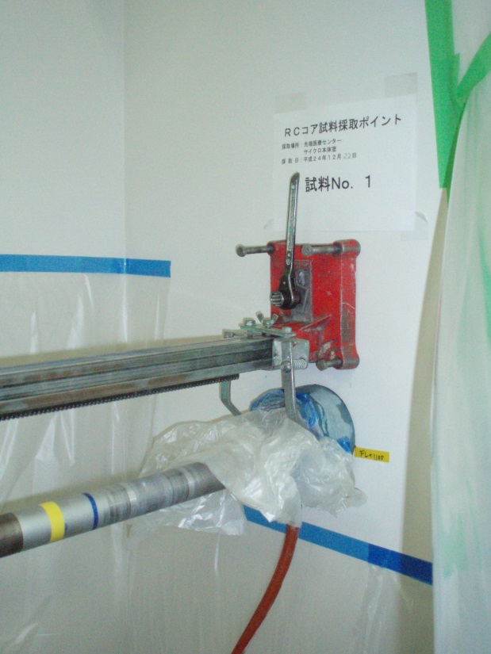
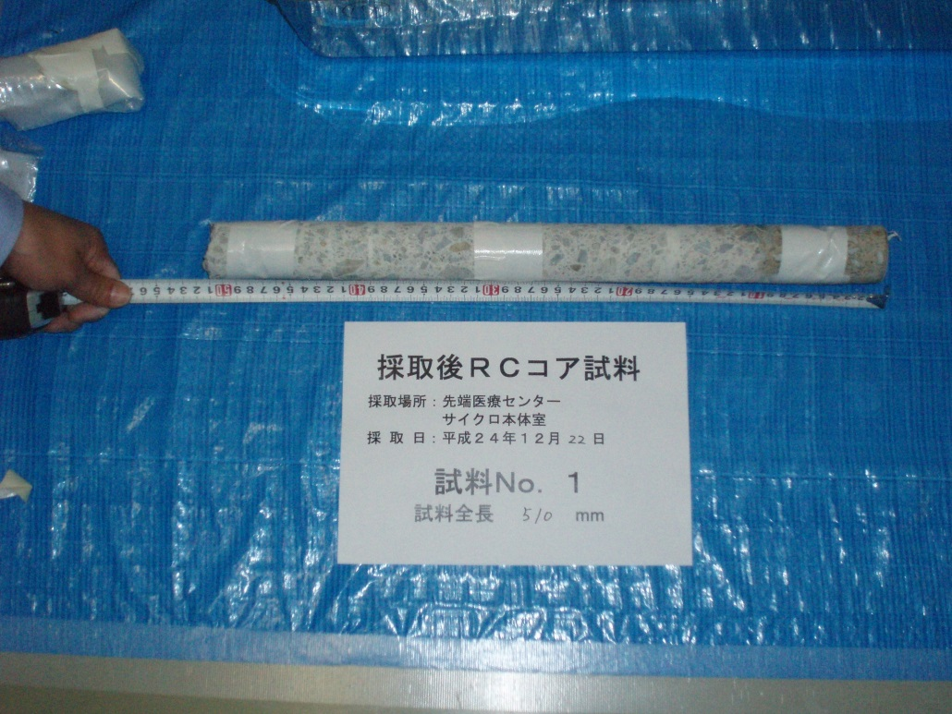
Concrete core sampling
Core sample（diameter: 5cm, length50cm）
Ge-detector (ORTECGMX-20195)

Slide 25
2001/8～2012/12
2012/12～2013/12
Comparison of C/E of Floor concrete

Slide 26
2001/8～2012/12
2012/12～2013/12
Comparison of C/E of wall concrete data
2001/8～2012/12

Slide 27
Activation of concrete
Major RI：H-3, Co-60, Eu-152, Sc-46, Cs-134
Products of Thermal neutron capture reaction
Maximum activity observed at 10cm in depth.
At 30cm in depth, activity decreased about one order.
Mn-54, Na-22 (Fast neutron reaction products) are observed in concrete near the target. Build up effect was not observed.
Activity of Co-60 sampled from surface was below 0.1Bq/g.

Slide 28
Outside of self-shield
CR-39, TLD were set for one month
Thermal neutron dose rate on operation：several μSv/h
Thermal neutron flux on operation： under 10²cm⁻²•s⁻¹
Activation by neutrons is negligibly small.

Slide 29
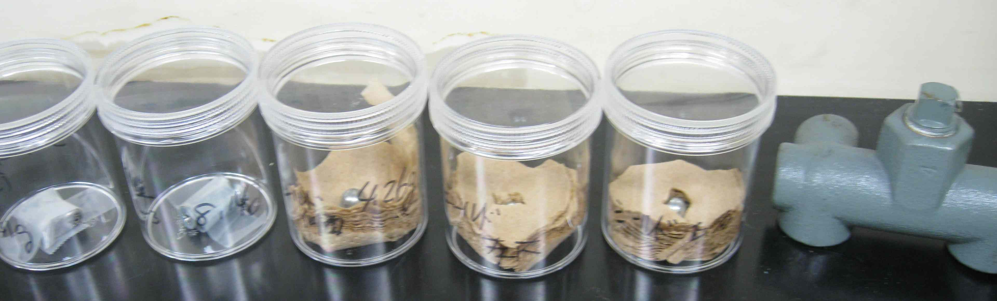
Metal samples
Metals used for more than 5 years were collected.
Fe, SUS, Brass, Al
Several g to several 100 ｇ
Measurement for several 10⁴ second (0.5 d) by Ge-detector: No activity was detected

Slide 30
Zoning of PET-cyclotrons
Without self-shield
  Inside the vault is activated area
Self-shield type
  No activated area : Outside the self-shield
  Activated area : Inside the self-shield
Toyoda -> Activation of cyclotron
Matsumura -> Activation of concrete

Slide 31
Conclusion
Neutron measurement suring operation is very effective to estimate activation of surrounding matereials.
To estimate induced activity, operation record is also important.
We will tried to define the activation zone in the facilities of SR, Tandem, Particle therapy.

Slide 33
Estimation of activity
Neutron fluence measurement under operation
Operational record
Material analysis
↓
Estimation of activity
And/or
Monte Carlo calculation by neutron transport + Induced activity

Slide 34
Measurement for decommissioning
Sampling -> Activity measurement
In-situ measurement using Ge-detector
->activity evaluation
Surface dose rate monitoring
We obtain the relationship between activity and dose
Decommissioning work can be performed by using survey-meters

