Slide 1
Evaluation of induced activity and assessment of in-situ clearance procedures for MedAustron ion therapy accelerator components
C. Weixelbaumer, R. Wanzenböck, M. Deutsch, L. Jägerhofer
EBG MedAustron GmbH, Wr. Neustadt, Austria

Slide 2
OUtline
MedAustron
Regulatory framework in Austria
Activation samples
ActiWiz and nuclide vectors
Geometry effects and dose rates
Clearance procedures
Summary and Conclusion

Slide 3
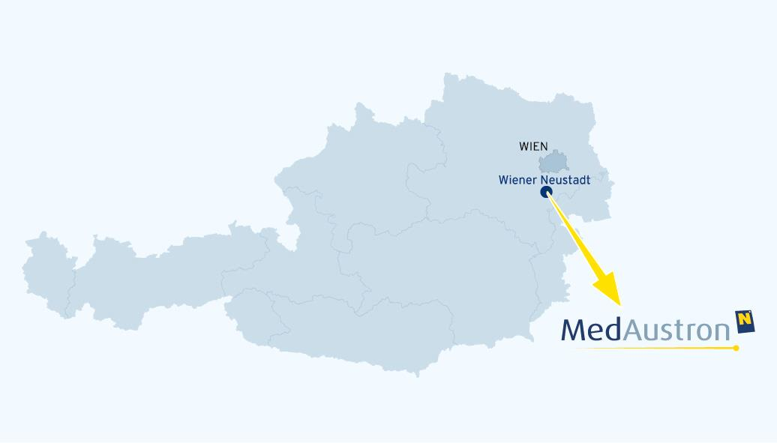
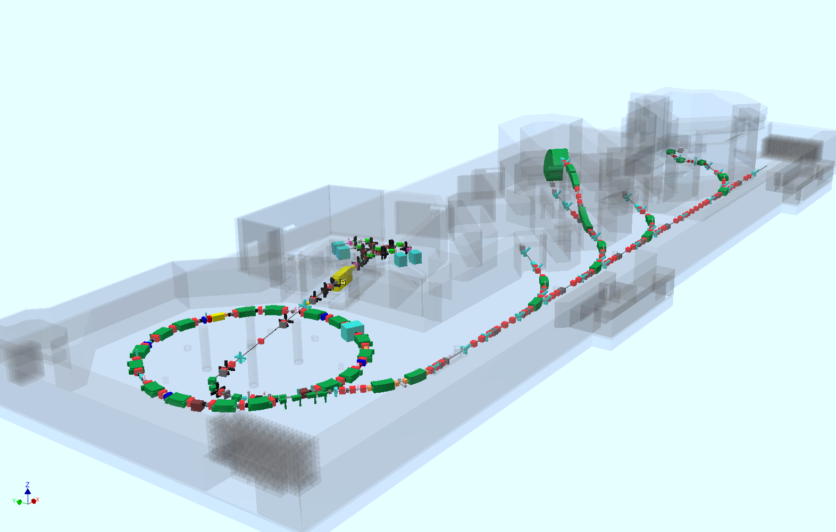
MedAustron
Centre for ion-beam therapy and research in Wr. Neustadt, Austria
Synchrotron based radiation therapy using protons and carbon ions
Approval from authorities via EIA (environmental impact assessment)
CE-certified according to MDD
(medical device directive)
First patient Dec. 2016

Slide 4
MedAustron Specs
Beam parameters | Planned | Present
Ion species | Proton, Carbon | Proton
Kinetic Energy [MeV/u] | p: 60-250 (800) C: 120-400 | p: 60-250
Beam size in [mm] | 4 - 10 | 4
Spill length in [s] | 0.1 - 10 | 5
Max. particles | p: < 2 x 10¹⁰ per spill C: < 2 x 10⁹ per spill | p: 2 x 10¹⁰ per Spill
Repetition rate [Hz] | max. 1 | ~1/7
Field size [cm²] | up to 20 x 20 | up to 20 x 20

Slide 5

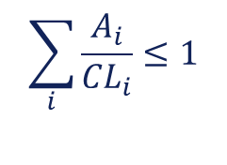
Regulatory Framework
Not much experience with activation in
Austria
In principle clearance is a formal regulatory
act
Clearance allowed for materials averaged over not more than 300 kg mass (except building rubble)
Max. values for Surface contamination and Clearance based on 10µSv limit
      $$\sum_{i}{\frac{A_{i}}{{CL}_{i}}}≤1$$
Notes:
- Kind of like Schrödingers cat – if you don‘t look you don‘t know if it‘s radioactive or not -> here it depends on when you look
- If there is no clearance limit and half life is <7d -> limit of exemption can be used

Slide 6
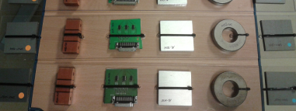

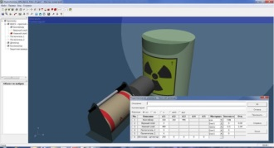
MOtivation
Material from accelerator areas is potentially radioactive and needs to be compared to CL (if it leaves radiation areas)
Goal is not to quantify as accurately as possible but to show that certain objects are well below legal limits
in-situ and on a short time scale
Activation samples
Uncertainties:
Material composition
Irradiation szenario
Nuclide production
process
Geometry
ActiWiz
LabSOCS/ ISOCS
Notes:
Material composition -> CE certified, actual samples, etc
Irradiation szenario -> weak point at the moment -> particle logging
Nuclide production prozess -> due to SUM < 1 even when checking for all nuclides you are never below -> ActiWiz (FLUKA)
Geometry -> mathematical efficiency calculations

Slide 7
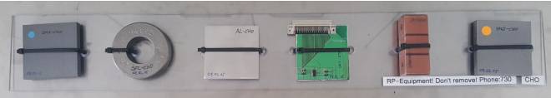
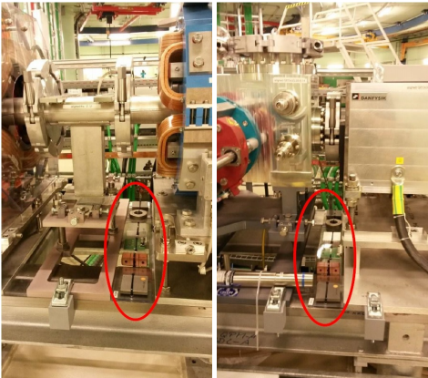
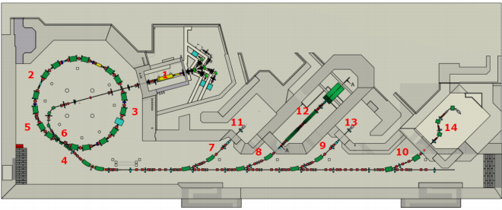
Activation Samples
Commonly used materials
(3x Steel, 1x Copper, 1x Aluminum, 1x Electronics (generic))
At known particle loss points

Slide 8
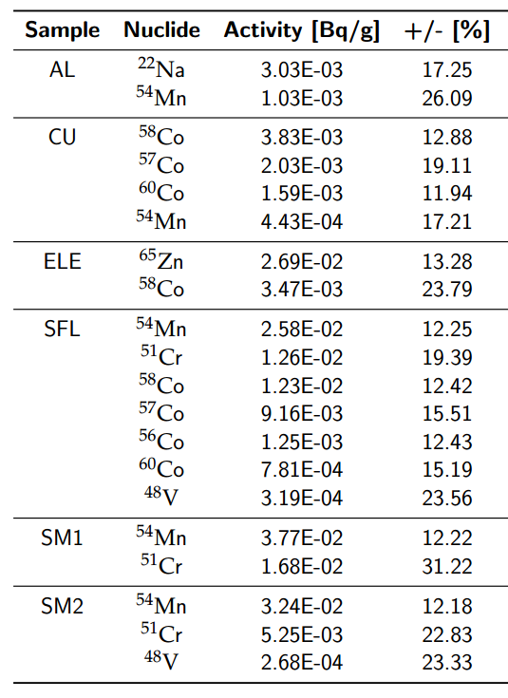
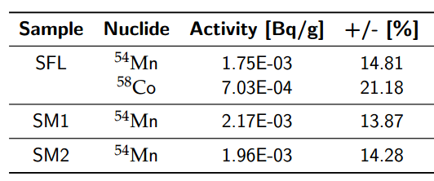
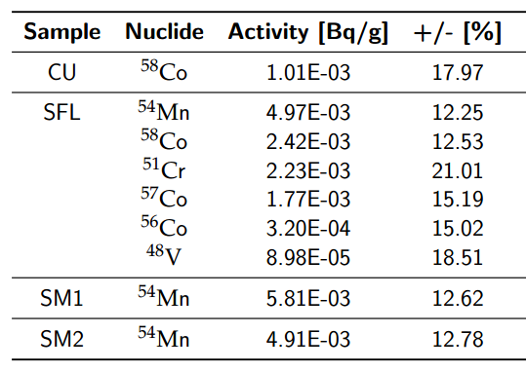
Measurement of Samples
Measured with stationary HPGe gamma spectrometer
Irradiation period: 15 months (mostly during commissioning)
Cooling time: 14 days

Slide 9


Actiwiz
Developed at CERN by H.Vincke and C.Theis [1]
Utilizes a large amount of generic FLUKA Monte Carlo Simulations to calculate activities in user defined materials
  Predefined particle type and energy
  (160 MeV/ 800 MeV protons)
  Predefined locations
  (beam impact area, within bulky material,..)
  User can define material composition,
  beam intensity, irradiation and cooling time
Simulate nuclide vector at the click of a button
[1] H. Vincke and C. Theis, „ActiWiz – Optimizing your nuclide inventory at proton accelerators with a computer code“, Progress in Nuclear Science and Technology,
Volume 4 (2014) pp. 228-232

Slide 10
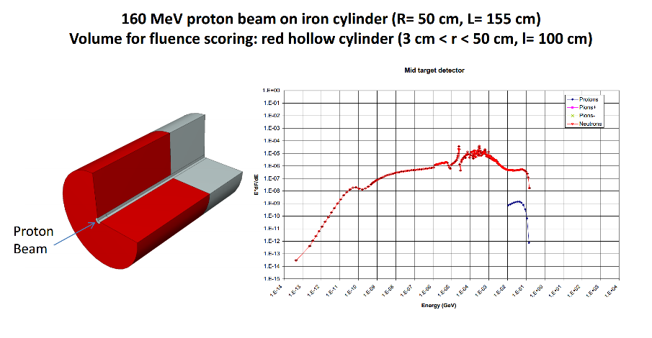
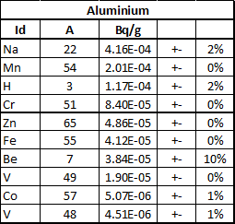
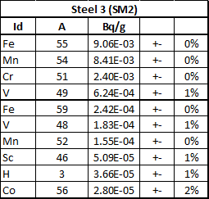
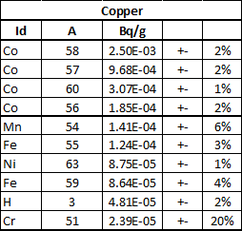
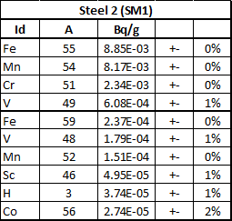
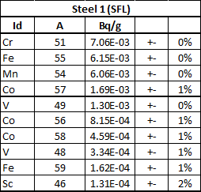
Simulated Nuclide Vectors
160 MeV protons (10⁷ p/s)
Within bulky material
Irradiation time: 15 months
Cooling time: 14 days
e.g. H-3, Fe-55 are very difficult to measure

Slide 11
Simulated Nuclide Vectors

Slide 12

Comparison: Sim Meas
Normalize weighted activities to total weighted activity to get percentage on how much each nuclide adds to reach CL and to be able to compare it to measurements
$$\frac{\frac{Ai}{CLi}}{\sum_{i}{\frac{Ai}{CLi}}}$$
Aluminium
 | % of CL contribution
Nuclide | Meas. | Sim.
Na-22 | 91.5 - 93 | 87
Mn-54 | 7 - 8.5 | 10
Steel 1 (SFL)
 | % of CL contribution
Nuclide | Meas. | Sim.
Mn-54 | 69 - 69.5 | 72
Co-58 | 14.5 | 2.5
Co-60 | 8.1 - 8.6 | 0.5
Co-56 | 6.7 | 20
Co-57 | 0.5 | 0.5
V-48 | 0.3 - 0.4 | 1.5
Cr-51 | 0.1 | < 0.5
Steel 2 (SM1)
 | % of CL contribution
Nuclide | Meas. | Sim.
Mn-54 | 96.7 - 98.1 | 96
V-48 | 1.7 - 3.1 | 1
Cr-51 | 0.1 - 0.2 | < 0.5
Copper
 | % of CL contribution
Nuclide | Meas. | Sim.
Co-60 | 69 - 72 | 42
Co-58 | 18.5 - 19 | 38
Mn-54 | 4.7 - 5 | 5
Co-56 | 4.2 - 6.7 | 13
Co-57 | 0.1 - 0.5 | 1
Steel 3 (SM2)
 | % of CL contribution
Nuclide | Meas. | Sim.
Mn-54 | 99.6 - 99.7 | 96
V-48 | 0.3 - 0.4 | 1
Cr-51 | 0.1 | < 0.5

Slide 13
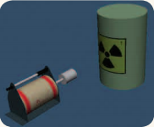
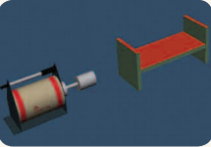
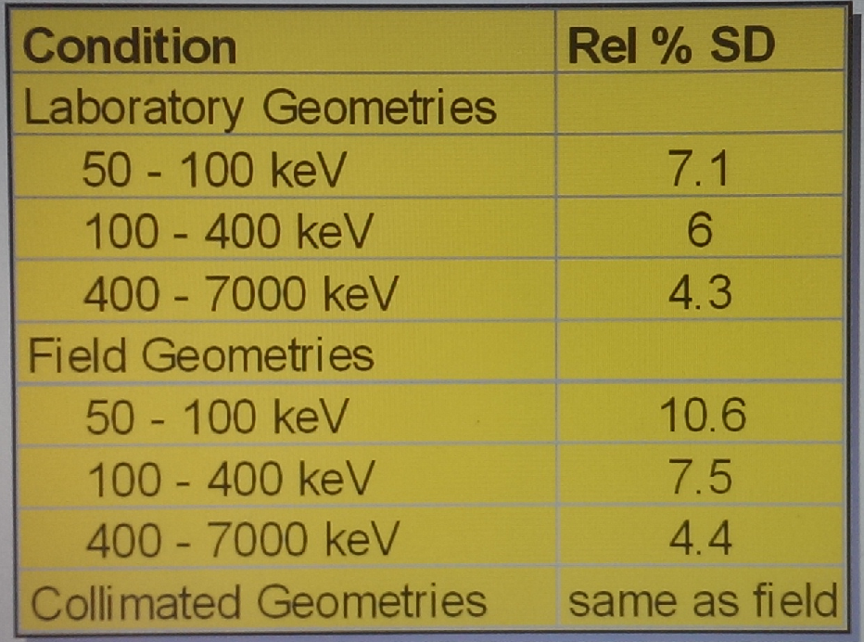
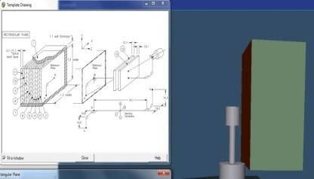
Geometry Effects
Nuclide vectors and their contribution to CL have been established
To get efficiencies for measurement we take into account the geometry of the object to clear (normally a very tedious task)
LabSOCS/ ISOCS [2]
Mathematical efficiency calibration package with fully factory characterized detector (uses NIST-sources and modelling with MCNP)
[2] http://www.canberra.com/literature/isocs/application_notes/ISOCS-LabSOCS-App-Note-C39530.pdf

Slide 14
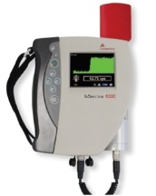
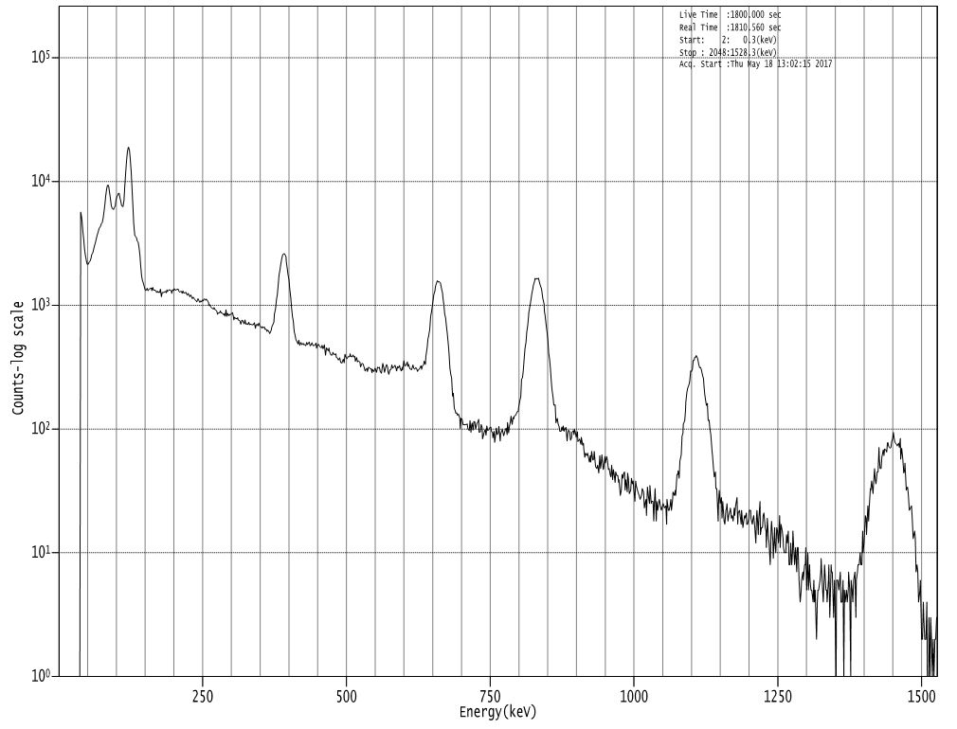
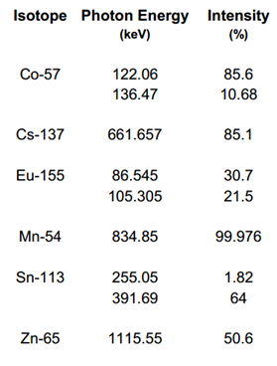
mobile Gamma spectrometer
(inspector 1000)
Handheld mobile gamma spectrometer with characterized 1.5” x 1.5” LaBr₃(Ce) probe
Intrinsic Peak at 1436 keV
MGS-4
(below LE)
Sample spectrum of a multi gamma standard to illustrate resolution;
Measurement time: 1800s
Notes:
Intrinsic Peak at 1436 keV line (La-138 undergoes EC -> excites Ba-138 -> 1436 keV line)

Slide 15

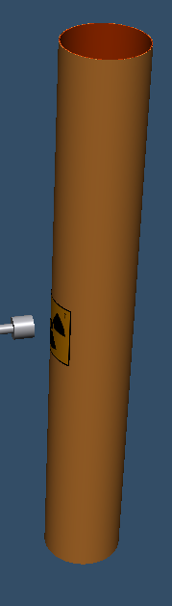
Clearance with mobile spectrometer
Nuclide vector inventory for different materials, cooling times (and irradiation scenarios)
Efficiency (geometry) catalogue
  Minimum measurement time to clear object
  (with safety factor of course)
Nuclide | Steel 1 (SFL) | Steel2 (SM1) | Steel3 (SM2)
Mn-54 | 72 % | 96 % | 96 %
 | LOD (1h) [Bq/g] | LOD/CL [%]
Na-22 | 1.6E-02 | 16 %
Mn-54 | 2.0E-02 | 5 %
Co-56 | 2.0E-02 | 10 %
Co-57 | 2.5E-02 | < 1 %
Co-58 | 1.2E-02 | 2 %
Co-60 | 1.9E-02 | 19 %
% of CL contribution for steel near loss point for 15 months and cooling of 14 days
Dimensions:
H x ø: 150 x 21 cm³
4.5 mm thick
Mass:
65 kg
Material:
Steel

Slide 16
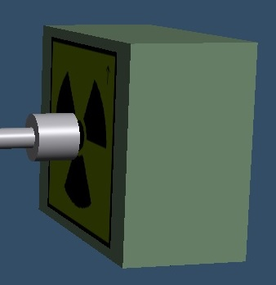

Clearance with mobile spectrometer
If nuclide vector and/or geometry not already known simulations (ActiWiz and ISOCS/LabSOCS) can be done on timescale of less than an hour
 | LOD (1h) [Bq/g] | LOD/CL [%]
Na-22 | 4.9E-02 | 49 %
Mn-54 | 5.9E-02 | 15 %
Co-56 | 6.0E-02 | 30 %
Co-57 | 4.0E-02 | < 1%
Co-58 | 3.3E-02 | 4 %
Co-60 | 5.8E-02 | 58 %
Nuclide | Al
Na-22 | 87 %
% of CL contribution for aluminium near loss point for 15 months and cooling of 14 days
Dimensions:
30 x 25 x 15 cm³
Mass:
5 kg
Material:
Aluminium

Slide 17
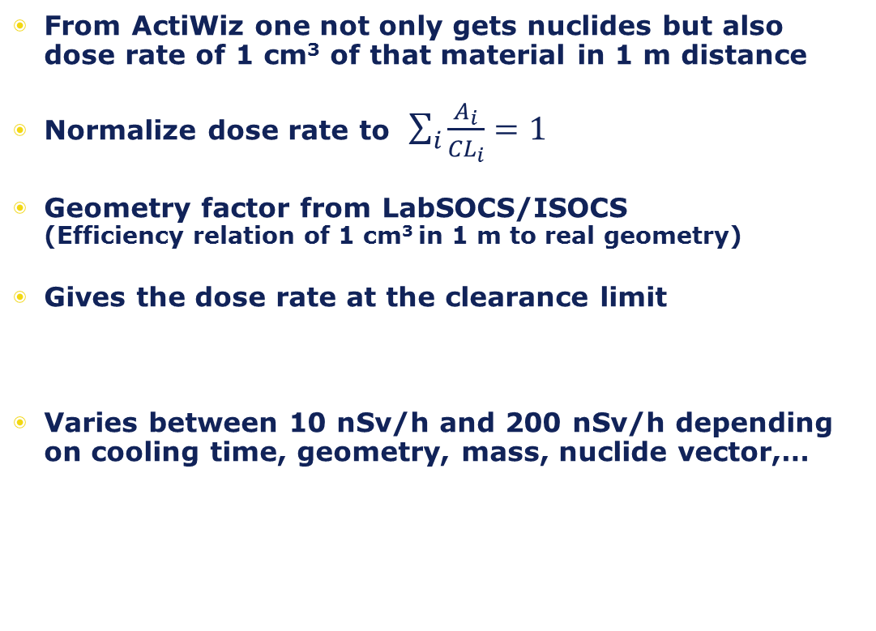
Clearance with DOSE RATE ?
From ActiWiz one not only gets nuclides but also dose rate of 1 cm³ of that material in 1 m distance
Normalize dose rate to $\sum_{i}{\frac{A_{i}}{{CL}_{i}}}=1$
Geometry factor from LabSOCS/ISOCS
(Efficiency relation of 1 cm³ in 1 m to real geometry)
Gives the dose rate at the clearance limit
Varies between 10 nSv/h and 200 nSv/h depending on cooling time, geometry, mass, nuclide vector,…

Slide 18
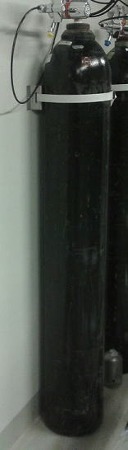
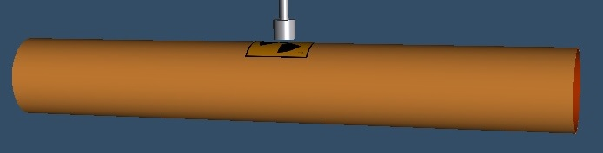
Clearance with DOSE RATE ?
Mass:
5 kg
Material:
Aluminium
Examples
If possible at all there is not much room for uncertainties (material impurities, measurement uncertainty, irradiation and cooling time,..)
Possible for certain materials and for regular clearances were material and irradiation scenario is well known
Cooling time | Dose Rate (at CL limit in 1cm) nSv/h
1 day | ~ 90 - 120
7 days | ~ 70 - 80
30 days | ~ 50 - 60
Cooling time | Dose Rate (at CL limit in 1cm) nSv/h
1 day | ~ 31
7 days | ~ 9
30 days | ~ 9
Mass: Material:
65 kg Steel

Slide 19
Summary and conclusion
Activation samples were used to establish nuclide vectors and reference points for absolute activation
Comparison of weighted nuclide vectors of activation samples shows good agreement with ActiWiz simulations
In-situ clearance by mobile LaBr₃(Ce) can be achieved on a timescale of less than an hour for most examined materials and geometries
Clearance by dose rate is limited to certain materials (e.g. Steel, Copper) in „good geometries and irradiation scenarios“ and leaves no room for errors (safety factors)

Slide 20
OUtlook
Remeasure activation samples to get better statistics
Analyze impact of impurities in material composition and uncertainties in irradiation scenarios on nuclide vectors and dose rates
establish uncertainty budget
Include more matieral types (Plastics, Brass, Electronics, Lead,..)
Analyse impact of new BSS

Slide 21
Thank you!
Questions ?
Contact:
christoph.weixelbaumer@medaustron.at

Slide 22
BACKup - Slides

Slide 23
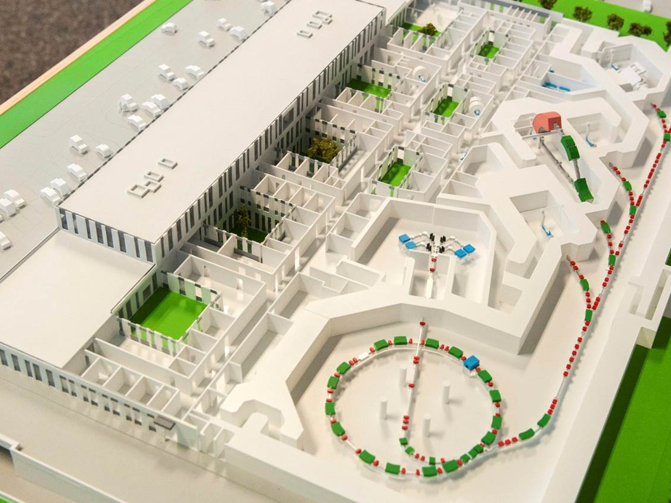
4
Treatment / clinical research:
  Proton Gantry (IR 4)
  Horizontal fixed beam (IR 3)
  Horizontal and vertical fixed beam
  (IR 2)
Non-clinical research:
  Horizontal fixed beam (IR 1)
2
3
1
Ion sources
Linear accelerator
7 MeV/u
Synchtrotron
p: 60-250(800) MeV
C: 120-400 MeV/u
Extraction line

Slide 24
Activation Samples
Bezeichnung | EN | C | Cr | Ni | Mo | Si | Mn | N | Andere
Inox 316LN | X2CrNiMoN17-13-3, 1,4429 | 0,030 | 16,00-18,50 | 12,00-14,00 | 2,00-3,00 | 1,00 | 2,00 | 0,14-0,20 | P≤0,045 S≤0,010 Co≤0,2
Bezeichnung | C | Si | Mn | P | S | Al
Isovac 250-35 A | 0,003 | 2,360 | 0,318 | 0,015 | 0,0054 | 1,050
Bezeichnung | C | Si | Mn | P | S | Al
Isovac 1300-100A | 0,002 | 0,510 | 0,530 | 0,109 | 0,0056 | 0,390
Bezeichnung | Cu | O
Kupfer | 99,99 | <0,0005
Bezeichnung | Si | Mg | Mn | Ti | Fe | Cu | Cr | Zn | Al | Ni | Ga | V
6082-T651 | 1,05 | 1,1 | 0,66 | 0,017 | 0,44 | 0,08 | 0,18 | 0,065 | 96,352 | 0,03 | 0,01 | 0,02

Slide 25
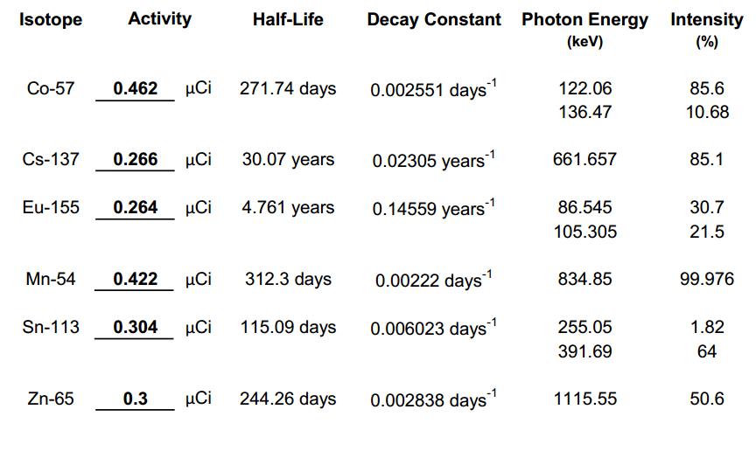
Certificate MGS-4

