Slide 1
Measurements and FLUKA Simulations of Bismuth, Aluminum and Indium Activation at the upgraded CERN Shielding Benchmark Facility(CSBF)
E. Iliopoulou, P. Bamidis, M. Brugger, R. Froeschl, A. Infantino, T. Kajimoto, N. Nakao,
S. Roesler, T. Sanami, A. Siountas, H. Yashima
ARIA 17, 22/05/2017

Slide 2
Outline
CHARM (CERN High energy AcceleRator Mixed field facility)
CSBF (CERN Shielding Benchmark Facility)
Activation benchmark campaign in September 2016
FLUKA simulations
Sensitivity studies
Results
Conclusions

Slide 3
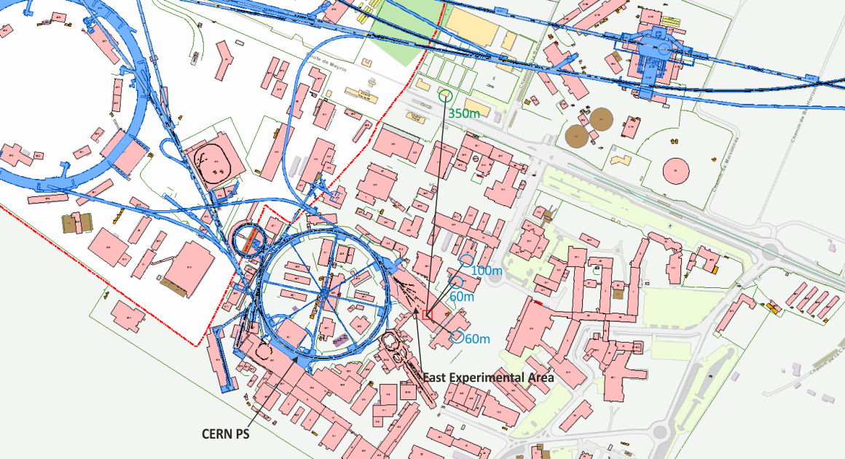
CHARM - Location

Slide 4
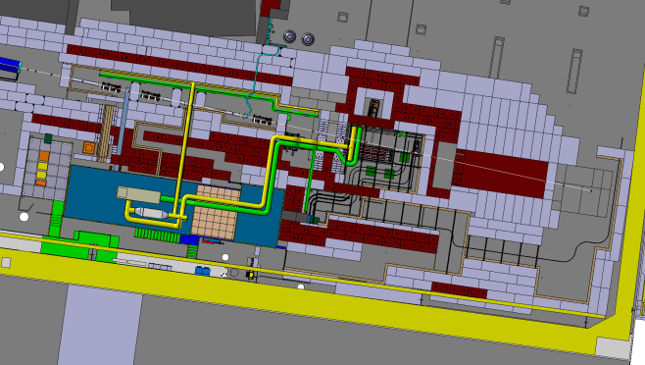
CHARM - Layout
Beam line
Target alcove
Target
Movable shielding
walls

Slide 5
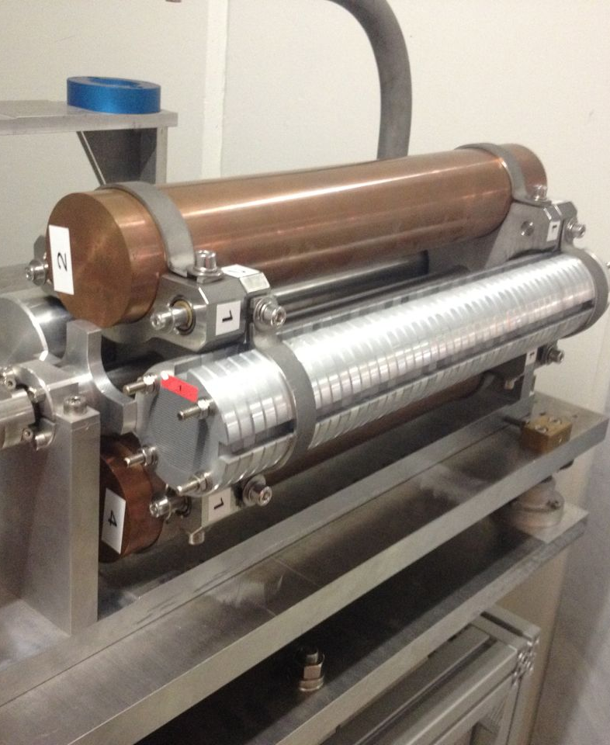
CHARM
Purpose
  Study radiation effects on electronic components (R2E project)
Beam characteristics
  Primary protons
  from the PS
  24 GeV/c momentum
  5 x 10¹¹ protons/pulse
  350ms pulse length
  max. average beam intensity 6.6 x 10¹⁰ p/s

Slide 6
CSBF (CERN Shielding Benchmark Facility)
Combined facility EN/EA, R2E and RP
Major upgrade for 2016 run
Purpose
  Characterization of the shielding properties of various materials
  Deep shielding penetration studies
    Detector calibration
    Detector inter-comparison
    Activation
Situated laterally above the CHARM target
  One week dedicated beam time per year
  Otherwise, parasitic use of the radiation field emerging from the CHARM target
Complementary to the CERF facility

Slide 7
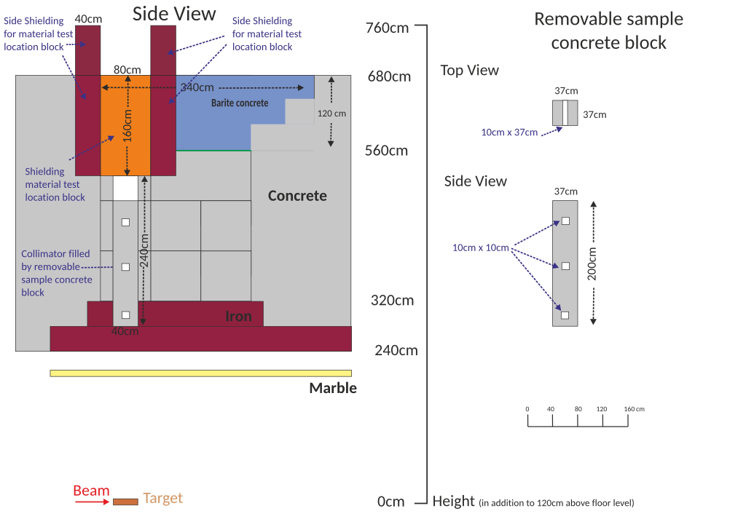
CSBF – Layout 2016

Slide 8
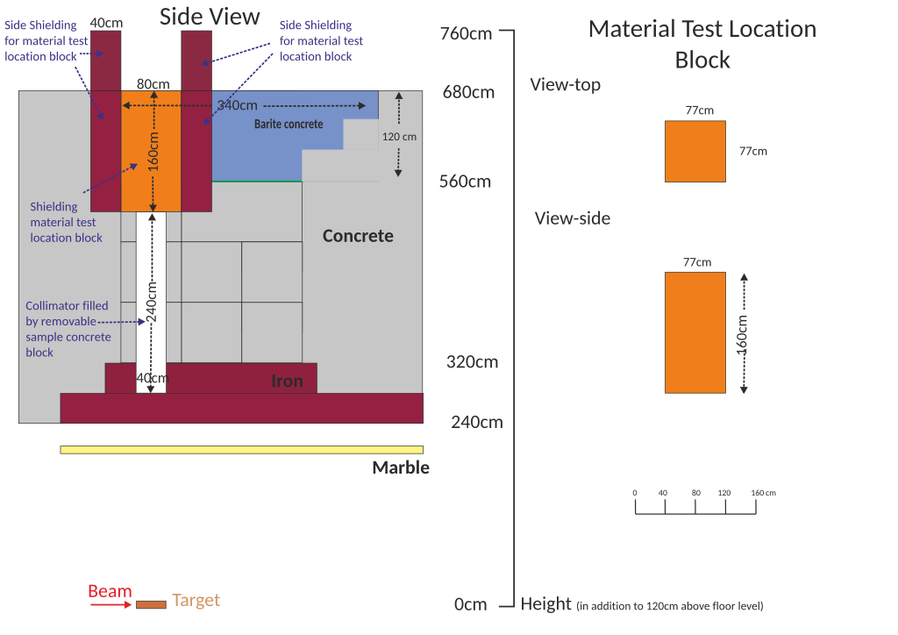
CSBF – Layout 2016

Slide 9
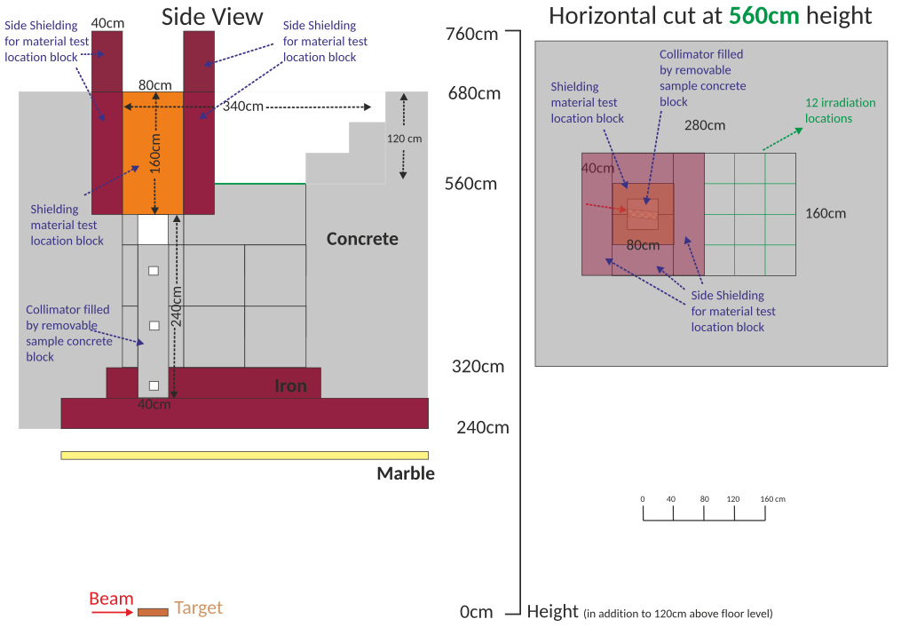
CSBF – Layout 2016

Slide 10
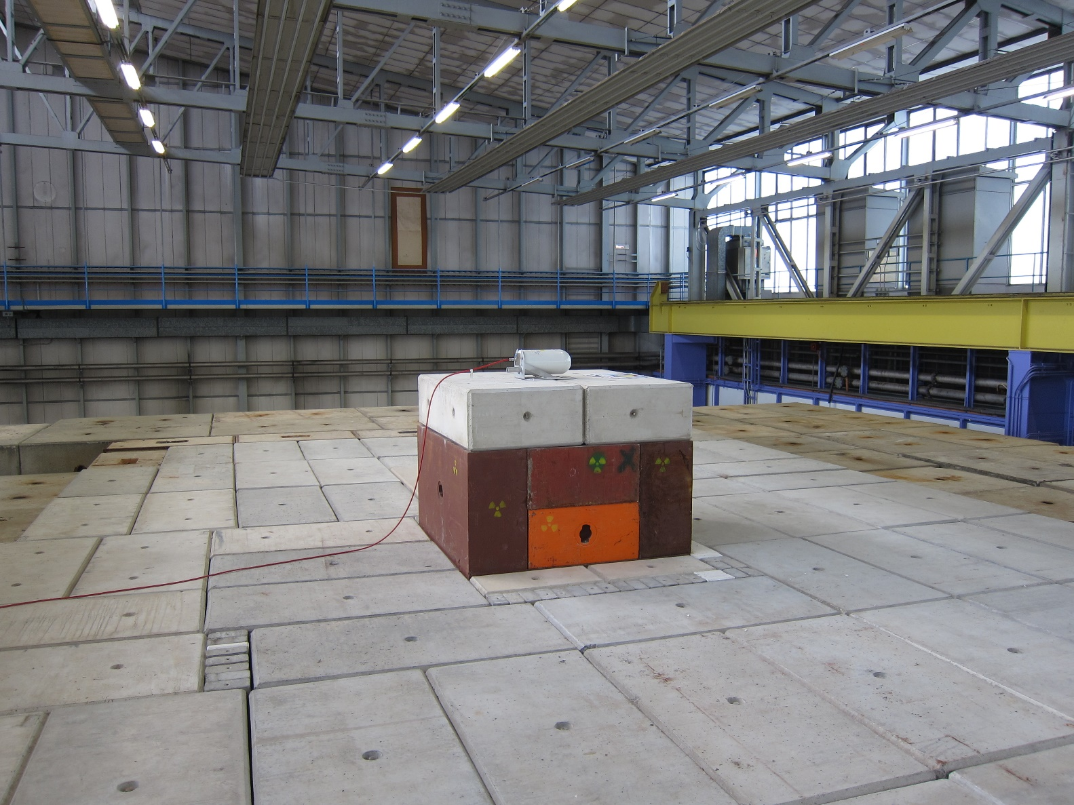
CSBF - Location

Slide 11
Activation benchmark campaign in September 2016
Bismuth, aluminum & indium samples
  14 disk samples
  Different heights in removable sample concrete block
Copper target
Specific production yield comparison
  FLUKA simulations
  Measured activity Production yield

Slide 12
FLUKA simulations
Protons with 24GeV/c on Cu target
  12mm x 12mm FWHM
Region importance biasing
Usrtrack – scoring for neutron fluence
  Weighting with a set of cross sections of Bi(n,xn)Bi, ²⁷Al(n,a)²⁴Na and ¹¹⁵In(n,n’)^{115m}In
Correct geometry description
  Scoring volumes

Slide 13
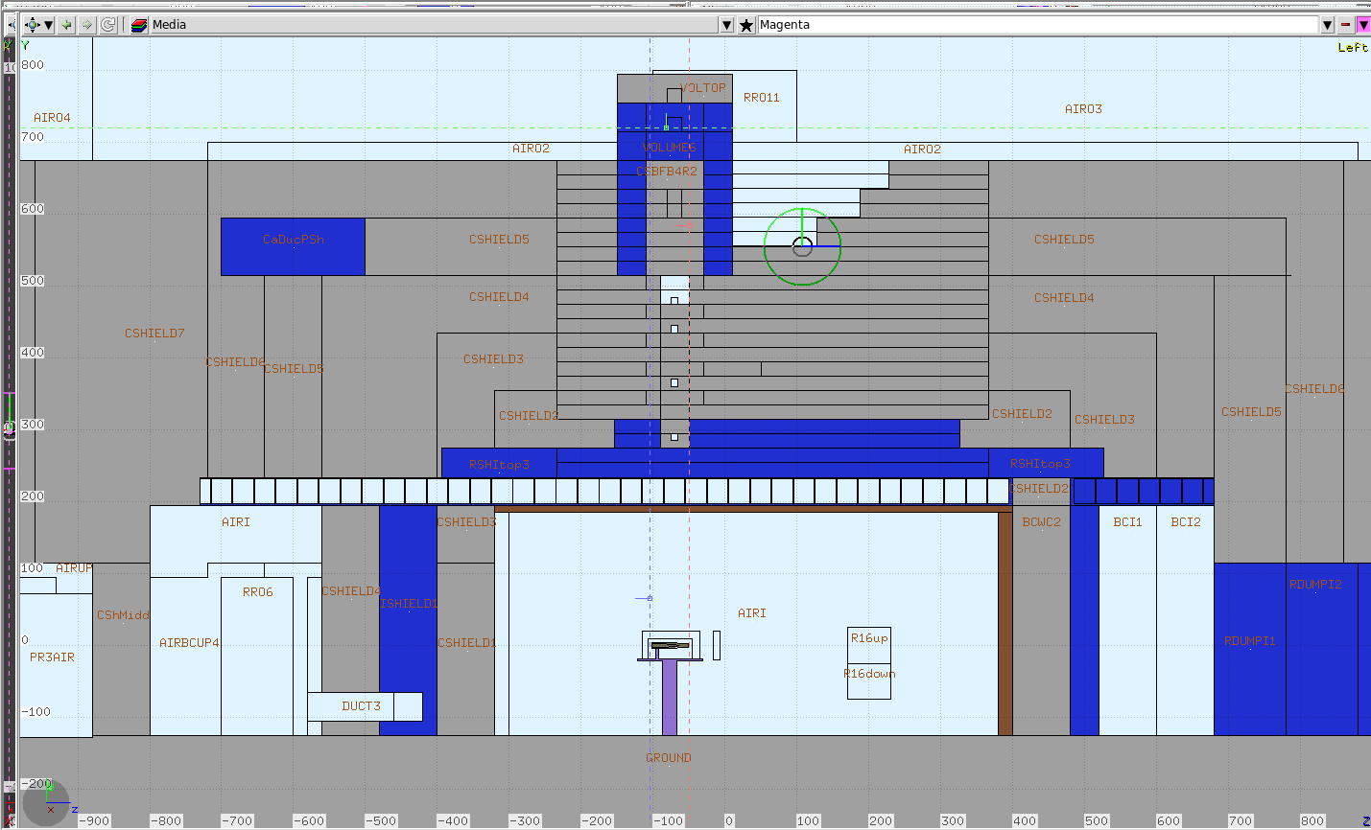
FLUKA simulations

Slide 14
Sensitivity studies
 | Type of uncertainty | Uncertainty ( %)
Simulations | Statistical Concrete density | 2 - 6 0.5 - 10
Measurements | γ-spectrometry sample weight beam intensity beam momentum beam position and profile target density target dimensions | 1.3 - 12 1 7 < 1 < 1 <1 <1

Slide 15
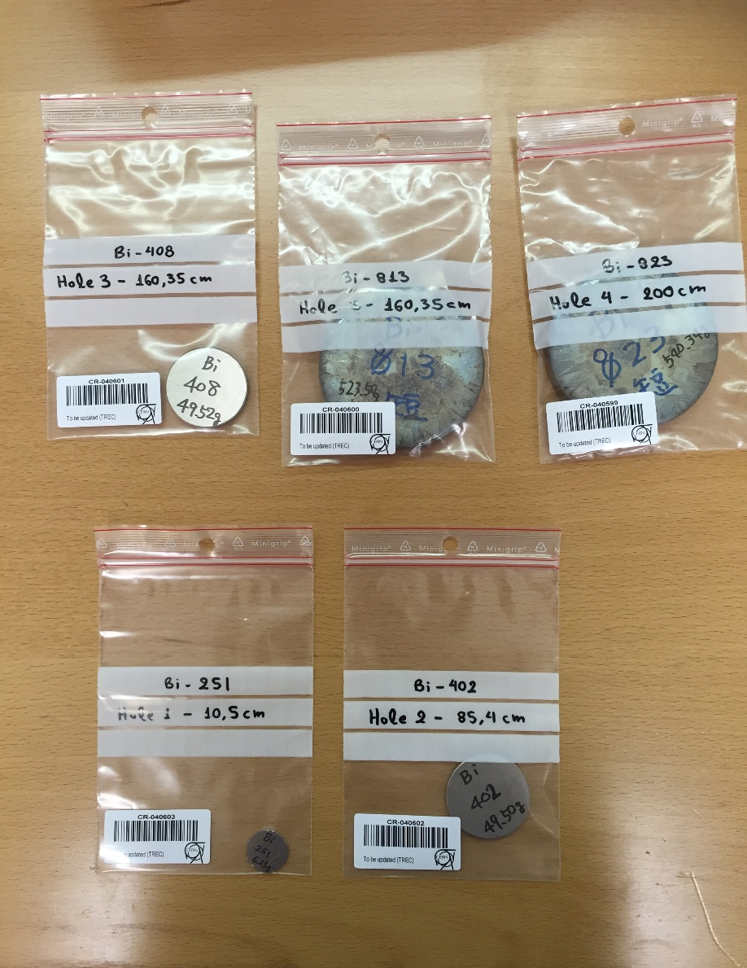
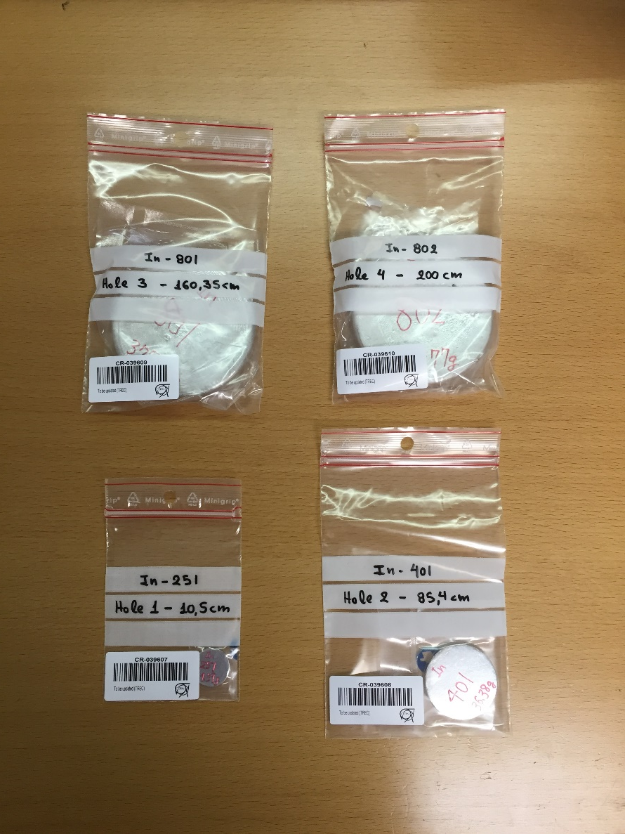
Samples

Slide 16
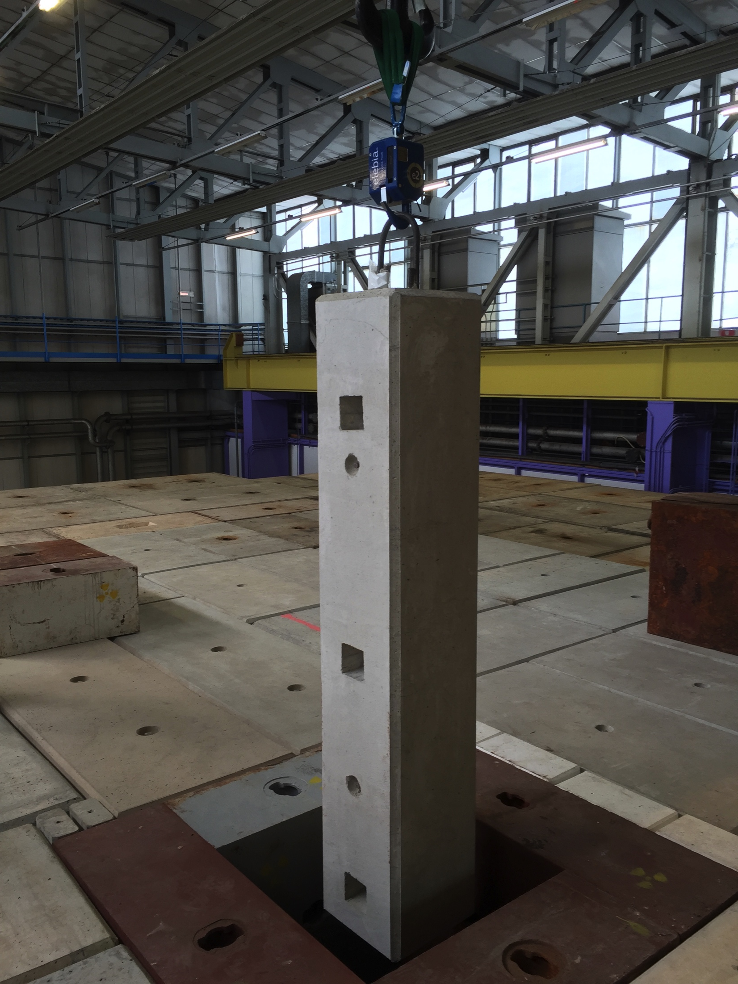
Sample placement

Slide 17
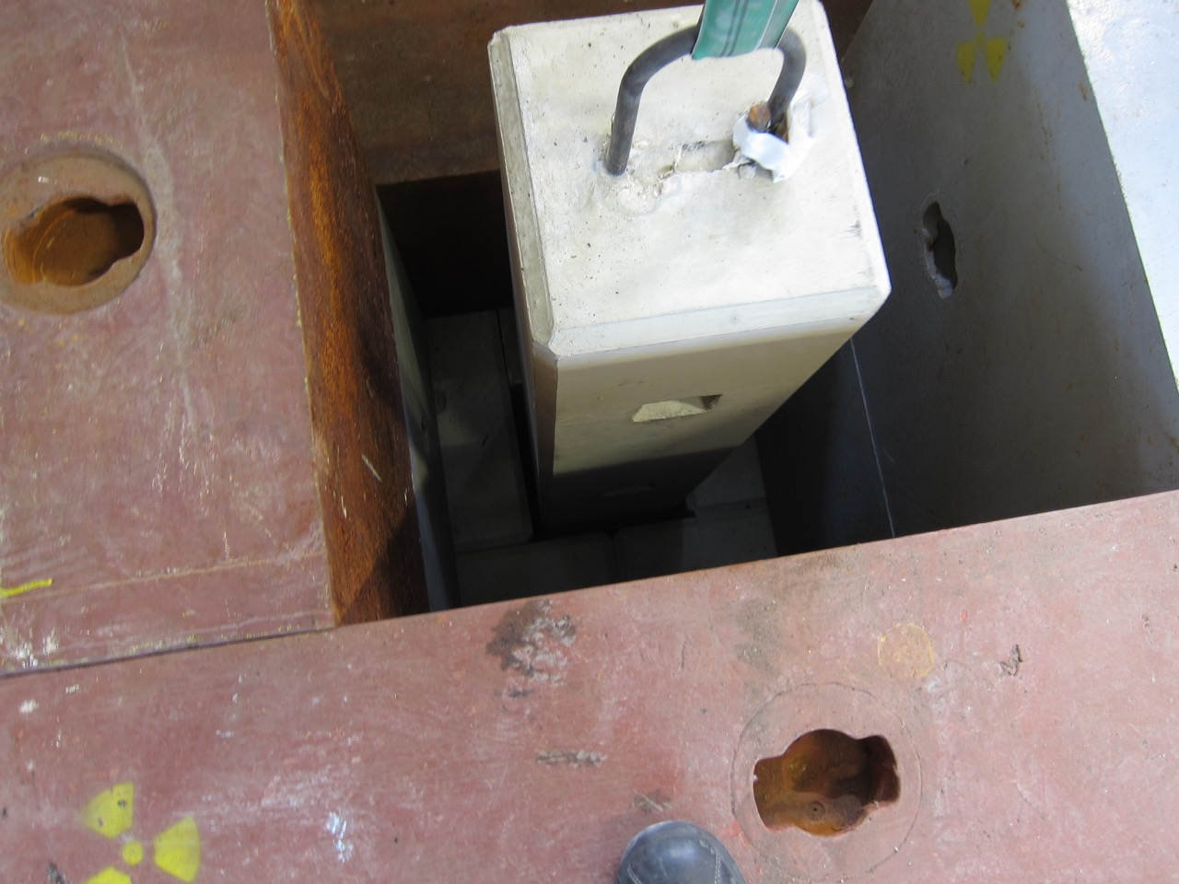
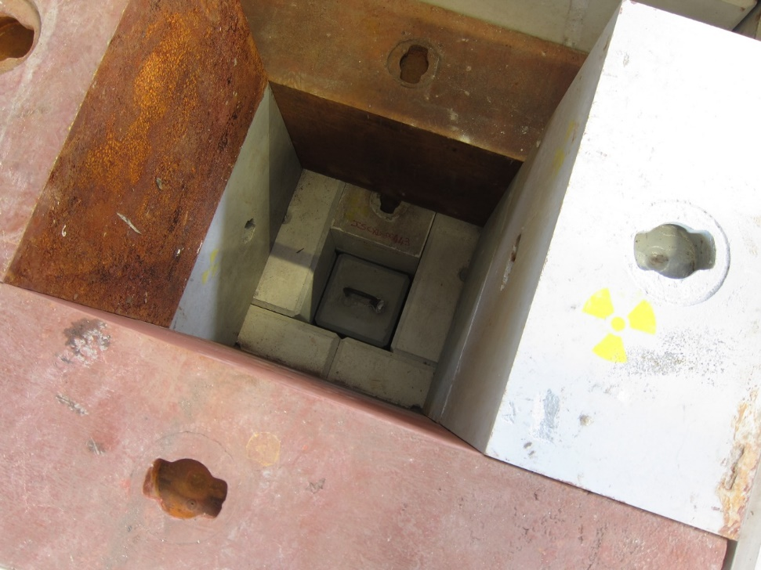
Sample placement

Slide 18
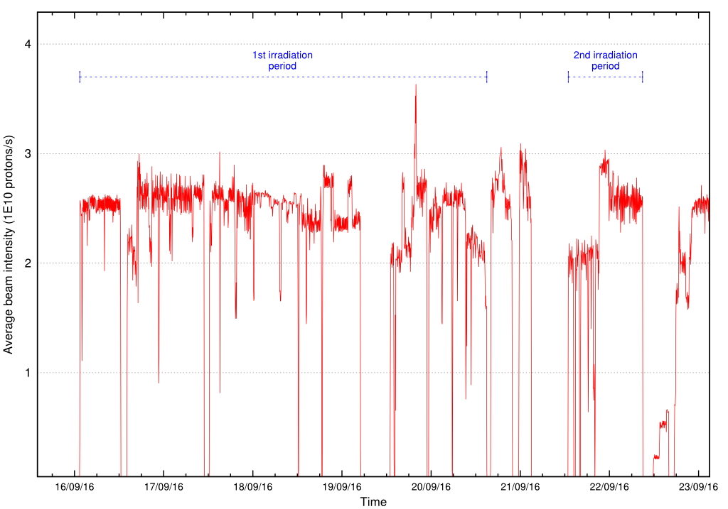
Beam intensity profile

Slide 19
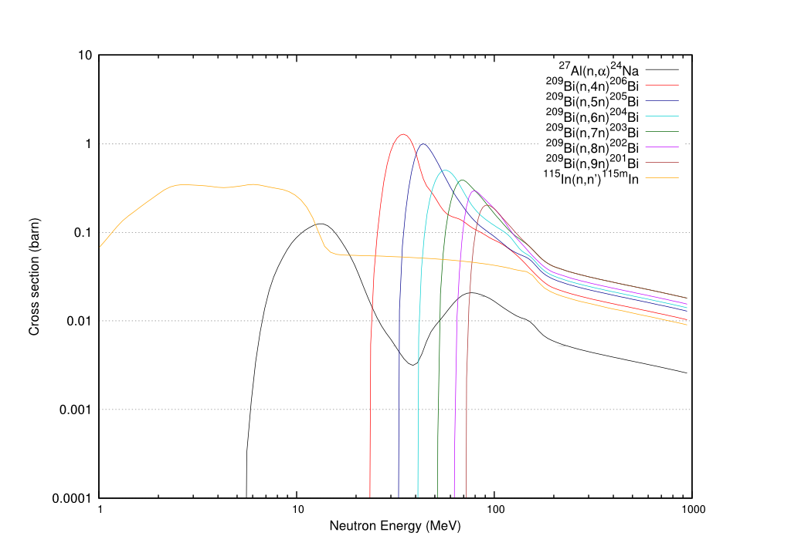

Slide 20
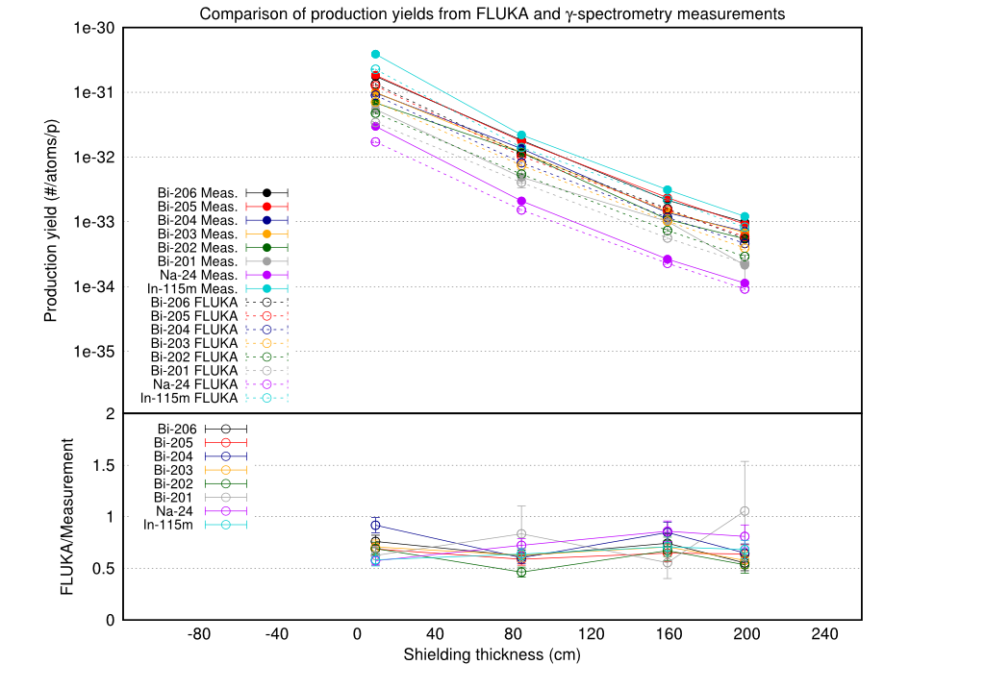

Slide 21
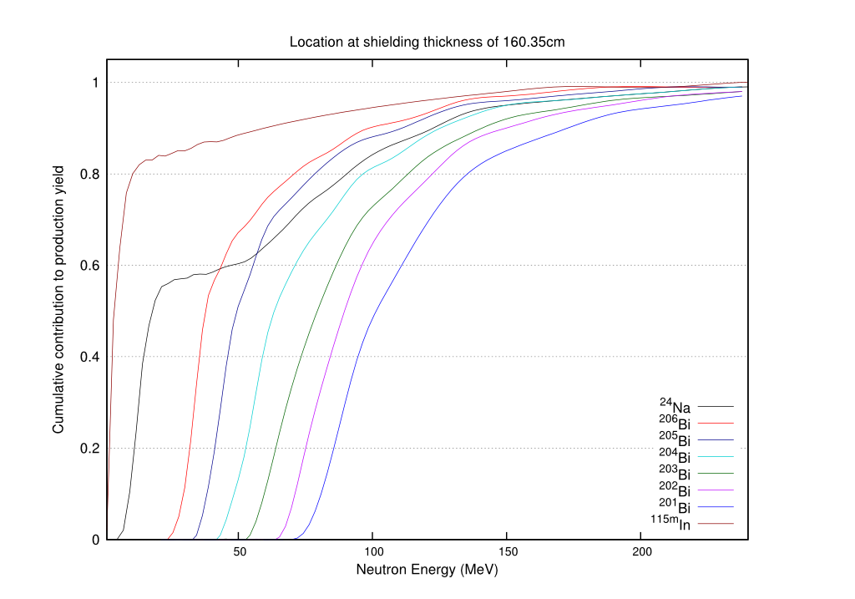

Slide 22
Results
Neutron Energy (MeV)
Radionuclide | q0.1 | q0.25 | q0.75 | q0.9
Bi-201 | 79.9 | 87.8 | 128 | 173
Bi-202 | 70.6 | 77.4 | 114 | 149
Bi-203 | 59.7 | 66.1 | 104 | 141
Bi-204 | 48.3 | 54.4 | 89.4 | 126
Bi-205 | 38.2 | 42.5 | 70.2 | 110
Bi-206 | 29.5 | 32.7 | 61.5 | 100
Na-24 | 9.39 | 12.2 | 79.7 | 122
In-115m | 1.63 | 2.33 | 7.99 | 59.7

Slide 23
Conclusions
Upgrade of CSBF for 2016 run
  Dedicated slots for activation experiments
Activation characterization campaign at the upgraded CSBF
Comparison of production yields between FLUKA and
γ-spectrometry measurements
Agreement better than a factor of 2

Slide 24
Thank you
for your attention!

Slide 25
BACKUP

Slide 26
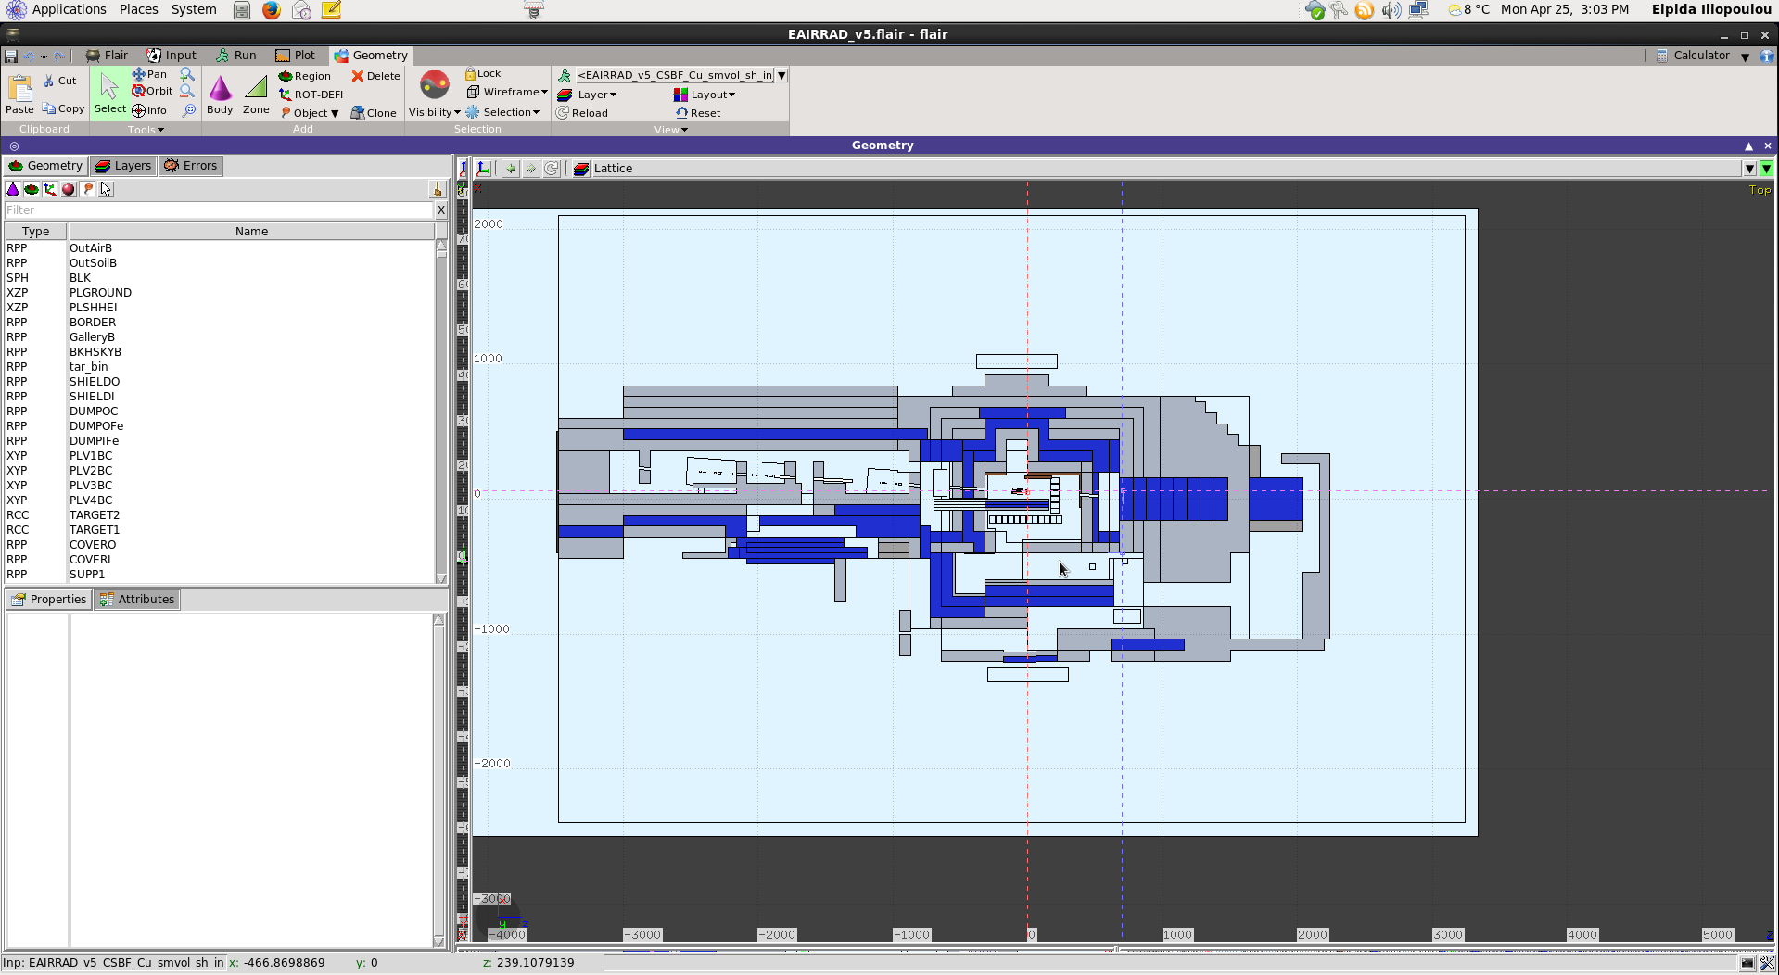
FLUKA simulations

Slide 27
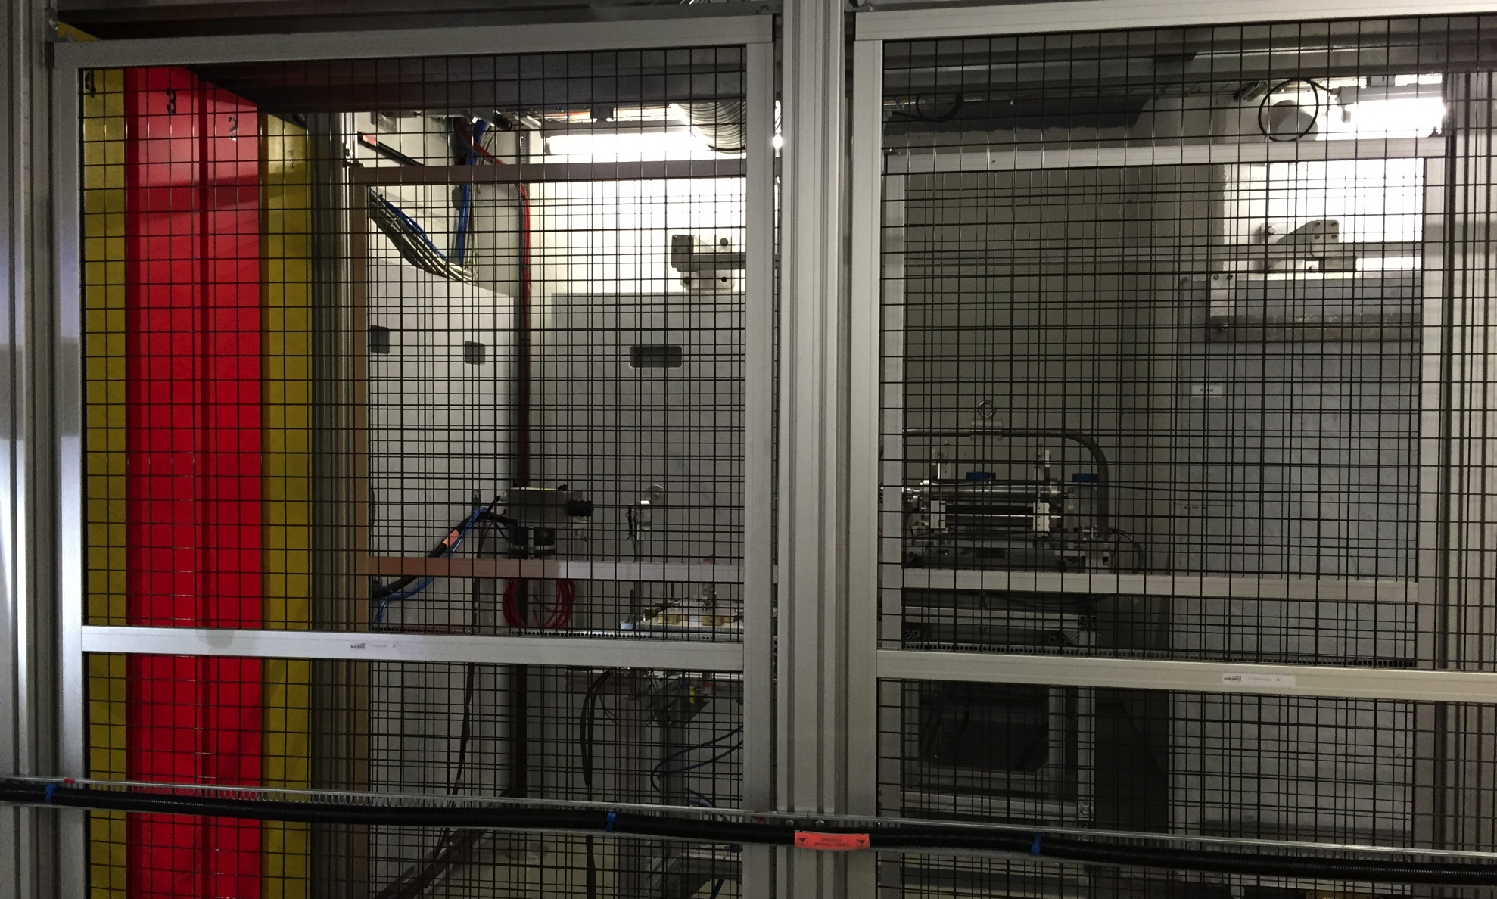
CHARM
4 movable shielding walls
Target holder

Slide 28
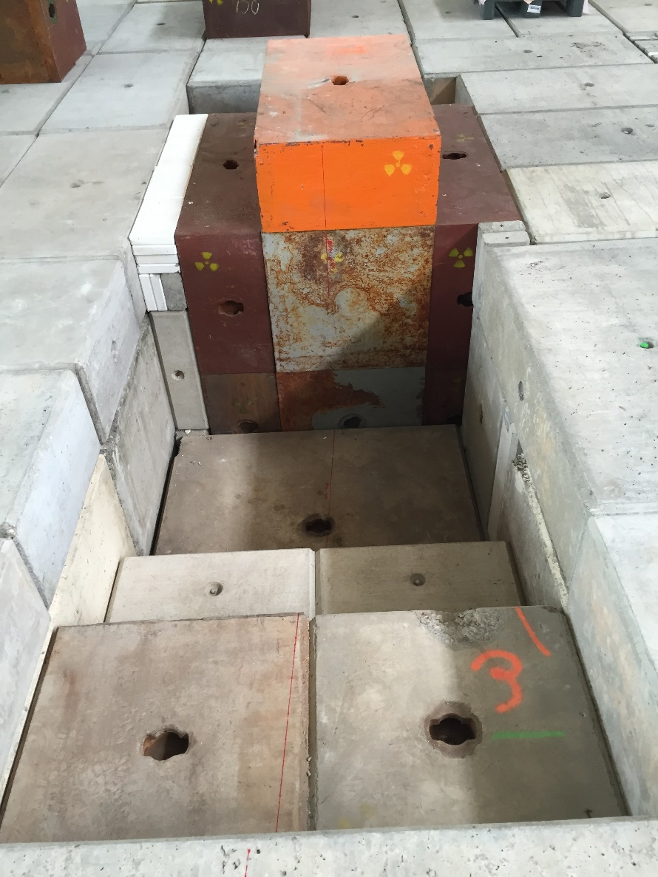
CSBF Upgrade

Slide 29
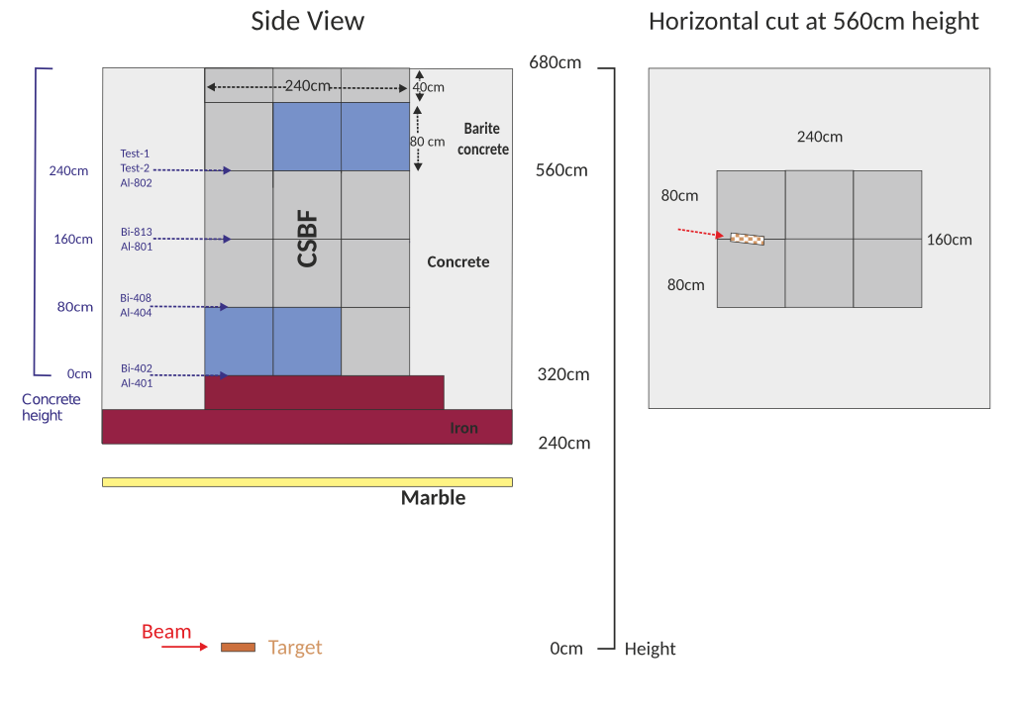
CSBF – Layout 2015

